Slide 1

SMART INDIA HACKATHON 2026
TITLE PAGE
Problem Statement ID – SIH26082
Problem Statement Title- Air Pollution–Weather Coupled Forecasting System for Delhi NCR
Theme- Disaster Management
PS Category- Software
Team ID- <your team ID>
Team Name (Registered on portal)- <your team name>

Slide 2
AIRSHED — 72-HOUR GRAP FORECAST
Your Team Name
Proposed Solution (Describe your Idea/Solution/Prototype)
Detailed explanation of the proposed solution
Correct a physics forecast instead of rebuilding one. CAMS (Copernicus) publishes global PM2.5 seven days ahead, free and keyless — but at ~40 km, and biased over India.
CAMS supplies the future: winds, transport, regional build-up. Our layer supplies the local: station-level bias correction and sub-grid detail.
Trained on 1.07 M station-hours, 77 CPCB stations, Feb 2025 onward. Every input is an archived forecast, never reanalysis, so training and serving see the same distribution.
How it addresses the problem
72 h PM2.5 at every station with a 10–90% interval, jointly with boundary-layer height and visibility — pollution and weather as one coupled system, which is what the problem statement asks for.
The output is the decision, not a number: the probability each GRAP stage I–IV is reached, with lead time and driver attribution ("upwind fires + shallow inversion").
Stage III is caught at 73.8% recall with 72 h of lead. GRAP measures need days to take effect — that is the difference between a forecast and a warning.
Innovation and uniqueness of the solution
The baseline is external and published, so beating it is a measured result, not a claim: 31.5% below raw CAMS and 20.6% below persistence, on 5 of 5 seasonal folds.
Persistence — "tomorrow is like today" — appears in every results table. It beats most published AQ models, and most published AQ models never report it.
Null results are published beside the wins: fires +0.9%, upwind corridor +0.0%, coupled multi-output −0.1%, each inside its own scatter. The same correction bolts onto the ministry's own model.
THE CORRECTION STACK
CAMS global physics forecast
~40 km · free · 7 days ahead · biased over India
Local signal we add
77 CPCB stations · GFS wind & boundary layer · FIRMS fires · METAR visibility
Airshed correction layer
LightGBM quantile · direct 24 / 48 / 72 h heads
PM2.5 p10–p50–p90 · 0.05° surface
GRAP stage probability + driver attribution

Slide 3
TECHNICAL APPROACH
Your Team Name
Technologies to be used (e.g. programming languages, frameworks, hardware)
Python 3.11 · LightGBM · Polars · DuckDB over Parquet · FastAPI · MapLibre GL + deck.gl · APScheduler — no GPU, no database server, no paid API or key for the physics: it runs on one laptop.
Methodology and process for implementation (Flow Charts/Images/ working prototype)
Below, left to right. Direct multi-horizon quantile heads (no recursive rollout, so 72 h error cannot compound), conformal calibration at 85.1% coverage, and a cache the demo never reads past — an upstream outage degrades it instead of killing it.
SOURCES (all free)
INGEST → CACHE
FEATURES
CORRECT
DECIDE → SERVE
CAMS PM2.5 forecast
Open-Meteo · ~40 km · 7 d
LightGBM corrector
9 quantile heads —
24/48/72 h × p10/p50/p90
Direct heads: no recursive rollout
Conformal calibration → 85.1% coverage
GRAP stage probability
P(stage I–IV) + lead time; SHAP grouped
into human causes
One module per source
fetch(start, end) → Parquet,
partitioned by date, idempotent
DuckDB over Parquet · 9.1 M rows
Hourly UTC index · IST only in the UI
Nothing below this line calls the network
Aligned supervised table
1.07 M station-hours
CAMS at the target hour
Observation lags & rolling means
Meteorology at true forecast lead
Upwind fire load · calendar & season
Split by time block, never at random
GFS meteorology
wind, boundary layer, humidity
Downscaled surface
Wind-aware graph → 0.05° grid, each cell
carrying its distance to a monitor
CPCB CAAQMS ground truth
via OpenAQ · 77 NCR stations
NASA FIRMS fires
VIIRS/MODIS · upwind load
Baselines & evaluation
persistence · raw CAMS · scaled CAMS
5 rolling-origin folds, whole-season holdout
FastAPI + MapLibre dashboard
/forecast /replay /grap · scheduled refresh
with a visible "last synced" age
METAR visibility
IEM archive · VIDP hourly

Slide 4
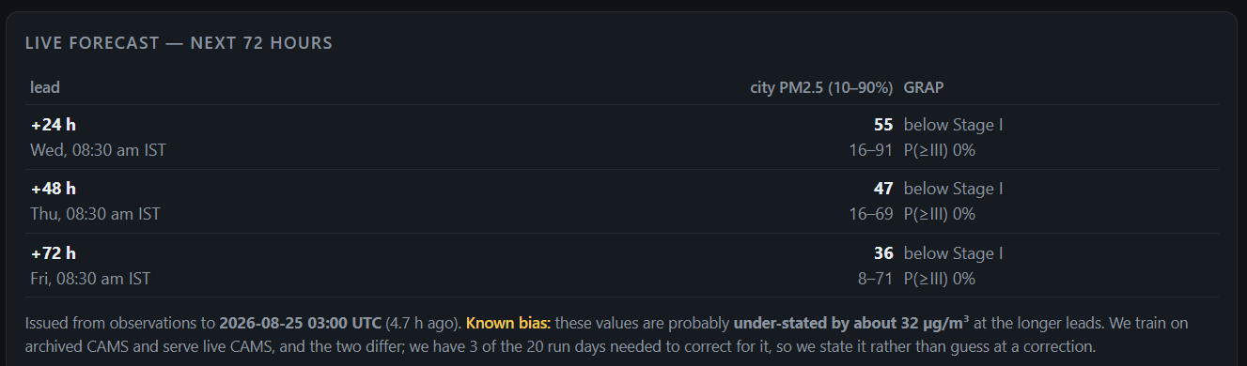
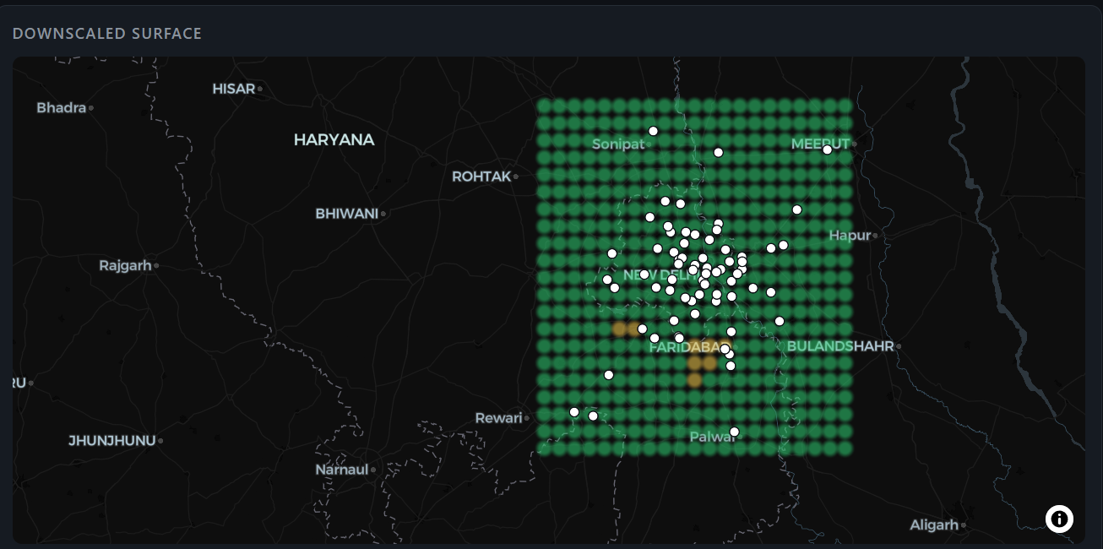
FEASIBILITY AND VIABILITY
Your Team Name
Analysis of the feasibility of the idea
Built and running end-to-end, not a proposal: 9.1 M cached rows, 77 stations, live 72 h forecast, historical replay, GRAP probabilities and a downscaled surface — the panels at right are that system, running today.
Zero data cost and zero licence cost. A resident archive job re-checks every 30 minutes and asks whether today's run is in the store, so sleep and reboots cannot make it miss.
Potential challenges and risks
One winter of trainable ground truth, so effects of a few percent cannot yet be separated from seasonal noise.
Train/serve gap: archived CAMS and live CAMS differ by −32 µg/m³ at day 2 on 3 run days; 20 settled days are needed before a correction for it can honestly be fitted.
CPCB stations go offline and relocate, and a nine-day January 2026 hole is upstream and unrecoverable.
Strategies for overcoming these challenges
Persistence in every table, whole-season holdout with a 96 h embargo, and 5 rolling-origin folds — a gain smaller than its own spread is reported as "cannot tell", not as a win.
Station gaps are treated as missing, never interpolated, and the CAMS run gap is shown on the dashboard as a "known bias" note instead of being quietly absorbed into the forecast.
Everything is cached and re-runnable offline; November 2026 is a second episode season that settles the open questions in one run.
THE SYSTEM AS IT RUNS TODAY
Live 72 h forecast with intervals and GRAP probability; wind-aware downscaled surface over the 77-station network. Both read the local cache.
9.1 M
rows cached
77
NCR stations
740 d
CAMS archive
₹0
data cost

Slide 5
IMPACT AND BENEFITS
Your Team Name
Potential impact on the target audience
CAQM and DPCC act through GRAP, and GRAP takes days to bite. Stage III at 73.8% recall and 66.0% precision with 72 h of lead turns a forecast into an actionable warning.
30 M+ NCR residents get a neighbourhood answer, not a city average: a 0.05° surface, 81.8 µg/m³ leave-one-station-out, 24.6% better than inverse-distance interpolation.
Every number ships with its interval and a visible "last synced" age, so an operator can see when the system is unsure or stale — the failure mode that ends operational trust in a forecast.
Benefits of the solution (social, economic, environmental, etc.)
Social — earlier school closures, construction halts and health advisories, with the interval shown everywhere so a marginal call looks marginal instead of certain.
Economic — fog risk three days out for IGI diversions and highway pile-ups: visibility skill improves 7.5% from pollution inputs (we report the number; the mechanism is not yet established).
Environmental — the surface says which part of the city is worse, and every cell carries its distance to the nearest monitor, so an unmonitored block is marked uncertain rather than quietly guessed.
Institutional — the correction layer is model-agnostic. It applies to the ministry's own SAFAR / Delhi DSS output as easily as to CAMS, so it adds to existing investment rather than competing with it, and it costs nothing to run.
72 h forecast error, 5 rolling folds
RMSE in µg/m³ — lower is better
Raw CAMS
91.4
Persistence
77.8
Airshed
61.9
−31.5% vs raw CAMS · −20.6% vs persistence
better on 5 of 5 seasonal folds
GRAP Stage III: 73.8% recall at 72 h lead
per-class recall, never overall accuracy — Stage IV is rare
85.1% interval coverage
against an 80% target
81.8 µg/m³ held-out, spatial
leave-one-station-out, 24.6% better than IDW
Gain vs raw CAMS by fold: +12.4 / +33.7 / +18.7 / +35.2 / +57.5%
Held-out episode, 22 Dec 2025 — observed 259 µg/m³, raw CAMS off by 123, Airshed off by 91.

Slide 6
RESEARCH AND REFERENCES
Your Team Name
Details / Links of the reference and research work
CAMS global forecast (Copernicus Atmosphere Monitoring Service), read free and keyless through the Open-Meteo Air Quality API — air-quality-api.open-meteo.com.
Open-Meteo Historical Forecast and Previous Runs APIs for archived past forecast runs — the training meteorology, at the lead it is actually used at. ERA5 reanalysis is deliberately excluded: it lags real time by ~5 days and cannot be served.
CPCB CAAQMS ground truth via the OpenAQ v3 API (api.openaq.org); NASA FIRMS VIIRS/MODIS active fire detections for stubble burning (firms.modaps.eosdis.nasa.gov); Iowa State IEM ASOS archive for measured METAR visibility at VIDP (mesonet.agron.iastate.edu).
GRAP stage thresholds transcribed from the CAQM published schedule; CPCB National AQI breakpoints for the 24-hour mean.
Prior art we position against, not around: SAFAR (IITM / MoES) and the Delhi Decision Support System already run the physics for NCR. Correcting an operational forecast is standard practice in operational meteorology; applying it to CAMS over NCR, and outputting the GRAP decision, is ours.
Method and every number on these slides: docs/results/ in the project repo — ablation.md, rolling.md, grap.md, loso.md, coupling.md, leadmatch.md, each regenerable by one command.
EVIDENCE ON DISK
CPCB ground truth · 2,552 d · 1.54 M rows
CAMS archive · 740 d · 1.37 M rows
GFS meteorology archive · 710 d · 1.21 M rows
Meteorology, lead-matched · 553 d · 2.70 M rows
METAR visibility, VIDP · 740 d · 18.9 k obs
FIRMS fire detections · 274 d · 23.5 k rows
Verified, not asserted
airshed gate rebuilds a week of every feature with sockets physically blocked, so "reads from cache" is a test, not a claim.
Next, and already scheduled
November 2026 — a second episode season settles fires, the upwind corridor, coupling and Stage IV in one run.

