Slide 1

SMART INDIA HACKATHON 2026
TITLE PAGE
Problem Statement ID – << fill from portal >>
Problem Statement Title – AI-driven assistant for groundwater data access
Theme – << fill from portal >>
PS Category – Software
Team ID – << fill from portal >>
Team Name – << your registered team name >>

Slide 2
INGRES: groundwater answers you can check
<< Team Name >>
Proposed Solution (Describe your Idea/Solution/Prototype)
Detailed explanation of the proposed solution
• Ask in plain English; get a grounded answer with a chart, a map and a citation for every figure
• Figures come from SQL over 36,879 CGWB station readings — never from the language model
• Two sources by question type: the database for how much water, the CGWB report for quality and causes
How it addresses the problem
• The data exists but sits in PDFs and portals a non-specialist cannot query
• Removes the specialist barrier while every figure keeps its station name and date
• Refuses questions outside Punjab groundwater instead of guessing
Innovation and uniqueness of the solution
• Verification-first: eight deterministic checks can block an answer before it is shown
• Three of five pipeline stages use no language model at all
• Model-checking-model was tried and failed — it approved a Bathinda station as the source for a Ludhiana figure
• Runs fully offline on a free local model: no internet, no API key, no cost per query
WHY THE OBVIOUS APPROACH FAILS
A typical chatbot
Question
Language
model
Answer
The number comes OUT of the model. Nothing can check it.
INGRES
Question
SQL
Model
writes prose
8 checks
The number goes INTO the model, and is checked again on the way out.
An unverifiable answer is shown as raw data, never as confident prose.

Slide 3
TECHNICAL APPROACH
<< Team Name >>
Technologies to be used (e.g. programming languages, frameworks, hardware)
• Backend: FastAPI · PostgreSQL · SQLAlchemy · NumPy
• Frontend: React · Recharts · Leaflet
• AI: Ollama running qwen2.5:7b locally · nomic-embed-text
• No vector database — 178 passages is a NumPy dot product
Methodology and process for implementation (Flow Charts/Images/ working prototype)
Query
understanding
Retrieval
Calculation
Response
Verification
LLM
CODE
CODE
LLM
CODE
Three of the five stages involve no language model. Every number passes through code.
WHERE THE DATA COMES FROM
CGWB CSV exports → cleaning → PostgreSQL
36,879 readings · 1,607 stations · 1996–2024
CGWB report PDF → chunking → vectors
178 passages · printed pages 1–78 · 153 assessment blocks

Slide 4
FEASIBILITY AND VIABILITY
<< Team Name >>
Analysis of the feasibility of the idea
• Built and running end to end on real CGWB data — a working prototype, not a concept
• Runs on one machine with no runtime network dependency; zero recurring cost
• Source data is public and officially published — no access or licensing risk
• 133 automated tests cover the deterministic core
Potential challenges and risks
• A language model inventing a plausible figure — the central risk for any water tool
• Single-user: one local model, no request queue
• One report in the semantic corpus; database is CGWB's published set to 2024, not live
• Deployment blocked in development — the network blocked every database port
Strategies for overcoming these challenges
• Eight blocking checks plus an advisory model reviewer; failure degrades to raw data
• Add a request queue and per-question timeout for concurrent users
• Corpus expansion is metadata-ready — each passage records its section, districts and scope
• Deploy inside the cloud network, where the port restriction does not apply
THE VERIFICATION GATE
Draft answer
Eight checks
citations · figures · districts · years · units
pass
fail
Answer shown
with citations
Raw data shown,
marked unverified
An unverifiable answer is never shown as if it were verified. The system fails to data, not to silence and not to a confident guess.
Six distinct failure paths are handled: out of scope · no quality data · district with no readings · checks rejected · model unusable · model unreachable.

Slide 5
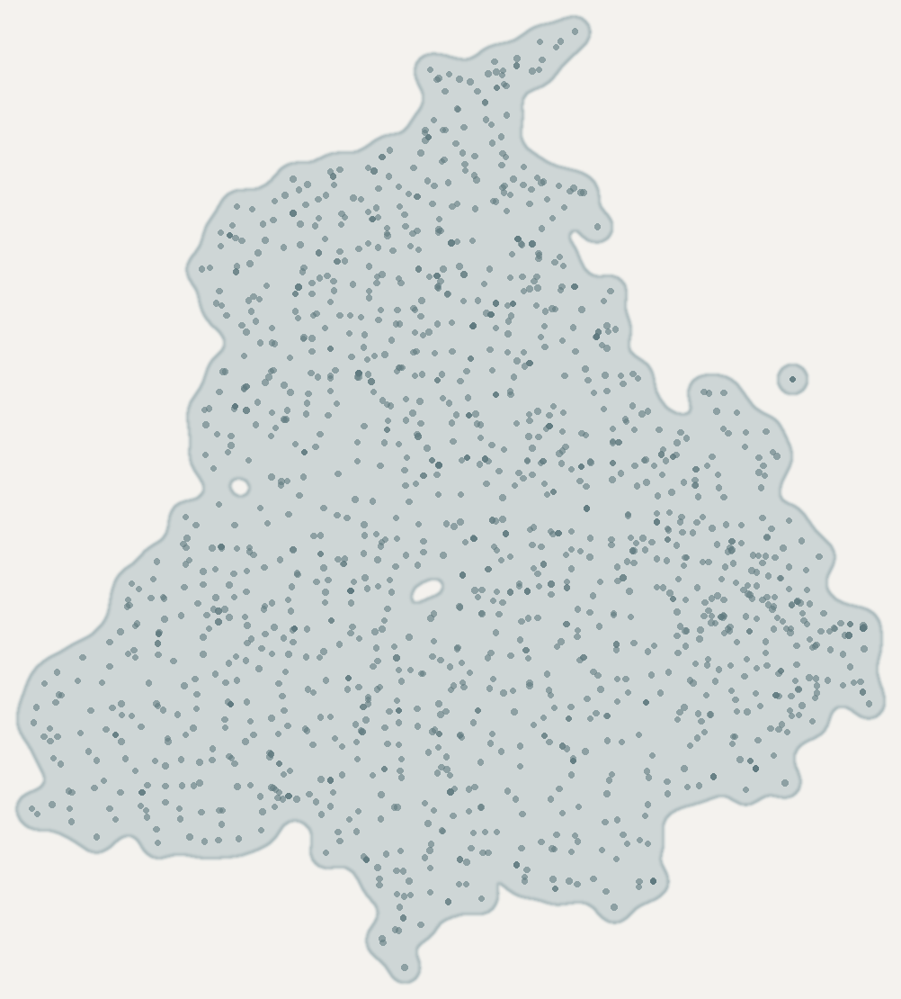
IMPACT AND BENEFITS
<< Team Name >>
Potential impact on the target audience
• Farmers and panchayats deciding where and how deep to drill
• District and block officials, and CGWB field staff
• Policy researchers, students and journalists
Benefits of the solution (social, economic, environmental, etc.)
Social
• Groundwater status becomes answerable by anyone who can type a question
• Every answer is citable, so decisions taken from it can be audited
Economic
• Better-informed borewell and cropping decisions; avoids drilling into a falling table
• No licensing or per-query cost — deployable without a budget line
Environmental
• Makes a slow crisis visible: 20 of 23 assessed districts are over-exploited
• Trend and projection views turn depletion into something a non-specialist can see
PUNJAB, BY CGWB CATEGORY
Pathankot
Fazilka
Muktsar
Over-exploited — 20
Safe — 3
1,606 monitoring stations — the outline is their own coverage
Malerkotla is categorised by CGWB but has no monitoring stations, so it is named here rather than plotted.

Slide 6
RESEARCH AND REFERENCES
<< Team Name >>
Details / Links of the reference and research work
• CGWB — Ground Water Resources of Punjab (as on 31 March 2024)
Block-wise resources and the water-quality chapters. Source of all 153 block assessments and the 178 indexed passages.
• National Water Data Portal (NWIC) — Ground Water Level, Manual Quarterly, CGWB
36,879 readings across 1,607 stations, 1996–2024. nwdp.nwic.gov.in
• GEC-2015 — Ground Water Estimation Committee methodology
The assessment methodology CGWB's resource estimation follows.
• BIS IS 10500 — Drinking Water Specification
Limits used in the report's quality chapter, e.g. fluoride 1.5 mg/L, uranium 0.03 mg/L.
• CGWB INGRES — India Ground Water Resource Estimation System
The national assessment system this assistant is designed to support. ingres.iith.ac.in
Methodology note
CGWB classifies assessment blocks, never districts. District categories shown by the system are derived from block counts, which are stored alongside as the supporting evidence. Cross-checking the extraction against a second table in the same report corrected four categories.

