Slide 1
Coursera Capstone
IBM Applied Data Science Capstone
Opening a restaurant in Hyderabad,Telangana
By: Yashwanth Gundela
June 2020

Slide 2
Business Problem
List of neighbourhoods in Hyderabad. This defines the scope of this project which is confined to the city of Hyderabad, the capital city of the state of Telangana in India.
Objective: A Quantifiable analysis that can be used to understand the distribution of different cultures and cuisines over Hyderabad City
Business question
In the city of Hyderabad, India, if a food vendor is looking to open a new restaurant, where would you recommend that they open it?

Slide 3
Data
Data required
List of neighbourhoods in Hyderabad
Latitude and longitude coordinates of the neighbourhoods
Venue data, particularly data related to restaurants
Sources of data
Wikipedia page for neighbourhoods (https://commons.wikimedia.org/wiki/Category:Suburbs_of_Hyderabad,_India)
Geocoder package for latitude and longitude coordinates
Foursquare API for venue data

Slide 4
Methodology
Web scraping Wikipedia page for neighbourhoods list
Get latitude and longitude coordinates using Geocoder
Use Foursquare API to get venue data
Group data by neighbourhood and taking the count of the frequency of occurrence of each venue category
Filter venue category by Food category
Perform clustering on the data by using k-means clustering
Visualize the clusters in a map using Folium

Slide 5
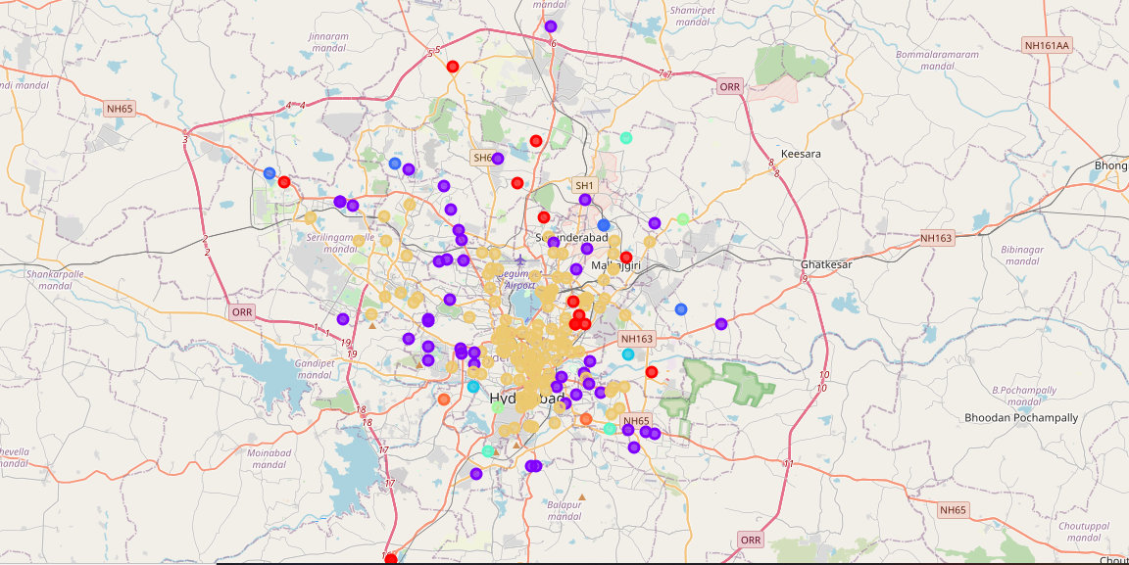
Results
Categorized the neighbourhoods into 8 clusters :
Cluster 0: Indian American.
Cluster 1: Cafés
Cluster 2: Pizza
Cluster 3: Fast Food
Cluster 4: Mix of Cuisines
Cluster 5: Snack places
Cluster 6: Indian Restaurant
Cluster 7: Vegetarian/ Vegan Restaurant

Slide 6
Observation
The neighborhoods of Hyderabad City were very briefly segmented into eight clusters and upon analysis, it was possible to rename them basis upon the categories of venues in and around that neighborhood.
Along with American cuisine, Italian(Pizza), Indian and Chinese are very dominant in Hyderabad City and so is the diversity statistics.

Slide 7
Limitations and Future Suggestions
The results of this project can be improved and made more inquisitive by using a current Hyderabad City’s dataset along with API platforms which are more interested in Food Venues (like Yelp, etc.)
The scope of this project can be expanded further to understand the dynamics of each neighbourhood and suggest a new vendor a profitable location to open his or her food place. Also, a government authority can utilize it to examine and study their city’s culture diversity better.

Slide 8
Conclusion
Hence, by looking at the results above, we can confidently state that Hyderabad city is a diverse place with multiple cuisines all blended within it and people inhabiting it are brimming with the rich, diverse culture brought about from their native lands to this city.
Findings of this project will help us to understand the distribution of different cultures and cuisines over Hyderabad City. Also, it can be utilized by a new food vendor who is willing to open his or her Restaurant or by a government authority to examine and study their city’s cultural diversity better.

Slide 9

Thank you!

