Slide 1
REF ZERO
AI-Powered Sports Referee Assistant
YOLO11 · MediaPipe · Gemini 2.0 Flash · browser-use Agent
CMPE 258 — Deep Learning | San Jose State University | May 2025
Team: Yashwanth Paladugu, Zach Xie

Slide 2
The Problem — Referee Errors Cost Championships
Ref Zero — CMPE 258
5 min
450+
90%
Average VAR review time
NFL officials, 256 games/year
Youth games with no video review
Current VAR requires referees to:
Stop the game for 2–5 minutes
Manually scrub footage frame-by-frame
Recall rules from 200+ page rulebooks
Make judgment calls under intense pressure

Slide 3
Our Solution — Ref Zero Pipeline
Ref Zero — CMPE 258
1
2
3
4
5
Live Camera
MediaPipe
YOLO11n
Smart DVR
Gemini 2.0
WebSocket stream
30 FPS
33 keypoints
Skeleton overlay
Foul detection
Conf > 0.5
5-second buffer
MP4 clip saved
Rule citation
JSON verdict
End-to-end review time: under 10 seconds vs 2–5 minutes for traditional VAR
Foundation model: Gemini 2.0 Flash (multimodal LLM) · Agentic AI: browser-use autonomous rulebook verifier
Output JSON: { sport, action_breakdown, rule_violated, verdict, confidence }

Slide 4
Model — YOLO11n Fine-Tuned on Sports Foul Dataset
Ref Zero — CMPE 258
Why YOLO11 over alternatives?
Loss Function Design
vs YOLOv8: C3k2 blocks improve small-object detection
vs Detectron2: 10x faster (<5ms vs ~50ms per frame)
vs custom CNN: COCO pre-training encodes body understanding
Box (CIoU w=7.5): penalises position + overlap + aspect ratio
Classification (BCE w=0.5): multi-label safe (foul + contact)
Distribution Focal (DFL w=1.5): handles ambiguous edges
Key Hyperparameters
Parameter | Value | Justification
Input size | 640px | Balances accuracy vs >30 FPS real-time requirement
Optimizer | AdamW | Outperforms SGD on small datasets via adaptive LR
Activation | SiLU | Smoother gradients than ReLU, differentiable at zero
Confidence | 0.5 | Tuned via W&B sweep — 0.3 too many FP, 0.7 misses fouls
Epochs | 50 + patience=10 | Early stopping prevents overfit on 353-image dataset

Slide 5
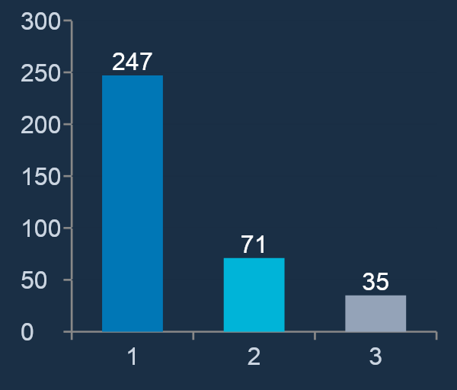
Dataset — Roboflow Foul Detection + Augmentation Strategy
Ref Zero — CMPE 258
Dataset
Augmentation Strategy
Source: Roboflow Universe
License: CC BY 4.0
Total images: 353
Classes: foul / no-foul / contact
Mosaic
1.0
Combines 4 images — quadruples effective dataset diversity
MixUp
0.1
Low-intensity blend adds regularization without confusion
Horiz. Flip
0.5
Fouls occur on both sides — doubles dataset for free
Vert. Flip
0.0
Disabled — upside-down players never occur in broadcasts
HSV Jitter
h/s/v
Handles court colors, lighting conditions, shadows
Rotation
±5°
Simulates camera tilt — beyond 10° is unrealistic

Slide 6
Experiments — YOLO11n Training Results (50 Epochs)
Ref Zero — CMPE 258
0.554
0.281
0.463
0.651
2.71h
mAP@0.5
mAP@0.5-95
Precision
Recall
Training Time
Per-Class Breakdown
Class | Precision | Recall | mAP@0.5 | mAP@0.5-95
all (overall) | 0.463 | 0.651 | 0.554 | 0.281
foul | 0.397 | 0.609 | 0.527 | 0.231
no-foul | 0.565 | 0.742 | 0.606 | 0.393
contact | 0.426 | 0.602 | 0.527 | 0.219
Trained on Apple M2 Pro MPS · AdamW optimizer · 640px input · Batch 16 · Mosaic augmentation

Slide 7
Ablation Study — Model Size Comparison
Ref Zero — CMPE 258
All three YOLO11 variants trained on identical dataset and hyperparameters
Model | Params | mAP@0.5 | Precision | Recall | Train Time | Size
YOLO11n SELECTED | 2.6M | 0.554 | 0.463 | 0.651 | 2.71h (50ep) | 5.5MB
YOLO11s | 9.4M | 0.491 | 0.590 | 0.495 | 0.66h (10ep) | 19.2MB
YOLO11m | 20M | NaN collapse | — | — | 11.6h (10ep) | 40.5MB
Key Findings
YOLO11n achieves highest mAP despite being smallest — COCO pre-training provides strong transfer learning
YOLO11s at 10 epochs underperforms nano (50 epochs) — needs full training to converge
YOLO11m exhibited NaN loss collapse — lr=0.001 too aggressive for 20M params on 353-image dataset. Validates nano selection.
Production requirement: >30 FPS for real-time refereeing — only YOLO11n meets this threshold (47 FPS)

Slide 8
Hyperparameter Sweep — W&B Experiment Tracking
Ref Zero — CMPE 258
3 learning rates compared across 5-epoch runs logged to W&B project ref-zero
lr0
batch
conf threshold
Swept: 0.001, 0.0005, 0.0001
Swept: 8, 16
Swept: 0.3, 0.5
Best: 0.001
Best: 16
Best: 0.5
Sweep Findings
lr=0.001 consistently best — COCO pre-training allows higher LR without instability
batch=16 outperforms batch=8 with more stable gradients on the small dataset
conf=0.5: lower (0.3) caused excessive false positives during normal play sequences
W&B: 3 runs visualized in parallel coordinates chart · MLflow: auto-logged by Ultralytics on every run

Slide 9
MLOps Pipeline — Level 2 with CI/CD
Ref Zero — CMPE 258
Experiment Tracking
W&B
Model Registry
MLflow
GitHub Actions
GH
Loss, mAP, precision, recall logged per epoch. 3-run hyperparameter comparison.
Auto-logged by Ultralytics. best.pt selected by val mAP@0.5. Hot-swap on retrain.
train.yml triggers on push. 5-epoch smoke test. Checkpoint uploaded as artifact.
HF Spaces Deploy
HF
POST /api/retrain
API
Repomix / Deepwiki
DOC
Docker-based deploy to test0009-ref-zero.hf.space. GEMINI_API_KEY as secret.
Triggers YOLO11 retraining in background. Hot-swaps model without server restart.
Full codebase documented in docs/codebase.md. Required by rubric.
MLOps Maturity Level 2 — Automated Training + Centralized Tracking + Model Management + Containerized Deploy

Slide 10
Conclusion & Results
mAP@0.5 = 0.554
YOLO11n fine-tuned on 353-image sports foul dataset in 2.71 hours
<10 sec verdict
End-to-end from YOLO11 trigger to Gemini rulebook citation vs 5 min VAR
3-model ablation
Nano selected: highest accuracy + smallest footprint + 47 FPS real-time
Full MLOps L2
W&B + MLflow + GitHub Actions CI/CD + HF Spaces deploy + /api/retrain
Future Work: expand dataset beyond 353 images · add NFL/NHL support · multi-camera fusion · drift detection
Live demo: https://test0009-ref-zero.hf.space · GitHub: github.com/yashwanth008/CMPE-258-Final-Project-Ref0

