Slide 1




TITLE PAGE
>Problem Statement Title - CollabSpark: Igniting Rapid, Creative Student Collaborations Across Disciplines
>Theme –student innovation
>Team ID –YASTEA25
>Team Name (Registered on Website) -codevyuh
>Participant Names –yashwanth,charishma
Sri Indu College of Engg & Tech - Cyber Club, Department of Cyber Security
Page 01

Slide 2

CODE VYUH
Collab Spark
Proposed Solution – CollabSpark
Problem: Students and developers often learn in isolation, lacking platforms for real-world, short-term collaborations. There’s no structured way to find teammates for quick, goal-driven projects. Without peer support and accountability, motivation drops and learning stagnates. Generic platforms aren’t built for spontaneous, interdisciplinary teaming. This leads to fragmented skill growth and missed opportunities for innovation.
Our Solution – What the Web App Does
Our web app, CollabSpark , enables users to:
Create or join short-term challenges (like building a mini app or solving a design task).
Collaborate with matched peers based on skills, interests, and availability.
Track progress publicly on their profile, creating visibility and motivation.
Build a lightweight portfolio from completed challenges.
It’s fast, minimal, and built for students to start collaborating in minutes. What Makes It Unique
Unlike generic chat or task apps, CollabSpark revolves around real, time-bound challenges that drive outcomes. Its minimal MVP ensures users engage instantly without complexity. The platform is future-ready, with potential to scale into hackathons, internships, and gamified learning ecosystems.
Sri Indu College of Engg & Tech - Cyber Club, Department of Cyber Security
Page 02

Slide 3
TECHNICAL APPROACH
CODE VYUH
Frontend React.js with Tailwind CSS for responsive design. Backend Node.js with Express or Firebase for scalability. Uses RESTful APIs for smooth frontend-backend communication.
Data & AI Stores data in PostgreSQL Uses OpenAI and a recommendation engine for smart matching.(In future)
Security User authentication via Clerk. Supports role-based access control for secure access.
Sri Indu College of Engg & Tech - Cyber Club, Department of Cyber Security
Page 03

Slide 4
Operational Feasibility: Easy onboarding, minimal UI complexity, and a familiar web app flow ensure smooth adoption by students and devs.
FEASIBILITY AND VIABILITY
CODE VYUH
Technical Feasibility: Built with a lightweight tech stack (Next.js, Firebase/Prisma), MVP can be developed swiftly with basic auth, challenge creation, and profile features.
Operational Feasibility: Easy onboarding, minimal UI complexity, and a familiar web app flow ensure smooth adoption by students and devs.
Market Viability: Taps into growing demand for project-based learning and peer collaboration; ideal for hackathon enthusiasts, bootcamp learners, and student communities.
Scalability: The modular design allows gradual feature addition—chat, analytics, GitHub/LinkedIn integration—without disrupting the core challenge flow.
Sri Indu College of Engg & Tech - Cyber Club, Department of Cyber Security
Page 04

Slide 5
IMPACT AND BENEFITS
CODE VYUH
Traditional collaboration often demands long-term involvement, which many students can't consistently manage due to tight schedules and academic workloads.
CollabSpark solves this by promoting short-term, focused challenges (1–3 days) that are:
Time-efficient: Designed to fit conveniently between lectures, exams, or internships.
Portfolio-friendly: Enable users to rapidly build real, verifiable work for resumes or GitHub.
Skill-expanding: Encourage trying new tools, stacks, or domains without high commitment.
Network-enriching: Connect users with peers across different backgrounds and skill sets, fostering multidisciplinary growth.
Sri Indu College of Engg & Tech - Cyber Club, Department of Cyber Security
Page 05

Slide 6
RESEARCH AND REFERENCES
CODE VYUH
>GitHub Student Survey 2023: 68% of students preferred small, outcome-oriented projects over semester-long collaborations.
>LinkedIn Learning: Quick portfolio projects rank higher for recruiter visibility than long-term coursework. >Harvard Business Review(https://hbr.org/2018/12/how-timeboxing-works-and-why-it-will-make-you-more-productive) Time-boxed projects reduce burnout, boost clarity, and enhance team efficiency.
We explored various AI tools like Claude AI and Lovable to enhance user experience and smart recommendations. For authentication, we integrated Clerk for secure and smooth login. I also referred to official documentation and revised it multiple times to ensure proper implementation and understanding. These tools helped us save time, add intelligence to our platform, and build a more interactive experience. Using AI made the project more innovative and user-friendly. Clerk also helped in managing roles and access efficiently. Overall, combining AI tools with clear documentation boosted both our learning and development speed.
Sri Indu College of Engg & Tech - Cyber Club, Department of Cyber Security
Page 06

Slide 7
CODE VYUH
FUTURE ENHANCEMENTS
AI-Based Team Matchmaking Use skill-tagged profiles and project goals to auto-suggest optimal team combinations.
Progress Analytics Dashboard Track individual contributions, deadlines met, and overall team efficiency.
Integrated Portfolio Builder Auto-generate project pages with code snippets, timelines, and team roles for GitHub/LinkedIn.
Micro-Certification Integration Award verifiable badges for roles like "Team Lead", "UI Designer", or "Backend Developer".
Alumni Mentorship Loop Enable alumni to guide ongoing batches through project reviews and live sessions.
Sri Indu College of Engg & Tech - Cyber Club, Department of Cyber Security
Page 07

Slide 8
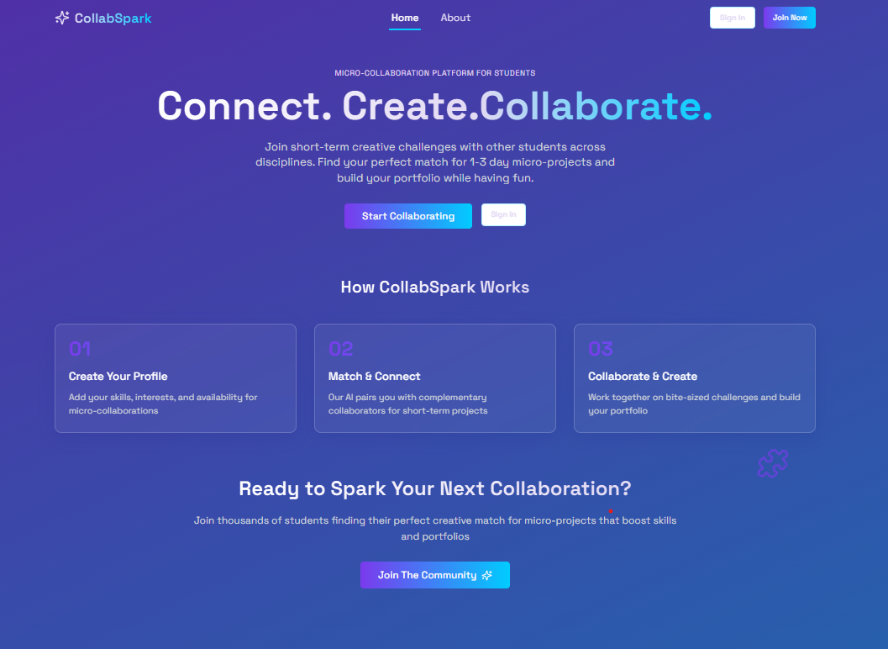
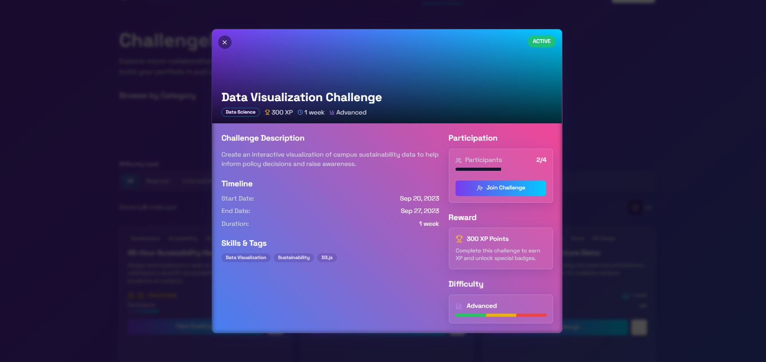
CODE VYUH
DEMO (IF APPLICABLE)
https://drive.google.com/file/d/1rCU-i_E66BFjNOPYXESaH5f7MF7XjTdC/view?usp=sharing (video1)
https://drive.google.com/file/d/1mh6YXK2cTFEmC8YkX_1zTxmPg27vmS_z/view?usp=sharing (video2)
Sri Indu College of Engg & Tech - Cyber Club, Department of Cyber Security
Page 08

Slide 9
CODE VYUH
CONCLUSION & THANK YOU
To encourage creativity and innovation, students need a platform that allows them to easily connect with peers from different fields. Traditional platforms are often too formal, long-term, or general, making it hard for students to collaborate quickly and explore their ideas. By providing a space for short-term, fun, and interdisciplinary projects, students can experiment, learn new skills, and work on real-world problems. This approach will help them develop important cross-functional skills, enhance their creativity, and make collaboration more accessible. Ultimately, such a platform can unlock the full potential of students, leading to greater innovation and better preparation for the future workforce.
Thank you for your attention!
Thank you to the organizers and mentors
Sri Indu College of Engg & Tech - Cyber Club, Department of Cyber Security
Page 09

