Slide 1

Real-Time
Pizza Sales
Dashboard
Built with Streamlit + Python + Data Simulation
Presented by: Sahana Sunddher
Platform: Google Colab

Slide 2

Table Of Contents
Introduction
Project Overview
Dataset Overview
Project Architecture
Dashboard Features
Key Technologies
My Novelty
Future Scope
Conclusion

Slide 3
Introduction
Creating a dynamic pizza sales dashboard that simulates and visualizes real-time orders using Python and Streamlit.
Tools Used:
Python
Pandas
Faker
Streamlit
Plotly (Charts)

Slide 4
Project Overview
Goal: To build an interactive, real-time dashboard for tracking pizza sales using simulated and historical data.
Key Features:
Real-time data simulation using Faker
Visualization of order trends, totals, and popular pizzas
Integration of historical Excel data and real-time streams
Why This Project?
Demonstrates end-to-end data pipeline: from generation, storage, visualization
Easy to scale and extend with predictive analytics or cloud deployment
Real-time dashboards are crucial in modern business intelligence and decision-making

Slide 5
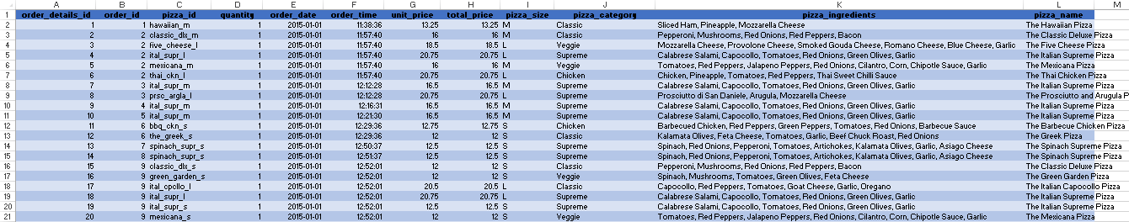
Dataset Overview
Historical Orders: Data Model - Pizza Sales.xlsx
Simulated Real-Time Orders: Generated using Faker in real_time_stream.py
Real-time fields generated:
✓ Customer Name ✓ Pizza Name ✓ Quantity ✓ Time of Order ✓ Total Price

Slide 6
Dashboard Features
Live Dashboard Includes:
Live Order Table (Last 20 Orders)
Sales Summary Metrics
Total Sales
Total Orders
Avg Order Value
Sales Trend (Smoothed with Rolling Average)
Top-Selling Pizzas

Slide 7
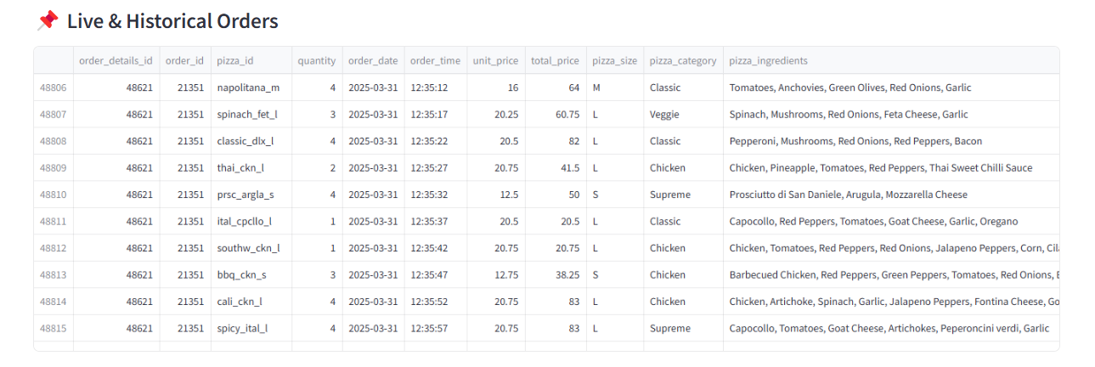

Slide 8
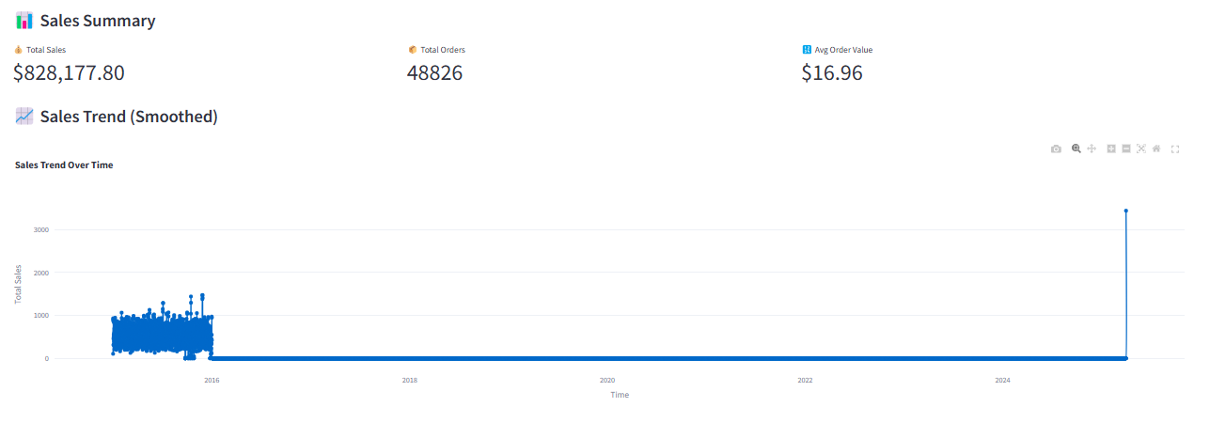
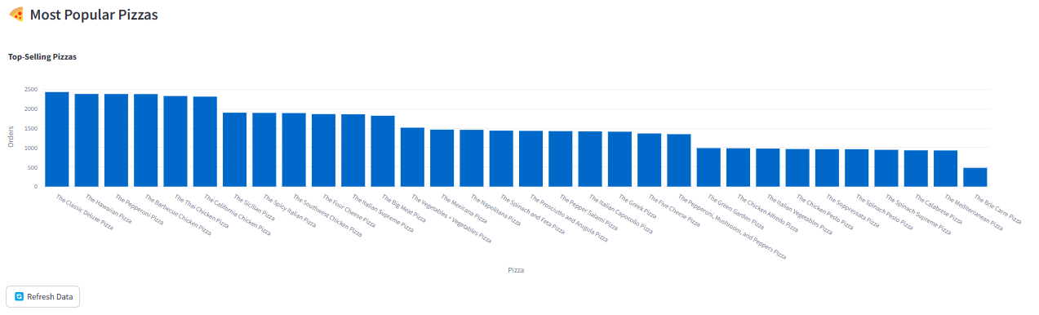

Slide 9
Key Technologies
Technology | Role
Streamlit | Web Dashboard Framework
Faker | Simulates real-time orders
Pandas | Data Wrangling
Plotly | Interactive graphs
Firebase(optional) | Cloud-based real-time DB

Slide 10


My Novelty
Future Scope
imulated live sales using Faker
Cloud-integrated (Firebase / or CSV)
Smoothed time series analysis
(6-hourly + rolling mean)
Custom visual insights + filters
Predictive analytics (sales forecasting)
Customer segmentation
Integration with order management systems
Cloud dashboard deployment
(Streamlit Cloud / GCP)

Slide 11
Conclusion
This project demonstrates how real-time data simulation and interactive dashboards can deliver insightful business analytics using simple yet powerful tools like Streamlit, Pandas, and Faker.
With optional Firebase integration, the system is scalable and cloud-ready, paving the way for advanced features like real-time collaboration, centralized data storage, and remote analytics.
The dashboard not only tracks sales and trends in real time, but also provides a strong foundation for adding machine learning, forecasting models, and customer behavior analysis in future.
Overall, this project showcases a complete pipeline from data generation to insightful visualizations in a way that's practical, innovative, and easily extensible.

Slide 12

Thank You

