Slide 1
Digital Portfolio
STUDENT NAME: YASHWANTH N
REGISTER NO AND NMID: 2422K0112 and asbruaz2422k0112
DEPARTMENT: BSc Computer Science
COLLEGE: COLLEGE/ UNIVERSITY - KPR College of arts science and research and Bharathiar University

Slide 2
PROJECT TITLE
FOOD PRODUCTION

Slide 3


AGENDA
Problem Statement
Project Overview
End Users
Tools and Technologies
Portfolio design and Layout
Features and Functionality
Results and Screenshots
Conclusion
Github Link
3/21/2024 Annual Review

Slide 4

PROBLEM STATEMENT
People often lack awareness about how food is produced, processed, and distributed, leading to waste and unsustainable practices. There is a need for a simple interactive portfolio website that explains food production, its types, processes, and sustainable methods using HTML, CSS, and JavaScript.

Slide 5

PROJECT OVERVIEW
This project is a food production portfolio website built with HTML, CSS, and JavaScript. It explains types, processes, and sustainable methods of food production in a simple and interactive way.

Slide 6

WHO ARE THE END USERS?
For your Food Production Portfolio website, the end users can be:
Students – to learn basics of food production.
Teachers / Educators – to use as a teaching aid.
Researchers – for quick reference.
General Public – to understand food production and sustainability.

Slide 7

TOOLS AND TECHNIQUES
HTML – for structuring web pages.
CSS – for styling and responsive design.
JavaScript – for interactivity and dynamic
customs.
VS Code / Sublime Text – as code editor.
Web Browser (Chrome/Edge/Firefox) – for testing and running the website.

Slide 8
POTFOLIO DESIGN AND LAYOUT
Header: Title + Navigation bar.
Home: Intro about food production.
Sections: Types, Process, Sustainability.
Gallery: Images/infographics.
Footer: Contact & references.
8

Slide 9
FEATURES AND FUNCTIONALITY
Responsive design – works on mobile & desktop.
Navigation menu – easy access to sections.
Interactive sections – food types, process, sustainability.
Image gallery – showcases visuals of food production.
Contact/footer – user details & references.

Slide 10
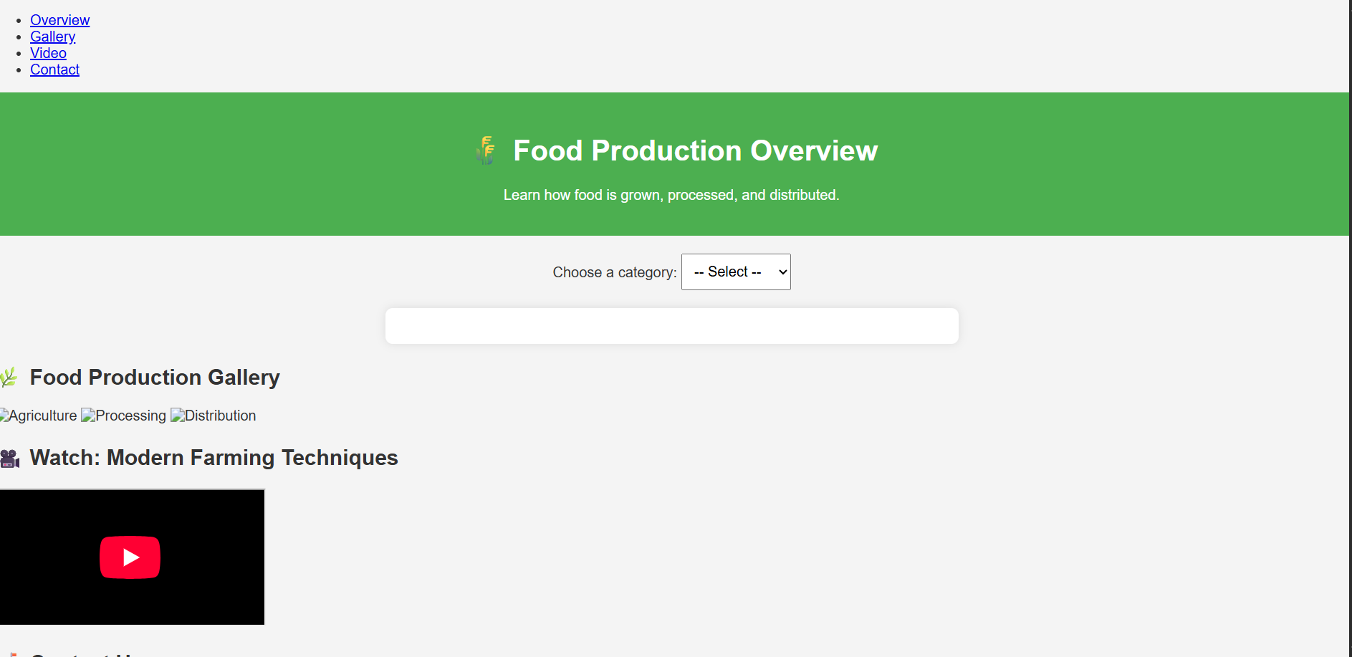

RESULTS AND SCREENSHOTS
3/21/2024 Annual Review
10

Slide 11
CONCLUSION
1. Project met its goal of educating users about food production.
2. Website demonstrates use of HTML, CSS, JavaScript.
3. Can be enhanced with more visuals and database integration.
11

