Slide 1

IOT-Controlled Landmine Detection Robot with Live Video Streaming
A project/dissertation submitted in partial fulfilment of the requirements for the degree of
Bachelor of Technology in Computer Science and Engineering
by
G.Sharath Kumar
Hall Ticket No. 21641A0575
P.Mahadev Raj
Hall Ticket No. 21641A05C6
K.Tharun
Hall Ticket No. 21641A0597
M.Yashwanth Reddy
Hall Ticket No. 21641A05A3
Under the guidance of
Dr.K.Rekha Devi
(Assistant Professor)
Department of Computer Science and Engineering
Vaagdevi College of Engineering
(UGC Autonomous, Accredited by NBA & NAAC with “A”)
Bollikunta, Khila Warangal (Mandal), Warangal Urban – 506005(T.S)
2024-2025

Slide 2
Abstract:
Our project presents a smart, IoT-controlled robot designed to detect landmines in post-war or high-risk areas, ensuring the safety of civilians and personnel. Built on Arduino technology (or ESP32), the robot features an integrated metal detector to identify buried landmines, a live video streaming module for real-time monitoring, and alert systems including a buzzer and LED for immediate notifications. The robot is fully remote-controlled, allowing users to explore dangerous areas with zero physical risk. Its simple design, low cost, and high functionality make it an efficient tool for humanitarian demining operations. By combining core safety features with modern tech, the robot offers a practical, field-ready solution to one of the most dangerous remnants of war.

Slide 3
Introduction
Landmines are invisible killers, posing a constant threat in post-conflict zones. Traditional demining methods are slow, dangerous, and labor-intensive, putting human lives at risk. Our solution combines automation, robotics, and IoT to revolutionize the process. The robot is equipped with metal detection, a robotic arm, and live video streaming, offering users full remote control and real-time visuals. This modern approach ensures faster, safer, and more efficient landmine detection compared to manual techniques.

Slide 4
Problem Statement
Manual detection methods are dangerous and inefficient
Existing robotic systems often lack accuracy and real-time feedback
Clear need for a safe, efficient, and user-friendly landmine detection robot

Slide 5
Literature Survey:-
Technologies used: Arduino, Raspberry Pi, GPR, AI
Common issues: High false positives and limited range
Navigation struggles: Poor terrain adaptability
Hybrid models: Improve detection but costly
IoT integration: Boost usability but lack robustness

Slide 6
Existing System
Basic bots with metal detectors and RF control
High false positives from undifferentiated metal detection
Limited communication range
No GPS or camera feed for location or visual feedback
Lack of real-time video feedback

Slide 7
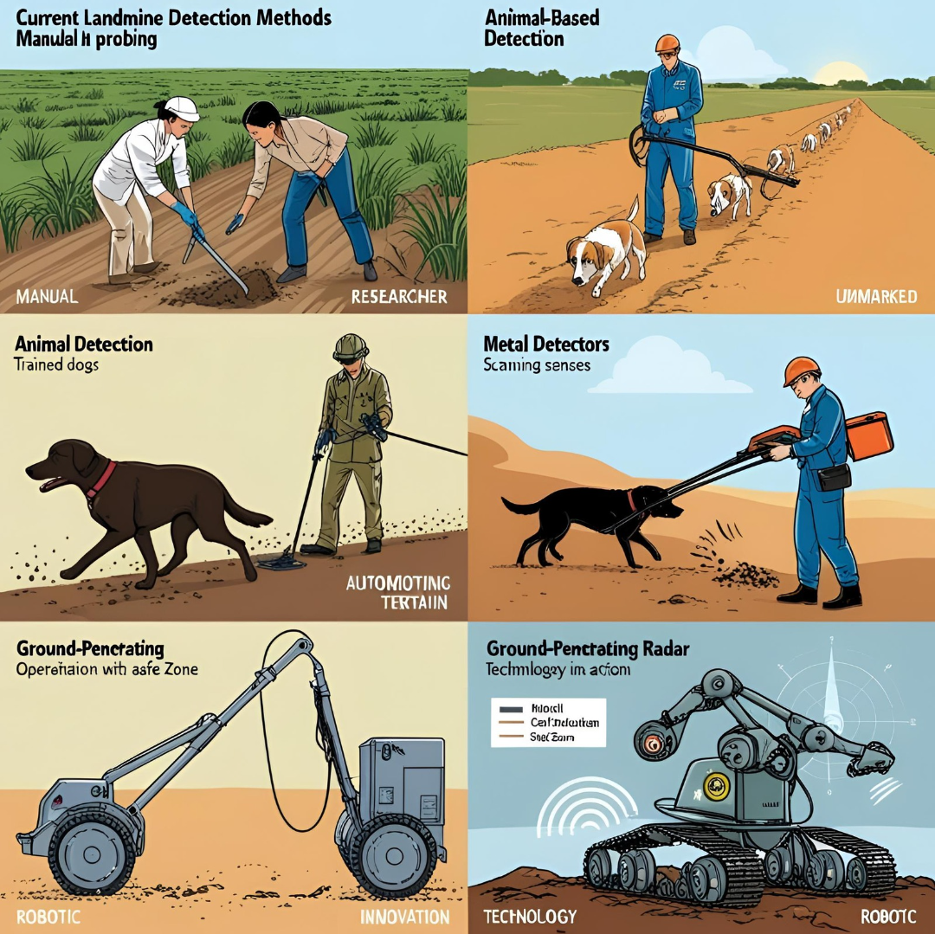

Slide 8
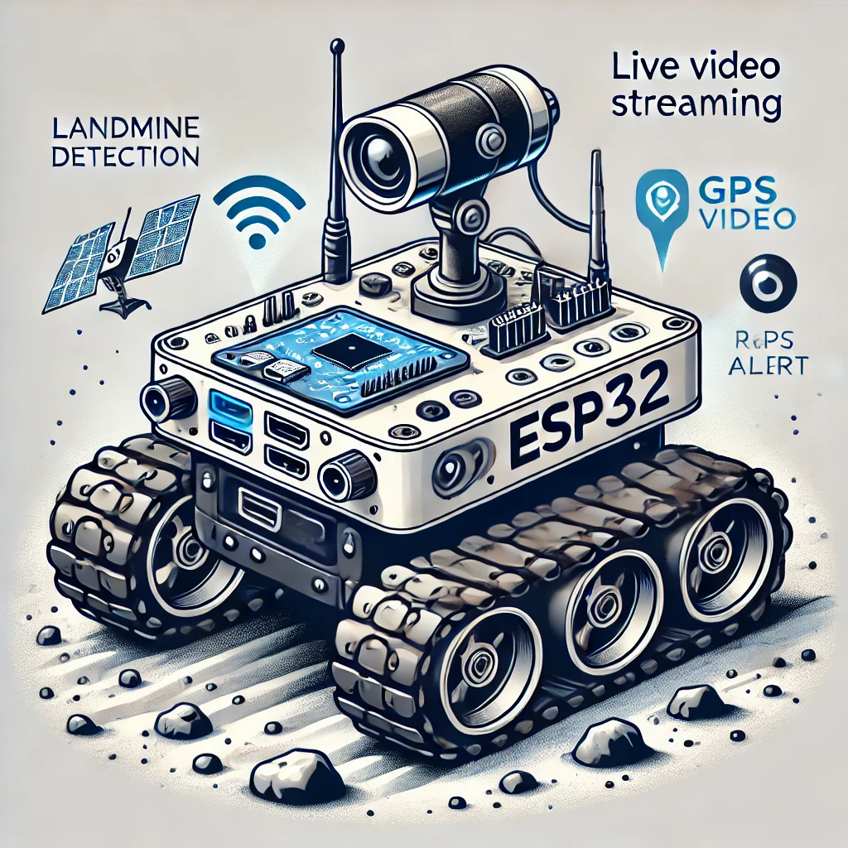
Proposed System
The proposed system uses an ESP32-controlled Landmine Detection Robot to improve safety and accuracy.
Rugged build and powerful DC motors for durability and control
Metal detector, buzzer, and LED for immediate alerts
Real-time video feedback for better decision-making
Robotic arm for safe interaction with objects
Optional GPS and AI integration for improved accuracy

Slide 9
Hardware Components:
Functional Features:
Detect underground metals
Remote camera monitoring for real-time visuals
Real-time alerts & remote control for instant action
Non-Functional Features:
Efficient power usage for longer operation
Modular and scalable for easy upgrades
Operates effectively in real-world terrain

Slide 10
Software Components:
Arduino IDE – For coding and uploading.
WiFi.h, ESP32Servo.h, WebServer.h, ESP32Cam.h – For connectivity, motor control, and video streaming.
MQTT, WebSockets – For real-time communication.
HTML/CSS/JavaScript – For web interface.

Slide 11
Methodology
System Design:
Use Arduino/ESP32 for central control and communication.
Integrate sensors, metal detectors, and camera for real-time feedback.
Robotic Arm Integration:
Attach a robotic arm for safe manipulation and marking of detected landmines.
Wireless Communication:
Utilize wireless modules for remote navigation and control.
Feedback Mechanism:
Implement real-time video and alerts (buzzer, LED) for operator safety.
Testing and Optimization:
Test the robot in varied terrains and optimize for efficient power usage and detection accuracy.

Slide 12
Modules Description
Detection: Metal Sensor for landmine identification
Movement: Motors + Drivers for mobility and terrain navigation
Vision: Wireless Camera for real-time visual feedback
Interaction: Robotic Arm for marking and handling objects
Alerting: Buzzer and LED for immediate operator notifications

Slide 13
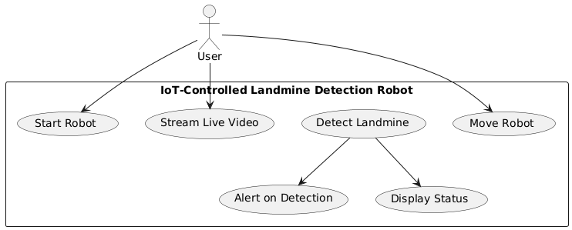
UML Diagrams
Use case Diagram :

Slide 14
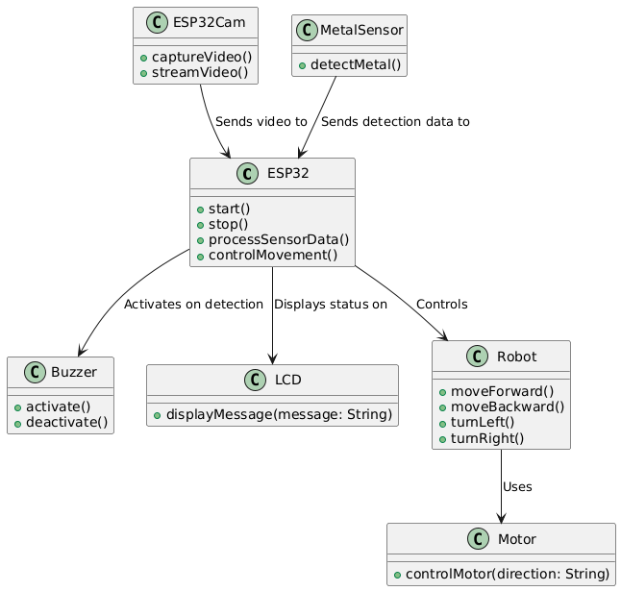
Class Diagram :

Slide 15
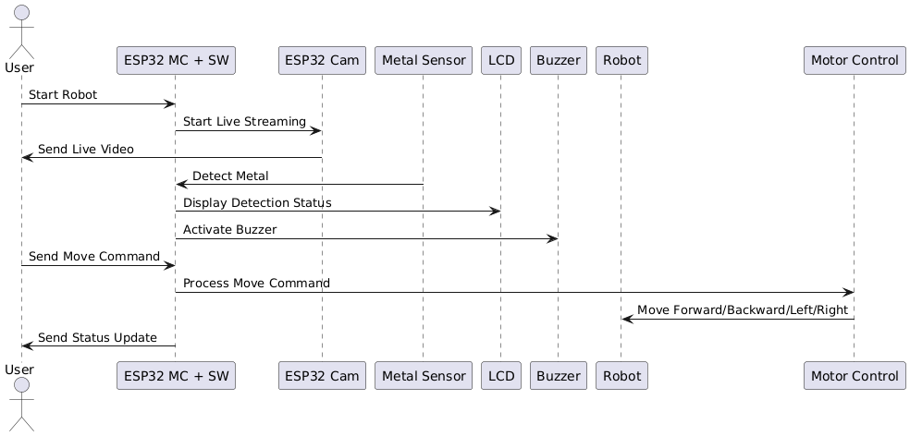
Sequence Diagram :

Slide 16
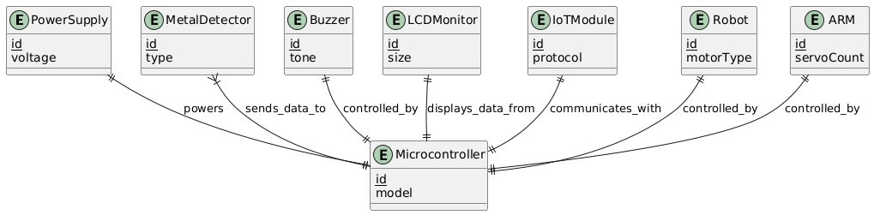
Entity-Relationship (ER) Diagram:

Slide 17
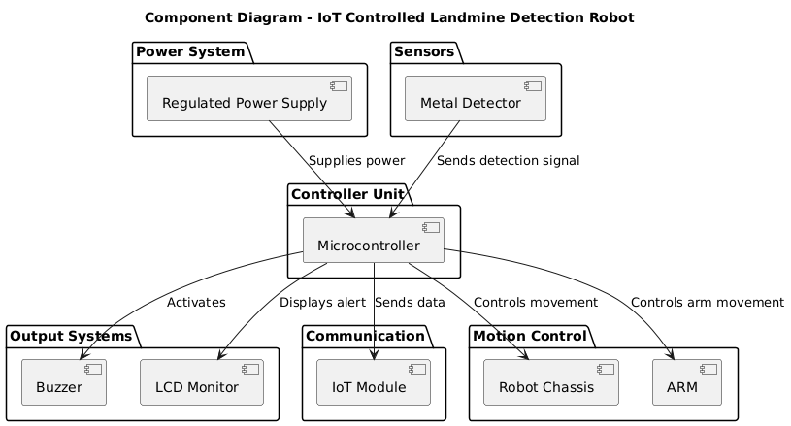
Component Diagram:

Slide 18
Implementation
Hardware: ESP32, sensors, robotic arm
Software: Arduino IDE, app interface
Connectivity: RF/Bluetooth/WiFi
Power: Rechargeable battery

Slide 19
Conclusion & Future scope :
The project has successfully developed a remote-controlled, safe, and live-streaming landmine detection robot, combining robust features like a metal sensor, wireless camera, robotic arm, and real-time alert systems. Moving forward, there are several planned upgrades to enhance its capabilities. AI integration will be added to improve the robot's ability to detect and classify various objects, distinguishing between landmines and scrap metal.
Additionally, GPS logging and mapping will be incorporated to provide accurate location tracking and better navigation in the field. To extend operational time, solar power will be integrated for longer endurance in challenging environments.

Slide 20
Thank You!!!

