Slide 1

Expense Management System Overview
This presentation will provide a comprehensive overview of our innovative Expense Management System, designed to streamline and optimize your financial well-being. Effective expense management is crucial for individuals and businesses alike, enabling you to make informed financial decisions and achieve your financial goals. We've incorporated a suite of modules and features to make your financial journey seamless and efficient.

Slide 2

Authentication Module
Sign In
Sign Up
OTP Verification
Forgot Password
Secure and reliable login for authorized users, ensuring data privacy and access control.
Easy registration process for new users, with clear instructions and intuitive forms.
Enhanced security with one-time passwords sent to registered devices, minimizing unauthorized access.
Convenient recovery options for users who have forgotten their login credentials, allowing them to regain access easily.

Slide 3
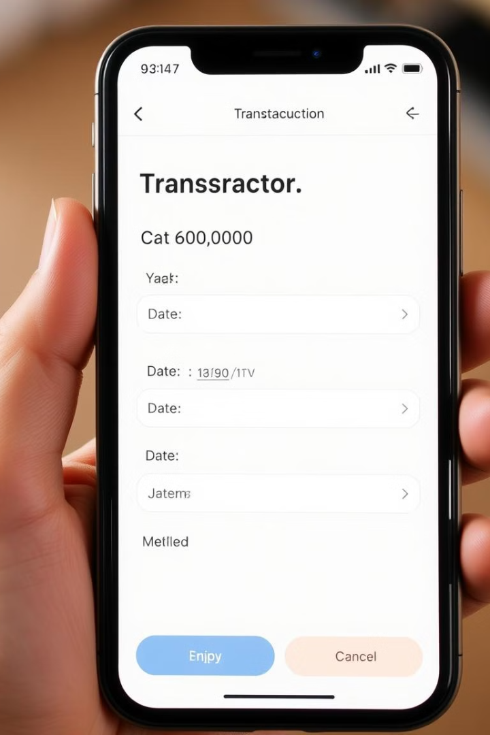
Add Transactions Module
Add Credit and Debit Transactions
Categorize Transactions
Effortlessly record all your financial transactions, including income and expenses, with detailed information.
Organize your transactions into meaningful categories (e.g., food, rent, entertainment) for better analysis and understanding.
Customize Transaction Details
Personalize each transaction with relevant notes, descriptions, and attachments for increased clarity.

Slide 4
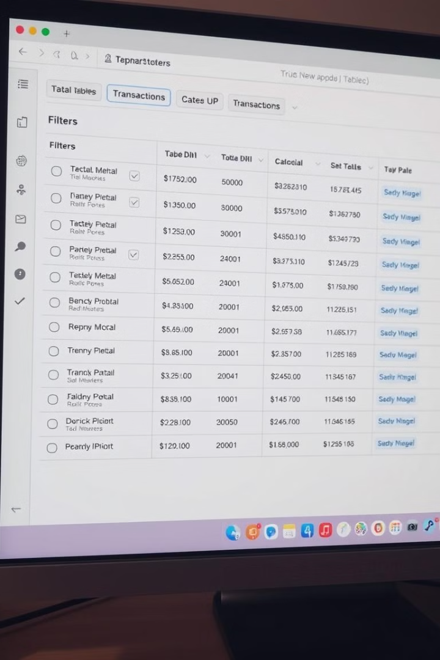




Manage Transactions Module
Filter by Payment Method
Edit/Delete Transactions
Easily filter transactions by payment method (e.g., card, cash, UPI) for quick insights.
Modify or remove incorrect transactions with ease, maintaining accuracy in your records.
Month-wise and Year-wise Filtering
Categorize and Sort Transactions
Analyze your financial data in specific timeframes, such as monthly or yearly, for trend analysis.
Organize your transactions by categories and sort them by date, amount, or payment method for easy access.

Slide 5
Monthly Insights Module
1
Month-Wise Summary
2
Visual Representations
3
Comparative Analysis
A comprehensive overview of income, expenses, and net savings for the current month.
Interactive charts and graphs, like pie charts, bar graphs, and line graphs, provide a visual representation of financial data.
Track financial progress by comparing current month's data with previous months for insightful trends.

Slide 6




Profile Module
Update Settings
1
Modify personal information, including contact details, address, and profile picture.
Change Themes
2
Customize the system's user interface with different themes and color palettes for a personalized experience.
Change Password
3
Securely update your password to protect your account from unauthorized access.
Manage Preferences
4
Configure various settings, including notification preferences, privacy settings, and account activity.

Slide 7
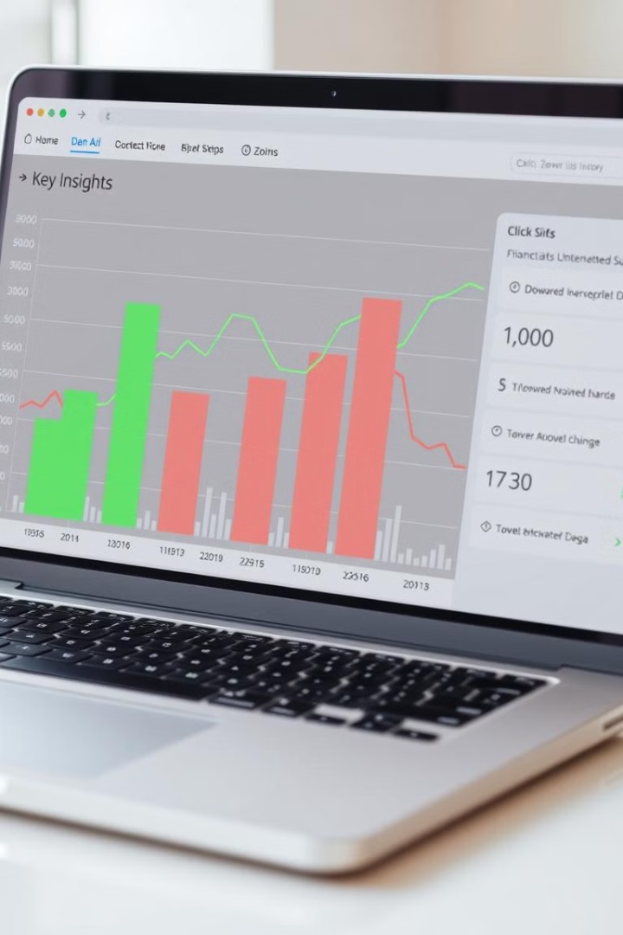



AI Insights Module
Suggested Goals
Receive personalized financial goals based on your income, spending patterns, and financial aspirations.
Personalized Tips
Benefit from AI-driven recommendations and strategies to help you achieve your financial goals faster.
Predictive Analysis
Gain insights into future expenses and savings based on historical data and current trends, enabling proactive financial planning.

Slide 8
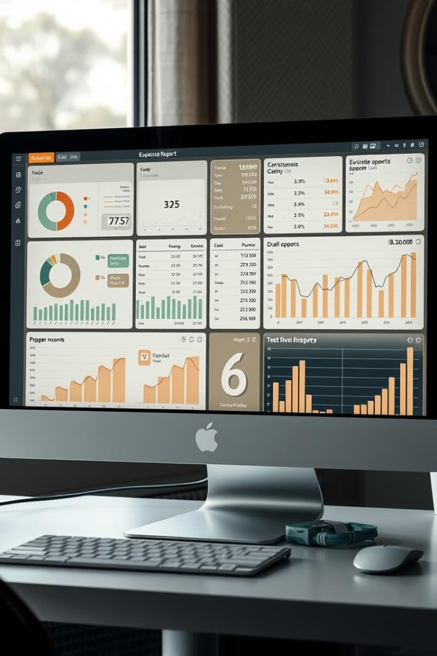
Reports Module
1
2
Custom Reports
PDF/Excel Export
Generate reports tailored to your specific needs, focusing on expenses, savings, and financial performance.
Export reports in various formats for easy sharing, printing, and offline access.
3
4
Data Visualization
Monthly Insights
Visualize your financial data with interactive charts and graphs for a deeper understanding of trends and patterns.
Receive detailed monthly analysis of your credit and debit transactions, providing a comprehensive overview of your financial activity.

Slide 9
Savings Tracking Module
Monthly Savings Display
1
Track your monthly savings after deducting your expenses, providing a clear picture of your financial progress.
Cumulative Savings Progress
2
View your overall savings accumulation over time, motivating you to reach your financial goals.
Real-time Tracking
3
Monitor your savings in real-time, providing instant feedback on your financial progress.

Slide 10
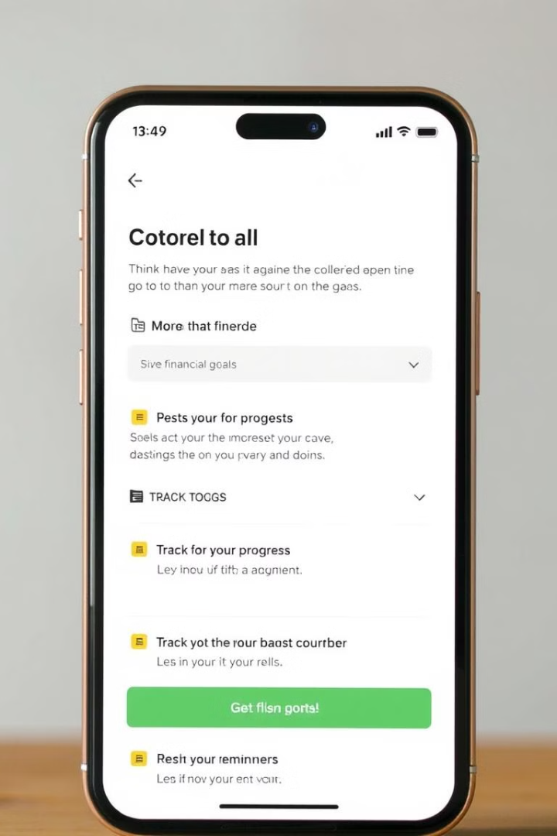
Goal Setting and Monitoring Module
1
Set Monthly Goals
2
Track Progress
Establish clear financial goals for each month, categorized by areas such as saving, spending limits, or investments.
Monitor your progress towards your goals in real-time, receiving updates on your achievements and areas for improvement.

Slide 11
Budgeting Tools Module
Category-Wise Budgets
Budget Limit Notifications
Detailed Expense Tracking
Create and manage budgets for different categories, like groceries, travel, and bills.
Receive notifications when you exceed budget limits, helping you stay on track.
Track expenses per category, providing insights into spending patterns.

Slide 12
Joint Account Module
Group Creation and Management: Invite collaborators to join your account with customized roles (e.g., administrator, viewer, contributor) and easily manage member access.
Account Switching: Seamlessly switch between your personal account and shared joint accounts, providing a convenient and efficient user experience with clear visual indicators of the currently active account.
Shared Expense Tracking: Track shared transactions with detailed categorization. Easily allocate expenses among collaborators, and generate reports on individual contributions to maintain transparency.
Collaborative Goals and Budgets: Set and monitor financial goals specific to your joint account, collaborating on budgeting and savings targets. Track progress toward shared objectives and make adjustments as needed.
Notifications and Insights: Receive real-time alerts and reports for shared account activities, including transaction updates, budget changes, and low-balance warnings. Gain valuable insights into joint account performance.

