Slide 1
INTERNET AND WEB TECHNOLOGY LAB
TOOLS TO BE USED :
1. HTML/CSS 2. JAVASCRIPT 3. PHP 4. MYSQL
SUBMITTED BY :
1. RISHABH SETHI ( 16IT8061 )
2. GUNTURU SAI YASHWANTH REDDY ( 16IT8062 )
3. APURVA SINGH ( 16IT8063 )

Slide 2
WORK DIVISION
GUNTURU SAI YASHWANTH REDDY - HTML/CSS
RISHABH SETHI - JAVASCRIPT
APURVA SINGH - PHP
Database (ie. MYSQL) will be handled by the entire team.

Slide 3
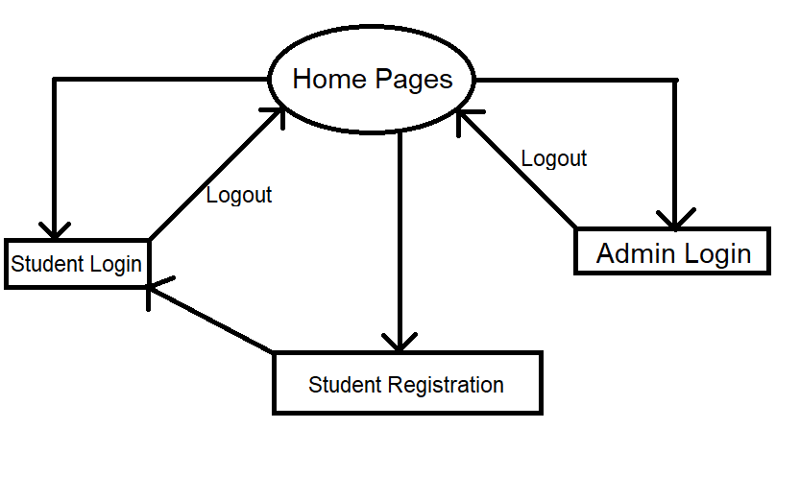
Work Panel

Slide 4
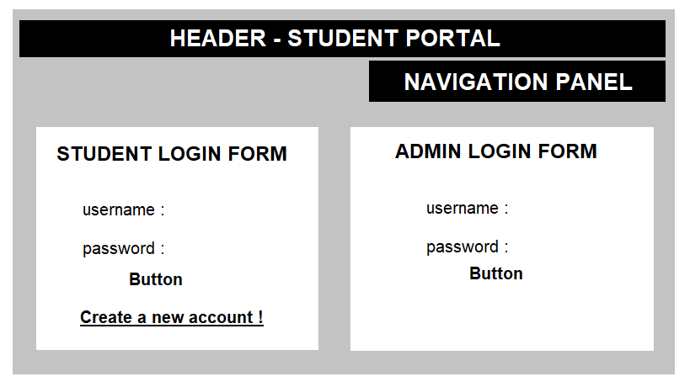
PAGE DESCRIPTION
Home Page :

Slide 5
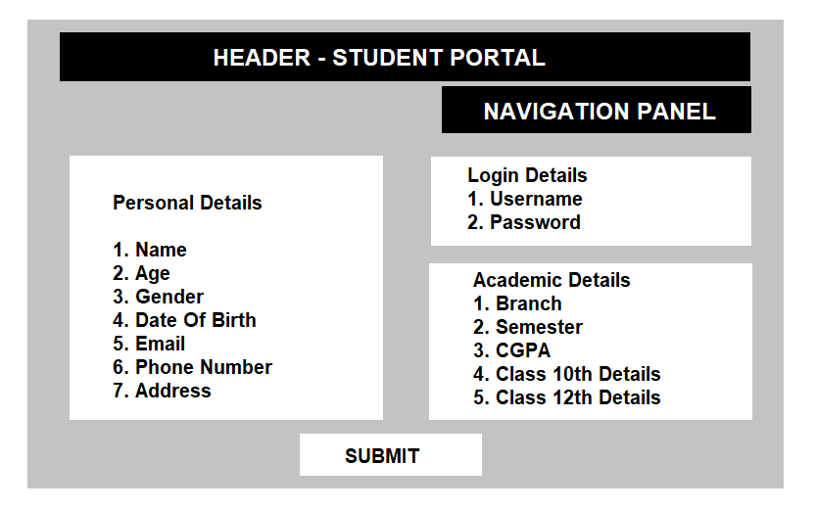
PAGE DESCRIPTION
Registration Page :

Slide 6
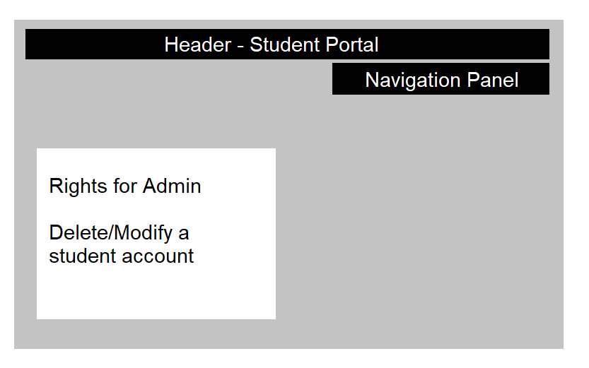
PAGE DESCRIPTION
Admin Panel :

Slide 7
WORK DIVISION
GUNTURU SAI YASHWANTH REDDY - HTML/CSS
RISHABH SETHI - JAVASCRIPT
APURVA SINGH - PHP
Database (ie. MYSQL) will be handled by the entire team.

Slide 8
2nd WEEK
(24/01/19—30/01/19)

Slide 9
TOOLS USED
HTML
CSS

Slide 10
WORK DIVISION
GUNTURU SAI YASHWANTH REDDY - HTML and CSS
RISHABH SETHI - CSS and PPT
APURVA SINGH - HTML and PPT

Slide 11
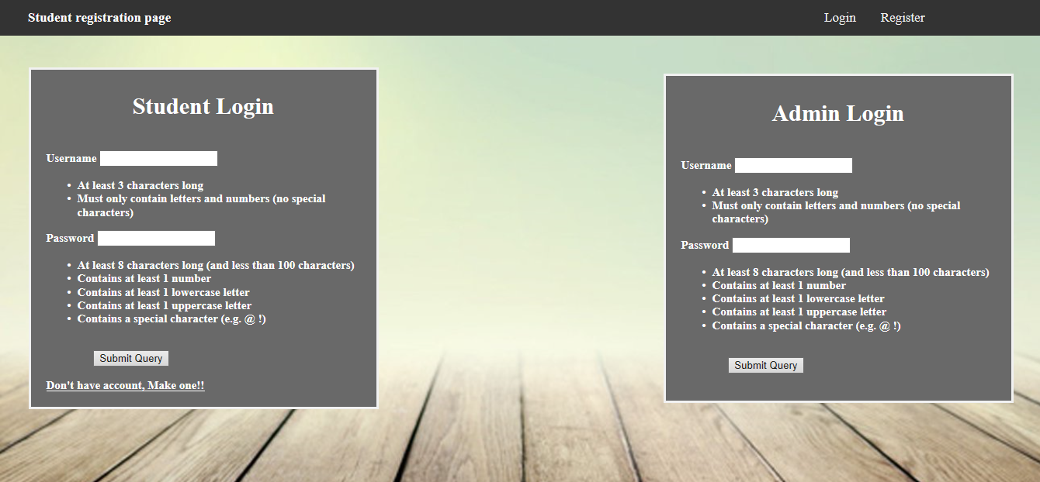
PAGE DESCRIPTION
Home Page :

Slide 12
PLAN FOR NEXT WEEK
To design registration page.
To link registration page with homepage.

Slide 13
WEEK 3
29/01/2019 to 06/02/2019

Slide 14
WORK DIVISION
Everyone was supposed to make a new Registration page. We selected the best page out of all 3.
PPT was done by Apurva and Rishabh
Registration page was visualised by Yashwant. Edited by Rishabh and Apurva

Slide 15
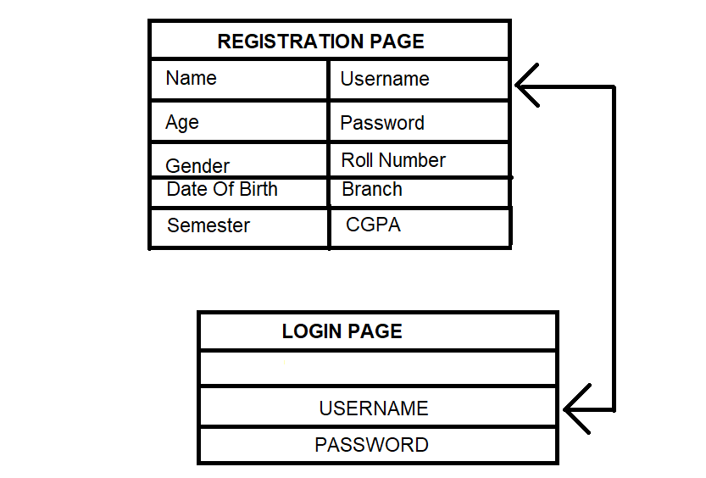
29/01/2019 to 06/02/2019
DATABASE SCHEMA

Slide 16
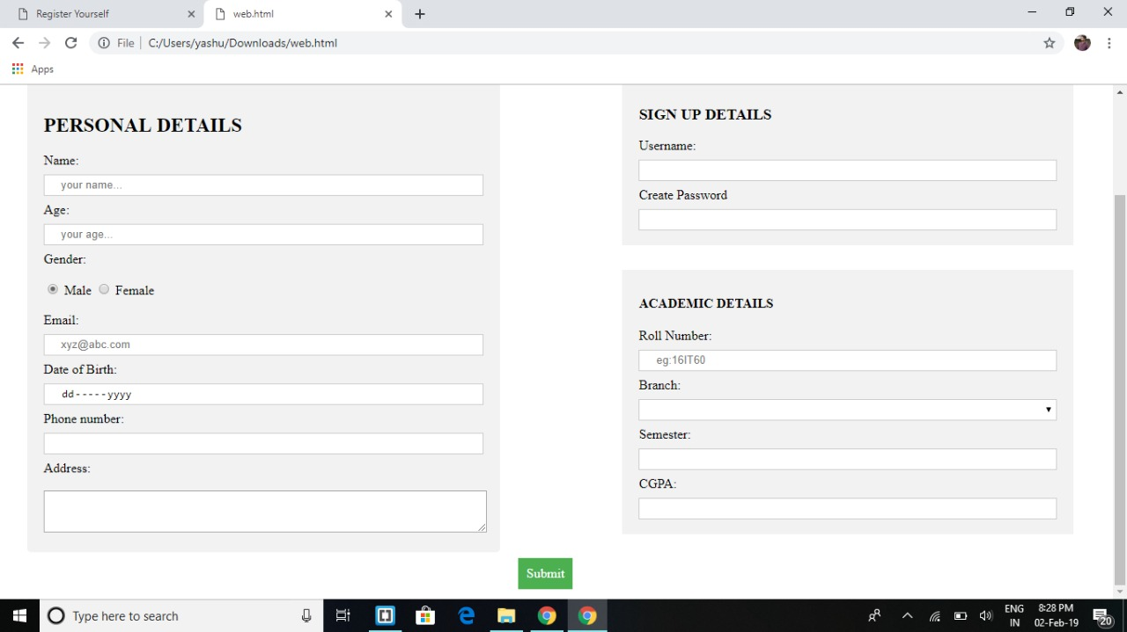
29/01/2019 to 06/02/2019
Registration Page

Slide 17
29/01/2019 to 06/02/2019
Fields Used
Text Field
Password
Radio Button
Drop Down Menu
Date
Text Area
Submit Button

Slide 18
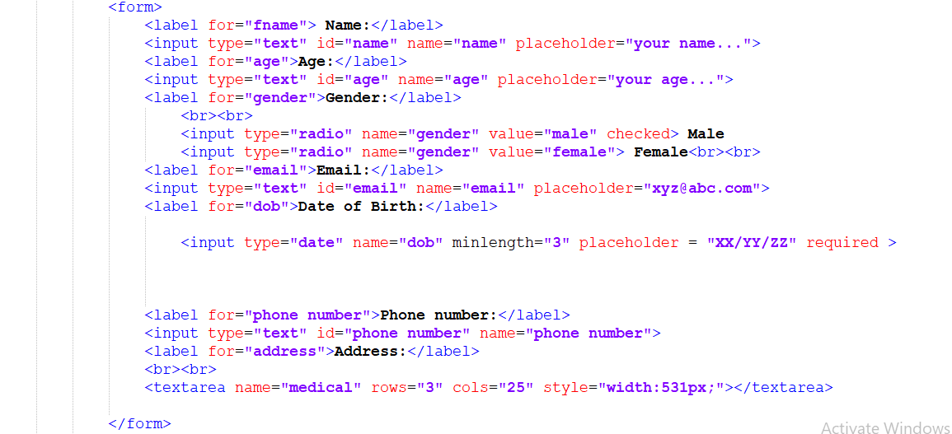
29/01/2019 to 06/02/2019
Code Snippet from Registration Form

Slide 19
29/01/2019 to 06/02/2019
Plan for next week
Try to learn Javascript and implement the basics form validation through javascript.

Slide 20
WEEK 4
07/02/2019 to 13/02/2019

Slide 21
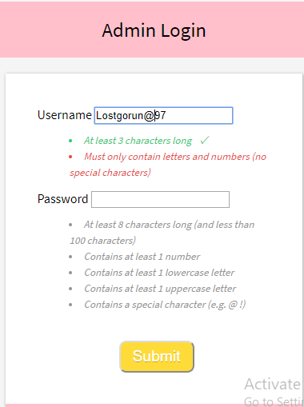
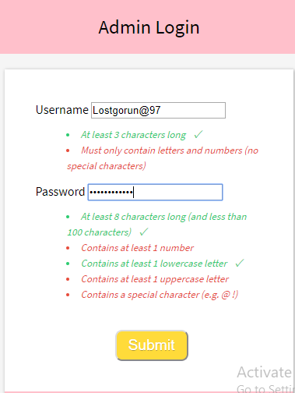
07/02/2019 to 13/02/2019
Login Form Validation

Slide 22
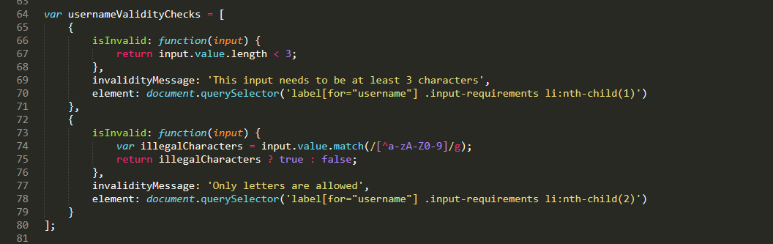
07/02/2019 to 13/02/2019
Login Form Validation

Slide 23
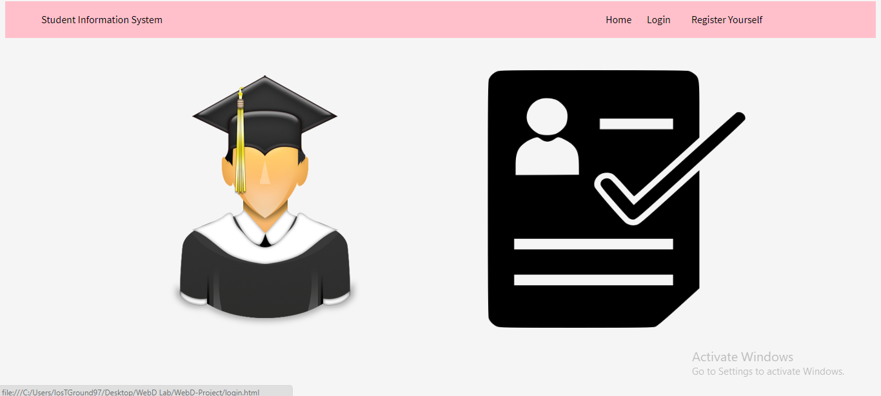
07/02/2019 to 13/02/2019
Addition Of Home Page

Slide 24
07/02/2019 to 13/02/2019
WORK DIVISION
Everyone was supposed to make a script file for form validation. We selected the best page out of all 3.
PPT was done by Apurva and Yashwant
Form validation was scripted by Rishabh. Edited by Yashwant and Apurva

Slide 25
07/02/2019 to 13/02/2019
Plan For Next Week
Implementation Of Form Vallidation on Register page.

Slide 26
WEEK 5
14/02/2019 to 20/02/2019

Slide 27
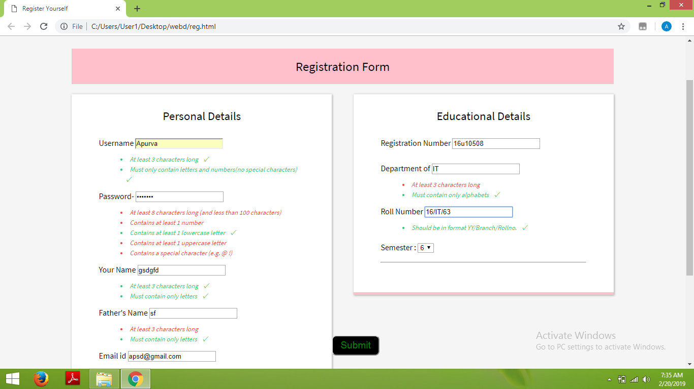
14/02/2019 to 20/02/2019
Registration Form Validation

Slide 28
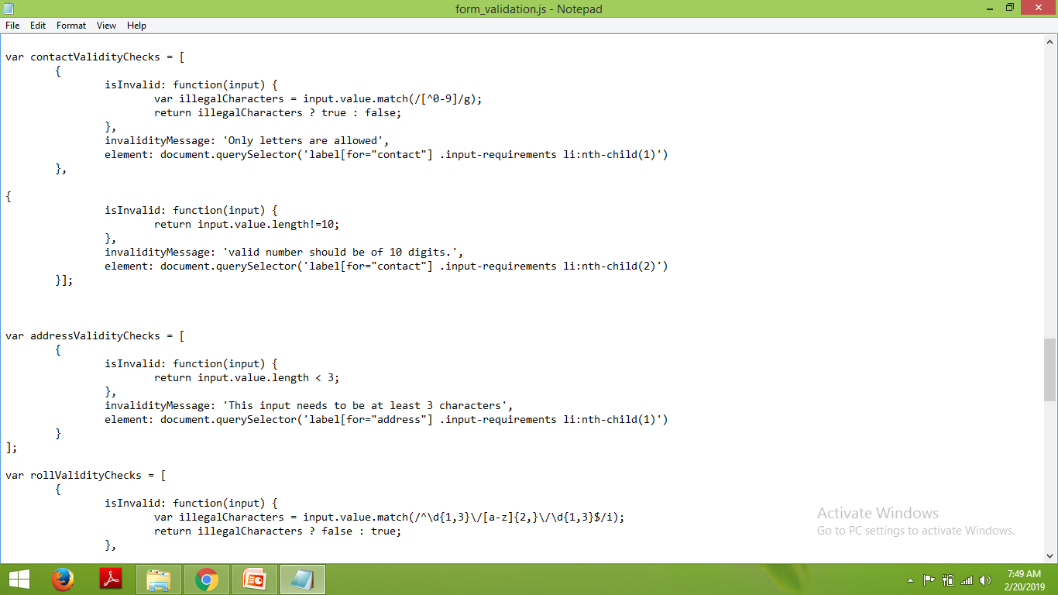
14/02/2019 to 20/02/2019
Registration Form Validation

Slide 29
14/02/2019 to 20/02/2019
WORK DIVISION

Slide 30
14/02/2019 to 20/02/2019
Plan For Next Week
Implementation Of Database schema .
Auto calculation of Age from Date of Birth.

Slide 31
WEEK 6
27/02/2019 to 06/03/2019

Slide 32
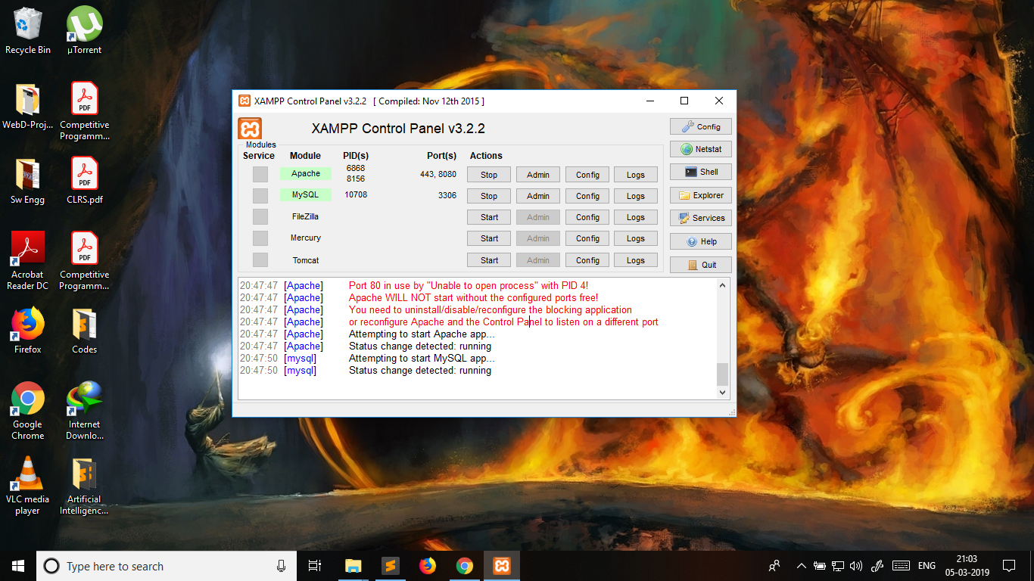
27/02/2019 to 06/03/2019
Installation of Apache Server for PHP

Slide 33
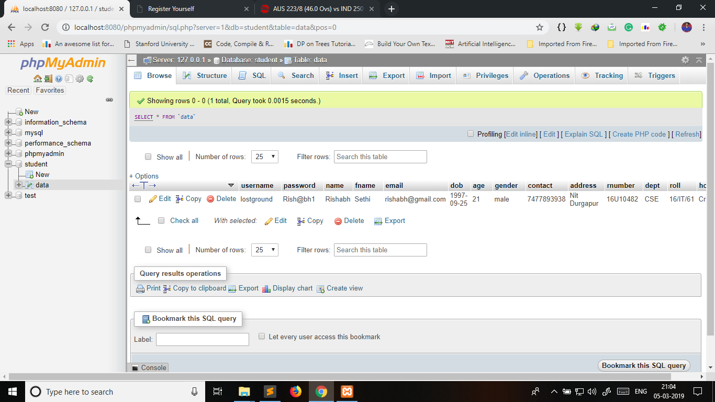
27/02/2019 to 06/03/2019
Implementation of DataBase

Slide 34
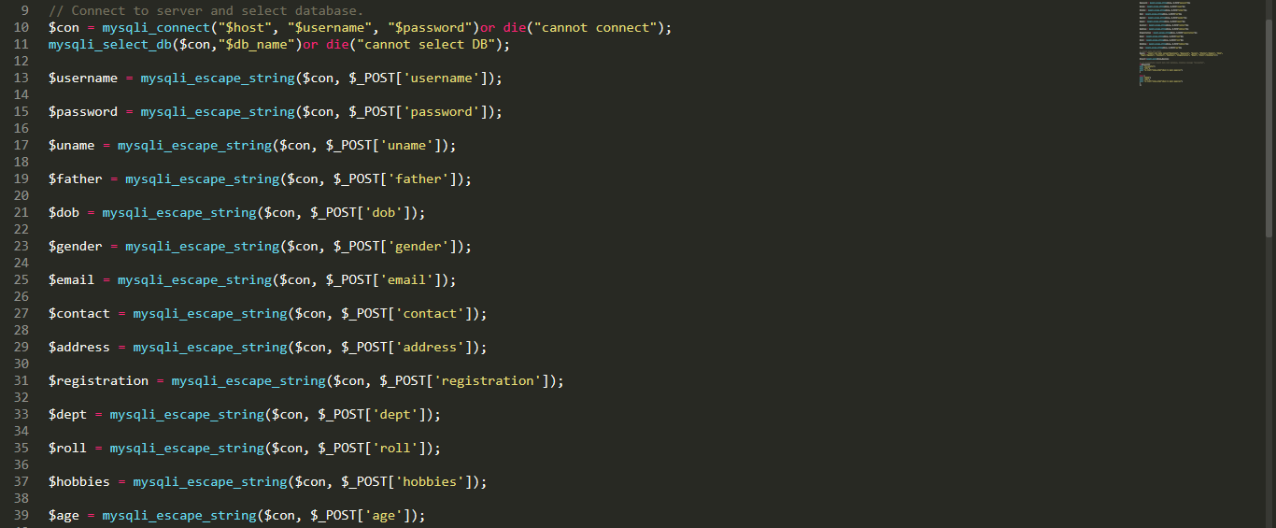
27/02/2019 to 06/03/2019
PHP Code

Slide 35
27/02/2019 to 06/03/2019
Work Division
1. Creation of Database and Table : Yashwant
2. Code for PHP : Rishabh and Apurva
3. PPT : Apurva

Slide 36
27/02/2019 to 06/03/2019
Plan For Next Week
Connecting Login Form with PHP and MYSQL database
Creating of Student Panel

Slide 37
WEEK 7
06/03/2019 to 13/03/2019

Slide 38
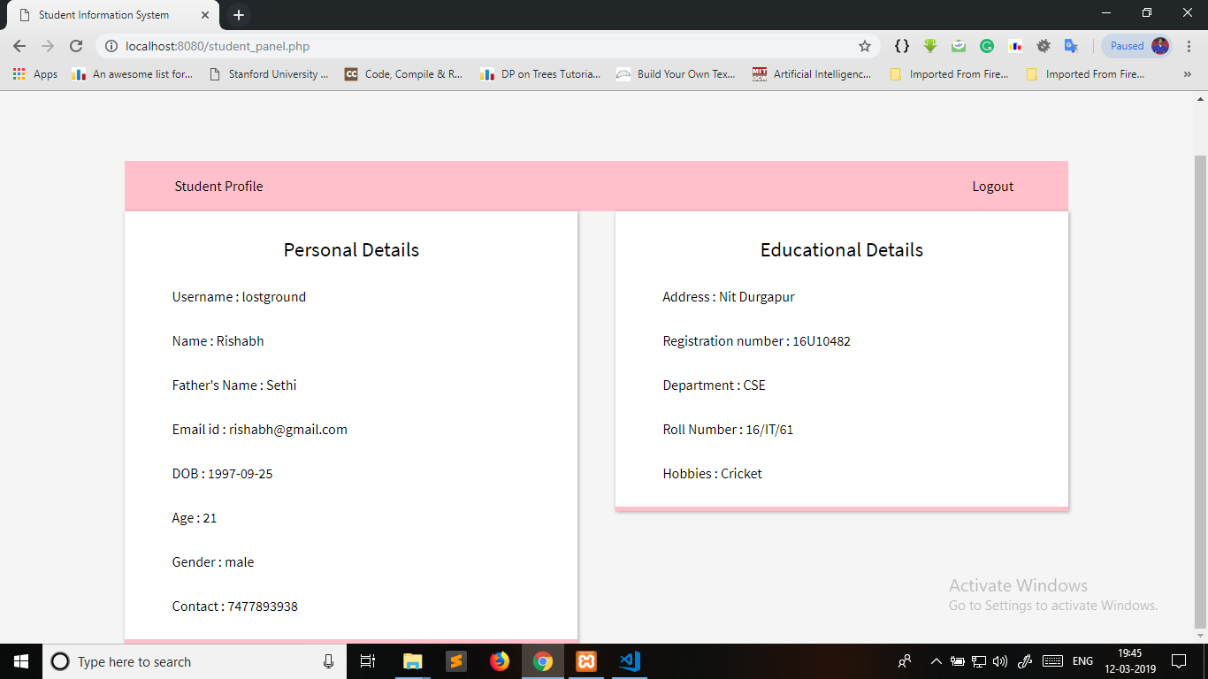
06/03/2019 to 13/03/2019
Student Panel

Slide 39
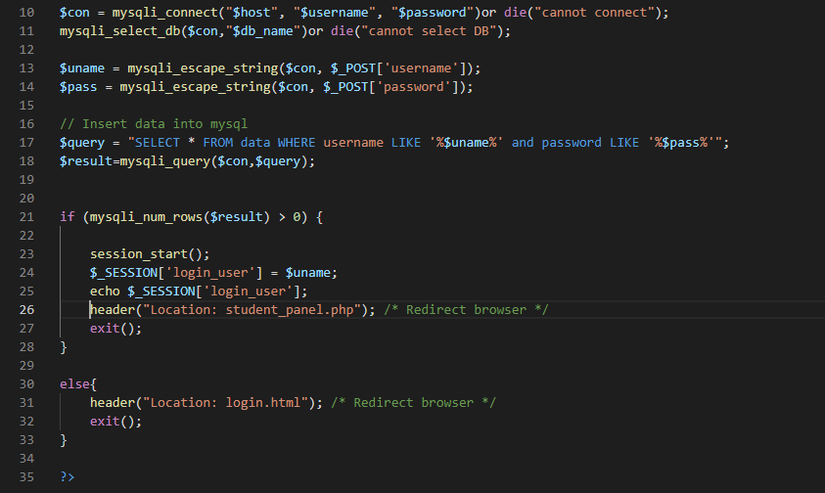
06/03/2019 to 13/03/2019
Code For PHP file in Login Form

Slide 40
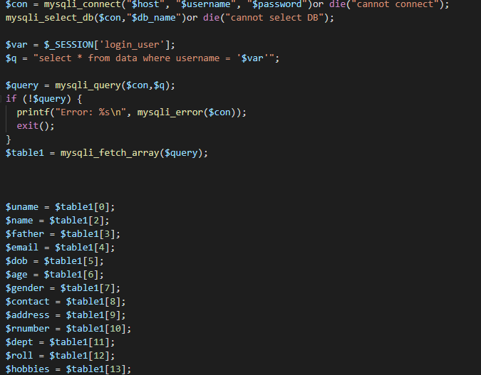
06/03/2019 to 13/03/2019
Code For PHP file in Student Panel

Slide 41
06/03/2019 to 13/03/2019
Work Division
1. Connecting PHP with LOGIN form: Yashwant Apurva
2. Student Panel : Rishabh
3. PPT : Yashwant

Slide 42
06/03/2019 to 13/03/2019
Plan For Next Week
Admin Panel

