Slide 1

Advancements in Health Prediction Using Machine Learning Techniques (Heart Disease)
University at Albany – State University of New York
Presented by Yashwanth Kotha

Slide 2
Contents
Introduction
Dataset Overview
Methodologies
Visualizations
Data Analysis
Machine learning
Results
Conclusions

Slide 3
Introduction
Recent years have seen a major rise in heart illness, particularly in the wake of the COVID-19 pandemic, which has been connected to a rise in cardiovascular problems.
More and more people are having unexpected medical crises, frequently without warning signs or knowledge of their underlying illnesses.
Machine learning presents a viable way to anticipate heart diseases based on lifestyle and medical data, which helps to solve this pressing problem.
We can find people who could be at risk of heart disease by using prediction algorithms to examine trends and risk factors.
Timely medical care made possible by early discovery can increase awareness and possibly save lives.

Slide 4
Flowchart
Data Collection
Data preprocessing
Exploratory Data Analysis
Statistical Analysis
Model training and validation
Final Model

Slide 5
Methodologies
List of the methodologies that are found in research papers are given below
Logistic regression
Decision tree
Random forest
Support Vector Machine
Naïve Bayes
Multilayer perceptron
XGBoost(Extreme Gradient Boosting)
K-Nearest Neighbors (KNN)
Probability

Slide 6
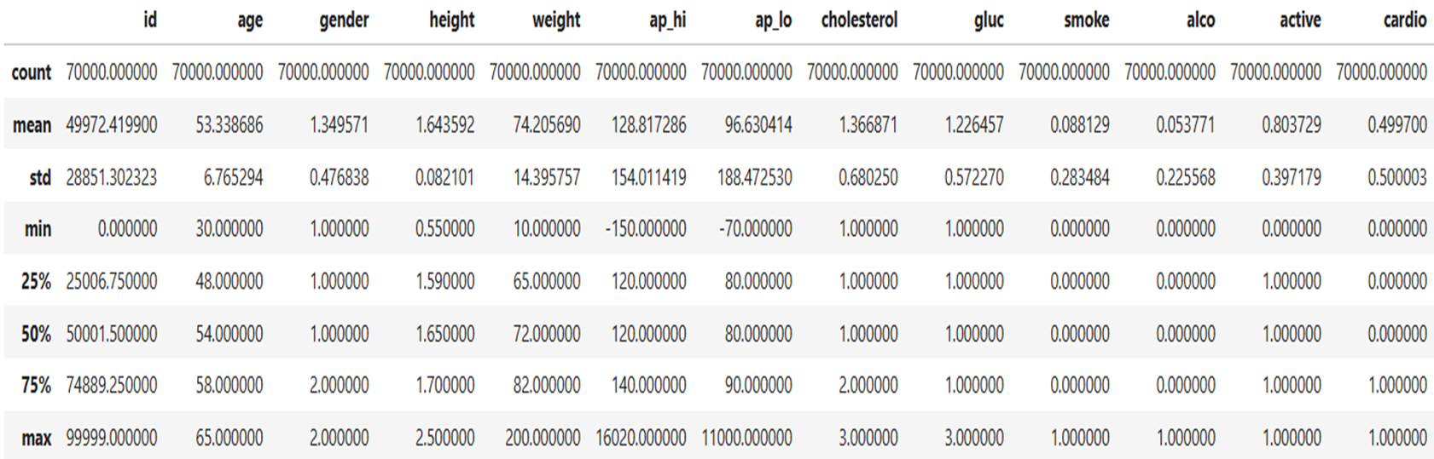
Dataset Overview
This Dataset collected from one of the journals that I have worked on.
It has over 70000 entries and 13 features including target variable.
The features include id, age, gender, height, weight, ap_hi, ap_ho, cholesterol, glucose, smoke, alcohol, active and cardio(1 or 0).
The target variable says whether a patient with above feature has cardio disease or not(1 or 0).

Slide 7
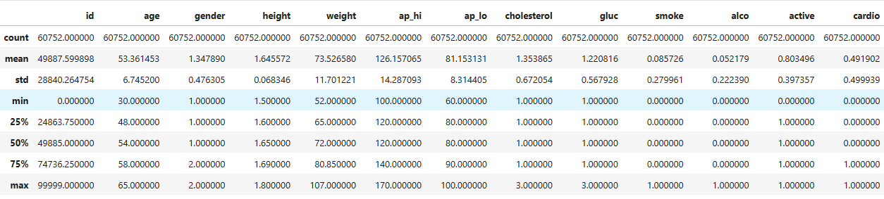
Data Cleaning
Some features contains outliers like age, height, ap_hi, ap_lo were filtered to exclude outliers by keeping only the values that fall within the 2.5th percentile and the 97.5th percentile. Resultant dataset consists of 60752 entries.

Slide 8
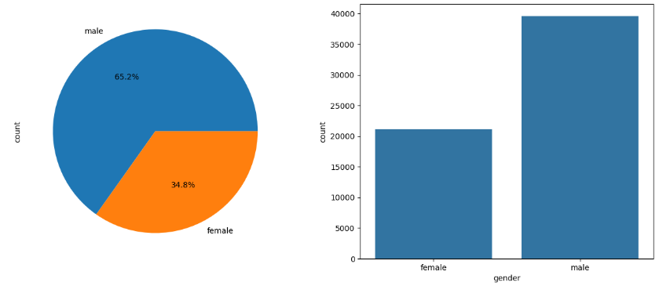
Exploratory Data Analysis
Understanding the relationships between variables using data visualizations.
Displaying the counts of how often each category.

Slide 9
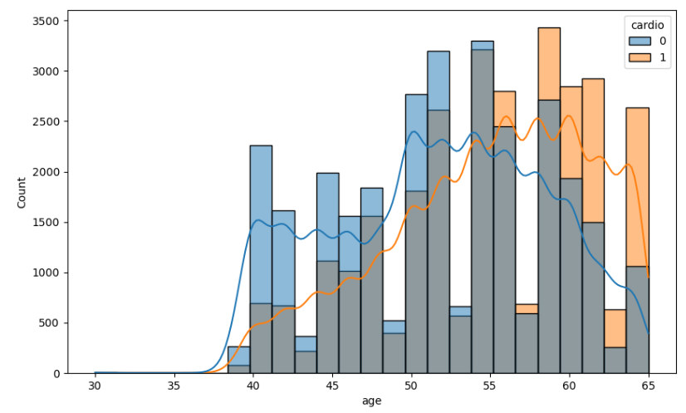
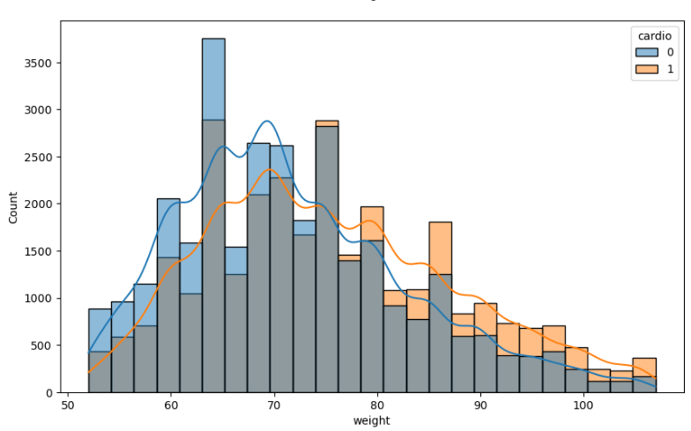
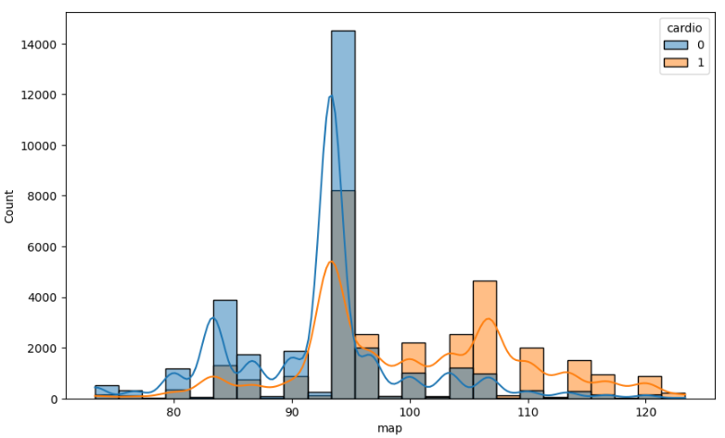
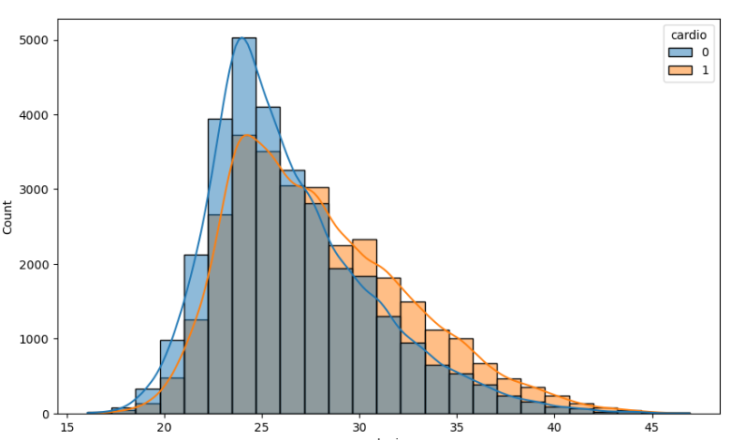
Exploratory Data Analysis

Slide 10
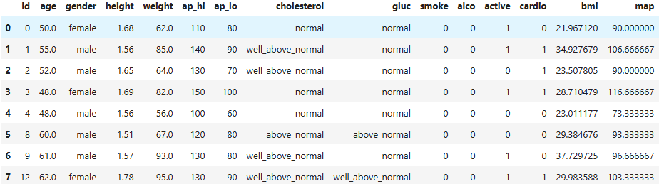
Feature Engineering
Creating new features using existing features Created new features BMI(Body Mass Index) and MAP(Mean Arterial Pressure) using features ap_lo and ap_hi . BMI=weight/height^2 MAP = (2*ap_lo + ap_hi )/3
Categorizing cholesterol & glucose columns into normal, above_normal, and well above normal

Slide 11
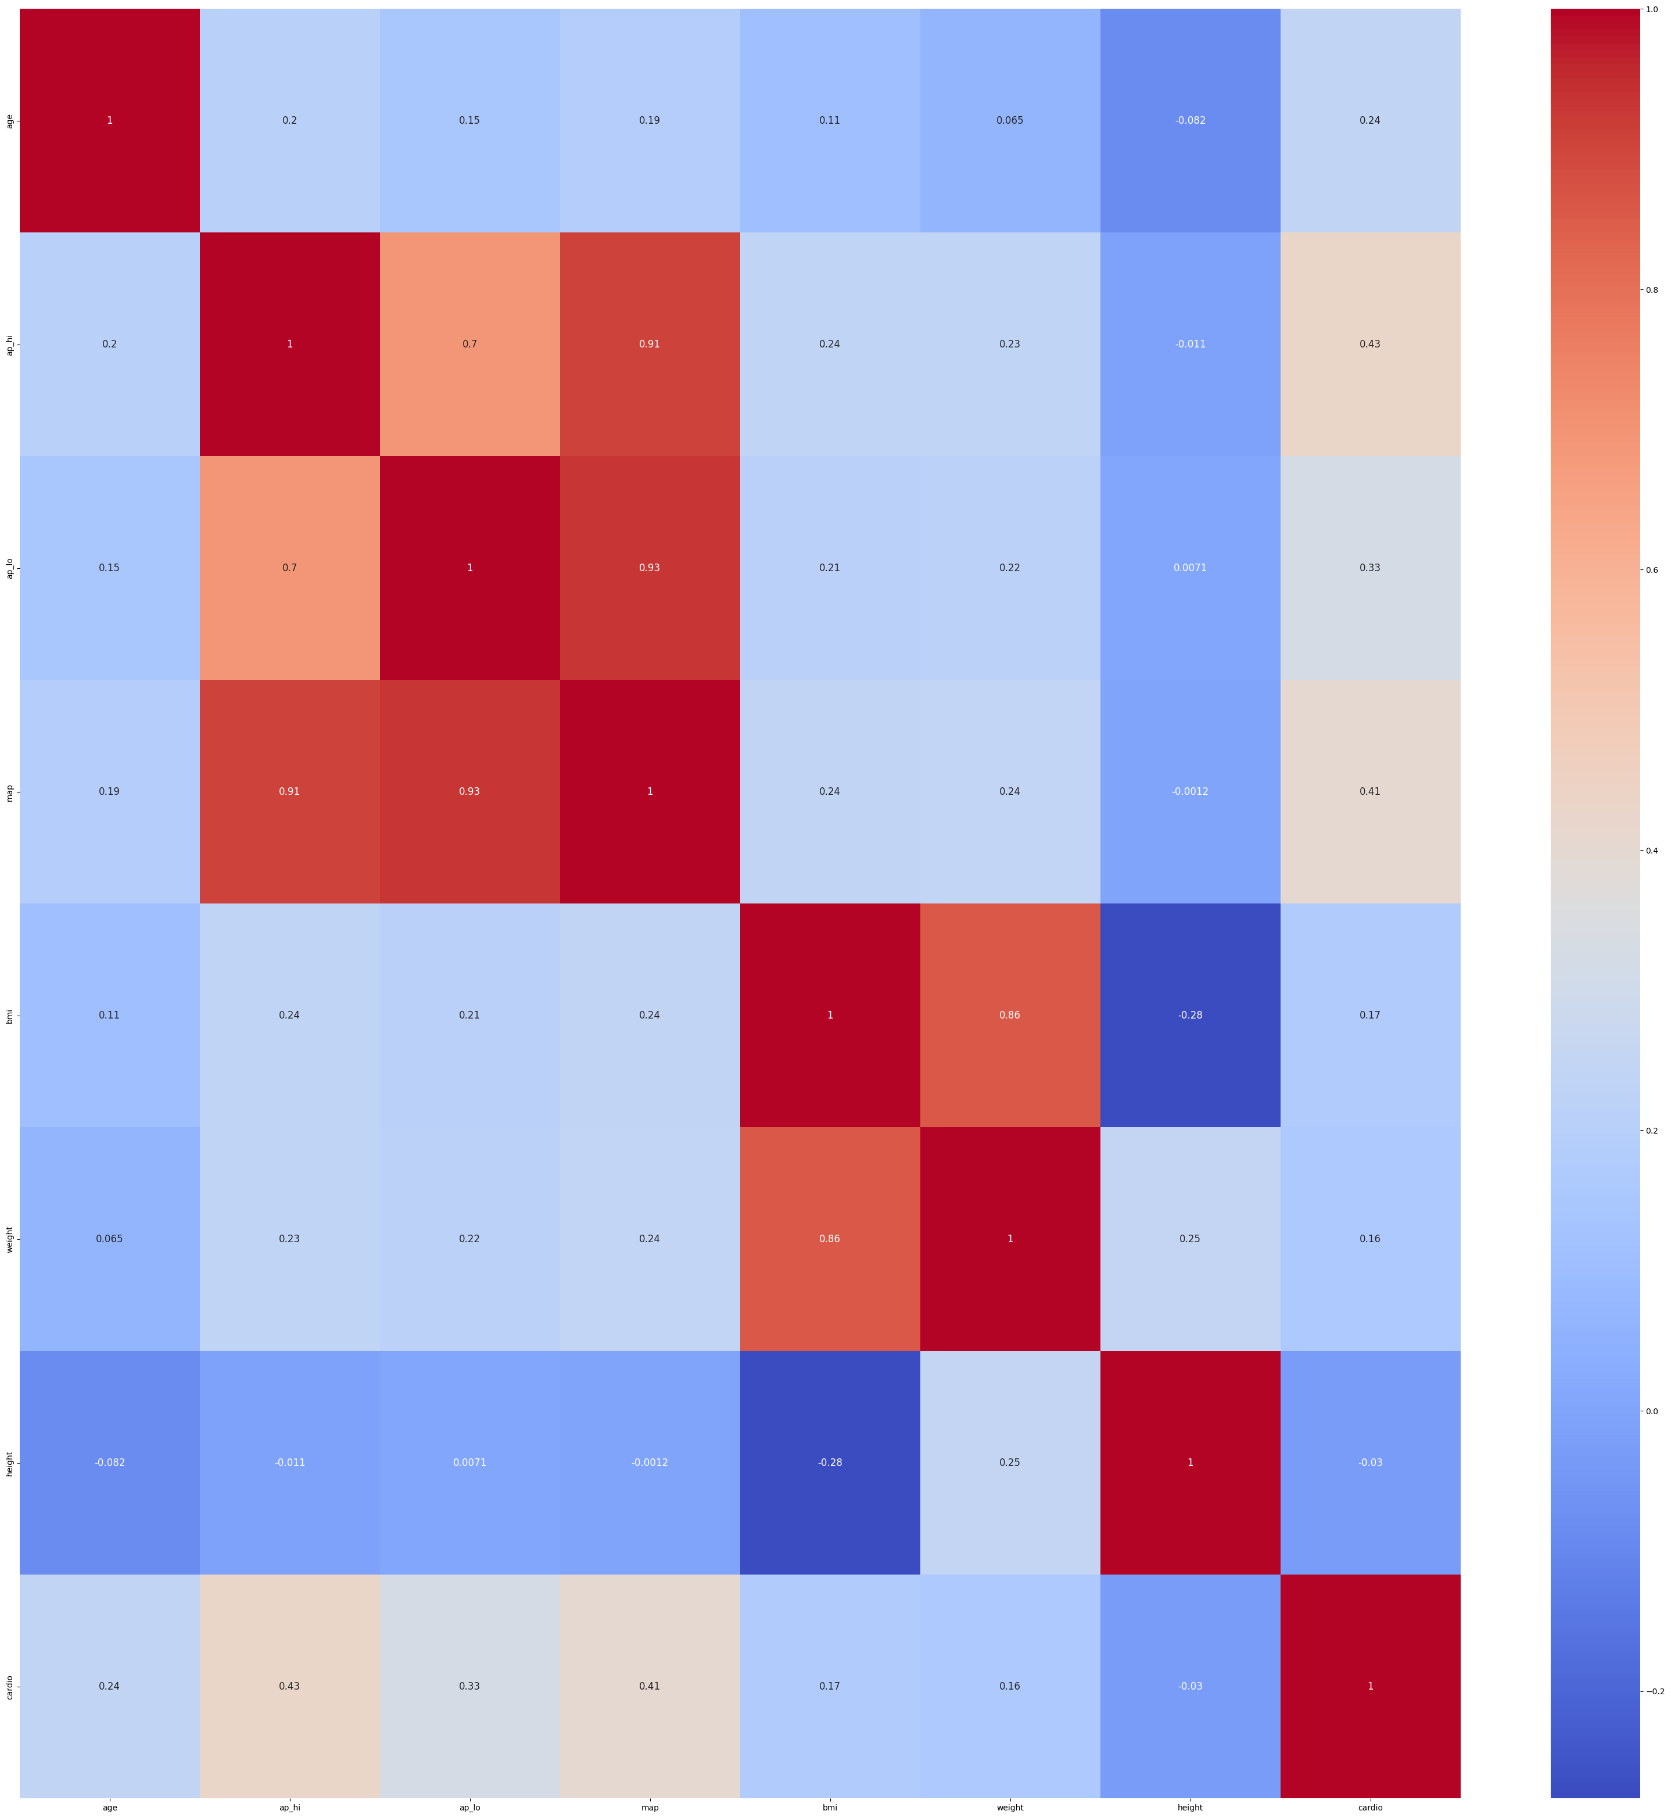
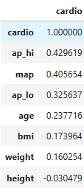
Correlation matrix using heat map

Slide 12
Probability
Given a dataset, the probability of an event occurring can be calculated using:
P(Event) = Number of Favorable Outcomes/Total Number of Outcomes
Probability of a patient having cardio disease between different age groups is given below: Probability of a patient having cardio disease from age between 0 and 10 is 0.0 Probability of a patient having cardio disease from age between 10 and 20 is 0.0 Probability of a patient having cardio disease from age between 20 and 30 is 0.0 Probability of a patient having cardio disease from age between 30 and 40 is 0.0012180668949170398 Probability of a patient having cardio disease from age between 40 and 50 is 0.09309981564392941 Probability of a patient having cardio disease from age between 50 and 60 is 0.24886423492230708 Probability of a patient having cardio disease from age between 60 and 70 is 0.14871938372399263

Slide 13
Probability
Probabilities Related to Cholesterol Levels and Cardiovascular Disease
For Normal Cholesterol (Cholesterol = 1) P(Cardio = 1 | Cholesterol = 1) = 0.435
P(Cardio = 0 | Cholesterol = 1) = 0.565
For Above Normal Cholesterol (Cholesterol = 2)
P(Cardio = 1 | Cholesterol = 2) = 0.593
P(Cardio = 0 | Cholesterol = 2) = 0.407
For Well Above Normal Cholesterol (Cholesterol = 3)
P(Cardio = 1 | Cholesterol = 3) = 0.759
P(Cardio = 0 | Cholesterol = 3) = 0.241
Insights
• As cholesterol levels increase, the probability of cardiovascular disease (P(Cardio = 1)) increases significantly.
• For normal cholesterol levels, the likelihood of no cardiovascular disease (P(Cardio = 0)) is higher.
• For well above normal cholesterol levels, the likelihood of cardiovascular disease (P(Cardio = 1)) dominates.

Slide 14
Probability
Probabilities Related to Weight and Cardiovascular Disease
For Low Weight
P(Cardio = 1 | Weight = Low) = 0.406
P(Cardio = 0 | Weight = Low) = 0.594
For Normal Weight
P(Cardio = 1 | Weight = Normal) = 0.454
P(Cardio = 0 | Weight = Normal) = 0.545
For High Weight
P(Cardio = 1 | Weight = High) = 0.517
P(Cardio = 0 | Weight = High) = 0.483
For Very High Weight
P(Cardio = 1 | Weight = Very High) = 0.605
P(Cardio = 0 | Weight = Very High) = 0.395
Insights
• As weight increases, the probability of cardiovascular disease (P(Cardio = 1)) increases significantly.
• Conversely, the probability of no cardiovascular disease (P(Cardio = 0)) decreases with increasing weight.

Slide 15
Probability
Probabilities Related to Glucose Levels and Cardiovascular Disease
For Normal Glucose (Glucose = 1)
P(Cardio = 1 | Glucose = 1) = 0.474
P(Cardio = 0 | Glucose = 1) = 0.526
For Above Normal Glucose (Glucose = 2)
P(Cardio = 1 | Glucose = 2) = 0.578
P(Cardio = 0 | Glucose = 2) = 0.422
For Well Above Normal Glucose (Glucose = 3)
P(Cardio = 1 | Glucose = 3) = 0.613
P(Cardio = 0 | Glucose = 3) = 0.387
Insights
• As glucose levels increase, the probability of cardiovascular disease (P(Cardio = 1)) increases significantly.
• Conversely, the probability of no cardiovascular disease (P(Cardio = 0)) decreases as glucose levels rise.

Slide 16
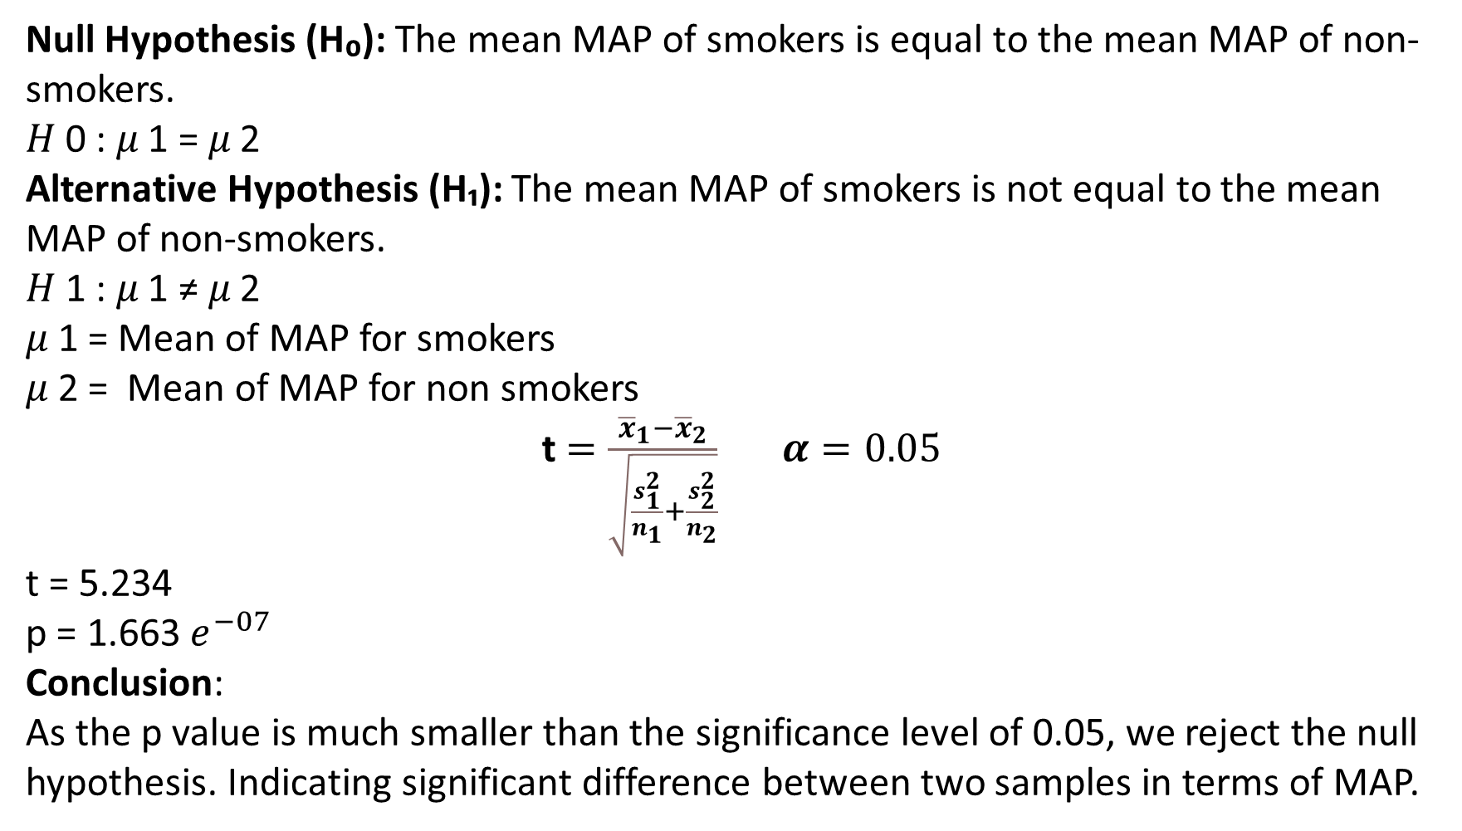
Hypothesis Testing
Null Hypothesis (H₀): The mean MAP of smokers is equal to the mean MAP of non-smokers.
𝐻 0 : 𝜇 1 = 𝜇 2
Alternative Hypothesis (H₁): The mean MAP of smokers is not equal to the mean MAP of non-smokers.
𝐻 1 : 𝜇 1 ≠ 𝜇 2
𝜇 1 = Mean of MAP for smokers
𝜇 2 = Mean of MAP for non smokers
t $=\frac{{\overline{x}}_{1}−{\overline{x}}_{2}}{\sqrt{\frac{s_{1}^{2}}{n_{1}}+\frac{s_{2}^{2}}{n_{2}}}}$ $α=0.05$
t = 5.234
p = 1.663 $e^{−07}$
Conclusion:
As the p value is much smaller than the significance level of 0.05, we reject the null hypothesis. Indicating significant difference between two samples in terms of MAP.

Slide 17
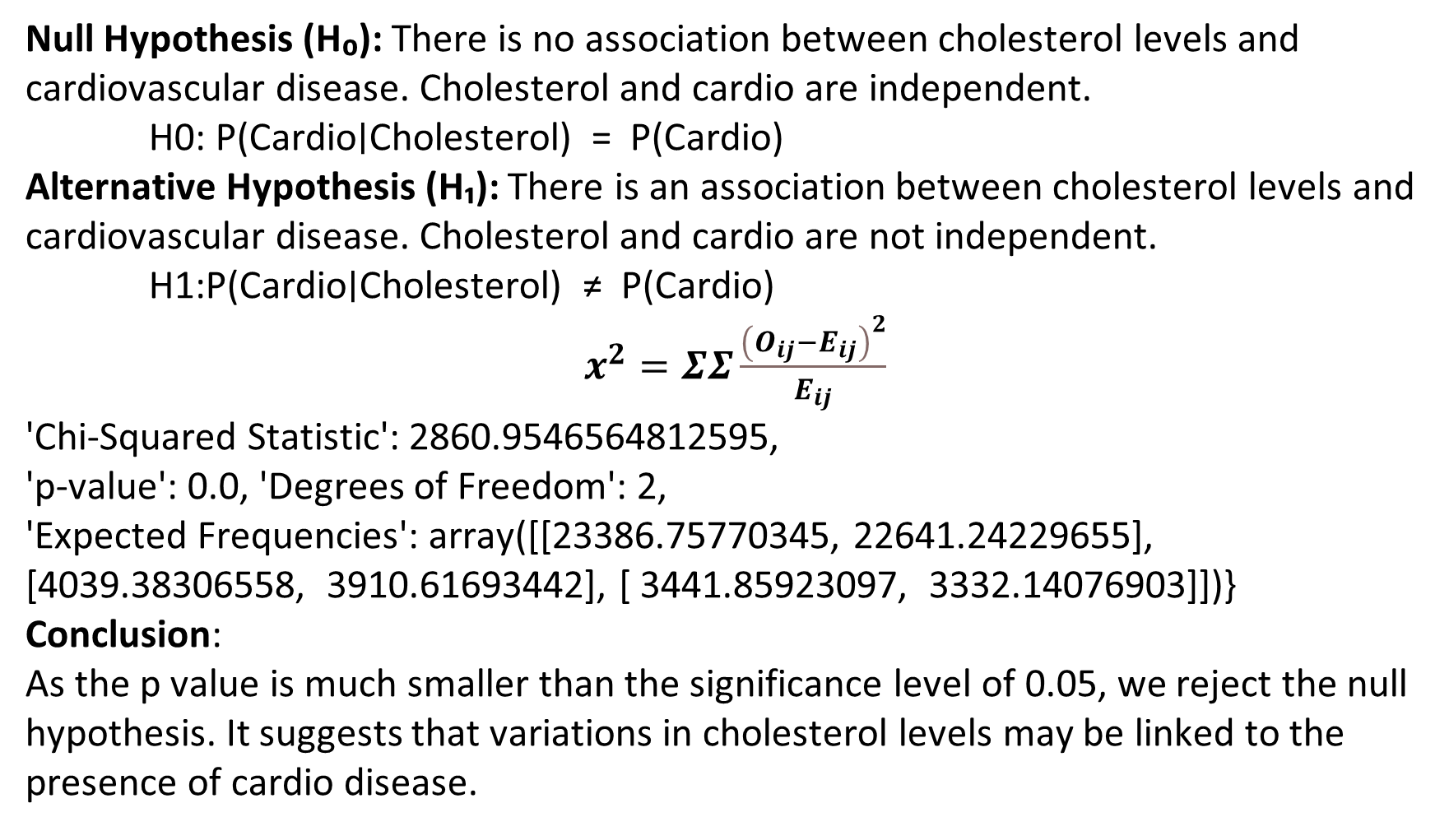
Hypothesis Testing using Chi square test
Null Hypothesis (H₀): There is no association between cholesterol levels and cardiovascular disease. Cholesterol and cardio are independent. H0​: P(Cardio∣Cholesterol) = P(Cardio)
Alternative Hypothesis (H₁): There is an association between cholesterol levels and cardiovascular disease. Cholesterol and cardio are not independent. H1​:P(Cardio∣Cholesterol) ≠ P(Cardio)
$x^{2}=ΣΣ\frac{{\left(O_{ij}−E_{ij}\right)}^{2}}{E_{ij}}$
'Chi-Squared Statistic': 2860.9546564812595,
'p-value': 0.0, 'Degrees of Freedom': 2,
'Expected Frequencies': array([[23386.75770345, 22641.24229655], [4039.38306558, 3910.61693442], [ 3441.85923097, 3332.14076903]])}
Conclusion:
As the p value is much smaller than the significance level of 0.05, we reject the null hypothesis. It suggests that variations in cholesterol levels may be linked to the presence of cardio disease.

Slide 18
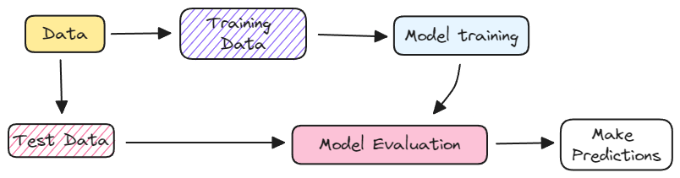
Machine Learning
Logistic Regression: Logistic regression is a supervised machine learning algorithm used for classification tasks where the goal is to predict the probability that an instance belongs to a given class or not.
Logistic regression is used for binary classification where we use sigmoid function, that takes input as independent variables and produces a probability value between 0 and 1

Slide 19
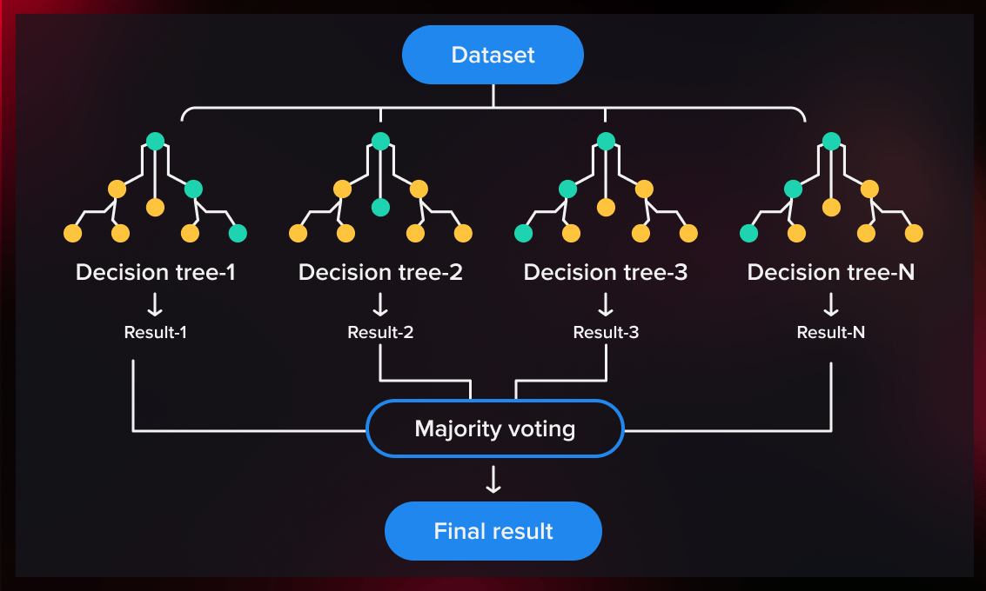
Machine Learning
Random Forest: It works by creating a number of Decision Trees during the training phase. Each tree is constructed using a random subset of the data set to measure a random subset of features in each partition.
This randomness introduces variability among individual trees, reducing the risk of overfitting and improving overall prediction performance.

Slide 20
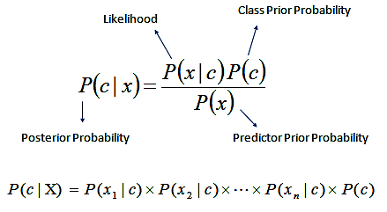
Machine Learning
Naïve Bayes: A Naive Bayes classifiers, a family of algorithms based on Bayes’ Theorem. Despite the “naive” assumption of feature independence, these classifiers are widely utilized for their simplicity and efficiency in machine learning.
The model comprises two types of probabilities that can be calculated directly from the training data:
(i) the probability of each class and
(ii) the conditional probability for each class given each x value.
Once calculated, the probability model can be used to make predictions for new data using Bayes theorem. When the data is real valued, it is common to assume a Gaussian distribution (bell curve) so that one can easily estimate these probabilities.
Naive Bayes is called naive because it assumes that each input variable is independent.

Slide 21
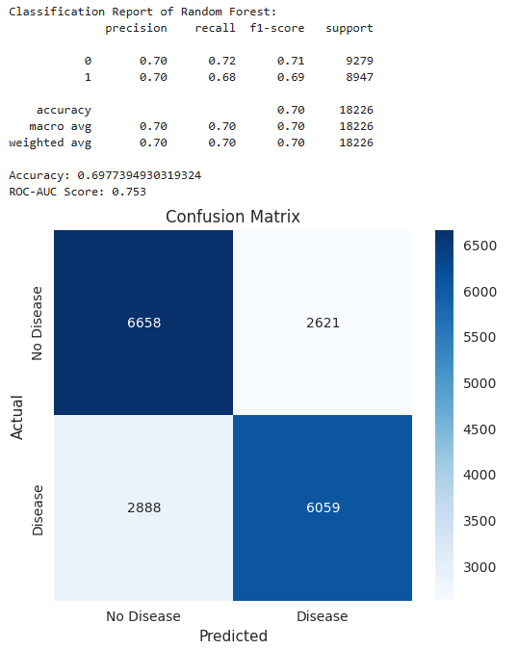
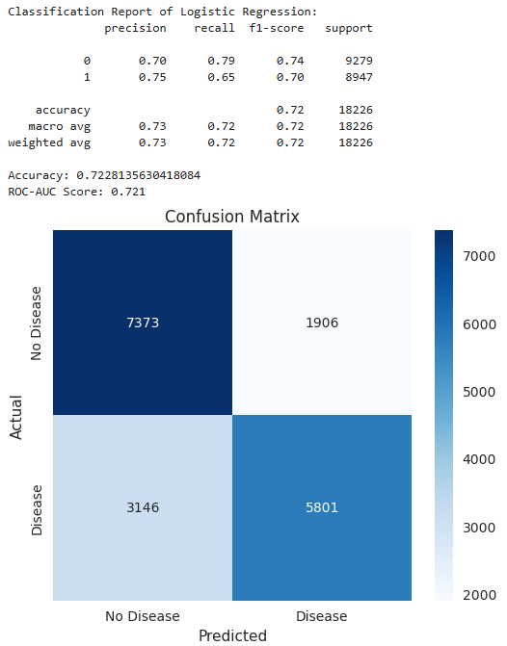
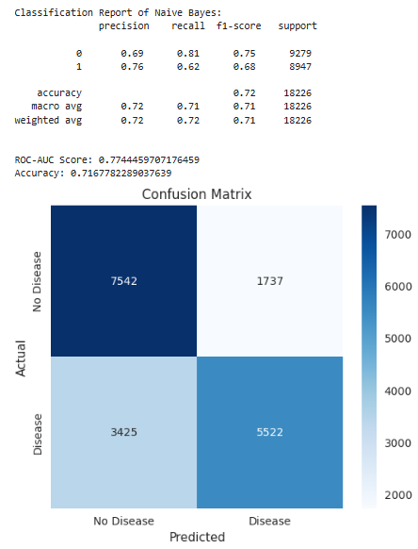
Performance Evaluation:

Slide 22
Results
Accuracy:
Logistic Regression outperforms the other models with 72.28% accuracy.
ROC-AUC Score:
Naive Bayes has the highest ROC-AUC score (0.774), followed by Random Forest (0.753), and Logistic Regression (0.721). This indicates that Naive Bayes is better at distinguishing between the classes.
Recall and Precision: -Logistic Regression has the best recall for class 0 (cardio disease- negative), but the recall for class 1 (cardio disease-positive) could be improved.
-Random Forest has a balanced performance between precision and recall across both classes.
-Naive Bayes struggles with identifying class 1 correctly (lower recall), but performs better overall in terms of ROC- AUC.

Slide 23
Conclusion
Age, cholesterol, and lifestyle habits such as smoking and alcohol consumption were identified as significant factors in cardiovascular risk.
Statistical analyses (e.g., Chi-Square tests, t-tests) confirmed relationships between these factors and cardiovascular disease.
Three machine learning models, Random Forest, Logistic Regression and Naïve Bayes were implemented, and their performances were evaluated based on classification metrics.

Slide 24
THANK YOU

