Slide 1
Cyberbullying Detection in Social Media Using Supervised ML & NLP Techniques

Slide 2
ABSTRACT
From the day internet came into existence, the era of social networking sprouted.
In the beginning, no one may have thought internet would be a host of numerous amazing services like the social networking.
Today we can say that online applications and social networking websites have become a non-separable part of one’s life.
Many people from diverse age groups spend hours daily on such websites.
Despite the fact that people are emotionally connected together through social media, these facilities bring along big threats with them such as cyber-attacks.
To identify word similarities in the tweets made by bullies and make use of machine learning and can develop an ML model automatically detect social media bullying actions.

Slide 3
OBJECTIVES
The main objective of our process is,
To provide an innovative preventative strategy that enables fast and accurate detection of cyberbullying case.
To effectively classify and predict the data.
To decrease sparsity problem.
To enhance the performance of the overall prediction results.

Slide 4
EXISTING SYSTEM
In this study, we attempted to explore this issue by compiling a global dataset of 37,373 unique tweets from Twitter.
Moreover, seven machine learning classifiers were used, namely, Logistic Regression (LR), Light Gradient Boosting Machine (LGBM), Stochastic Gradient Descent (SGD), Random Forest (RF), AdaBoost (ADB), Naive Bayes (NB), and Support Vector Machine (SVM).
In existing, Cyberbullying incidents are increasing day by day as technology rolls out. A large number of cyberbullying incidents are reported by companies each year. The existing system doesn’t effectively classify and predict the tweets which is presented in the social media.

Slide 5
DISADVANTAGES
The results is low when compared with proposed
It doesn’t efficient for large volume of data’s
Time consumption is high
Theoretical limits.

Slide 6
PROPOSED SYSTEM
In this system, we have to take the twitter cyberbullying dataset as input. Then we have to implement the Natural Language Processing (NLP) techniques for text cleaning.
Then we have to implement the feature extraction technique for improving the existing system results.
Here, we have to improve the detection accuracy rate by using the feature extraction such as count vectorization. It means, to encode the text as integers or numeric value to create the feature vectors.
After that, we have to implement the two different machine learning algorithms such as Decision tree and naïve bayes
The experimental results shows that, some performance metrics such as accuracy. In proposed system, we have to improve the accuracy rate when compared with existing system.

Slide 7
ADVANTAGES
It is efficient for large number of datasets.
To implement the feature extraction technique.
The experimental result is high when compared with existing system.
The prediction results is efficient.
To classify the result effectively.
Time consumption is low.

Slide 8
FLOW DIAGRAM

Slide 9


Handling missing values
Input data
Preprocessing
Label Encoding
Dataset
Drop unwanted columns
Stop words, stem words
NLP techniques
Remove punctuations
Feature Extraction/ Vectorization
Count vectorization
Test
Data Splitting
DT and NB
Train
Accuracy
Classification
Predictions
Visualizations

Slide 10
MODULES
Data selection
Data preprocessing
NLP techniques
Data Splitting
Feature extraction
Classification
Result Generation

Slide 11
METHODOLOGY
Data selection: The data selection is the process of selecting the data for detecting the cyber bullying. In this project, the twitter dataset is used for detecting bullying. The dataset which contains the information about the user name, Tweets, annotations.
Data preprocessing: Data pre-processing is the process of removing the unwanted data from the dataset. Pre-processing data transformation operations are used to transform the dataset into a structure suitable for machine learning. Missing data removal: In this process, the null values such as missing values and Nan values are replaced by 0. Then , we have to drop unwanted columns because it is not required for our process.

Slide 12
METHODOLOGY
NLP techniques: NLP is a field in machine learning with the ability of a computer to understand, analyze, manipulate, and potentially generate human language.Cleaning (or pre-processing) the data typically consists of a number of steps: Remove punctuation: Punctuation can provide grammatical context to a sentence which supports our understanding. Tokenization: Tokenizing separates text into units such as sentences or words. It gives structure to previously unstructured text. eg: Plata o Plomo-> ‘Plata’,’o’,’Plomo’.Stemming: Stemming helps reduce a word to its stem form.
Data splitting: Data splitting is the act of partitioning available data into. two portions, usually for cross-validatory purposes. One portion of the data is used to develop a predictive model. and the other to evaluate the model's performance.

Slide 13
METHODOLOGY
Feature Extraction/vectorization: It is a process of encoding text as integers (i.e.) numeric form to create feature vectors so that machine learning algorithm can understand our data. In our process, we have to implement the count vectorization .
Classification: In this step, we have to implement the two different machine learning algorithms such as Decision tree and naives bayesWith the help of machine learning algorithms , we have to analyse the cyberbullying cases.
Result generation:In this step, we have to analyse the some performance metrics such as accuracy, precision, recall and f1-score. Then , we have to predict the text that is cyberbullying case or non cyberbullying cases. Then we have to compare the both the algorithm results which one is efficient.

Slide 14
SCREENSHOTS

Slide 15
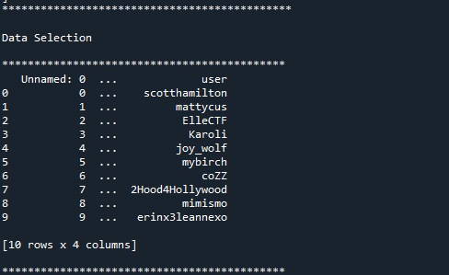
DATA SELECTION

Slide 16
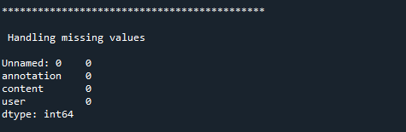
PREPROCESSING

Slide 17
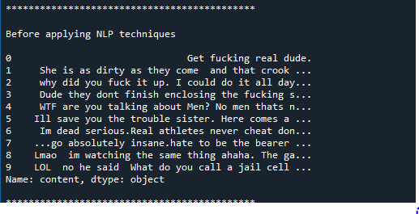
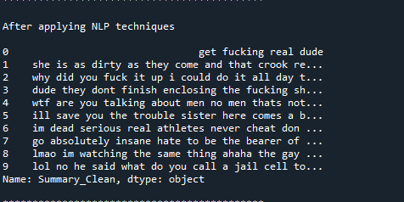
NLP

Slide 18
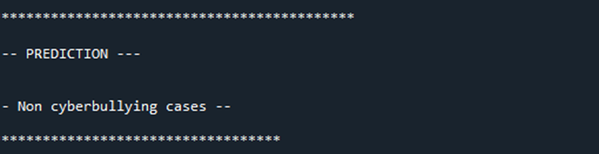
PERFORMANCES

Slide 19
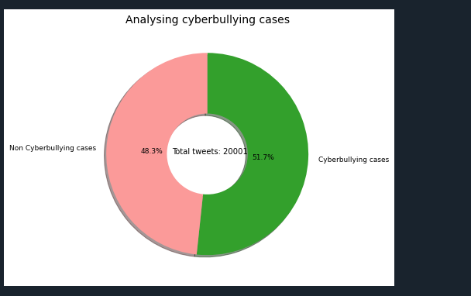
PERFORMANCES

Slide 20
SYSTEM REQUIREMENTS
SOFTWARE REQUIREMENTS:
O/S : Windows 7.
Language : Python
Front End : Anaconda Navigator – Spyder
HARDWARE REQUIREMENTS:
System : Pentium IV 2.4 GHz
Hard Disk : 200 GB
Mouse : Logitech.
Keyboard : 110 keys enhanced
Ram : 4GB

Slide 21
LITERATURE SURVEY

Slide 22
Title | Year | Author | Methodology | Advantages | Disadvantages
Detecting Offensive Language in Social Media to Protect Adolescent Online Safety. | 2012 | Ying Chen, Yilu Zhou, Sencun Zhu, and Heng Xu | user-level offensiveness detection seems a more feasible approach. so, the Lexical Syntactic Feature (LSF) architecture to detect offensive content and identify potential offensive users in social media. We distinguish the contribution of pejoratives/profanities and obscenities in determining offensive content, and introduce hand-authoring syntactic rules in identifying name-calling harassments. | Lexical Syntactic Feature (LSF) detection is fast and accurate. | Lexical Syntactic Feature (LSF) cannot handle large data for prediction

Slide 23
Title | Year | Author | Methodology | Advantages | Disadvantages
Opinion Mining and Social Networks: a Promising Match | 2011 | K. Jedrzejewski and M. Morzy | The role and importance of social networks in preferred environments for opinion mining and sentiment analysis. Selected properties of social networks that are relevant with respect to opinion mining are described and general relationships between the two disciplines are outlined. The related work and basic definitions used in opinion mining is given. Then, our original method of opinion classification is introduced and we test the algorithm on datasets acquired from social networks and thus report the results. | Sentiment analysis is a useful for any organization for which public sentiment or attitude towards them is important for their success | Automated sentiment analysis tools do a really great job of analysing text for opinion and attitude, but they're not perfect.

Slide 24
Title | Year | Author | Methodology | Advantages | Disadvantages
Analyzing Labelled Cyberbullying Incidents on the Instagram Social Network. | 2015 | H. Hosseinmardi, S. A. Mattson, R. I. Rafiq, R. Han, Q. Lv, and S. Mishra | Cyberbullying is a growing problem affecting more than half teens. The main goal is to study cyberbullying incidents in the social network. In this work, we have collected a sample data and their associated comments. We then designed a study and employed human contributors at the crowd-sourced Crowd Flower website to label these media sessions for cyberbullying. A detailed analysis of the labelled data is then presented, including a study of relationships between cyberbullying and a host of features. | Crowd Flower transcribes data from multiple sources into comprehensible transcripts. | Crowd Flower workforce has limitations and are difficult to manage.

Slide 25
Title | Year | Author | Methodology | Advantages | Disadvantages
Using Machine Learning to Detect Cyberbullying | 2011 | Kelly Reynolds, April Kontostathis, Lynne Edwards | Cyberbullying is the use of technology as a medium to bully someone. It has been an issue for many years, the recognition of its impact on young people has recently increased. Social networking sites provide a fertile medium for bullies, and teens and young adults who use these sites are vulnerable to attacks. Through machine learning, we can detect language patterns used by bullies and their victims, and develop rules to automatically detect cyberbullying content. | With ML, you don’t need to babysit your project every step of the way. Since it means giving machines the ability to learn, it lets them make predictions and also improve the algorithms on their own. | Machine Learning requires massive data sets to train on, and these should be inclusive/unbiased, and of good quality. There can also be times where they must wait for new data to be generated.

Slide 26
REFERENCES
[1] C. C. Aggarwal and C. K. Reddy, Data Clustering: Algorithms and Applications. Boca Raton, FL, USA: CRC Press, 2013.
[2] N. Ahmad and J. Siddique, “Personality assessment using Twitter tweets,” Procedia Comput. Sci., vol. 112, pp. 1964–1973, Sep. 2017.
[3] T. Ahmad, A. Ramsay, and H. Ahmed, “Detecting emotions in English and Arabic tweets,” Information, vol. 10, no. 3, p. 98, Mar. 2019.
[4] A. Bandi and A. Fellah, “Socio-analyzer: A sentiment analysis using social media data,” in Proc. 28th Int. Conf. Softw. Eng. Data Eng., in EPiC Series in Computing, vol. 64, F. Harris, S. Dascalu, S. Sharma, and R. Wu, Eds. Amsterdam, The Netherlands: EasyChair, 2019, pp. 61–67.

Slide 27
REFERENCES
[5] F. Barbieri and H. Saggion, “Automatic detection of irony and humour in Twitter,” in Proc. ICCC, 2014, pp. 155–162.
[6] R. Bhat, V. K. Singh, N. Naik, C. R. Kamath, P. Mulimani, and N. Kulkarni, “COVID 2019 outbreak: The disappointment in Indian teachers,” Asian J. Psychiatry, vol. 50, Apr. 2020, Art. no. 102047.
[7] D. M. Blei, A. Y. Ng, and M. I. Jordan, “Latent Dirichlet allocation,” J. Mach. Learn. Res., vol. 3, pp. 993–1022, Jan. 2003.
[8] P. Boldog, T. Tekeli, Z. Vizi, A. Dénes, F. A. Bartha, and G. Röst, “Risk assessment of novel coronavirus COVID-19 outbreaks outside China,” J. Clin. Med., vol. 9, no. 2, p. 571, Feb. 2020.

Slide 28
Thank You…

