Slide 1
Project Overview
• Title: Air Quality Monitoring and Prediction
• Team Name: Dragons
• Members: Ayan Srivastava, Aditi Singh , Indranil Samantha
• College: Jaypee University of Engineering and technology , Guna
• Contact: 221b112@juetguna.in , 221b026@juetguna.in , 221b183@juetguna.in

Slide 2
Problem Statement
• Urban sustainability challenge: Poor air quality due to pollution in cities.
• Importance: Air quality impacts public health, quality of life, and urban sustainability.

Slide 3
Solution Description
• AI-Driven Solution: AI models for real-time air quality monitoring and future prediction.
• How Solution Solves the Problem: Detects pollution hotspots and predicts future air quality for proactive measures.

Slide 4
Technical Architecture
• AI Algorithm: Time Series models (ARIMA, LSTM).
• Programming Language: Python, Scikit-Learn, Air Quality datasets.
• Datasets : https://www.kaggle.com/datasets/rohanrao/air-quality-data-in-india

Slide 5
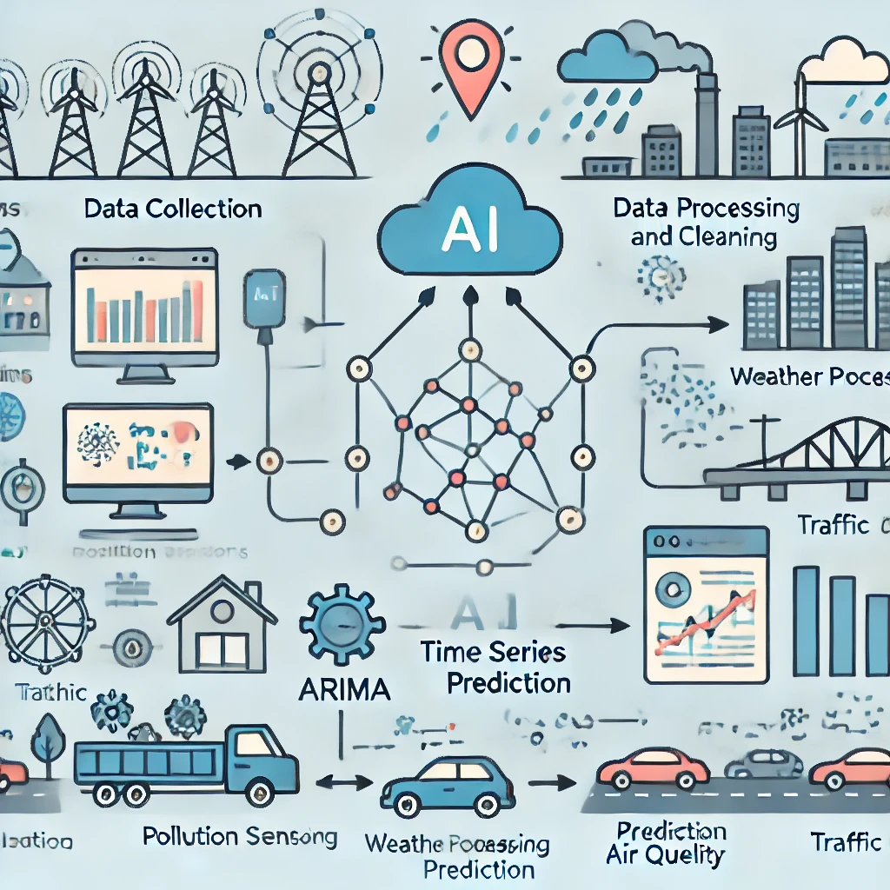
• Visual Diagram:

Slide 6
Social and Economic Impact
• Promoting Sustainability: Improves public health by predicting pollution trends.
• Environmental, Economic, and Social Impact: Reduces healthcare costs and improves life quality.

Slide 7
Integration with Existing Ecosystem
• AI system integrates seamlessly with city-wide IoT sensors, pollution control systems, and transportation data.

Slide 8
Potential and Scalability
• Scalability: The solution can be applied to multiple cities with minor adaptations.
• Market Opportunity: Increasing demand for smart city solutions.

Slide 9
Intel Libraries and Frameworks
• Intel SW/HW Components: Intel OpenVINO Toolkit, Intel AI Analytics Toolkit.
• Optimized Libraries: Intel Distribution of Python.
• Frameworks: TensorFlow, PyTorch.
• Toolkits: Intel AI Kit for Edge Devices.
• Intel DevCloud: Used for model training and optimization.
• Hugging Face Models: Pretrained AI models for enhanced prediction accuracy.

