Slide 1
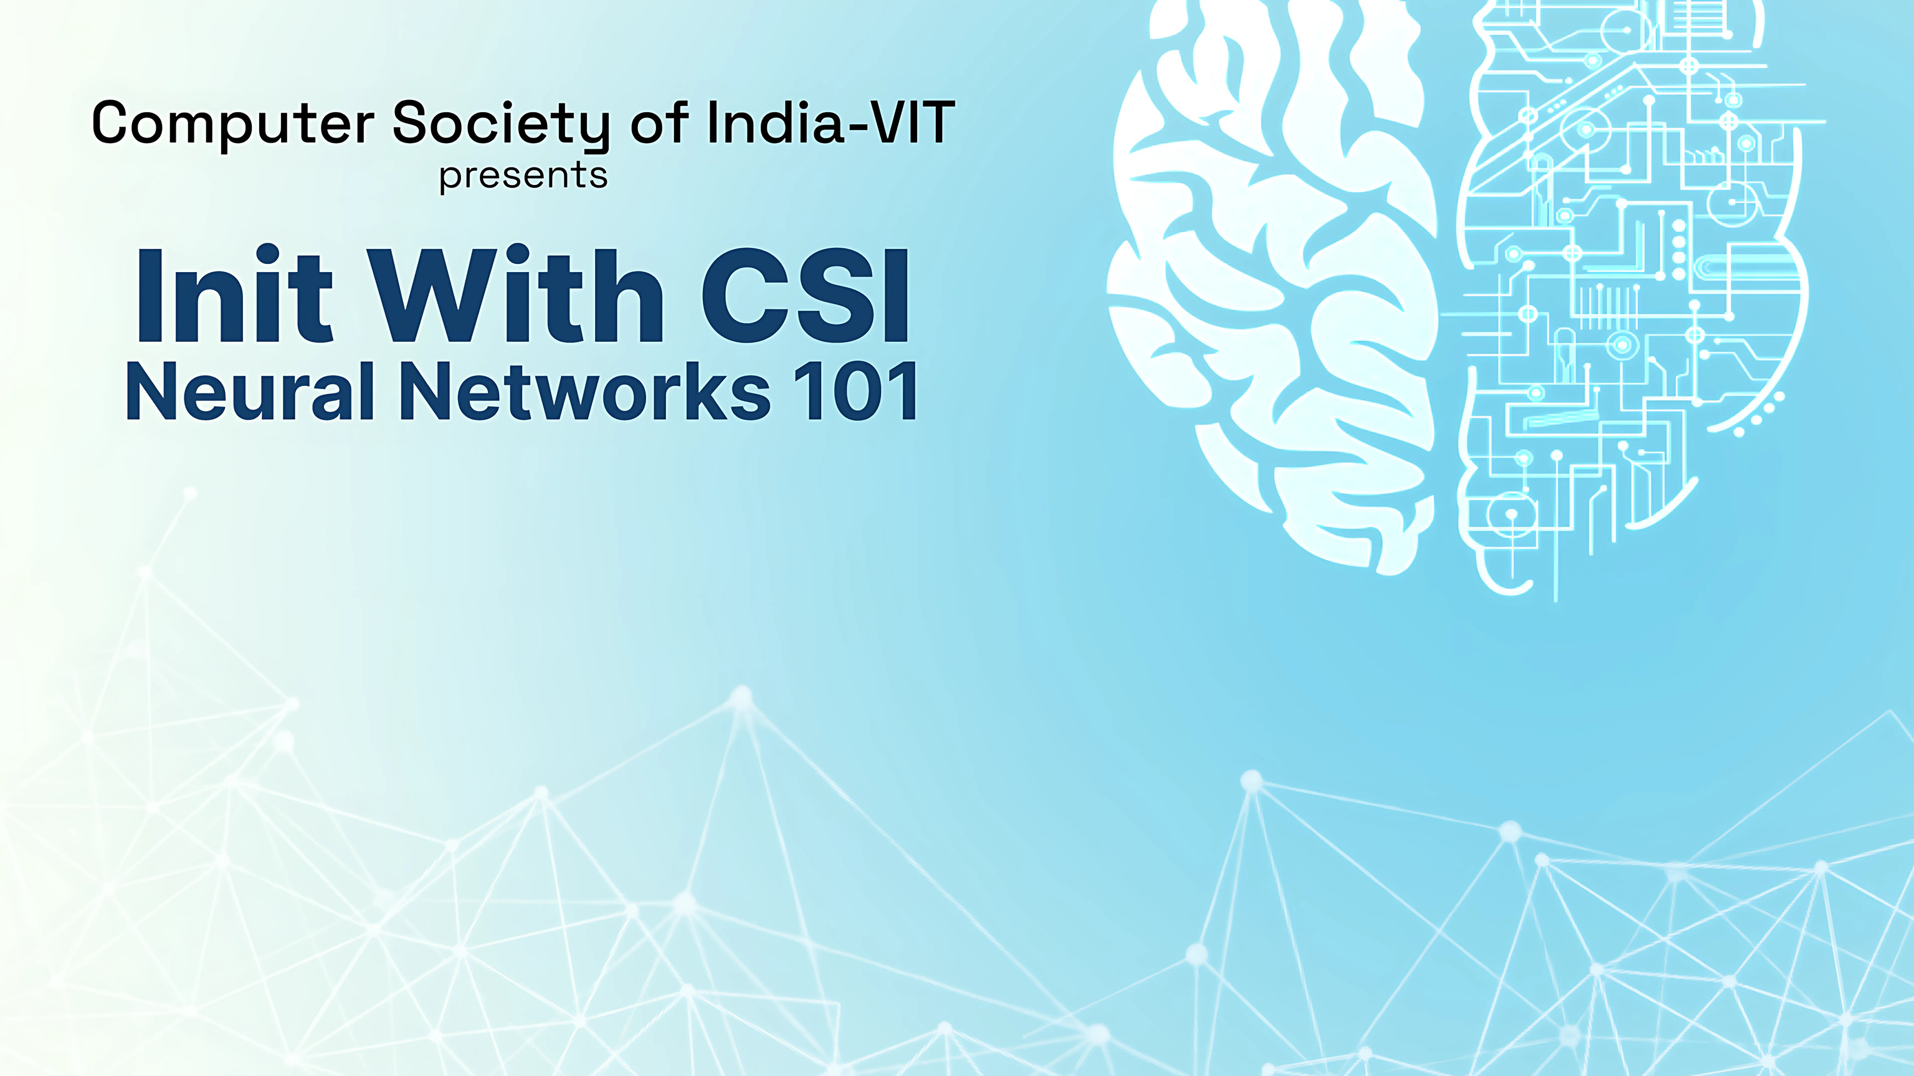
Unlocking the Power of AI,
One Neuron at a Time!
Build your own Neural Net from Scratch!!

Slide 2


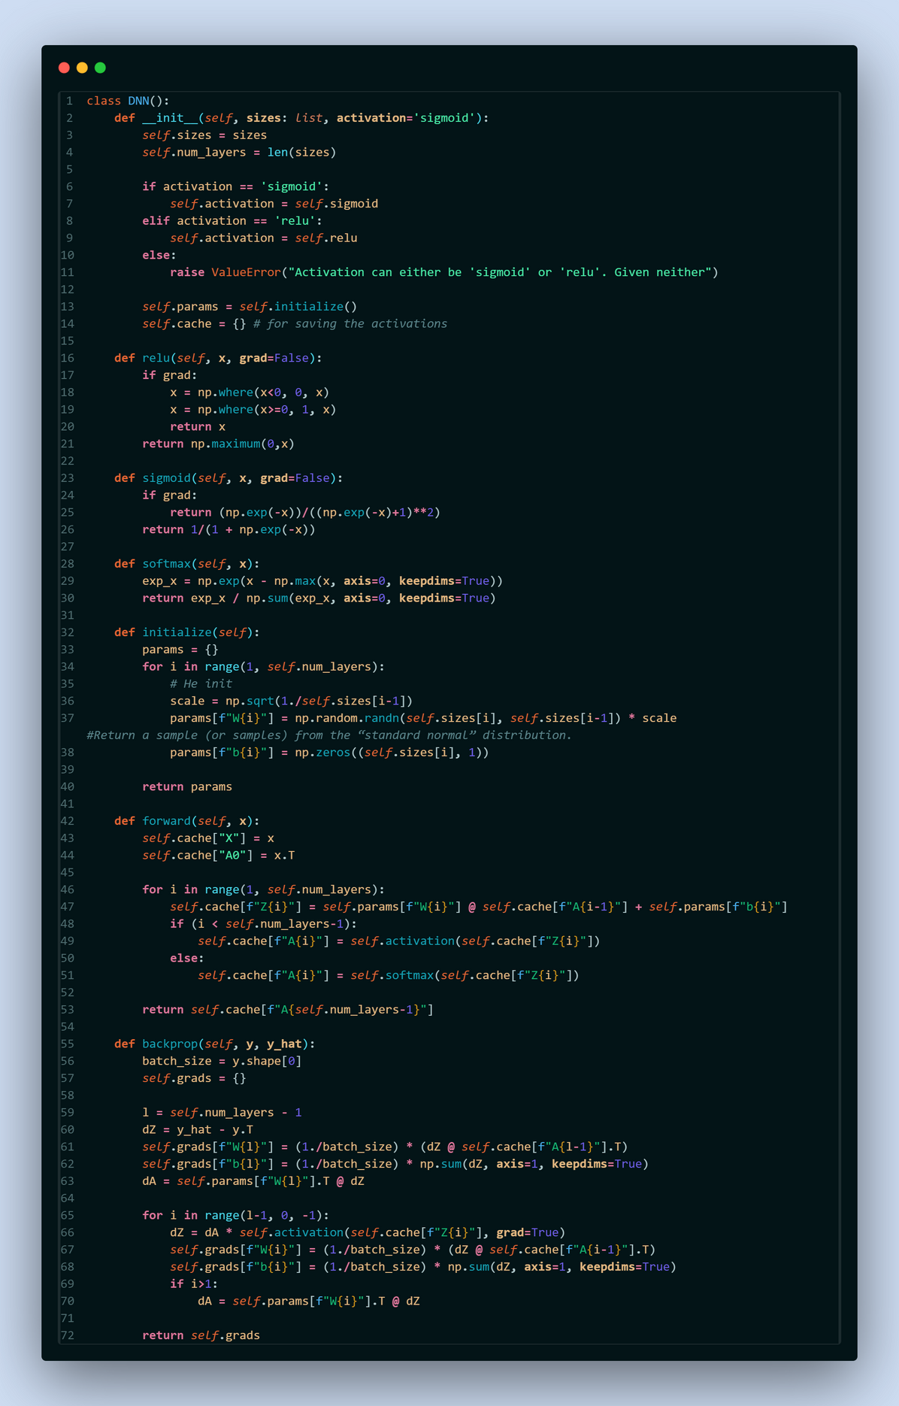
What will you build in this session?

Slide 3
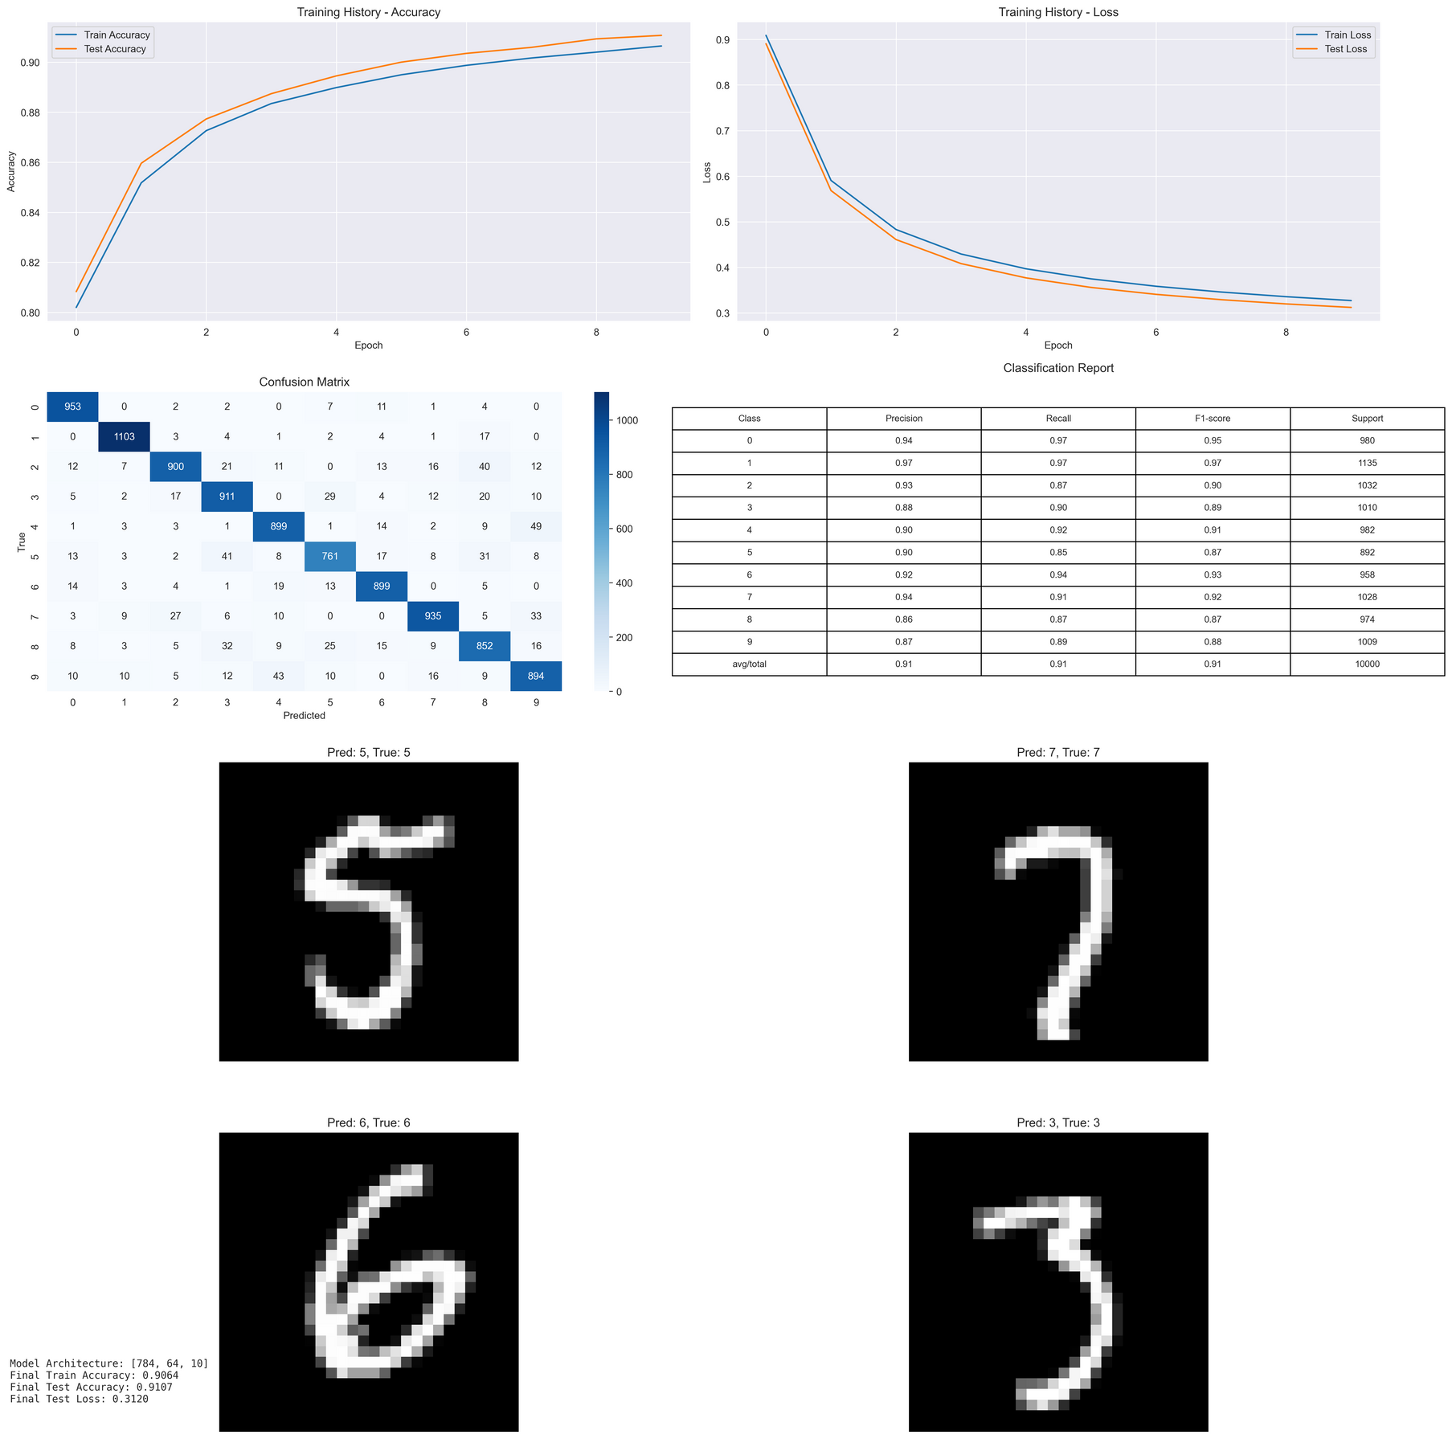
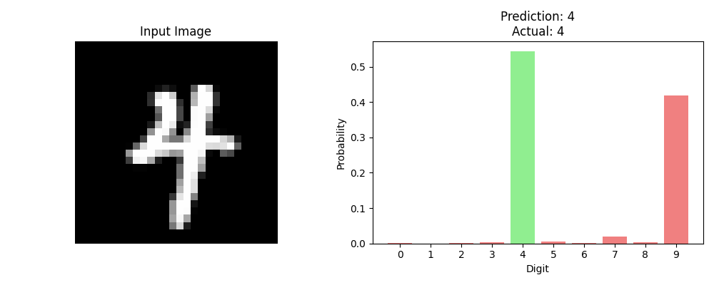
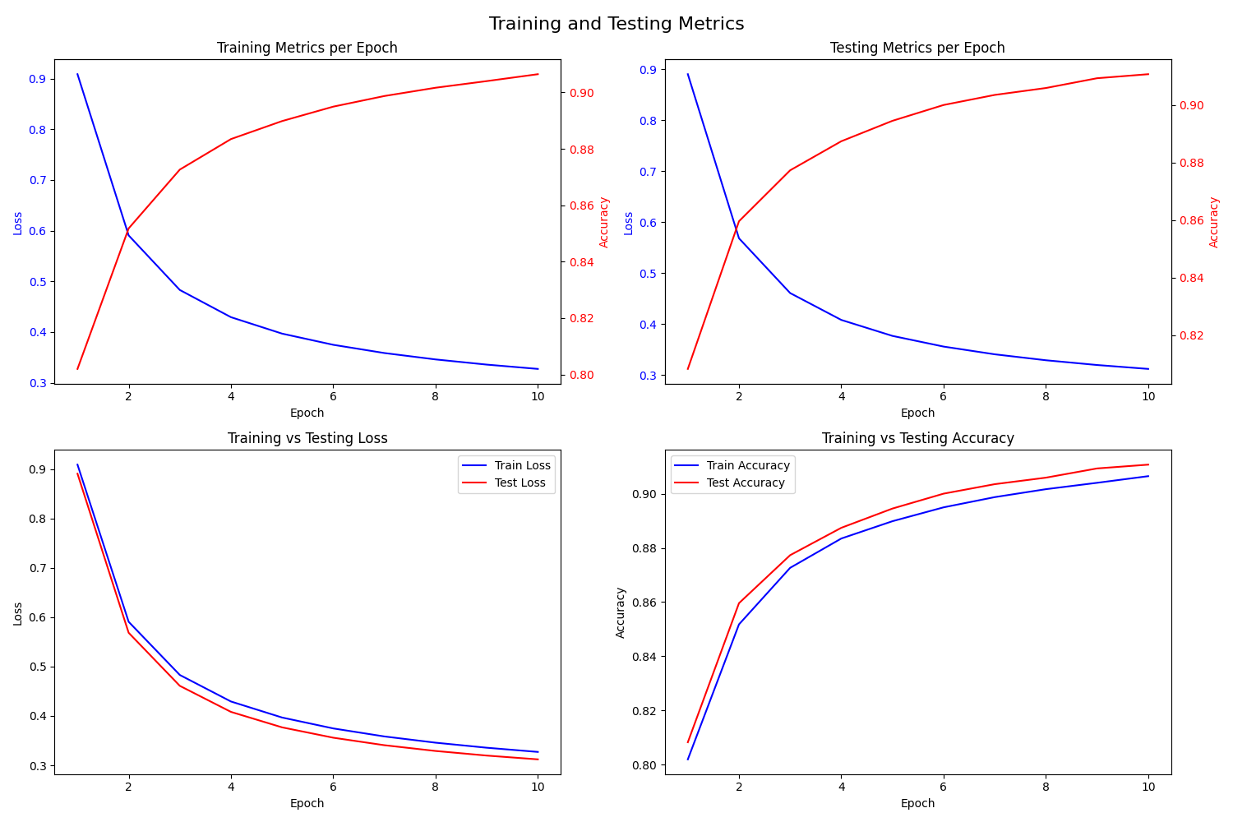

Slide 4




Who are we?
and why should you listen to us?
Hamsini Natarajan
Mohit Talgotra
Yashwanth Erukulla
Prapti Siva
AI & ML, Senior Core Tech Members
Computer Society of India-VIT

Slide 5
What is Machine Learning?
Machine Learning is defined as computational methods that uses experience to improve performance or to make accurate predictions.
Where is it used: 🤔
Email, Netflix, Spotify, Amazon, Chatbots, Customer Support and more

Slide 6
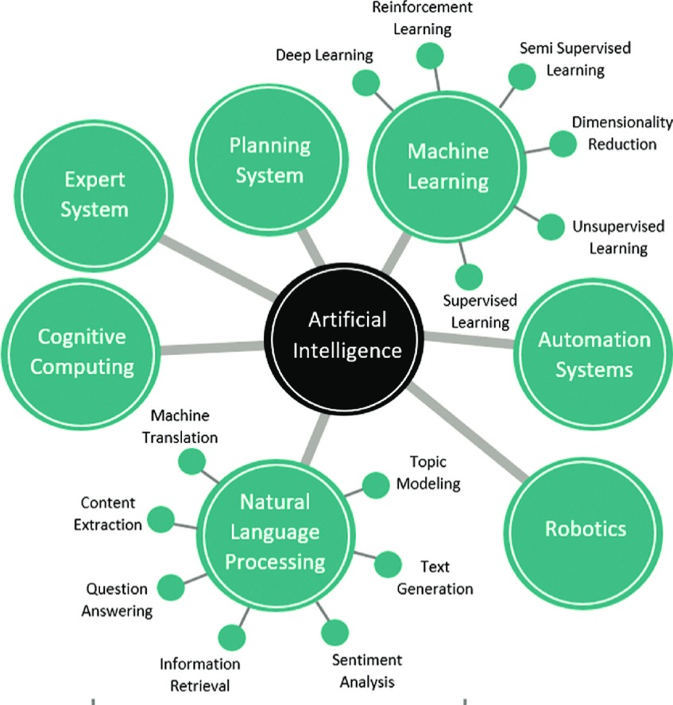

Slide 7
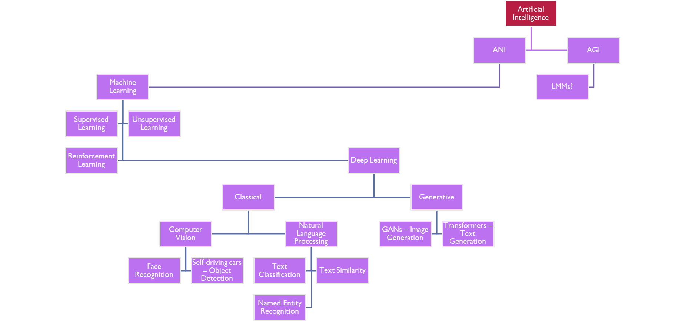

Slide 8
Supervised Learning
Our goal is to create a model that can learn the relationship between x (inputs) and y (outputs) so that it can predict y for new data.
This process is called Supervised Learning, where the model learns from labeled examples (data with known outcomes).
If y is a number, this is called Regression. The model tries to find a continuous pattern, such as drawing a best-fit line through points.
If y is a category , this is called Classification. The model learns decision rules to separate different groups.

Slide 9
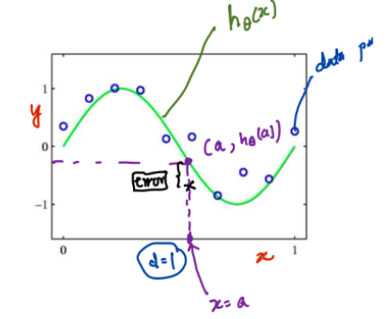
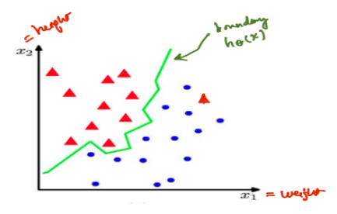
Regression
Classification

Slide 10
Unsupervised Learning
The goal is to discover hidden patterns or meaningful relationship in unlabeled data and understand the overall structure of the dataset.
Clustering: Identifies meaningful groupings within the data, such as k-means or Expectation Maximization.
Dimensionality Reduction: Compresses data while retaining important features, useful for downstream tasks (e.g., PCA, LDA, auto-encoders).
Correlation Analysis: Finds meaningful relationships between variables, such as concordance or Pearson’s correlation.

Slide 11
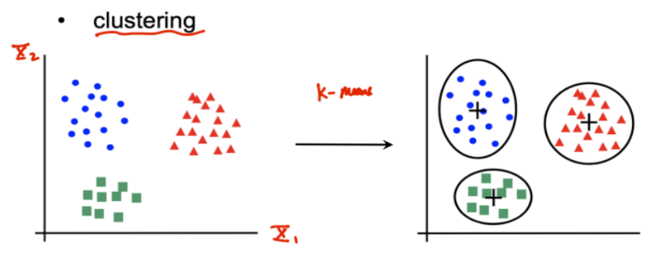

Slide 12
Reinforcement Learning
An agent interacts with an environment and learns by receiving rewards (positive values) or punishments (negative values) based on its actions. The goal is to maximize long-term rewards by making the best decisions over time. Widely applied in robotics, gaming, and autonomous systems where continuous learning is essential.
Walking Robots: Reward for each step, punishment for falling.
Game AI (e.g., AlphaGo): Learning optimal strategies through trial and error.
Self-Driving Cars: Making real-time decisions based on past experiences.

Slide 13
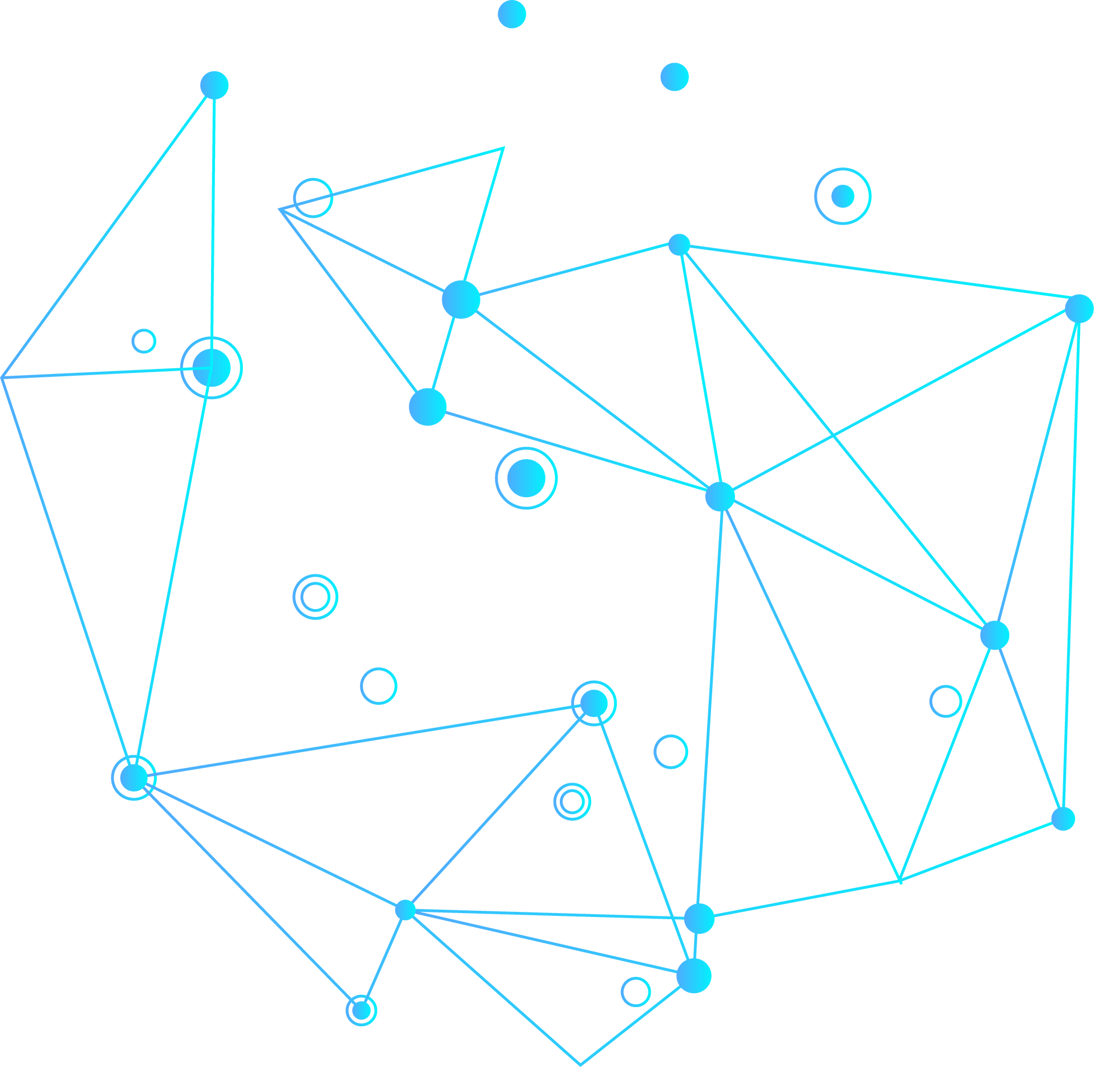
Regression
Regression is a statistical and machine learning technique used to analyze the relationship between variables and make predictions. It helps in understanding how the dependent variable (output) changes based on independent variables (inputs).

Slide 14
Types of Regression
Simple Linear Regression – Using one input variable (one independent variable) to predict an output (one dependent variable) value.
Straight-line equation: y=mx+b
Multiple Regression – Uses multiple input variables to predict an outcome (like our flight delay example).
Logistic Regression – Used for classification (e.g., predicting if a flight will be delayed or on time).

Slide 15
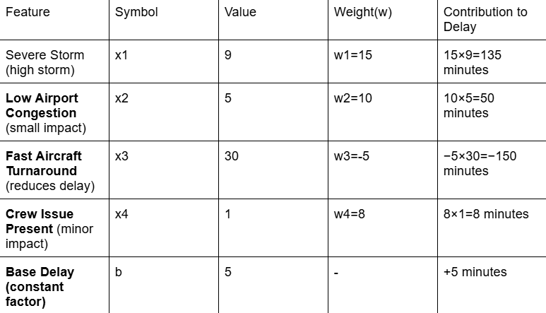
Flight Delay Example
Regression Equation:
y=w1x1 + w2x2 + w3x3 + w4x4 + b
Where:
y = Predicted delay (minutes)
x1 = Weather severity
x2 = Air traffic congestion
x3 = Aircraft turnaround time
x4 = Crew issue (Yes/No)
b = Base delay
w1, w2, w3, w4 = Weights
y=(15×9)+(10×5)+(−5×30)+(8×1)+5
y = 135 + 50 - 150 + 8 + 5
y=48 minutes
So, the predicted delay for this flight is 48 minutes.

Slide 16
Logistic Regression Example
1️. Importing Required Libraries
numpy: Handles numerical computations.
matplotlib.pyplot: Used for plotting graphs.
pandas: Used for loading and handling the dataset.
SimpleImputer: Handles missing data by filling empty values.
ColumnTransformer & OneHotEncoder: Convert categorical variables into numeric form.
LabelEncoder: Converts categorical dependent variables (Yes/No) into binary form (1/0).
StandardScaler: Standardizes numeric data for better model performance.
train_test_split: Splits the dataset into training and test sets.
LogisticRegression: Implements logistic regression for classification.
accuracy_score, confusion_matrix, classification_report: Used for model evaluation.

Slide 17
Logistic Regression Example
2️. Loading the Dataset
3️. Handling Missing Data
4️. Encoding Categorical Data
5️. Splitting the Dataset into Training and Test Sets
6️. Feature Scaling
7️. Training the Logistic Regression Model
8️. Making Predictions
9️. Comparing Actual vs Predicted Values
10. Evaluating Model Performance
11.Visualizing Actual vs Predicted Values

Slide 18
Bias:
Difference between predicted values and actual values.
High bias means the model makes simplistic assumptions and has low accuracy.
Variance:
Measures how much predictions change with different datasets.
High variance means the model is too sensitive to small changes and captures noise instead of patterns.

Slide 19
Goal: Find the right balance to ensure good performance on new data.
Underfitting (High Bias): Model is too simple.
High training error and low accuracy on both training and test data.
Training error ≈ Testing error (both high).
Optimal Model (Balanced):
Training error is slightly lower than test error.
Learns meaningful patterns and performs well on new data.
Overfitting (High Variance):
Model is too complex and memorizes training data.
Low training error but high test error.
Performs well on training data but poorly on unseen data.

Slide 20
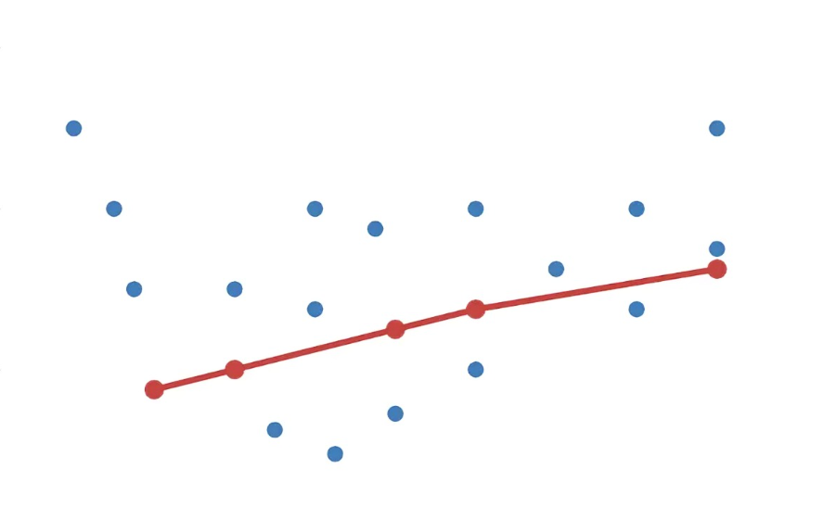
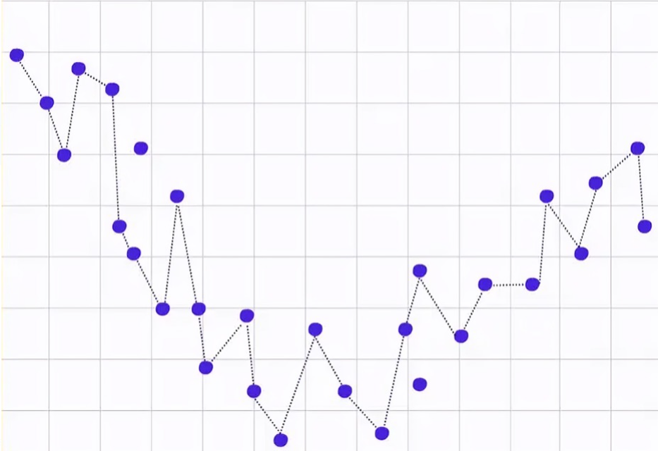
Underfitting
Overfitting

Slide 21
What is Vectorization?
Vectorization is the process of replacing loops with optimized array operations to make computations faster. Instead of processing one element at a time, we perform operations on entire arrays at once using libraries like NumPy (Python) and TensorFlow.

Slide 22
What is a NumPy Array?
A NumPy array (ndarray) is an optimized data structure that stores numbers efficiently and allows us to perform fast operations. It is much faster than a Python list because it uses contiguous memory allocation and vectorized operations.

Slide 23
1.Creating a 1D Array
🔹 Shape (5,) → This means a 1D array with 5 elements.
🔹Dimension 1 → It's a single-dimensional array.
2. Creating a 2×3 Matrix (2 rows, 3 columns)
🔹 Shape (2, 3) → 2 rows, 3 columns.
🔹Dimension 2 → It’s a 2D matrix.
3. Creating a 4×5 Matrix (4 rows, 5 columns)
🔹 Shape (4,5) → 4 rows, 5 columns.
🔹 Dimension 2 → It’s a 2D matrix.
4.Creating a 3D Array (2 Matrices of 2×3)
🔹 Shape (2, 2, 3) → 2 matrices, each of size 2×3.
🔹 Dimension 3 → It's a 3D tensor.

Slide 24
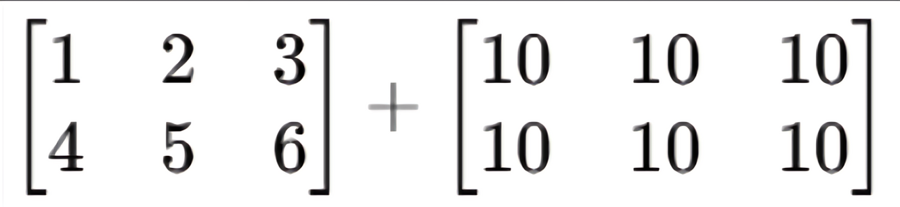
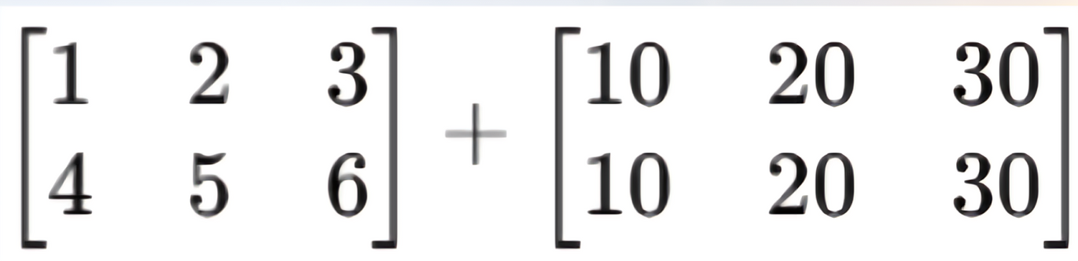
5.Broadcasting a Scalar to a Matrix
6. Broadcasting a 1D Array to a 2D Matrix

Slide 25
What are Neural Networks ?
Home
Neural networks are models that learn from data using layers of connected units called neurons. They process information step by step to make predictions.

Slide 26
Types of Neural Networks
Home
Convolutional Neural Networks (CNNs):
Used for image recognition and computer vision tasks.
Detect patterns like shapes and textures in images.
Common in facial recognition, object detection, and medical imaging.
Recurrent Neural Networks (RNNs):
Used for time-based or sequential data like text and speech.
Remember past inputs to understand sequences.
Used in chatbots, language translation, and speech recognition.

Slide 27
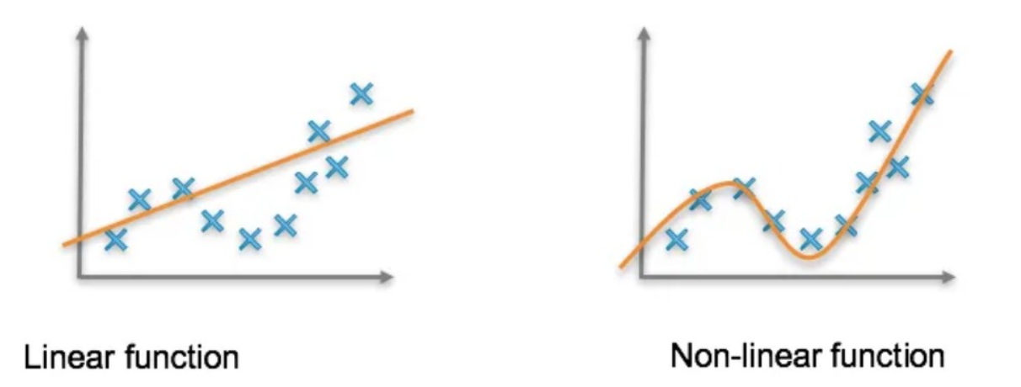
Home

Slide 28
Handling Non-Linearity
Home
Neural networks handle this by using layers and activation functions to learn complex patterns.
How Neural Networks Introduce Non-Linearity:
Multiple Layers: Process data in steps, learning from simple to complex features (e.g., edges, curves).
Activation Functions: Add non-linearity, allowing the model to learn curves and patterns instead of just straight lines.
Examples: ReLU, Sigmoid, Tanh help neurons react differently to inputs.
Pattern Detection: Instead of separating data with a straight line, neural networks learn shapes, clusters, and deep relationships.

Slide 29
Why are Neural Networks better ?
Home
Feature Learning (Automatic Extraction)
No need for manual feature selection—neural networks learn patterns from raw data.
In images, early layers detect edges, deeper layers recognize objects.
In text, networks learn word meanings through embeddings.
Efficient Computation & Optimization
Use GPUs/TPUs to process large data quickly.
Optimization algorithms (SGD, Adam, RMSprop) improve training speed.
Handles Unstructured Data
Works with images, text, audio, and video—unlike traditional models that need structured data.
CNNs for images (Face ID, self-driving cars).
RNNs, LSTMs, Transformers for text & speech (ChatGPT, Siri, Google Translate).

Slide 30
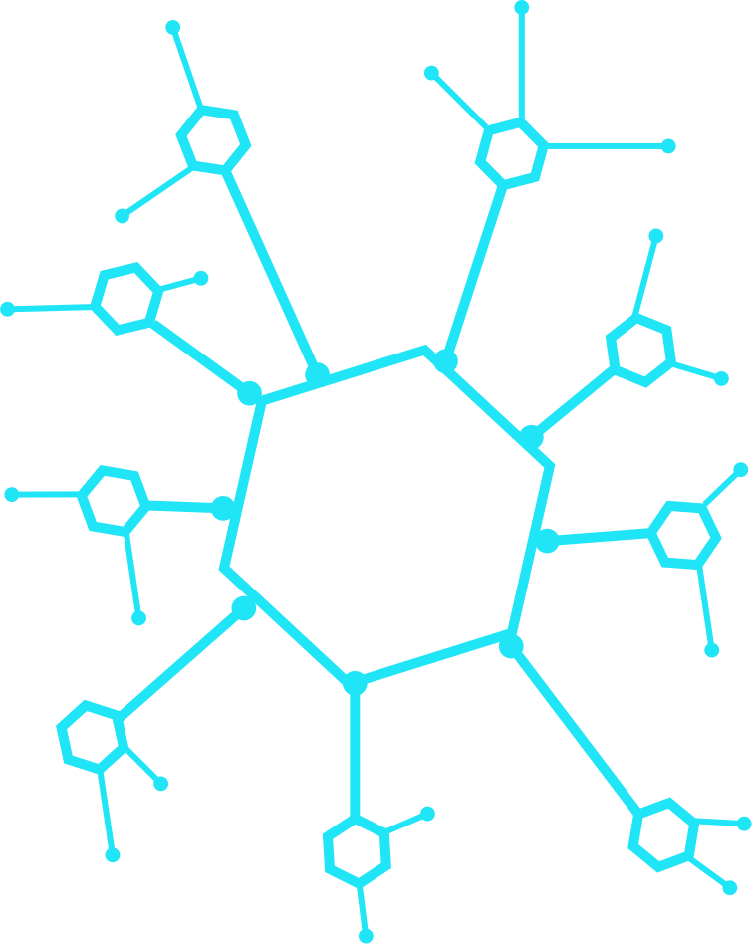
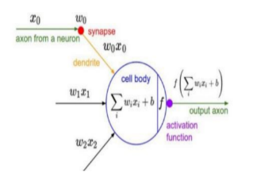
What is a Perceptron ?
A Perceptron is the simplest type of artificial neuron, acting as a binary classifier. It takes multiple inputs, applies weights, sums them, applies an activation function, and produces an output (0 or 1)

Slide 31
Step 1: Why Do We Need a Perceptron?
Before deep learning, simple models struggled with certain classification tasks. The perceptron was the first step toward neural networks and laid the foundation for more advanced models.
Solves Simple Classification Problems → Example: Detecting spam vs. non-spam emails.
Inspired by Biological Neurons → Mimics how human neurons process information.
Foundation of Neural Networks → Forms the basis for complex models like CNNs & RNNs.
Step 2: Components of a Perceptron
A perceptron consists of the following:
Inputs (X₁, X₂, ..., Xₙ) → Features such as pixel brightness in an image or words in text.
Weights (W₁, W₂, ..., Wₙ) → Assigned to each input to determine its influence.
Bias (b) → Shifts the decision boundary to improve learning flexibility.
Summation Function (Σ) → Computes the weighted sum:
Z=(W1⋅X1)+(W2⋅X2)+...+(Wn⋅Xn)+b
Activation Function (f(Z)) → Decides if the neuron activates (outputs 1 or 0).

Slide 32
Step 3: Choosing an Activation Function
The activation function introduces non-linearity, allowing perceptrons to handle more complex problems.
Step Function → Outputs 1 if input ≥ threshold, else 0.
Works well for binary classification but fails for complex data.
Sigmoid → Outputs a value between 0 and 1.
Useful when probabilities are needed but suffers from slow learning.
ReLU (Rectified Linear Unit) → Outputs 0 for negatives, Z for positives.
Faster training and helps avoid vanishing gradients in deep networks.
Step 4: Weight Initialization
Weight initialization is crucial for learning. If done incorrectly, the perceptron may learn too slowly or get stuck in poor solutions.
Random Initialization → Weights are set to small random values.
Too Small Weights → Learning is slow because updates are tiny.
Too Large Weights → Can cause unstable learning and poor convergence.
Best Approach? → Use techniques like Xavier (Glorot) Initialization or He Initialization for deep networks.

Slide 33
Step 5: Building the Perceptron

Slide 34
Step 6: Why Can’t a Perceptron Solve XOR?
A single-layer perceptron can only solve problems where the data is linearly separable (i.e., a straight line can separate the classes).
AND & OR are linearly separable → A perceptron can classify them.
XOR is NOT linearly separable → A single perceptron fails because it can only learn straight-line decision boundaries.
Solution? → Use a Multi-Layer Perceptron (MLP) with hidden layers and non-linear activation functions.
Step 7: Improving the Perceptron
To solve complex problems like XOR, we need enhancements:
Multi-Layer Perceptrons (MLP) → Adding hidden layers enables learning of complex patterns.
Gradient Descent & Backpropagation → Algorithms that adjust weights to improve accuracy.
Better Activation Functions → Sigmoid, Tanh, and ReLU allow deeper networks to learn effectively.
Regularization (Dropout, L2) → Prevents overfitting by ensuring the model generalizes well to new data.

Slide 35

MultiLayer Perceptron:
Forward Propagation , Backward Propagation and Gradient Descent

Slide 36
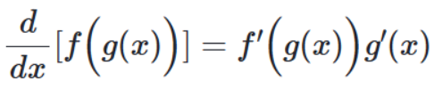
What is the Chain Rule?
The chain rule is a fundamental concept in calculus that helps compute derivatives of composite functions.
Mathematical Definition:
If a function g(x) is nested inside another function f(x), the derivative of f(g(x)) with respect to x is:
This means that:
First, take the derivative of the outer function f(x), but keep g(x) inside.
Then, multiply by the derivative of the inner function g(x).

Slide 37
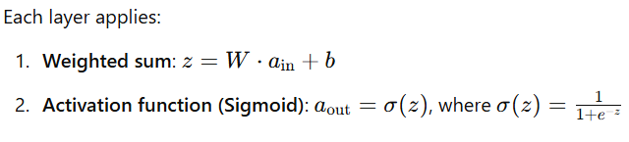
Neural Network Example
Step 1: Understanding the Network Structure
We have:
Input Layer: 2 neurons
Hidden Layer 1: 3 neurons (Weights: W1, Bias: b1)
Hidden Layer 2: 2 neurons (Weights: W2, Bias: b2)
Output Layer: 1 neuron (Weights: W3W3W3, Bias: b3b3b3)

Slide 38
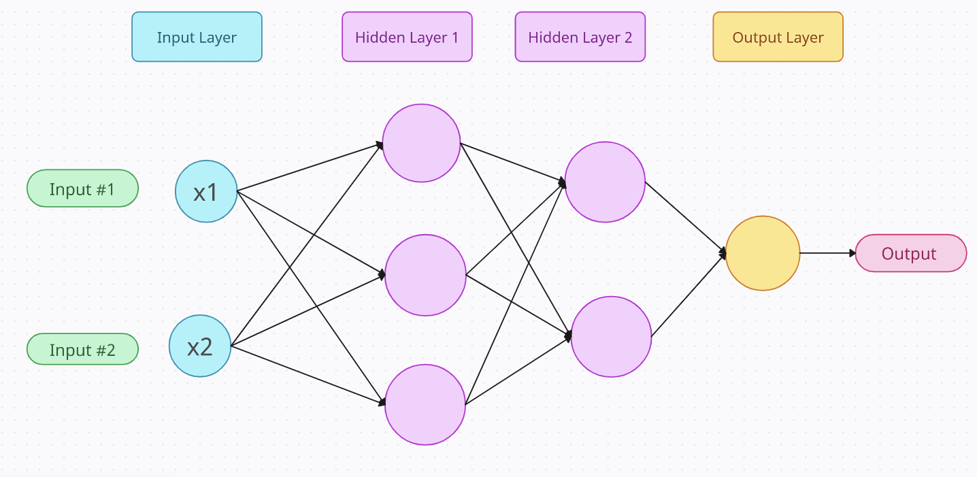








Slide 39
What is Forward Propagation?
Forward Propagation is the process of passing input data through the neural network to generate an output. It gives us the value we want to predict.

Slide 40
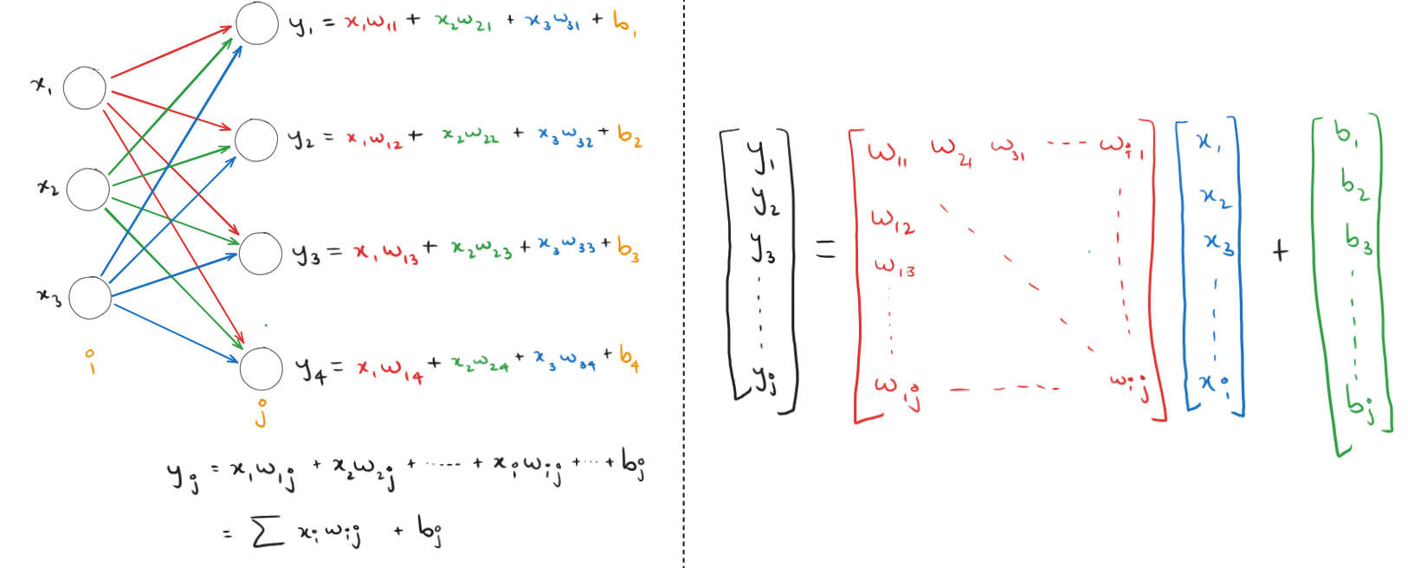

Slide 41
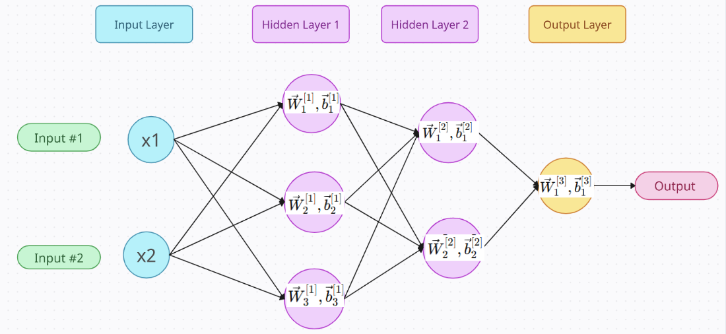
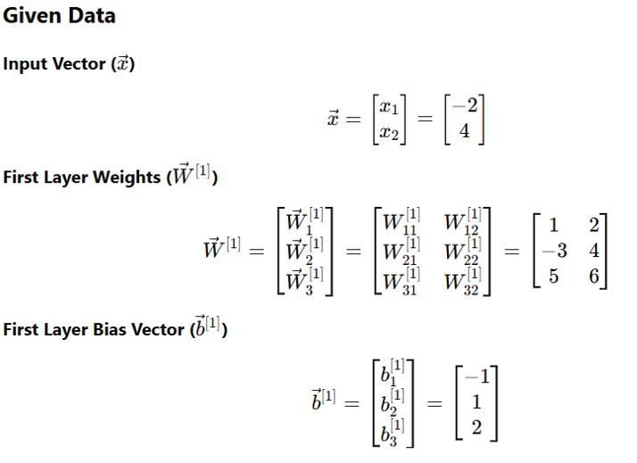
Forward Propagation Calculation

Slide 42
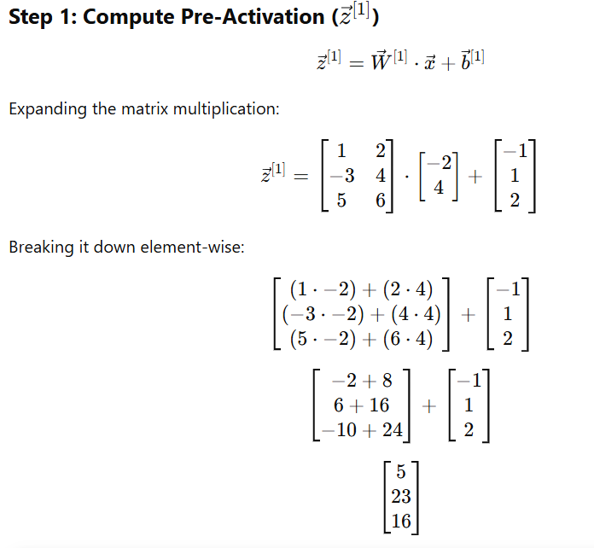
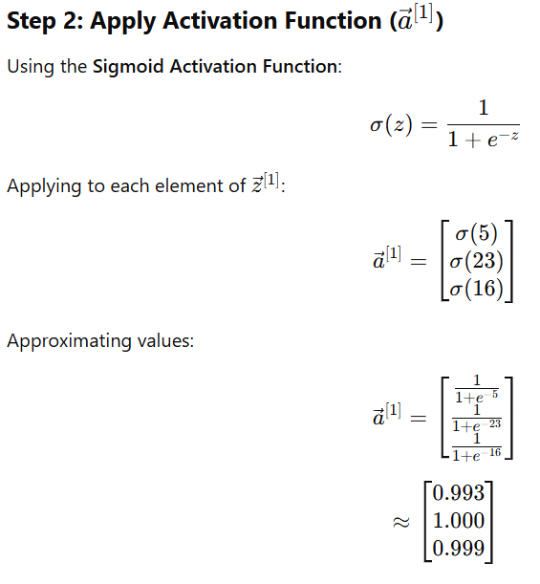
First Hidden Layer

Slide 43
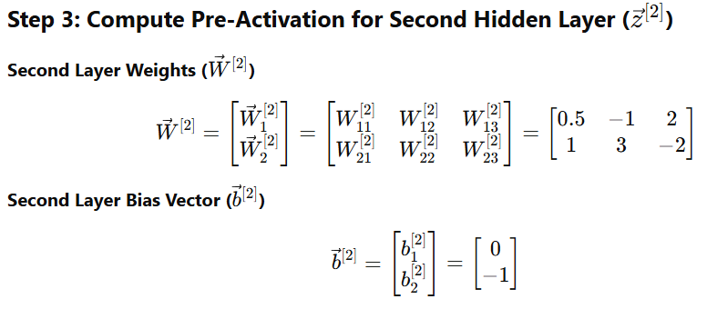
Second Hidden Layer

Slide 44
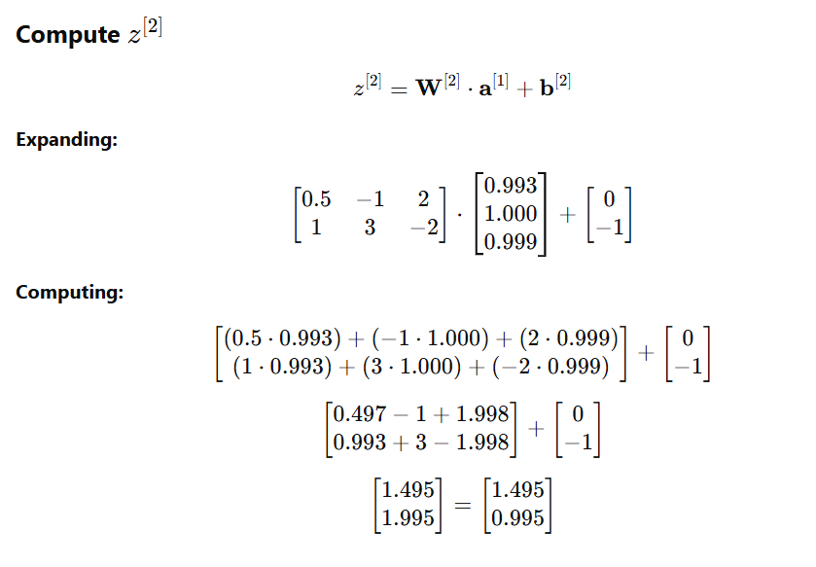
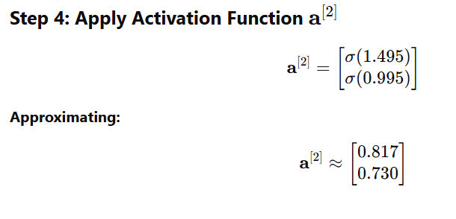
Second Hidden Layer

Slide 45
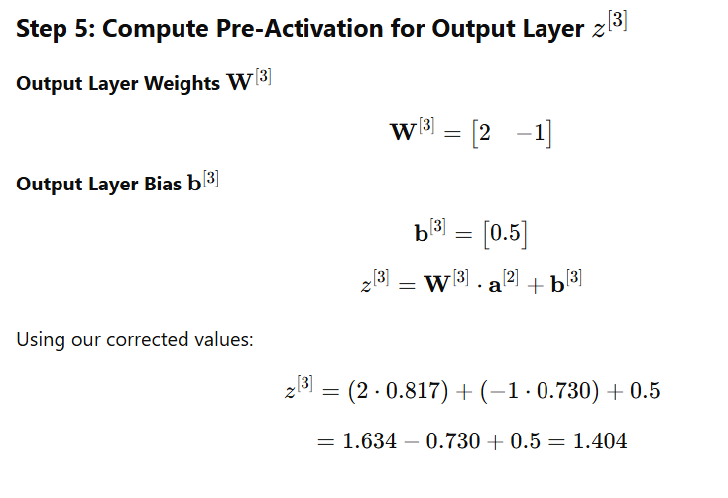
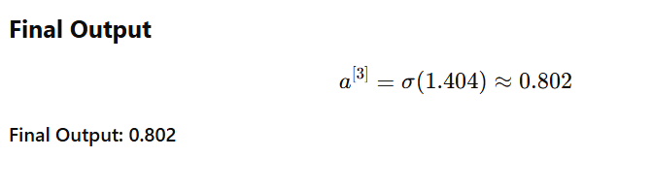
Output Layer

Slide 46
Gradient Descent
1. Introduction to Gradient Descent
Gradient Descent is an optimization algorithm used to minimize loss functions by adjusting model parameters iteratively.
2. Intuition: Finding the Lowest Point in a Valley
Imagine standing on top of a hill (high loss value).
Your goal is to reach the lowest point (optimal model parameters).
You look around and take small steps in the steepest downward direction.
If steps are too big, you might overshoot the lowest point.
If steps are too small, progress will be slow.
Eventually, after many steps, you reach the lowest point—this is how Gradient Descent finds the optimal parameters in a neural network.

Slide 47
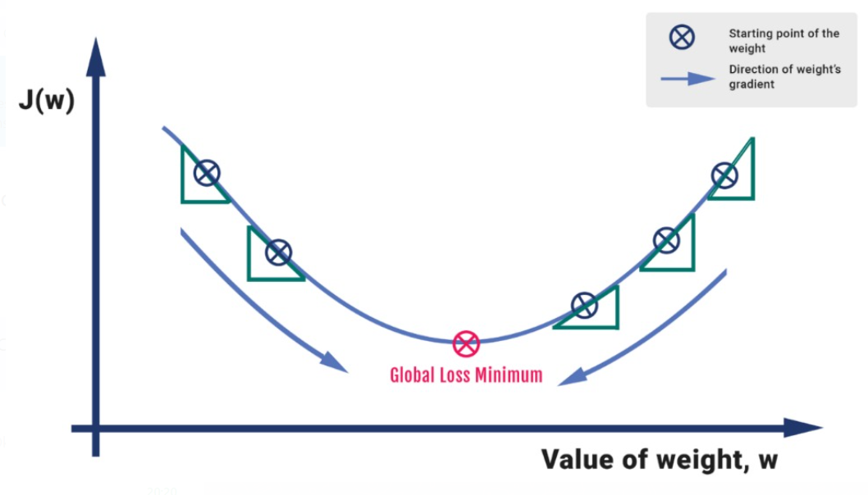

Slide 48
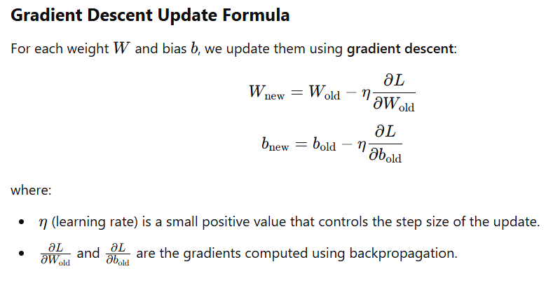
Backward Propagation
BackPropagation is the process of adjusting weights to reduce the error in predictions.

Slide 49
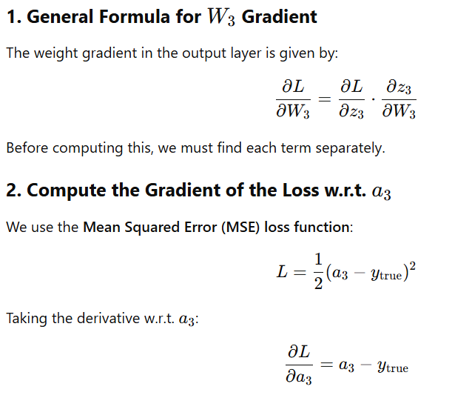
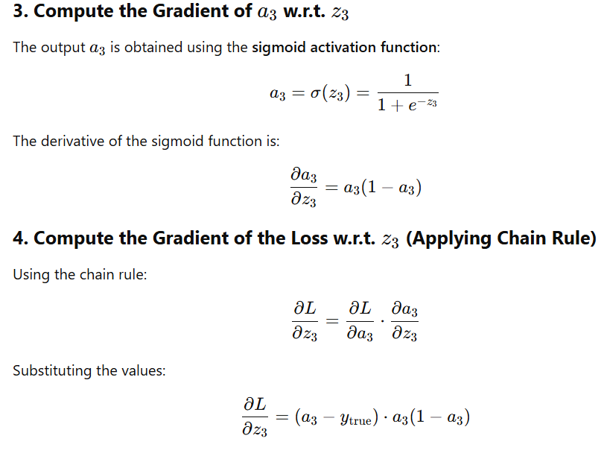
Backward Propagation
Step 1: Compute Gradients for W3 and b3 (Output Layer)

Slide 50
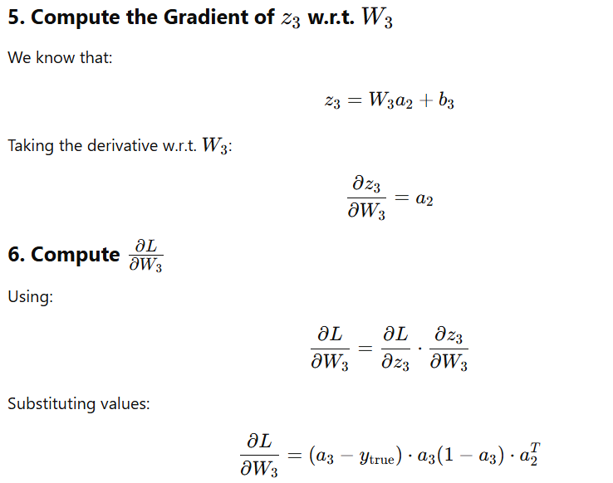
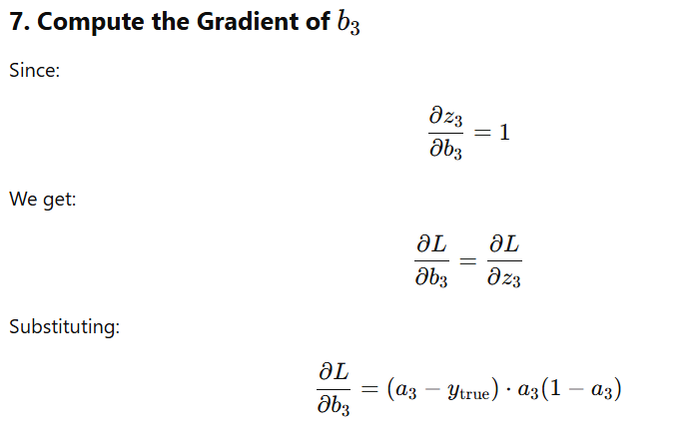
Backward Propagation

Slide 51
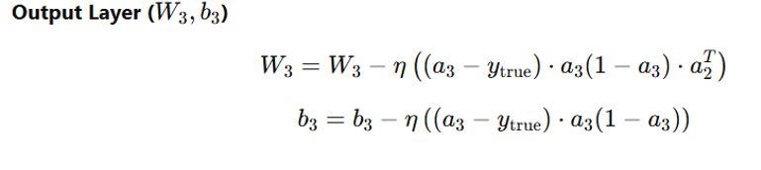
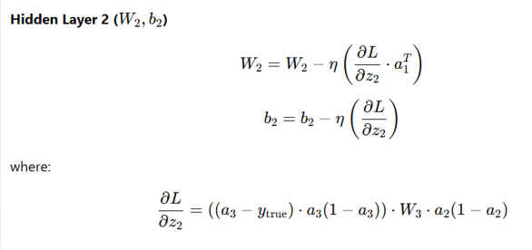
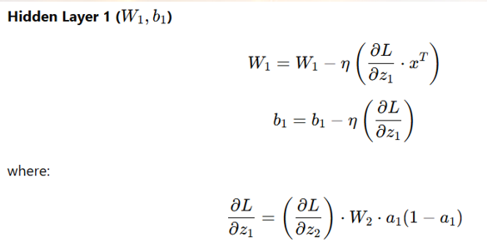
Gradient Descent Updates for Each Layer

Slide 52
Types of Gradient Descent
Full Batch
Stochastic
Mini Batch

Slide 53
How Gradient Descent Works in Neural Networks
Forward Propagation:
Inputs are passed through the network.
Each layer applies weights and biases to compute an output.
The final output is compared to the actual value using a loss function.
Computing the Loss:
The loss function (e.g., Mean Squared Error, Cross-Entropy) quantifies the difference between predicted and actual values.
Backpropagation & Gradient Calculation:
Using backpropagation, we compute gradients of the loss function with respect to each weight and bias using the chain rule of calculus.
Parameter Update using Gradient Descent:
The gradients indicate how much each weight should be adjusted.

Slide 54

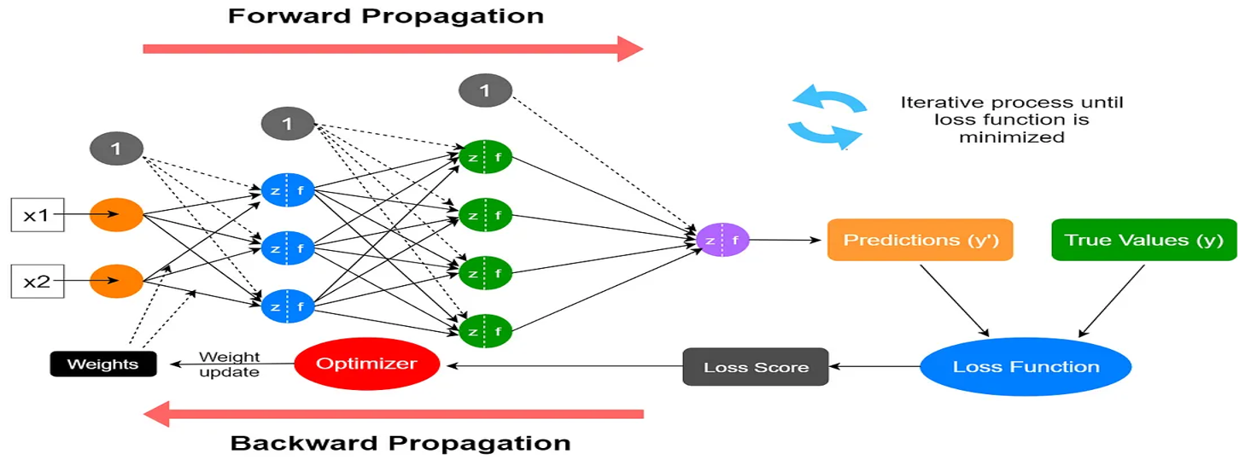

Slide 55
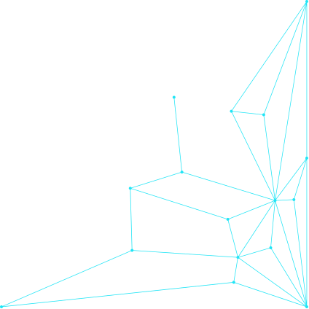
Thank You!

