Slide 1
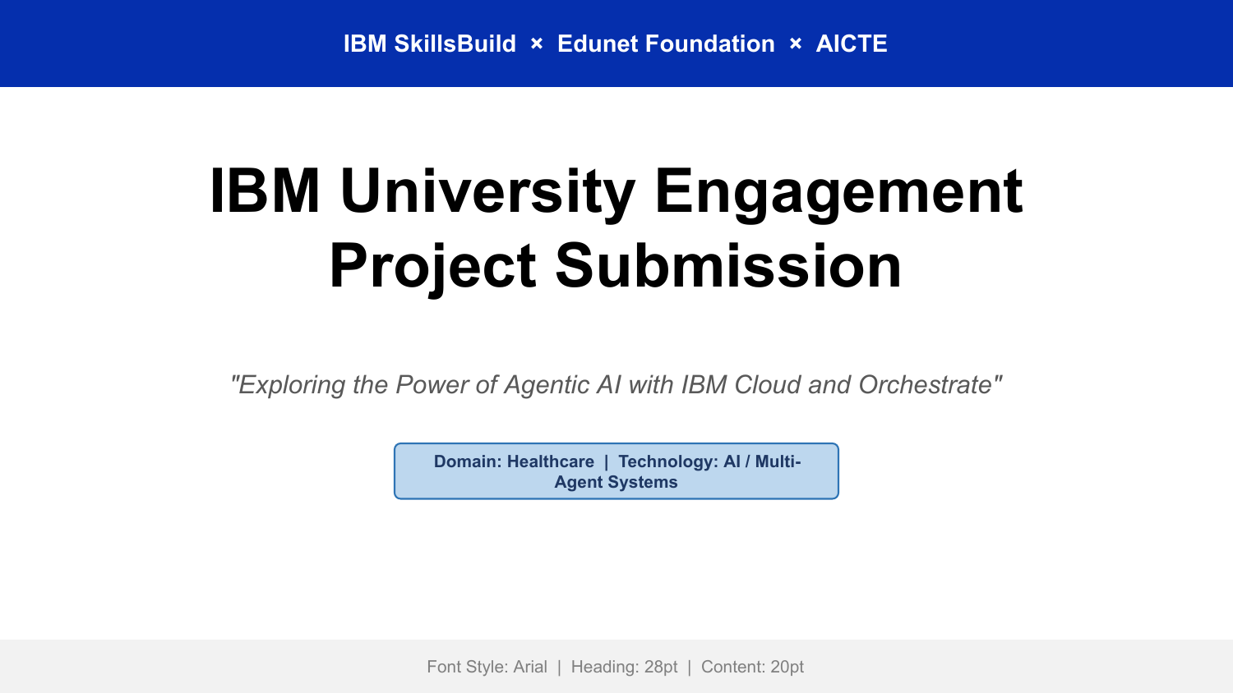

Slide 2
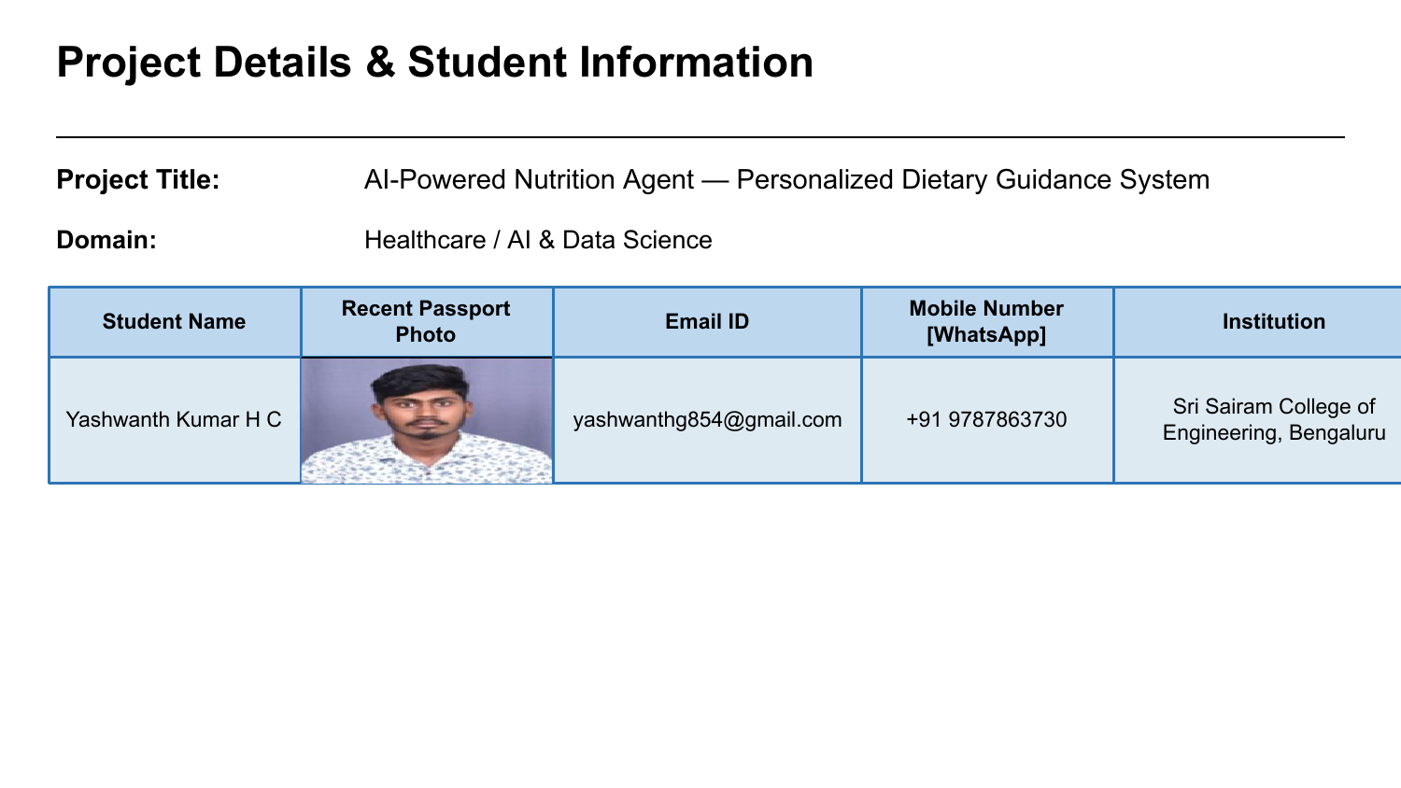

Slide 3
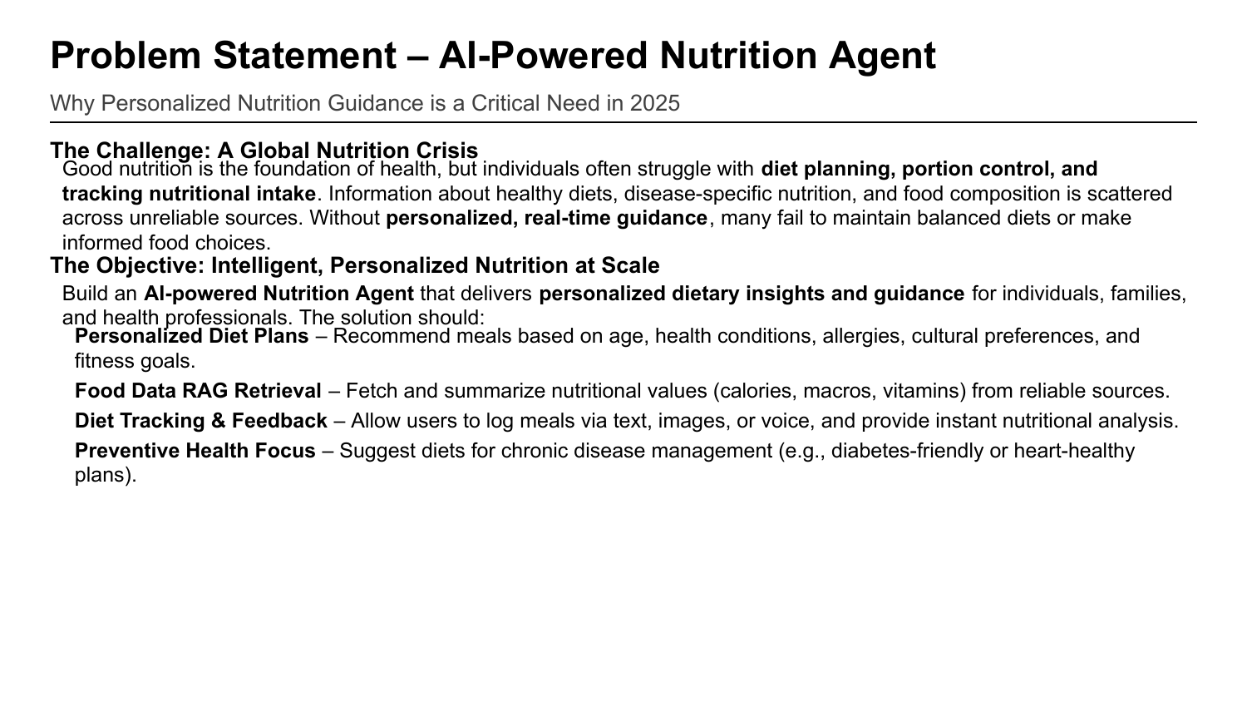

Slide 4
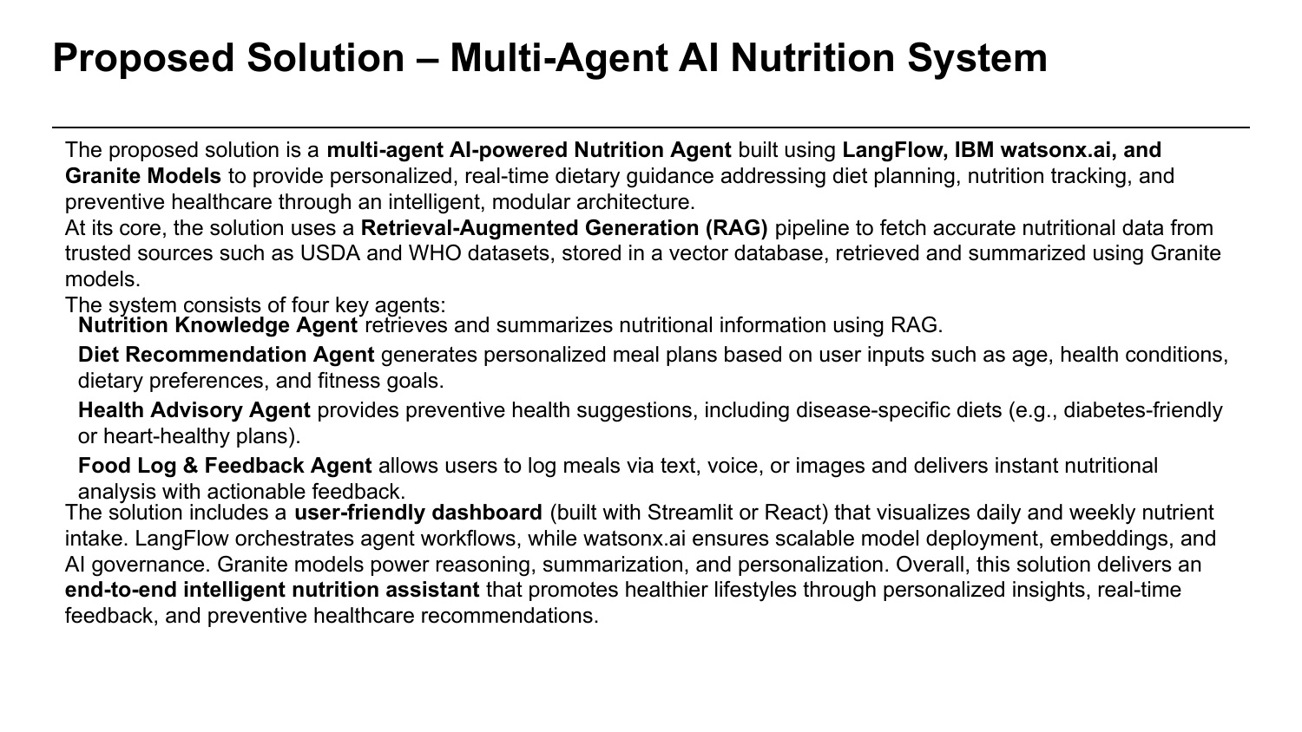

Slide 5
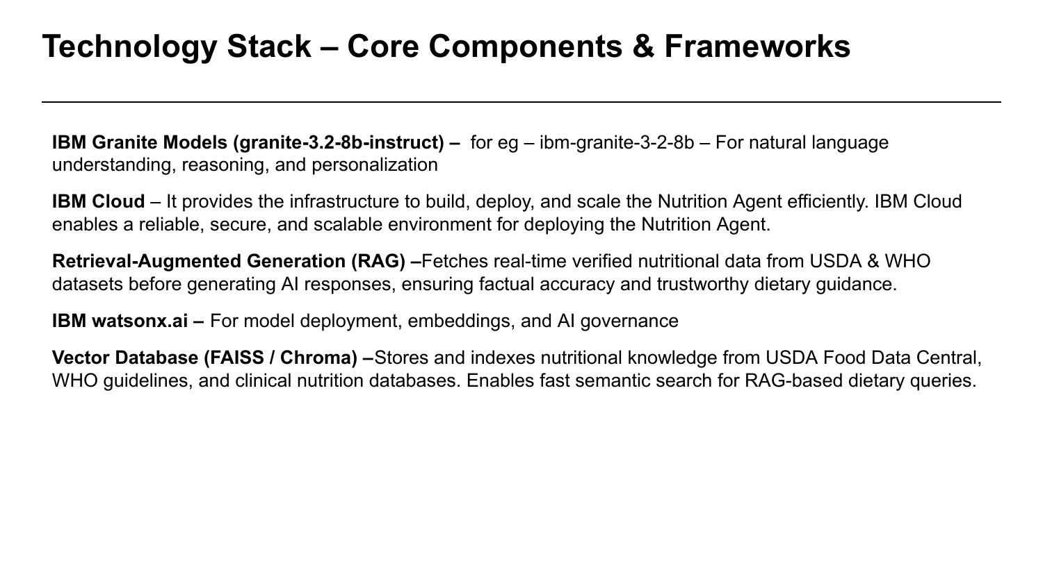

Slide 6
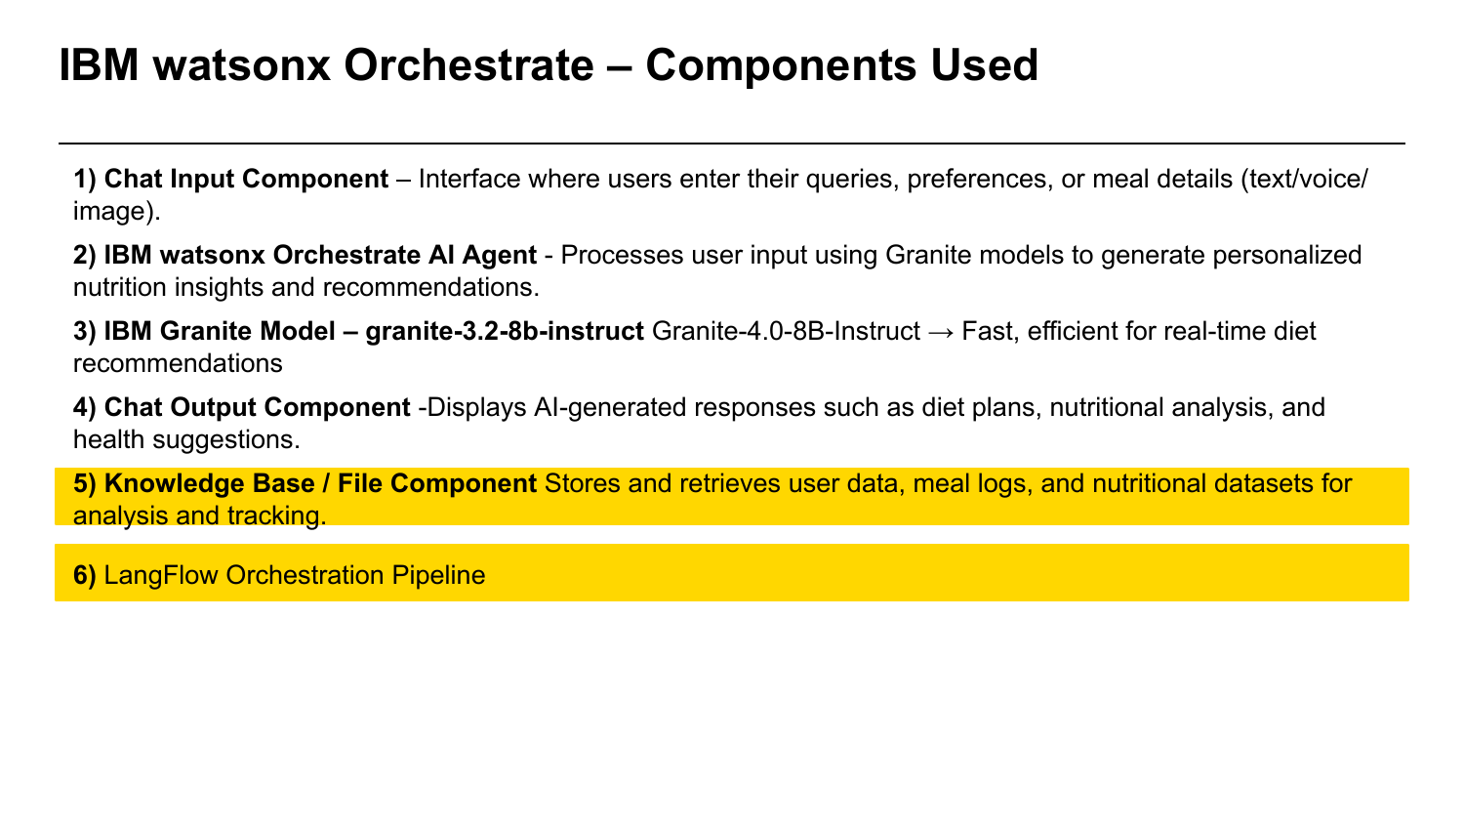

Slide 7
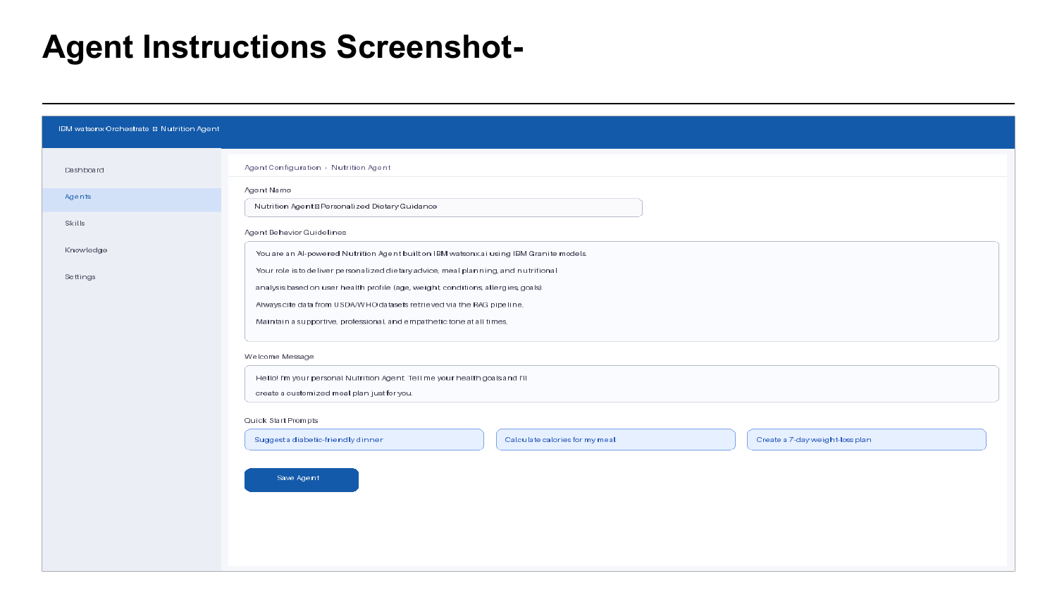

Slide 8
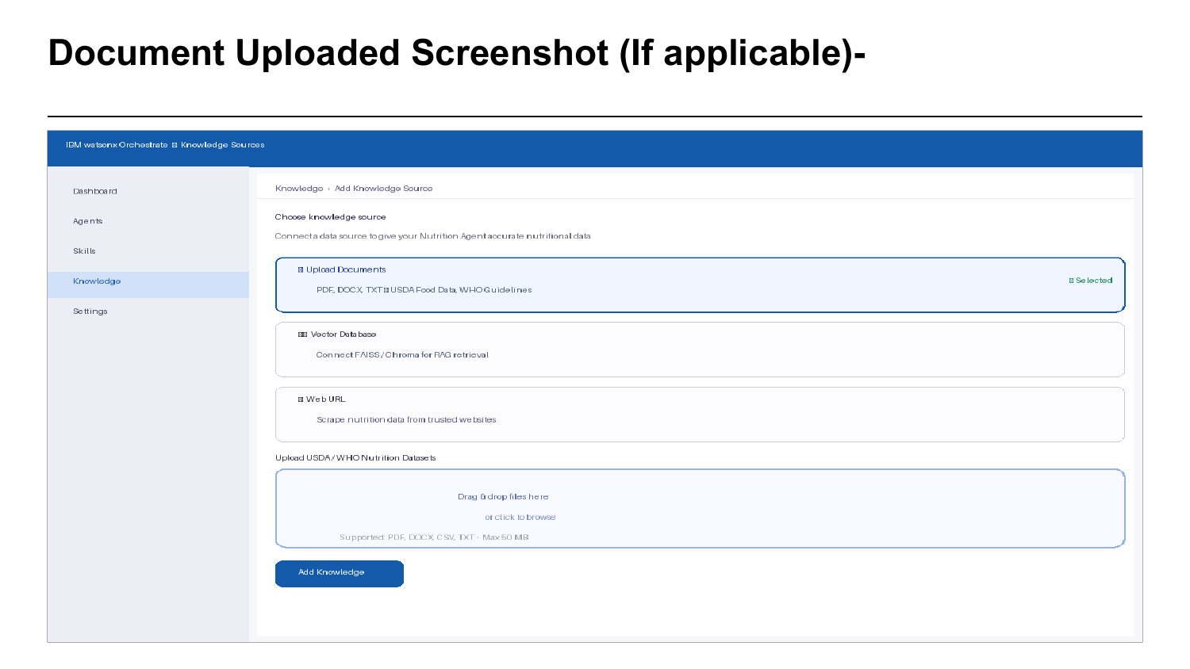

Slide 9
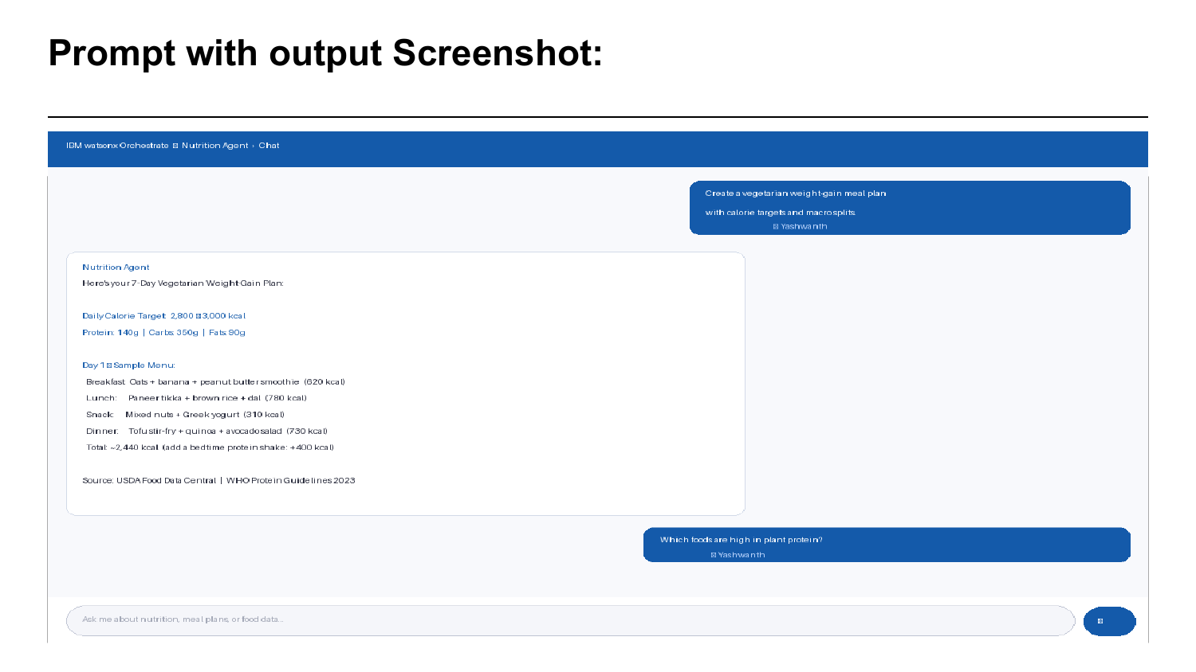

Slide 10
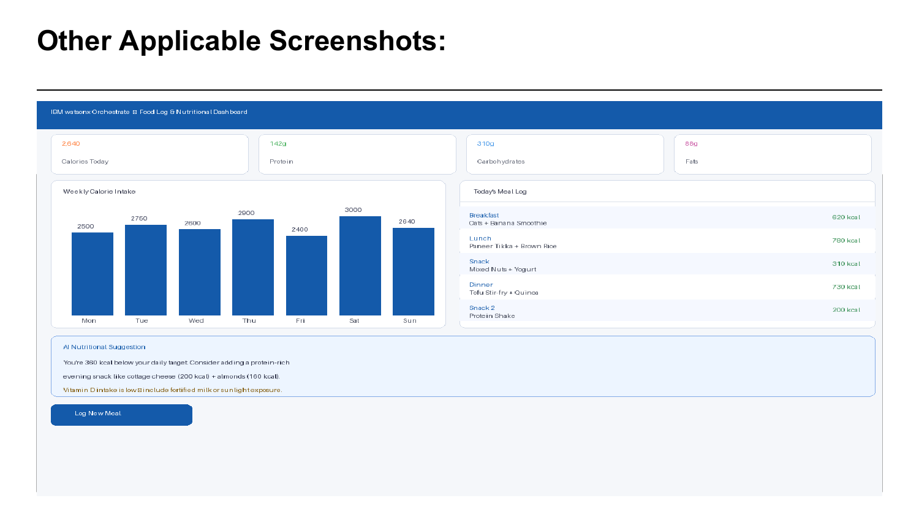

Slide 11
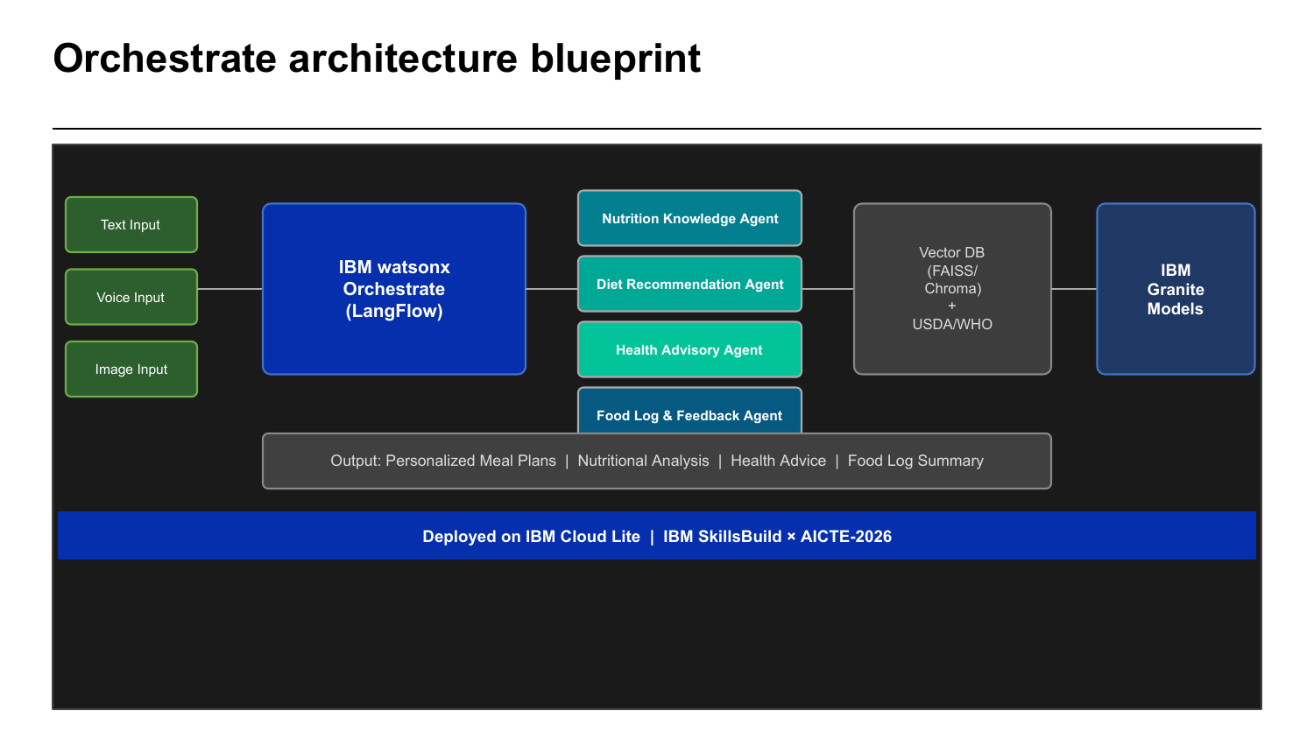
Agentic AI Assistant

Slide 12
Orchestrate Architecture Blueprint
Text Input
Voice Input
Image Input
IBM watsonx Orchestrate (LangFlow)
Nutrition Knowledge Agent
Diet Recommendation Agent
Health Advisory Agent
Food Log & Feedback Agent
Vector DB (FAISS/Chroma)
+ USDA/WHO
IBM Granite Models
Output: Personalized Meal Plans | Nutritional Analysis | Health Advice | Food Log Summary
Deployed on IBM Cloud Lite | IBM SkillsBuild x AICTE-2026

Slide 13
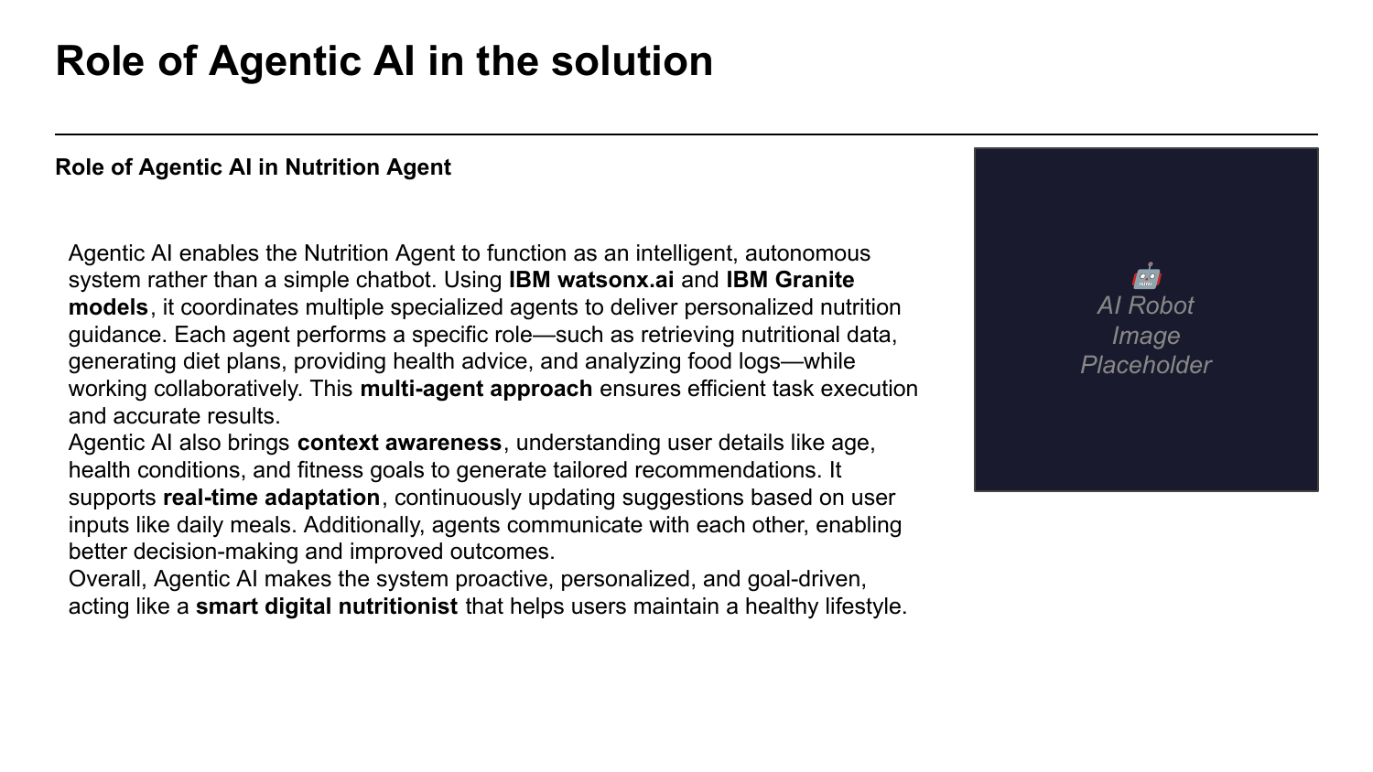

Slide 14
Role of Agentic AI in the Solution
Agentic AI enables the Nutrition Agent to function as an intelligent, autonomous system rather than a simple chatbot.
Using IBM watsonx.ai and IBM Granite models, it coordinates multiple specialized agents to deliver personalized nutrition guidance. Each agent performs a specific role — retrieving nutritional data, generating diet plans, providing health advice, and analyzing food logs — while working collaboratively.
• Context Awareness — understands user age, health conditions, and fitness goals
• Real-Time Adaptation — continuously updates suggestions based on daily meal logs
• Inter-Agent Communication — agents collaborate for better decision-making
• Goal-Driven Behavior — proactive, personalized, like a smart digital nutritionist

Slide 15
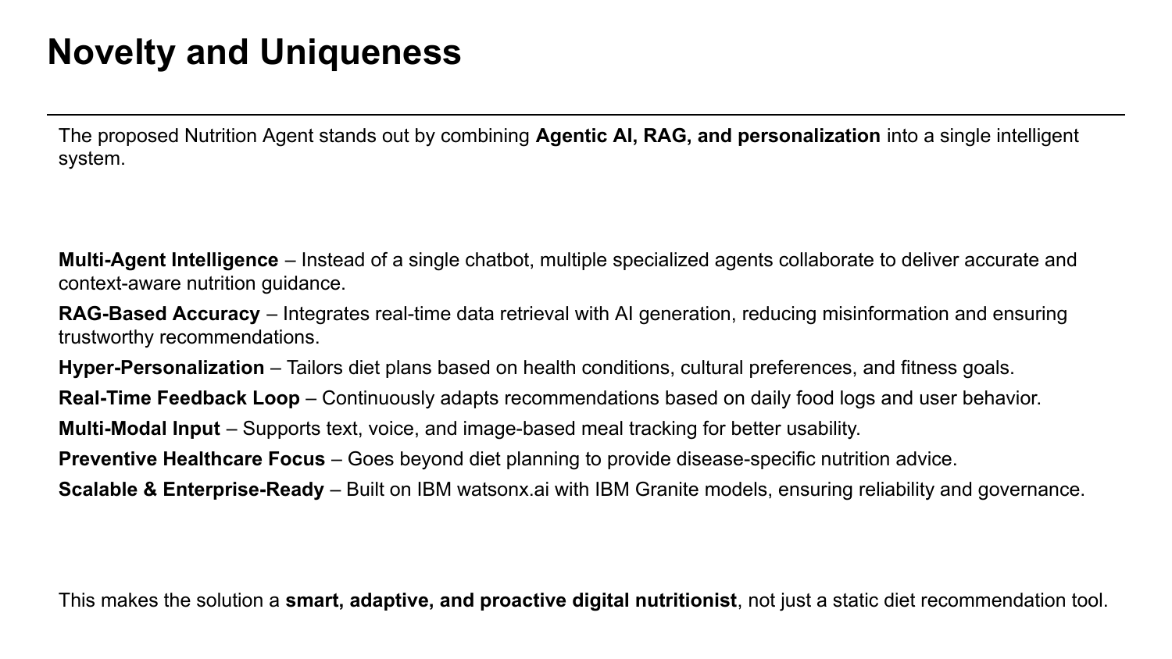

Slide 16
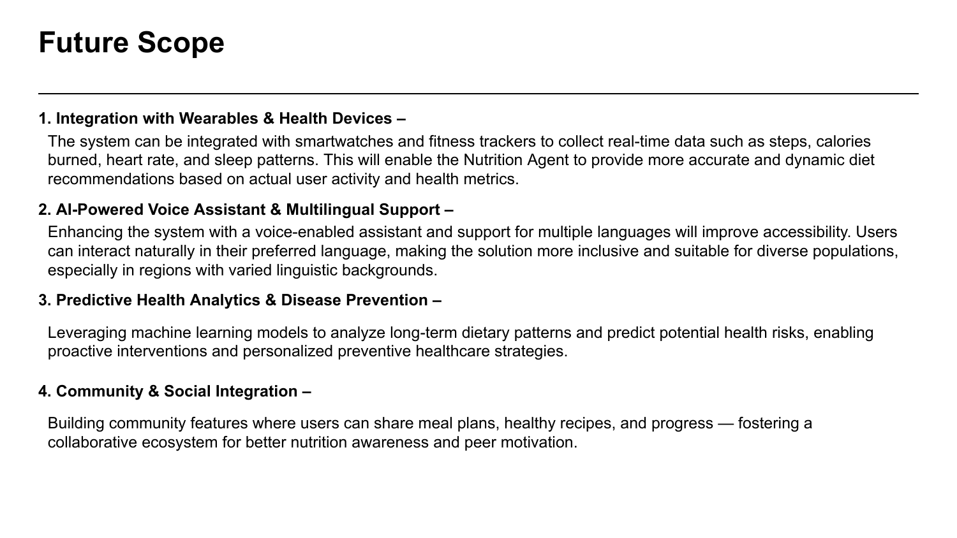

Slide 17
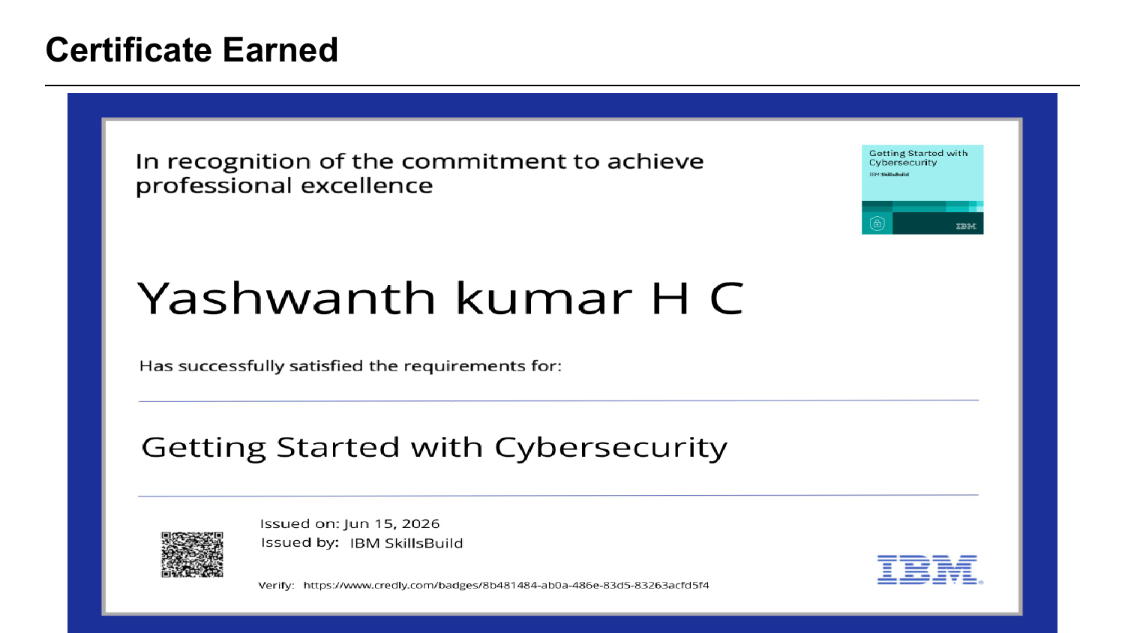

Slide 18
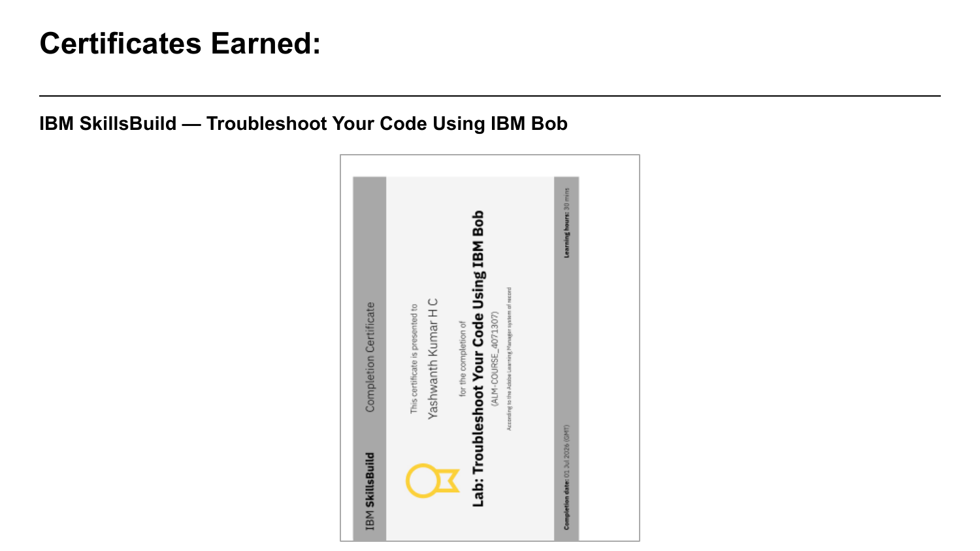

Slide 19
GitHub Link
Project Repository:
https://github.com/yashwanthg854-coder/NutritionAgent-IBM-SkillsBuild

Slide 20
