Slide 1
“Implementation and Comparison of Two Cache Prefetching Schemes”
Group Members :
1. Yashwanth Katta
2. Avinash Ayalasomayajula
3. Neel Kanjaria
Under the guidance of :
Dr. Sandip Ray
Mr. Karthikeyan Rajasekaran

Slide 2
Proposal
Hardware implementation of “Instruction Prefetching Schemes” using Simplescalar.
Implementation of “Hybrid Prefetching”.
Implementation of “Wrong Path Prefetching”.
Comparing both the above prefetching schemes on the basis of various cache parameters.

Slide 3
Motivation
Processor speed vs memory latency.
Increasing demand for superscalar processors
With data prefetching being successfully implemented, instruction prefetching is being extensively studied.
Of many theories, a few have been implemented and few are still being studied.

Slide 4
Next Line Prefetching
Aim is to prefetch the next sequential address to the current address being fetched by the cache.[1]
We introduce a variable called “prefetch_blk_count” in “cache create”, which allows the user to give the number of sequential addresses to be prefetched.
We then introduce a function by the name “cache_prefetch_block”. When the cache is accessed for an instruction “addr”, on a miss this “cache_prefetch_block” is also accessed and this function prefetches the next sequential addresses ( as many as specified by the user) into the cache.

Slide 5
Wrong Path Prefetching
In Wrong Path Prefetching we prefetch two cache address.
The first prefetch address is the next sequential address to the current cache block address being fetched by the cache.
The second prefetch address is would be the target if the current instruction being fetched is a branch instruction.
By combining the branch-prediction and the previously programmed ‘Next Line Prefetching’ we have implemented ‘Wrong Path Prefetching’.[1]
The branch predictor is set to always taken, so that the branch target is always prefetched.

Slide 6
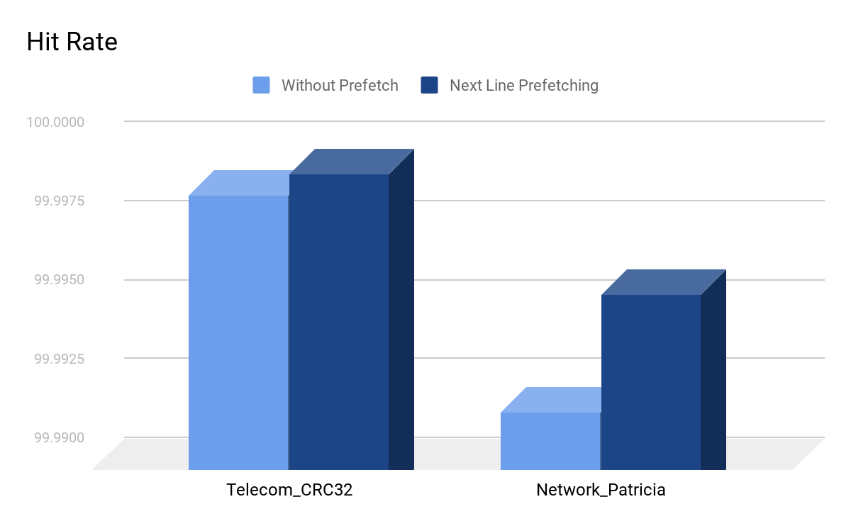
No Prefetch VS Next Line

Slide 7
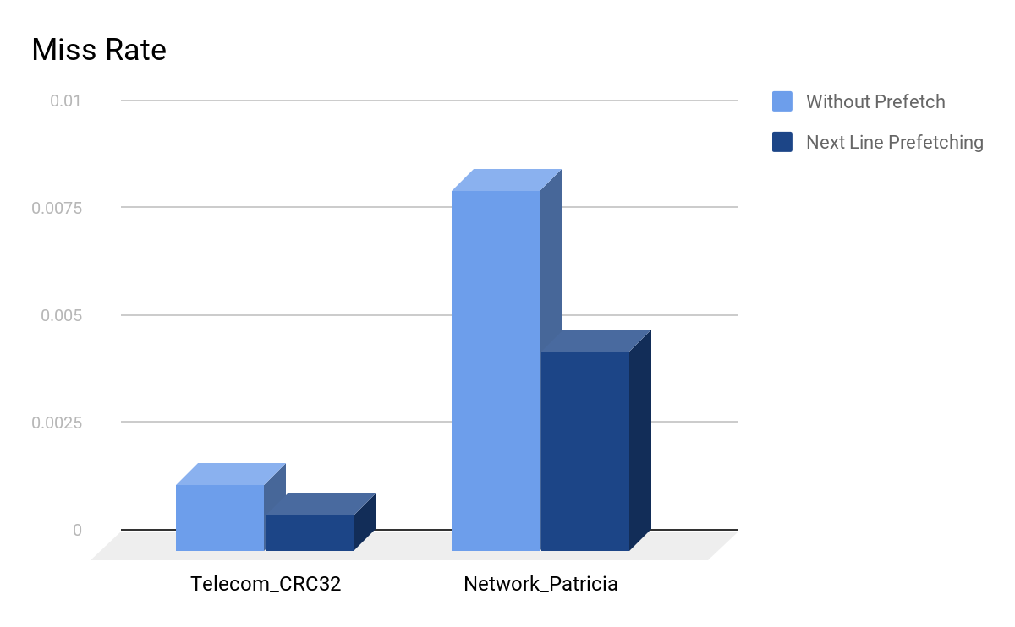

Slide 8
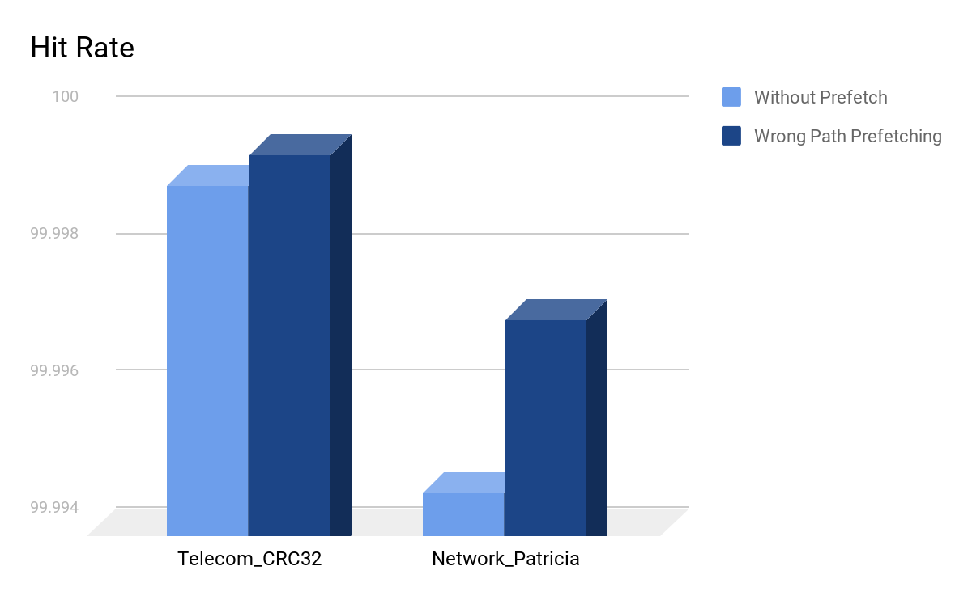
No Prefetch VS Wrong Path

Slide 9
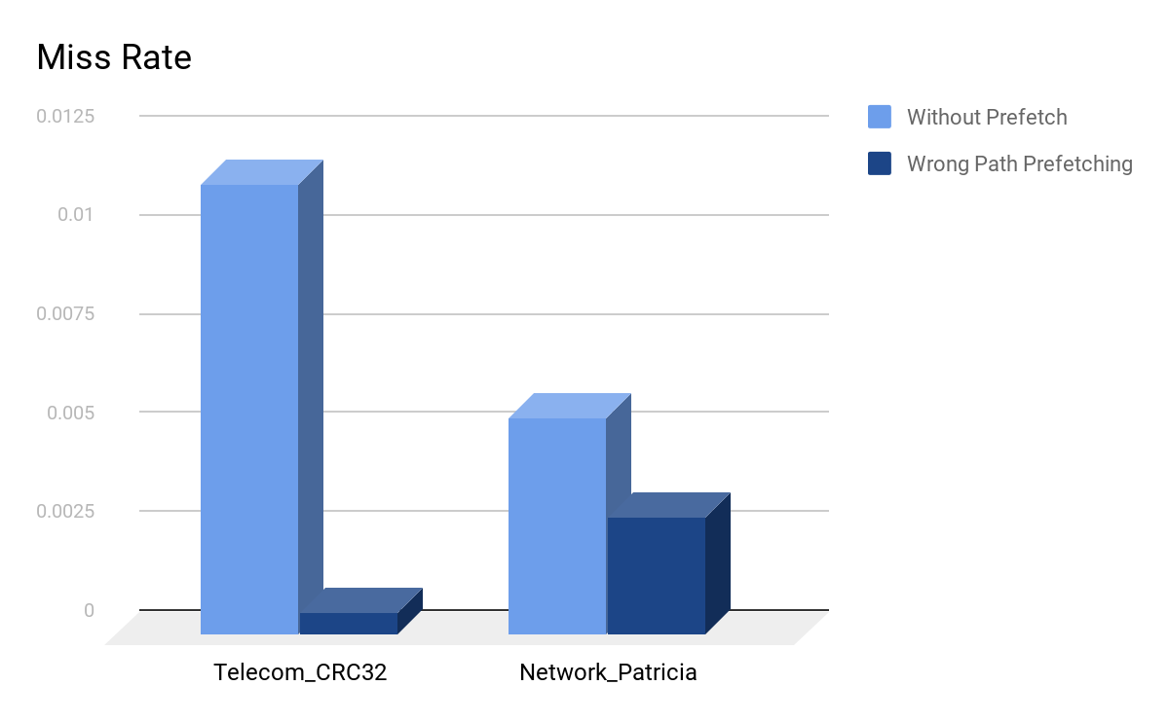

Slide 10
To Be Implemented:
Target Line Prefetching
Hybrid Prefetching ( Uses both Next Line and Target Line)

Slide 11
Conclusion
The comparison has been established using a histogram.
It is quite evident that the prefetching schemes are quite advantageous over normal schemes.
Hybrid Prefetching has to be implemented.

Slide 12
References:
http://web.engr.oregonstate.edu/~benl/Projects/prefetch_report/final.html
http://vhosts.eecs.umich.edu/mibench/source.html
http://www.ecs.umass.edu/ece/koren/architecture/Simplescalar/lab1.htm
http://www.simplescalar.com/docs/hack_guide_v2.pdf

