Slide 1

Predictive Modeling of Student Mental Health and Academic Performance: Insights from University Data
Prasanna Kumar Vemula
Mohan Naik Palithya
Keerthiviswaja Pappu
Neeharika Angirekula

Slide 2
Table of Content
Data Description
Data Attributes
Data Visualization
Regression
Confusion Matrix

Slide 3
Data Description
The data has been taken from the Kaggle and can be found in the following link https://www.kaggle.com/datasets/abdullahashfaqvirk/student-mental-health-survey
The format of the file is csv (comma separated values).
Demographics:
Gender and age of students
University affiliation
Academic Information:
Degree level (undergraduate/postgraduate) and major
Academic year (e.g., 2nd year, 3rd year)
Current CGPA
Residential and Campus Experiences:
Residential status (on-campus or off-campus)
Experiences of campus discrimination
Lifestyle and Well-being:
Frequency of sports engagement
Study satisfaction and perceived academic workload
Academic pressure and financial concerns
Quality of social relationships
Mental Health Indicators:
Frequency of depression, anxiety, and feelings of isolation
Insecurity about the future
Stress relief activities (e.g., sports, online entertainment, social connections, religious activities)

Slide 4
Data Attributes
The data attributes are as following:
Gender
Age
University
Degree Level
Degree Major
Academic Year
CGPA
Residential Status
Campus Discrimination
Sports Engagement
Study Satisfaction
Academic Workload
Academic Pressure
Financial Concerns
Social Relationships
Depression
Anxiety
Isolation
Future Insecurity
Stress Relief Activities

Slide 5
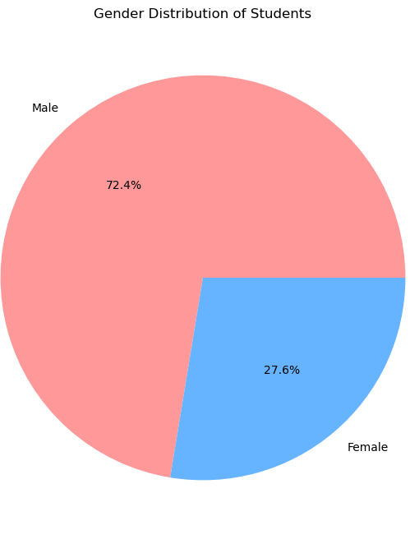
Data Visualization
Male students: 72.4% of the population
Female students: 27.6% of the population
Significant gender imbalance, with males outnumbering females by nearly 3 to 1

Slide 6
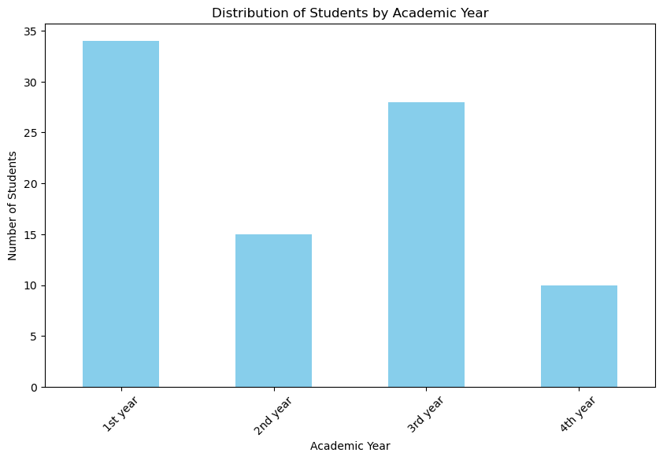
Bar Chart for Academic Year and Number of Students
-The graph represents the distribution of students by academic year.
-The x-axis shows four categories: 1st year, 2nd year, 3rd year, and 4th year.
-The y-axis represents the number of students.
-The majority of students are in the 1st year, with approximately 34 students.
-The 3rd year has the second highest number of students, with around 27 students.
-There are fewer students in the 2nd year (about 16 students).
-The 4th year has the least number of students, with approximately 9 students.
-This pattern suggests a higher enrollment of students in earlier years, with a declining number of students in later academic years.

Slide 7
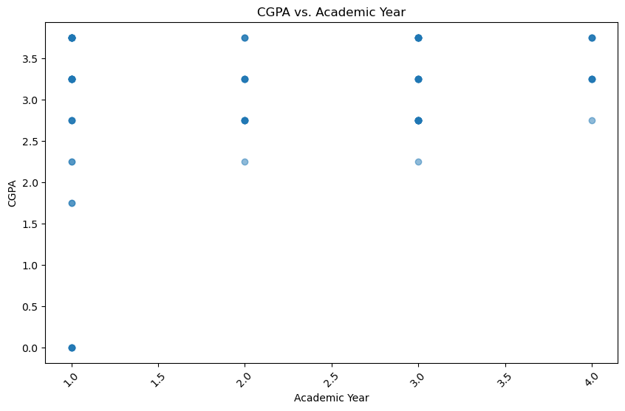
Scatter Plot for Academic Year and CGPA
The graph displays the relationship between CGPA (Cumulative Grade Point Average) and Academic Year.
The x-axis represents the Academic Year, ranging from 1st to 4th year.
The y-axis represents CGPA, ranging from 0.0 to 4.0.
1st-year students show a wide range of CGPAs, with some as low as 0.0 and others as high as 3.5+.
2nd-year students also have varying CGPAs, ranging between 2.0 and 3.5.
3rd-year students tend to have CGPAs between 2.0 and 3.5, with a relatively smaller spread compared to 1st-year students.
4th-year students show CGPAs in a tighter range, mostly between 2.0 and 3.5, with no extremes.
The plot suggests that students in later years tend to have CGPAs within a narrower range compared to students in their 1st year.

Slide 8
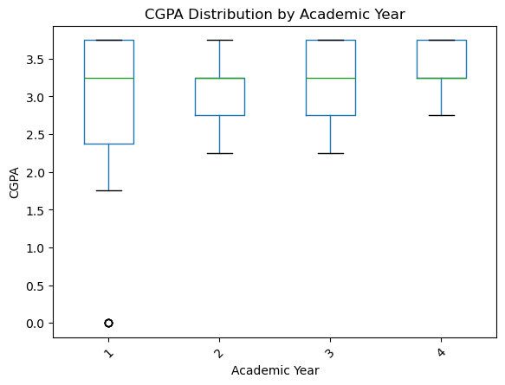
CGPA Distribution by Academic Year
Students tend to improve their academic performance over time, as evidenced by the increasing median CGPA across the academic years.
While the general trend is positive, there are some fluctuations in performance between years. For example, year 2 showed slightly more variability in student grades.
The distributions were skewed to the right, especially in the earlier years, suggesting a larger proportion of students with lower GPAs. This skewness decreased in later years, indicating a more even distribution of grades.
The boxplot allows for easy comparison of the distributions across years. For instance, the median CGPA for year 4 was higher than that for year 1, and the variability in grades was lower in year 3 compared to year 2.

Slide 9
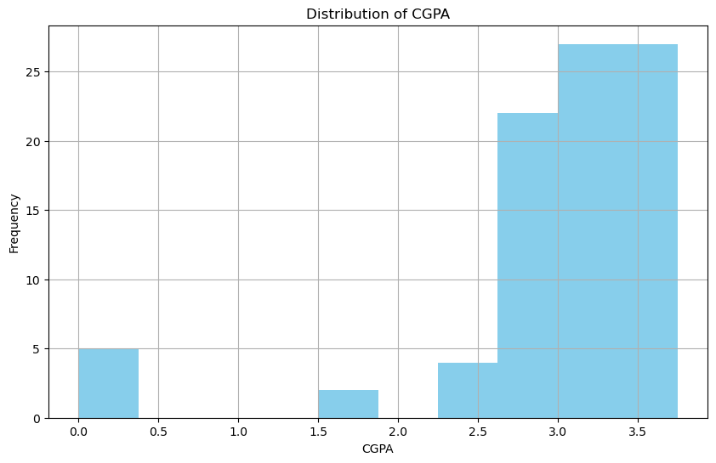
CGPA Distribution
The histogram shows a right-skewed distribution, indicating that a larger proportion of students have lower CGPA scores compared to higher ones.
The highest frequency occurs between 3.0 and 3.5, suggesting that the majority of students have CGPA scores in this range.
There is a clear mode between 3.0 and 3.5, indicating that this is the most common CGPA range.
The left tail of the distribution is longer than the right tail, further emphasizing the skewness to the right.
The right-skewness indicates a larger proportion of students with lower CGPA scores.

Slide 10
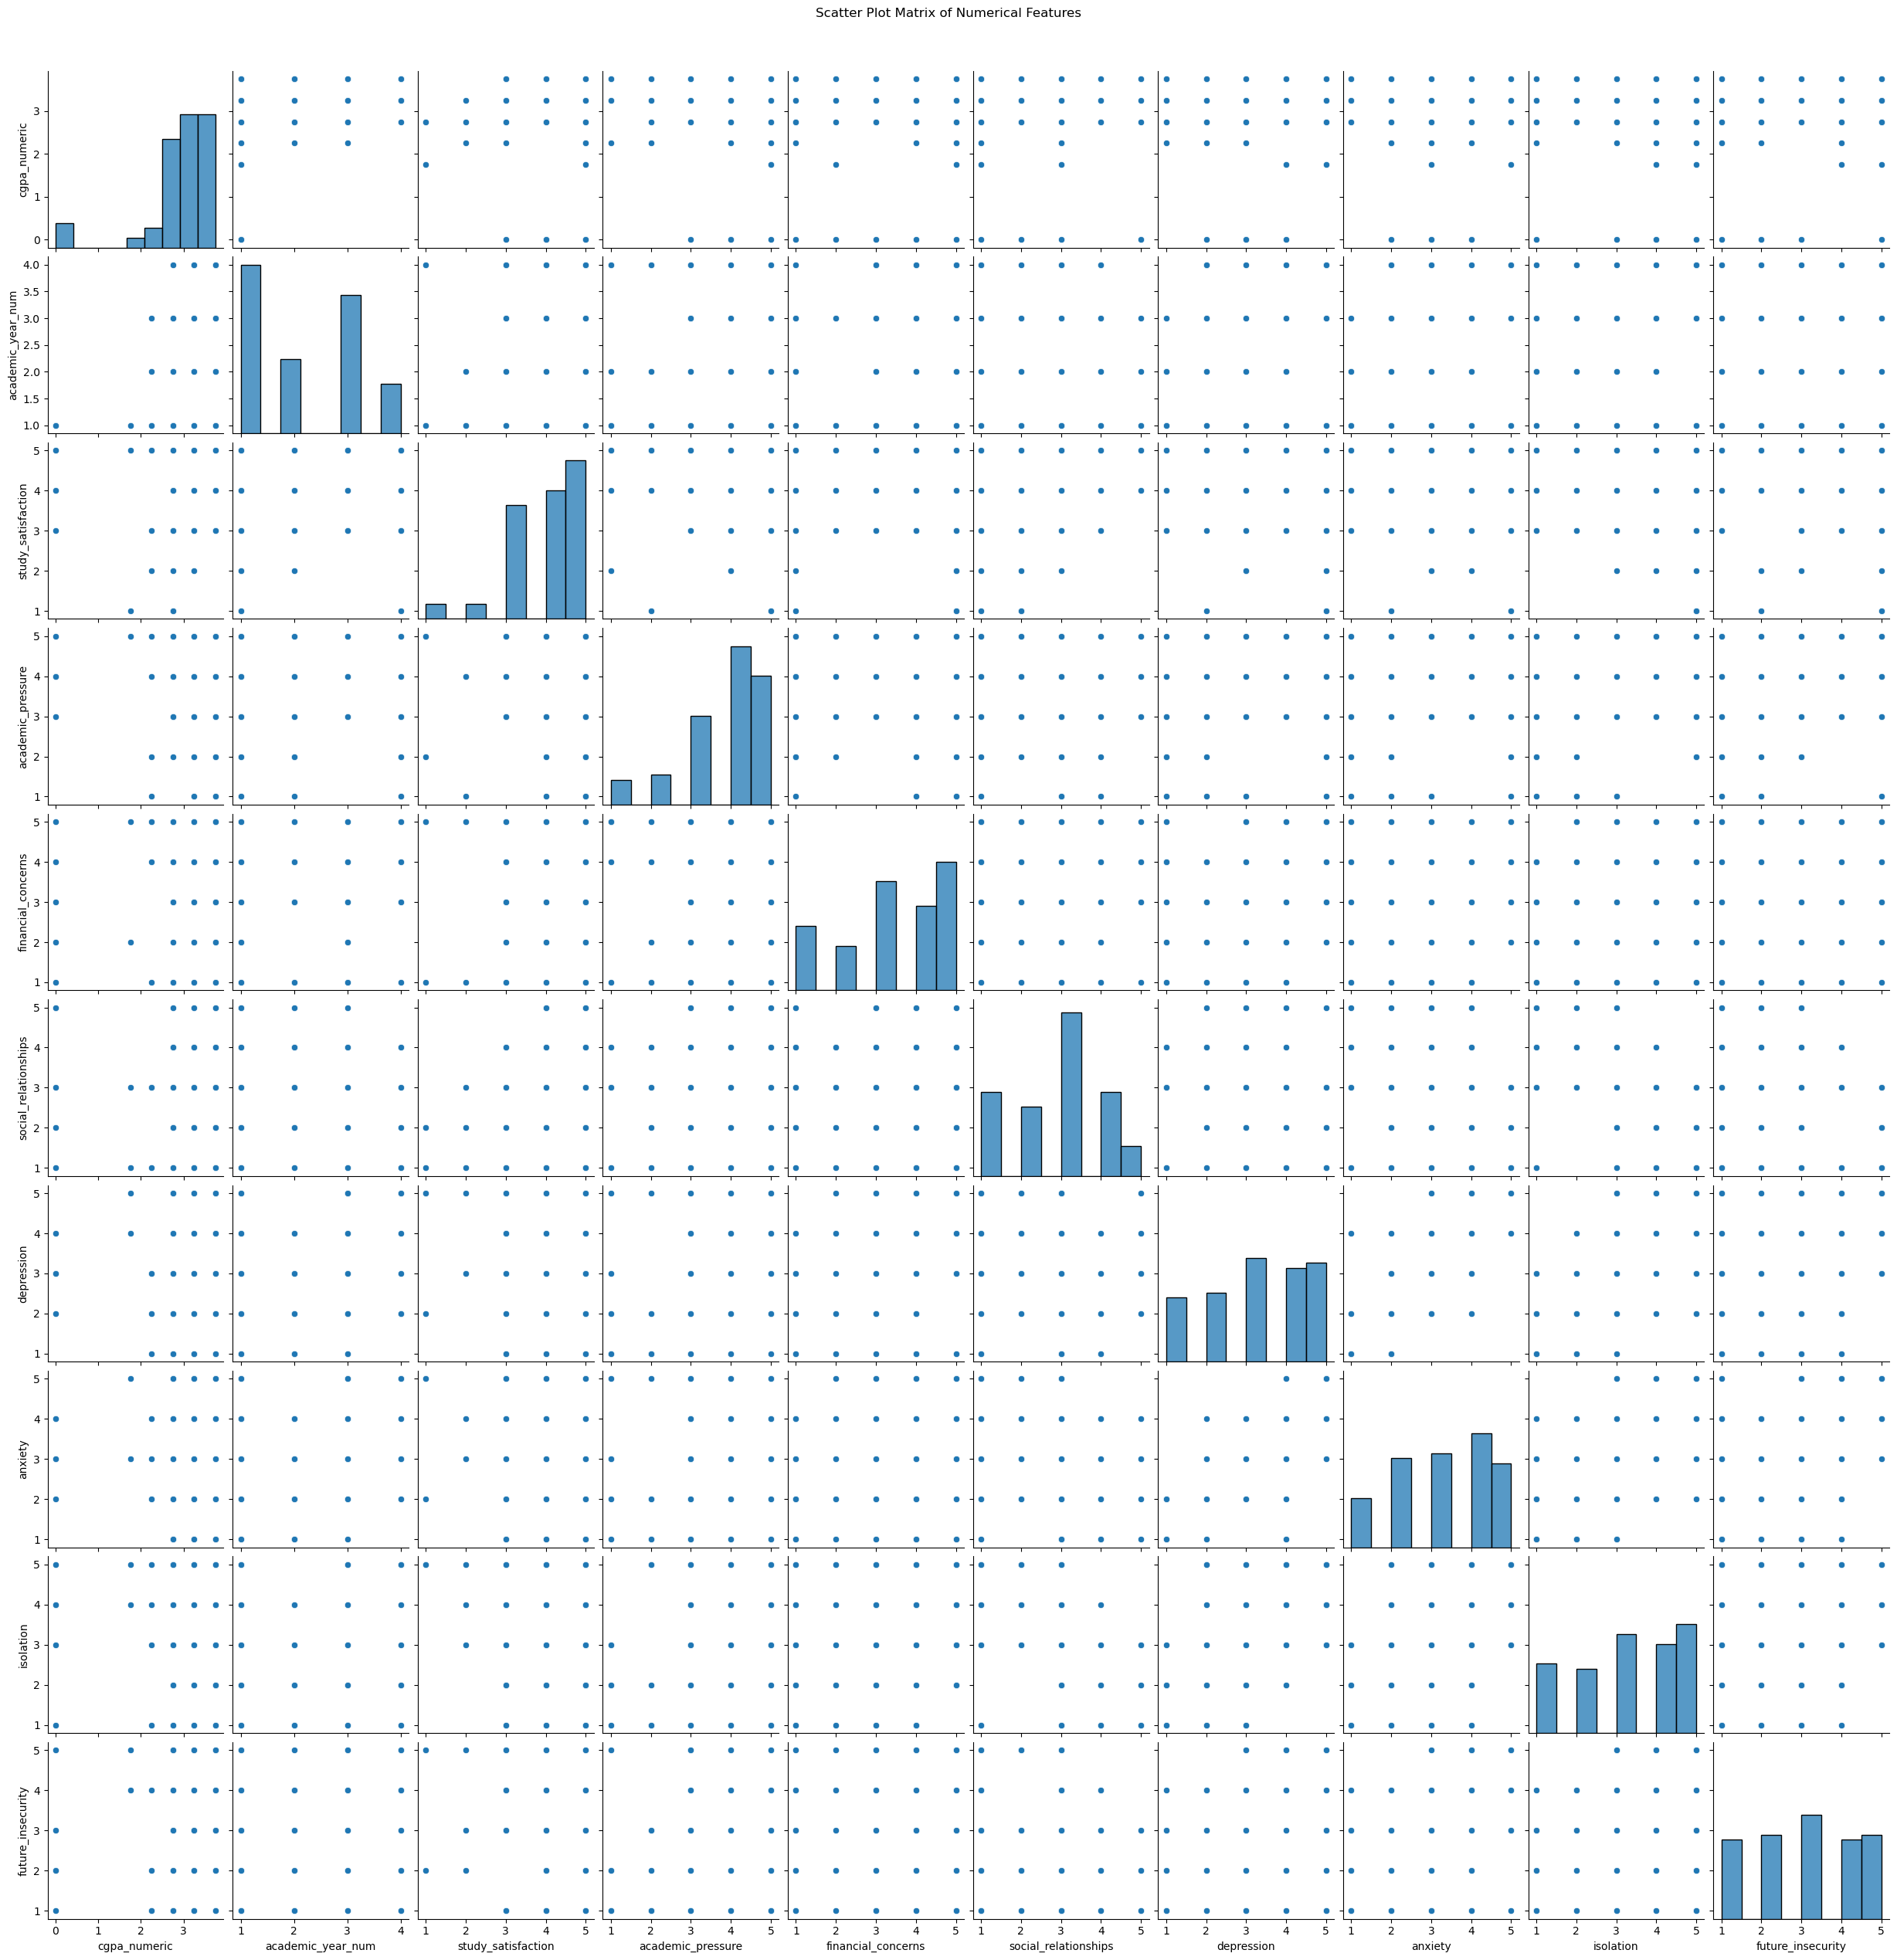
Scatter Plot for all Features
1. CGPA and Mental Health (Depression/Anxiety)
Negative correlation: Higher levels of depression or anxiety are likely associated with lower CGPA. This suggests that students struggling with mental health issues may face academic challenges.
2. Study Satisfaction and Academic Pressure
Negative correlation: As academic pressure increases, study satisfaction tends to decrease. Students feeling overwhelmed by academic demands are less likely to be satisfied with their academic experience.
3. Academic Year and Academic Pressure
Positive correlation: Academic pressure tends to increase as students progress to later academic years. This reflects the growing expectations and workload placed on students over time.
4. Depression and Anxiety
Strong positive correlation: Students experiencing high levels of depression are likely to also experience high levels of anxiety. These two factors often go hand in hand in terms of mental health.
5. Financial Concerns and Mental Health (Depression/Anxiety)
Positive correlation: Students facing financial difficulties are more likely to report higher levels of depression and anxiety, indicating that financial stress is a significant contributor to mental health challenges.

Slide 11
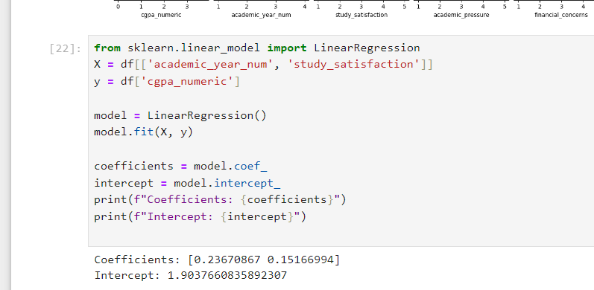
Regression
Academic Year Coefficient (0.2367):
This coefficient indicates that for each one-unit increase in the academic year number (e.g., moving from Year 1 to Year 2), the CGPA is expected to increase by approximately 0.2367 units, assuming study satisfaction remains constant. This suggests that as students advance in their academic years, their CGPA tends to improve, which may reflect increased knowledge, experience, or academic skills over time.
2. Study Satisfaction Coefficient (0.1517):
This coefficient suggests that for each one-unit increase in study satisfaction (measured on a specified scale), the CGPA is expected to increase by about 0.1517 units, assuming the academic year remains constant. This indicates a positive relationship between how satisfied students are with their studies and their academic performance, implying that higher study satisfaction is associated with better CGPA.
Intercept (1.9038):
The intercept represents the expected value of CGPA when both the academic year number and study satisfaction are zero. In practical terms, this value may not have a meaningful interpretation, especially if a value of zero for academic year or study satisfaction is not realistic within the context of your dataset. However, it does provide a baseline level of CGPA from which the effects of the two predictors are measured.
The linear regression model indicates that both academic year and study satisfaction significantly contribute to explaining variations in CGPA. As students progress through their academic years and report higher levels of study satisfaction, their CGPA tends to increase, highlighting the importance of both academic advancement and student engagement in academic performance.

Slide 12
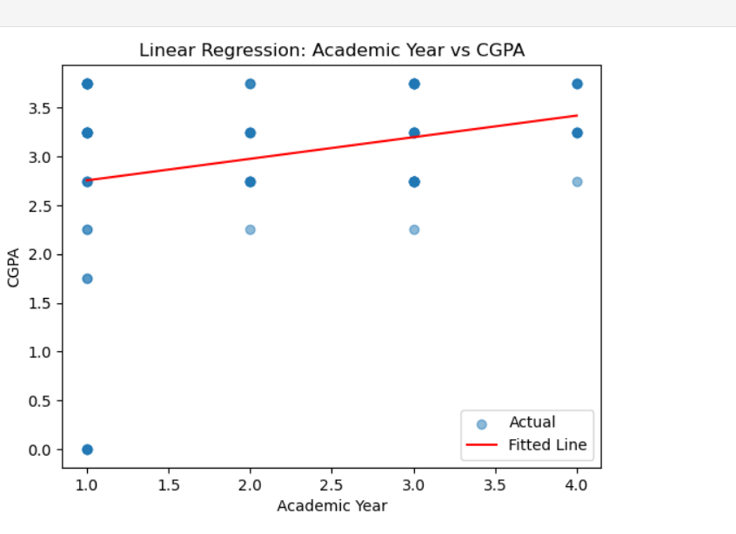
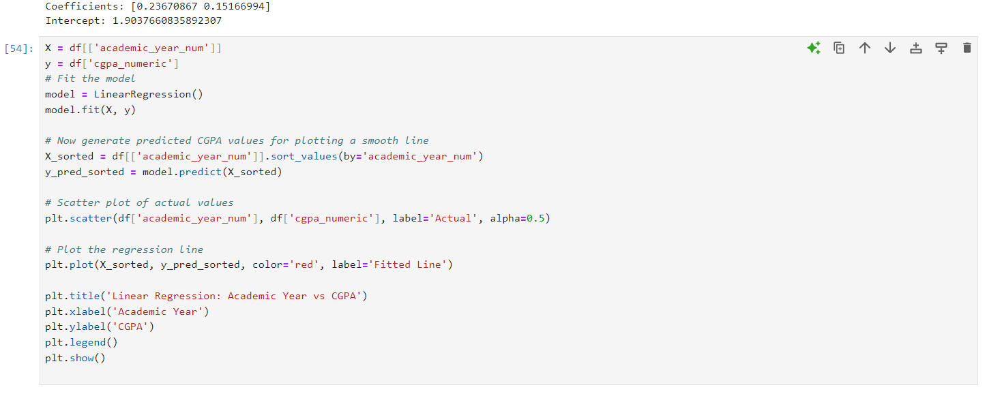
Linear Regression Graph
The red regression line shows a slight upward slope, indicating a positive correlation between Academic Year and CGPA. As students advance through their academic years, their CGPA tends to increase.
There is considerable variation in CGPA values within each academic year, as seen in the scattered blue points. This suggests that individual performance differs significantly among students.
CGPA values range from 0 to 4, with most values falling between approximately 2.0 and 3.5.
While there is an overall increase in CGPA as the academic year progresses, the improvement is relatively small, suggesting that factors other than academic progression may influence CGPA.
Some points are considered outliers, particularly those with low CGPA in higher academic years, indicating that not all students perform equally well as they progress through their studies.
The weak correlation suggests that additional factors (e.g., study habits, extracurricular activities, or support systems) could be explored to better understand the influences on CGPA.
The graph provides a general insight into academic performance trends over time, useful for educators and administrators to identify areas for academic support.
The regression equation is: CGPA = 0.22 * (Academic Year) + 2.53

Slide 13
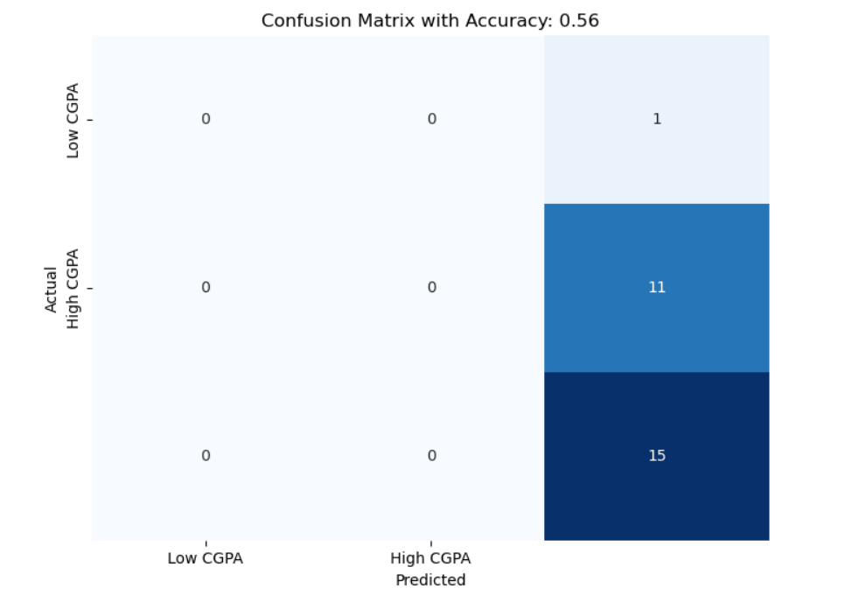
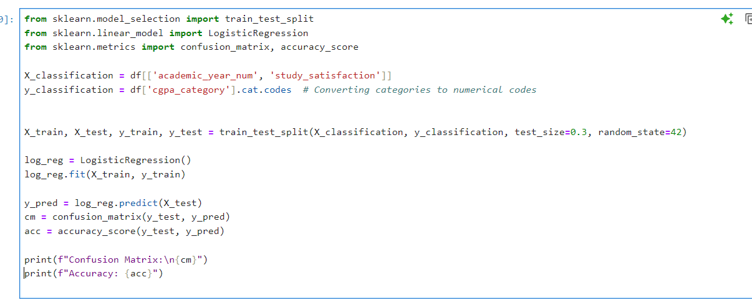
Confusion Matrix
Model Performance:
The model's overall accuracy is 0.56 or 56%, which is relatively low.
This indicates that the model's predictive power is only slightly better than random chance (50%).
Prediction Bias:
The model consistently predicts "High CGPA" for all instances, regardless of the actual outcome.
This suggests a strong bias in the model towards the "High CGPA" class.
True Positives:
The model correctly identified 11 instances of "High CGPA".
This represents the model's only successful predictions.
False Positives:
15 "Low CGPA" instances were incorrectly classified as "High CGPA".
This high number of false positives indicates poor specificity.
False Negatives:
There is 1 false negative, where a "Low CGPA" instance was misclassified.
This suggests the model rarely identifies "Low CGPA" cases correctly.
True Negatives:
The model did not correctly identify any "Low CGPA" instances (0 true negatives).
This further emphasizes the model's inability to distinguish between classes.
Class Imbalance:
The actual data shows 12 "Low CGPA" instances and 15 "High CGPA" instances.
This slight class imbalance might contribute to, but doesn't fully explain, the model's bias.
The model needs significant refinement to improve its ability to distinguish between classes.

Slide 14
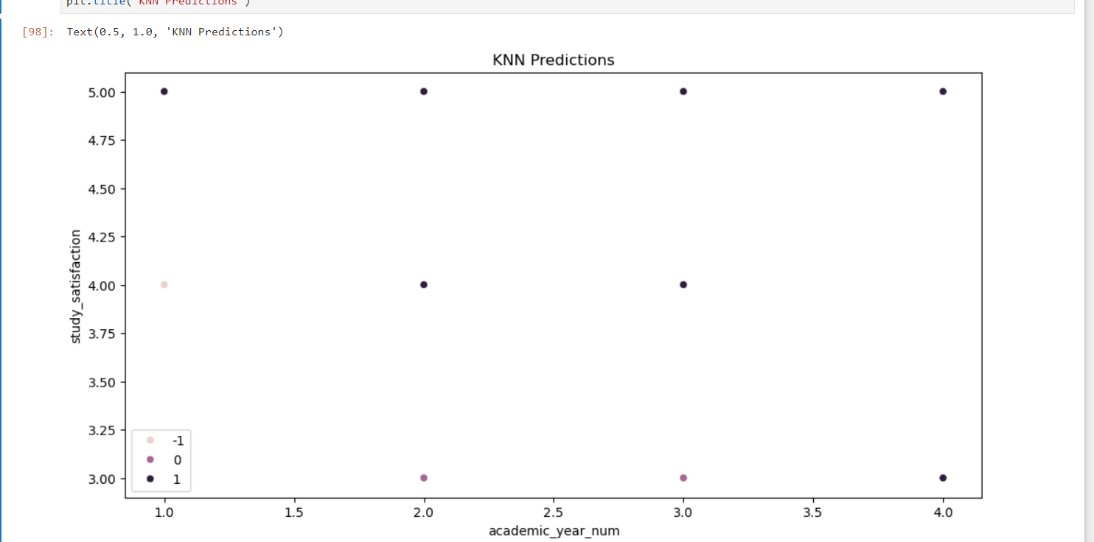
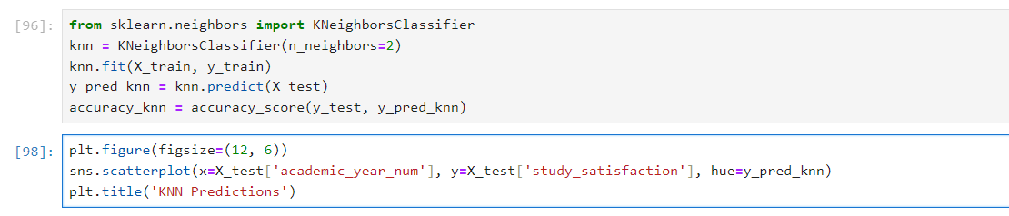
KNN Regression for CGPA Prediction
K Neighbors =2
KNN predicts the CGPA based on the nearest neighbors’ features (academic year and study satisfaction).
Closer data points in the graph suggest that these students have similar CGPAs.
The model tries to cluster students based on their satisfaction and academic year, and assigns similar CGPAs accordingly.
4th-year students (right side of X-axis) tend to have higher CGPAs (darker color points).
Higher study satisfaction (upper Y-axis) is often associated with higher predicted CGPA.
Students across all years show a range of CGPAs, but those with higher satisfaction generally show better outcomes.:
KNN effectively differentiates between students with high study satisfaction and their corresponding CGPA.
The accuracy of the model is approximately 62.96%

Slide 15
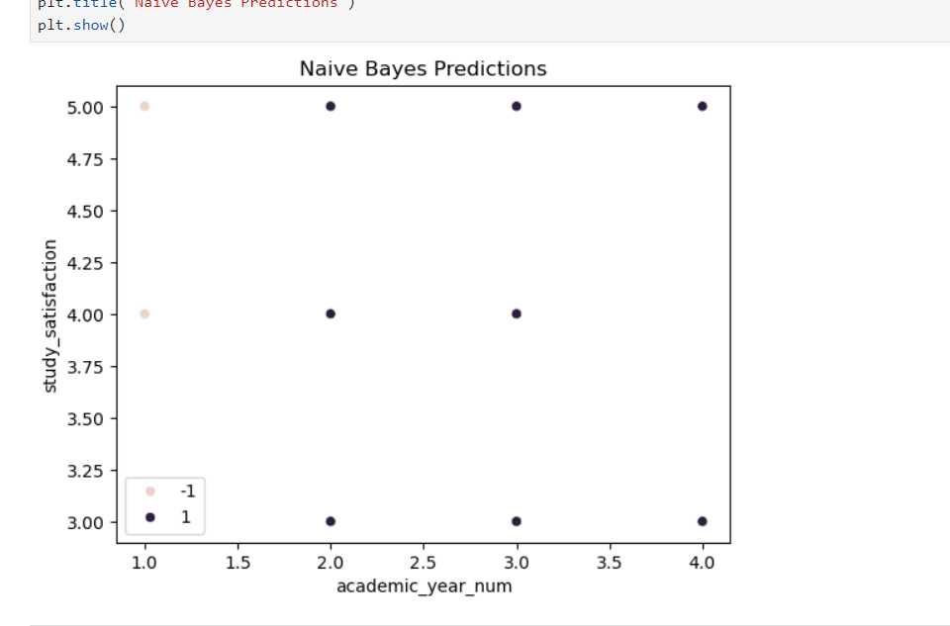
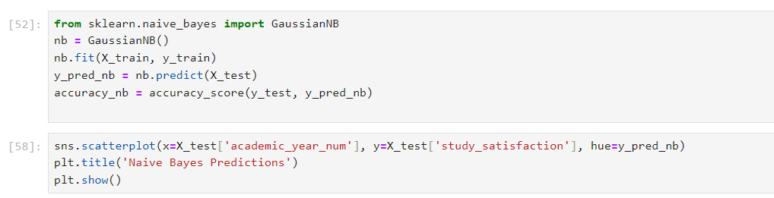
Naïve Bayes Prediction
The Naive Bayes model appears to classify most students into high CGPA (1), particularly those in higher academic years (2nd to 4th year) and with varying study satisfaction.
Only a few students (light-colored points) are predicted to have lower CGPA (-1), mostly those in the 1st year with lower study satisfaction.
Patterns:
4th-year students tend to have high CGPA predictions regardless of their study satisfaction.
Students with low study satisfaction in the earlier years (1st year) are predicted to have lower CGPA (-1).
Unlike KNN, Naive Bayes has a clearer separation between high and low CGPA predictions, with fewer intermediate or neutral predictions.
This interpretation shows that the Naive Bayes model is more rigid in its prediction categories and potentially overlooks more granular trends, particularly for students with intermediate study satisfaction and CGPA levels.
The accuracy of the model is about 48.15%.

Slide 16
KNN vs Naive Bayes
Model 1 KNN
Accuracy 62.96%
Model 2 Naïve Bayes
Accuracy 48.15%
KNN performed with a better accuracy of 62.96%,showing more more adpatiblity to the variations in academic year and study satisfaction.
Naïve Bayes struggled with accuracy of 48.15%,due to its assumption of feature independence which might not align with dataset structure.
KNN is the better model for this dataset, providing a higher accuracy and better classification for predicting CGPA based on academic year and study satisfaction.

Slide 17
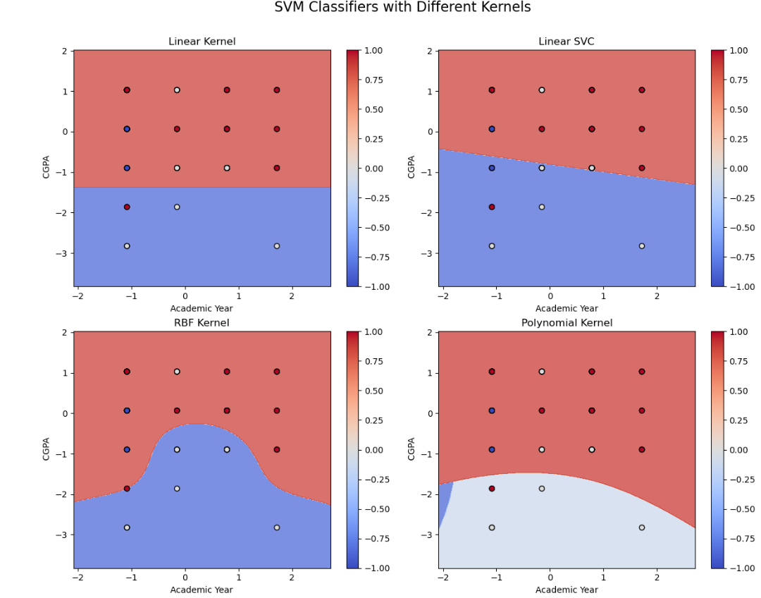
SVM
The linear kernel and linear SVC classifiers have straight-line decision boundaries, dividing the space into two linear regions. The accuracy of the model is 66.6%. The linear kernel and linear SVC classifiers have straight-line decision boundaries, dividing the space into two linear regions.
The RBF kernel classifier has a curved, non-linear decision boundary, allowing it to capture more complex data patterns. The accuracy of the model is 73.56%. The RBF kernel classifier has a curved, non-linear decision boundary, allowing it to capture more complex data patterns.
The polynomial kernel classifier also has a non-linear, polynomial-shaped decision boundary, further increasing the flexibility of the classification. The accuracy of the model is 62%. The polynomial kernel classifier also has a non-linear, polynomial-shaped decision boundary, further increasing the flexibility of the classification.
The differences in decision boundaries illustrate how the kernel selection can impact the SVM's ability to separate the data points and classify them accurately, depending on the underlying data structure.
Overall, the graph demonstrates the influence of the kernel choice on the SVM's decision-making process and the tradeoffs between simple linear models and more complex non-linear models.

Slide 18
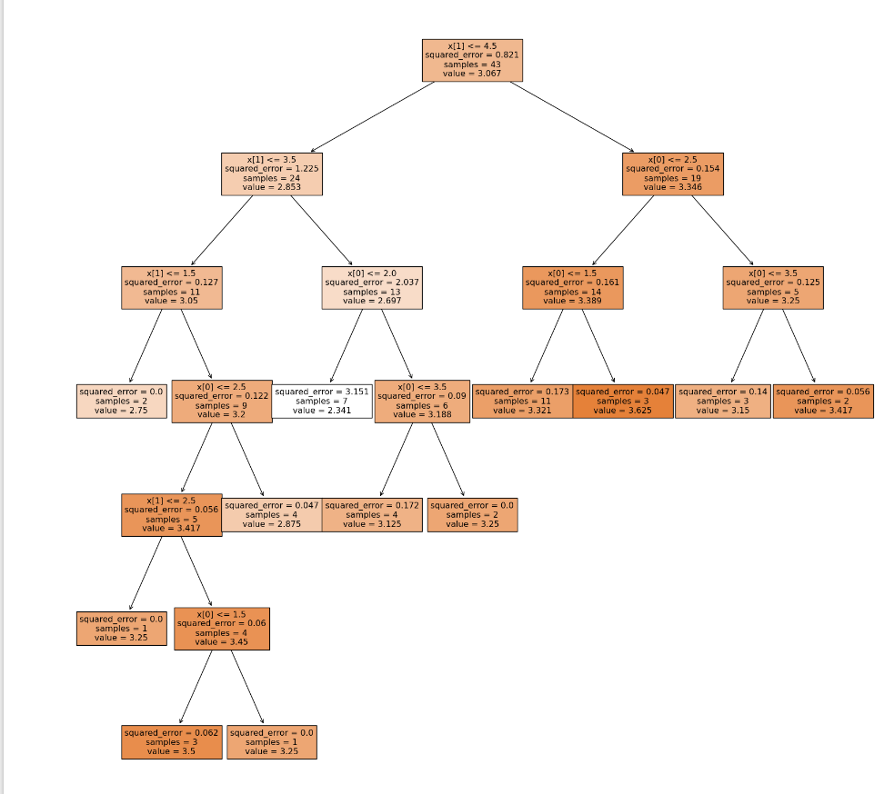
Random Forest
Model Type: Random Forest Regressor
Predicts cgpa_numeric using academic_year_num and study_satisfaction.
An ensemble of multiple decision trees to improve prediction accuracy.
Key Features:
Root Node: Checks academic_year_num <= 3.5.
Left Branch: Splits further by study_satisfaction <= 2.0.
Right Branch: Splits by academic_year_num > 3.5.
Performance Metrics:
R-squared (R²): -0.17
Negative value indicates poor performance, worse than predicting the mean target.
Root Mean Squared Error (RMSE): 0.80
High RMSE suggests predictions are off by 0.80 units on average.
Model shows poor predictive performance.
Further feature engineering or model tuning may be needed.

Slide 19
Conclusion
The dataset reveals a complex interplay between academic factors, campus experiences, and student mental health, highlighting the need for comprehensive support strategies in higher education.
Mental health indicators show significant variability across different student demographics, suggesting that tailored, personalized interventions are crucial for effective student well-being.
By mapping the multidimensional aspects of student mental health—including academic pressure, social relationships, and stress relief activities—the research provides actionable insights for universities to develop holistic student support systems.
The student distribution across academic years reveals a distinctive pattern of higher enrollment in earlier years (1st and 3rd years), with a significant decline in student numbers in the 4th year, potentially indicating challenges in program progression or completion rates.
The study reveals a complex interconnection between academic performance, mental health, and external stressors, with significant correlations indicating that factors like academic pressure, financial concerns, and study satisfaction directly impact students' psychological well-being.
Mental health challenges, particularly depression and anxiety, demonstrate a strong interrelationship and are closely linked to academic experiences, suggesting that comprehensive support systems must address both academic and psychological dimensions of student life.
The linear regression model reveals a modest but positive correlation between academic year progression and CGPA, suggesting that students tend to improve academically as they advance through their studies, though individual performance varies significantly.
While academic progression and study satisfaction contribute to CGPA improvement, the weak correlation indicates that multiple complex factors beyond academic year influence student performance, highlighting the need for comprehensive support and personalized academic strategies
The predictive models demonstrate limited effectiveness, with accuracies ranging from 56% to 62.96%, indicating significant challenges in predicting student academic performance using current features and methodologies.
While models show potential insights into the relationship between study satisfaction, academic year, and CGPA, their low predictive power suggests the need for more sophisticated modeling approaches and the inclusion of additional contextual factors to improve predictive accuracy.
Naïve Bayes struggled with accuracy of 48.15%,due to its assumption of feature independence which might not align with dataset structure.
The kernel selection significantly impacts the Support Vector Machine's performance, with non-linear kernels (RBF and Polynomial) demonstrating improved capability to capture complex data patterns compared to linear models, as evidenced by accuracy variations ranging from 62% to 73.56%.
The analysis reveals that different kernel techniques offer unique approaches to decision boundary creation, highlighting the importance of selecting an appropriate kernel that can effectively distinguish and classify student performance characteristics.
The Random Forest Regressor demonstrates significant limitations in predicting student CGPA, with a negative R-squared value and high root mean squared error, indicating that the current model and selected features are insufficient for accurate academic performance prediction.
The poor model performance underscores the complexity of predicting academic outcomes and highlights the critical need for more sophisticated feature selection, advanced modeling techniques, and a comprehensive understanding of the factors influencing student academic performance.
Among the analyzed models, the RBF (Radial Basis Function) Kernel Support Vector Machine (SVM) demonstrates the highest predictive accuracy at 73.56%, making it the most effective model for understanding and predicting student academic performance.
The comparative analysis reveals that non-linear models, particularly the RBF Kernel SVM, outperform linear approaches by capturing more complex relationships between academic factors like study satisfaction and CGPA.

Slide 20
References
Hinze V, Montero-Marin J, Blakemore SJ, Byford S, Dalgleish T, Degli Esposti M, Greenberg MT, Jones BG, Slaghekke Y, Ukoumunne OC, Viner RM, Williams JMG, Ford TJ, Kuyken W. Student- and School-Level Factors Associated With Mental Health and Well-Being in Early Adolescence. J Am Acad Child Adolesc Psychiatry. 2024 Feb;63(2):266-282. doi: 10.1016/j.jaac.2023.10.004. Epub 2023 Oct 20. PMID: 37866473; PMCID: PMC10935542.
Chu T, Liu X, Takayanagi S, Matsushita T, Kishimoto H. Association between mental health and academic performance among university undergraduates: The interacting role of lifestyle behaviors. Int J Methods Psychiatr Res. 2023 Mar;32(1):e1938. doi: 10.1002/mpr.1938. Epub 2022 Sep 10. PMID: 36087035; PMCID: PMC9976597.

Slide 21
Contribution
Neeharika Angirekula -Project-1,2,6
Prasanna Kumar Vemula –Project 2,3,4
Mohan Naik Palithya-Project 3,4,7
Keerthiviswaja Pappu-5,6,7

Slide 22

Thank you

