Slide 1

Volt AI
AI Voice Agent SaaS Platform
Machine Learning Project · Department of AI & DS
Ayush Singh (2410080023) | Yashwant (2410080018)
Faculty: Dr. P Harsha | Dr. Madhu

Slide 2

INTRODUCTION
What Is an AI Voice Agent?
An AI Voice Agent is an intelligent system that uses speech recognition, natural language processing, and text-to-speech synthesis to conduct real-time, human-like conversations — automating customer interactions at scale.
Modern Business Need
The Gap
Customers expect instant, 24/7 support. Traditional call centers cannot scale to meet demand without significant cost.
Legacy systems rely on manual handling — slow, expensive, and prone to errors during peak hours.
The Opportunity
AI voice automation bridges the gap, delivering consistent, intelligent, and scalable customer engagement.

Slide 3

PROBLEM STATEMENT
The Cost of Manual Customer Support
Manual Handling
Human agents are slow, inconsistent, and limited by working hours — leading to long wait times and customer churn.
High Operational Cost
Staffing, training, and infrastructure for traditional call centers consume significant budgets with limited ROI.
No Scalability
Surge in query volume overwhelms teams. Businesses lack an elastic, on-demand support layer.

Slide 4

PROPOSED SOLUTION
Introducing Volt AI
Volt AI is a SaaS-based, AI-powered voice assistant platform designed to automate customer conversations in real time — combining machine learning with cloud-native scalability.
AI Voice Assistant
SaaS Platform
Real-Time Communication
Understands and responds to natural speech using STT, NLP, and TTS in a seamless pipeline.
Multi-tenant, cloud-hosted architecture enabling rapid onboarding and elastic scaling for any business size.
Sub-second latency response engine powered by FastAPI and optimized inference pipelines.

Slide 5

SYSTEM ARCHITECTURE
Technology Stack & Architecture
Backend API
FastAPI REST services
Database
MongoDB document storage
AI Engine
STT, NLP, and TTS processing
Volt AI uses a clean REST API-driven architecture separating concerns across layers — React + Vite for a responsive frontend, FastAPI for high-performance backend logic, MongoDB for flexible document storage, and an integrated AI engine for voice and language processing.

Slide 6
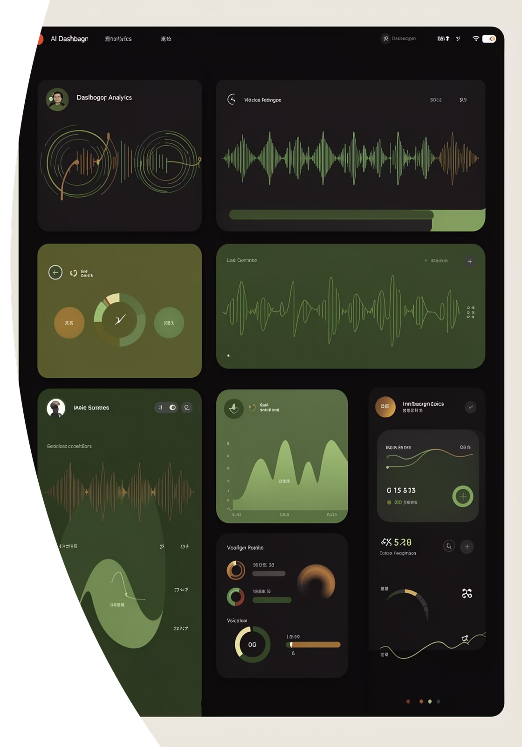
KEY FEATURES
What Volt AI Delivers
Voice Interaction
End-to-end STT → NLP → TTS pipeline for natural, human-like voice conversations.
NLP Understanding
Intent recognition and entity extraction for accurate, context-aware responses.
Secure Access
OAuth 2.0 authentication with Two-Factor Authentication (2FA) for enterprise-grade security.
Dashboard & Analytics
Real-time metrics on call volume, resolution rates, sentiment, and agent performance.

Slide 7

WORKING FLOW
How Volt AI Processes a Conversation
User Speaks
Speech-to-Text
NLP Processing
Backend & TTS
The entire pipeline operates in real time, delivering intelligent voice responses with minimal latency — creating a seamless, natural conversation experience for end users.

Slide 8
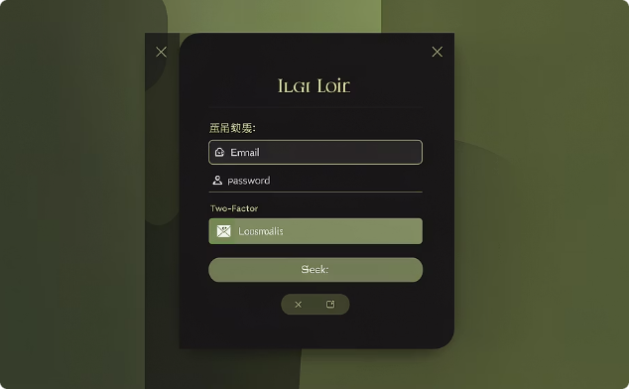
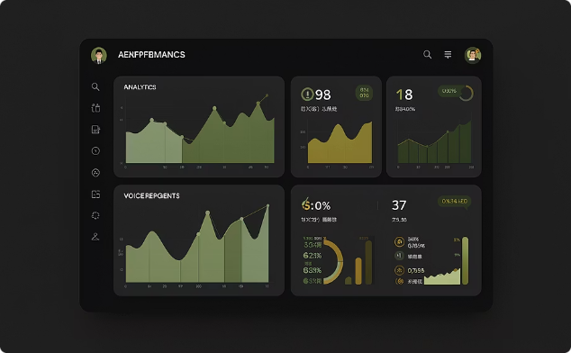
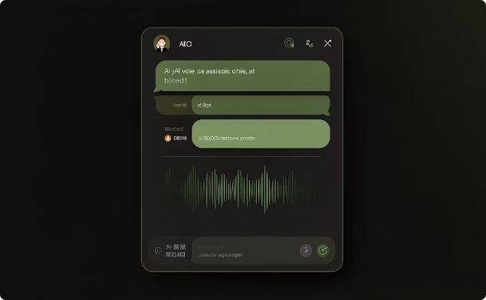
UI SCREENS
Platform Interface
Volt AI features a clean, modern interface designed for both end users and administrators.
Login Page
Dashboard
AI Assistant Screen
Secure OAuth 2.0 login with 2FA support, clean dark theme, and minimal friction onboarding.
Centralized control panel with real-time call analytics, agent performance, and usage insights.
Live voice interaction interface with visual waveform feedback, conversation history, and intent display.

Slide 9
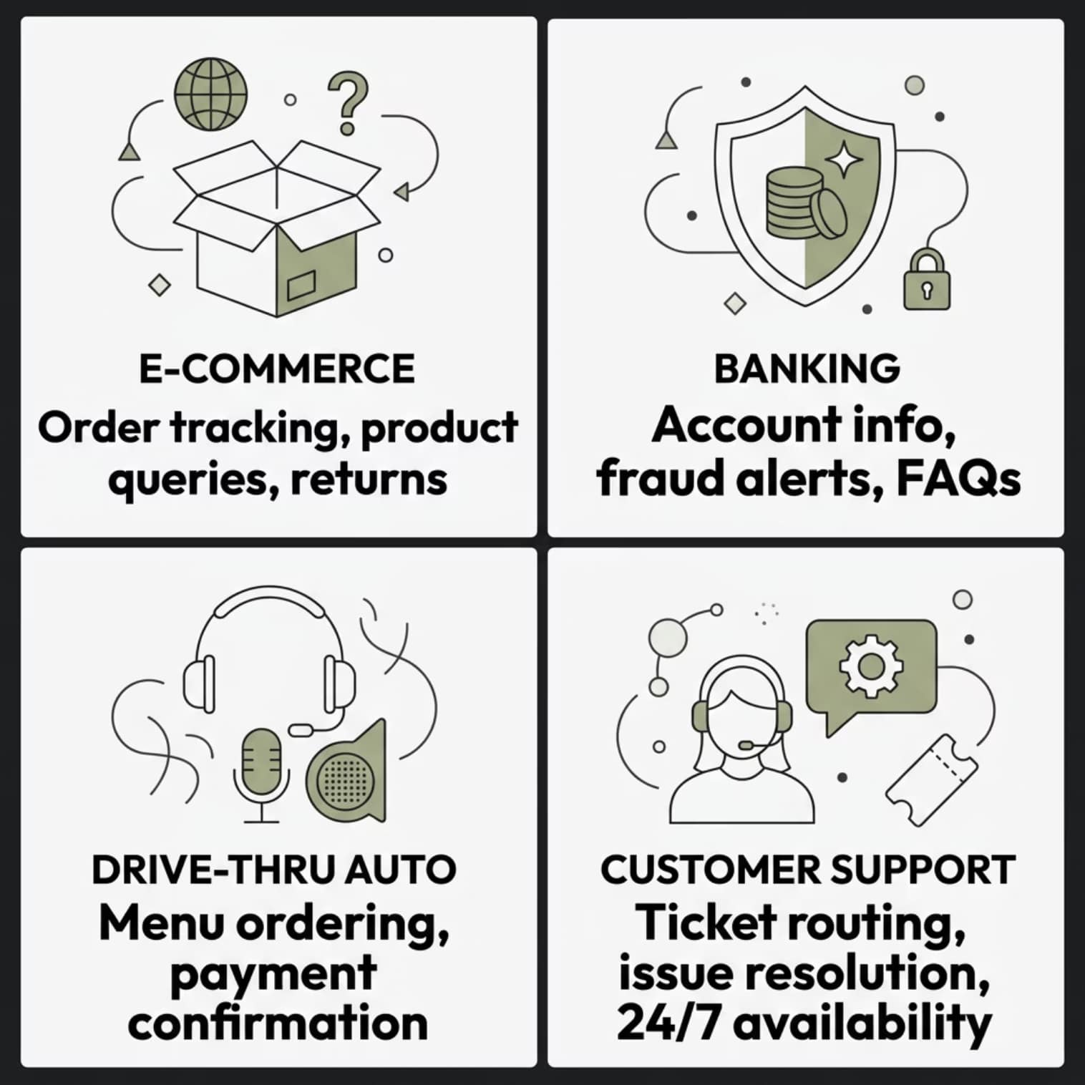

APPLICATIONS & ADVANTAGES
Where Volt AI Makes an Impact
Core Advantages
Scalable — Handles thousands of concurrent voice sessions without performance degradation.
Cost-Efficient — Reduces operational costs by automating up to 80% of routine queries.
24/7 Availability — No downtime, no shifts — always on, always responsive.
Fast Response — Sub-second latency ensures natural, fluid conversation flow.

Slide 10

CONCLUSION
Limitations, Future Scope & Takeaways
Current Limitations
Future Roadmap
01
Requires substantial training data for domain-specific accuracy.
Multilingual support needs expansion beyond current language coverage.
Integrate Large Language Models (LLMs) for richer context handling.
02
LLM integration is pending for advanced conversational depth.
Expand multilingual and regional dialect recognition capabilities.
03
Add emotion & sentiment detection for adaptive responses.
Volt AI transforms customer interaction by combining ML-powered voice intelligence with a scalable SaaS architecture — a future-ready solution for modern enterprises.

