Slide 1
AI POWERED ACADEMIC ASSISTANT
Presented By,
Name: Yashwanth Ramachandra HR
Usn: 01JST24PDS019
Branch: Mtech (Data Science)
Department: Information Science
College: JSS Science And Technology University
Guide:
Name: Dr. Umesh KK
Designation: Professor
Department: Information Science and Engineering
JSS Science and Technology University Mysuru

Slide 2
Contents:
  Introduction
Open issues and Challenges
Problem Statement
Objective
System Requirement and Specification
System Architecture
System Design
Methodology
References

Slide 3
Introduction
Academic students need to work with large amounts of textbooks, research papers, notes, and other learning materials.
Finding relevant information and understanding lengthy academic documents can be time-consuming.
Traditional document search mainly relies on keywords and may not understand the semantic meaning of a student's query.
Retrieval-Augmented Generation (RAG) combines semantic retrieval with a language model to provide answers grounded in the uploaded academic documents.
The proposed AI-Powered Academic Assistant uses Sentence Transformers and FAISS for semantic retrieval and TinyLlama 1.1B for response generation.

Slide 4
Problem Statement
Academic information is distributed across multiple documents, making it difficult for students to obtain relevant information quickly and consistently.
Existing systems may provide information without sufficient document-specific context, which can result in incomplete or less reliable responses.
Students lack a unified platform that supports learning, document understanding, answer assessment, interview preparation, and career guidance in one system.
Evaluating descriptive answers manually requires considerable time and may not provide consistent and objective feedback to students.
There is a need for an integrated AI-based solution that can retrieve relevant academic content, generate meaningful responses, evaluate answers, and provide personalized academic and career support.

Slide 5
Objectives
To develop an AI-Powered Academic Assistant that provides context-aware academic support using uploaded educational documents.
To implement RAG with Sentence Transformers and FAISS for efficient semantic retrieval of relevant academic information.
To use TinyLlama 1.1B for generating answers and summaries based on the retrieved academic context.
To develop modules for question answering, document summarization, answer evaluation, and mock interview preparation.
To provide AI-based career assistance through skill analysis, career recommendations, job recommendations, and interview preparation.
To evaluate student answers using Cosine Similarity, Keyword Matching, and BERTScore to provide meaningful and consistent feedback.

Slide 6
Literature Survey
Paper | Year | Methods / Technologies | Key Finding
A Survey over RAG with Autonomous Models – Muhammad Arslan et al. | 2024 | RAG, LLMs, semantic search, vector retrieval | RAG improves the reliability, accuracy, and usefulness of LLM-based systems across domains.
Educational Assistant Based on Large Language Models Using RAG Framework – Umair Hasan Khan et al. | 2025 | RAG, OCR, Sentence Transformers, Llama-2-7B, Mistral-7B | RAG with open-source LLMs provides an effective approach for university question answering; Llama-2 performed better in the reported evaluation.
Unimib Assistant: Designing a Student-Centric Chatbot Based on RAG Technology – Chiara Antico et al. | 2024 | RAG, ChatGPT, PDF/PPT/web data, student feedback | A student-focused RAG chatbot can provide accessible and context-aware academic information and can be improved through user feedback.

Slide 7
Open Issues and Challenges
Hallucination Problem
Long Document Processing
Context Limitation
Retrieval Accuracy
Answer Evaluation Challenges
Bias in AI Models
Data Privacy & Security
Computational Cost

Slide 8
System Requirements and Specifications
Hardware Requirements
Processor: Intel i5 or above
RAM: Minimum 8GB (16GB recommended)
Storage: 10GB free space
Internet connection
Software Requirements
Operating System: Windows / Linux / macOS
Python 3.9+
Libraries:
                NLP libraries
            Vector database
            PDF processing tools
            Web framework (Flask /FastAPI / Streamlit)
          Transformer-based LLM

Slide 9
Functional Specifications
Upload academic documents
Perform text extraction & chunking
Generate embeddings
Retrieve relevant content
Generate summarized & cited answers
Maintain conversation memory
Non-Functional Specifications
High response accuracy
Fast response time
Scalable architecture
User-friendly interface
Secure document handling

Slide 10
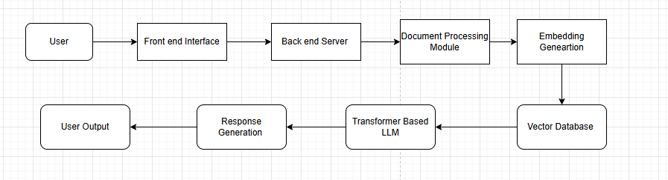
System Architecture

Slide 11
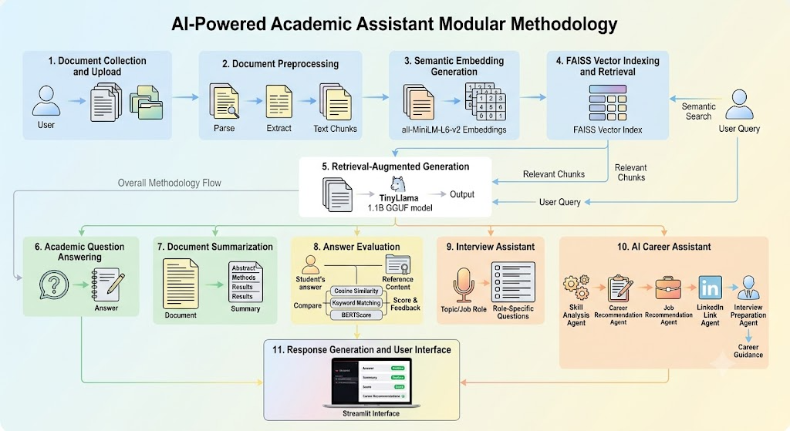
Methodology

Slide 12
Result and Discussion
Question Answering: The system successfully generated context-aware answers by retrieving relevant information from uploaded academic documents.
Answer Evaluation: Student descriptive answers were evaluated using Cosine Similarity, Keyword Matching, and BERTScore. In the tested case, 10 question–answer pairs achieved an overall score of 78.6/100.
Interview Assistant: The system successfully generated customized technical and academic interview questions based on the selected topic or job role.
AI Career Assistant: The system analyzed user-provided technical skills and generated suitable career paths, job roles, LinkedIn job-search links, and interview questions.
Overall Discussion: The results show that the proposed system successfully integrates multiple academic and career-support functionalities into a single platform, providing students with a more convenient and interactive environment for learning, self-assessment, interview preparation, and career development.

Slide 13
Conclusion
Developed a unified AI-powered academic platform that combines document-based learning, question answering, summarization, answer evaluation, interview preparation, and career guidance.
The integration of RAG, Sentence Transformers, FAISS, and TinyLlama enables the system to generate responses based on the user's academic documents.
The combination of Cosine Similarity, Keyword Matching, and BERTScore provides a multi-dimensional approach to evaluating descriptive answers.
The multi-agent AI Career Assistant extends the system beyond academic learning by providing personalized career and job recommendations based on user skills.
Overall, the proposed system demonstrates the potential of Generative AI and RAG-based techniques to provide personalized, context-aware, and interactive academic assistance.

Slide 14
THANK YOU

