Slide 1
CAN PROTOCOL
Controller Area Network

Slide 2
History
First introduced in February of 1986 by Robert Bosch GmbH
Developed because existing serial buses in the early 1980s were not able to fulfill all the requirements to be used in passenger cars
Intel released the first CAN controller chip in 1987
In November 1993 the CAN ISO standard was published
First applications included use by an elevator manufacturer and some textile machine manufacturers
Multiple higher level protocols for CAN have been developed since 1994

Slide 3
Why Use CAN ?
Electrically robust with built-in error and arbitration features. These are automatic !
Differential pair reduces EMI in/out.
Cheap wiring: twisted pair
Many controllers, parts & software available.
Really, really easy to add another node.
Hard work is done by the CAN controller.
Many chips have implemented CAN.
Very easy to add and subtract nodes.

Slide 4
CAN Speeds
Is specified from ~10 Kbps to 1Mbps.
Can’t change speed dynamically…ever !
125, 250 & 500 Kbps common.
Longer cable runs means slower frequency.
1 Mbps a bit hard to manage in a real system.
Better controllers and transceivers make higher speeds easier.

Slide 5
High Points of the CAN Bus
Uses a Differential twisted pair of wires.
The highest priority message gets thru.
Uses non-destructive arbitration.
The priority of message is its identifier.
0 has the highest priority. Always.
No Master or Slave – Peer to Peer.
All nodes see all messages on network.
…except their own…..

Slide 6
Applications
● Most common use is in the automobile industry
○ Used to connect subsystems within an electronic control unit as well as connect electronic control units together
○ Typically the largest control unit in a vehicle is the engine control unit
○ Modern automobiles may have up to 70 electronic control units
○ Many devices in cars use CAN including the radio, transmission,
airbags, ABS, cruise control, and power steering
● CAN is also used in both railway and aerospace applications
● Other applications include use in hospital equipment, elevators, and even coffee machines

Slide 7
CAN protocol specification
CAN Specification 2.0 describes the base frame format (using 11-bit CAN-identifier) and the extended frame format (using 29-bit CAN-identifier).
A CAN device that uses 11-bit identifiers is commonly called CAN 2.0A
A CAN device that uses 29-bit identifiers is commonly called CAN 2.0B.

Slide 8
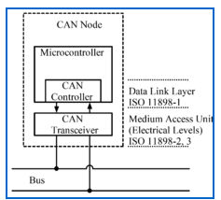
CAN Bus Node

Slide 9
Central processing unit. microprocessor, or host processor
The host processor decides what the received messages mean and what messages it wants to transmit.
Sensors, actuators and control devices can be connected to the host processor.
CAN controller.often an integral part of the microcontroller
Receiving: the CAN controller stores the received serial bits from the bus until an entire message is available, which can then be fetched by the host processor (usually by the CAN controller triggering an interrupt).
Sending: the host processor sends the transmit message(s) to a CAN controller, which transmits the bits serially onto the bus when the bus is free.

Slide 10
Transceiver Defined by ISO 11898-2/3 Medium Access Unit [MAU] standards
Receiving: it converts the data stream from CANbus levels to levels that the CAN controller uses. It usually has protective circuitry to protect the CAN controller.
Transmitting: it converts the data stream from the CAN controller to CAN bus levels.

Slide 11
Recessive and Dominant Bits
Recessive is 2.5 volts CAN Hi and Lo. Difference is 2.5 – 2.5 = 0 volts. Call this a “1”
Dominant is CAN_Hi 3.5v CAN_Lo 1.5v. Difference is 3.5 – 1.5 = 2.0 volts. Call this a “0”
The important voltage is the difference between CAN Hi and Lo and not to ground.

Slide 12
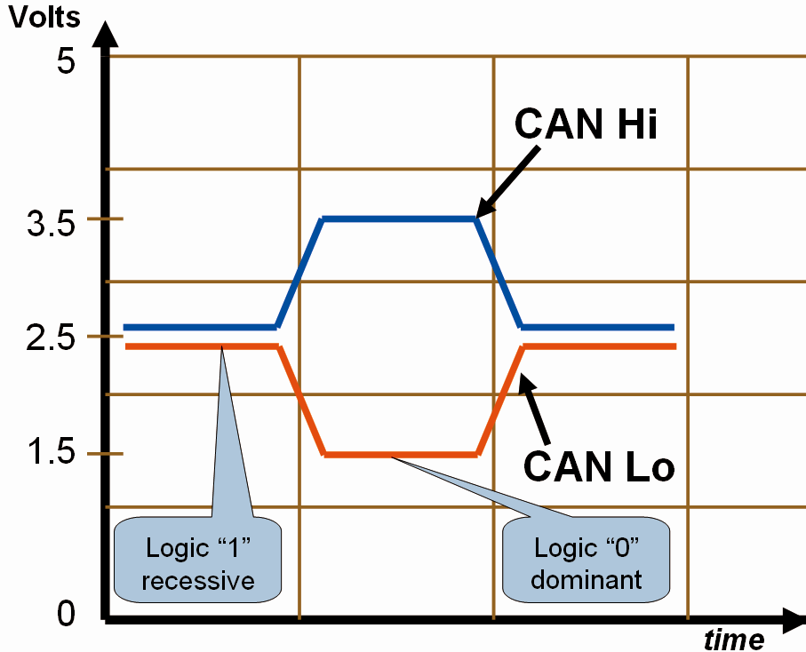
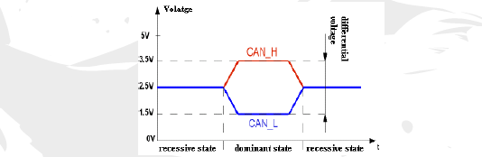
Differential Signalling

Slide 13
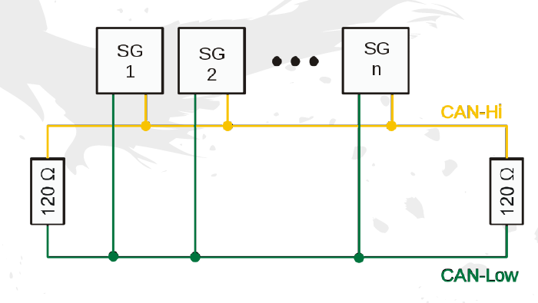
Topology

Slide 14
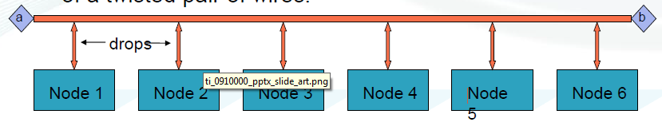
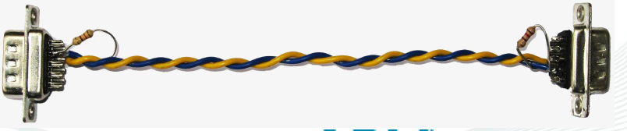
Construction of a CAN Network
The main CAN backbone and drops are comprised of a twisted pair of wires.
a,b = 120 Ω ½ watt termination resistors.
Drops use the same twisted pair of wires as the backbone.

Slide 15
Frame Types
1. Data
2. Remote
3. Error
4. Overload

Slide 16
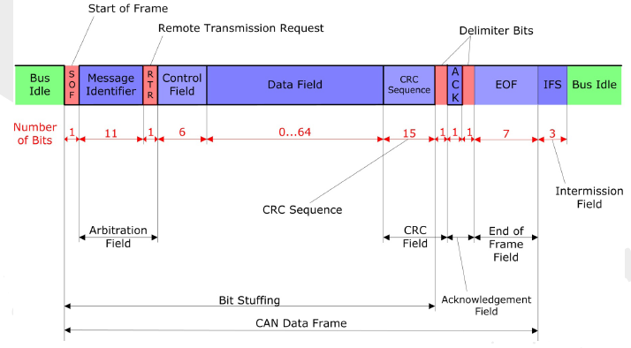
11bit identifier Data Frame or Remote frame

Slide 17
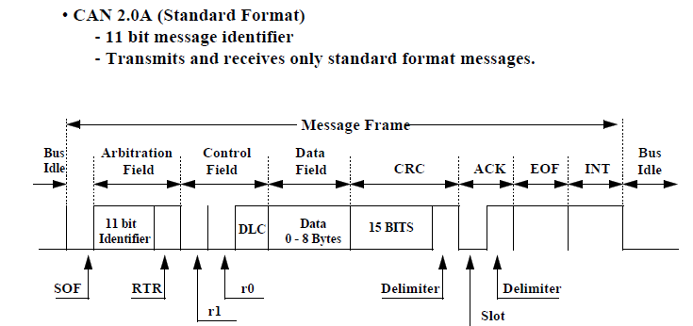

Slide 18
Field name | Length (bits) | Purpose
Start-of-frame | 1 | Denotes the start of frame transmission
Identifier (green) | 11 | A (unique) identifier for the data which also represents the message priority
Remote transmission request (RTR] | 1 | RTR = 0 - DOMINANT in data frame RTR = 1 - RECESSIVE in remote frame
Identifier extension bit (IDE) | 1 | Declaring if 11 bit message ID or 29 bit message ID is used. Dominant (0) indicate 11 bit message ID Recessive (1) indicate 29 bit message ID
Reserved bit (r0) | 1 | Reserved bit (it must be set to dominant (0), but accepted as either dominant or recessive)
Data length code (DLC) (yellow) | 4 | Number of bytes of data (0–8 bytes) DataByteCount = 8 × DLC.3 + 4 × DLC.2 + 2 × DLC.1 + DLC.0
Data field (red) | 0–64 (0-8 Bytes) | Data to be transmitted (length in bytes dictated by DLC field)

Slide 19
Field name | Length (bits) | Purpose
CRC | 15 | CRC
CRC delimiter | 1 | Must be recessive (1)
ACK slot | 1 | Transmitter sends recessive (1) and any receiver can assert a dominant (0)
ACK delimiter | 1 | Must be recessive (1)
End-of-frame (EOF) | 7 | Must be recessive (1)

Slide 20
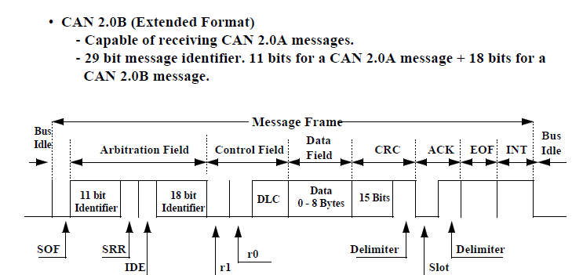
Extended frame format

Slide 21
Field name | Length (bits) | Purpose
Start-of-frame | 1 | Denotes the start of frame transmission
Identifier A | 11 | A (unique) identifier for the data which also represents the message priority
Substitute remote request (SRR) | 1 | Must be recessive (1). Optional The SRR bit is a recessive bit. It is transmitted in extended frames at the position of the RTR bit of standardframes.
Identifier extension bit (IDE) | 1 | Declaring if 11 bit message ID or 29 bit message ID is used. Dominant (0) indicate 11 bit message ID Recessive (1) indicate 29 bit message ID
Identifier B | 18 | Second part of the (unique) identifier for the data which also represents the message priority
Remote transmission request (RTR] | 1 | RTR = 0 - DOMINANT in data frame RTR = 1 - RECESSIVE in remote frame

Slide 22
Field name | Length (bits) | Purpose
Reserved bit (r0,r1) | 2 | Reserved bit (it must be set to dominant (0), but accepted as either dominant or recessive)
Data length code (DLC) (yellow) | 4 | Number of bytes of data (0–8 bytes)
Data field (red) | 0–64 (0-8 Bytes) | Data to be transmitted (length in bytes dictated by DLC field) DataByteCount = 8 × DLC.3 + 4 × DLC.2 + 2 × DLC.1 + DLC.0
CRC | 15 | CRC
CRC delimiter | 1 | Must be recessive (1)
ACK slot | 1 | Transmitter sends recessive (1) and any receiver can assert a dominant (0)
ACK delimiter | 1 | Must be recessive (1)
End-of-frame (EOF) | 7 | Must be recessive (1)

Slide 23
The CAN Data Frame
The CAN data frame is composed of seven fields
1.Start of frame (SOF).
2. arbitration.
3.Control.
4.data.
5.Cyclical redundancy check (CRC).
6.acknowledge (ACK) .
7. end of frame (EOF).
CAN message bits are referred to as “dominant” (0) or “recessive” (1). The SOF field consists of one dominant bit. All network nodes waiting to transmit synchronize with the SOF and begin transmitting at the same time.
An arbitration scheme determines which of the nodes attempting to transmit will actually control the bus.

Slide 24
Arbitration
The arbitration field of the CAN message consists of an 11- or 29-bit identifier and a remote transmission (RTR) bit.
The CAN arbitration scheme is called “carrier sense multiple access with collision detection” or CSMA/CD, and assures that the highest priority message is broadcast.
Message priority is determined by the numerical value of the identifier in the arbitration field, with the lowest numerical value having the highest priority.
Non-destructive, bit-wise arbitration resolves conflicts among competing transmitters. This means that the bus can be thought of as acting like an AND gate

Slide 25
If any node writes a dominant (0) bit on the bus, every node will read a dominant bit regardless of the value written by that node. Every transmitting node always reads back the bus value for each bit transmitted. If a node transmits a recessive bit and reads back a dominant bit, it immediately stops transmitting.
The RTR bit simply distinguishes between data frames and remote frames.
In data frames, the RTR bit must be dominant.
In Remote frames it must be recessive.

Slide 26
Priority Levels
Message with highest priority gets thru.
Lowest Identifier has priority.
000 beats 001, 123 beats 256. Always.
Arbitration evaluated in real-time.
Uses Recessive and Dominant bits.
A node can (and must!) see itself and others on the bus in real time.
Note: a node can’t see its own ID and data.
All this happens without your intervention !

Slide 27
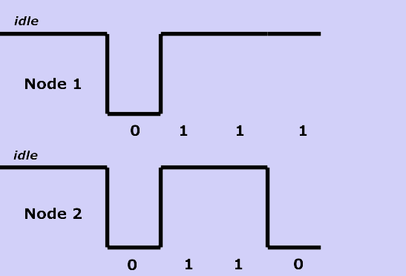
Bit-wise Arbitration

Slide 28
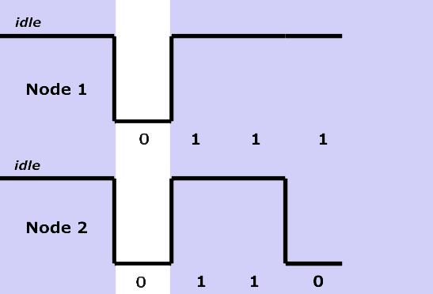
Both are dominant (0)…

Slide 29
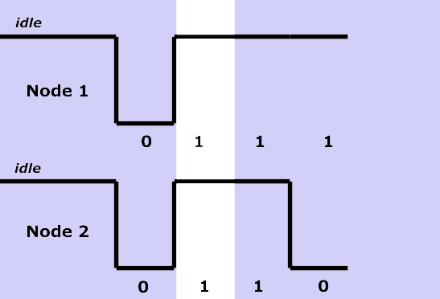
Both are recessive…

Slide 30
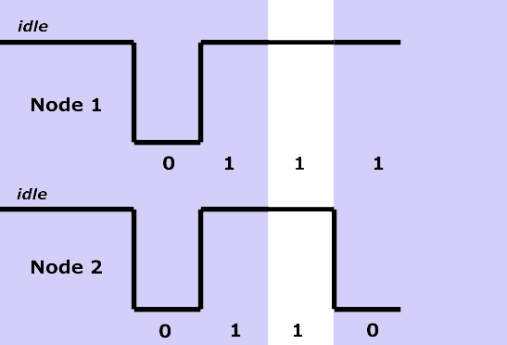

Slide 31
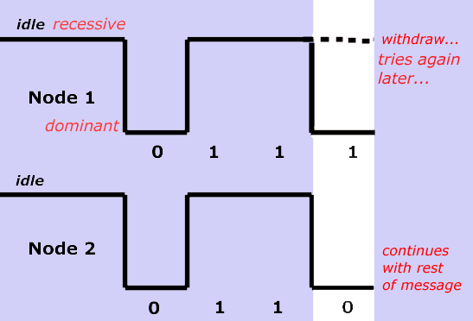
Node 2 WINS !

Slide 32
if 11 and 29 bit same identifier at the same time – 11 bit wins arbitration.
i.e. 11010101010 & 11010101010101100101001101000

Slide 33
SRR bit - Substitute Remote Request
The SRR bit is a recessive bit. It is transmitted in extended frames at the position of the RTR bit of standard frames.
IDE bit - Identifier Extension
The IDE bit differentiates between standard and extended frames.
In standard frames this bit is dominant,
whereas in extended frames this bit is recessive.

Slide 34
Data Length Code (DLC)
The number of bytes in the data field of a message is coded by the data length code.
With RTR = 1, this value indicates the number of data bytes requested to be sent back, with the same encoding.
The range of the data byte count is 0 to 8 bytes and is coded as follows:
DataByteCount = 8 × DLC.3 + 4 × DLC.2 + 2 × DLC.1 + DLC.0
For reasons of compatibility no data length code >8 should be used. If a value >8 is selected, 8 bytes are transmitted in the data frame with the data length code specified in DLC.

Slide 35
Cyclic Redundancy Field
The Cyclic Redundancy Field (CRC field) follows and is used to detect possible transmission errors.
The CRC Field consists of a 15 bit CRC sequence, completed by the recessive CRC Delimiter bit.

Slide 36
Acknowledge Field.
During the ACK Slot bit the transmitting node sends out a recessive bit.
Any node that has received an error free frame acknowledges the correct reception of the frame by sending back a dominant bit

Slide 37
Advantages
● reliability
○ differential signaling
● priority
○ easily prioritize messages
● low wire count
● node independence
○ can add / remove nodes
○ node breakdown doesn't bring down
network

Slide 38
Disadvantages
● regulate wire length
○ particularly for high speeds
● requires termination
○ resistor

Slide 39
LPC 1768 REGISTERS CONFIGARATION
1.PCONP REGISTER
The PCONP register allows turning off selected peripheral functions for the purpose of saving power.
Set the proper bit in the PCONP register to enable CAN1 controller.
LPC_SC->PCONP|=0X---------------;

Slide 40
2. Peripheral Clock Selection registers 0 and 1
Select appropriate clock for CAN1. For setting the baud rate
LPC_SC->PCLKSEL0|=0X………..;

Slide 41
3.Pin selection
select appopriate PINSEL register for CAN1 pins
LPC_PINCON->PINSEL0|=0X…………

Slide 42
CAN Mode register “CAN1MOD”
1.It is 32 bit register
2.It is Read and write register

Slide 43
BIT | SYMBOL | VALUE | FUNCTION
0 | RM (RESETMODE) | 0 | The CAN Controller is in the Operating Mode, and certain registers can not be written.
 |  | 1 | CAN operation is disabled, writable registers can be written and the current transmission/reception of a message is aborted.
1 | LOM Listen Only Mode. | 0 | The CAN controller acknowledges a successfully received message on the CAN bus. The error counters are stopped at the current value.
 |  | 1 | The controller gives no acknowledgment, even if a message is successfully received. Messages cannot be sent, and the controller operates in “error passive” mode. This mode is intended for software bit rate detection and “hot plugging”.

Slide 44
BIT | SYMBOL | VALUE | FUNCTION
2 | STM ( Self Test Mode.) | 0 | A transmitted message must be acknowledged to be considered successful.
 |  | 1 | The controller will consider a Tx message successful even if there is no acknowledgment received.
3 | TPM Transmit Priority Mode. | 0 | The transmit priority for 3 Transmit Buffers depends on the CAN Identifier.
 |  | 1 | The transmit priority for 3 Transmit Buffers depends on the contents of the Tx Priority register within the Transmit Buffer.

Slide 45
BIT | SYMBOL | VALUE | FUNCTION
4 | SM SLEEP MODE | 0 | Normal operation.
 |  | 1 | The CAN controller enters Sleep Mode if no CAN interrupt is pending and there is no bus activity. See the Sleep Mode description
5 | RPM Receive Polarity Mode. | 0 | RD input is active Low (dominant bit = 0).
 |  | 1 | RD input is active High (dominant bit = 1) -- reverse polarity.
6 | - | - | Reserved, user software should not write ones to reserved bits.

Slide 46
BIT | SYMBOL | VALUE | FUNCTION
7 | TM Test Mode. | 0 | Normal operation.
 |  | 1 | The TD pin will reflect the bit, detected on RD pin, with the next positive edge of the system clock.
31:8 |  | Reserved, user software should not write ones to reserved bits. The value read from a reserved bit is not defined.

Slide 47
CAN Command Register (CAN1CMR)
1.It is 32 bit register
2.Writing to this write-only register initiates an action within the transfer layer of the CAN Controller.
3. Reading this register yields zeroes.

Slide 48
BIT | SYMBOL | VALUE | FUNCTION
0 | TR | Transmission Request.
 |  | 0 | No transmission request.
 |  | 1 | The message, previously written to the CANxTFI, CANxTID, and optionally the CANxTDA and CANxTDB registers, is queued for transmission from the selected Transmit Buffer. If at two or all three of STB1, STB2 and STB3 bits are selected when TR=1 is written, Transmit Buffer will be selected based on the chosen priority scheme
1 | AT | Abort Transmission.
 |  | 0 | Do not abort the transmission.
 |  | 1 | if not already in progress, a pending Transmission Request for the selected Transmit Buffer is cancelled.

Slide 49
BIT | SYMBOL | VALUE | FUNCTION
2 | RRB | Release Receive Buffer.
 |  | 0 | Do not release the receive buffer.
 |  | 1 | The information in the Receive Buffer (consisting of CANxRFS,CANxRID, and if applicable the CANxRDA and CANxRDB registers) is released, and becomes eligible for replacement by the next received frame. If the next received frame is not available, writing this command clears the RBS bit in the Status Register(s).
3 | CDO | Clear Data Overrun.
 |  | 0 | Do not clear the data overrun bit.
 |  | 1 | The Data Overrun bit in Status Register(s) is cleared.

Slide 50
BIT | SYMBOL | VALUE | FUNCTION
4 | SRR | Self Reception Request.
 |  | 0 | No self reception request.
 |  | 1 | The message, previously written to the CANxTFS, CANxTID, and optionally the CANxTDA and CANxTDB registers, is queued for transmission from the selected Transmit Buffer and received simultaneously. This differs from the TR bit above in that the receiver is not disabled during the transmission, so that it receives the message if its Identifier is recognized by the Acceptance Filter.
5 | STB1 | Select Tx Buffer 1.
 |  | 0 | Tx Buffer 1 is not selected for transmission.
 |  | 1 | Tx Buffer 1 is selected for transmission.

Slide 51
BIT | SYMBOL | VALUE | FUNCTION
6 | STB2 | Select Tx Buffer 2
 |  | 0 | Tx Buffer 2 is not selected for transmission.
 |  | 1 | Tx Buffer 2 is selected for transmission.
7 | STB3 | Select Tx Buffer 3.
 |  | 0 | Tx Buffer 3 is not selected for transmission.
 |  | 1 | Tx Buffer 3 is selected for transmission.
31:8 |  |  | Reserved, user software should not write ones to reserved bits.

Slide 52
CAN Global Status Register (CAN1GSR)
1.The content of the Global Status Register reflects the status of the CAN Controller.
2.This register is read-only, except that the Error Counters can be written when the RM bit in the CANMOD register is 1.
3. Bits not listed read as 0 and should be written as 0.

Slide 53
BIT | SYMBOL | VALUE | FUNCTION
0 | RBS | Receive Buffer Status.
 |  | 0 | No message is available.
 |  | 1 | At least one complete message is received by the Double Receive Buffer and available in the CANxRFS, CANxRID, and if applicable the CANxRDA and CANxRDB registers. This bit is cleared by the Release Receive Buffer command in CANxCMR, if no subsequent received message is available.
1 | DOS | Data Overrun Status.
 |  | 0 | No data overrun has occurred since the last Clear Data Overrun command was given/written to CANxCMR (or since Reset).
 |  | 1 | A message was lost because the preceding message to this CAN controller was not read and released quickly enough (there was not enough space for a new message in the Double Receive Buffer).

Slide 54
BIT | SYMBOL | VALUE | FUNCTION
2 | TBS | Transmit Buffer Status.
 |  | 0 | At least one of the Transmit Buffers is not available for the CPU, i.e. at least one previously queued message for this CAN controller has not yet been sent, and therefore software should not write to the CANxTFI, CANxTID, CANxTDA, nor CANxTDB registers of that (those) Tx buffer(s).
 |  | 1 | All three Transmit Buffers are available for the CPU. No transmit message is pending for this CAN controller (in any of the 3 Tx buffers), and software may write to any of the CANxTFI, CANxTID, CANxTDA, and CANxTDB registers.
3 | TCS | Transmit Complete Status.
 |  | 0 | At least one requested transmission has not been successfully completed yet.
 |  | 1 | All requested transmission(s) has (have) been successfully completed.

Slide 55
BIT | SYMBOL | VALUE | FUNCTION
4 | RS | Receive Status.
 |  | 0 | The CAN controller is idle.
 |  | 1 | The CAN controller is receiving a message.
5 | TS | Transmit Status.
 |  | 0 | The CAN controller is idle.
 |  | 1 | The CAN controller is sending a message.

Slide 56
BIT | SYMBOL | VALUE | FUNCTION
6 | ES | Error Status.
 |  | 0 | Both error counters are below the Error Warning Limit.
 |  | 1 | One or both of the Transmit and Receive Error Counters has reached the limit set in the Error Warning Limit register.
7 | BS | Bus Status.
 |  | 0 | The CAN Controller is involved in bus activities
 |  | 1 | The CAN controller is currently not involved/prohibited from bus activity because the Transmit Error Counter reached its limiting value of 255.
15:8 |  |  | Reserved, user software should not write ones to reserved bits. The value read from a reserved bit is not defined.
23:16 | RXERR |  | The current value of the Rx Error Counter (an 8-bit value).
31:23 | TXERR |  | The current value of the Tx Error Counter (an 8-bit value).

Slide 57
CAN Status Register (CAN1SR)
This read-only register contains three status
while those relating to transmission reflect the status of each of the 3 Tx Buffers.

Slide 58
BIT | SYMBOL | VALUE | FUNCTION
0 | RBS | Receive Buffer Status.
 |  | 0 | No message is available.
 |  | 1 | At least one complete message is received by the Double Receive Buffer and available in the CANxRFS, CANxRID, and if applicable the CANxRDA and CANxRDB registers. This bit is cleared by the Release Receive Buffer command in CANxCMR, if no subsequent received message is available.
1 | DOS | Data Overrun Status.
 |  | 0 | No data overrun has occurred since the last Clear Data Overrun command was given/written to CANxCMR (or since Reset).
 |  | 1 | A message was lost because the preceding message to this CAN controller was not read and released quickly enough (there was not enough space for a new message in the Double Receive Buffer).

Slide 59
BIT | SYMBOL | VALUE | FUNCTION
2 | TBS1 | Transmit Buffer Status 1.
 |  | 0 | Software cannot access the Tx Buffer 1 nor write to the corresponding CANxTFI, CANxTID, CANxTDA, and CANxTDB registers because a message is either waiting for transmission or is in transmitting process.
 |  | 1 | Software may write a message into the Transmit Buffer 1 and its CANxTFI,CANxTID, CANxTDA, and CANxTDB registers.
3 | TCS1 | Transmission Complete Status.
 |  | 0 | The previously requested transmission for Tx Buffer 1 is not complete.
 |  | 1 | The previously requested transmission for Tx Buffer 1 has been successfully completed.

Slide 60
BIT | SYMBOL | VALUE | FUNCTION
4 | RS | Receive Status.
 |  | 0 | The CAN controller is idle.
 |  | 1 | The CAN controller is receiving a message.
5 | TS1 | Transmit Status 1.
 |  | 0 | There is no transmission from Tx Buffer 1.
 |  | 1 | The CAN Controller is transmitting a message from Tx Buffer 1.

Slide 61
BIT | SYMBOL | VALUE | FUNCTION
6 | ES | Error Status.
 |  | 0 | Both error counters are below the Error Warning Limit.
 |  | 1 | One or both of the Transmit and Receive Error Counters has reached the limit set in the Error Warning Limit register.
7 | BS | Bus Status.
 |  | 0 | The CAN Controller is involved in bus activities
 |  | 1 | The CAN controller is currently not involved/prohibited from bus activity because the Transmit Error Counter reached its limiting value of 255.

Slide 62
BIT | SYMBOL | VALUE | FUNCTION
8 | RBS | Receive Buffer Status.
 |  | 0 | No message is available.
 |  | 1 | At least one complete message is received by the Double Receive Buffer and available in the CANxRFS, CANxRID, and if applicable the CANxRDA and CANxRDB registers. This bit is cleared by the Release Receive Buffer command in CANxCMR, if no subsequent received message is available.
9 | DOS | Data Overrun Status.
 |  | 0 | No data overrun has occurred since the last Clear Data Overrun command was given/written to CANxCMR (or since Reset).
 |  | 1 | A message was lost because the preceding message to this CAN controller was not read and released quickly enough (there was not enough space for a new message in the Double Receive Buffer).

Slide 63
BIT | SYMBOL | VALUE | FUNCTION
10 | TBS2 | Transmit Buffer Status 2.
 |  | 0 | Software cannot access the Tx Buffer 2 nor write to the corresponding CANxTFI, CANxTID, CANxTDA, and CANxTDB registers because a message is either waiting for transmission or is in transmitting process.
 |  | 1 | Software may write a message into the Transmit Buffer 2 and its CANxTFI,CANxTID, CANxTDA, and CANxTDB registers.
11 | TCS2 | Transmission Complete Status.
 |  | 0 | The previously requested transmission for Tx Buffer 2 is not complete.
 |  | 1 | The previously requested transmission for Tx Buffer 2 has been successfully completed.

Slide 64
BIT | SYMBOL | VALUE | FUNCTION
12 | RS | Receive Status.
 |  | 0 | The CAN controller is idle.
 |  | 1 | The CAN controller is receiving a message.
13 | TS2 | Transmit Status 2.
 |  | 0 | There is no transmission from Tx Buffer 2.
 |  | 1 | The CAN Controller is transmitting a message from Tx Buffer 2.

Slide 65
BIT | SYMBOL | VALUE | FUNCTION
14 | ES | Error Status.
 |  | 0 | Both error counters are below the Error Warning Limit.
 |  | 1 | One or both of the Transmit and Receive Error Counters has reached the limit set in the Error Warning Limit register.
15 | BS | Bus Status.
 |  | 0 | The CAN Controller is involved in bus activities
 |  | 1 | The CAN controller is currently not involved/prohibited from bus activity because the Transmit Error Counter reached its limiting value of 255.

Slide 66
BIT | SYMBOL | VALUE |  | FUNCTION
16 | RBS | Receive Buffer Status.
 |  | 0 | No message is available.
 |  | 1 | At least one complete message is received by the Double Receive Buffer and available in the CANxRFS, CANxRID, and if applicable the CANxRDA and CANxRDB registers. This bit is cleared by the Release Receive Buffer command in CANxCMR, if no subsequent received message is available.
17 | DOS | Data Overrun Status.
 |  | 0 |  | No data overrun has occurred since the last Clear Data Overrun command was given/written to CANxCMR (or since Reset).
 |  | 1 |  | A message was lost because the preceding message to this CAN controller was not read and released quickly enough (there was not enough space for a new message in the Double Receive Buffer).

Slide 67
BIT | SYMBOL | VALUE | FUNCTION
18 | TBS3 | Transmit Buffer Status 3.
 |  | 0 | Software cannot access the Tx Buffer 3 nor write to the corresponding CANxTFI, CANxTID, CANxTDA, and CANxTDB registers because a message is either waiting for transmission or is in transmitting process.
 |  | 1 | Software may write a message into the Transmit Buffer 3 and its CANxTFI,CANxTID, CANxTDA, and CANxTDB registers.
19 | TCS3 | Transmission Complete Status.
 |  | 0 | The previously requested transmission for Tx Buffer 3 is not complete.
 |  | 1 | The previously requested transmission for Tx Buffer 3 has been successfully completed.

Slide 68
BIT | SYMBOL | VALUE | FUNCTION
20 | RS | Receive Status.
 |  | 0 | The CAN controller is idle.
 |  | 1 | The CAN controller is receiving a message.
21 | TS3 | Transmit Status 3.
 |  | 0 | There is no transmission from Tx Buffer 3.
 |  | 1 | The CAN Controller is transmitting a message from Tx Buffer 3.

Slide 69
BIT | SYMBOL | VALUE |  | FUNCTION
22 | ES | Error Status.
 |  | 0 | Both error counters are below the Error Warning Limit.
 |  | 1 | One or both of the Transmit and Receive Error Counters has reached the limit set in the Error Warning Limit register.
23 | BS | Bus Status.
 |  | 0 | The CAN Controller is involved in bus activities
 |  | 1 | The CAN controller is currently not involved/prohibited from bus activity because the Transmit Error Counter reached its limiting value of 255.
31:24 |  |  | Reserved, the value read from a reserved bit is not defined.

Slide 70
CAN Interrupt Enable Register (CAN1IER)
BIT | SYMBOL | FUNCTION
0 | RIE | Receiver Interrupt Enable. When the Receive Buffer Status is 'full', the CAN Controller requests the respective interrupt.
1 | TIE1 | Transmit Interrupt Enable for Buffer1. When a message has been successfully transmitted out of TXB1 or Transmit Buffer 1 is accessible again (e.g. after an Abort Transmission command), the CAN Controller requests the respective interrupt.
2 | EIE | Error Warning Interrupt Enable. If the Error or Bus Status change (see Status Register), theCAN Controller requests the respective interrupt.

Slide 71
BIT | SYMBOL | FUNCTION
3 | DOIE | Data Overrun Interrupt Enable. If the Data Overrun Status bit is set (see Status Register), the CAN Controller requests the respective interrupt.
4 | WUIE | Wake-Up Interrupt Enable. If the sleeping CAN controller wakes up, the respective interrupt is requested.
5 | EPIE | Error Passive Interrupt Enable. If the error status of the CAN Controller changes from error active to error passive or vice versa, the respective interrupt is requested.

Slide 72
BIT | SYMBOL | FUNCTION
6 | ALIE | Arbitration Lost Interrupt Enable. If the CAN Controller has lost arbitration, the respective interrupt is requested.
7 | BEIE | Bus Error Interrupt Enable. If a bus error has been detected, the CAN Controller requests the respective interrupt.
8 | IDIE | ID Ready Interrupt Enable. When a CAN identifier has been received, the CAN Controller requests the respective interrupt.

Slide 73
BIT | SYMBOL | FUNCTION
9 | TIE2 | Transmit Interrupt Enable for Buffer2. When a message has been successfully transmitted out of TXB2 or Transmit Buffer 2 is accessible again (e.g. after an Abort Transmission command), the CAN Controller requests the respective interrupt.
10 | TIE3 | Transmit Interrupt Enable for Buffer3. When a message has been successfully transmitted out of TXB3 or Transmit Buffer 3 is accessible again (e.g. after an Abort Transmission command), the CAN Controller requests the respective interrupt.
31: 11 | - | Reserved, user software should not write ones to reserved bits. The value read from a reserved bit is not defined.

Slide 74
CAN Bus Timing Register (CAN1BTR)
1.This register controls how various CAN timings are derived from the APB clock.
2. It can be read at any time but can only be written if the RM bit in CAN mod is 1.
4.It defines the values of the Baud Rate Prescaler (BRP)
5.The Synchronization Jump Width (SJW).
6.It defines the length of the bit period, the location of the sample point The number of samples to be taken at each sample point.

Slide 75
BIT | SYMBOL | FUNCTIONS
9:0 | BRP | Baud Rate Prescaler. The APB clock is divided by (this value plus one) to produce the CAN clock.
13:10 | ------ | Reserved, user software should not write ones to reserved bits. The value read from a reserved bit is not defined.
15:14 | SJW | The Synchronization Jump Width is (this value plus one) CAN clocks.
19:16 | TESG1 | The delay from the nominal Sync point to the sample point is (this value plus one) CAN clocks.

Slide 76
BIT | SYMBOL | FUNCTIONS
22:20 | TESG2 | The delay from the sample point to the next nominal sync point is (this value plus one) CAN clocks. The nominal CAN bit time is (this value plus the value in TSEG1 plus 3) CAN clocks.
23 | SAM | 0 The bus is sampled once (recommended for high speed buses)
 |  | 1 The bus is sampled 3 times (recommended for low to medium speed buses to filter spikes on the bus-line)
31:24 |  | Reserved, user software should not write ones to reserved bits. The value read from a reserved bit is not defined.

Slide 77
Baud Rate Prescaler (BRP)
The period of the CAN system clock tSCL is programmable and determines the individual bit timing. The CAN system clock t SCL is calculated using the following equation:
t SCL = t CAN supplied CLK *(BRP + 1)
T scl = t CLK × (512 × BRP.9 + 256 × BRP.8 + 128 × BRP.7 + 64 × BRP.6 + 32 × BRP.5 + 16 × BRP.4 + 8 × BRP.3 + 4 × BRP.2 + 2 × BRP.1 + BRP.0 + 1)

Slide 78
Synchronization Jump Width
To compensate for phase shifts between clock oscillators of different bus controllers, any bus controller must re-synchronize on any relevant signal edge of the current transmission.
The synchronization jump width tSJW defines the maximum number of clock cycles a certain bit period may be shortened or lengthened by one re-synchronization:
tSJW = tSCL *(SJW + 1)
tSJW = tscl ´ (2 ´ SJW.1 + SJW.0 + 1)

Slide 79
Time segment 1 and time segment 2
tSYNCSEG = tSCL
tTSEG1 = tSCL *(TSEG1 + 1)
tTSEG2 = tSCL *(TSEG2 + 1)
tSYNCSEG = 1 x tscl;
tTSEG1 = tscl x (8 xTSEG1.3 + 4 x TSEG1.2 + 2 xTSEG1.1 + TSEG1.0 + 1)
tTSEG2 = tscl (4 xTSEG2.2 + 2 xTSEG2.1 + TSEG2.0 + 1)

Slide 80
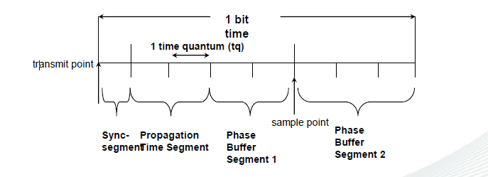
CAN Bit Timing
Each bit consists of a # of time quantum (tq).
Each tq is a fixed length.
TQs added and subtracted as clock syncs.
Tqs are set by designer in CAN controller chip.

Slide 81
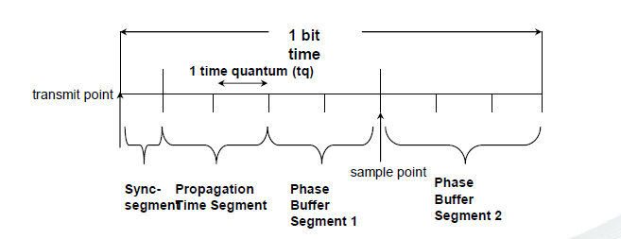
Timings for this example
Assume 500 Kbps CAN network.
Bit time = 1/(500 x 103) = 2 usec.
With 8 tqs, tq time is 2 usec/8 = 250 nsec.
Sample point is 250 nsec(5) = 1,250 nsec.

Slide 82
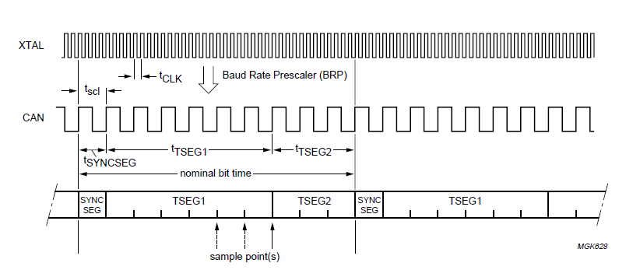

Slide 83
Transmit Buffers (TXB)
The TXB represents a Triple Transmit Buffer.
Each Transmit Buffer is able to store a complete message which can be transmitted over the CAN network.
The CAN Controller consist of three Transmit Buffers. Each of them has a length of 4 words and is able to store one complete CAN message

Slide 84
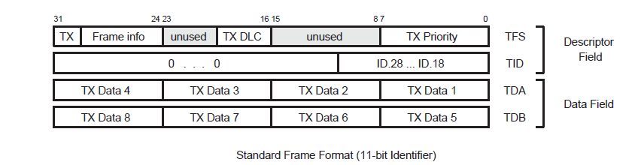

Slide 85
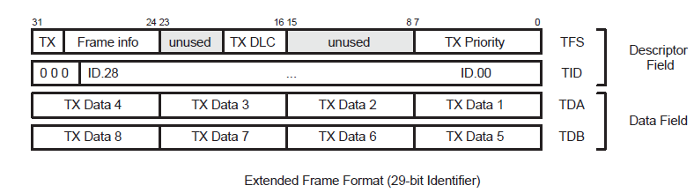

Slide 86
CAN Transmit Frame Information register (CAN1TFI1/CAN1TFI2/CAN1TFI13]
When the corresponding TBS bit in CANSR is 1, software can write to one of these registers.
first word of the Descriptor Field includes the TX Frame Info that describes the
Frame Format.11bit identifier or 29 bit identifier
3. Remote or Data Frame.
2.Data Length .
4. TX Priority register .

Slide 87
BIT | SYMBOL | FUNCTION
7:0 | PRIO | If the TPM (Transmit Priority Mode) bit in the CANxMOD register is set to 1, enabled Tx Buffers contend for the right to send their messages based on this field. The buffer with the lowest TX Priority value wins the prioritization and is sent first.
15:8 | ---------- | Reserved.
19:16 | DLC | Data Length Code. This value is sent in the DLC field of the next transmit message. In addition, if RTR = 0, this value controls the number of Data bytes sent in the next transmit message, from the CANxTDA and CANxTDB registers: 0000-0111 = 0-7 bytes 1xxx = 8 bytes
29:20 | --------- | Reserved.
30 | RTR | This value is sent in the RTR bit of the next transmit message. If this bit is 0, the number of data bytes called out by the DLC field are sent from the CANxTDA and CANxTDB registers. If this bit is 1, a Remote Frame is sent, containing a request for that number of bytes.

Slide 88
BIT | SYMBOL | FUNCTION
31 | FF | “0” the next transmit message will be sent with an 11-bit Identifier (standard frame) “1” the message will be sent with a 29-bit Identifier (extended frame format).

Slide 89
CAN Transmit Identifier register (CAN1TID[1/2/3]
When the corresponding TBS bit in CANxSR is 1, software can write to one of these registers to define the Identifier field of the next transmit message. Bits not listed read as 0and should be written as 0.
The most significant bit, and it is transmitted first on the bus during
the arbitration process. The Identifier acts as the message's name, used in a receiver for acceptance filtering, and also determines the bus access priority during the arbitration process.

Slide 90
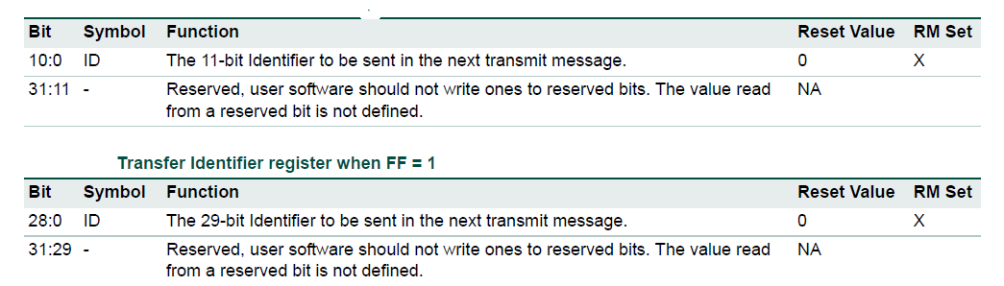

Slide 91
CAN Transmit Data register A (CAN1TDA[1/2/3]
When the corresponding TBS bit in CANSR is 1, software can write to one of these registers to define the first 1 - 4 data bytes of the next transmit message.
The Data Length Code defines the number of transferred data bytes. The first bit transmitted is the most significant bit of TX Data Byte 1.

Slide 92
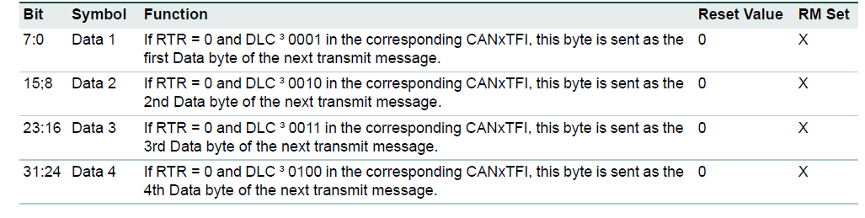

Slide 93
CAN Transmit Data register B (CAN1TDB[1/2/3])
When the corresponding TBS bit in CANSR is 1, software can write to one of these registers to define the 5th through 8th data bytes of the next transmit message.
The Data Length Code defines the number of transferred data bytes. The first bit transmitted is the
most significant bit of TX Data Byte 1.

Slide 94
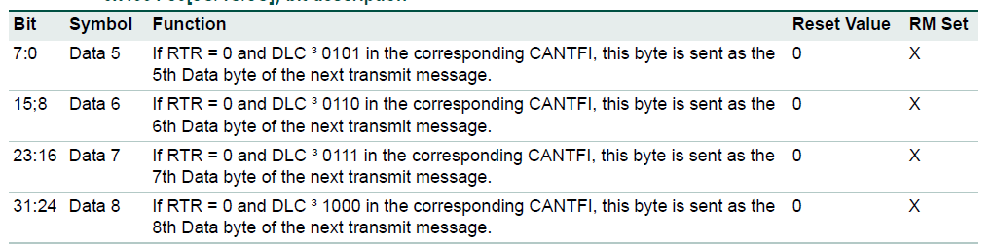

Slide 95
Receive Buffer (RXB)
The Receive Buffer (RXB) represents a CPU accessible Double Receive Buffer.
With the help of this Double Receive Buffer
concept the CPU is able to process one message while another message is being received.

Slide 96
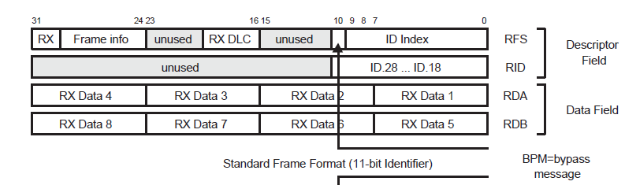

Slide 97
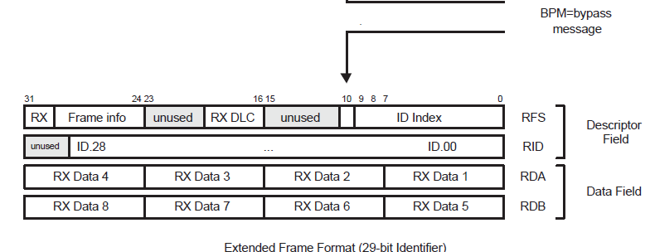

Slide 98
CAN Receive Frame Status register (CAN1RFS)
This register defines the characteristics of the current received message.
It is read-only in normal operation but can be written for testing purposes if the RM bit in CANxMOD is 1.

Slide 99
BIT | SYMBOL | FUNCTION
9:0 | ID Index | BP = 0, this value is the zero-based number of the Lookup Table RAM entry at which the Acceptance Filter matched the received Identifier. BP=1, the current message was received in AF Bypass mode, the ID Index field a is meaningless.
10 | BP | If this bit is 1, the current message was received in AF Bypass mode, the ID Index field a is meaningless.
15:11 | ------------- | Reserved, user software should not write ones to reserved bits. The value read from a reserved bit is not defined.

Slide 100
BIT | SYMBOL | FUNCTION
19:16 | DLC | The field contains the Data Length Code (DLC) field of the current received message. RTR = 0, this is related to the number of data bytes available in the CANRDA and CANRDB registers as follows: 0000-0111 = 0 to 7 bytes1000-1111 = 8 bytes RTR = 1, this value indicates the number of data bytes requested to be sent back, with the same encoding.
29:20 | -------- | Reserved, user software should not write ones to reserved bits. The value read from a reserved bit is not defined.
30 | RTR | RTR = 0, this is related to the number of data bytes available in the CANRDA and CANRDB registers as follows: 0000-0111 = 0 to 7 bytes1000-1111 = 8 bytes With RTR = 1, this value indicates the number of data bytes requested to be sent back, with the same encoding.
31 | FF | 0 in this bit indicates that the current received message included an 11-bit Identifier, 1= indicates a 29-bit Identifier.

Slide 101
CAN Receive Identifier register (CAN1RID)
This register contains the Identifier field of the current received message.
It is read-only in normal operation but can be written for testing purposes if the RM bit in CAN mod is 1.
It has two different formats depending on the FF bit in CANRFS.

Slide 102
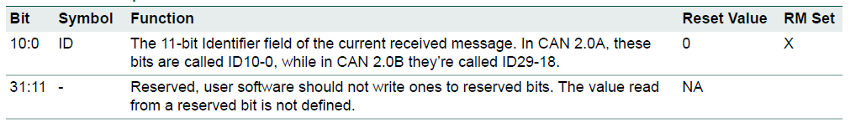
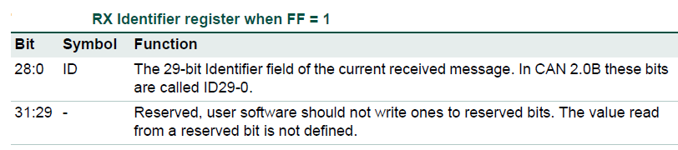

Slide 103
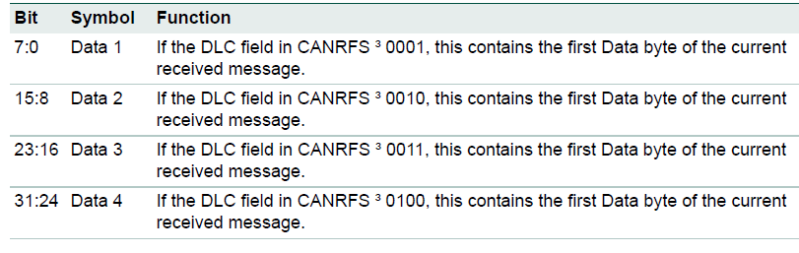
CAN Receive Data register A (CAN1RDA)

Slide 104
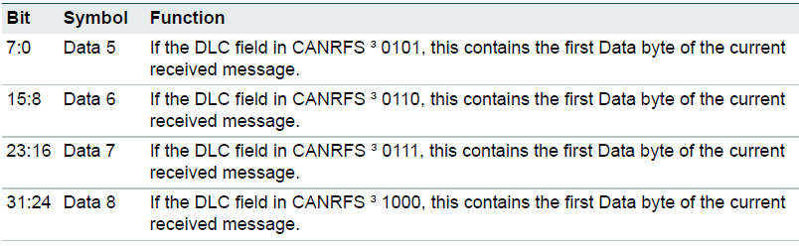
CAN Receive Data register B (CAN1RDB)

Slide 105
Global acceptance filter
This block provides lookup for received Identifiers (called Acceptance Filtering in CAN terminology) for all the CAN Controllers.
It includes a 512 X 32 (2 kB) RAM in which
software maintains one to five tables of Identifiers. This RAM can contain up to 1024
Standard Identifiers or 512 Extended Identifiers, or a mixture of both types.

Slide 106
The Acceptance Filter can be put into different modes by setting the according AccOff,AccBP, and eFCAN bits in the Acceptance Filter Mode Register.
A write access to all section configuration registers is only possible during the Acceptance Filter Off and Bypass Mode. Read access is allowed in all Acceptance Filter Modes.

Slide 107
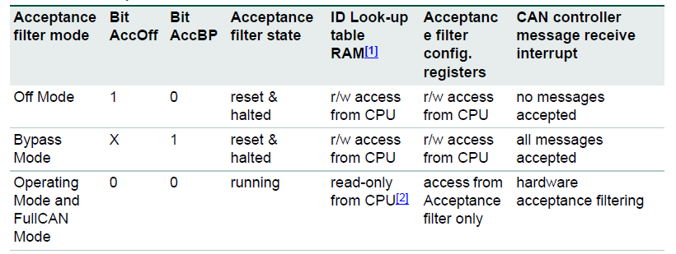
Acceptance filter modes

Slide 108
Acceptance filter Off mode
The Acceptance Filter Off Mode is typically used during initialization. During this mode an unconditional access to all registers and to the Look-up Table RAM is possible.
The Acceptance Filter Off Mode, CAN messages are not accepted and therefore not stored in the Receive Buffers of active CAN Controllers.

Slide 109
Acceptance filter Bypass mode
The Acceptance Filter Bypass Mode can be used for example to change the acceptance filter configuration during a running system, e.g. change of identifiers in the ID-Look-up Table memory.
During this re-configuration, software acceptance filtering has to be used.It is recommended to use the ID ready Interrupt (ID Index) and the Receive Interrupt (RI). In this mode all CAN message are accepted and stored in the Receive Buffers of active CAN Controllers.

Slide 110
Acceptance filter Operating mode
The Acceptance Filter is in Operating Mode when neither the AccOff nor the AccBP in the Configuration Register is set and the eFCAN = 0.
Full CAN mode
The Acceptance Filter is in Operating Mode when neither the AccOff nor the AccBP in the Configuration Register is set and the eFCAN = 1.

Slide 111
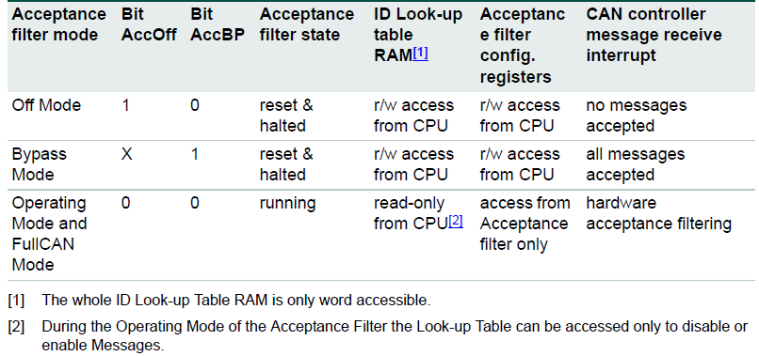

Slide 112
Acceptance Filter Mode Register (AFMR)
The AccBP and AccOff bits of the acceptance filter mode register are used for putting the acceptance filter into the Bypass and Off mode.

Slide 113
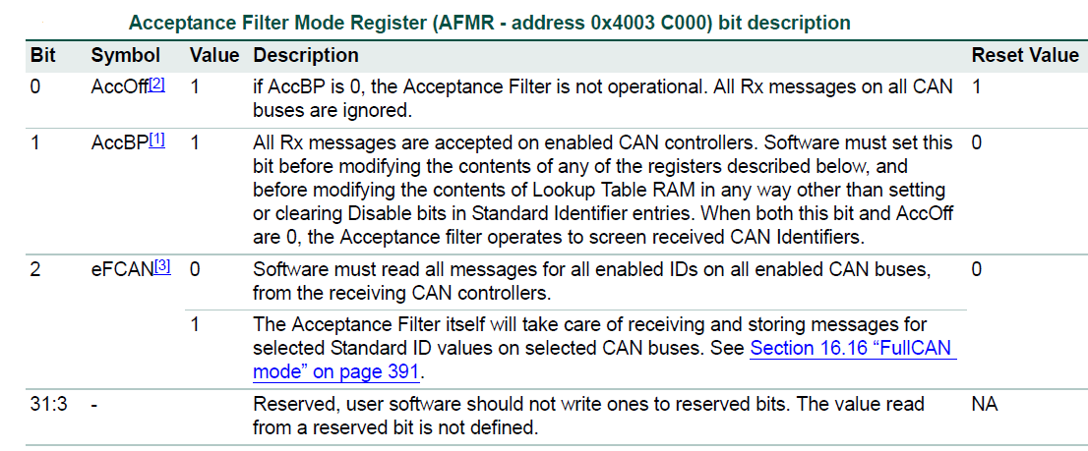

Slide 114
ID look-up table RAM
Five 12-bit section configuration registers
1.Standard Frame Individual Start Address register (SFF_sa).
2. Standard Frame Group Start Address register (SFF_GRP_sa).
3. Extended Frame Start Address register (EFF_sa).
4. Extended Frame Group Start Address register (EFF_GRP_sa).
5.End of AF Tables register (ENDofTable).
Note:Write access to the look-up table section configuration registers are possible only during the Acceptance filter bypass mode or the Acceptance filter off mode.

Slide 115
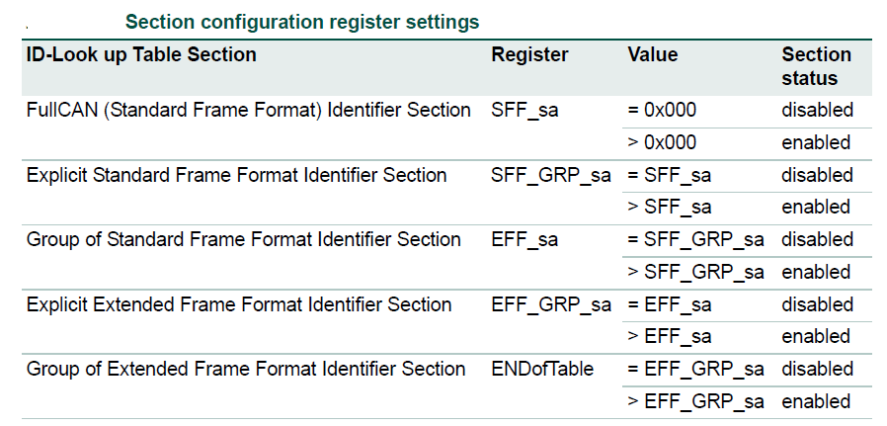

Slide 116
1.Standard Frame Individual Start Address register (SFF_sa)
Bit | Symbol | Description
1:0 | - | Reserved, user software should not write ones to reserved bits. The value read from a reserved bit is not defined.
10:2 | SFF_sa | The start address of the table of individual Standard Identifiers in AF Lookup RAM. If the table is empty, write the same value in this register and the SFF_GRP_sa register. write zeroes in bits 31:11 and 1:0 of this register.
31:11 | - | Reserved, user software should not write ones to reserved bits. The value read from a reserved bit is not defined.

Slide 117
2.Standard Frame Group Start Address register (SFF_GRP_sa)
Bit | Symbol | Description
1:0 | - | Reserved, user software should not write ones to reserved bits. The value read from a reserved bit is not defined.
10:2 | SFF_GRP_sa | The start address of the table of grouped Standard Identifiers in AF Lookup RAM.. .If the table is empty, write the same value in this register and the EFF_sa register. write zeroes in bits 31:11 and 1:0 of this register.
31:11 | - | Reserved, user software should not write ones to reserved bits. The value read from a reserved bit is not defined.

Slide 118
3.Extended Frame Start Address register (EFF_sa)
Bit | Symbol | Description
1:0 | - | Reserved, user software should not write ones to reserved bits. The value read from a reserved bit is not defined.
10:2 | EFF_sa | The start address of the table of individual Extended Identifiers in AF Lookup RAM. .If the table is empty, write the same value in this register and the EFF_GRP_sa register write zeroes in bits 31:11 and 1:0 of this register.
31:11 | - | Reserved, user software should not write ones to reserved bits. The value read from a reserved bit is not defined.

Slide 119
4.Extended Frame Group Start Address register (EFF_GRP_sa)
Bit | Symbol | Description
1:0 | - | Reserved, user software should not write ones to reserved bits. The value read from a reserved bit is not defined.
10:2 | Eff_GRP_sa | The start address of the table of grouped Extended Identifiers in AF Lookup RAM.. If the table is empty, write the same value in this register and the ENDofTable register write zeroes in bits 31:11 and 1:0 of this register.
31:11 | - | Reserved, user software should not write ones to reserved bits. The value read from a reserved bit is not defined.

Slide 120
5.End of AF Tables register (ENDofTable)
Bit | Symbol | Description
1:0 | - | Reserved, user software should not write ones to reserved bits. The value read from a reserved bit is not defined.
10:2 | Eff_GRP_sa | The address above the last active address in the last active AF table. write zeroes in bits 31:11 and 1:0 of this register.
31:11 | - | Reserved, user software should not write ones to reserved bits. The value read from a reserved bit is not defined.

Slide 121
ID look-up table RAM
The Whole ID Look-up Table RAM is only word accessible.
A write access is only possible during the Acceptance Filter Off or Bypass Mode.
Read access is allowed in all Acceptance Filter Modes.

Slide 122
Standard (11-bit) Identifiers
If Standard (11-bit) Identifiers are used in the application, at least one of 3 tables in Acceptance Filter RAM must not be empty.
If the optional “FullCAN mode” is enabled, the
first table contains Standard identifiers for which reception is to be handled in this mode.
The next table contains individual Standard Identifiers
The third contains ranges of Standard Identifiers
The tables of FullCAN and individual Standard Identifiers must be arranged in ascending numerical order, one per halfword, two per word.

Slide 123
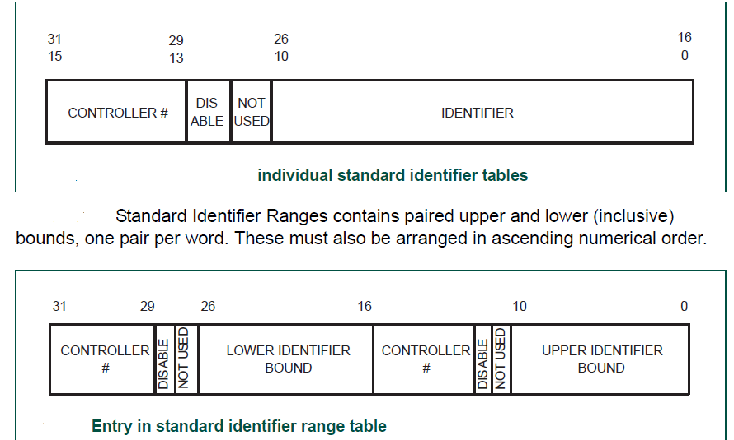
CAN Controller (SCC = 000(CAN1) SCC = 001 (CAN2)) .

Slide 124
Extended (29-bit) Identifiers
If Extended (29-bit) Identifiers are used in the application, at least one of the other two tables in Acceptance Filter RAM must not be empty.
one for individual Extended Identifiers
one for ranges of Extended Identifiers.
The table of individual Extended Identifiers
must be arranged in ascending numerical order.

Slide 125
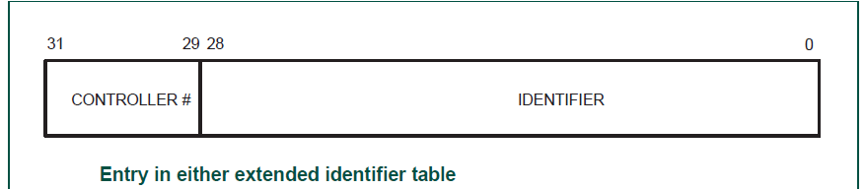

Slide 126
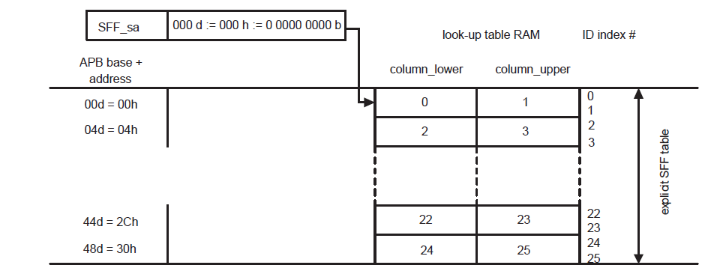
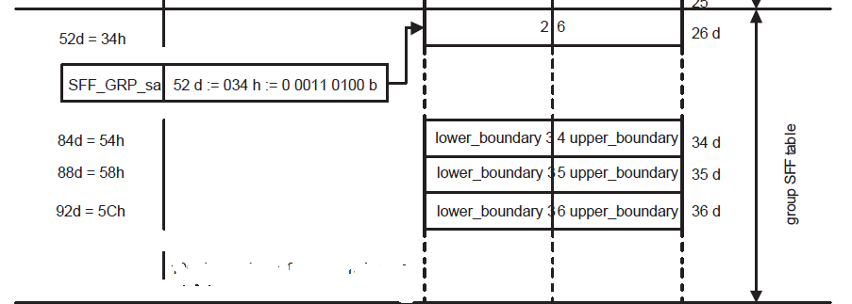
Example of acceptance filter tables and ID index values

Slide 127
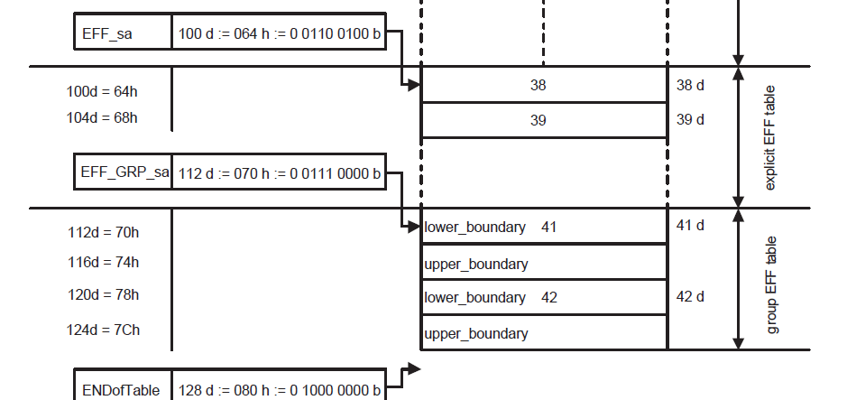

Slide 128
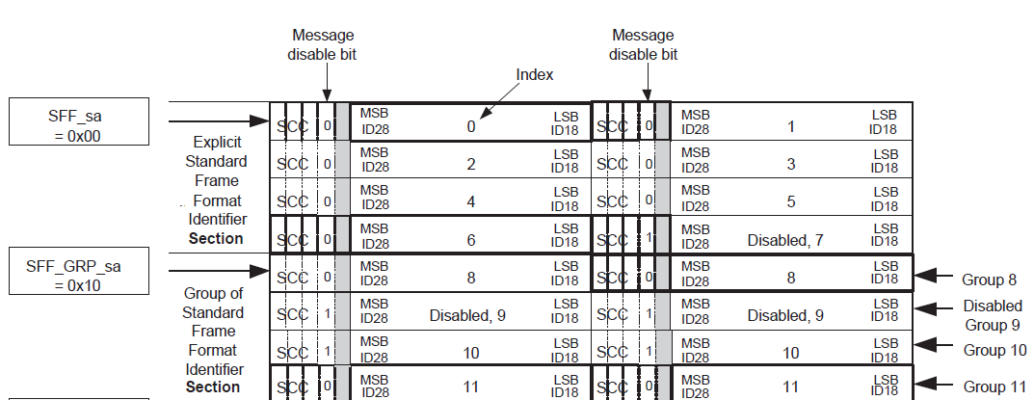

Slide 129
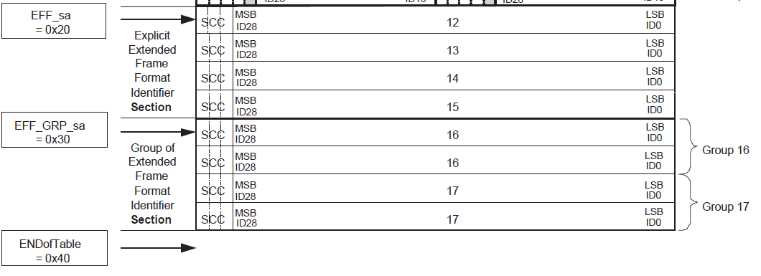

Slide 130
CAN TRANSMITTER ALGORITHM
1.Enable CAN BLOCK in PCONP Register
2.Configure CAN Peripheral clock in PCLK register.
3.Make pin numbers P0.0 and P0.1 as CAN pins
4.Enter the CAN in disable mode using CANMODE REGISTER
5.Clear all bits in command register

Slide 131
6.Sert the appropriate bits in BTR register
7.Enable receiver interrupt in IIER register.
8.Clear global register. GSR register.
9. Make CAN block in operating mode unsing CAN mode register.

