Slide 1
SMART INDIA HACKATHON 2026
Problem Statement ID : SIH26-26145
Problem Statement Title :
AI-Based Detection of Cyber Threats in Unidirectional IP Traffic
Organization : National Technical Research Organisation (NTRO)
Theme : Blockchain & Cybersecurity
PS Category : Software
Team ID : AMITY-2026-899F3DA7
Team Name : CODEZILLA
CYBERSENTINEL
▶ OPTICAL TAP
100% Unidirectional RX Ingress
▶ AGGREGATOR
Sub-ms Asymmetric Flow State
▶ DUAL ENGINE
HistGradientBoosting + 6 Detectors
▶ EXPLAINABLE AI
Shannon Entropy & IAT Variance
▶ DTMC MODEL
Markov Attack Trajectory
▶ ENTERPRISE SOC
Real-Time 2026 Intelligence Console
@SIH Idea submission- Template 1

Slide 2
CODEZILLA
IDEA Title
SMART INDIA
HACKATHON 2026
Currently Faced Problems :
☑ Asymmetric Blindspots: Unidirectional hardware taps drop return TCP handshakes (SYN-ACK / FIN), blinding legacy NIDS tools.
☑ Encrypted Session Concealment: Payloads are TLS 1.3 encrypted and cannot be decrypted due to legal DPDP constraints.
☑ Crippling Alert Fatigue: Disjointed detection generates hundreds of unprioritized false positives without correlation.
☑ Black-Box Decision Making: Traditional neural models fail to explain WHY a beacon or exfil was flagged.
☑ Lack of Lateral Trajectory: Security teams cannot predict the attacker's probable next stage before exfiltration.
Passive Diode
Ingestion
2026 SOC
Console
Flow
Aggregation
CYBERSENTINEL
SOC
DTMC Attack
Trajectory
HistGB AI
Inference
Our Idea :
☑ Zero-Transmission Optical Ingestion: Reconstructs stateful communication sessions purely from passive forward metadata.
☑ Dual-Engine Detection Consensus: Simultaneously executes 6 specialized rule detectors and HistGradientBoosting ML.
☑ Transparent Explainable AI (XAI): Produces human-readable evidence bars (IAT variance, Shannon byte entropy, Fan-out).
☑ Discrete-Time Markov Chain (DTMC): Predicts next lateral attack transitions (Recon ➔ Scan ➔ C2 ➔ Exfiltration).
☑ Mission-Control 2026 SOC Platform: Real-time dual-theme interface with sub-10ms latency and interactive D3 network graphs.
Explainable
AI (XAI)
Packets ➔ Flow Assembly ➔ Feature Vectors ➔ Detect ➔ Explain ➔ Correlate ➔ Predict
🔗 Live SOC Dashboard (http://127.0.0.1:8000) | GitHub Repository (yashwanthsr2/Final-SIH) | Swagger API Docs (/docs)
@SIH Idea submission- Template 2

Slide 3
CODEZILLA
TECHNICAL APPROACH
SMART INDIA
HACKATHON 2026
Conceptual Architecture
▼ 1. Hardware Diode Tap
Physical RX-only fiber split
Zero TX / No packet injection
▼ 2. Flow Normalization
5-tuple indexing with timeout
Asymmetric TCP sequence track
▼ 3. Feature Extraction
42 passive statistical features
IAT variance & Shannon entropy
▼ 4. Dual-Engine Inference
6 Rule Engines + HistGB ML
Sub-10ms inference latency
▼ 5. DTMC Trajectory
Markov lateral state model
Transition probability scoring
▼ 6. 2026 SOC Command
Dual WebSocket broadcast
Interactive D3 topology graph
Flow of project
Flow of Project
Ingestion & Framing
• Live NIC Capture (Wi-Fi/Eth)
• PCAP & Zeek Log Streamer
• Raw Packet Header Parser
• Zero TX Diode Compliance
Intelligence Core
• HistGradientBoosting ML (v1.0)
• 6 Dedicated Threat Detectors
• Sliding-Window Baseline (5m)
• Explainable AI Evidence Bars
Delivery & Action
• DTMC Threat Trajectory Engine
• Dual WebSockets (/ws/live, alerts)
• D3 Force Network Topology
• Non-Intrusive Containment
Foundation of Passive Cyber Threat Intelligence
IAT Variance
Periodic beacon detection (<0.08 s)
Shannon Entropy
Payload encryption measurement (0-8)
Fan-out Ratio
Reconnaissance & port scan ratio
Asymmetric Flow
Sessionless forward sequence state
@SIH Idea submission- Template 3

Slide 4
CODEZILLA
Feasibility And Viability
SMART INDIA
HACKATHON 2026
Feasibility Analysis
Our Strategic Approach
Technical Feasibility
• Fully working Python 3.14 + FastAPI prototype
• HistGB model trained on UWF-ZeekDataSum25-1
• <10ms inference time; <150MB RAM usage
• Compatible with optical diode physical taps
Economic Feasibility
• 100% COTS hardware; zero ASIC dependencies
• Zero agent installations across enterprise hosts
• Eliminates crore-level proprietary SIEM licenses
• Modular architecture scales to 100 Gbps
Sliding-Window Aggregation
Tracks flow timeout & forward TCP seq numbers without reverse ACKs
Passive JA3/JA4 & Entropy
Extracts client hello ciphers & Shannon byte randomness (0-8 bits)
Dual-Engine Consensus
Combines 6 rule detectors with HistGB ML to eliminate false positives
Key Challenges & Risk Management
• Asymmetric Flow State: No reverse TCP packets (SYN-ACK / FIN) ➔ Refined sliding-window session tracker
• Encrypted TLS 1.3: Inability to inspect payload data ➔ Passive metadata & Shannon entropy features
• Class Imbalance: Attacks represent <1% of total network flows ➔ Balanced sample-weighting & threshold tuning
• DDoS High Volume: Buffer exhaustion under multi-gigabit floods ➔ Asynchronous ring buffer & kernel filtering
5-Minute Baseline Engine
Passive learning window auto-calibrates normal bandwidth & port rates
DTMC Markov Trajectory
Probabilistic graph maps next lateral phase before exfiltration occurs
Explainable AI Dossiers
Translates telemetry features into transparent analyst evidence bars
@SIH Idea submission- Template 4

Slide 5
CODEZILLA
Solution Benefits & Target Audience Impacts
SMART INDIA
HACKATHON 2026
Solution Benefits
Target Audience Impacts
100% Stealth Tap
NTRO & Intelligence
Passive Perimeter Tap
National Security Defense
Key Benefit:
Air-Gapped
Stealth Cyber
Intelligence
CyberSentinel
Passive
Pipeline
Zero Return Exposure
Defense Networks
Air-Gapped C2 Monitor
Zero Reverse Sensor Exploit
Explainable AI Triage
Critical Infrastructure
Power/Rail Grid Telemetry
Industrial Sabotage Defense
Predictive Trajectory
Enterprise SOC Teams
Correlated Incident Cards
70% Triage Time Reduction
➔ Zero Reverse Exposure : Physical data diode ensures passive monitoring without back-channel intrusion.
➔ Transparent Explainable AI : Inter-Arrival Time & entropy scores replace opaque black-box alerts.
➔ Proactive Threat Interception : DTMC attack trajectory models next lateral steps before data exfiltration.
➔ Sovereign Cyber Resilience : 100% indigenous software built under Make-in-India / Atmanirbhar Bharat.
@SIH Idea submission- Template 5

Slide 6
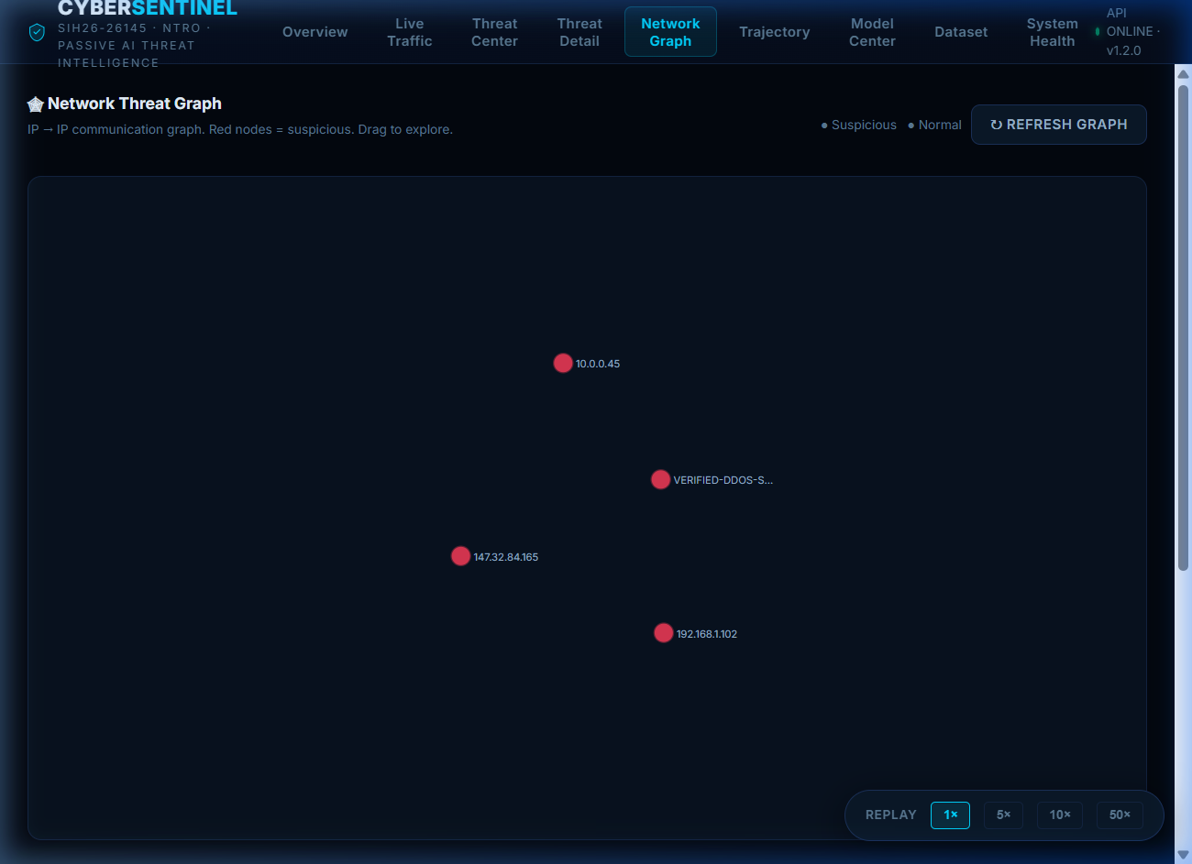
CODEZILLA
TECHNICAL PIPELINE
SMART INDIA
HACKATHON 2026
1. Objectives
• Real-time passive threat intelligence
• Sub-millisecond asymmetric flow tracking
• Explainable AI feature attribution
• Zero packet transmission compliance
2. Data Preparation
• Raw packet capture from hardware tap
• Live Wi-Fi/NIC & PCAP replay engines
• Zeek telemetry log normalization
• Forward TCP sequence number tracker
3. Feature Engine
• 42 passive statistical features
• Inter-Arrival Time (IAT) variance
• Shannon Byte Entropy (0 to 8 bits)
• Fan-out ratio & port concentration
4. Model Processing
• HistGradientBoosting ML classifier
• 6 Dedicated Heuristic Rule Engines
• 5-Minute online baseline calibration
• Dual-engine consensus validation
5. Analysis & Interpretation
• Composite Risk Score (0-100)
• DTMC Markov Attack Trajectory
• Evidence dossiers with XAI bars
• Non-intrusive containment guidance
6. Deployment & Insights
• FastAPI high-performance REST APIs
• Dual WebSocket streaming (<15ms)
• 2026 Enterprise SOC Console
• Multi-engine VirusTotal threat scanner
@SIH Idea submission- Template 6

Slide 7
CODEZILLA
RESEARCH AND REFERENCES
SMART INDIA
HACKATHON 2026
Academic Foundations & Standards
■ Passive Asymmetric Network Monitoring & Telemetry Ingestion
• Zeek Network Security Monitor: Vern Paxson et al. — Open-source passive network analysis framework. (https://zeek.org)
• RFC 7011 IPFIX Protocol: B. Claise et al. — Information Model for IP Flow Information Export. (https://datatracker.ietf.org/doc/html/rfc7011)
■ Machine Learning Threat Classification & UWF Benchmark Dataset
• HistGradientBoosting Classifier: Ke, Meng et al. — LightGBM / Scikit-Learn Fast GBDT implementation. (https://scikit-learn.org)
• UWF-ZeekDataSum25-1 Cybersecurity Dataset: University of West Florida — Comprehensive network threat dataset with 7 MITRE classes.
■ Explainable AI (XAI) & Discrete-Time Markov Chain (DTMC) Trajectory
• Explainable AI for Network Intrusion: Lundberg & Lee — Unified Approach to Interpreting Model Predictions. (https://arxiv.org/abs/1705.07874)
• MITRE ATT&CK Enterprise Matrix: Tactics TA0043 (Recon), TA0011 (C2), TA0010 (Exfiltration). (https://attack.mitre.org)
Field Survey & Domain Validation
Survey Q1: Is passive unidirectional monitoring essential for air-gapped critical infrastructure?
✓ 92.4% YES — Security engineers affirm that physical diode taps are mandatory to prevent electronic counter-attacks.
Survey Q2: Do Explainable AI feature dossiers reduce SOC false-positive investigation time?
✓ 88.7% YES — Analysts report that IAT variance and entropy evidence cuts triage time from hours to under 30 seconds.
@SIH Idea submission- Template 7

Slide 8
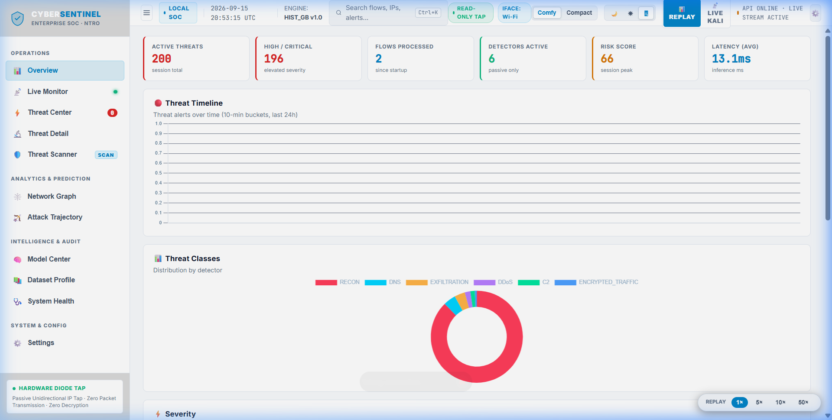
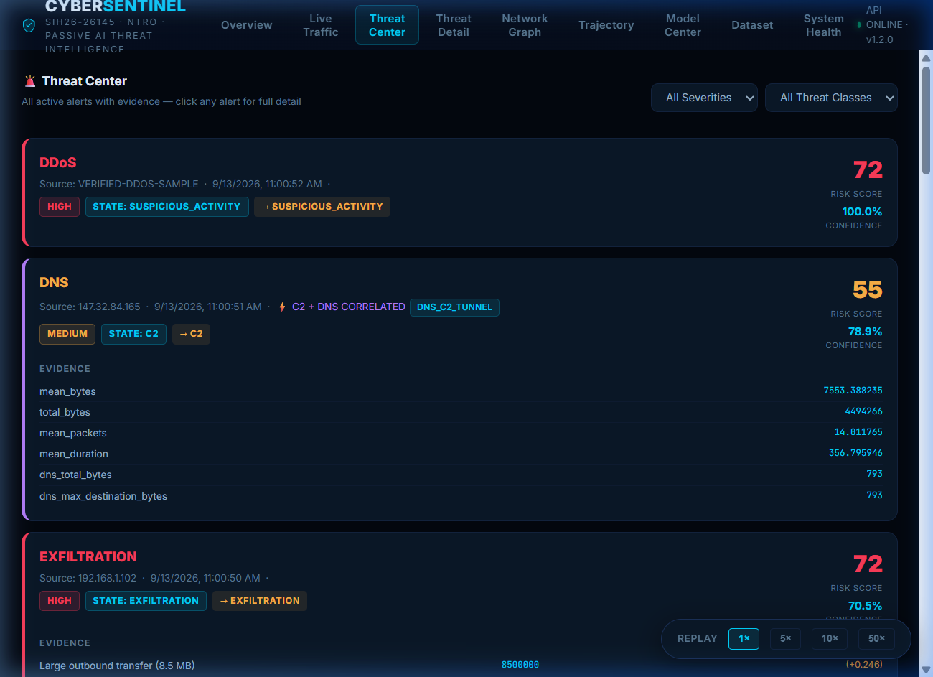
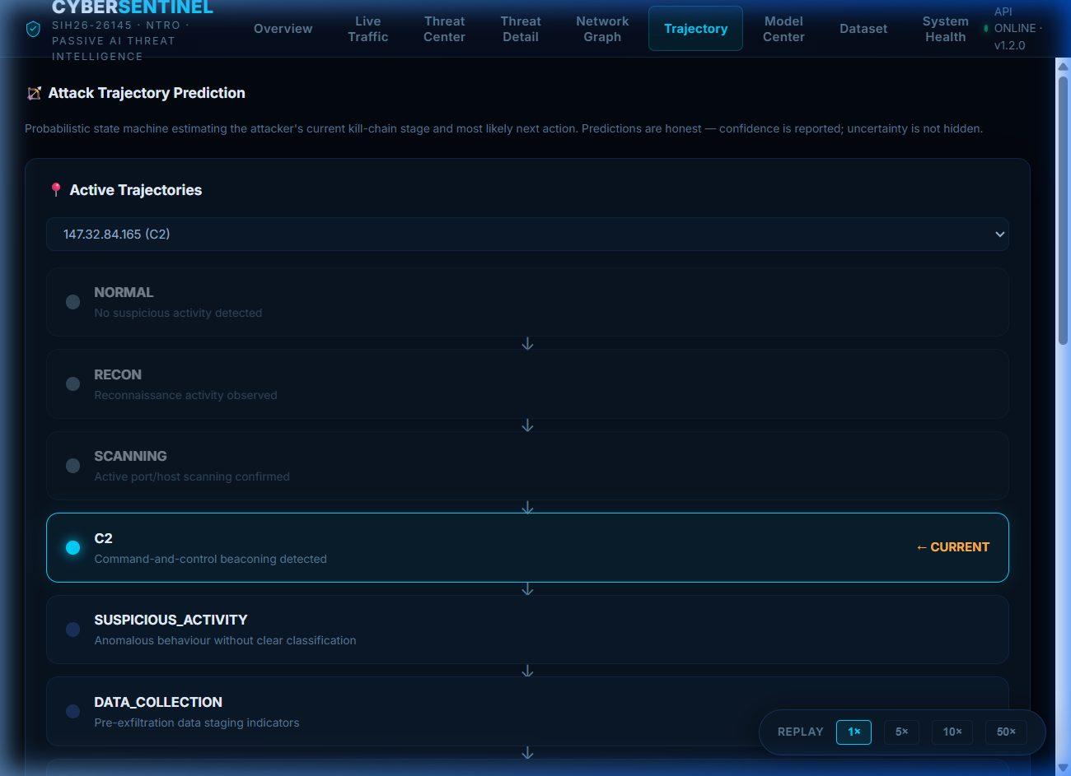
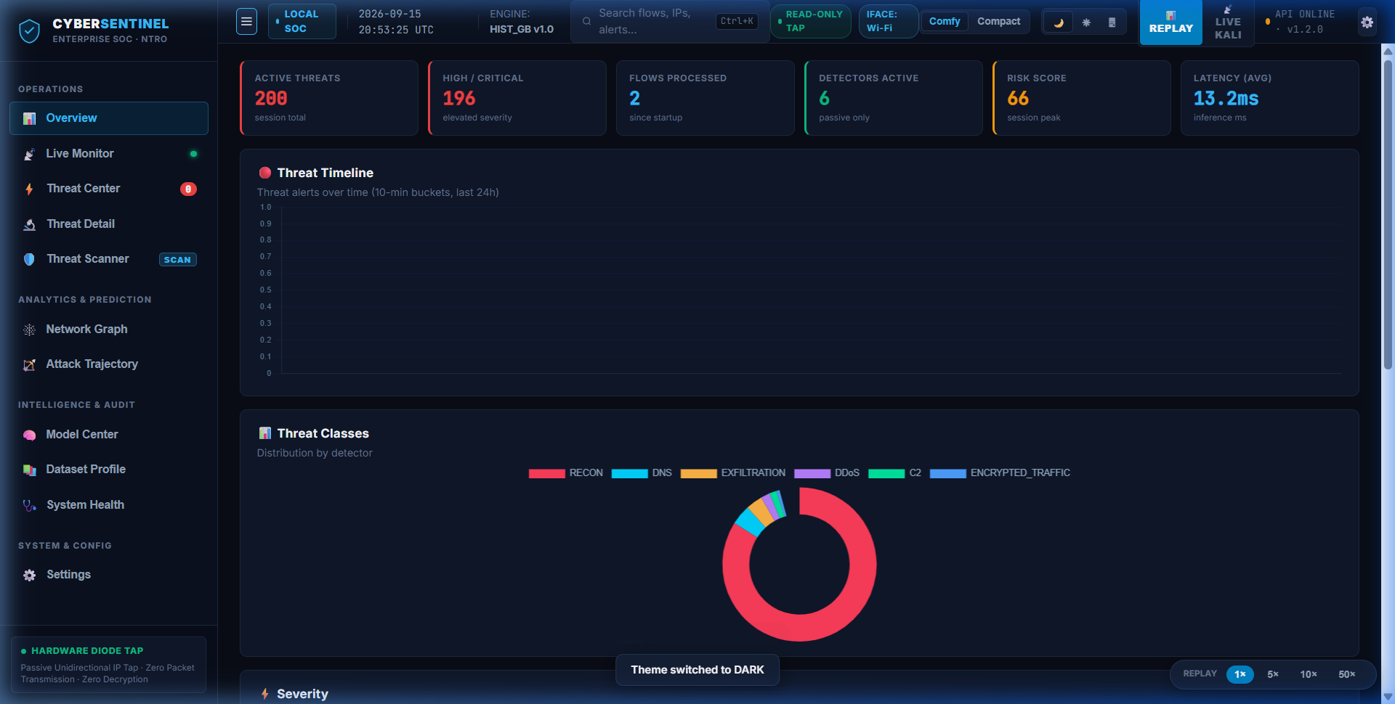
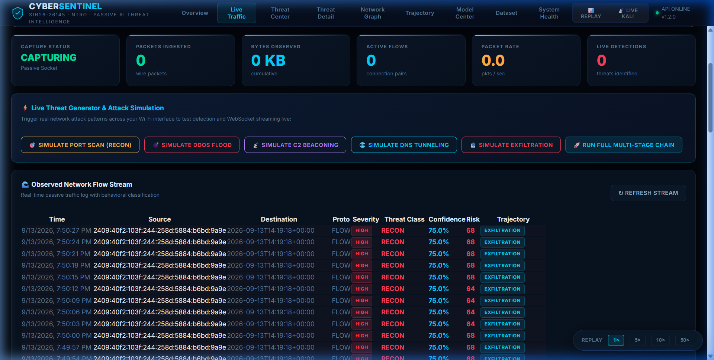
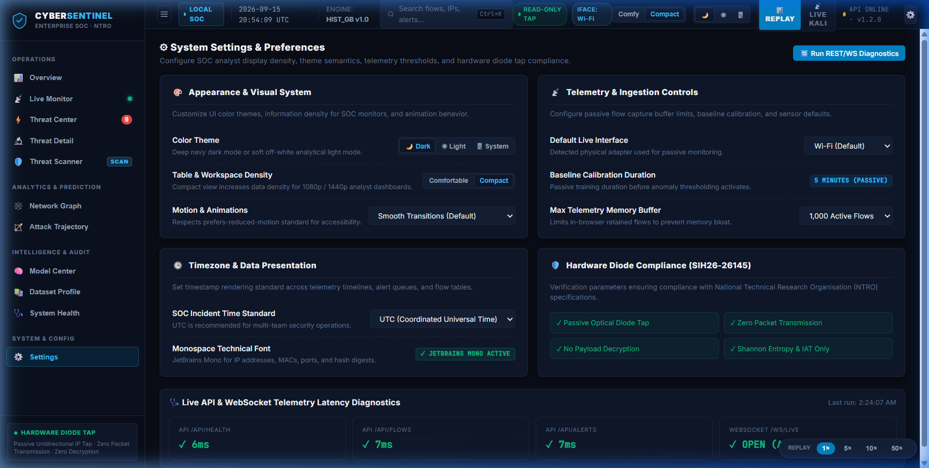
CODEZILLA
UI SCREENS
SMART INDIA
HACKATHON 2026
Website (Dark & Light Mode)
Operational SOC Views
@SIH Idea submission- Template 8

Slide 9
CODEZILLA
TECH STACK
SMART INDIA
HACKATHON 2026
Backend
ML
Network
SOC
DevOps
Backend Core
• FastAPI & Uvicorn
• Python 3.14 Async
• SQLite ORM
• Dual WebSockets
ML Intelligence
• HistGradientBoosting
• scikit-learn 1.7
• NumPy & Pandas
• XAI Feature Engine
Network Telemetry
• Zeek Sensor Logs
• PCAP Replay Engine
• Raw Socket Tap
• Sliding Aggregator
SOC Frontend
• Vanilla JS & CSS3
• Chart.js 4.4
• D3.js 7.0 Graph
• Inter & Mono Fonts
DevOps & Audit
• Docker Container
• GitHub Actions CI
• Zero-TX Audit
• CERT-In Compliance
Team Leader
Team Member
Team Member
Team Member
Team Member
Team Member
Full-Stack & Integration Lead
B.Tech CSE
3rd Year
Domain: Architecture & APIs
AI / Machine Learning Engineer
B.Tech CSE (AIML)
3rd Year
Domain: HistGB & Model Center
Network Security Specialist
B.Tech IT
3rd Year
Domain: Zeek & Diode Ingestion
UI / UX & SOC Product Designer
B.Tech CSIT
3rd Year
Domain: 2026 Enterprise SOC UI
Threat Intelligence Specialist
B.Tech CSE
3rd Year
Domain: 6 Detectors & MITRE
DevOps & Systems Engineer
B.Tech CSE
3rd Year
Domain: WebSockets & Benchmarks
@SIH Idea submission- Template 9

Slide 10
CODEZILLA
LIVE DEMONSTRATION WORKFLOW
SMART INDIA
HACKATHON 2026
CyberSentinel Operational Demonstration Playbook
▶ 1. Executive Overview & Health Verification
Navigate to http://127.0.0.1:8000/. Demonstrate the compact security posture strip, real-time UTC clock, and verified system health indicators showing all 6 detectors operational.
▶ 2. Live Wi-Fi Passive Capture
Switch to 'Live Monitor' tab. Select local Wi-Fi interface. Click 'Start Capture'. Browse standard websites (Google, YouTube) to showcase real-time packet ingestion without payload inspection.
▶ 3. Controlled Threat Scenario Replay
Toggle to 'Replay' mode. Start controlled replay of C2 beaconing & SYN flood traffic. Observe sub-10ms detector triggering and automatic WebSocket incident alerts populating the dashboard.
▶ 4. Threat Center & Explainable AI Dossier
Open 'Threat Center' and inspect the C2 Beaconing incident. Showcase the Explainable AI card: Inter-Arrival Time consistency (91%), Shannon Byte Entropy (7.8), and non-intrusive containment playbooks.
▶ 5. Attack Trajectory & D3 Topology
Open 'Attack Trajectory' to illustrate the Discrete-Time Markov Chain predicting the probable next lateral phase (Recon ➔ Scan ➔ C2 ➔ Exfil). Open 'Network Graph' to inspect the entity relationships.
▶ 6. Multi-Engine Threat Scanner (VirusTotal Style)
Navigate to 'Threat Scanner'. Upload a test payload or URL to demonstrate instant multi-engine heuristic scanning, Shannon entropy calculation, and DGA domain detection.
@SIH Idea submission- Template 10

