Slide 1
Finding suitable locations to open a Cinema hall in Bengaluru, INDIA
Yashwanth S

Slide 2
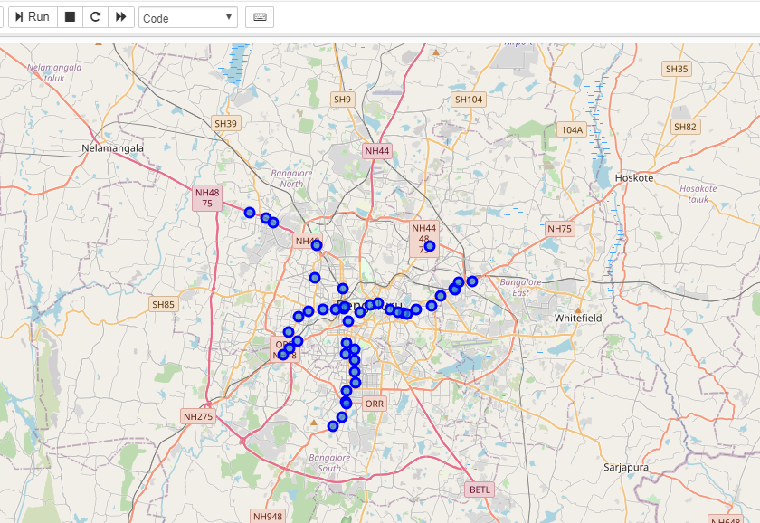
Business Problem • The cinema hall should be located near a metro station • Things to be considered: Number of existing theatres in the area Distance from each station to nearest cinema hall
Data
• Starting point: Majestic, Obtain its geospatial coordinates
• Using Foursquare API:
Find all metro stations in a radius of 35 km fromMajestic
Find existing theatres in a radius of 2km from each station
Calculate minimum distance from every station to a theatre

Slide 3
Data Description, Transformation and Cleaning • 40 initial metro stations found • Out of the remaining 40 metro stations 38 found with theatres in their vicinity No data for 2 stations (either non-existent data or no stations around these stations) • Only theatres categories with description “Cinema hall” were considered. All other categories (Drama’, ‘Podium’, ‘Festival’ etc.) were excluded • Data were normalized for the final calculations

Slide 4
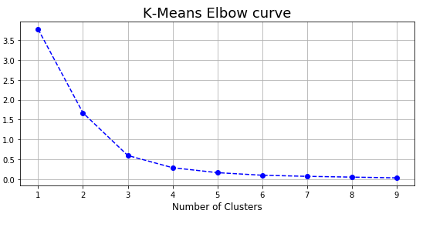
Methodology
Machine Learning (K-Means clustering algorithm) was used to create clusters of
stations
3 numbers of clusters were calculated based on the algorithm recommendation
(elbow method)

Slide 5
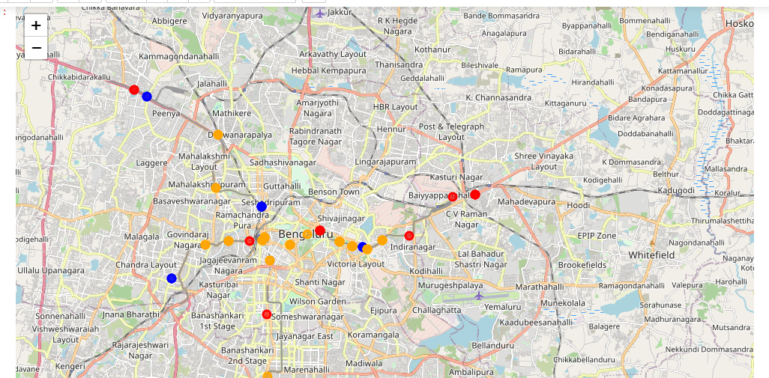
Results Metro Stations Cluster Map

Slide 6
Results 2 Cluster 1 – LOW potential (Red on the map) There are already many existing theatres in the area and the neares theatre is in most cases in a relatively short distance from the station. [7 metro stations] Cluster 2 - AVERAGE potential (Orange on the map) Although not a prohibitive metro station to open a theatres in its vicinity, there is already a fair number of theatres in the area and the nearest one is not far from the metro station. [16 stations] Cluster 3 - HIGH potential (Blue on the map) There are not many already existing theatres in the area and the nearest theatres is in most cases relatively not in a short distance to the metro station. [4stations]

Slide 7
Discussion - Conclusion • Possible areas that were not in the Foursquare database should also be examined so that it can be determined if it is just lack of data about these stations or indeed there are no theatress in the vicinity of the stations. • A lot more factors can be considered when choosing an appropriate location. Some examples of extra factors can be: Population density in the area Number of businesses operating in the area to work Average age and household income in the area Property prices in the area • The above results can be a good starting point for a prospective businessman that is interested in opening a theatres. Similar methodology can be used for other types of businesses probably with customized criteria.

