Slide 1
Class CS 671
Computer Vision-Final Project
Knee OA Classification Using Bone Distance
By
Yashwanth Varre (U01758611)

Slide 2
Contents
Introduction
Literature review
Block Diagram
Dataset
Methodology
Weka software
Experimental Results
References

Slide 3
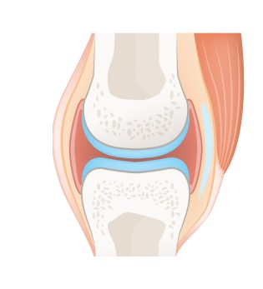
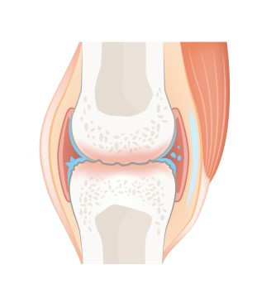
Introduction
Osteoarthritis : Osteo - bone; ARTHROS- joint; ITIS - inflammation.
Osteoarthritis is a degenerative joint disease.
This occurs when the smooth cartilage joint surface wears out.
Femur and tibia bones with healthy cartilage
Osteoarthritis

Slide 4
Literature Review
Some of the previous techniques are:
Artificial neural network back propagation method for measuring the severity of Osteoarthritis.
Some of methods used cartilage thickness as a main feature to measure Osteoarthritis.
Measuring the cartilage loss for a certain period of time.

Slide 5
Block Diagram
Input Dataset
Canny edge detection
Segmentation
Distance feature
CSV
Weka
Result

Slide 6
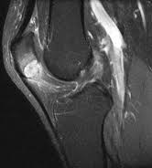
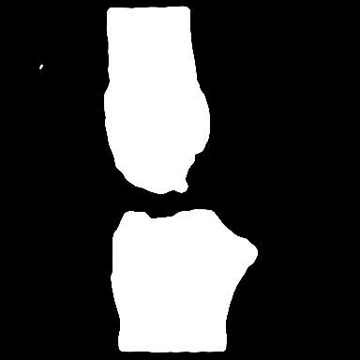
Dataset
The dataset contains segmented images of 3D knee MRI images.
The MRI images are already segmented into binary images with U-net.
The dataset contains more than 30,000 images taken from the MRI’s of more than 190 patients.
3D Knee MRI image
MRI image after performing U-net

Slide 7
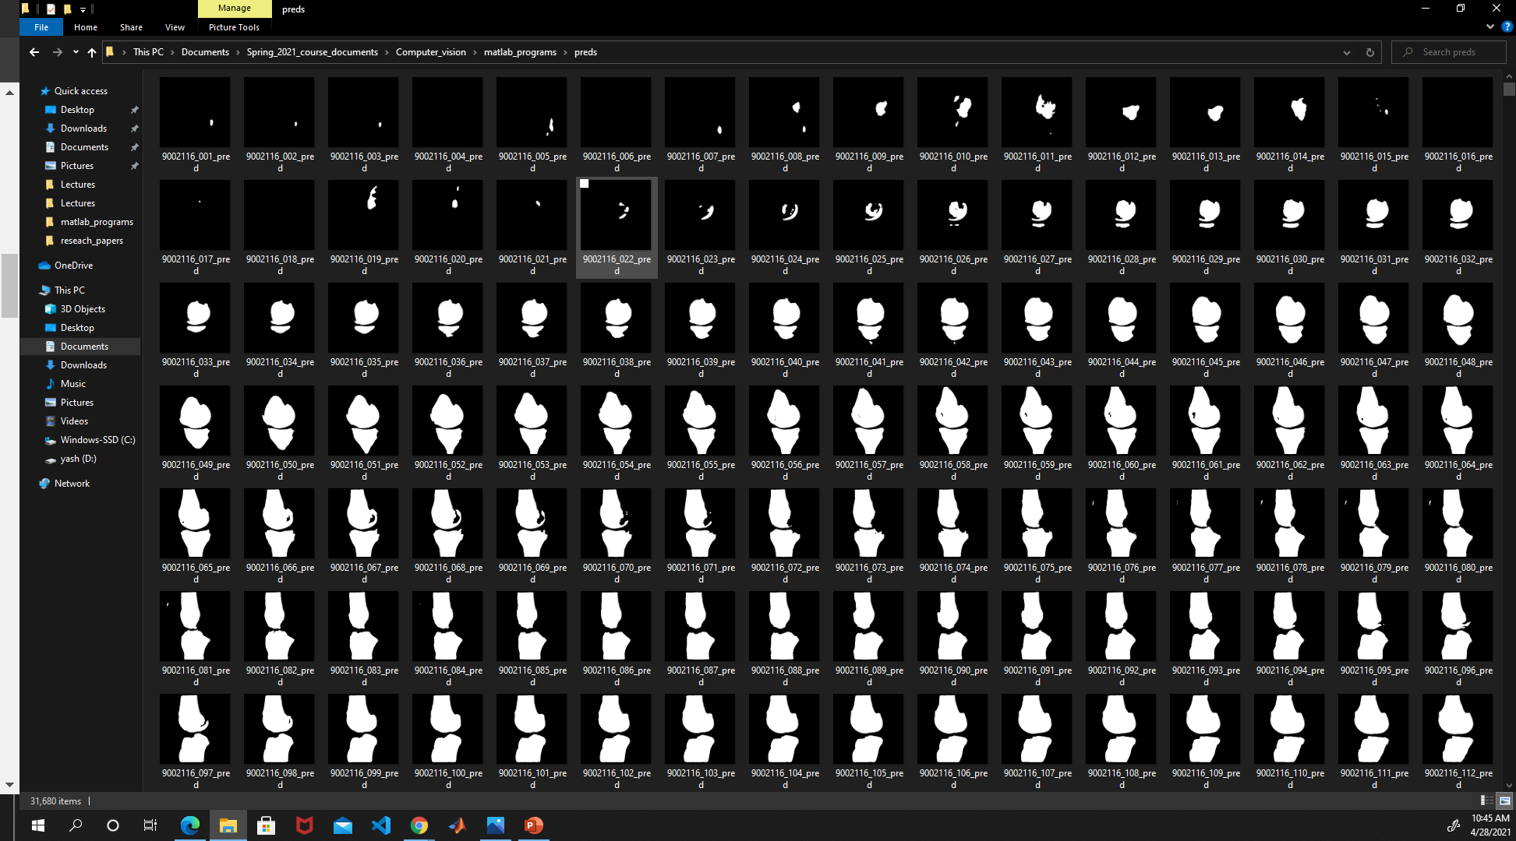
Screenshot of Dataset

Slide 8
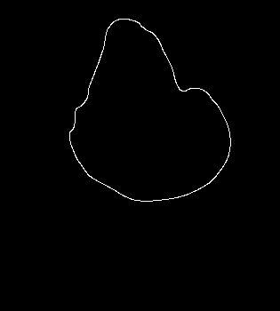

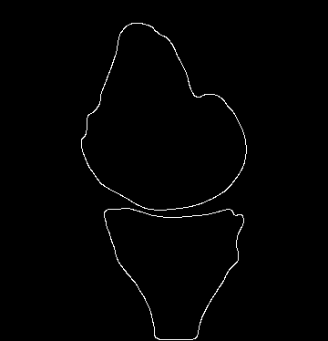
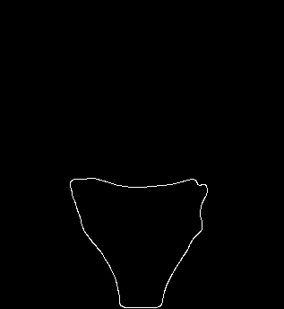
Methodology
3) Object 1
4) Object 2
1) Input Image
2)Edge Detection

Slide 9
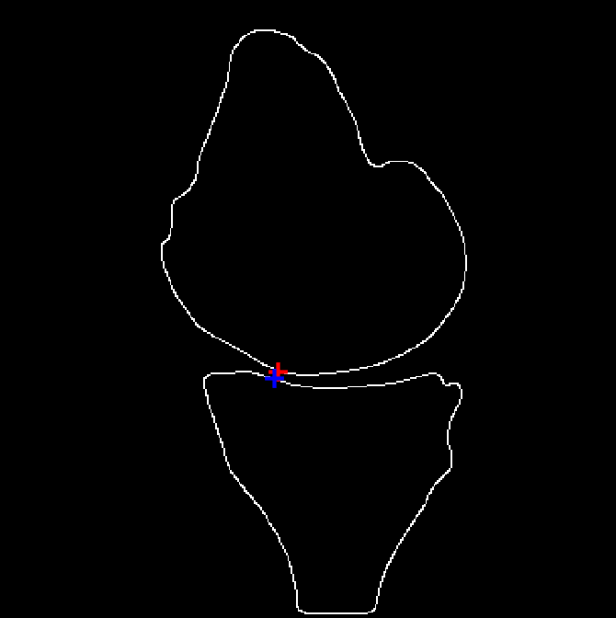
5) Finding the minimum distance between 3 and 4 will give us our desired feature.
6) Applying the steps 1-5 for all the images in the dataset.
7) Place the features in a vector and convert them to CSV file format.

Slide 10
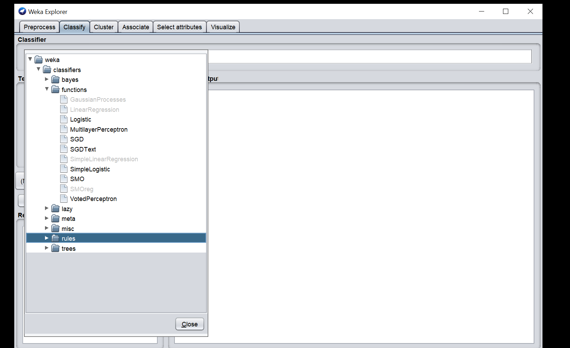
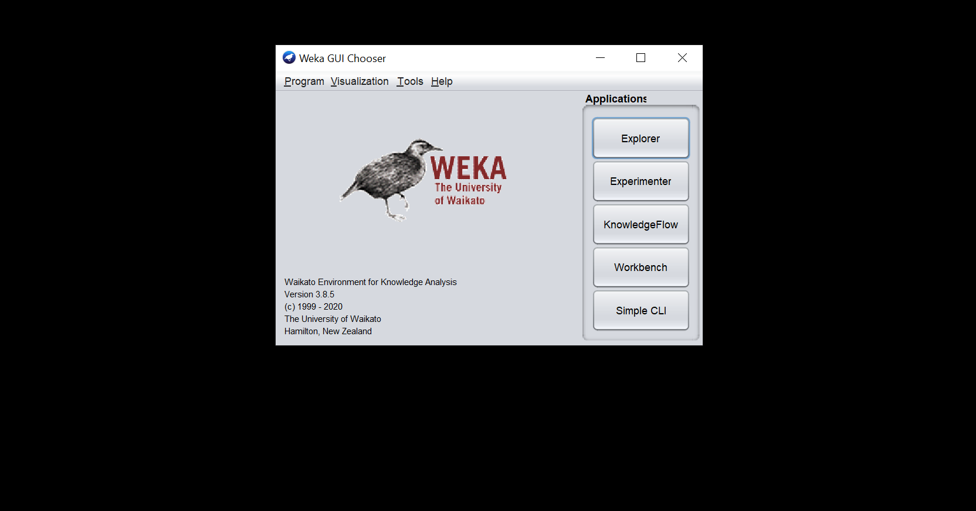
Weka Software
Weka ( Waikato Environment for Knowledge Analysis).
This is developed by University of Waikato, New Zealand.

Slide 11
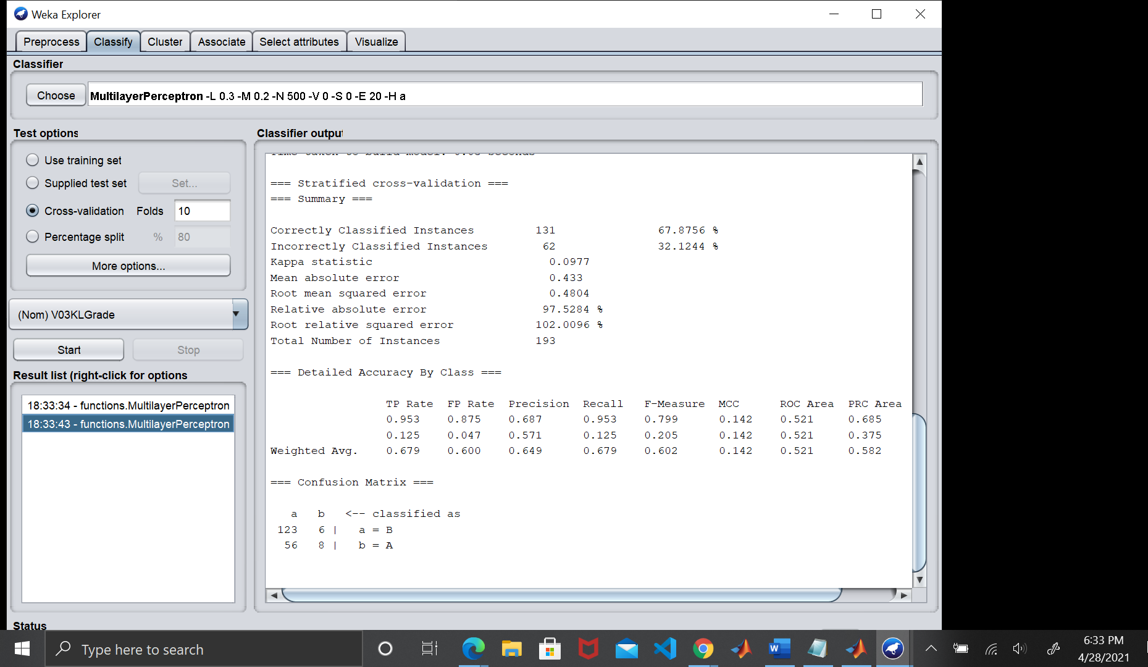
Results

Slide 12
References
A Survey on Exploration and Classification of Osteoarthritis Using Image Processing Techniques,International Journal of Scientific & Engineering Research, Volume 7, Issue 6, June-2016
Measurement of Cartilage Thickness for Early Detection of Knee Osteoarthritis (KOA),Sanjeevakumar Kubakaddi # , Dr KM Ravikumar* Harini DG 2013 IEEE Point-of-Care Healthcare Technologies (PHT) Bangalore, India, 16 - 18 January, 2013
Knee Joint Cartilage Visualization and Quantification in Normal and Osteoarthritis,M. S. Mallikarjuna Swamy,Proceedings of 2010 International Conference on Systems in Medicine and Biology 16-18 December 2010, liT Kharagpur, India.

