Slide 1
Foreign Currency Exchange Rate Forecast
Replicating Stanford CS229 project #34 on public data
Catherine D (CS120) · Yashwitha (CS121)
Machine Learning Mini Project · November 2026
Notes:
Catherine: Good morning. Our project replicates a Stanford CS229 student project that used machine learning to forecast exchange rates. We rebuilt it on free public data and tested whether its results hold up.

Slide 2
Can machine learning beat the random walk?
CS229 project #34 (Stanford, 2019) forecast the daily GBP, EUR and JPY rate against the US dollar with six ML models.
It claimed a Random Forest explains most of the daily movement and makes money trading.
We rebuilt the study on free data and asked one question: does any model beat “tomorrow’s rate = today’s”?
What the paper claims
R² = 0.74
Random Forest explains 74% of daily return variance; up to +10.5% trading profit
Meese & Rogoff (1983)
Random walk wins
Predicting no change beats structural economic models out of sample
Notes:
Catherine: The paper reports a Random Forest R-squared of 0.74 on daily returns and up to 10.5% profit. That contradicts a famous 1983 result by Meese and Rogoff: predicting no change, the random walk, beats economic models. Our question is simple: does any model beat tomorrow equals today?

Slide 3
We rebuilt the paper end to end
1
2
3
4
5
Data
Features
Split
Models
Evaluation
GBP, EUR, JPY vs USD, daily, 2003–2018
15 exchange-rate features + 8 macro factors
80 / 10 / 10 in time order
Logistic, Lasso, Ridge, SVM, Random Forest, MLP
Exp 1 direction, Exp 2 return, $100 trading simulation
What we added so the result is valid
Random-walk and majority baselines
Macro data used only after release
Bad-price cleaning
Trading costs (2 bp)
Significance and seed checks
Notes:
Catherine: We kept everything the paper specified: the three currency pairs, the same 15 features plus 8 macro factors, the 80/10/10 split, the six models, both experiments and the trading rule. We added five things the paper lacked, shown at the bottom, because without them you cannot tell skill from luck.

Slide 4
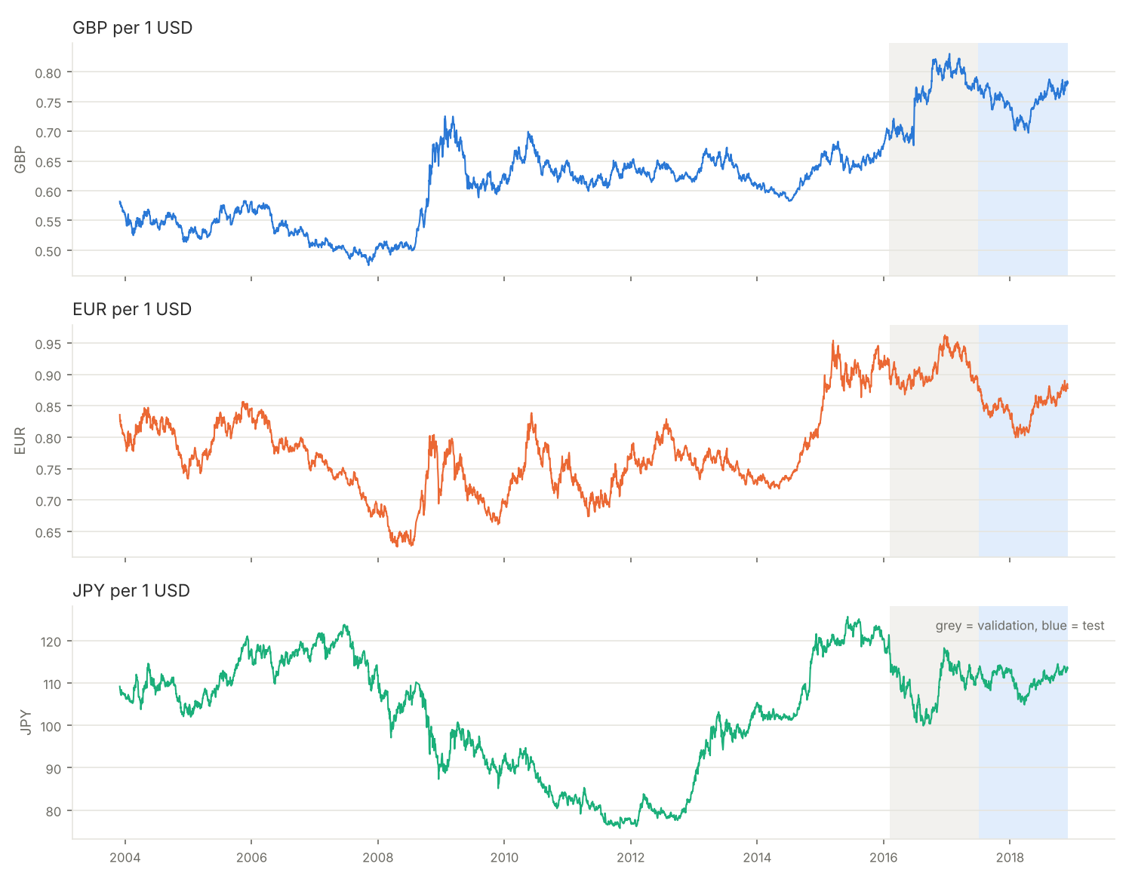
Data: three USD pairs, 2003–2018
Exchange rates | Yahoo Finance (GBP=X, EUR=X, JPY=X)
Macro factors | Yahoo stock indexes, FRED CPI, Fed funds, recession flag, federal debt
Paper used | Bloomberg and CRSP (paid)
Period | 1 Dec 2003 – 30 Nov 2018
Trading days | ≈ 3,880 per pair
Typical daily move | 0.60–0.65%
Up days | 49.5–50.4%
Jul 2017 – Nov 2018
our test period, almost the paper's (Mar 2017 – Nov 2018)
Notes:
Catherine: Bloomberg and CRSP are paid, so we used Yahoo Finance for exchange rates and stock indexes and FRED for the four US economic series. Yahoo's GBP and EUR history only starts in December 2003, so we start there instead of 2001; the end date matches the paper. Note the bottom of the table: the typical day moves about 0.6% and up days are almost exactly 50%, so there is very little to predict.

Slide 5
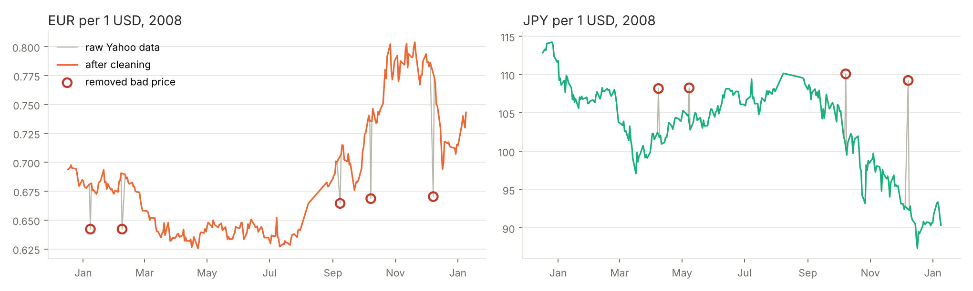
Yahoo had nine bad prices in 2008
Rule: drop a price more than 3% away from both neighbours when the neighbours agree, i.e. a one-day spike that snaps back.
9 prices
89.5 → 2.3
0 GBP rows
5 EUR + 4 JPY, all on the 8th of a month
EUR excess kurtosis after cleaning (JPY 110.9 → 3.9)
removed; real jumps like Brexit are kept
Notes:
Catherine: While checking the data report we found a Yahoo data error: one-day spikes of 3 to 15 percent in EUR and JPY, always on the 8th of a month in 2008, that reverse the next day. GBP is clean on the same dates. Our rule removes exactly these nine rows and nothing else. We ran everything with and without the fix: the conclusions do not change.

Slide 6
23 features, each known on the day
Set | Features | Count
fx7 | Log return today and yesterday; average log return over 5, 10, 20, 60, 120 days | 7
fx15 | fx7 + log rate, its square and cube; average log rate over 5, 10, 20, 60, 220 days | 15
fx15_macro | fx15 + S&P 500, S&P 100, Nasdaq, Dow returns; CPI change, Fed funds, recession flag, debt change | 23
No look-ahead
March CPI is dated 1 March but released mid-April, so the model only sees it from 15 April.
CPI, recession flag
+45 days
Federal debt
+180 days
Targets
Exp 1: will tomorrow's rate go up? (yes / no)
Exp 2: tomorrow's log return, log(rate t+1 / rate t)
Fed funds, stock indexes
+1 day
Notes:
Catherine: These are the paper's three feature sets, defined exactly as in its section 3.2. Every feature uses data up to day t only. For the economic data we go one step further than the paper: each value is used only after it was actually published. Otherwise the model would know March inflation on 1 March. Unit tests check both rules.

Slide 7
Chronological split with explicit baselines
Train 80%
Val 10%
Test 10%
Train Oct 2004 – Feb 2016 · ≈ 2,930 days
Validation Feb 2016 – Jun 2017 · ≈ 367 days
Test Jul 2017 – Nov 2018 · ≈ 367 days
Models (as in the paper)
Baselines we added
Selection
Logistic / linear regression
Lasso and Ridge
SVM (RBF; poly in Exp 2)
Random Forest, 1000 trees, depth 100
MLP, 64 → 32 units
Random walk: tomorrow = today
Majority class
Same direction as today
Historical mean return
Momentum: repeat today's move
Hyperparameters chosen on validation
Refit on train + validation
Test set scored once
Never shuffled
Notes:
Yashwitha: Data is split in time order, never shuffled, so the model only ever learns from the past. Hyperparameters are chosen on validation, and the test period, July 2017 to November 2018, is used once. That test period almost matches the paper's. In the middle are the baselines the paper never measured, most importantly the random walk.

Slide 8
Direction prediction is a coin flip
0.503 – 0.529
accuracy range across all 18 model × feature-set combinations
p = 0.52
for the best model (MLP, 52.9%) after correcting for 18 tries
0.51 – 0.55
the paper's own range: this part replicates
Notes:
Yashwitha: Experiment 1 predicts whether the rate goes up tomorrow. Every model, ours and the paper's, sits around 50 percent. Our best, an MLP at 52.9 percent, looks above chance, but we tried 18 combinations, and after a Bonferroni correction the p-value is 0.52. So this part of the paper replicates: direction is a coin flip. Note the chart axis starts at 0.45 to make the small differences visible.

Slide 9
No model beats “tomorrow = today”
Lasso
chosen on validation, with every coefficient shrunk to 0: a constant forecast
−0.06 to −0.02
our Random Forest test R² by pair (paper: 0.70 to 0.78)
+0.4%
best improvement over the random walk (SVM poly), not chosen on validation
Notes:
Yashwitha: Experiment 2 predicts tomorrow's return. The bars show improvement over the random walk; below zero means worse than predicting no change. Almost everything is below zero, and Random Forest is the worst. Using the paper's own selection rule, validation picks Lasso, and its best setting zeroes every coefficient, so it predicts a constant. The data are telling us the best forecast is no change. The paper's Random Forest R-squared of 0.74 becomes minus 0.06 to minus 0.02.

Slide 10
The two “wins” did not survive checks
SVM poly, Exp 2
MLP, Exp 2
55.4%
direction accuracy on the test period (p = 0.002 after correction)
53.5%
direction accuracy with random seed 42
Validation, GBP
48.9%
Seeds 0 and 2
47.4%, 49.2%
Validation, EUR
48.1%
Seeds 3 and 4
50.2%, 49.9%
Validation, JPY
51.4%
Seed 1
51.6%
No skill on validation; not the model validation chose
Seed luck: other seeds give 47–52%
Notes:
Yashwitha: Two results looked like real skill, so we checked them. SVM-poly called the direction right 55 percent of the time on the test period, but trained on the training data alone it scores 48 to 51 percent on the validation period, and validation would never have picked it. The MLP's 53.5 percent came from random seed 42; five other seeds give 47 to 52 percent. Real skill has to show up on validation data and across seeds.

Slide 11
Trading loses money once costs are added
$83 – $97
all 7 currency combinations lose money with a 2 bp cost
83% of days
holding a foreign currency (all 3): costs dominate
$100.00
the selected model (Lasso) never trades
Notes:
Yashwitha: The trading rule starts with 100 dollars and each day holds the currency predicted to strengthen most. Grey dots are the paper's results, green ours with no cost, amber ours with a 2 basis point cost per conversion. With costs, every combination loses money. The Random Forest trades on 83 percent of days, so costs eat 11 percent of capital. The model validation selected, Lasso, never trades at all.

Slide 12
Paper vs ours: what replicates
Result | Paper | Ours | Replicates?
Direction accuracy (Exp 1) | 0.51 – 0.55 | 0.50 – 0.53 | Yes
Model chosen on validation | Random Forest (R² 0.74) | Lasso, constant forecast | No
Random Forest test R² | 0.70 – 0.78 | −0.06 to −0.02 | No
Cash from $100, all 3 currencies | $101.30 | $93.94 ($83.15 with cost) | No
Random-walk baseline | cited, never measured | measured: nothing beats it | —
Why R² = 0.74 can't be right: a model that explains 74% of daily return variance would call the direction correctly on most days. The paper's own direction accuracy is about 50%.
Notes:
Yashwitha: Summing up against the paper. Direction accuracy replicates. The regression and trading results do not. The key inconsistency: an R-squared of 0.74 on daily returns would mean near-perfect direction calls, yet the paper's own accuracy is around 50 percent. Likely the R-squared was computed on in-sample data or with features that leaked the next day.

Slide 13
The random walk still wins
Without a random-walk baseline, point-in-time data and validation checks, daily FX forecasting results are easily overstated.
Limitations
Next steps
Live demo
python main.py --quick
One test window (17 months)
No Diebold–Mariano test
Yahoo data, recession-flag hindsight
Walk-forward validation
LSTM / GRU (paper's suggestion)
Interest-rate differentials
Notes:
Both: Our conclusion: on public data, with the paper's own models and features, nothing beats the random walk, which is Meese and Rogoff's 1983 result again. The methodological lesson is that baselines, point-in-time data and validation checks are what separate real skill from luck. Limitations: one test window and no Diebold-Mariano test. Now a short live demo using cached data.

