Slide 1
Workshop on Database Application Development using PHP
Organized by
Department of Information Science and Engineering
&
Infy Challengers Club
Venue: Vivekananda Lab

Slide 2
Keynote Speaker
Dr. Thara D K
HOD, Dept. of ISE
CIT, Gubbi

Slide 3
Workshop on Database Application Development using PHP
By,
Anil Kumar
Asst. Prof.
Dept. of ISE
CIT, Gubbi.

Slide 4
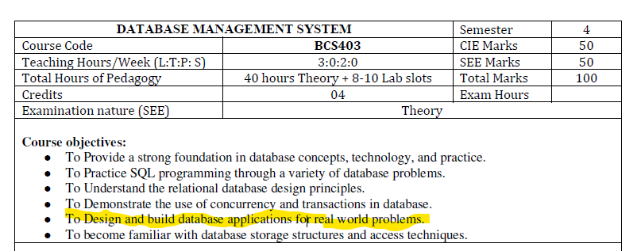
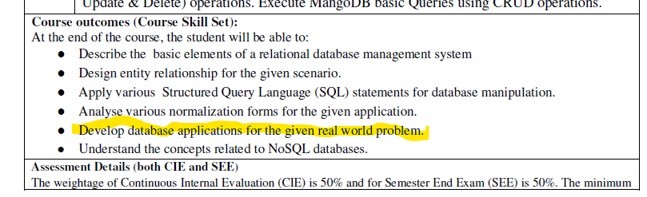
why we are here today

Slide 5

ignition

Slide 6
Contents
Live projects Demonstration
HTML
HTML Forms
PHP
Installation of XAMPP software
Database Connection
Stored Procedure
Triggers

