Slide 1
Indian IT-BPO Industry: Building Future Ready Organizations
Chennai, 28-29 July 2010

Slide 2
Key Topics
Past Decade – Employment Facts and Impact
HR’s four levers to build “Future Ready” Organizations
    Sustained Investment in Training
    Opportunities for Career Growth
    Managing People Challenges effectively
    Ensuring Cost Competitiveness
  HR Best Practices and NASSCOM Initiatives

Slide 3
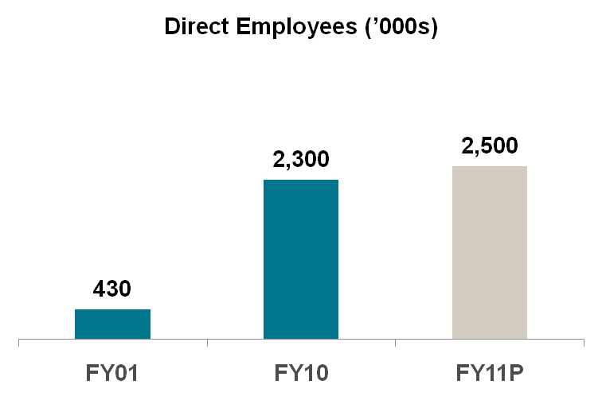
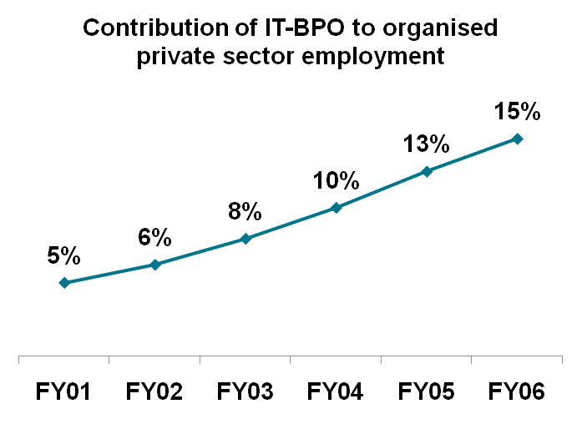


6X increase in direct employment;3X increase in the share of organized private sector
~6x
45% of total incremental urban employment in the last decade
By 2020 - Direct employment of 10 million; Indirect employment of 20 million

Slide 4






Employment opportunities for diverse sections of the society
Employment beyond
Urban areas
~58% of the IT-BPO workforce is from tier 2/3 cities
~ 56% employees are chief bread earners
Young demographics
Changing aspirations of India’s youth
Created high paying jobs
Setting new standards of work environment
Bridging the
gender divide
~37% women employees in FY09; account for 45% of fresher intake
~26% of the female employees are chief wage earners
Empowering the
youth
Industry average age: ~27 years
Livelihood for
Economically
backward
~5% of the IT-BPO workforce from economically backward sections
By 2020
5 mn women employees
4 mn direct employees in tier 2/3 locations
Employing the
Differently abled
~60% of companies provide employment to differently abled people
*NASSCOM Evalueserve survey findings, 7500 participants pan India

Slide 5



Leading transformation in Tier 1 cities; extending impact to Tier 2/3 locations
Tier 1
Tier 2/3
  Direct employment - 1.9 million
  Indirect employment - 7.3 million
  Direct employment - 1.7 lakh
  Direct dependents supported- 4X
  ~ 2X growth in FY05-09 in engineering colleges and technical graduates
    58% of the total engineering colleges
    62% of the total intake of technical graduates
  1.7X growth in FY05-09 in engineering colleges and technical graduates
    Number of engineering colleges- 985
    Number of technical graduates - 508,000
    Skill Development trainings in tier 2/3 locations
By 2020: 4.1 mn incremental direct jobs in tier 1 locations; 3.8 mn incremental direct jobs in tier 2/3 locations

Slide 6
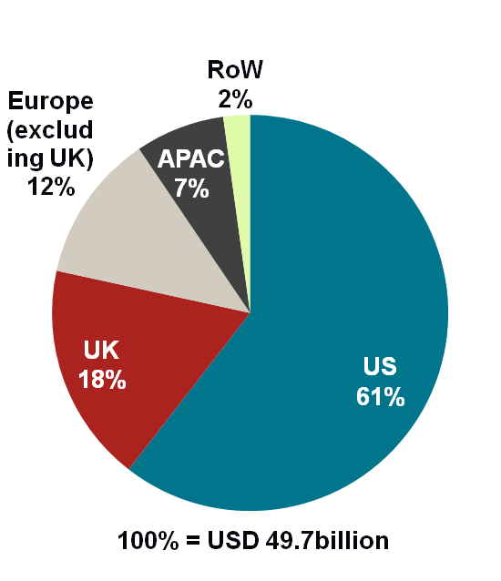

Global and Diversified workforce
IT-BPO Exports revenue by Geography, FY2010
(nos) | 2007 | 2008 | 2009
Countries of Operations | ~48 | ~52 | ~60
Operating Centers | 340 | ~400 | ~460
Finland
Germany
Hungary
Netherlands
Romania
Sweden
Canada
UK & Ireland
Poland
Russia
France
USA
Spain
Italy
China
Japan
Morocco
Egypt
Mexico
S. Arabia
India
Taiwan
Guatemala
Philippines
Sri Lanka
Brazil
Tanzania
Australia
Argentina
South Africa
New Zealand
2.2 million employees;~60 countries;
35+ Languages; 5% Foreign nationals
* Illustrative list of countries represented above

Slide 7
NASSCOM Top 20 IT-BPO Employers in India FY2010
Rank | Company
1. | Tata Consultancy Services
2. | Infosys Technologies Ltd
3. | Wipro Ltd
4. | Cognizant Technology Solutions India Pvt Ltd
5. | HCL Technologies Ltd
6. | Genpact Limited
7. | MphasiS Ltd
8. | Intelenet Global Services Ltd*
9. | Tech Mahindra Ltd
10. | Aegis Ltd
Rank | Company
11. | Capgemini Consulting India Pvt Ltd.
12. | WNS Global Services (P) Ltd*
13. | Firstsource Solutions Ltd*
14. | CSC India Pvt Ltd
15. | 3i Infotech Ltd
16. | Hinduja Global Solutions Ltd*
17. | L&T Infotech
18. | Patni Computer Systems Ltd
19. | Exl Service.com (India) Pvt Ltd*
20. | Aditya Birla Minacs Worldwide Ltd*
Note:
* indicate pure-play BPO firms
This list is based on the India-based FTE headcount of firms with IT-BPO operations in India, as reported to NASSCOM in its annual survey
Based on publicly available information, few other MNC's such as Accenture, Convergys, HP India and IBM would have also featured in this list. However, as they have not participated in the survey, we do not have all the required details and are unable to rank them.
Most companies on this list are engaged in IT as well as BPO

Slide 8
Industry in the process of building high energy workforce focused on future aspirations
Past decade
Future Decade
  Largely domestic workforce
  Multicultural workforce, 15-20% foreign origin
  Indian policies and processes
  Global policies and processes
  Tier I delivery focus in India
  Tier 2/3 and rural opportunities
  Delivery-centric management with limited career focus
  Multiple, specialized domain expertise
  “Generalist” skill set
  Domain-specific business knowledge
  Tier 1 focus in India
  Tier II and rural opportunities
  Talent pool focused on delivery
  Talent pool with value add capability through innovation, analytics, ER&D

Slide 9
Key Topics
Past Decade – Employment Facts and Impact
HR’s four levers to build “Future Ready” Organizations
    Sustained Investment in Training
    Opportunities for Career Growth
    Managing People Challenges effectively
    Ensuring Cost Competitiveness
  HR Best Practices and NASSCOM Initiatives

Slide 10

Sustained investment in training
BPO
IT Services
MORE INTENSIVE
NAC
SPECIALIZATION
MORE INTENSIVE
NAC-TECH
SPECIALIZATION
College
Post College
Pre College
Efficiency
Certification
Analytics
F&A
HR
Insurance
College
Post College
Pre College
Efficiency
Certification
Within college and outside:
- Engineering, RIM, Testing, etc
Investing in training through structured training programs; affiliation with academia; In-house universities

Slide 11
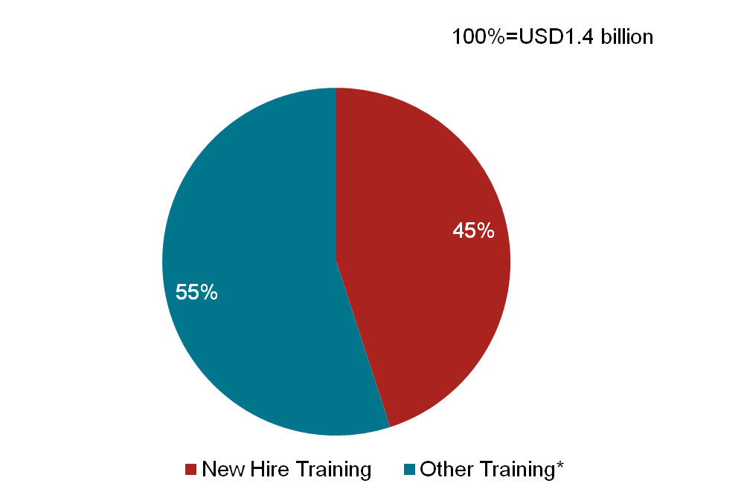
Industry supplementing the Education system
Break-up of Human Capital Management costs
Spend of USD 1.4 billion on training activities in FY09
5% of total annual employee time spent on training; Average training period for new employees – 14-16 weeks
Average training period for existing employees – 2 weeks
45% of training spend on new employees - USD 630 million
Average amount spend on training new employees =USD 4350 - 40% of cost of an average engineering course
* Other costs include training for existing employees, employee welfare, salaries for training staff, training material costs

Slide 12
Emerging as a “Skill Factory” –
Introducing/upgrading new skills
Industry Ready
Language, Process, S&M skills, Research & Analytics
Future Ready
Employment Generation - Urban and Rural
Process and Vertical specialists
IT Services
BPO
ER&D
Domain skills across sectors: BFSI, Healthcare, Retail, Telecom, etc.
Cross-platform skills: SAP, Oracle, Java
Technical skills: Mainframe, Dot net, J2EE, Open Systems, etc
Domain skills: BFSI, Consulting (IFRS), Retail, Healthcare, Telecom, etc.
Customer facing skills: Client interaction, sales & marketing, customer service, voice/accent training, etc
Domain skills across sectors: Aerospace, Automobiles, Energy, Telecom, etc
Services: Plant engineering, Sustainability/Green, Energy, Infrastructure engineering, etc

Slide 13
Infosys’ Technical University:
Developing technical and project management talent
CASE BACKGROUND
Infosys’ Education and Research (E&R) department facilitates company growth through knowledge acquisition, dissemination and management. Research, technical and project management related education programs are conducted for both in-house and strategic customers of Infosys.
PROGRAMS:
Foundation Program: Comprising generic training and stream specific training (like J2EE, Open Systems, Dot net, Mainframe) over 50 to 90 days for engineers selected from campuses:
Long Cycle Program: For freshers with Non-IT background
Fast Track program: For freshers with IT background
Non-Engineering graduates
2) Just-In-Time Training: Courses delivered to employees based on sudden/unforeseen requirements
Project Management CoE: Focused to establish high standard in Project Management through competency development, experiential knowledge sharing and analysis of project excellence
Campus Connect: Partnership with over 470 colleges for providing training in technical and soft skills; also work with policy making bodies such as AICTE to include industry centric electives
Higher Education Scheme: Continuing education through distance learning programs or certification with reputed institutions
Inter-Connect: Align learning programs to realize client requirements , promote competency development through collaboration and involvement of practitioners
E-Learning Programs: TAL (Technology assisted learning) enables individuals to do a self-study of a course on their own, assisted by exercises at beginning and end of each topic. CBTs (Computer based tutorials) are training courses that can run on the PC or be accessed via web

Slide 14
EXL Insurance Academy - Creating
Insurance Specialists
INDUSTRY SPECIFIC TRAINING
IMPACT
EXL’s Insurance Academy – A team of 26 professionals that includes in-house faculty, guest faculty and content developers. These resources are proficient in insurance subjects and have been drawn from the insurance industry in India, the U.S. and the U.K.
ACADEMY OFFERINGS:
Certification programs: Three levels of certification programs (e.g., beginner, intermediary and advanced) through education partners in the U.S. and the U.K.
Specialized trainings: Programs such as Workers’ Compensation, Premium Audit, Dental Insurance, Medical Expense, Medical Billing, Claims Underwriting, Auto and Home Insurance, Commercial Insurance, Reinsurance, Reinsurance Accounting, etc.
Content designing, development, and new-hire training: Designing client training programs, 40 hours of mandatory training for new hires
600 certified to date
2,300 employees covered
12,000 professionals trained across EXL

Slide 15
Key Topics
Past Decade – Employment Facts and Impact
HR’s four levers to build “Future Ready” Organizations
    Sustained Investment in Training
    Opportunities for Career Growth
    Managing People Challenges effectively
    Ensuring Cost Competitiveness
  HR Best Practices and NASSCOM Initiatives

Slide 16




Industry investing in vibrant career growth; retooling employee skill sets
Career Architecture maps
Internal job rotations
Continuous improvement projects
Best practice sharing
GLOBAL EXPOSURE
Cross cultural integration and Best practice sharing
Joint training programs
Cross polarization of project teams
Global compliance group for global integration
DEFINED CAREER PATH
MULTI SKILLING
  Competency Frameworks
    Expertise across end to end industry value chains through job rotations
    Funding/reimbursement of further education; certification programs
    Cross skilling/multi-skilling/up-skilling across technology / platforms / services
BUILDING LEADERSHIP POOLS
Strong domain leadership programs to understand core business functions
Ops, Finance, IT, HR, Commercial Leadership
Rigorous career and succession planning process
Global Leadership Cadre program; shadow boarding; accelerated career path program

Slide 17
Genpact’s Career Development
Framework: Moving up the value chain
Multiple Career Paths based on Skills, Knowledge & Job Interest
Business
Leader
Ops Leader
Manager Ops
AVP SME
Manager SME
Build Operating Leaders
Build Knowledge Leaders
Assistant Mgr
F&A OPs
Assistant Mgr
Subject Mkt Expert
Accounting Mgmt Trainee
Domain Expert Trainee
Process Developers
Skill Level 1
Skill Level 3
Skill Level 2
Skill Level 4
Process Associates
Training & Development Initiatives to Support the Career Path
License to Operate
Training Roadmap for each Employee
Business Rotations & On-the-job experience
F&A Domain Certifications - CFA, GAAP

Slide 18
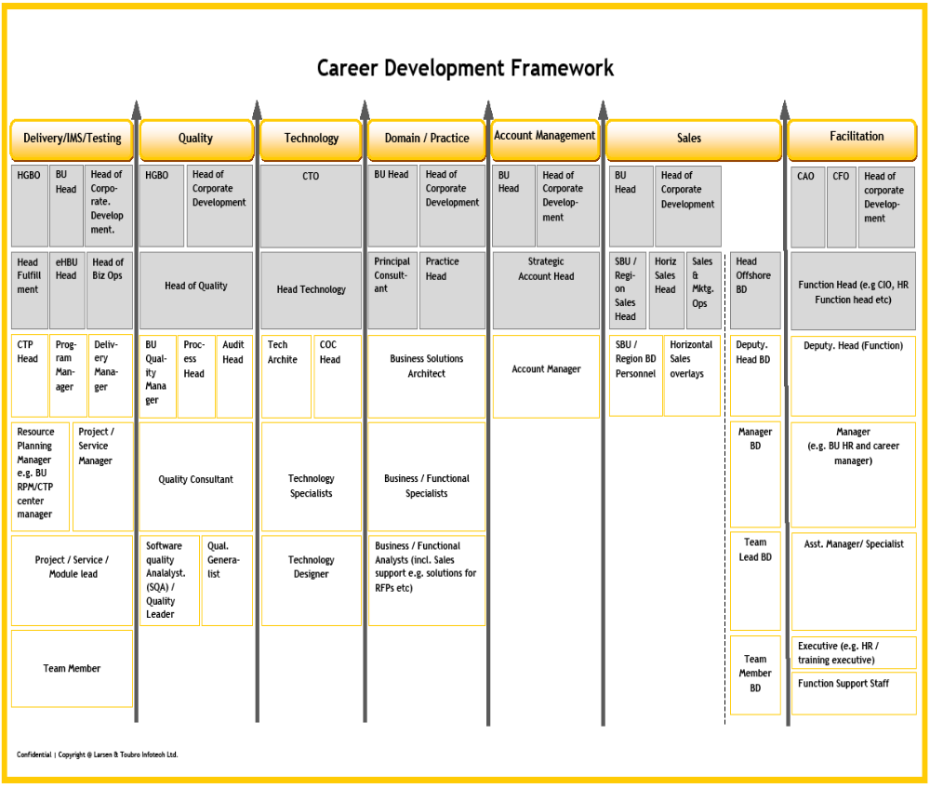



Case Example – L&T Infotech’s Career
Development Framework
  Career Development Framework has Seven career tracks with detailed job descriptions
  Employees design their development plans based on individual aspirations & opportunities available
Career Counselors Mobility: Inter/intra tracks
Competency development

Slide 19
MphasiS’ Aarambh Program – Building leadership from within
CASE BACKGROUND - MphasiS started an employee leadership capability building program- AARAMBH in 2008. Aimed at identifying high potential employees at the entry level and the junior cadre across the enterprise and grooming them for leadership at the middle management level. The program is tailored to support the various business units and functions that exist in MphasiS by coupling a strong framework with unique business constraints and requirements.
For example, in HR, identified individuals spend 5 months each working in 3 different HR functions – from manning the help desk, to background verification and HR line – both learning and delivering on the day to day tasks.. In the last 3 months, the employee is aligned to a function outside HR to get an outside-in perspective so that they can come back and be a better partner to the business.
This is supported by a strong learning deliverable as well, where each employee must complete mandatory learning courses, conduct knowledge sharing sessions and much more.
BENEFITS:
The company has retained 100 per cent of the employees who graduated from this program
Employees had transformed into generalists with a strong functional foundation
Productivity of the employees increased substantially
One of the graduates program managed the mid-year enterprise performance management, process, another helped build the enterprise potential program and yet another drove the migration of the enterprise personnel MIS from one platform to another

Slide 20
Key Topics
Past Decade – Employment Facts and Impact
HR’s four levers to build “Future Ready” Organizations
    Sustained Investment in Training
    Opportunities for Career Growth
    Managing People Challenges effectively
    Ensuring Cost Competitiveness
  HR Best Practices and NASSCOM Initiatives

Slide 21
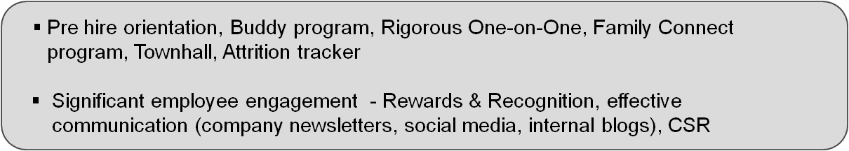
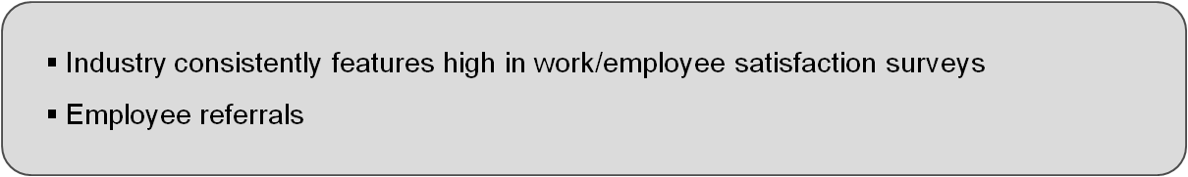
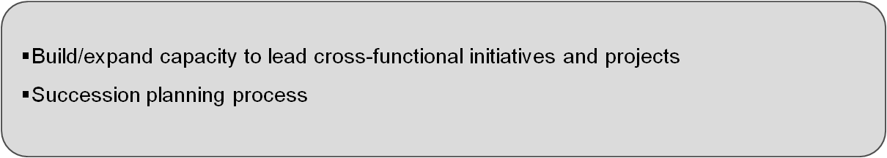
Industry taking significant measures to manage challenges effectively
High Attrition levels
  Monetary benefits: Retention bonus, rewarding meritocracy, ESOP’s
  Non-monetary benefits: Continuous skill development; innovation culture; accelerated growth track, job rotation
Employee retention
Attracting right talent
Leadership pipeline; trained middle management

Slide 22




Employee Engagement – culture that permeates through the organization
Awards to recognise, acknowledge, appreciate and reward employee’s achievement / exemplary Performance
Cross-functional groups for projects
Group activities –sports / arts / music
Leadership interaction
Education, Green IT, health, rural development, upliftment of women and children, etc
Company newsletters
Social media
Internal blogs
Steria
Individuals: Pat on the Back Award, Star Performer Award, Long Service Award, Star of the Month Award, Instant Recognition and Special Awards, etc
Teams: Star Team Award and Team Award
Mahindra Satyam
Game Changers: To identify key Associates to lead transformation journey
Leadership & Location Councils: Empowerment and distributed leadership for decentralized and quicker decision making
Rainmakers: Sales Associates get-together to share notes on business , market development, etc
IBM Daksh
E.X.I.T.E. camps: For girl students to take up science as a career , thus enhancing the resource pool
S.T.E.M. camps: To encourage children with special needs to take up science & technology as a career. They go through a 5-day camp and year-long mentoring by employees
Mahindra Satyam
Lets Talk: Leadership & HR connect sessions with offshore and onsite emps
CEO Blog: Communicates with employees; also seeks ideas / views and opinions on various topics
Q Zone: Employees can raise a concern or provide constructive suggestions on key processes

Slide 23

Mahindra Satyam – Using Innovation as a retention tool
Strategize
Seeing Opportunity
Transform
Investments in Innovation
Realize
Innovation Rollout
Innovation for Excellence Award: Organization wide Innovation contest to generate novel ideas; Senior leaders act as Mentors
Investment Council: Forum which evaluates and invests
in new ideas
Shadow Board: Encourages young leaders to give innovative ideas by involving them in strategic planning
Recommends specific proposal to CEO and COO
Oversees and monitors progress on approved investments
Futurus – for co invention with customers
BI innovation lab with the Economic Development Board Singapore
Competency CoEs – created with Alliance partners for various horizontals (SAP,
Oracle, BI, CPM, IES) and Verticals (Aero, BFSI, Mfg)
Mobility labs in collaboration with CanvasM
Engineering Validation Lab
Customer specific
innovation lab
iDecisionsTM: BI Framework which was enhanced based on a Grant by Govt of Singapore, based on license sale of analytical applications
Engineering Lab: Design and prototype development of beverage dispenser for an F&B major
Oracle Delivery Express: "Delivery XPress" offers its ERP customers a rapid execution tool with accelerators to support different service offerings
World Cup 2010: Built the first web based, integrated, scalable, reusable Event Management System for FIFA; designed and built the Team Services product being used for
a first time at the World Cup

Slide 24
Key Topics
Past Decade – Employment Facts and Impact
HR’s four levers to build “Future Ready” Organizations
    Sustained Investment in Training
    Opportunities for Career Growth
    Managing People Challenges effectively
    Ensuring Cost Competitiveness
  HR Best Practices and NASSCOM Initiatives

Slide 25
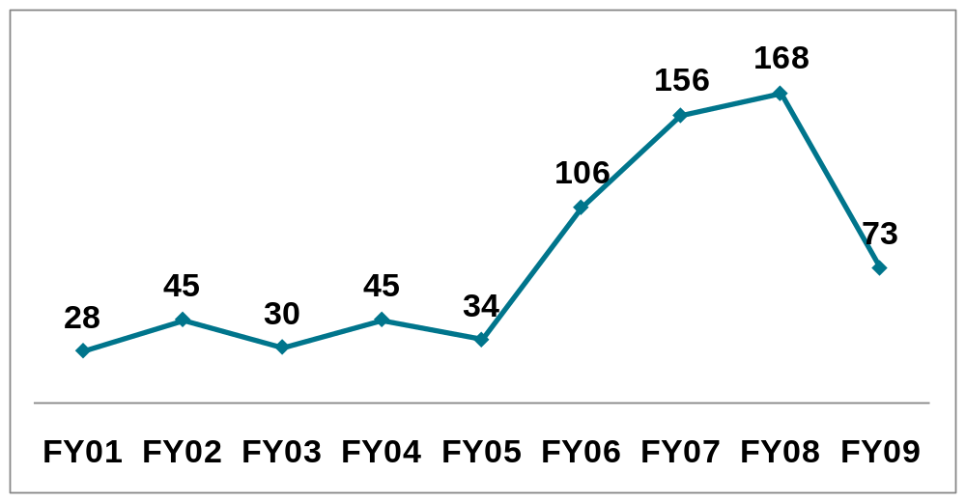

HR pivotal in maintaining Industry’s
cost competitiveness
Annual Incremental engineering fresher addition, ‘000, FY01-09
Hiring Fresher's
  Average Fresher to lateral ratio – 70:30
Just-in-time hiring
Build vs Buy
Hiring from Tier 2/3 cities
Alternative talent pools – increasing ratio of non-engineers
Cumulative fresher addition (FY01-09)
  IT- 684,000

Slide 26
Improving access to potential hires – Targeting tier 2/3 cities
As part of its hiring strategy, Genpact has been sourcing talent from tier-2 and tier-3 locations through its “Storefronts”
Genpact’s “Storefronts”
Spread across 20 cities including:
Bhubaneshwar
Chandigarh
Cochin
Indore
Jamshedpur
Lucknow
Candidates walk in directly for interviews
Candidates found fit are hired on the spot
Candidates also gain information about Genpact’s business
Contributes 20% of hires

Slide 27
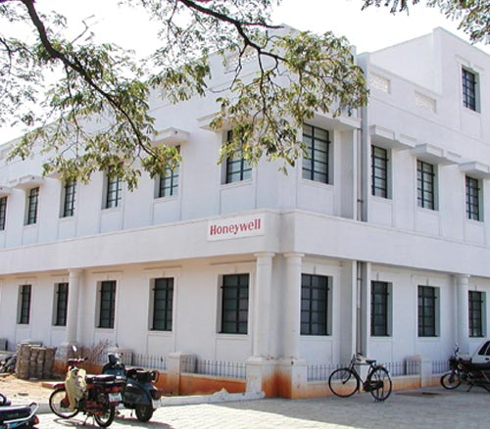
Honeywell Technologies: Leveraging
Madurai for Engineering talent
Honeywell campus, Madurai
~ 20 engineering colleges in and around Madurai
Strategically located in Tamil Nadu in close proximity to many engineering colleges
Honeywell has set up a development centre in Madurai due to availability of a large engineer base. It provides development work for various projects in aerospace and automation and control solutions.
It also imparts training to engineering professionals in the core areas and technologies that are in use in Honeywell products and businesses.
HTSL Madurai has established relations with regional engineering colleges so as to have a pipeline of competent engineering professionals

Slide 28
Key Topics
Past Decade – Employment Facts and Impact
HR’s four levers to build “Future Ready” Organizations
    Sustained Investment in Training
    Opportunities for Career Growth
    Managing People Challenges effectively
    Ensuring Cost Competitiveness
  HR Best Practices and NASSCOM Initiatives

Slide 29
Industry Best Practices
Insist on Relieving Letters
Ethical Hiring
Campus Hiring in 8th semester
Support reference checks and mandate background checks
Check on non-compete agreements from customer contracts
Service Notice Period with previous employer
Discourage frequent job-hoppers (less than 6 months)
Partnership with Executive Recruiters Association to follow similar practices.

Slide 30
NASSOM initiatives – broad based and aligned to Industry aspirations
Short Term (0-12 months) | Medium Term (12-24 months) | Long Term (24 months onwards)
Finishing Schools: Focus on soft skills and domain competencies and certifications and assessments NAC, NAC-Tech | Finishing Schools, Establishing New IIIT - Phase I Vocational Skill Development NAC, NAC-Tech | Establishing New IIIT-Phase II Scaling up PhD program Vocational Skill Development NAC, NAC-Tech
Industry-Academia Faculty mentorship programs (CSR) | National Faculty Development Program Industry-Academia Faculty mentorship programs (CSR) | National Faculty Development Program
Education Web of Collaboration Research Study Participation in Key Government policy Initiatives (NKC) & (NSDM) etc Events (Forums, IT Seminars, Summits) | Education Web of Collaboration Participation in Key Government policy Initiatives | Education Web of Collaboration Participation in Key Government policy Initiatives
STUDENTS
FACULTY
OTHERS

Slide 31
Thank You

