Slide 1
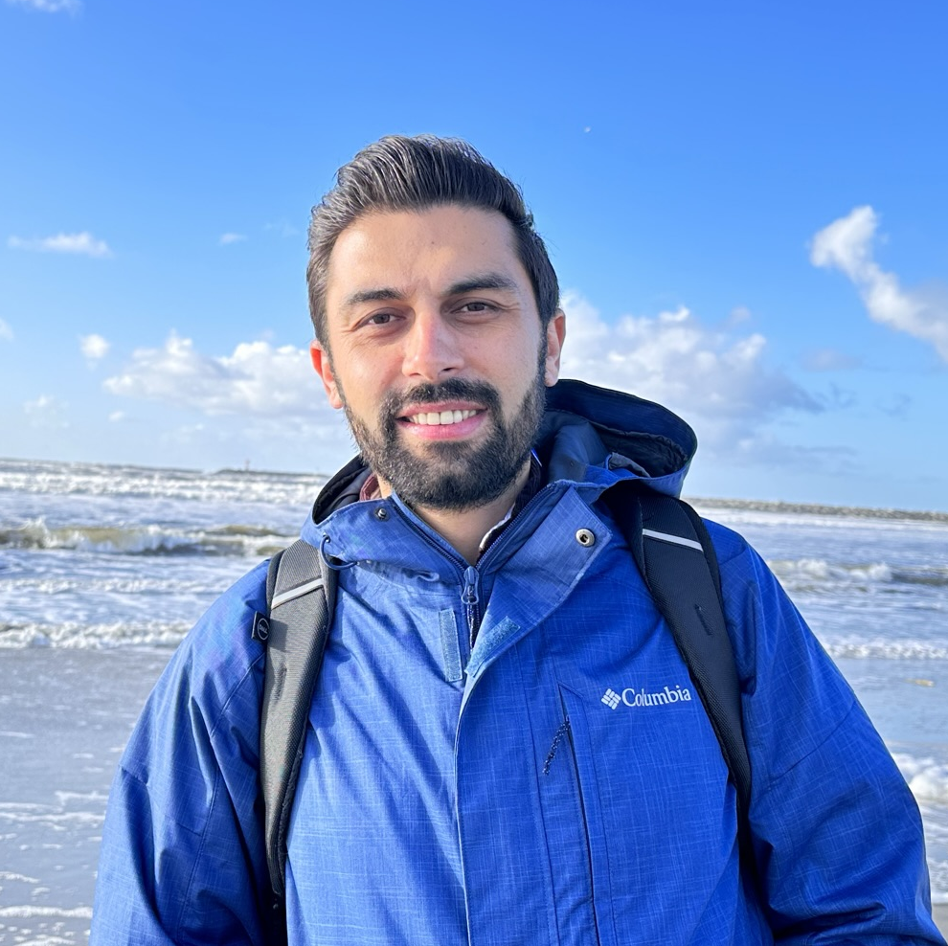


















YASIN TOPCU
470-3282021
@zmyasintopcu
yasin-topcu-67072379
● Plant Breeding ● Genetics ● Genomics
● Bioinformatics ● Statistics
yasin.topcu@uga.edu
yasin-topcu.github.io
ABOUT ME
Enthusiastic and passionate plant breeder with specialization in tomato breeding, genetics and genomics and over six years of extensive experience in breeding, QTL mapping, molecular marker development, high throughput genotyping, gene cloning, and computational analysis. Skilled in utilizing traditional and cutting-edge breeding tools and techniques to develop improved and adaptable crops. Proficient in molecular genetics and genomics, as well as proven track record of delivering quick and efficient results. Excellent communicator, able to collaborate with diverse teams and effectively communicate complex scientific concepts. Excellent team player. A strong leader with ability to motivate and inspire teams, manage conflicts effectively, and promote a positive work environment. Committed to continuous personal and professional growth and possess a strong work ethic and positive attitude.
BIO
Birth Date
01 January 1989
Nationality
Turkish
Location
Athens, GA, USA
Language
English, Turkish
EDUCATION
RESEARCH EXPERIENCE
2017-2021
University of Georgia
Postdoctoral Research Associate
Ph.D. Institute of Plant Breeding, Genetics and Genomics Athens, GA, USA
Center for Applied Genetic Technologies, UGA
January 2022- Present
Supervisor: Dr. Esther van der Knaap
2017
University of Alabama
Graduate Research Assistant
Intensive English Program (IEP), B2/C1 English level
Institute of Plant Breeding, Genetics and Genomics, UGA
August 2020- January 2022
Supervisor: Dr. Esther van der Knaap
2012-2015
Akdeniz University
M.Sc., Horticultural Science
Summer Internship
2008-2012
Akdeniz University
Kibbutz Elifaz, Eilat, South District, Israel
June 2010- August 2010
B.Sc., Horticultural Science
SKILLS
FELLOWSHIP
R programming
Linux programming
Graphic designing
Big data and WGS
QTL mapping
GWAS and GBS
Diversity analysis
RNA/QTL seq
Tissue culture
CRISPR/Cas cloning
Genotyping
Marker designing
Scientific writing
Web designing
Microsoft office
The John Ingle Innovation in Plant Breeding Award 2019
YLSY International Graduate Education Scholarship issued by Ministry of National Education (Turkey) · Jul 2015
MSc scholarships issued by European Cooperation in Science & Technology 2012-2015
AWARDS
2nd place, Poster competition, 2018 IPBGG Retreat
European Cooperation in Science & Technology Travel Award 2014
Valedictorian Award: Issued by Akdeniz University, Faculty of Agriculture, Department of Horticulture · Jun 2012
PUBLICATIONS
REFERENCES
HOBBIES
Please visit:
https://yasin-topcu.github.io/publications/
To be provided upon request

