Slide 1

Alkaram Bakers Website
Fresh cakes, pastries and sweets, ordered online from Karachi
Notes:
Welcome. This presentation shows the finished Alkaram Bakers website: what customers see, how ordering works, and what is left to do before it goes live.

Slide 2



A complete online bakery on one page
33
5
12
Rs. 2,000
menu items
menu categories
page sections
free delivery from
Working shopping cart
Items are saved in the browser and totals update instantly.
Menu and gallery filters
Visitors show one category at a time.
Works on phone and desktop
The layout adapts from a laptop screen down to a phone.
Built with HTML, CSS and JavaScript, plus Bootstrap 5. No server or build step is needed.
Notes:
The site is one page with twelve sections. It has no backend, so it can be hosted anywhere. The free delivery threshold of Rs. 2,000 is applied automatically in the cart.

Slide 3
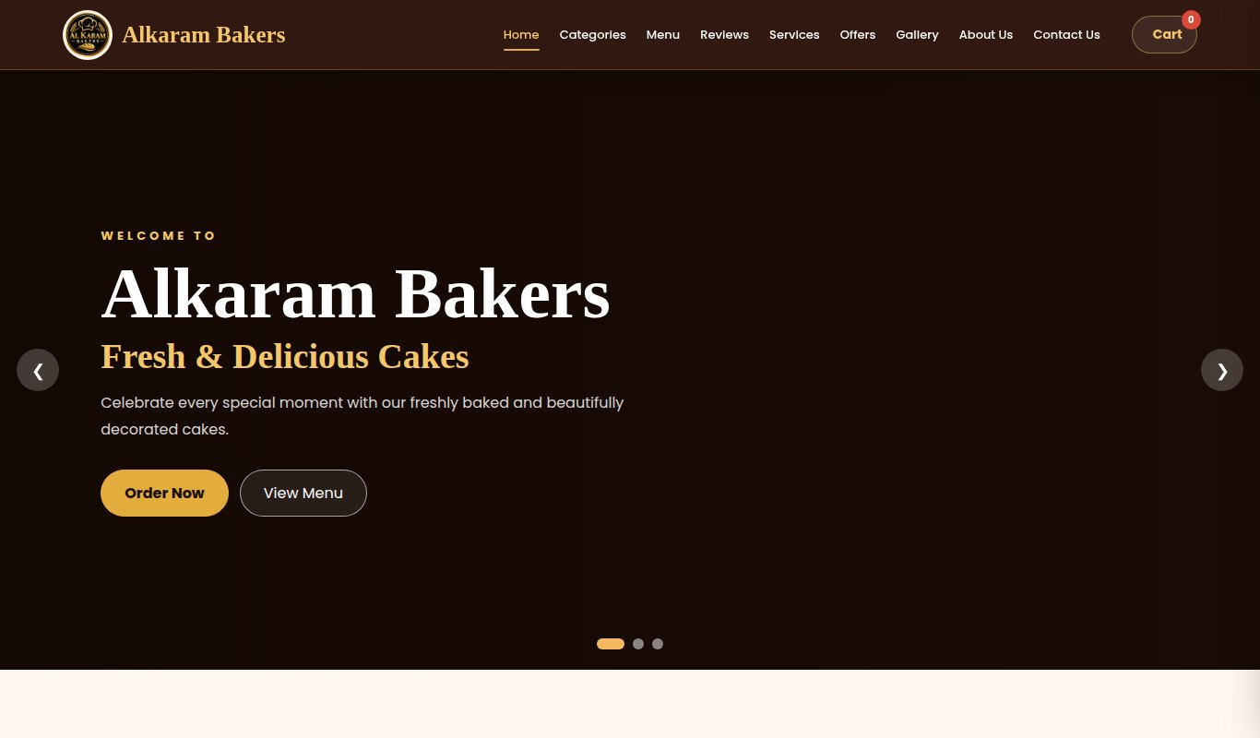
Home page: first impression
Sticky navbar
Stays on screen and highlights the section you are in, with the cart always one tap away.
Three-slide hero
Changes every 5 seconds. Order Now goes to categories, View Menu goes to the menu.
Clear next step
Every slide has two buttons, so a visitor never has to hunt for how to order.
Photos load from the internet on the live site and show as the logo here.
Notes:
This is the top of the page. The navbar, hero slider and the two call-to-action buttons are all working. Product photos need internet, so in this screenshot they appear as the logo.

Slide 4
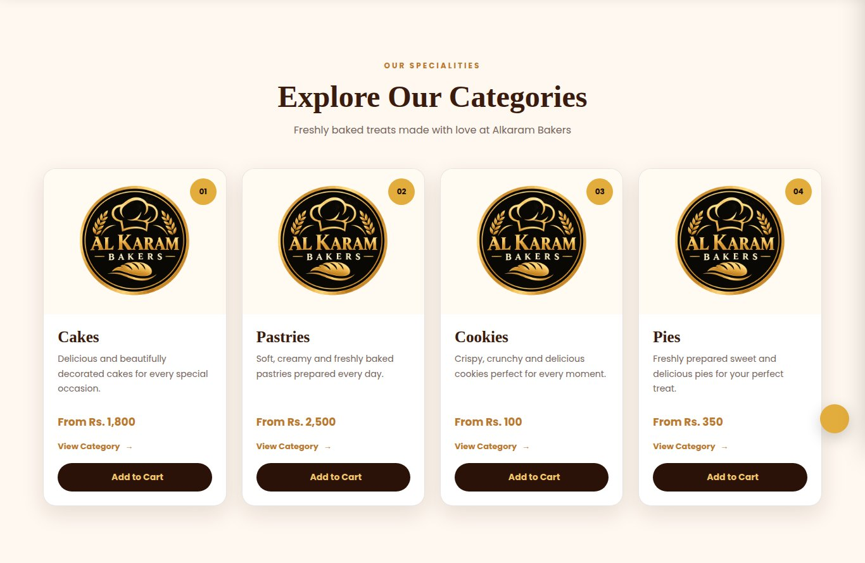
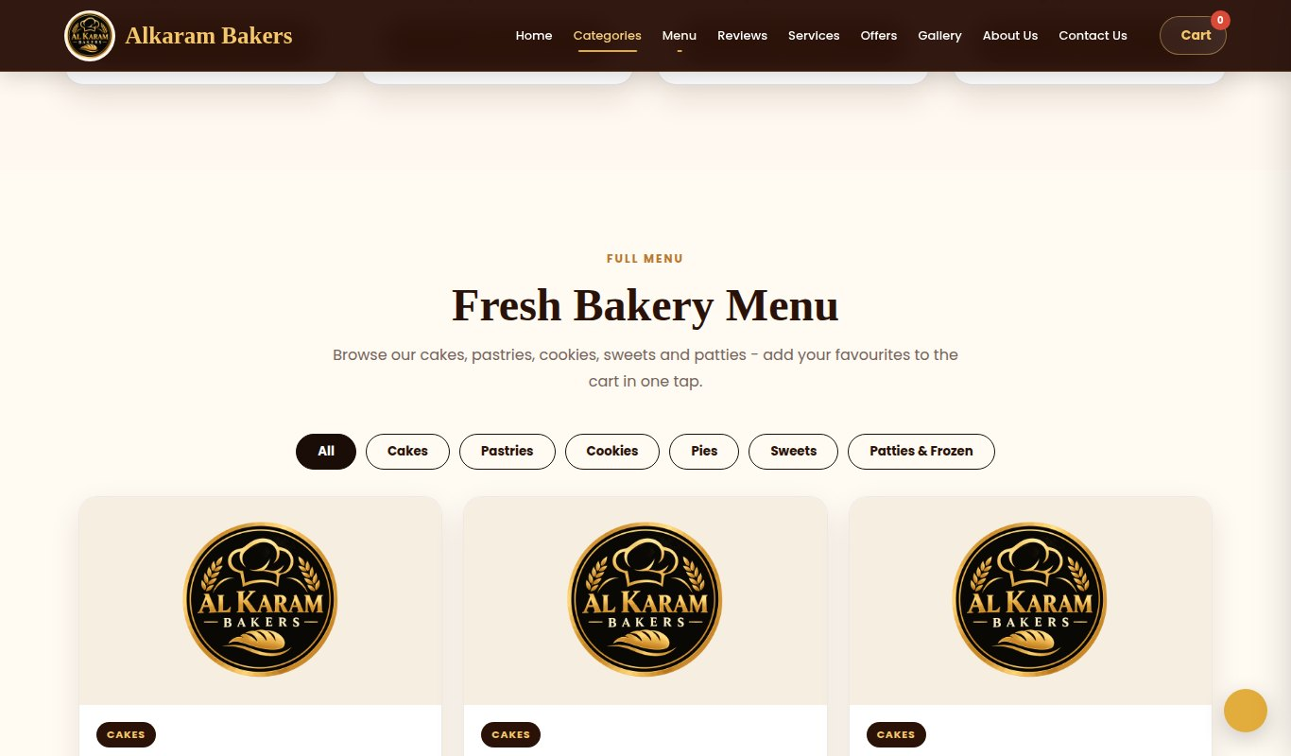
Browse by category or the full menu
Four category cards with starting prices and Add to Cart
Menu with filter buttons. Each item has its own Add to Cart
Starting prices on the category cards now follow the real menu prices.
Notes:
Visitors can start from a category card or go straight to the menu. The View Category link jumps to the menu with that category selected. Pies has no items yet, so it shows a message asking visitors to contact the bakery.

Slide 5
The menu in numbers
Cakes are 27% of the menu. Pastries all cost Rs. 2,500, and sweets and patties all cost Rs. 100.
Notes:
Left: cakes have nine items and every other category has six. Right: lowest and highest price in each category. If the flat prices are not the real prices, edit data-price on each item in index.html.

Slide 6
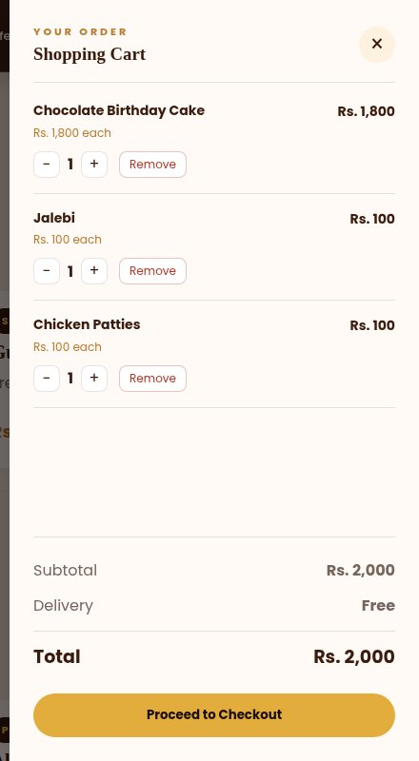
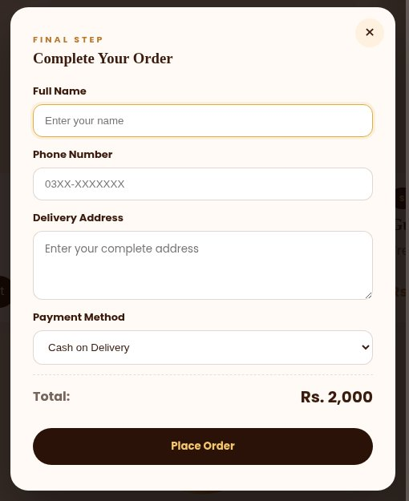
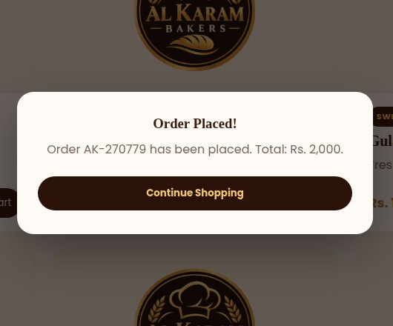
From cart to confirmed order
Cart: quantity controls, delivery and total
Checkout: name, phone, address, payment
Order placed with an order number
Delivery is Rs. 150, and free when the subtotal reaches Rs. 2,000.
Notes:
In this example the cart total is exactly Rs. 2,000, so delivery shows as Free. The cart is saved in the browser, so it survives a refresh.

Slide 7

How an order flows
1
2
3
4
5
Add to cart
The visitor taps Add to Cart and the drawer opens.
Delivery added
Rs. 150, or free from Rs. 2,000.
Checkout
Name, phone, address and payment method.
Place order
The order gets a number such as AK-270779.
Send on WhatsApp
The order opens in WhatsApp for the visitor to send.
One setting decides whether you receive orders
Add your WhatsApp number to SETTINGS in script.js. Without it, an order is saved only in the customer’s own browser.
Notes:
The most important thing to set before launch is the WhatsApp number. Format: country code plus number, with no plus sign or spaces, for example 923001234567.

Slide 8
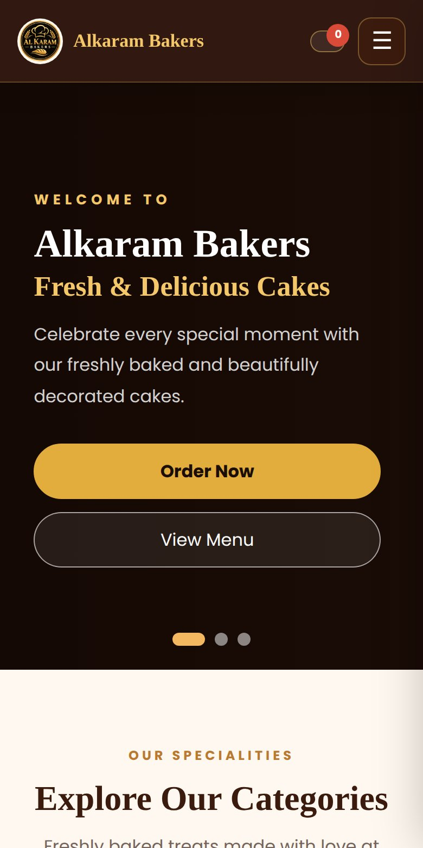
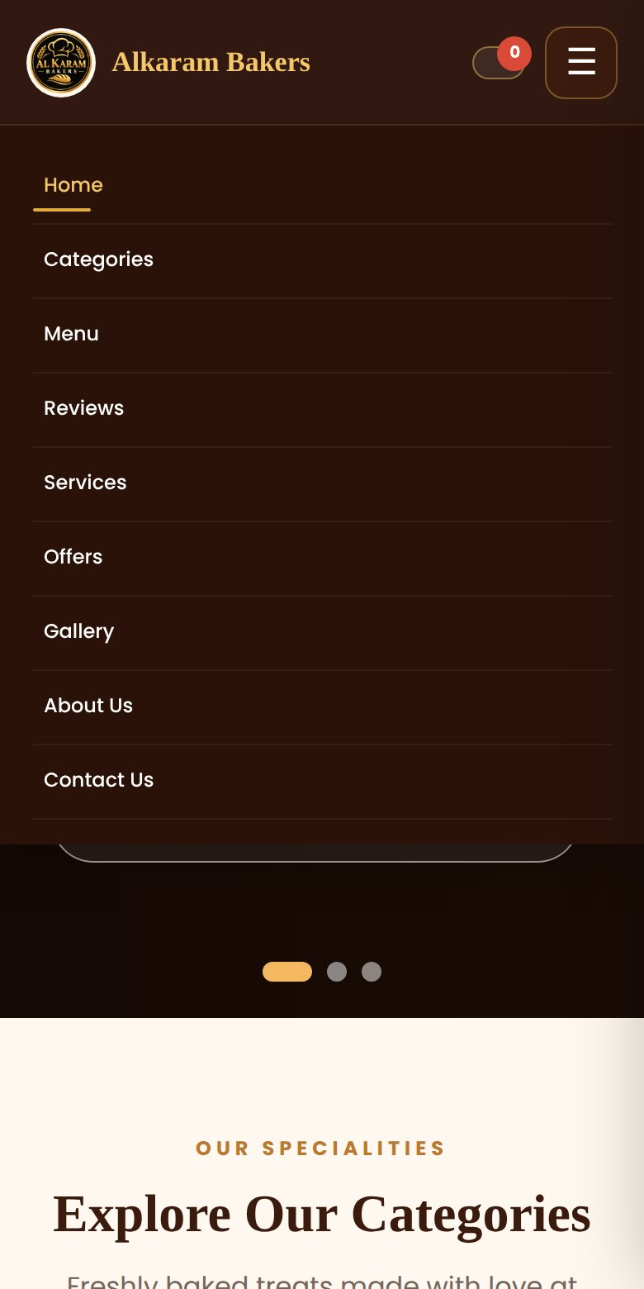
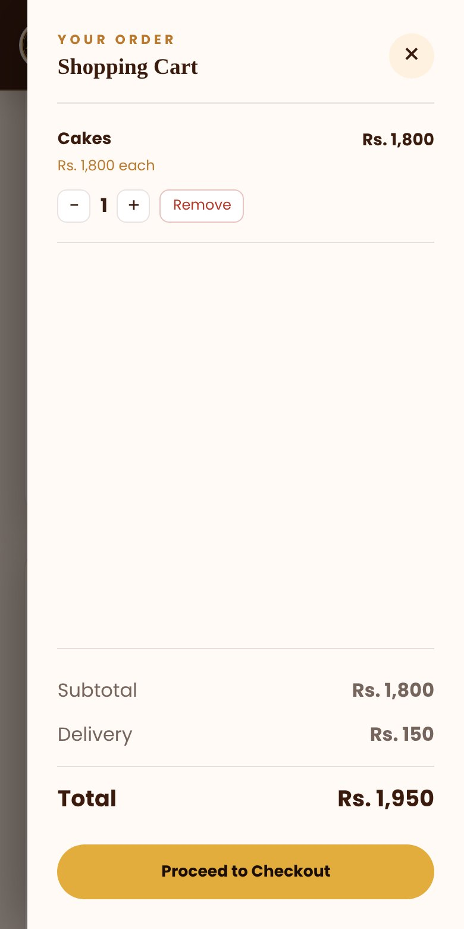
Works on phones too
Hamburger menu
The navbar collapses into one tap on small screens.
One column
Cards stack so every product photo and price stays readable.
Full-height cart
The cart drawer fills the screen and keeps Checkout in reach.
Notes:
Below 992 pixels wide the layout switches to the phone version. Most bakery customers will order from a phone.

Slide 9


What was fixed
Cart price bug
Two cakes with the same name were merged at the wrong price.
Free delivery
The Rs. 2,000 offer was never applied. Now it is.
Checkout popups
They had no styling and sat open at the page bottom.
Add to Cart buttons
Category buttons were plain browser buttons. Now styled.
Menu filters
Pies no longer blanks the menu, and the menu has its own filters.
Broken links
Five sitemap links and the hero View Menu button now go to the right place.
Notes:
These were the main problems found when the original files were reviewed. Everything was tested in a browser: cart, checkout, filters, the mobile menu and the sitemap links.

Slide 10
Five updates before going live
Phone number Replace 03XX-XXXXXXX in the contact section and the Google data.
WhatsApp number Set it in script.js so orders reach you.
Product photos Save your own photos in the images folder instead of web links.
Prices and item count Check the flat prices, and fix "50+ items" against the 33 on the menu.
Social links Point Instagram, Facebook and X to your real pages.
Thank you
Notes:
After these five updates the site is ready to upload. Then submit sitemap.xml in Google Search Console.

