Slide 1
IBM Capstone
What is the best place to open a restaurant in Canberra, Australia?

Slide 2

Business case
To find a suitable location to open a restaurant in the city of Canberra in Australia

Slide 3
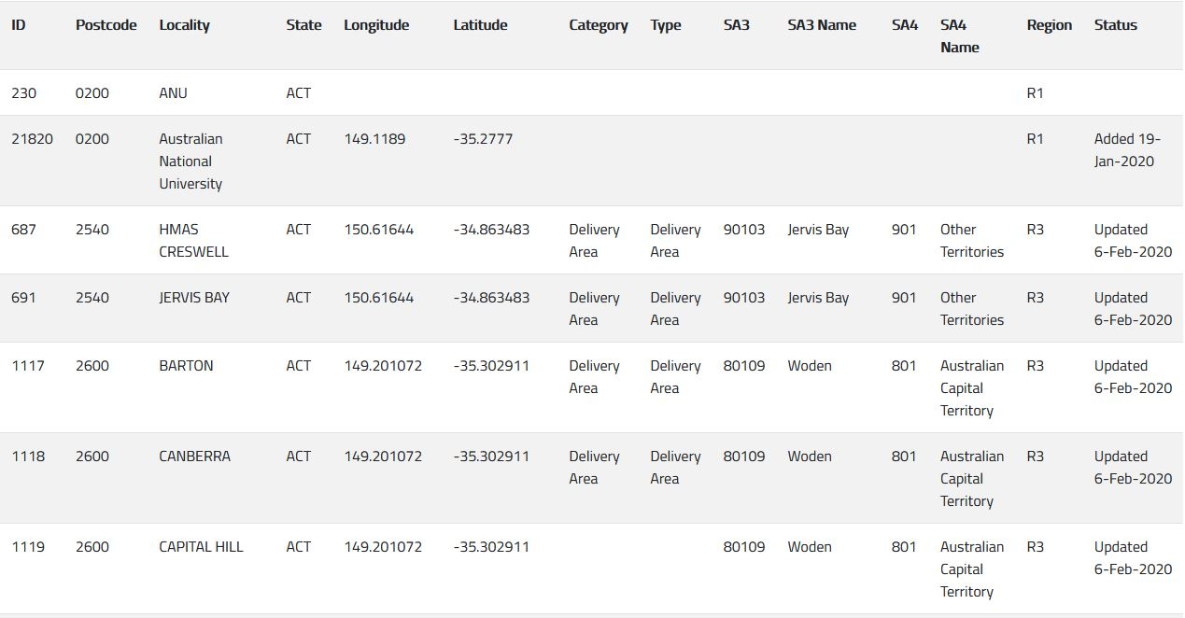
Data sources
Mathew Proctor postcode dataset
Foursquare API

Slide 4
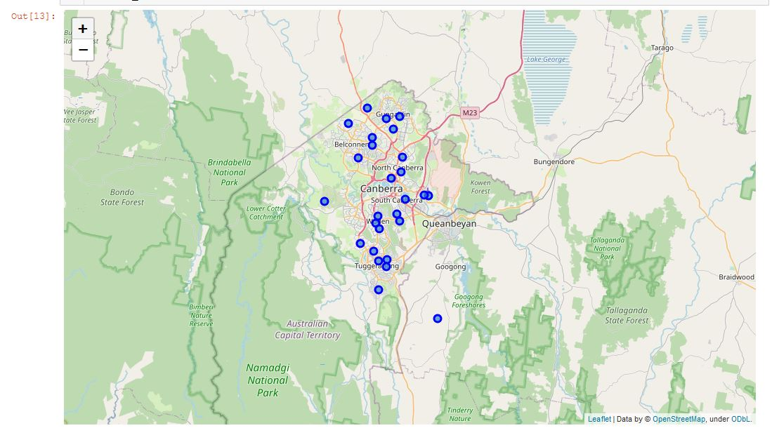
Methodology
The image to the left shows a map of all areas by their postcodes. This was generated through the Mathew proctor dataset and folium
Utilise the K-means clustering algorithm to group all postcode areas in Canberra by the make of venues

Slide 5
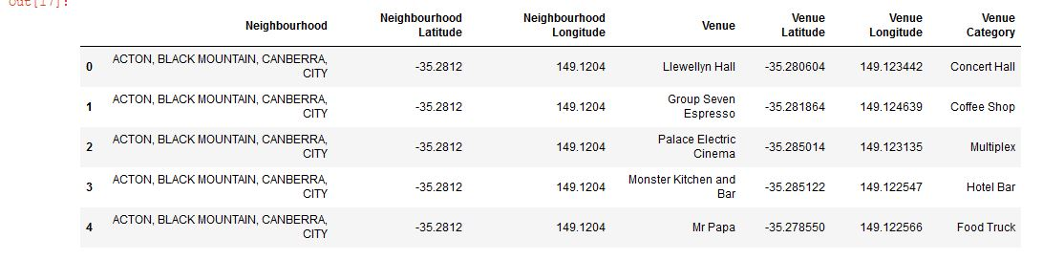
Foursquare usage
Foursquare is used to retrieve all venues in each postcode

Slide 6
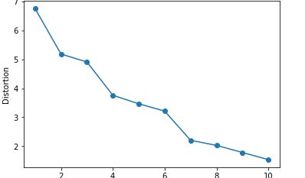
K-means clustering
K-means clustering is an unsupervised machine learning algorithm which is used to group datapoints together into clusters of similar qualities.
K represents the number of centroids for data sets to be grouped into
The optimal value for K depends on the size of data and its variation. The optimal value can be found through the elbow method shown to the left. In this case, K should be 6.

Slide 7
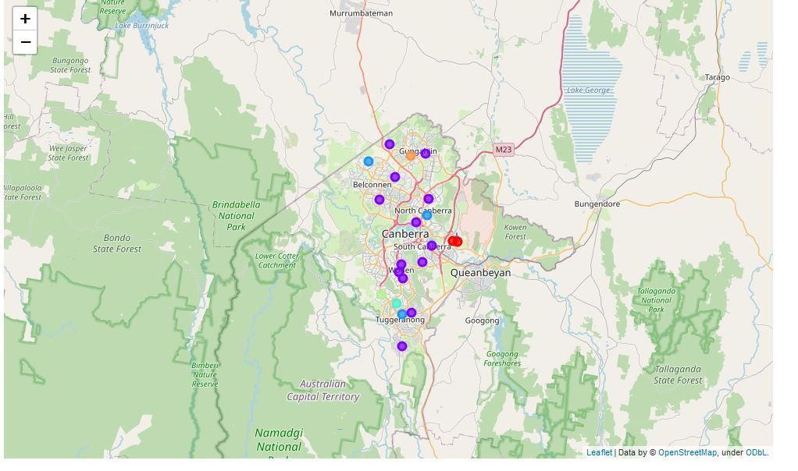
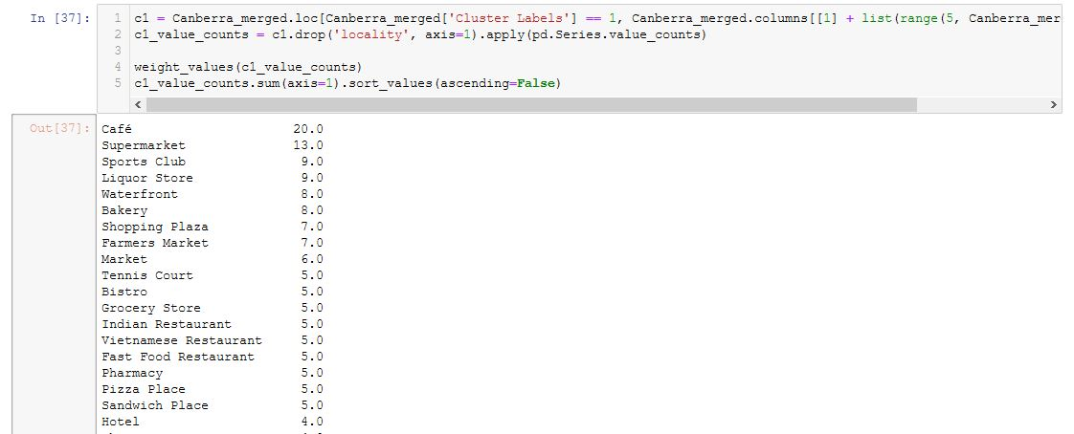
Results
Cluster 1 (Purple)

