Slide 1



Slide 2

MFCC Feature Extraction
Project Members
Fırtına Hüseyin GÖKTAŞ
Göktuğ SARAY
Hacı Ali SAYAR
Ömer Osman DEDE
Yasin ALPTEKİN
Lecturer
Prof. Dr. Ömer Nezih GEREK

Slide 3

Steps for Feature extractıon ın speech recognıtıon
Pre-emphasis
Framing
Windowing
|FFT|
Cepstral lifting
Mel-Cepstrum
Delta cepstrum

Slide 4
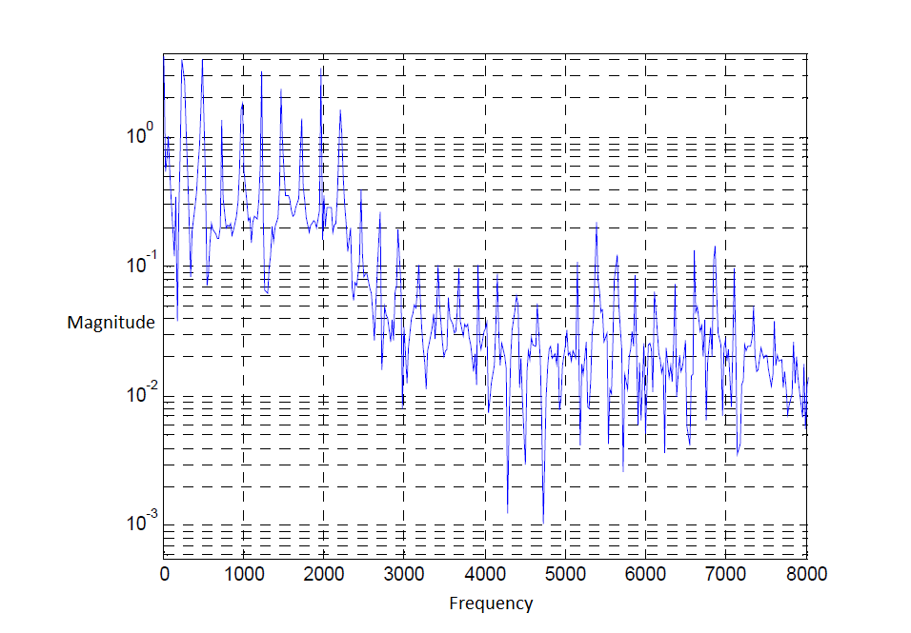
Pre-Emphasis
Lower frequencies
To eliminate
Uses the FIR filter

Slide 5
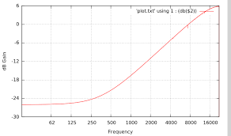
Human speech has low pass structure.
To perform pre-emphasis, we choose some value α between .95 and .97. Then each value in the signal is re-evaluated using this formula:
H(z) = 1 – az⁻¹
This filter named as pre-emphasis filter.

Slide 6
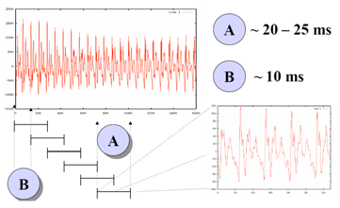
Framing
Signal divides the specific time part
for signal stabilizing
20-30 ms frames are better.

Slide 7

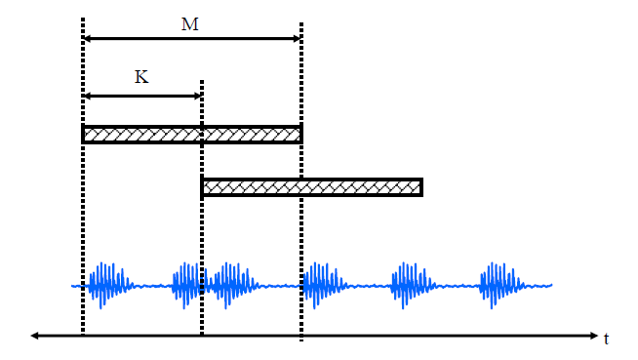
M --- >framing duration.
M-K → overlap region
K ==== ~~>10-15 ms.
M is excessive => unable to tracking on spectral changing
M is small => unable to achieve harmonic values.

Slide 8
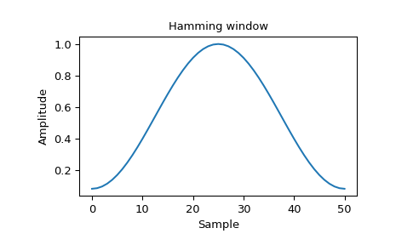
Windowing
Signals multiply with a windowing function as w(n) on the time domain.It’s named as windowing.
windowing eliminates discontiunity
Hamming windowing function.
w(n)=0.54-0.46cos(2πn/N-1)

Slide 9
FFT
s(n)=e(n)*h(n)
Use to achieve the cepstrum values.
Speech signal =
input excitation signal + response signal of the system.
Top is in the time domain.
Bottom is in the frequency domain.
S(w)=E(w)H(w)

Slide 10
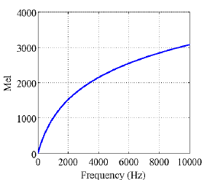
Mel - Cepstrum
MEL
percerved frequency of a tone
Fmel = 1127 ln ( 1 + (f hz/700))

Slide 11
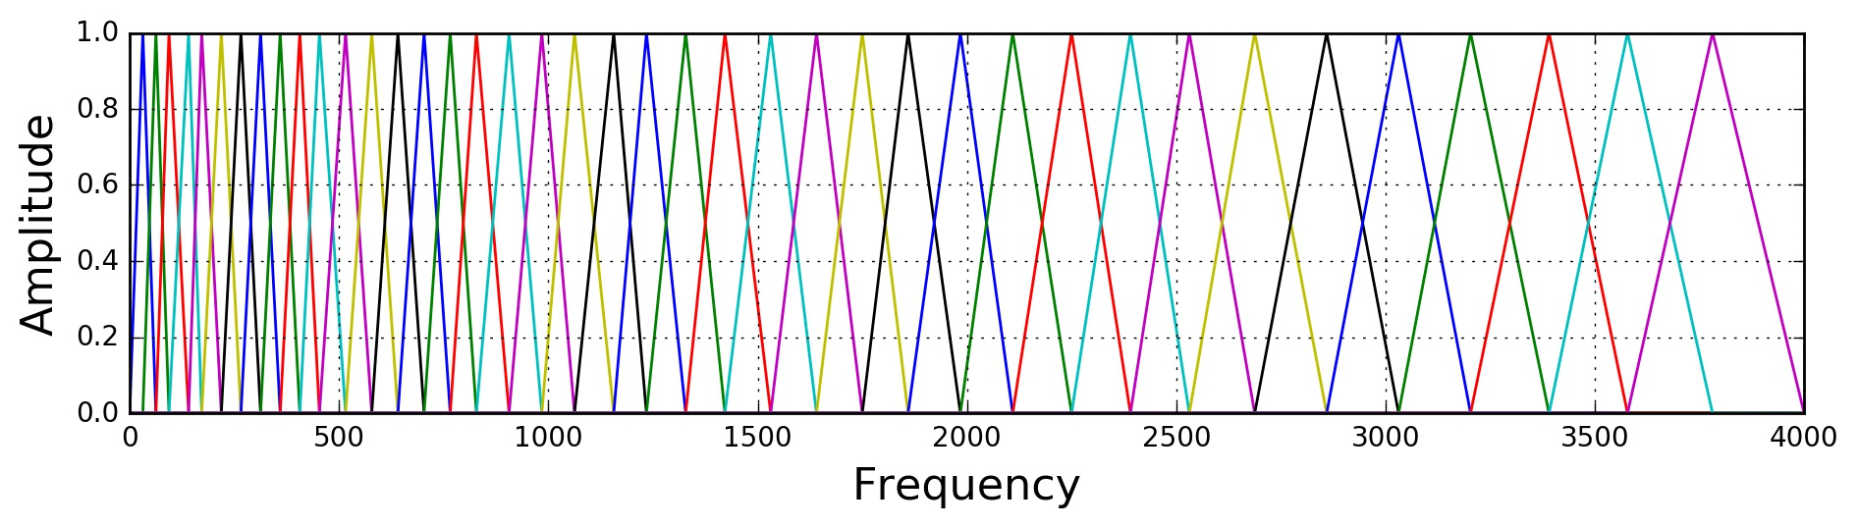
Mel Filter Bank
Apply on
Mel-scaled power spectrum
=~40
To extract frequency bands

Slide 12
Logarithm
s(n)=e(n)*h(n)
Speech signal =
input excitation signal + response signal of the system.
Top is in the time domain.
Bottom is in the frequency domain.
S(w)=E(w)H(w)

Slide 13
|S(w)|=|E(w)|.|H(w)|
WE GOT S(W) VALUE.WHAT FOR IT USES?
If logarithm implement on the formula then we can separate the values as a sum.
Log|S(w)|=Log|E(w)| + Log|H(w)|

Slide 14

The separation can be done by taking IDFT of the linearly combined log spectra of excitation and vocal tract system components.
c(n)=IDFT(log|S(w)|)=IDFT(log|E(w)|+log|H(w)|)

Slide 15
Low-time liftering
Liftering
Vocal tract
Liftering operation is similar to filtering operation in the frequency domain
High-time liftering
excitation

Slide 16
MFCC
Mel Filter Bank
Highly correlated
Take Discrete Cosine Transform
=~12
Use some of them

Slide 17
Thanks for your attentions!
References:
https://haythamfayek.com/2016/04/21/speech-processing-for-machine-learning.html
HTK Book , Steve Young , Gunner Evermann
Otomatik konuşma tanıma algoritmalarının uygulamaları , Köksal Öcal
Introduction to Speech Processing , Ricardo Gutierrez-Osuna
https://searchcrm.techtarget.com/definition/speech-recognition
aclweb.org/anthology/D18-2016
…..

