Slide 1
masterfrıdge
Team members
Yasin gökçe şahin 201511210
Eyüp can Turgut 201411062 BEEBUDDIES

Slide 2
Descrıptıon
The purpose of our application is to facilitate the process of selecting food for housewives and singles at home. Imagine a system that tells you what you can do according to the materials in your fridge; for example, if you have eggplant, pepper, onion, garlic, tomato and tomato paste, your fridge will offer you to cook şakşuka. The user chooses what kind of meal to prepare and the program presents recipes according to the ingredients in the fridge.

Slide 3
Functıonal requırements
This application can work on PC.
Every user can input their own foods on their fridges.
When the application is installed, users can create their own accounts.
Users shall be able to display recipes without registering.
Users who are enrolled can choose any categories between breakfast, lunch and dinner.

Slide 4
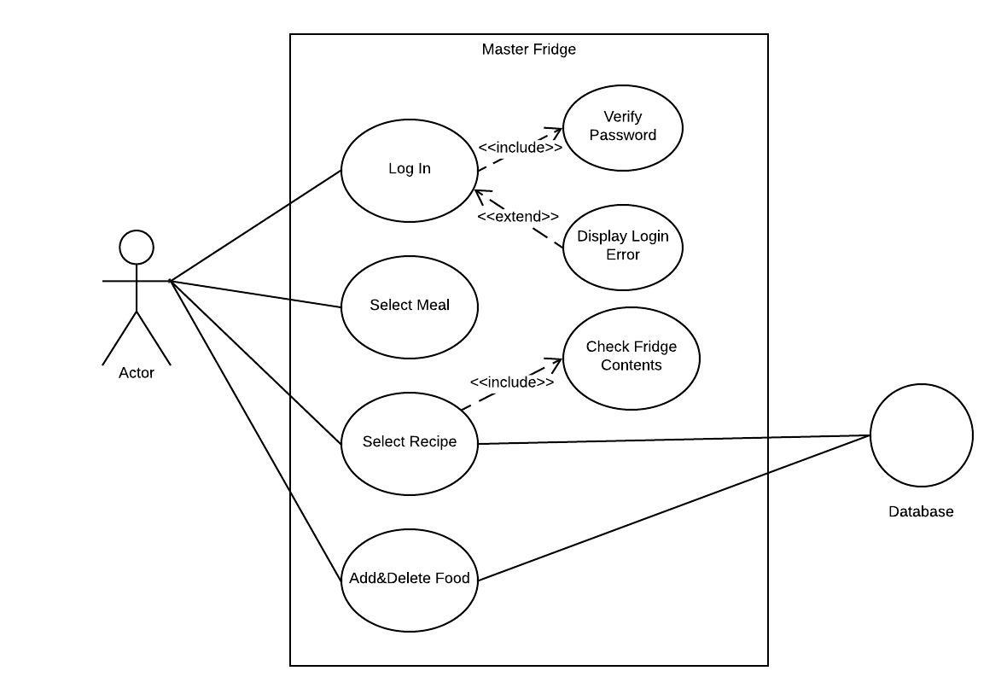
USE CASE MODEL

Slide 5
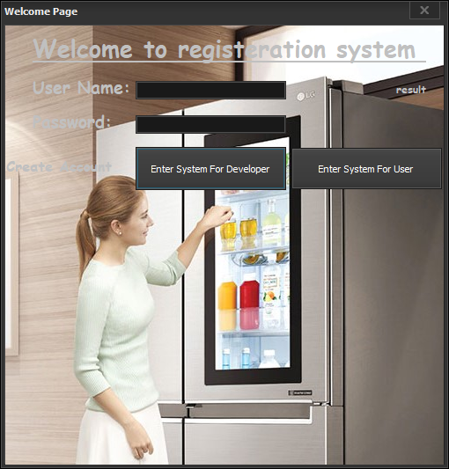
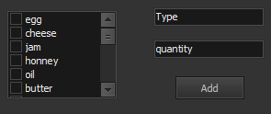
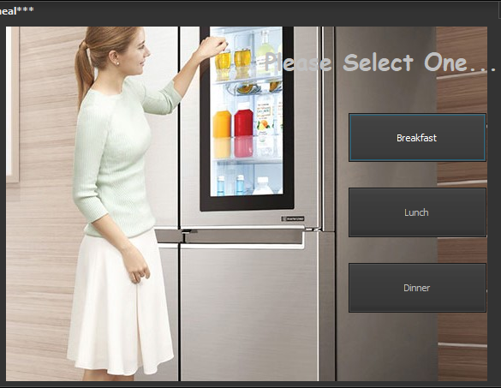
Subsystems
Log-In
Add/Delete Food
Recipes

Slide 6
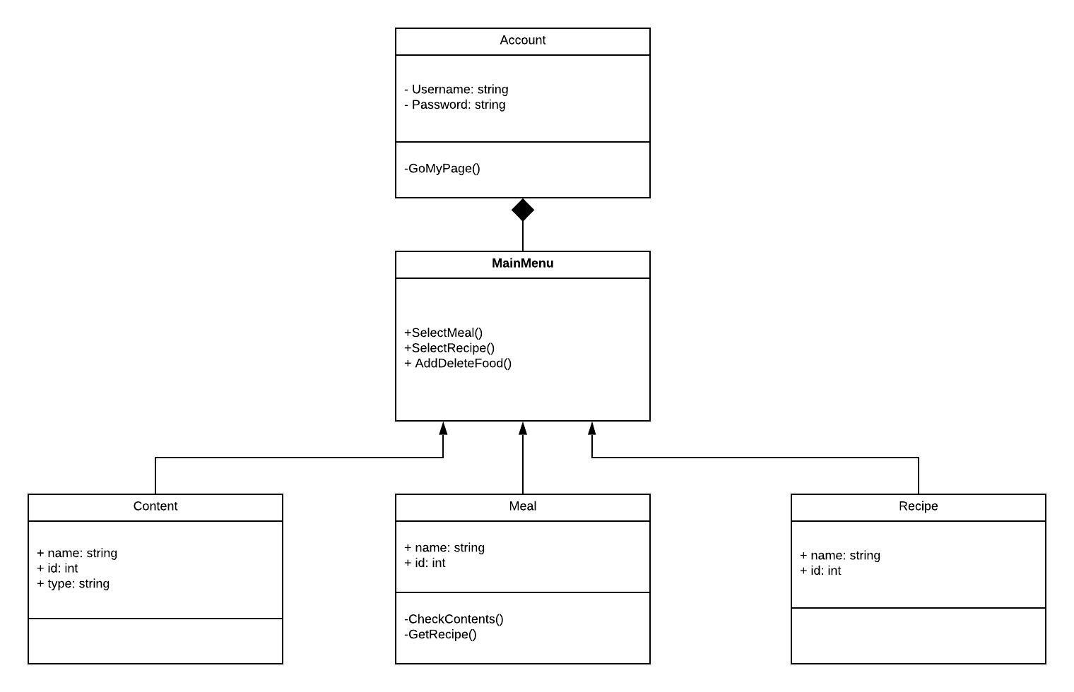
CLASS DIAGRAM

Slide 7
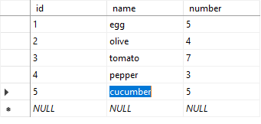
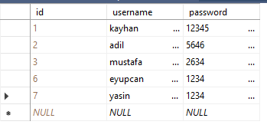
Databases
Users
Foods

Slide 8
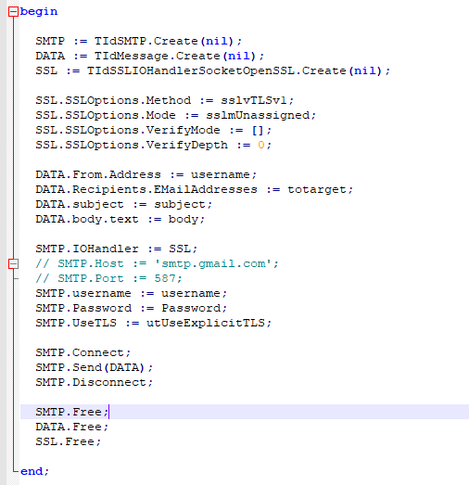
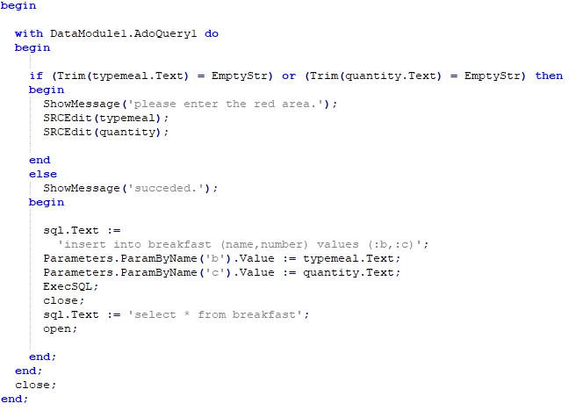
Code examples
Registering
Meal

