Slide 1


CyberSight DW
A Multi-Backend Data Warehouse for Cybersecurity Threat Intelligence
IKT553 Project Demo
Yasin Hessnawi
22.04.2026

Slide 2
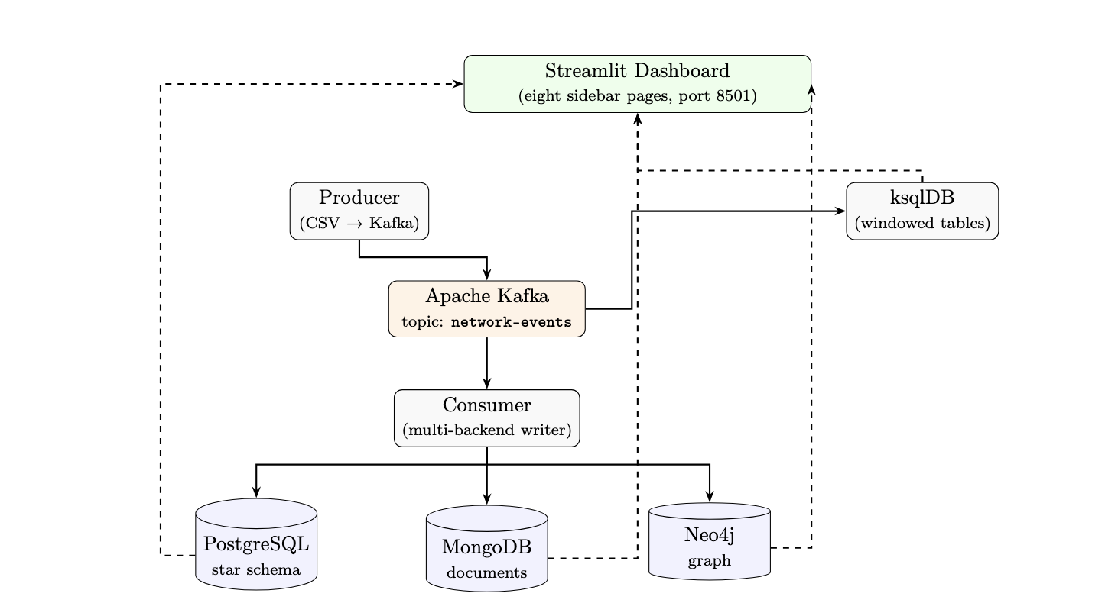
System Architecture

Slide 3
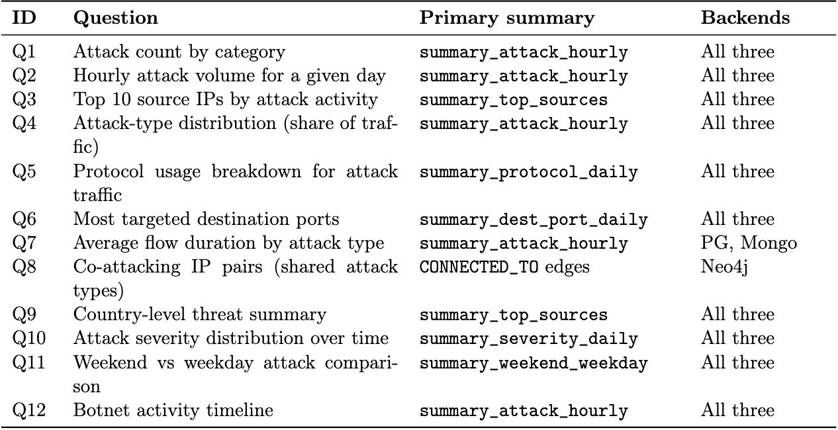
Decision-Support Queries

Slide 4
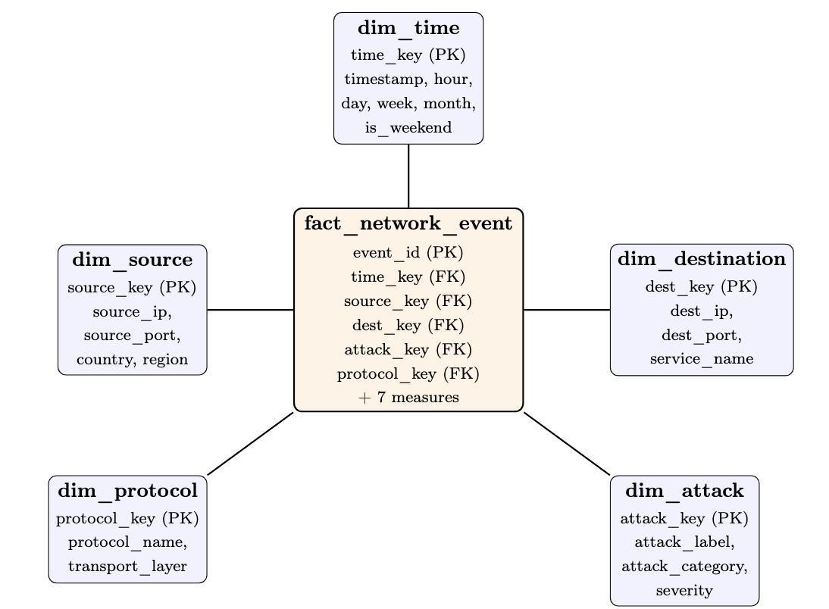
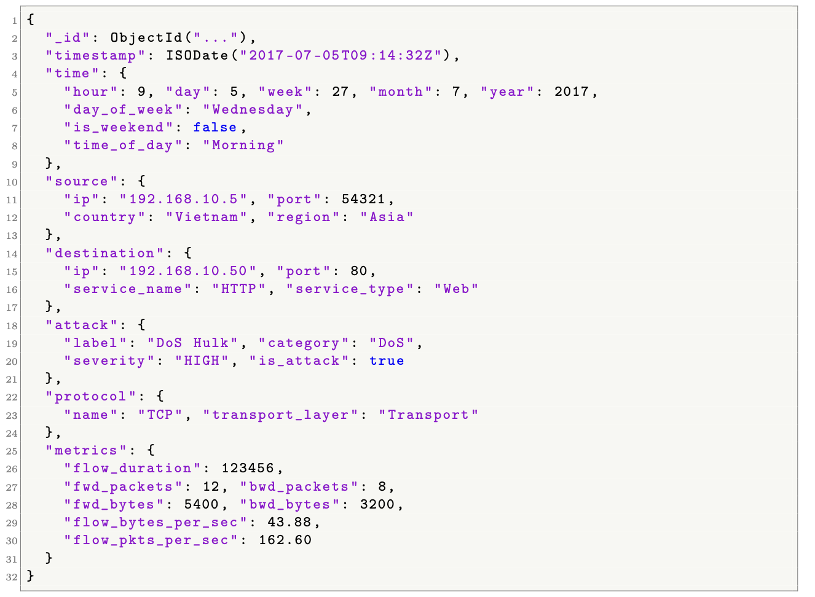
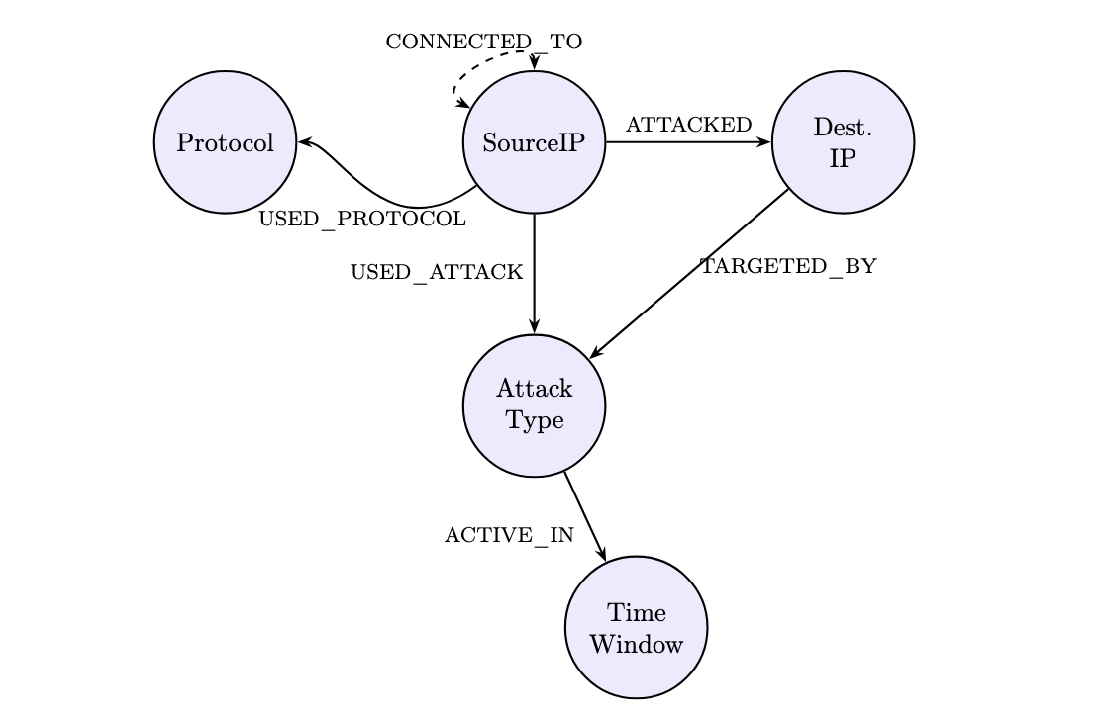
Three Models, Same Data

Slide 5
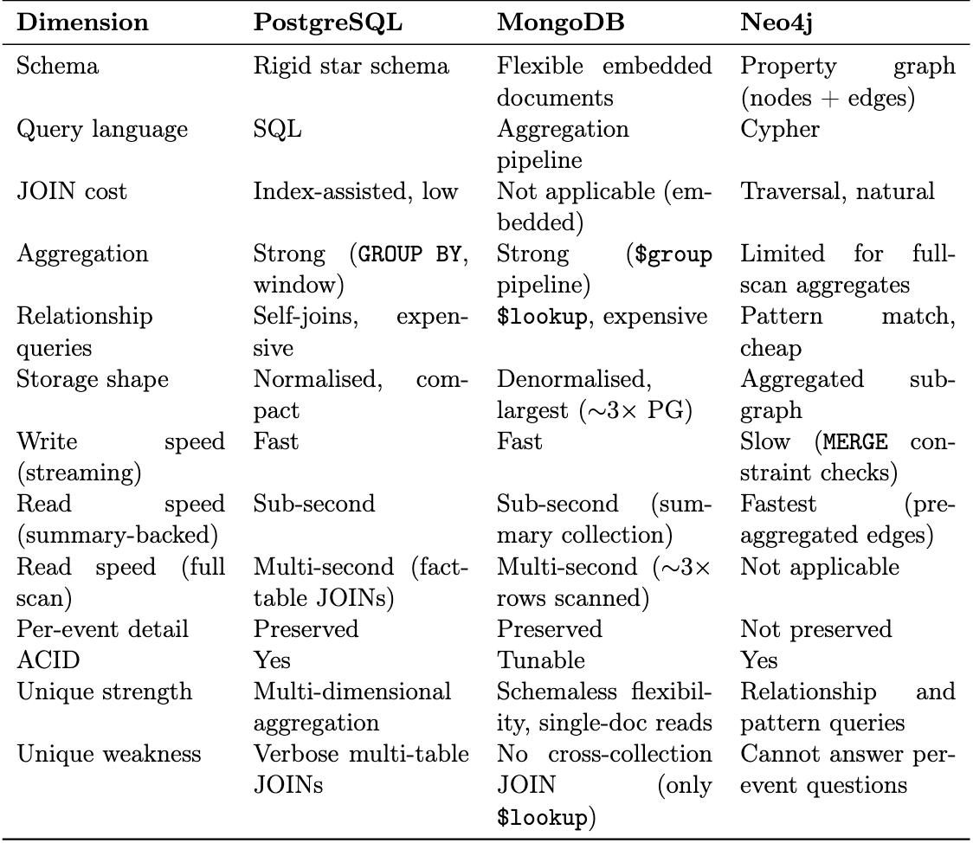
Relational vs NoSQL

Slide 6
Live System
Dashboard: http://localhost:8501
Neo4j Browser: http://localhost:7475
Code repo: https://github.com/yasinhessnawi1/CyberSight_DW
ksqlDB REST: http://localhost:8088

Slide 7
Thank you for your time.

