Slide 1
Credit Card Fraud Detection Presentation
By Yasin Kusan

Slide 2
The Problem
The problem here in my project is to detect the fraudulent credit card transactions saving millions of dollars for individuals and companies.

Slide 3
The Data
The dataset used in this project is obtained from Kaggle.
https://www.kaggle.com/c/ieee-fraud-detection/data

Slide 4
Data Wrangling
12 columns were dropped due to more than 90% of missing data
Data types were OK, so did not change types
Checked to duplicate rows, there was none.
If less than 5% of the column is missing then I filled the column with “0”
For the remaining columns, I replaced the Nan’s with the mean of the column
The original dataset has 2 files af data:
1- transaction
(590540, 394)
2- identity
(144233, 41)

Slide 5
Exploratory Data Analysis

Slide 6
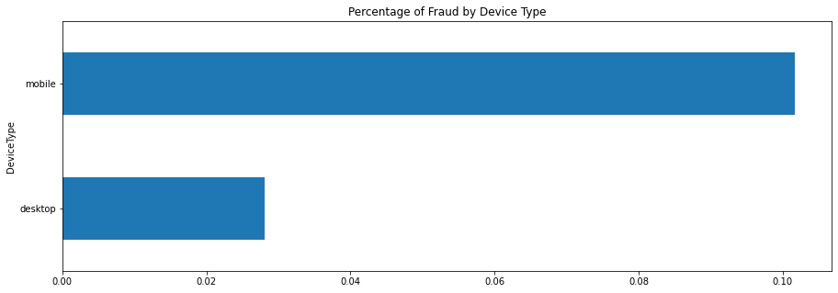

Slide 7
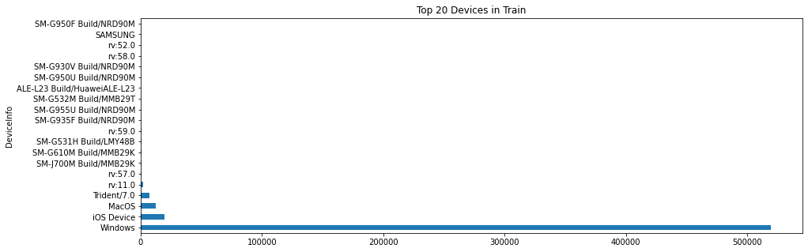

Slide 8
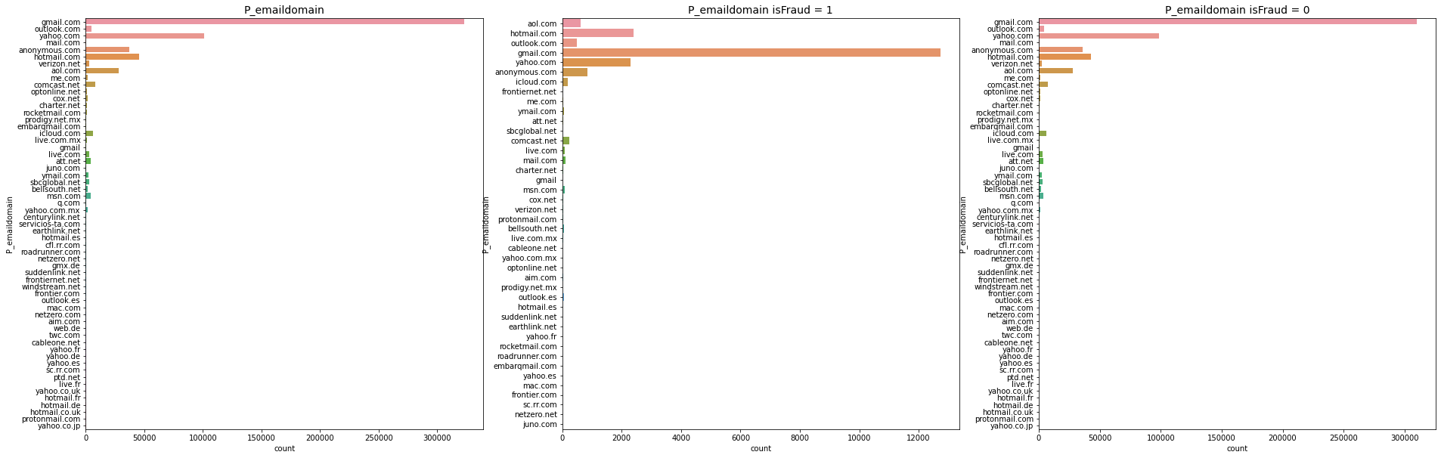
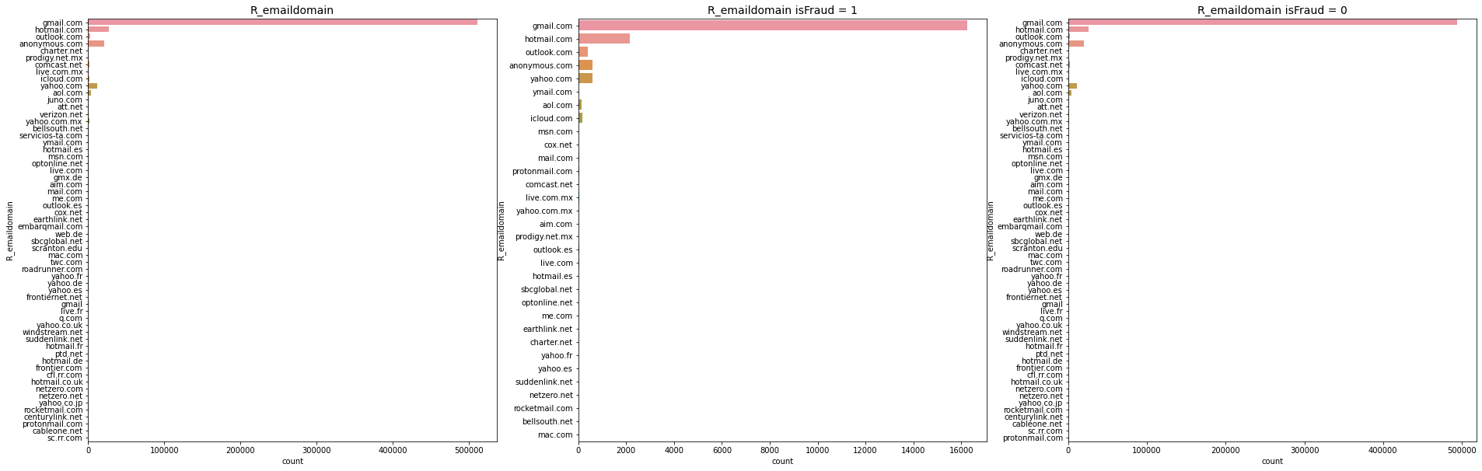

Slide 9
Model Selection
Logistic Regression
Random Forest
XGBoost

Slide 10
Model | Parameter | Precision | Recall | F1 | Accuracy
Logistic R. w/o over/under Sampling | default | 0.78 | 0.30 | 0.44 | 0.97
Logistic R. with over/under Sampling | default | 0.25 | 0.62 | 0.35 | 0.92
Random Forest | default | 0.61 | 0.61 | 0.61 | 0.97
XGBoost | default | 0.61 | 0.64 | 0.63 | 0.97
XGBoost | 'max_depth': 9, 'min_child_weight': 1 | 0.65 | 0.70 | 0.67 | 0.98

Slide 11
Best Model
The best model was XGBoost with the best parameters were as follows: 'max_depth': 9, 'min_child_weight': 1 and the model improved a lot.
The model was able to detect 70% of the Fraud transactions and 99% of the Non-Fraud transactions.

Slide 12
FUTURE WORK
Due to the computation limitation of my machine, I couldn’t try all of the parameters and a large set of parameters during hyperparameter tuning. So this work can be done with a stronger machine or in the cloud.

