Slide 1
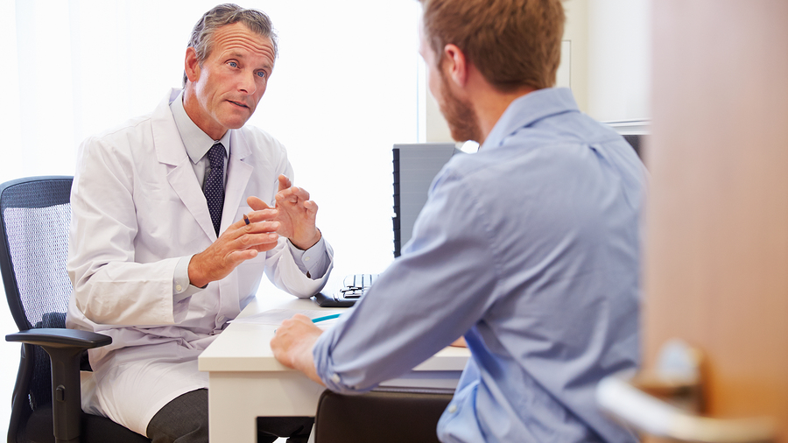
Smart Doctor
Appointment
Yasin Rezaei, Yeganeh Khajepoor, Hosein Mirhoseini
Notes:
Links:
https://unsplash.com/photos/fzOITuS1DIQ

Slide 2
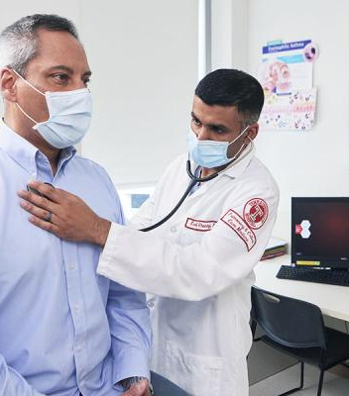
ABOUT Project
In this project our goal is to design a mobile software so you can be aware of your disease based on the symptoms you have right now.
Then, based on your disease you’ll be able to book doctor’s appointment!
Notes:
Links:
https://www.pexels.com/photo/photo-of-men-talking-to-each-other-3285197/

Slide 3

We are going to cover:
Advantages of this app
Design process
App’s features
Machine learning model
Testing
Notes:
Links:
https://www.pexels.com/photo/photo-of-person-holding-pen-3184635/

Slide 4
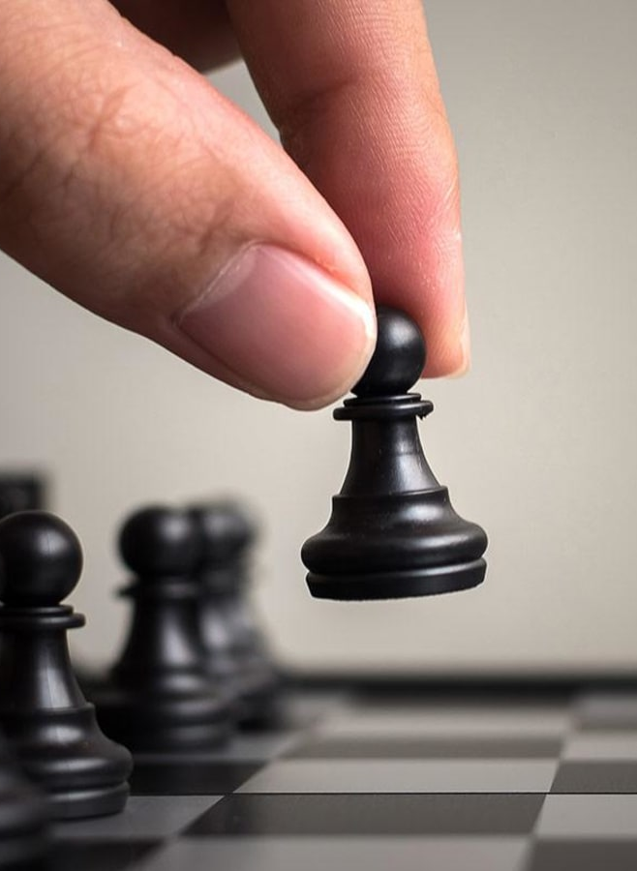
Advantages of this app
Easy to use
95%
Disease diagnosis
100%
UI/UX
90%
Fast and comfortable
90%
Notes:
Links:
https://www.pexels.com/photo/man-in-black-suit-jacket-wearing-white-headphones-3779414/

Slide 5
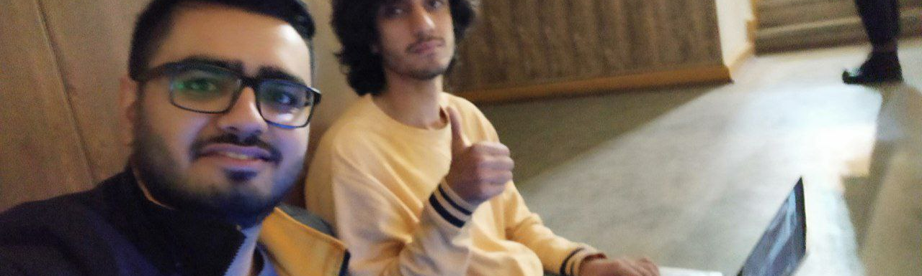
Design Process
After knowing abilities of each individuals, we started the design process.
ERD and Wireframe design
Deciding about what kind of design technologies we want to use
Programming, creating and testing!
Notes:
Links:
https://unsplash.com/photos/wD1LRb9OeEo

Slide 6
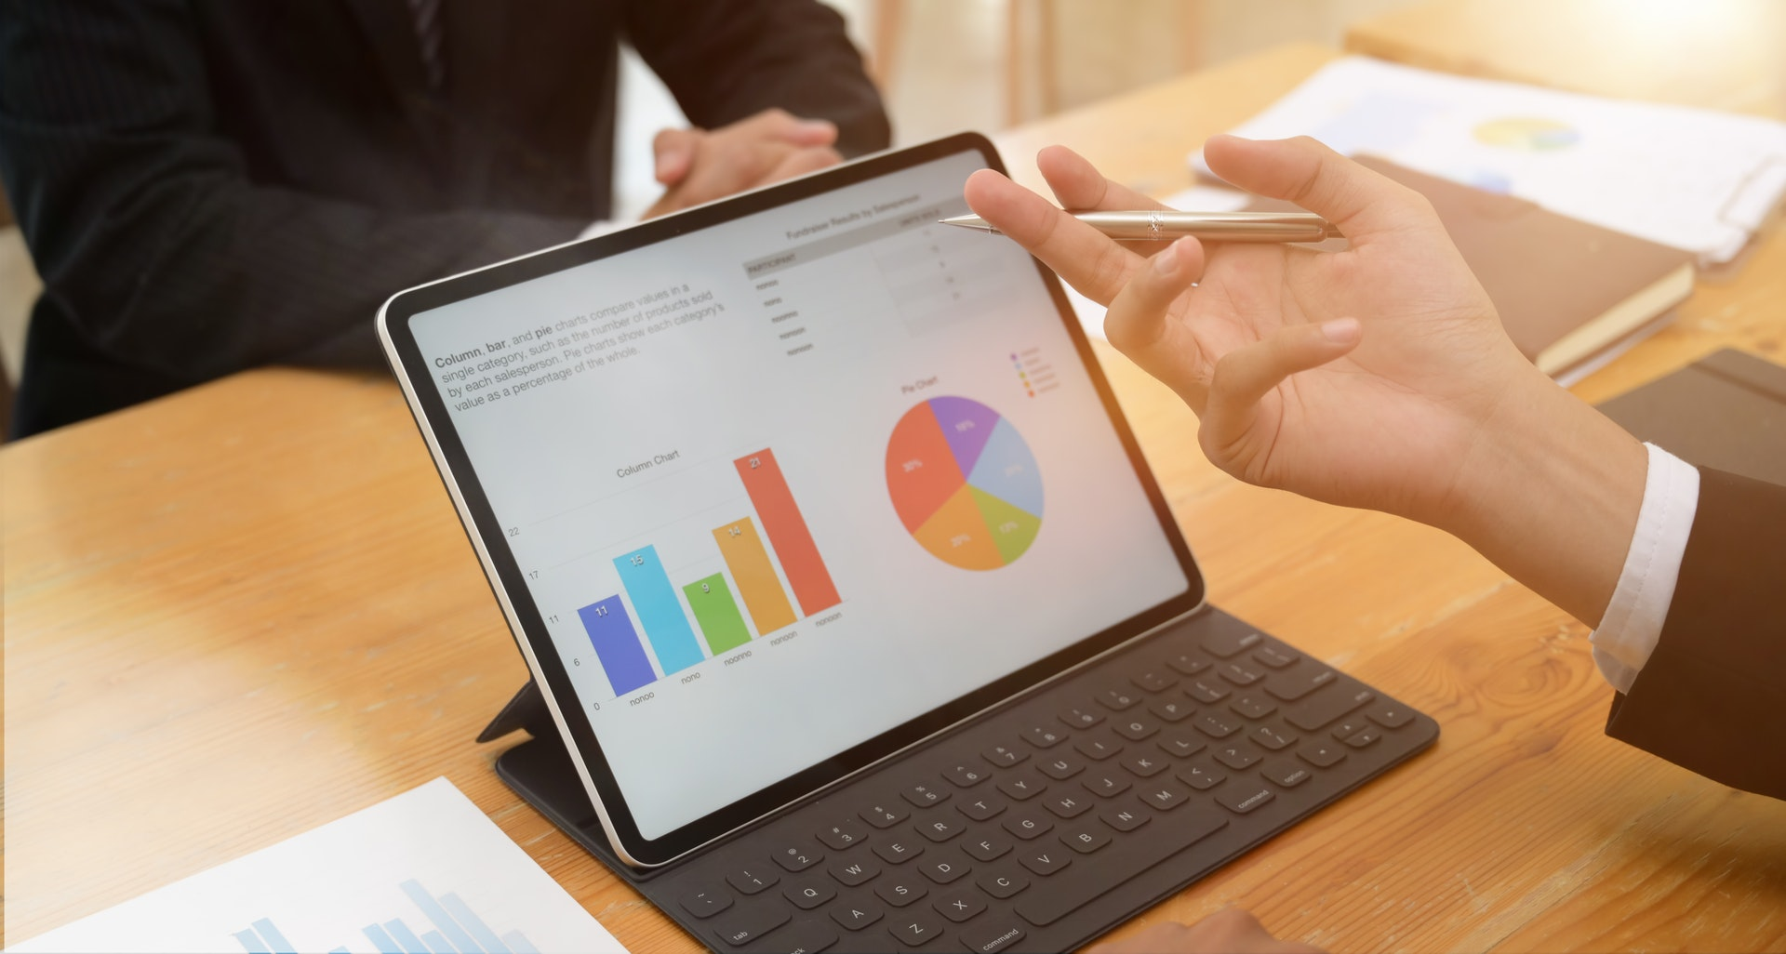
It’s not important that you’re sick!
It’s sick that you’re important!
– Hosein Mirhoseini
Quote Slide
Notes:
Links:
https://www.pexels.com/photo/photo-of-person-holding-black-tablet-3734641/

Slide 7


App’s features
Easy medical test
Booking doctor appointment
Chatting with doctors
Reliable test result
Medical facts! (Exciting requirements)
Note: You can find all the details in final report of project!
Notes:
Links:
https://www.pexels.com/photo/photo-of-people-looking-on-laptop-3182750/

Slide 8
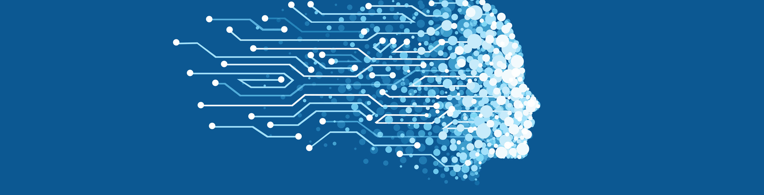

Machine Learning
Model
By sure our core competencies here is out machine learning model! Imagine you don’t need to visit a doctor for every little symptoms. Or search google and says that you might have cancer!
So, with all our confidence we can say we NAIL IT HERE.
First we find the best dataset for this prepose! 132 symptoms and 500 cases!
Then we find the best machine learning algorithm which is “Decision tree”
In the end, you can see the result:
Notes:
Links:
https://www.pexels.com/photo/photo-of-people-looking-on-tablet-3182835/

Slide 9

Testing
In this project we had two kind of tests.
API Test
User Test
Notes:
Links:
https://www.pexels.com/photo/photo-of-people-sitting-near-wooden-table-3183188/

Slide 10
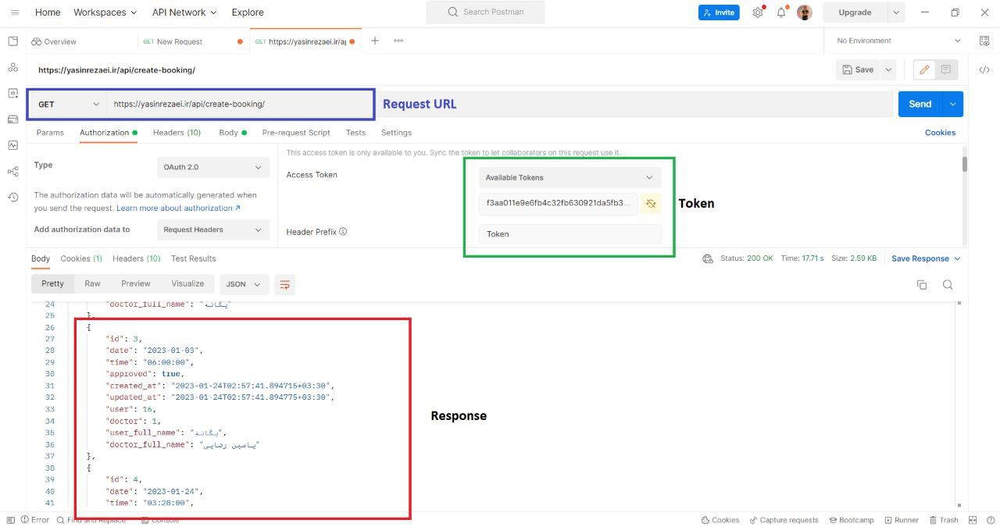
API Test using POSTMAN
Notes:
Links:
https://www.pexels.com/photo/photo-of-men-talking-to-each-other-3285197/

Slide 11
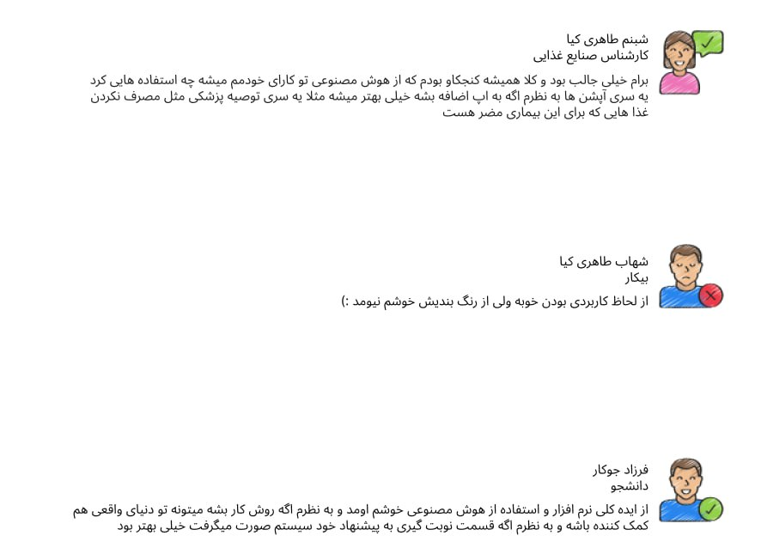
User Test
Notes:
Links:
https://www.pexels.com/photo/photo-of-men-talking-to-each-other-3285197/

Slide 12
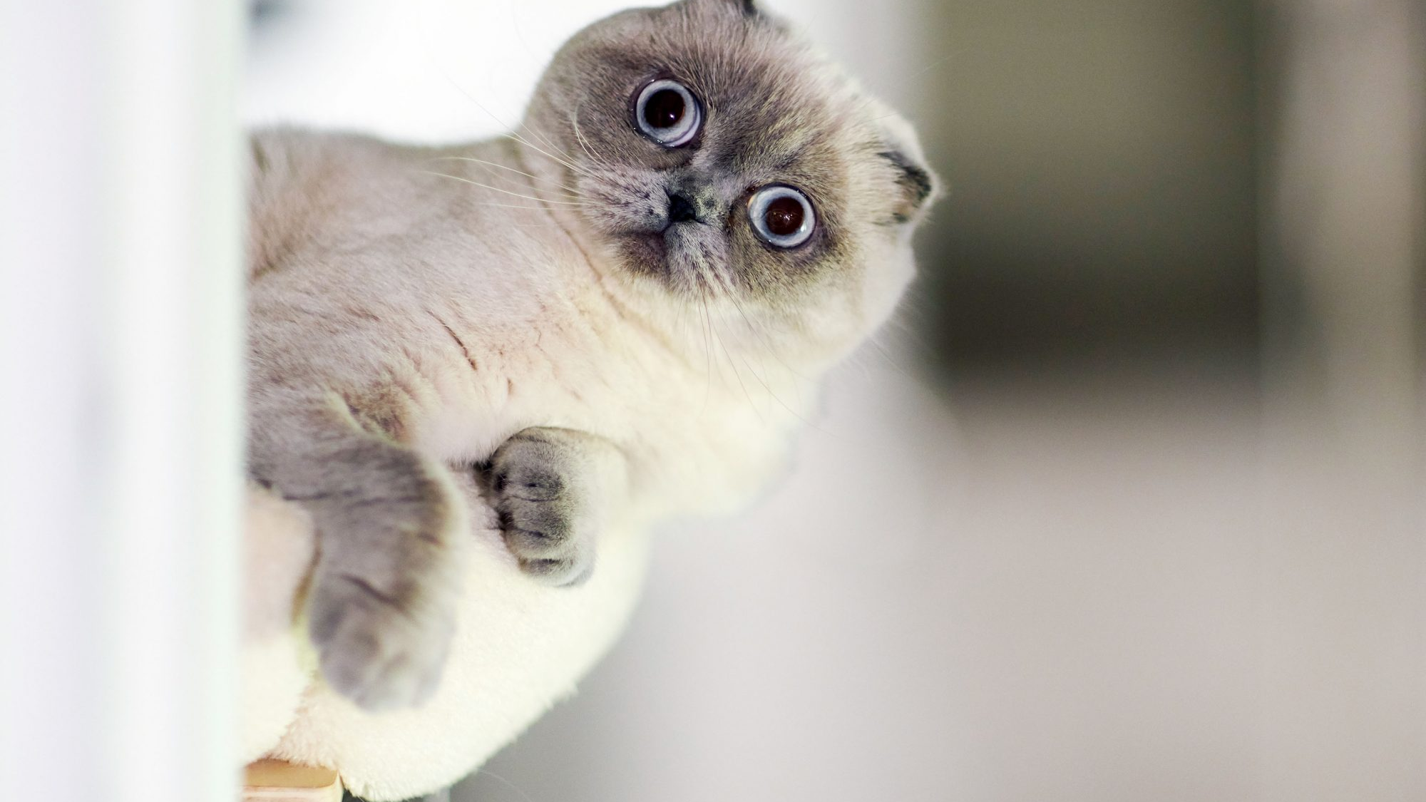
THANK YOU!
Notes:
Links:
https://unsplash.com/photos/fzOITuS1DIQ

