Slide 1

A Trusted Authorisation Framework for Multi-Party Patient Consent in Healthcare Data Sharing
Principal Supervisor: Professor Farookh Hussain
Co-Supervisor: Dr. Firas Al-Doghman
Presenter: Yasir Dhaifallah O Alyoubi
STUDENT ID #: 24724078
Notes:
Good afternoon everyone. My name is Yasir Alyoubi. My principal supervisor is Professor Farookh Hussain, and my co-supervisor is Dr Firas Al-Doghman.
My research asks one simple question: when a doctor asks for a patient's data, how can the system be sure the request is really allowed? Not only who is asking, but also: did the patient and the guardians agree, and is the request still inside what they agreed to?

Slide 2
OUTLINE
01
RESEARCH PROBLEM
06
OVERVIEW SOLUTION OF OBJECTIVES
02
LITERATURE REVIEW
07
RESEARCH CONTRIBUTIONS
03
RESEARCH GAP
08
PUBLICATIONS
04
RESEARCH QUESTIONS AND OBJECTIVES
09
RESEARCH PLAN
05
RESEARCH METHODOLOGY
10
REFERENCES
Notes:
This is the outline . I start with the research problem, then the literature review and the research gap. Then I present the research questions and objectives, and the research methodology. After that, I give an overview of the solution for each objective, with the prototype and its validation. I finish with the research contributions, my publications and my research plan.

Slide 3
THE RESEARCH PROBLEM
Healthcare data is shared between many independent parties: patient, guardians, doctor, hospital.
Today, consent is a stored record. It shows that permission was given, but it checks nothing at access time.
A valid identity does not prove the right to see this patient's data.
A request can ask for more data than allowed, or arrive after the consent expired or was revoked.
None of the reviewed studies proves or tests the whole decision.
The main problem is that there is no trusted mechanism that checks identity, authority, multi-party approval, policy, time and lifecycle together in one access decision, with evidence that it is secure.
Notes:
Let me start with the problem. Health data is shared between many independent parties: the patient, the guardians, the doctor and the hospital.
Today, consent is usually just a stored record. It says that permission was given, but it does not check anything when someone asks for the data.
A valid login does not prove you have the right to see this patient's data. A request can also ask for more data than agreed, or come after the consent has expired or been revoked.
So the main problem is: there is no trusted mechanism that checks all these conditions together, in one decision, with evidence that it is secure.

Slide 4
THE KEY IDEA
Consent is not a stored record. It is an object checked at every request.
C = (I, A, P, T, L, E)
I Identity
Who is the patient, the doctor and each guardian (DID).
A Authorisation
The guardian set G and how many approvals are needed (N).
P Policy
The purpose and the data scope that were agreed.
T Time
When the consent starts and when it expires.
L Lifecycle
The state of the consent, from creation to expiry or revocation.
E Evidence
Signatures, the token, and whether it is revoked.
Notes:
Our key idea is to check consent at every data request, not just store it. We check identity, required approvals, purpose and data scope, time, consent status, and supporting evidence. Access is allowed only when all required checks pass.
----------------------------------------------------------------------------------------------------------------------------
My key idea is simple. Consent should not be a record that we store. It should be an object that the system checks at every request.
I call this object C, and it has six parts. I is identity: who the patient, doctor and guardians are. A is authorisation: the guardian set as G and how many approvals are needed. P is policy: the purpose and the data scope. T is time: when the consent starts and ends. L is lifecycle: the current state of the consent. E is evidence: signatures, the token, and the revocation status.

Slide 5
Systematic Literature Review
Study Selection Process
179 Records Identified
21 Duplicates Removed
158 Titles Screened
76 Records Excluded by title
82 Abstracts Screened
43 Records Excluded
39 Full-text Studies Assessed
14 Studies Excluded
25 Studies Included in Analysis
8
Notes:
This slide shows how I selected the studies for my literature review.
I started with 179 records and removed 21 duplicates. After screening the titles and abstracts, I reviewed 39 full-text studies. I excluded 14 and included 25 studies in the final analysis.

Slide 6
Database Search Results
A total of 179 records were identified from seven academic databases before removing duplicates.
Publication range: 2020–2026
Search String
("Healthcare" OR "Health Data" OR "Medical Records")AND
("Consent" OR "Authorisation" OR "Authorization") AND
("Trust" OR "Multi-party" OR "Multi-party Approval")
6
Notes:
This slide shows my database search results.
I searched seven academic databases for studies published from 2020 to 2026. I found 179 records before removing duplicates. SpringerLink had the most results, followed by Scopus and IEEE Xplore.

Slide 7
Inclusion and exclusion criteria
Included
Excluded
Healthcare data sharing
Outside healthcare or the authorisation scope
Consent or authorisation relevant to data access
Authentication alone or a superficial mention of consent
A model, mechanism, system or evaluation that addresses a review question
Non-peer-reviewed work and duplicate publications
Peer-reviewed English paper with full text
Publication between 2020 and 2026
7
Notes:
Here in this slide I show inclusion and exclusion criteria. I included peer-reviewed English studies from 2020 to 2026 on consent or authorisation for healthcare data sharing. Each study had to address a review question and have its full text available. I excluded unrelated studies, duplicates, non-peer-reviewed work, and studies that only covered authentication or briefly mentioned consent.
.

Slide 8
QUALITY ASSESSMENT
Quality inclusion uses QA1–QA4
Item | Inclusion question
QA1 | Does the study define a consent model covering identity, authority, policy, and evidence?
QA2 | Does the study verify participant identities and their authorisation authority
QA3 | Does the study support consent decisions requiring approval from multiple authorised participants?
QA4 | Does the study enforce purpose, data scope, and approval rules before allowing access?
QA5 | Does the study manage consent validity, expiry, and revocation?
QA6 | Does the study validate security and access decisions through formal analysis or implementation testing?
10
Notes:
For the quality assessment. I used six questions, each linked to a research question. I checked consent modelling, identity and authority, multi-party approval, policy enforcement, time and revocation, and security validation.

Slide 9
LIST OF THE ANALYSED STUDIES
Study | Authors and year | Article title
S1 | Abbasi et al. (2026) | Nexa: Enabling Secure, Scalable, and Decentralized Management of Electronic Health Records Using Threshold Cryptography and Public Blockchains
S2 | Albalwy et al. (2021) | A Blockchain-based dynamic consent architecture to support clinical genomic data sharing (ConsentChain): Proof-of-concept study
S3 | Al Amin et al. (2023) | Informed Consent as Patient Driven Policy for Clinical Diagnosis and Treatment: A Smart Contract Based Approach
S4 | Ekholm et al. (2025) | Implementing electronic informed consent in rare disease genomics
S5 | Eneh et al. (2026) | Demo: EdgeConsent: On-Chain Attribute-Based Access Control for Data Consent Management
S6 | Hagström et al. (2024) | Minors’ and guardian access to and use of a national patient portal: A retrospective comparative case study of Sweden and Finland
S7 | Jaiman and Urovi (2020) | A Consent Model for Blockchain-Based Health Data Sharing Platforms
S8 | Zhao and Su (2024) | A threshold traceable delegation authorization scheme for data sharing in healthcare
S9 | Li et al. (2026a) | Privacy-Preserving Fine-Grained EMR Access Control for IoMT: A Hybrid RBAC-Smart Contract Scheme With Attribute-Based Authorization
S10 | Madine et al. (2020) | Fully Decentralized Multi-Party Consent Management for Secure Sharing of Patient Health Records
S11 | Maruthi and Singh (2025) | Enhancing Security and Privacy of IoMT Data for Unconscious Patient With Blockchain
S12 | Mei et al. (2026) | Efficient Dual-Revocation CP-ABE for Secure and Fine-Grained Data Sharing in IoMT
S13 | Panagoulias et al. (2026) | Blockchain-Enabled Trust and Compliance for Clinical AI: Decentralized Governance Without Decentralized Data Storage
S14 | Phuyal et al. (2026b) | Enabling Cross-Institution Health Data Sharing in Norway: EUDI Wallets, On-Chain Consent, and openEHR↔FHIR Translation
S15 | Phuyal et al. (2026a) | A Blockchain-Based Architecture for Dynamic and Auditable Patient Consent in Secondary Use of Health Data
S16 | Punia et al. (2025) | An access control system for cloud-based healthcare systems driven by blockchain
S17 | Román-Martínez et al. (2023) | Blockchain-Based Service-Oriented Architecture for Consent Management, Access Control, and Auditing
S18 | Hema et al. (2026) | Patient Centric Cryptographic Protection of Cloud Electronic Health Records
S19 | SooHoo et al. (2026) | Development of the authentication and authorization processes for the iAgree portal, a platform for patient-controlled data sharing across health systems
S20 | Tan et al. (2024) | Secure and privacy-preserving sharing of personal health records with multi-party pre-authorization verification
S21 | Tith et al. (2020) | Patient consent management by a purpose-based consent model for electronic health record based on blockchain technology
S22 | Tremper et al. (2026) | Mainzelliste: Ten years of pseudonymization, record linkage, and informed consent management
S23 | Tseng et al. (2025) | EMR-Chain: Decentralized Electronic Medical Record Exchange System
S24 | Wu et al. (2022) | Apply Trust Computing and Privacy Preserving Smart Contracts to Manage, Share, and Analyze Multi-site Clinical Trial Data
S25 | Wu and Zhang (2025) | HealthDID: An efficient and authorizable multi-party privacy-preserving EMR sharing system based on DID
11
Notes:
Here are the list of the 25 primary studies

Slide 10
STUDY COMPARISON: S1–S13
Study | Req 1 | Req 2 | Req 3 | Req 4 | Req 5 | Req 6
S1 Abbasi et al. (2026) | NO | NO | NO | NO | NO | NO
S2 Albalwy et al. (2021) | Yes | NO | NO | Yes | NO | Yes
S3 Al Amin et al. (2023) | Yes | NO | NO | NO | NO | NO
S4 Ekholm et al. (2025) | NO | Yes | Yes | NO | NO | NO
S5 Eneh et al. (2026) | Yes | NO | NO | Yes | Yes | NO
S6 Hagström et al. (2024) | NO | Yes | NO | NO | Yes | Yes
S7 Jaiman and Urovi (2020) | Yes | NO | NO | Yes | NO | Yes
S8 Zhao and Su (2024) | NO | NO | Yes | NO | NO | Yes
S9 Li et al. (2026a) | NO | NO | NO | Yes | Yes | NO
S10 Madine et al. (2020) | Yes | Yes | Yes | NO | Yes | NO
S11 Maruthi and Singh (2025) | NO | NO | Yes | NO | NO | Yes
S12 Mei et al. (2026) | NO | NO | NO | Yes | Yes | Yes
S13 Panagoulias et al. (2026) | Yes | NO | NO | Yes | Yes | Yes
11
Notes:
Moving to STUDY COMPARISON This table compares studies S1 to S13 against my six requirements.
--------------------------------------------------------------------------------------------------------------------------
Yes means the study fully meets the requirement. NO means it does not fully meet it.
You can see that each study is strong in some areas but weak in others. For example, Madine and colleagues meet four requirements, but not policy and assurance. No row is Yes across all six columns.

Slide 11
STUDY COMPARISON: S14–S25
Study | Req 1 | Req 2 | Req 3 | Req 4 | Req 5 | Req 6
S14 Phuyal et al. (2026b) | Yes | Yes | NO | NO | NO | Yes
S15 Phuyal et al. (2026a) | NO | NO | NO | NO | NO | NO
S16 Punia et al. (2025) | NO | NO | Yes | Yes | Yes | NO
S17 Román-Martínez et al. (2023) | Yes | NO | NO | Yes | NO | NO
S18 Hema et al. (2026) | Yes | NO | NO | Yes | Yes | NO
S19 SooHoo et al. (2026) | NO | NO | NO | NO | NO | NO
S20 Tan et al. (2024) | Yes | Yes | Yes | NO | NO | NO
S21 Tith et al. (2020) | Yes | NO | NO | Yes | NO | NO
S22 Tremper et al. (2026) | NO | NO | NO | NO | NO | NO
S23 Tseng et al. (2025) | NO | Yes | NO | NO | NO | NO
S24 Wu et al. (2022) | NO | NO | NO | NO | NO | NO
S25 Wu and Zhang (2025) | Yes | Yes | NO | NO | NO | Yes
12
Notes:
This is the second half of the comparison, until the study S25.
-----------------------------------------------------------------------------------------------------
The pattern is the same. Multi-party approval, in the Req 3 column, is mostly missing.
For example, Phuyal and colleagues are strong on identity and assurance, but consent is given by one patient only, with no multi-party approval. So no single study meets all six requirements, and this is the gap my research addresses.

Slide 12
RESEARCH GAP
Existing healthcare consent and access-control research provides many of the necessary technological building blocks. However, there is still a need for an integrated Trust Computing framework that treats patient consent as a verifiable authorisation object, verifies identity, trust, and authority, supports multi-party authorisation, and enforces access policies and data-scope restrictions.
Notes:
So the reseaech gap for my study is
So the research gap for my study is the lack of one integrated framework that verifies identity and authority, supports multi-party consent, and enforces access policies, data scope, time limits, and lifecycle .

Slide 13
MAIN RESEARCH QUESTION
How can a trust-oriented computing framework establish and enforce trustworthy multi-party consent for decentralised healthcare data sharing under identity, authority, and policy constraints?
Notes:
From this research gap comes my main research question which is How can we build a trusted framework for multi-party consent in healthcare data sharing?
----------------------------------------------------------------------------------------------------------------------------------------------
Establish means creating trusted participants and a collective decision. Enforce means checking these conditions every time someone asks for data.

Slide 14
SUB-RESEARCH QUESTIONS
RQ1
How can patient consent be modelled as a trust-aware authorisation object that explicitly represents identity, authority requirements, policy constraints, and authorisation evidence?
RQ2
How can decentralised identities and verifiable credentials establish trustworthy participants while explicitly separating identity authentication from authorisation authority?
RQ3
How can multiple independently verified participants jointly establish a trustworthy consent decision without allowing a single participant to unilaterally authorise sensitive healthcare data access?
RQ4
How can policy, purpose, and data-scope constraints be incorporated into authorisation decisions so that valid identities and sufficient approvals cannot be used to obtain unauthorised healthcare data?
RQ5
How can temporal validity and consent lifecycle controls ensure that an authorisation remains valid only within its permitted time interval and lifecycle state, and is rejected after expiration, revocation, or an unauthorised state transition?
RQ6
How can the security properties of the proposed trust-oriented authorisation mechanism be formally defined and empirically evaluated to demonstrate that the implemented framework correctly enforces authorised and unauthorised healthcare data-access decisions?
Notes:
Here are the 6 sub questions I have
RQ1 focuses on consent modelling.
RQ2 covers identity and authority.
RQ3 addresses multi-party approval.
RQ4 examines access policies and data scope.
RQ5 deals with time, expiry, and revocation.
RQ6 evaluates security and access decisions.

Slide 15
RESEARCH OBJECTIVES
Objective | Description
RO1 | To develop a trust-aware consent model that represents patient consent as a structured and evaluable authorisation object.
RO2 | To develop a decentralised identity and authority verification mechanism using decentralised identifiers and verifiable credentials.
RO3 | To develop a threshold-based multi-party authorisation mechanism through which multiple independently verified participants and guardians can jointly establish a trustworthy consent decision.
RO4 | To develop a policy-aware authorisation mechanism that evaluates the purpose and data scope of a requested operation against the constraints defined by the consent.
RO5 | To extend the trust-oriented framework with temporal validity and consent lifecycle controls.
RO6 | To formally analyse and empirically evaluate whether the implemented framework satisfies its defined trust and authorisation properties under representative healthcare data-sharing scenarios.
Notes:
So, we take the previous six sub-research questions and turn them into six research objectives, as shown here.
--------------------------------------------------------------------------------------------------------------------------------
Each research question has one objective.
RO1 builds the consent model. RO2 verifies identity and authority with DIDs and verifiable credentials. RO3 builds the multi-party approval with a threshold. RO4 checks the purpose and the data scope of each request. RO5 adds time and lifecycle controls. RO6 analyses and tests the security of the whole framework.
--------------------------------------------------------------------------------------------------------------------------
RO1 turns consent from a stored record into an object with six parts: identity, authorisation, policy, time, lifecycle and evidence. At every request, the system checks the request against these parts. For example, if the consent allows only Observation and Medication, a request for Procedure is denied, even from the right doctor.”
--------------------------------------------------------------------------------------------------------------------------------
“RO2 separates identity from authority. The DID shows who the participant is, and the verifiable credential shows what they are allowed to do, for example that they are a doctor or a guardian. A valid DID alone never gives access. In the prototype, each guardian’s credential is checked before their signature is accepted, and the doctor’s credential is checked at every request, together with a check that this is the doctor named in the consent. Full DID resolution is planned for the next stage.”
---------------------------------------------------------------------------------------------------------------------
“RO3 makes consent a collective decision. The patient defines a guardian set G, and the consent becomes active only when the required number of guardians approve. Each guardian signs an EIP-712 approval, and the system checks that the signer is in G. Approvals from outsiders and repeated approvals are not counted, so no single person can activate the consent alone. In the prototype, every listed guardian must sign: two of two in the demo.”
------------------------------------------------------------------------------------------------------------------------
“The rule is N-of-N, so every guardian in G must sign. The prototype accepts more than two guardians, but I showed and tested it with two, so two of two.”
-------------------------------------------
RO3 makes consent a collective decision. The patient chooses a guardian set G, and the consent becomes active only when every guardian in G signs. Each guardian signs an EIP-712 approval, and the system checks that the signer is in G. Approvals from outsiders and repeated approvals are not counted, so no single person can activate the consent alone. I tested it with two guardians, so two of two. Then a soulbound token is minted on Sepolia in the background.”
----------------------------------------------------------------
“RO4 checks each request against the consent policy. A valid identity and all the approvals are still not enough. The requested data must be inside the scope the patient agreed to, and the purpose must be a supported purpose. For example, if the consent allows only Observation and Medication, a request for Procedure is denied. An empty request is also denied. In the prototype, the request uses the consent’s own purpose, so comparing a separate request purpose is planned for the next stage.”
------------------------------------------------------------------------
“RO5 adds time and lifecycle. A consent is not valid forever. It has a start and an end time, and a state such as pending, active, expired or revoked. At every request, the system checks the time window and the state, and access is allowed only when the consent is ACTIVE. Today, the validity window is stored on-chain, and revocation works end to end, with an on-chain revoke transaction. In the next stage I will add the SUSPENDED state, the transition check, consent changes and a formal lifecycle model.”
-----------------------------------------------------------------------------------------
“RO6 checks that the framework really does what it should, in two ways. The testing part is done: 46 automated tests pass, including twelve attack scenarios, and all attacks are refused. I also measured gas, confirmation time and processing time. The formal part is for the next stage: proofs or model checking, to show that no path in the system can give access when a condition fails.”
------------------------------------------------------------------------------------------------
“The six objectives build on each other to answer one question: is this data request really allowed? Take a patient, Ahmed, who is a minor. In RO1, Ahmed creates a consent as an object, not just a record: it names Dr Khalid, two guardians, the purpose Treatment, only Observation and Medication data, and a time window from October to December. In RO2, the system checks each person’s identity with a DID and their authority with a verifiable credential, and identity alone never gives access. In RO3, the consent becomes active only when both guardians sign, so no single person can approve alone. In RO4, when Dr Khalid asks for data, a request for Observation is allowed, but a request for Procedure is denied. In RO5, if he asks in January after the consent has expired, or after Ahmed revokes it, the request is denied. In RO6, I showed that all of this works: 46 tests pass and all twelve attacks are refused, and formal proofs come in the next stage. So Dr Khalid sees the data only when every condition is true at the same time.”

Slide 16
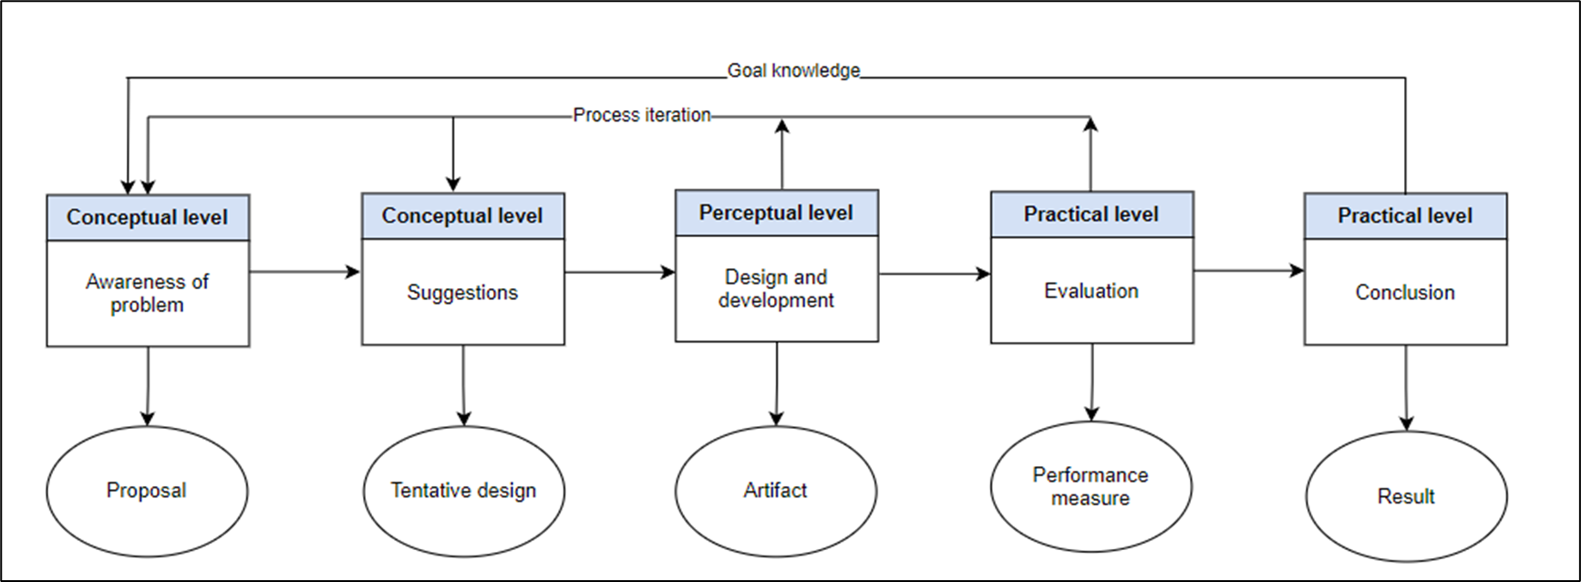
Research Methodology
RESEARCH METHODOLOGY
DSR METHODOLOGY
Design Science Research Methodology Process Model (Peffers et al. 2007)
Notes:
Here is the research methodology we used, which is based on Design Science Research (DSR).
It has five stages, starting with identifying the problem, followed by designing, developing, and testing our solution.
Finally, we evaluate the results and present our conclusions.
----------------------------------------------------------------------------------------------------------------------
The arrows show that knowledge from each stage goes back into the process, so the design improves in each iteration.

Slide 17
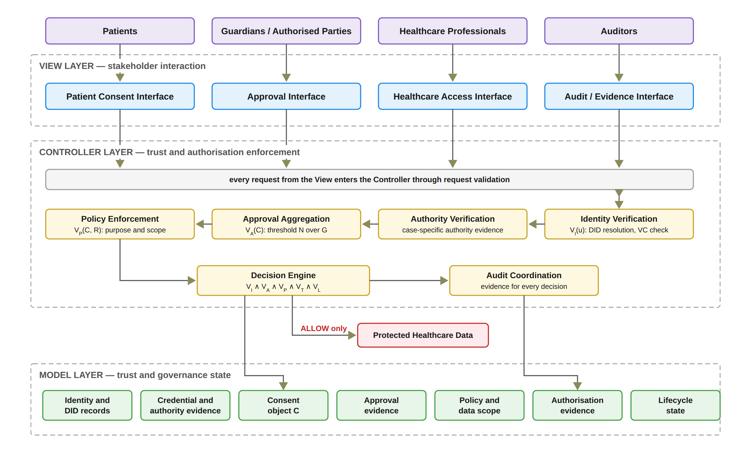
FRAMEWORK ARCHITECTURE
Notes:
Here we show the MVC architecture model.
It has three layers.
First, the View allows users to interact with the system.
Second, the Controller checks identity, authority, approvals, policy, time, and consent status.
Third, the Model stores consent information and evidence.
Access is allowed only when all checks pass.

Slide 18
THE DECISION RULE
Decision(C, R, t) = ALLOW ⟺ VI(u) ∧ VA(C) ∧ VP(C, R) ∧ VT(C, t) ∧ VL(C)
VI
Identity and authority validity
VA
Collective authorisation validity
VP
Policy and contextual compliance
VT
Temporal validity
VL
Consent lifecycle validity
One failed check is enough to say DENY.
Every access decision, allowed or denied, is written to the audit ledger with its decision matrix.
Notes:
This is the heart of the framework. Access is allowed only when five checks are all true.
VI checks identity and authority. VA checks that all required guardians approved. VP checks the purpose and data scope. VT checks the time window. VL checks the lifecycle state.
If any one check fails, the answer is DENY. Every decision
, allowed or denied, is written to the audit ledger.
------------------------------------------------------------------------
C The consent object C = (I, A, P, T, L, E): who is involved, which guardians must approve, the purpose and data scope, the time window, the lifecycle state and the evidence.
R The access request: what the doctor asks for, meaning the data modules (S_R) and the purpose.
t The time of the request: the moment the doctor asks for the data.
u The requesting participant, for example the doctor.
“t is the time of the request. VT is the check that uses it: it compares t with the consent’s validity window T, and passes only when t is between the start and the end time.”

Slide 19
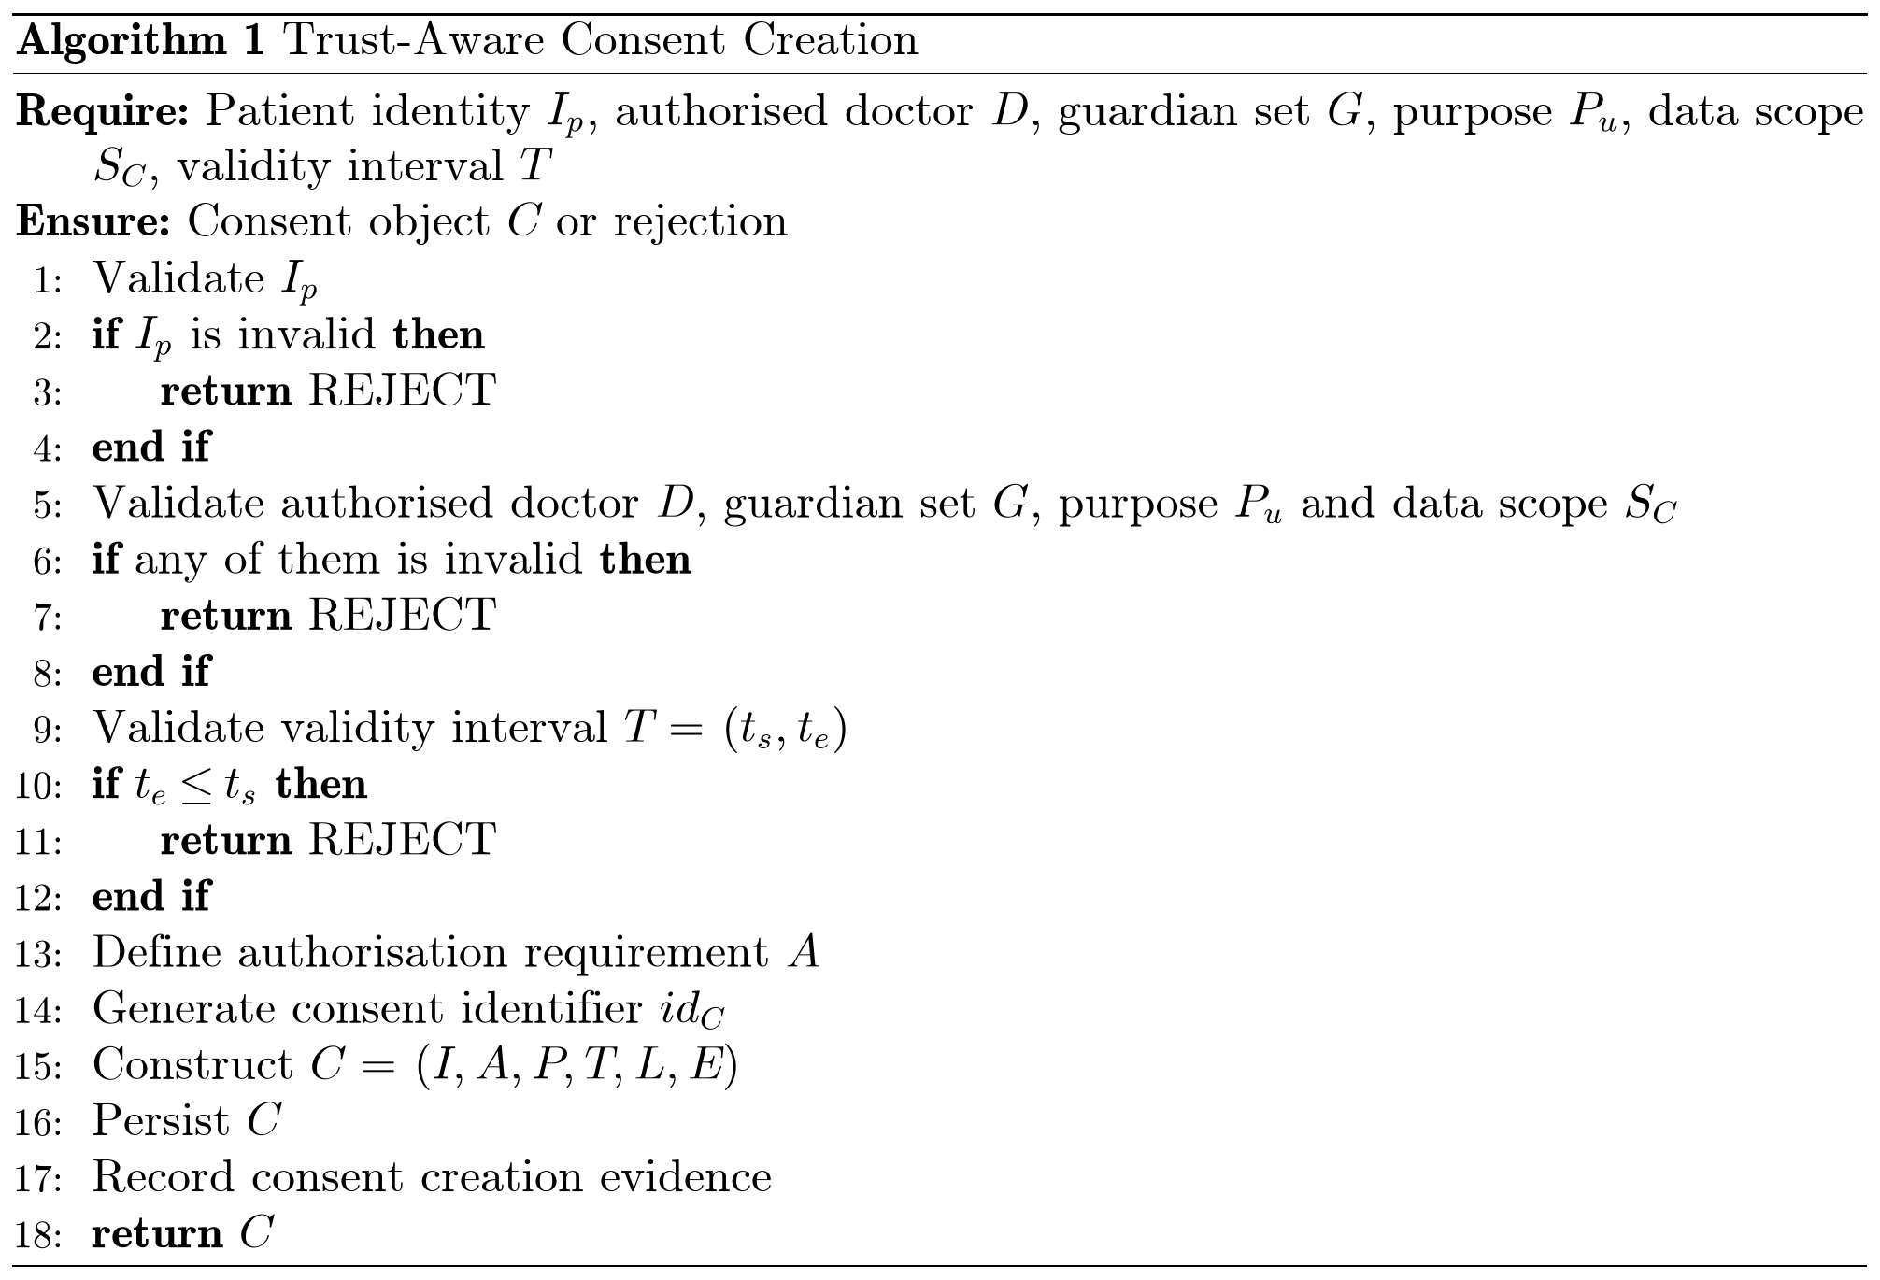
Proposed solution for objective 1
RO1: Trust-Centric Consent Model
Status: Done
The patient chooses the doctor, the guardians, the data modules, and the start and expiry time.
In this prototype the purpose is fixed to Treatment.
Bad input is rejected, for example an empty data scope or a malformed guardian DID.
The system creates the consent object, assigns a consent identifier, persists the record, and records the creation event in the audit layer.
Notes:
For Objective 1, I developed a trust-aware consent model.
First, the patient selects the doctor, guardians, data scope, and validity time.
Next, the system checks the information and rejects any invalid input.
Finally, my framework which name is HALAH, creates a consent ID, saves the consent, and records the evidence in the audit log.
--------------------------------------------------------------------------------------------------------------------------------------------
Inputs and Output
Require: Patient identity I_p, authorised doctor D, guardian set G, purpose P_u, data scope S_C, validity interval T
Explanation: The algorithm starts by receiving the information required to create a consent.
Ensure: Consent object C or rejection
Explanation: The algorithm either creates a valid consent or rejects the request.
Step-by-Step Explanation
Line 1: Validate I_p
First, we verify the patient’s identity.
Line 2: if I_p is invalid then
We check whether the patient’s identity is invalid.
Line 3: return REJECT
If the identity is invalid, the request is rejected.
Line 4: end if
This completes the identity validation check.
Line 5: Validate authorised doctor D, guardian set G, purpose P_u and data scope S_C
Next, we check the other parts of the consent: that the doctor is authorised, that the guardians are valid, that the purpose of using the patient’s data is valid, and that the data scope, which is the patient data that can be accessed, is valid.
Line 6: if any of them is invalid then
We check whether any of these four parts is invalid.
Line 7: return REJECT
If one of them is invalid, the request is rejected, and no consent is created.
Line 8: end if
This completes these four checks.
Line 9: Validate validity interval T = (t_s, t_e)
We check the consent’s start and end times.
Line 10: if t_e ≤ t_s then
We check whether the end time is earlier than or equal to the start time.
Line 11: return REJECT
If the time interval is invalid, the request is rejected.
Line 12: end if
This completes the time validation check.
Line 13: Define authorisation requirement A
We define the conditions that must be met later before access can be granted, such as the required guardian approvals.
Line 14: Generate consent identifier id_C
We generate a unique identifier for the consent.
Line 15: Construct C = (I, A, P, T, L, E)
We build the consent object from its six parts: identity I, authorisation requirements A, policy P (the purpose and the data scope), time T (the validity interval), the lifecycle state L, which starts as pending until the guardians approve, and evidence E.
Line 16: Persist C
We store the newly created consent object.
Line 17: Record consent creation evidence
We record evidence of the consent creation for auditing and traceability.
Line 18: return C
Finally, we return the successfully created consent object.
Note: In the prototype, the purpose is fixed to Treatment. The consent is saved off-chain in the state PENDING_SIGNATURE, and nothing goes on the blockchain until all guardians approve.

Slide 20
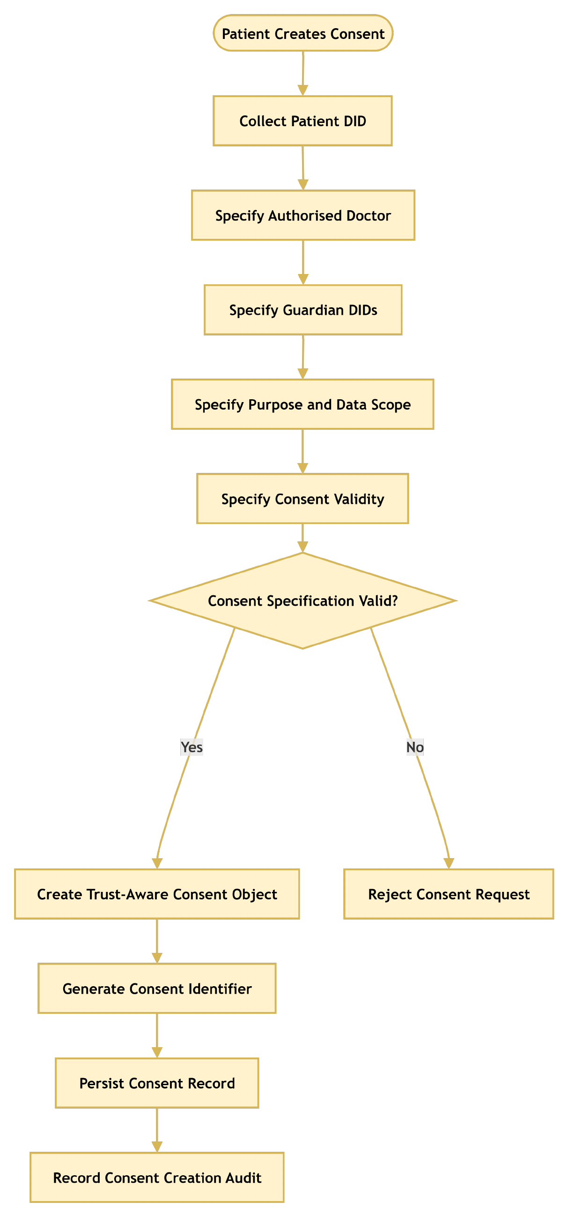
RO1: Trust-Centric Consent Model
Notes:
The flowchart here shows how Objective 1 works.
First, the system collects and checks the consent information.
If anything is invalid, the request is rejected.
Otherwise, the system creates the consent, gives it an ID, saves it, and records the event in the audit log. Notable, I already finish this objective

Slide 21
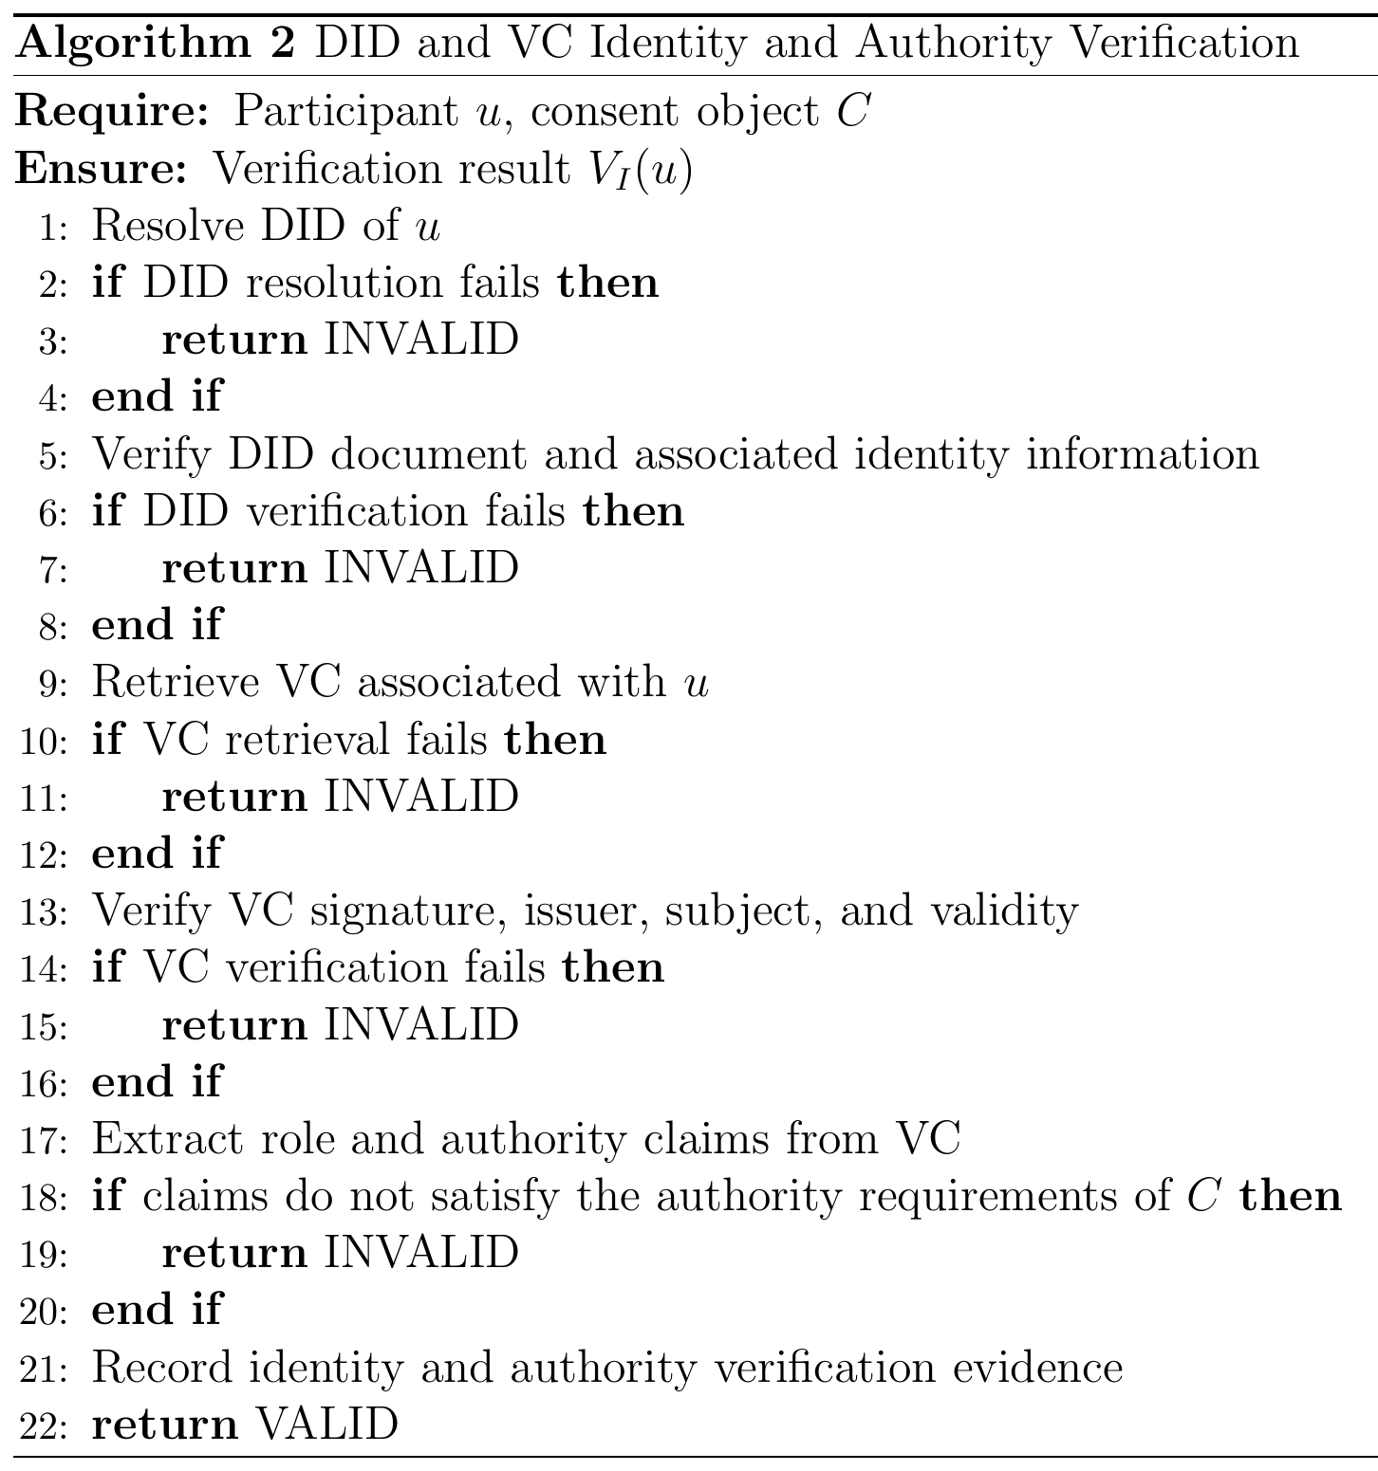
Proposed solution for objective 2
RO2: Decentralised Identity and Authority Trust
Status: Done
Identity is checked through the DID; authority through a verifiable credential.
Identity is not authority: a valid DID alone never gives access.
In the HALAH implementation, the Guardian workflow uses a selected guardian DID and invokes VC verification before adding the guardian's signature to the consent.
Full DID resolution is planned for the next stage.
Notes:
In Objective 2, we aim to develop a **decentralised identity and authority verification mechanism**.
I check who the person is and what they are allowed to do.
The DID (Decentralised Identifier) is used for identity, and the VC (Verifiable Credential) is used to verify their authority.
In HALAH, the guardian's credential is checked before their signature is added.
------------------------------------------------------------------------------------------------------------------
Inputs and Output
Require: Participant u, consent object C
Explanation: The algorithm starts by receiving the participant who wants to take part and the consent object that defines the required authority.
Ensure: Verification result V_I(u)
Explanation: The algorithm returns VALID if both the participant’s identity and authority are verified, or INVALID otherwise. This result is not an access decision by itself; the later stages use it.
Step-by-Step Explanation
Line 1: Resolve DID of u
First, we resolve the participant’s DID to find their DID document.
Line 2: if DID resolution fails then
We check whether the DID could not be resolved.
Line 3: return INVALID
If the DID cannot be resolved, the participant is invalid and the process stops.
Line 4: end if
This completes the DID resolution check.
Line 5: Verify DID document and associated identity information
Next, we check that the DID document is well formed and that its keys can be trusted.
Line 6: if DID verification fails then
We check whether the DID verification failed.
Line 7: return INVALID
If it failed, we return INVALID.
Line 8: end if
This completes the DID verification check.
Line 9: Retrieve VC associated with u
Then, we retrieve the participant’s verifiable credential, which holds claims such as their role.
Line 10: if VC retrieval fails then
We check whether a credential could not be found.
Line 11: return INVALID
Without a credential, the participant cannot show any authority, so we return INVALID.
Line 12: end if
This completes the credential retrieval check.
Line 13: Verify VC signature, issuer, subject, and validity
We check that the signature is correct, the issuer is trusted, the credential belongs to this participant, and it is still within its valid time period.
Line 14: if VC verification fails then
We check whether any of these four checks failed.
Line 15: return INVALID
If any check fails, we return INVALID.
Line 16: end if
This completes the credential verification check.
Line 17: Extract role and authority claims from VC
Next, we read the role and authority claims from the credential, for example doctor or guardian.
Line 18: if claims do not satisfy the authority requirements of C then
We compare these claims with the authorisation requirements of consent C.
Line 19: return INVALID
If the claims do not meet the requirements, we return INVALID. A valid identity alone never gives access.
Line 20: end if
This completes the authority check.
Line 21: Record identity and authority verification evidence
We record the evidence, such as the DID, the credential, the issuer, the claims and the time, for auditing.
Line 22: return VALID
Finally, we return VALID, which means the participant’s identity and authority are both verified.
Note: Today, the guardian workflow verifies the guardian’s credential before adding the signature to the consent. Full DID resolution, in lines 1 to 8, is planned for the next stage.

Slide 22
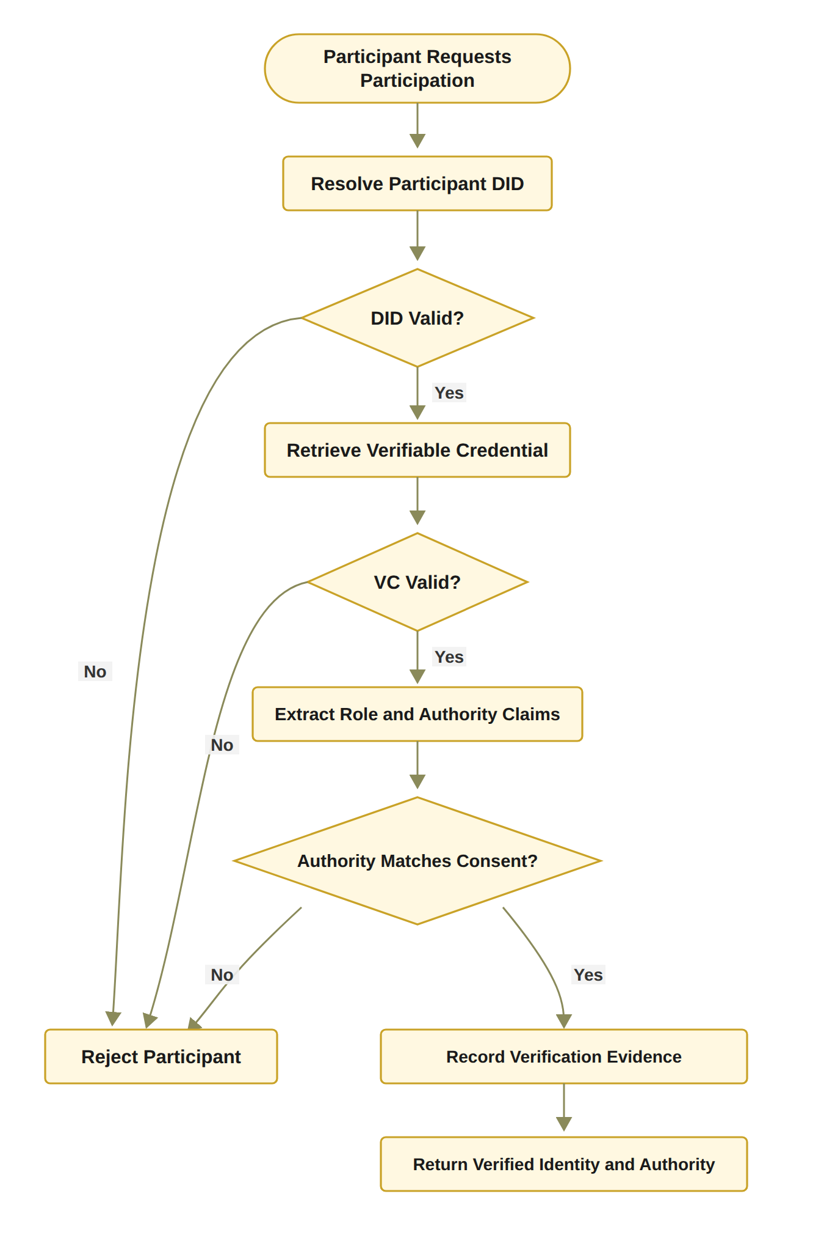
RO2: Decentralised Identity and Authority Trust
Notes:
This flowchart shows how Objective 2 works.
First, the system checks the participant's DID and verifiable credential.
Next, it checks if their role and authority match the consent requirements.
If any check fails, the participant is rejected.
Otherwise, the system records the evidence and confirms their identity and authority. Notable, I already finish this objective

Slide 23
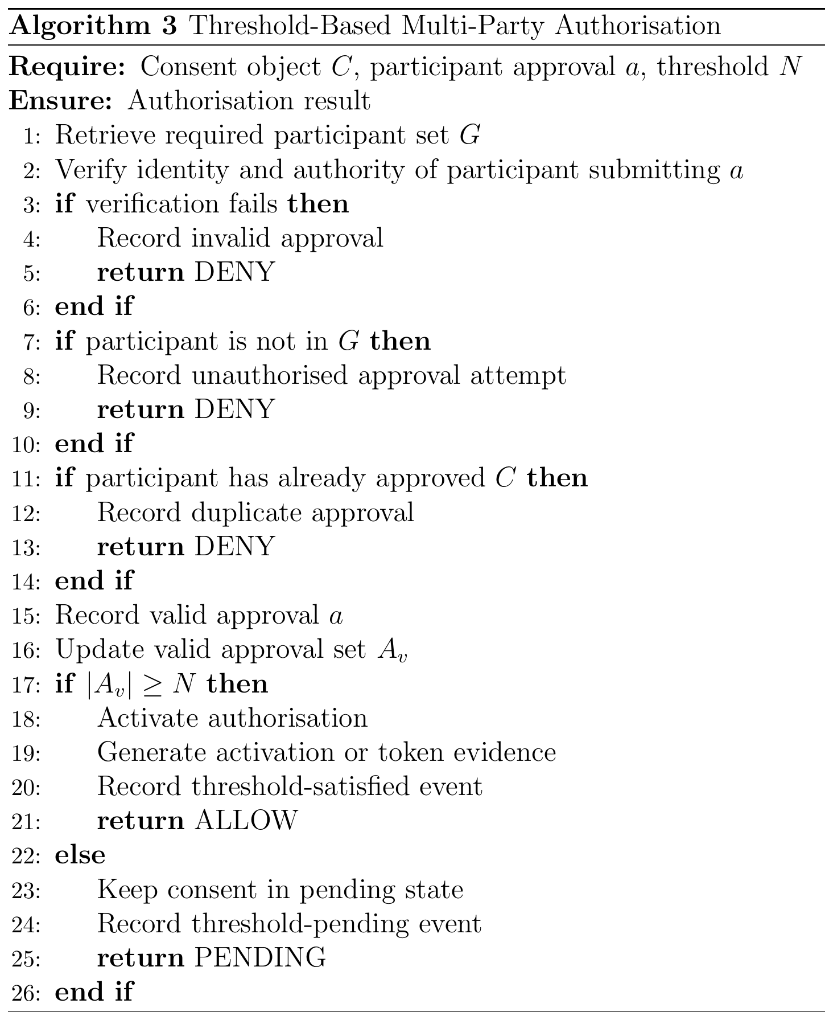
Proposed solution for objective 3
RO3: Trustworthy Multi-Party Authorisation
Status: Done
The guardian set G is fixed when the consent is created.
Each guardian signs a digital approval; the system checks who signed and that this person is in G.
Approvals from outsiders and duplicates are not counted; a signature replayed from another consent fails the identity check.
N-of-N rule: every listed guardian must sign (2-of-2 in the demo).
When all have signed, the consent becomes active.
In the prototype the guardian keys are derived from the guardian DIDs; wallet-held keys are for the next stage.
Notes:
For Objective 3, I developed a multi-party approval method .
In HALAH, both guardians must approve the consent.
The system checks each guardian and rejects invalid or duplicate approvals.
If only one guardian approves, the consent stays pending.
When both guardians approve, the consent becomes active.
---------------------------------------------------------------------------------------------------------------------------------
Note: In the prototype, N is the number of guardians, so the demo needs 2-of-2. When the threshold is met, a local token is recorded and the consent becomes active
--------------------------------------------------------------------------------------------------------------------------------------
Inputs and Output
Require: Consent object C, participant approval a, threshold N
Explanation: The algorithm receives the consent, one approval from a participant, and the number of valid approvals that are needed.
Ensure: Authorisation result
Explanation: The algorithm returns ALLOW, PENDING or DENY for this approval.
Step-by-Step Explanation
Line 1: Retrieve required participant set G
First, we retrieve the set G of participants who are allowed to approve this consent, for example the guardians.
Line 2: Verify identity and authority of participant submitting a
Next, we verify the identity and authority of the person who submitted the approval. This can use the DID and VC check from Algorithm 2.
Line 3: if verification fails then
We check whether this verification has failed.
Line 4: Record invalid approval
If it failed, we record the approval as invalid.
Line 5: return DENY
The approval is denied, and it does not count towards the threshold.
Line 6: end if
This completes the identity and authority check.
Line 7: if participant is not in G then
Then, we check whether the participant is outside the required participant set G.
Line 8: Record unauthorised approval attempt
If so, we record it as an unauthorised approval attempt.
Line 9: return DENY
The approval is denied, because only members of G can be counted.
Line 10: end if
This completes the membership check.
Line 11: if participant has already approved C then
Next, we check whether this participant has already approved this consent.
Line 12: Record duplicate approval
If so, we record a duplicate approval.
Line 13: return DENY
The extra approval is denied, so one person cannot be counted twice.
Line 14: end if
This completes the duplicate check.
Line 15: Record valid approval a
The approval has passed all three checks, so we record it as valid.
Line 16: Update valid approval set A_v
We add this approval to the set of valid approvals, A_v.
Line 17: if |A_v| ≥ N then
We check whether the number of valid approvals has reached the threshold N.
Line 18: Activate authorisation
If it has, we activate the authorisation, so the consent can move on to the access-control stage.
Line 19: Generate activation or token evidence
We generate evidence of the activation, such as a consent token. It can include the consent identifier, the threshold N and the approving participants.
Line 20: Record threshold-satisfied event
We record in the audit log that the threshold was met, for traceability.
Line 21: return ALLOW
The result is ALLOW.
Line 22: else
Otherwise, the threshold has not been reached yet.
Line 23: Keep consent in pending state
We keep the consent in the pending state, so access is not activated.
Line 24: Record threshold-pending event
We record a threshold-pending event, so we can see later how many approvals are still needed.
Line 25: return PENDING
The result is PENDING, and the consent waits for more approvals.
Line 26: end if
Finally, this completes the threshold check, and the algorithm ends.
Note: In the prototype, N is the number of guardians, so the demo needs 2-of-2. When the threshold is met, a local token is recorded, and the mint is anchored on the Sepolia test network in the background.

Slide 24
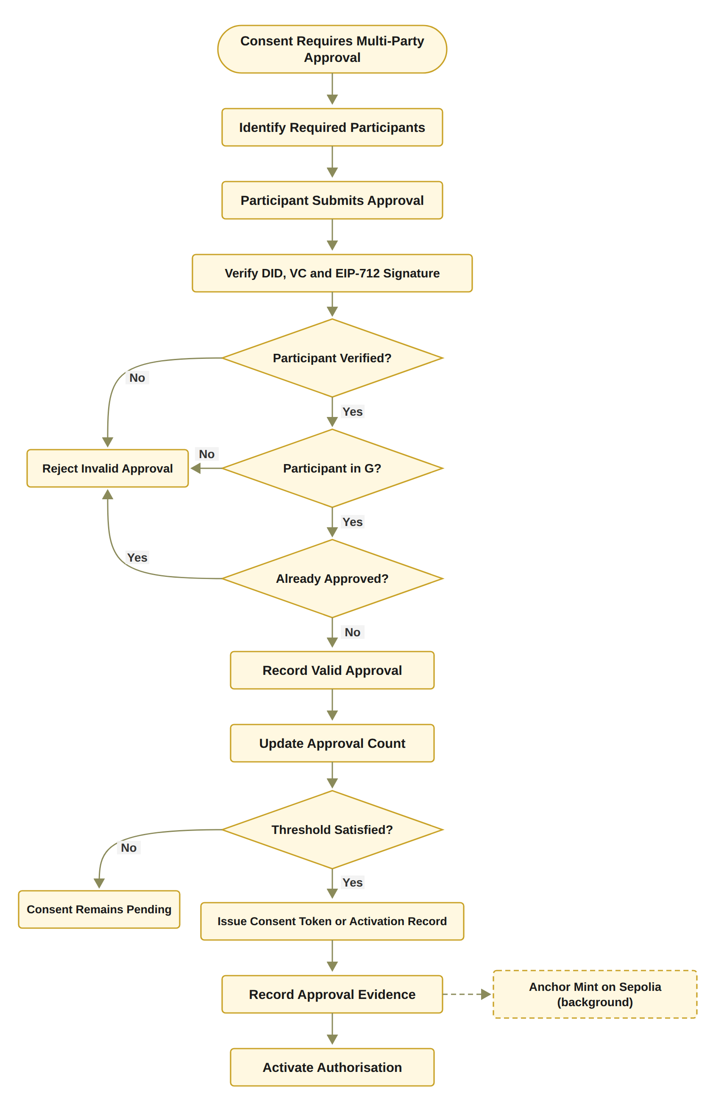
RO3: Trustworthy Multi-Party Authorisation
Status: Done
Notes:
Here the flowchart shows how Objective 3 works.
First, the system checks the guardian's identity and signature.
Next, it checks if the guardian is authorised and has not already approved.
If a check fails, the approval is rejected.
If only one guardian approves, the consent stays pending.
When both guardians approve, the consent becomes active, and the evidence is recorded.
And this objective has been achieved

Slide 25
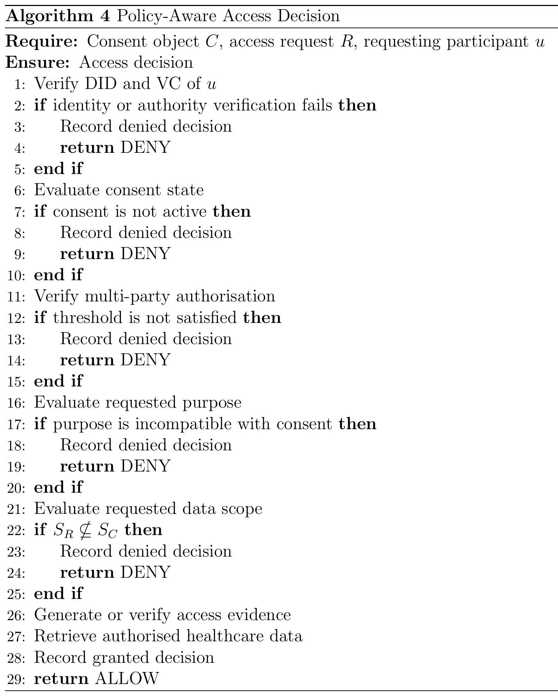
Proposed solution for objective 4
RO4: Policy- and Context-Aware Access Control
Status: Done
The requested data must be a non-empty subset of the agreed data scope.
The purpose must be a supported purpose of the consent.
Time and the lifecycle state are checked in the same decision.
Access evidence must be verified before any data is retrieved.
Example: asking for Procedure when only Observation and Medication were agreed gives DENY.
Notes:
In Objective 4, we aim to develop a policy-aware method for healthcare data access.
First, the system checks identity, approvals, and consent status.
Next, it checks the purpose, data scope, and time.
If any check fails, access is denied.
Otherwise, access is allowed, and the decision is recorded.
----------------------------------------------------------------------------------------------------------------------------------
Inputs and Output
Require: Consent object C, access request R, requesting participant u
Explanation: The algorithm starts with the patient’s consent, the request for data, and the participant who makes the request, for example a doctor.
Ensure: Access decision
Explanation: The algorithm returns one decision, ALLOW or DENY, and it records that decision.
Step-by-Step Explanation
Line 1: Verify DID and VC of u
First, we verify the decentralised identifier and the verifiable credential of the requester. This uses the identity check from Algorithm 2.
Line 2: if identity or authority verification fails then
We check whether the identity or authority check for the requester has failed.
Line 3: Record denied decision
If it has failed, we record the denied decision for auditing.
Line 4: return DENY
The request is denied and stops here.
Line 5: end if
This completes the identity and authority check.
Line 6: Evaluate consent state
Next, we check the current state of the consent. It must be active, within its validity period, and not revoked.
Line 7: if consent is not active then
We check whether the consent is not active.
Line 8: Record denied decision
If the consent is not active, we record the denied decision.
Line 9: return DENY
The request is denied.
Line 10: end if
This completes the consent state check.
Line 11: Verify multi-party authorisation
Then, we verify the multi-party authorisation. We compare the number of valid approvals, |A_v|, with the required threshold N.
Line 12: if threshold is not satisfied then
We check whether there are fewer valid approvals than the threshold.
Line 13: Record denied decision
If there are not enough approvals, we record the denied decision.
Line 14: return DENY
The request is denied.
Line 15: end if
This completes the multi-party authorisation check.
Line 16: Evaluate requested purpose
Next, we compare the purpose of the request with the purpose the patient allowed in the consent.
Line 17: if purpose is incompatible with consent then
We check whether the purpose does not match the consent. This stops valid credentials from being used for a purpose the patient did not allow.
Line 18: Record denied decision
If the purpose does not match, we record the denied decision.
Line 19: return DENY
The request is denied.
Line 20: end if
This completes the purpose check.
Line 21: Evaluate requested data scope
We look at the data the request asks for, S_R, and the data the patient allowed, S_C.
Line 22: if S_R ⊈ S_C then
We check whether the request asks for data outside the allowed scope. For example, the request may ask for Procedure records when only Observation and Medication records are allowed.
Line 23: Record denied decision
If the request goes outside the scope, we record the denied decision.
Line 24: return DENY
The request is denied.
Line 25: end if
This completes the data scope check.
Line 26: Generate or verify access evidence
All checks have passed, so we generate or verify the evidence for this decision. In the flowchart on the next slide, this is the Groth16 proof, which must be valid before any data is released.
Line 27: Retrieve authorised healthcare data
Then, we retrieve only the data inside the authorised scope, and nothing more.
Line 28: Record granted decision
We record the granted decision, so an auditor can see why and when access was given.
Line 29: return ALLOW
Finally, we return ALLOW, and the requester receives the authorised data.
Note: In the prototype, the request uses the consent’s own purpose, so the purpose check confirms that it is a supported healthcare purpose. The requested scope must also be non-empty.

Slide 26
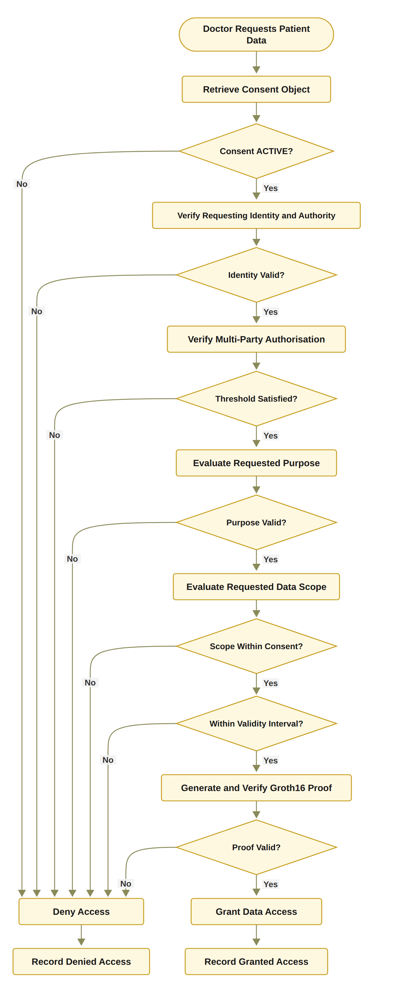
RO4: Policy- and Context-Aware Access Control
Notes:
Here the flowchart shows Objective 4. And As I said previously, if any check fails, the access will be denied .
Also this objective is done
--------------------------------------------------------------------------------------
This flowchart shows Algorithm 4. It checks the consent state, then the identity, then the approvals, then the purpose, then the data scope, then the time window, and finally the access proof. Any failure gives DENY and is recorded. Only when everything passes does the system return the authorised data.

Slide 27
Proposed solution for objective 5
RO5: Temporal and Lifecycle Trust
Status: In Progress
Working now: the validity window is stored on-chain and checked at every request.
Working now: revocation end to end, including an on-chain revoke transaction.
Design: L is the lifecycle state (CREATED, PENDING, ACTIVE, SUSPENDED, REVOKED, EXPIRED), checked by VL(C) = ValidState(C) ∧ ValidTransition(C).
Working now: a clear lifecycle: PENDING_SIGNATURE, PENDING_TOKEN, NOT_STARTED, ACTIVE, EXPIRED, REVOKED.
Next stage: the SUSPENDED state, the lifecycle transition check, consent modification, delegation, guardian-set changes and a formal lifecycle model.
Notes:
In Objective 5, we aim to develop a mechanism to ensure that consent is valid and trusted over time.
This work is still in progress.
Currently, HALAH checks the consent time and status before allowing access.
It also supports consent revocation.
If the consent has expired or been revoked, access is denied.
In the next stage, I will add more lifecycle controls, such as suspension and consent changes.

Slide 28
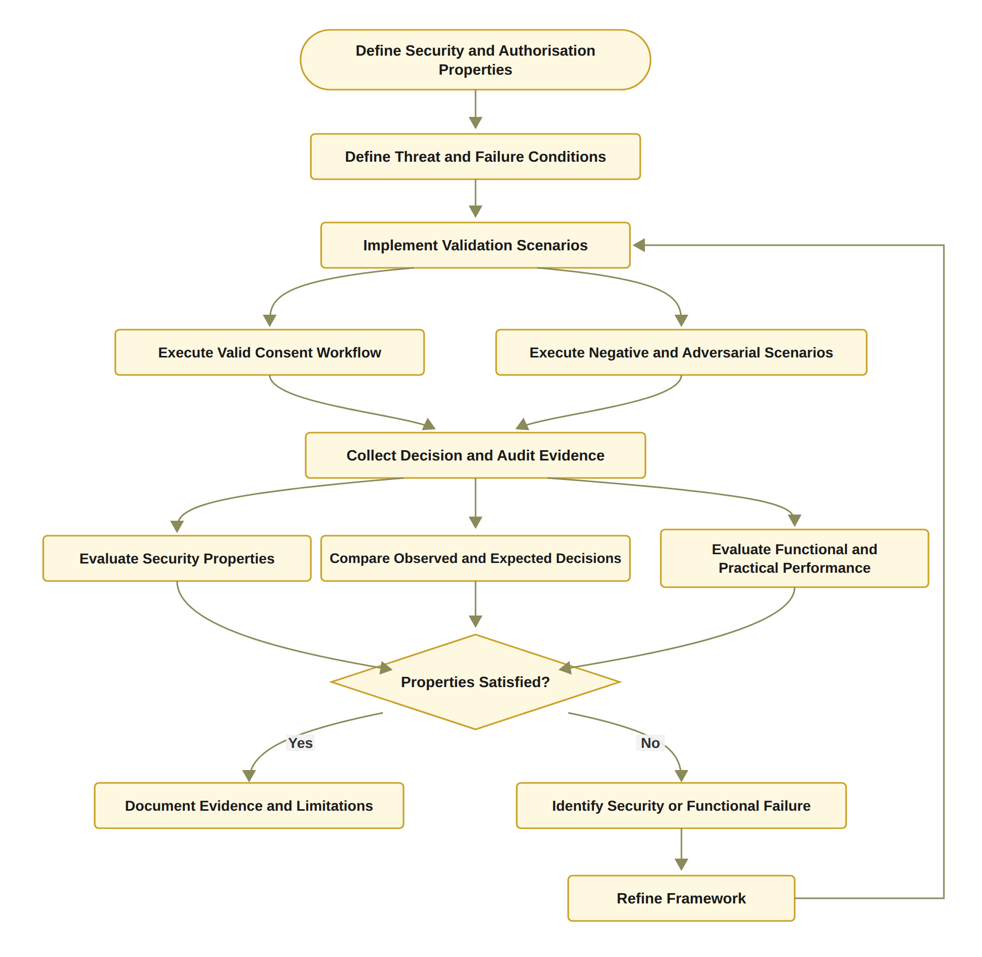
Proposed solution for objective 6
RO6: Formal Security Assurance and Empirical Validation
Status: Partially completed
Done: 46 automated tests pass, including 12 attack scenarios A1 to A12.
Done: gas, confirmation latency and processing time measured.
Next stage: formal proofs or model checking of the security properties, and a larger evaluation under load.
Notes:
Finally in Objective 6, we aim to develop and evaluate security testing methods to ensure the system is secure and reliable.
So far, all 46 automated tests have passed, including 12 attack scenarios.
I also measured gas costs, confirmation time, and processing time.
In the next stage, I will add formal security proofs and more testing.

Slide 29
THE HALAH PROTOTYPE
Four interfaces
Patient, guardian, doctor and auditor
Identity and credentials
A DID for every participant; a verifiable credential is checked before access or approval
Multi-party approval
Every listed guardian signs a digital approval; the consent becomes active only when all have signed
Decision engine
VI ∧ VA ∧ VP ∧ VT ∧ VL checked at every request; one failed check gives DENY
Data
Synthetic Synthea records: Observation, Medication, Condition, Procedure
Evidence
Audit ledger of consent events and access decisions; medical records stay inside the application
Notes:
For the upcoming slides, i will explain HALAH prototype.
HALAH has four interfaces: patient, guardian, doctor, and auditor.
It checks identity, authority, and guardian approvals.
It also checks access rules, time, and consent status before allowing access.
The system uses synthetic Synthea healthcare data and records decisions in an audit log.
-----------------------------------------------------------------------------------
HALAH means History Access Link for Authorised Healthcare.
It has four interfaces: patient, guardian, doctor and auditor. Every participant has a DID, and a verifiable credential is checked before access or approval. Every listed guardian must sign, and the consent becomes active only when all have signed. The decision engine checks the five conditions at every request, and one failed check gives DENY. The data are synthetic Synthea records. The audit ledger keeps all events, and the medical records stay inside the application.

Slide 30
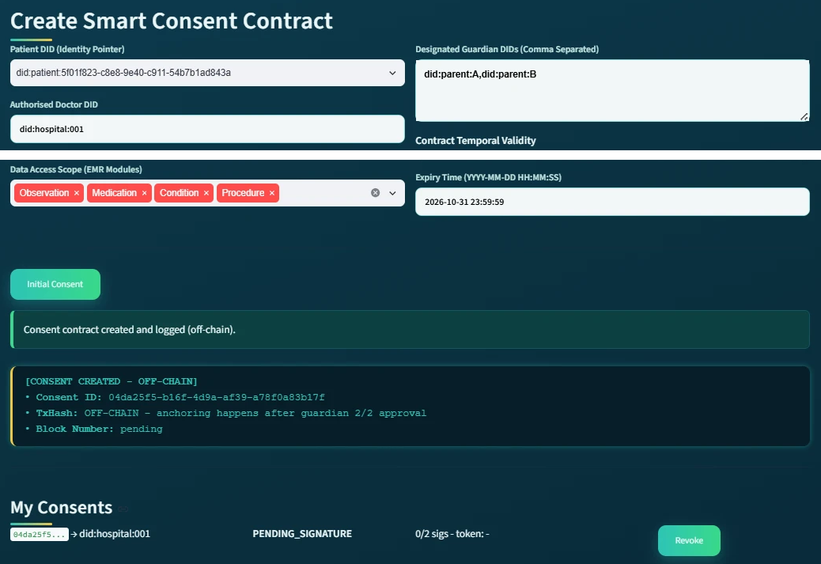
DEMO 1: THE PATIENT CREATES THE CONSENT
RO1
Consent as an evaluable object
The patient enters the doctor's DID, two guardians, the data modules and the end date.
The system saves the consent and gives it an ID.
The state is PENDING_SIGNATURE, with 0 of 2 signatures.
The consent is not active yet.
Patient screen, consent 04da25f5 (shown in two parts)
Notes:
in Halah prototype This is the patient screen.
First, the patient selects the doctor, two guardians, the data to share, and the expiry date.
Next, HALAH creates the consent and gives it an ID.
The consent stays pending until both guardians approve.
At this stage, access is not allowed.
--------------------------------------------------------------------------------------
:
لو سألوا "ليش ما فيه شي على البلوكتشين؟":
“The consent goes on-chain only after both guardians approve. Until then it is pending, so nothing is anchored.”
لو سألوا "وين RO1 هنا؟":
“This is RO1. The consent is created as a structured object with identity, guardians, data scope and time, so it can be checked at every request later.”
لو سألوا "هل النظام يتحقق من المدخلات؟":
“Yes. Bad input is rejected, for example an empty data scope, a malformed DID, or an end date before the start date.”

Slide 31
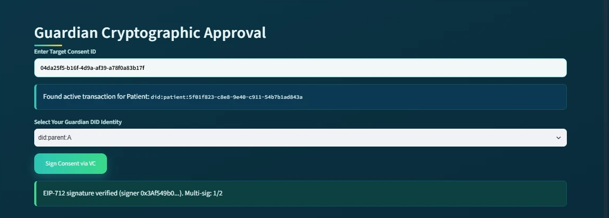
DEMO 2: THE FIRST GUARDIAN APPROVES
RO2 + RO3
Guardian A enters the consent ID and chooses their DID.
The first guardian signs a digital approval. The system checks the signature and finds who signed.
The counter shows 1 of 2. The consent stays pending.
Guardian screen at the first approval: signature verified, 1 of 2 signatures
Notes:
This is the first guardian's screen.
First, the guardian enters the consent ID and selects their DID.
Next, the guardian signs the consent, and HALAH checks the signature.
The system now shows 1 out of 2 approvals.
The consent stays pending until the second guardian approves.

Slide 32
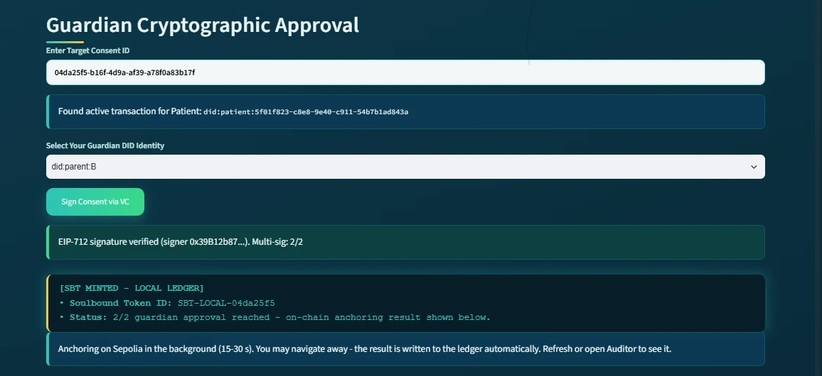
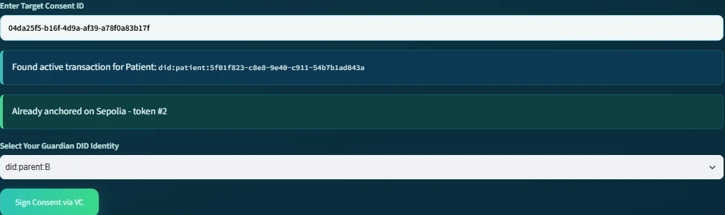
DEMO 3: SECOND APPROVAL, CONSENT ACTIVE
RO3
Threshold reached: 2 of 2, the consent becomes active
The second signature is verified. Now 2 of 2 guardians have signed.
The consent becomes active.. The guardian does not wait.
Same screen, after signed
Second approval: 2 of 2 guardians signed
Notes:
Now, the second guardian signs the consent.
HALAH checks the signature, and the system shows 2 out of 2 approvals.
The consent becomes active

Slide 33
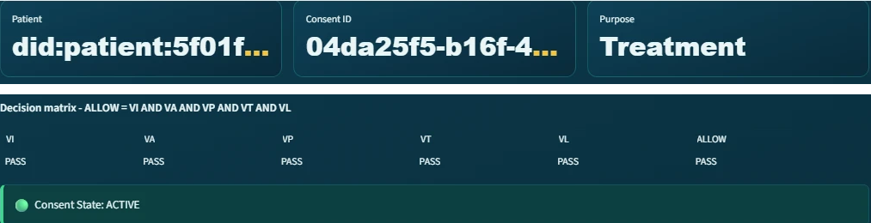
DEMO 4: THE DOCTOR IS ALLOWED
RO2 + RO4
The doctor opens the consent: patient, consent ID and purpose, Treatment. The state is ACTIVE.
The decision matrix shows VI, VA, VP, VT, VL all PASS, so ALLOW.
VP is the policy check: the purpose is checked here, and the scope when the doctor asks for the data.
Doctor screen, consent 04da25f5 (shown in two parts)
Notes:
This is the doctor's screen.
After both guardians approve, the consent becomes active.
HALAH checks five conditions: identity, authority, policy, time, and consent status.
All checks pass, so the system allows access.
The doctor can now request data within the agreed scope.

Slide 34
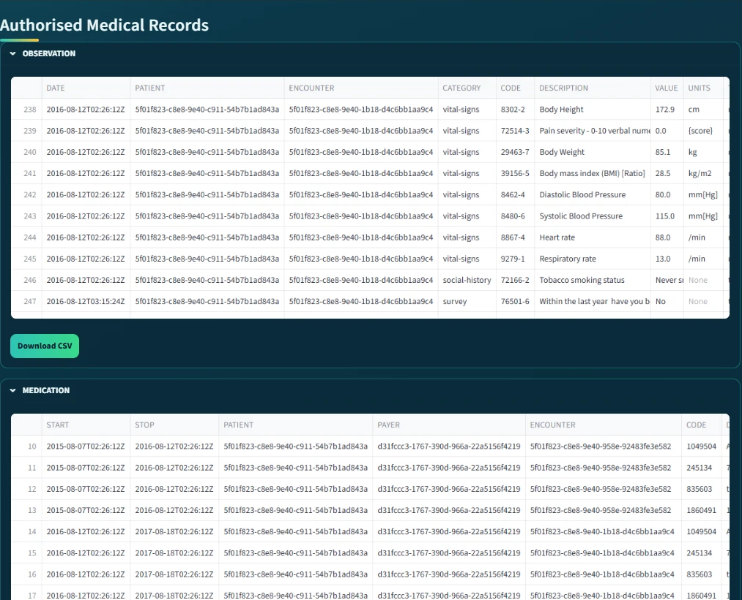
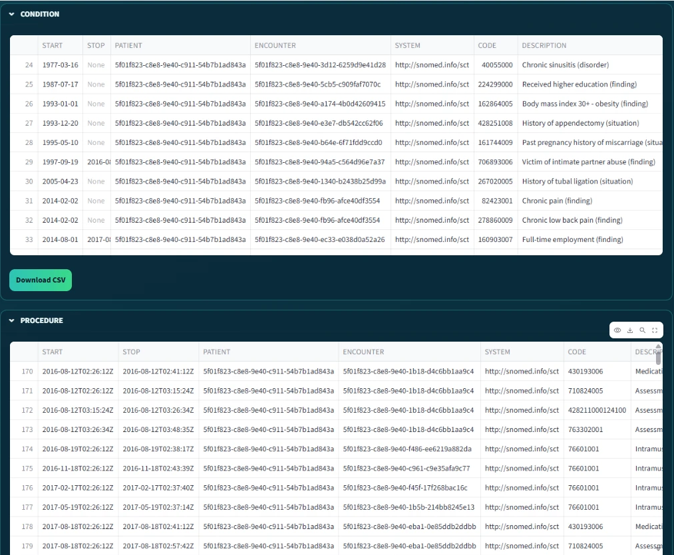
DEMO 5: ONLY THE AUTHORISED RECORDS
RO4
After ALLOW and the proof check, the screen shows the records, one table per module.
Only the four modules in the consent are shown. A request outside the scope is refused (attack test A4).
The data are synthetic Synthea records, not real patients.
Authorised records: Observation and Medication
Authorised records: Condition and Procedure
Notes:
This slide shows the healthcare records the doctor can access.
After all checks pass, HALAH displays only the approved data.
The four modules are Observation, Medication, Condition, and Procedure.
Any request outside the approved scope is denied.
-----------------------------------------------------------------------------------
All records come from the synthetic dataset
All records come from the synthetic Synthea dataset, not real patients.

Slide 35
VALIDATION
Evidence | What it checks | Pass rule | Result
Valid scenarios | Legitimate requests get access | Observed = expected | Scenarios 1 to 3: consent created, 2-of-2 approval, ALLOW
Negative scenarios | Wrong requests are refused | Any failed check gives DENY | Scenario 5: revoked consent refused
Attack scenarios | Deliberate attempts to bypass a check, A1 to A12 | Every attack is refused | 12 of 12 refused
Automated tests | 32 functional tests and 14 adversarial tests | All pass | 46 of 46 pass
Notes:
This slide shows how I validated HALAH.
First, I tested valid and invalid requests.
Next, I tested 12 attack scenarios, and all were rejected.
In total, all 46 automated tests passed.

Slide 36
VALIDATION: THE RECORDED DECISIONS
Time (24 Sep) | Consent | VI | VA | VP | VT | VL | Decision | Access
09:51:36 | f050c29a | PASS | PASS | PASS | PASS | PASS | ALLOW | GRANTED
09:51:39 | f050c29a | PASS | PASS | PASS | PASS | PASS | ALLOW | GRANTED
11:02:52 | 04da25f5 | PASS | PASS | PASS | PASS | PASS | ALLOW | GRANTED
11:04:16 | 04da25f5 | PASS | PASS | PASS | PASS | PASS | ALLOW | GRANTED
11:04:26 | 04da25f5 | PASS | PASS | PASS | PASS | PASS | ALLOW | GRANTED
Allowed requests: all five checks PASS, decision ALLOW, access GRANTED (Scenario 3).
After revocation (Scenario 5) the request was refused before any decision was logged; the prototype now logs these refusals too.
Notes:
This table shows the access decisions recorded in HALAH.
All five checks passed for these requests, so access was allowed.
After the consent was revoked, access was denied.
The updated system also records denied requests.

Slide 37
VALIDATION: THE RECORDED DECISIONS
Date and time | Consent | VI | VA | VP | VT | VL | Decision | Access
24 Sep 09:51:36 | f050c29a | PASS | PASS | PASS | PASS | PASS | ALLOW | GRANTED
24 Sep 09:51:39 | f050c29a | PASS | PASS | PASS | PASS | PASS | ALLOW | GRANTED
24 Sep 11:02:52 | 04da25f5 | PASS | PASS | PASS | PASS | PASS | ALLOW | GRANTED
24 Sep 11:04:16 | 04da25f5 | PASS | PASS | PASS | PASS | PASS | ALLOW | GRANTED
24 Sep 11:04:26 | 04da25f5 | PASS | PASS | PASS | PASS | PASS | ALLOW | GRANTED
11 Oct 17:42:04 | 18ab9b62 | FAIL | PASS | PASS | PASS | PASS | DENY | DENIED
11 Oct 17:42:39 | 18ab9b62 | PASS | FAIL | PASS | PASS | FAIL | DENY | DENIED
Allowed requests (24 September): all five checks PASS, decision ALLOW, access GRANTED (Scenario 3).
After revocation (Scenario 5) the request was refused before any decision was logged.
The prototype now logs every refusal. Local test run, 11 October 2026: a doctor not named in the consent fails VI, and the request after revocation fails VA and VL. Both are DENY.
Notes:
This table shows the access decisions recorded in HALAH.
All five checks passed for these requests, so access was allowed.
After the consent was revoked, access was denied.
The updated system also records denied requests.

Slide 38
VALIDATION: ATTACK SCENARIOS
ID | Attack | Target | Before hardening | After hardening
A1 | Approval signed by a signer outside G | A | Accepted* | Refused
A2 | Guardian signature replayed from another consent | I | Refused | Refused
A3 | Same guardian approves twice to reach N | A | Accepted* | Refused
A4 | Requested scope exceeds the authorised scope | P | Refused | Refused
A5 | Request with an empty scope | P | Accepted* | Refused
A6 | Request before notBefore or after expiry | T | Refused | Refused
A7 | Requester declares a different jurisdiction | P | Refused | Refused
A8 | Access after revocation | L | Refused | Refused
A9 | Tampered Groth16 proof or public signal | E | Refused | Refused
A10 | Honest proof for an expired consent | T | Refused | Refused
A11 | Mint or revoke by a non-owner, or token transfer | Contract | Refused | Refused
A12 | Invalid or forged credential | I | Accepted‡ | Refused
Notes:
I also attacked my own system. This table shows each attack, the part of the consent it targets, and the result before and after hardening.
Some attacks, marked Accepted, passed at unit level before the hardening, when the service function was called directly. For A1, A3 and A5, the interface already blocked them. A12 was accepted before the credential check was added. After hardening, all twelve attacks in this table are refused.
-------------------------------------------------------------------------------------------------------------------
A11 attacks the smart contract itself. An account that is not the owner tries to mint a consent token, revoke someone else’s consent, or transfer the token. All three are refused: only the owner can mint or revoke, and the token is soulbound, so it cannot be transferred. This test runs the contract code on a local test chain, not on Sepolia.

Slide 39
Traditional EHR vs. HALAH Framework
Aspect | Traditional EHR access control | HALAH framework
Identity | Central identity provider; institution login | A DID for every participant; identity kept separate from authority
Consent | A stored record that permission was given | An object C = (I, A, P, T, L, E), checked at every request
Approval | A static permission set by one party | All listed guardians sign a digital approval; no single party can approve alone
Access check | Log in, then check a static permission | VI ∧ VA ∧ VP ∧ VT ∧ VL checked at every request; one failed check gives DENY
Time and revocation | Hard to verify once the permission is stored | Validity window and revocation checked at every request
Audit | A record that consent occurred | Every access decision, allowed or denied, logged with its decision matrix
Notes:
This slide compares traditional EHR systems with my HALAH framework.
Traditional systems often use central logins and stored permissions.
In HALAH, we check identity, authority, guardian approvals, access rules, time, and revocation.
Every request is checked, and every decision is recorded.
This makes access decisions easier to verify and audit.

Slide 40
DATASET OVERVIEW
Aspect | Description
Dataset | Synthea 1K, a public synthetic healthcare dataset containing 1,000 simulated patient records.
Data Type | Synthetic patient demographics, medical conditions, medications, and procedures
Data Format | CSV files
Data Usage | Healthcare data-access scenarios for prototype testing
Data Privacy | No real patient data is used
Notes:
This slide shows the dataset used in my research.
I used Synthea 1K, which contains public 1,000 simulated patient records.
The data includes patient information, medical conditions, medications, and procedures.
I used this dataset to test healthcare data access in HALAH.
No real patient data was used.

Slide 41
RESEARCH CONTRIBUTIONS
Scientific Contributions
This research proposes a trust-centric consent model that integrates identity, authority,
multi-party approval, and policy constraints into a unified healthcare authorisation framework.
This research proposes a multi-party authorisation mechanism that requires approval from
multiple verified participants before granting healthcare data access, where collective consent is required.
This research proposes a trust-aware authorisation approach that evaluates identity, authority,
collective approval, and policy compliance when determining healthcare data-access permissions.
Notes:
This slide shows the three main scientific contributions of my research.
First, I propose a consent model that combines identity, authority, multi-party approval, and policy.
Second, I develop a system that requires approval from multiple authorised people.
Third, I propose a trust-aware approach that checks these conditions before allowing access to healthcare data.

Slide 42
RESEARCH CONTRIBUTIONS
Social Contributions
This research aims to help patients and their guardians manage consent for sharing sensitive healthcare information, supporting greater control over healthcare data access.
This research aims to support patient privacy by restricting healthcare data access according to authorised purposes and data scopes.
This research aims to support transparency and accountability in healthcare data sharing by providing verifiable records of consent activities and access decisions.
Notes:
This slide shows the three main social contributions of my research.
First, it helps patients and guardians control who can access their health data.
Second, it protects patient privacy by limiting access to approved purposes and data.
Third, it improves transparency by recording consent activities and access decisions.

Slide 43
RESEARCH PLAN
Task | Description | Target date | Status
Chapters 1–4 | Introduction, SLR, Research Questions and Objectives, Research Methodology | Completed | Done
Chapter 5 | Research Architecture (MVC) and framework design and Proposed solution for RO2 | May 2026 | Done
Chapter 6 | Proposed solution for RO3 | Jul 2026 | Done
Publication 1 | Conference paper submission, BWCCA 2026 | Sep 2026 | Done
Chapter 7 | Proposed solution for RO4 | Sep 2026 | Done
Publication 2 | SLR paper journal submission | Oct 2026 | Ready for submission
Chapter 8 | Proposed solution for RO5 | Nov 2026 | In progress
Chapter 9 | Conclusion and Future work | Dec 2026 | Planned
Publication 3 | Journal paper on formal security assurance, lifecycle trust and the evaluation of HALAH | Jan 2027 | Planned
Final assessment | Candidature Assessment 3 | Feb 2027 | Planned
Thesis | Complete thesis submission | May 2027 | Planned
Notes:
This slide shows my research plan.
So far, I have completed Chapters 1 to 7 and submitted my BWCCA conference paper.
I am now working on Chapter 8 and preparing my literature review paper for submission.
Next, I plan to finish the remaining work and complete CA3 in February 2027.
My target is to submit my PhD thesis in May 2027.

Slide 44
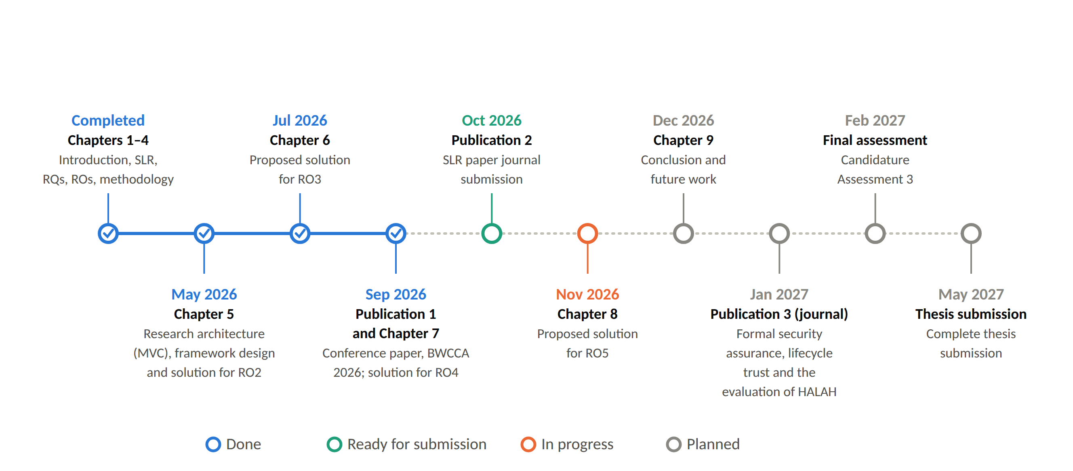
RESEARCH TIMELINE
Notes:
Here is the timeline of my research. Which shows the research plan with the publications.
As i said, My final target is to submit my PhD thesis in May 2027.
--------------------------------------------------------------------------------------------------------
Chapters one to seven and the BWCCA conference paper are done. The SLR journal paper is ready for submission, and Chapter 8 on RO5 is in progress. In December, Chapter 9 with the conclusion. In January 2027, the journal paper on formal assurance. Then the next candidature assessment in February 2027, and thesis submission in May 2027.

Slide 45
RESEARCH PUBLICATIONS
# | Title | Venue | Year | Status
1 | A Blockchain-Based Framework for Evaluating User Identity Trustworthiness in Real Estate | 2025 IEEE International Conference on E-Business Engineering (ICEBE) | 2025 | Published
2 | Blockchain-Based Reputation Borrowing Model to Address the Cold Start Problem for New Users in Real Estate | 2025 IEEE International Conference on E-Business Engineering (ICEBE) | 2025 | Published
3 | A Smart Contract-Governed Lifecycle Protocol for Reputation Borrowing in Blockchain-Based Real Estate Platforms | ICEBE 2026 | 2026 | Accepted
4 | A Trusted Multi-Party Consent Governance Framework for Decentralized Multi-Stakeholder Data Sharing | BWCCA 2026 | 2026 | Accepted
5 | Blockchain-Based Reputation Provenance Tracing for Newcomer Bootstrapping in Real Estate | BWCCA 2026 | 2026 | Accepted
Notes:
And here are the list of my research publications.
I published two papers at IEEE ICEBE in 2025.
Three more papers were accepted in 2026: one at ICEBE and two at BWCCA.
Paper number 4 is directly related to my PhD research on multi-party consent.

Slide 46
REFERENCES
Bloemen, R., Logvinov, L. & Evans, J. 2017, EIP-712: Typed structured data hashing and signing, Ethereum Improvement Proposals, no. 712, viewed 6 October 2026, https://eips.ethereum.org/EIPS/eip-712.
Cai, B. 2022, ERC-5484: Consensual soulbound tokens, Ethereum Improvement Proposals, no. 5484, viewed 6 October 2026, https://eips.ethereum.org/EIPS/eip-5484.
Entriken, W., Shirley, D., Evans, J. & Sachs, N. 2018, ERC-721: Non-fungible token standard, Ethereum Improvement Proposals, no. 721, viewed 6 October 2026, https://eips.ethereum.org/EIPS/eip-721.
Ethereum Foundation 2026b, Networks, ethereum.org developer documentation, viewed 7 October 2026, https://ethereum.org/en/developers/docs/networks/.
Groth, J. 2016, 'On the size of pairing-based non-interactive arguments', Advances in Cryptology – EUROCRYPT 2016, LNCS, vol. 9666, pp. 305–326, Springer, https://doi.org/10.1007/978-3-662-49896-5_11.
Page, M.J., McKenzie, J.E., Bossuyt, P.M., Boutron, I., Hoffmann, T.C., Mulrow, C.D. et al. 2021, 'The PRISMA 2020 statement: An updated guideline for reporting systematic reviews', BMJ, vol. 372, p. n71, https://doi.org/10.1136/bmj.n71.
Walonoski, J., Kramer, M., Nichols, J., Quina, A., Moesel, C., Hall, D. et al. 2018, 'Synthea: An approach, method, and software mechanism for generating synthetic patients and the synthetic electronic health care record', Journal of the American Medical Informatics Association, vol. 25, no. 3, pp. 230–238, https://doi.org/10.1093/jamia/ocx079.
Peffers, K., Tuunanen, T., Rothenberger, M.A. & Chatterjee, S. 2007, ‘A design science research methodology for information systems research’, Journal of Management Information Systems, vol. 24, no. 3, pp. 45–77, https://doi.org/10.2753/MIS0742-1222240302.
Notes:
These are the references I used in this presentation

Slide 47
Thank You
Notes:
Thank you for your attention.
Can you explain your project in simple words?
My system shares a patient’s health data only when all their guardians agree. Every time someone asks for the data, the system checks the consent again.
2. Who is this system for?
It is for patients who cannot decide alone, like children or older people. It also helps their guardians and their doctors.
3. What did you actually build?
I built a working web prototype. The patient creates a consent, the guardians approve it, and the doctor asks for access. The system checks the request, decides, and records the result.
4. How do you know a guardian is really a guardian?
Each guardian has a digital credential from a trusted issuer. The system checks the credential is real, belongs to that person, is still valid and has the right role.
5. What happens if one guardian does not approve?
The consent stays pending, so nobody can see the data. This is safer, but it can be slower.
6. Why do you check the consent every time, and not only once?
Things can change. A consent can expire or be cancelled, so the system checks it again on every request.
7. What happens if someone tries to fake an approval?
The signature check fails, so the approval does not count. I tested 12 attacks like this, and the system refused all of them.
8. Why do you need the audit ledger?
It records every decision, with the time and the result of each check. Later, anyone can see who asked for data and why it was allowed or denied.
9. What are the limits of your prototype?
It uses synthetic data and demo keys. It has not been tested in a real hospital yet.
10. What will you do next?
I will finish RO5 and RO6 and add the formal proofs. Then I will write the thesis, due in May 2027.
What is your novelty?
Other studies check only some of the conditions, or they check consent once and then stop. In my framework, every request must pass all the conditions together: identity, authority, approval from all guardians, purpose, time and lifecycle state. The patient also chooses the guardians.
If they push: “Multi-party approval already exists in the literature, but only at one moment, for example at registration. In my work it is checked on every request.”
What is your main contribution?
My main contribution has three parts:
A consent model. Consent is an object with six parts that can be checked, not just a yes-or-no record.
A multi-guardian approval method. Only real, verified approvals count, and the same guardian cannot be counted twice.
A decision rule. Five checks run on every request, and all of them must pass.
I showed this in a working prototype and tested it with 46 tests and 12 attacks.
One-sentence version: “Data is shared only when identity, authority, all guardians, purpose, time and state are all valid, and this is checked every time.”
10 more questions
1. What gap did you find in the literature?
I found two gaps. First, no study puts all the conditions into one decision. Second, no study proves or fully tests the whole decision.
2. How did you review the literature?
I did a systematic review using PRISMA 2020. I included papers from 2020 to 2026 and analysed 25 studies in full.
3. Multi-party consent already exists. What is different in yours?
In other studies, it happens only once, like at registration. In mine, it is checked on every request, and the patient picks the guardians.
4. What research method did you use?
Design Science Research. I found the problem, suggested a solution, built it, tested it and drew conclusions. It fits because I am building and testing a system.
5. What are the six parts of your consent?
Identity, authority (the guardians and how many must approve), policy (purpose and which data), time, lifecycle state and evidence.
6. What states can a consent be in?
Pending, active, revoked or expired. Only an active consent allows access.
7. How many guardians can a patient have?
The patient decides how many, and all of them must approve. I tested it with two guardians.
8. What can a doctor ask for the data for?
Only treatment, research or emergency. Any other purpose is denied.
9. Did anything go wrong during testing?
Yes. At first, three attacks (A1, A3 and A5) worked when the code was called directly. I fixed the code, and now all 12 attacks are refused.
10. Have you published anything?
Yes. One paper has been accepted at BWCCA 2026.
I took these answers from your report. For Q8, the code also checks jurisdiction, but I left it out as you asked.
Likely questions and short answers:
1. Why blockchain, if the data stays off-chain?
It gives a shared record that cannot be changed quietly: the consent state and the revocation. No medical data is on the chain.
2. What is new?
The consent object carries all the conditions. Multi-party approval is a condition of every access, not a backup path. And the whole decision is tested against attacks.
3. Why is RO6 only partly done?
The testing is done. The formal proofs are the next stage.
4. Why Groth16?
It proves the consent has not expired without showing the secret. Today the prover and verifier run on the same server, so it shows the ZK step works; it is not yet an extra privacy guarantee.
5. Why did some attacks pass before the hardening?
Only when the service functions were called directly, not through the screens. The checks are now in the service layer, so they are refused on every path.
6. The guardian keys come from the DIDs. Can someone else sign?
In the prototype, yes in principle. That is a known limitation. Wallet-held keys and full DID resolution are planned for the next stage.
7. Why N-of-N and not k-of-n?
N-of-N is the safest setting: no guardian can be bypassed. k-of-n is a direct generalisation for future work.

