Slide 1

A Trusted Authorisation Framework for Multi-Party Patient Consent in Healthcare Data Sharing
Principal Supervisor: Professor Farookh Hussain
Co-Supervisor: Dr. Firas Al-Doghman
Presenter: Yasir Dhaifallah O Alyoubi
STUDENT ID #: 24724078
Notes:
Good morning everyone. My name is Yasir Alyoubi. My principal supervisor is Professor Farookh Hussain, and my co-supervisor is Dr Firas Al-Doghman. This is my candidature reassessment. My research asks one simple question. When a doctor asks for a patient's data, how can the system be sure that this request is really allowed? Not just who is asking. Also, did the patient and the guardians agree? Is the request inside the agreed data? And is the consent still valid today? I will show you the problem, what the literature says, my framework, the working prototype, and the results.

Slide 2
OUTLINE
01
RESEARCH PROBLEM & KEY IDEA
06
CONTRIBUTION & SIGNIFICANCE
02
LITERATURE REVIEW
07
LIMITATIONS & NEXT STEPS
03
GAP, QUESTIONS & OBJECTIVES
08
PUBLICATIONS & RESEARCH PLAN
04
METHODOLOGY & FRAMEWORK
09
DEMO: THE HALAH PROTOTYPE
05
VALIDATION & EVALUATION
10
REFERENCES
Notes:
Here is the plan for my talk. First, the research problem and the key idea. Then the literature review. Then the gap, the questions and the objectives. After that, the methodology, the framework and its six steps. Then the validation and the evaluation results, and the contribution and the significance of the research. Then I talk about the limitations, the next steps, my publications and the research plan. Then I show a short demonstration of the prototype through the slides, with real prototype screens from 24 September 2026, and I finish with the references.

Slide 3
THE PROBLEM
Healthcare data is shared between many independent parties: patient, guardians, doctor, hospital.
Today, consent is a stored record. It shows that permission was given, but it checks nothing at access time.
A valid identity does not prove the right to see this patient's data.
A request can ask for more data than allowed, or arrive after the consent expired or was revoked.
None of the reviewed studies proves or tests the whole decision.
The Min problem is that There is no trusted mechanism that checks identity, authority, multi-party approval, policy, time and lifecycle together in one access decision, with evidence that it is secure.
Notes:
Let me start with the problem. Health data is very sensitive. One decision to share it can involve many people: the patient, one or more guardians, the doctor, and the hospital. Today, consent is usually just a record that is saved somewhere. That record says permission was given. But it does not check anything when someone asks for the data. A valid login does not mean you have the right to see this patient's data. And even with approval, a request can ask for more data than the patient allowed, or it can come after the consent has expired or has been cancelled. So the real problem is this: there is no single trusted decision that checks all of these things together.

Slide 4
THE KEY IDEA
Consent is not a stored record. It is an object checked at every request.
C = (I, A, P, T, L, E)
I Identity
Who is the patient, the doctor and each guardian (DID).
A Authorisation
The guardian set G and how many approvals are needed (N).
P Policy
The purpose and the data scope that were agreed.
T Time
When the consent starts and when it expires.
L Lifecycle
The state of the consent, from creation to expiry or revocation.
E Evidence
Signatures, the token, and whether it is revoked.
Notes:
Here is my answer in simple words. Consent should not be a record that we store. It should be an object that the system checks every time. I call this object C, and it has six parts. I is identity: who is involved. A is authorisation: which guardians must approve, and how many. P is policy: the purpose and the data that was agreed. T is time: when the consent starts and when it ends. L is lifecycle: the state of the consent, from creation to expiry or revocation. And E is evidence: the signatures, the token, and whether the consent was cancelled. At every request, the system checks all six parts. If one part fails, the answer is no.

Slide 5
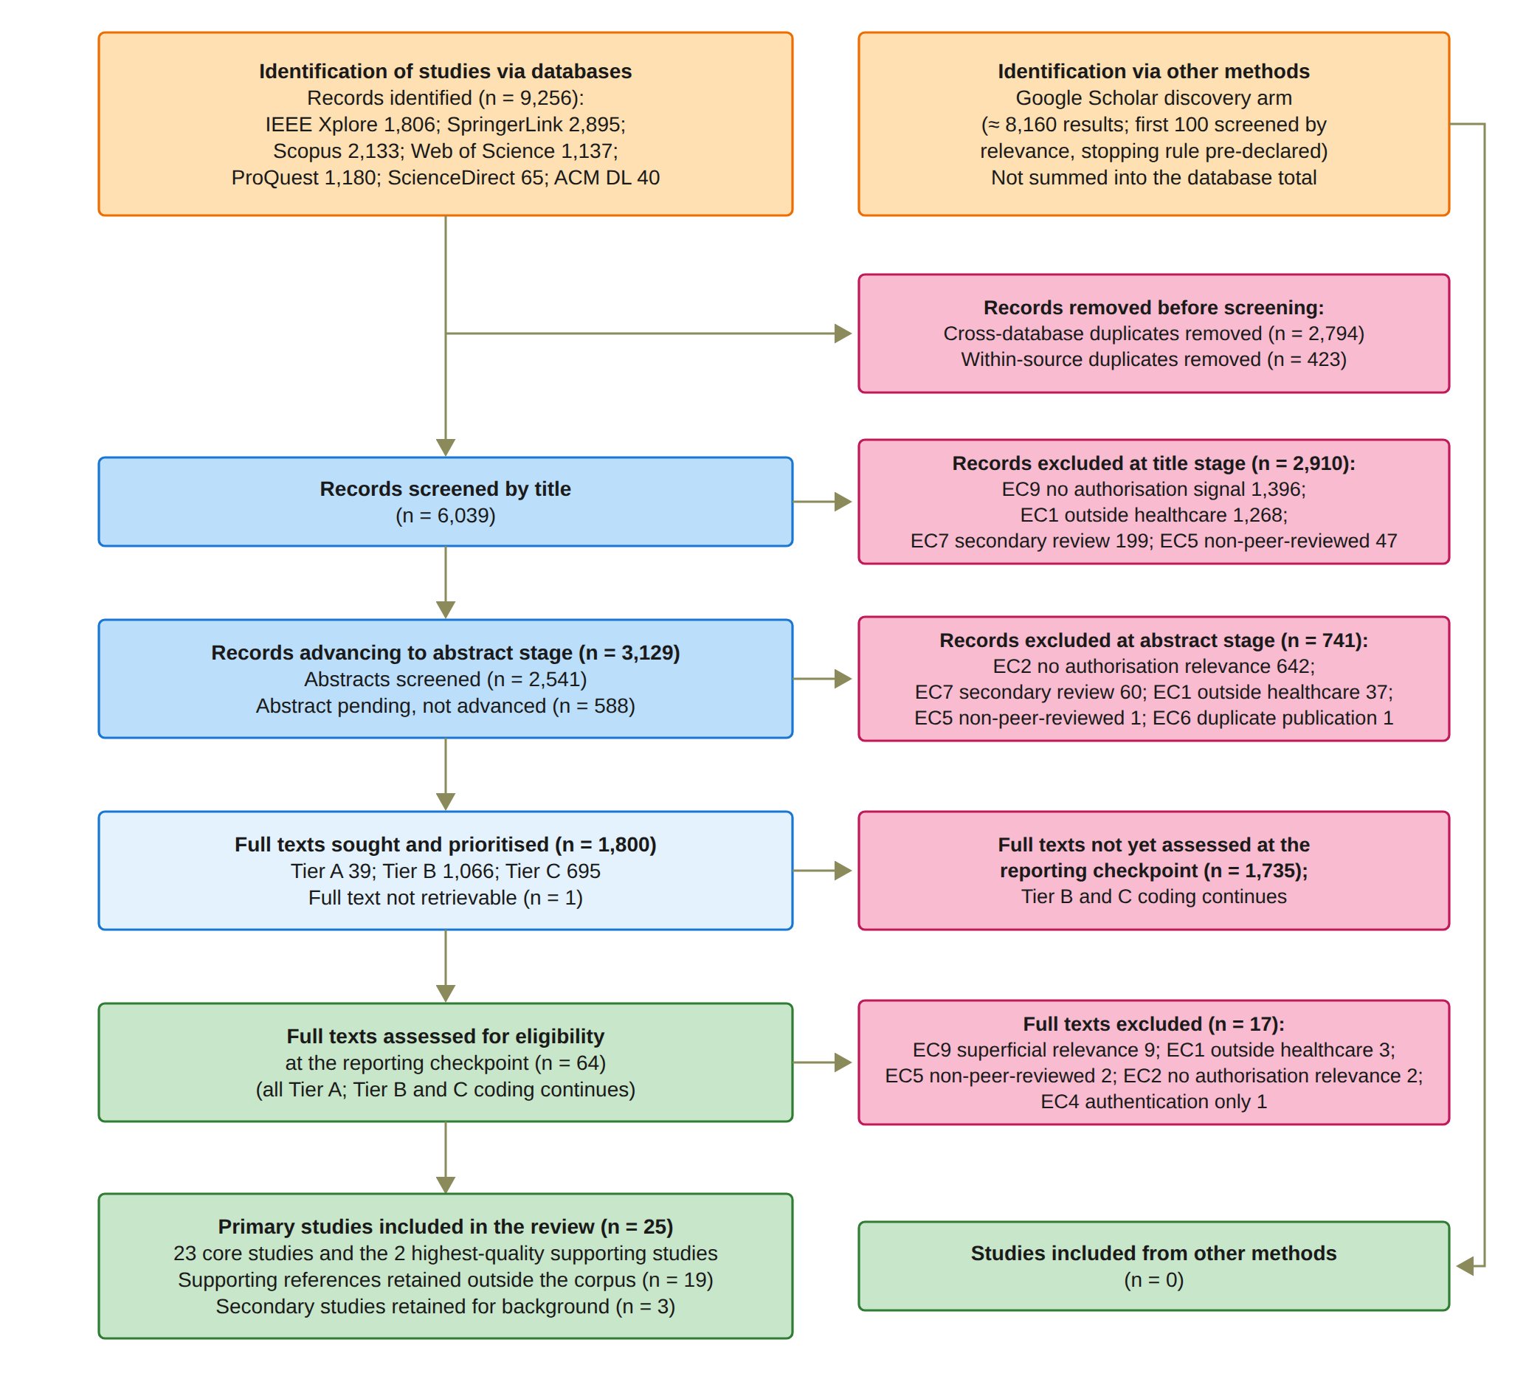
LITERATURE REVIEW
9,256
records from seven databases
47
studies met the criteria at the checkpoint
25
primary studies analysed (23 core + 2)
Notes:
This is how I did the literature review. I followed the PRISMA 2020 method. Before I started screening, I wrote a protocol that fixed the questions, the databases, one search query, the criteria and the quality items. I searched seven databases. They gave me 9,256 records. After I removed duplicates, 6,039 were screened by title. 3,129 went on to the abstract stage, and 2,541 of them were screened. Then 1,800 full texts were put in order of priority. At the reporting checkpoint, 64 full texts were assessed and 47 met the criteria. From these, I analysed 25 primary studies in depth: 23 core studies and 2 supporting studies.

Slide 6
SYSTEMATIC LITERATURE REVIEW
Trustworthy multi-party patient consent in healthcare data sharing
Review aim
01
Identification
Search healthcare, authorisation and trust concepts
Identify which trust conditions existing systems enforce, how they combine them, and what evidence supports the resulting access decision.
02
Inclusion and exclusion criteria
Apply predefined inclusion and exclusion criteria
03
Screening
Remove duplicates and assess relevance in stages
04
Quality and synthesis
Code evidence and compare six requirements
5
Notes:
This review asks how existing healthcare consent mechanisms establish a trustworthy authorisation decision. It examines which conditions are enforced, how they are combined, and what evidence supports the decision.
Protocol v1.1 fixed the review questions, databases, master query, eligibility criteria, codebook and quality items before screening. The author carried out the screening, coding and quality assessment up to the reporting checkpoint.
There are seven literature-review questions, mapped to six requirements. Review Questions 1 to 5 map to Req 1 to Req 5; Review Questions 6 and 7 together map to Req 6. These are distinct from the six project research questions.
PRISMA 2020 supports transparent reporting. It is not a study-quality score and does not establish that this checkpoint corpus is exhaustive.
Method reference: Page, M.J. et al. (2021), “The PRISMA 2020 statement: An updated guideline for reporting systematic reviews”, BMJ, 372, n71. DOI: https://doi.org/10.1136/bmj.n71. The citation and DOI were confirmed against the official BMJ record. Publisher page: https://www.bmj.com/content/372/bmj.n71.short.
Source: Yasir_CA2_Report_Template_Structure (9).docx, Section 2.2. All review counts and corpus findings are those recorded on 10 September 2026.

Slide 7
01 IDENTIFICATION: SOURCES AND SEARCH
Seven database arms returned 9,256 records before deduplication
Searches: August–September 2026
Publication range: January 2020–2026
Search concepts
Healthcare data AND Consent / authorisation AND Trust / multi-party
Report checkpoint: 10 September 2026
6
Notes:
The seven database searches returned 9,256 records: IEEE Xplore 1,806; SpringerLink 2,895; Scopus 2,133; Web of Science 1,137; ProQuest 1,180; ScienceDirect 65; and ACM Digital Library 40.
IEEE Xplore, Scopus, Web of Science and ProQuest were searched on 24 August 2026. SpringerLink, ScienceDirect and Google Scholar were searched on 25 August. ACM was searched on 5 September as a late arm, which is a declared limitation. Full-text coding began on 26 August.
The master query used three concept blocks joined by AND: healthcare data, consent and authorisation, and trust and multi-party concepts. The exact search terms are not reproduced in the provided report. This slide shows the concept blocks, not an invented search string.
Google Scholar was a separate discovery arm: approximately 8,160 results, with the first 100 screened by relevance using a predefined stopping rule. It added no primary studies and is not included in the 9,256 database total.
The sentinel test retrieved all four healthcare-scoped papers from twelve predefined sentinels. Eight were missed; one miss remained unexplained. This is not twelve-out-of-twelve recall.
Source: Yasir_CA2_Report_Template_Structure (9).docx, Section 2.2 and Figure 2.1. All review counts and corpus findings are those recorded on 10 September 2026.

Slide 8
02 Inclusion and exclusion criteria CRITERIA
Predefined criteria selected relevant mechanisms and evaluations
Included
Excluded from the primary corpus
Healthcare data sharing
Outside healthcare or the authorisation scope
Consent or authorisation relevant to data access
Authentication alone or a superficial mention of consent
A model, mechanism, system or evaluation that addresses a review question
Non-peer-reviewed work and duplicate publications
Peer-reviewed English paper with full text
Publication between January 2020 and 2026
Secondary reviews, with selected background references retained separately
Report checkpoint: 10 September 2026
7
Notes:
The eligibility criteria were defined before screening. Inclusion required healthcare data; consent, authorisation, access control, trust or governance relevant to data access; and a mechanism, model, system or evaluation relevant to a review question. Studies also had to be peer-reviewed English papers with full text, published from January 2020 to 2026.
Nine exclusion criteria were fixed in advance. The slide summarises the exclusions for work outside healthcare or the authorisation scope, authentication alone, superficial consent references, non-peer-reviewed work, duplicate publications and secondary reviews.
A study was not excluded because it contradicted the proposed gap. Its relevance was assessed through its contribution to the review questions rather than through one keyword.
Three secondary studies were retained separately for background. They are not part of the 25 primary studies. Keeping a background reference does not make it an included primary study.
Source: Yasir_CA2_Report_Template_Structure (9).docx, Section 2.2 and Figure 2.1. All review counts and corpus findings are those recorded on 10 September 2026.

Slide 9
03 Filtration process
Pending records remain visible in the selection process
9,256 records identified
2,794 cross-database + 423 within-source duplicates
6,039 unique records screened by title
2,910 excluded by title
3,129 advanced to abstract stage
588 abstracts pending
2,541 abstracts screened
741 excluded by abstract
1,800 full texts sought and prioritised
8
Notes:
This slide separates screened records from pending records. Removing 2,794 cross-database duplicates and 423 within-source duplicates from 9,256 records leaves 6,039 unique records.
Title screening excluded 2,910: 1,396 without an authorisation signal, 1,268 outside healthcare, 199 secondary reviews and 47 non-peer-reviewed records. The remaining 3,129 advanced to the abstract stage.
Of these, 2,541 abstracts were screened. Another 588 remained pending because the exports contained no abstracts, mostly from SpringerLink. Pending records were not excluded and did not advance to full text.
Abstract screening excluded 741: 642 without authorisation relevance, 60 secondary reviews, 37 outside healthcare, one non-peer-reviewed record and one duplicate publication. This left 1,800 full texts sought and prioritised.
The reconciliation is 6,039 = 2,910 title exclusions + 741 abstract exclusions + 588 pending abstracts + 1,800 advanced records. The title-plus-abstract exclusions total 3,651, not 4,239.
Method reference: Page et al. (2021), PRISMA 2020, https://doi.org/10.1136/bmj.n71.
Source: Yasir_CA2_Report_Template_Structure (9).docx, Figure 2.1 and Section 2.2. All review counts and corpus findings are those recorded on 10 September 2026.

Slide 10
03 SELECTION: FULL-TEXT CHECKPOINT
25 primary studies form the comparative analysis
1,800 full-text pool
1,735 not yet assessed
1 report not retrievable
64 full texts assessed
17 full-text exclusions
47 studies met the criteria
3 secondary studies for background
44 fully coded and quality passed
19 supporting references outside the primary corpus
25 primary studies analysed
9
Notes:
The 1,800 full-text pool was prioritised as Tier A 39, Tier B 1,066 and Tier C 695. At the checkpoint, all 39 Tier A reports and 25 further reports had been assessed: 64 in total. Another 1,735 remained unassessed and one could not be retrieved.
Seventeen assessed reports were excluded: nine for superficial relevance, three outside healthcare, two non-peer-reviewed, two without authorisation relevance and one for authentication alone. This left 47 reports retained after assessment.
The 47 comprise 44 fully coded, quality-passing reports and three secondary background studies. The 44 coded reports comprise 25 primary studies and 19 supporting references outside the primary corpus.
The primary corpus contains 23 core studies plus the two highest-quality supporting studies, each scoring 7.0: Albalwy, Brass and Davies (2021) and Li et al. (2026a). A study was core if its gap-impact verdict contradicted, weakened or narrowed the gap, or its multi-party dimension was Yes or Partial. Coding of Tiers B and C continues.
Supporting-study DOI links: https://doi.org/10.2196/27816 and https://doi.org/10.1109/JIOT.2025.3633504.
Source: Yasir_CA2_Report_Template_Structure (9).docx, Section 2.2, Figure 2.1 and Table 2.2. All review counts and corpus findings are those recorded on 10 September 2026.

Slide 11
04 QUALITY ASSESSMENT AND EVIDENCE CODING
Quality inclusion uses QA1–QA4, while QA5–QA8 determine the evidence tier
Item | Inclusion question
QA1 | Patient consent or consent-governed healthcare access?
QA2 | An authorisation or access-decision mechanism?
QA3 | A framework, model, protocol or architecture?
QA4 | Validation by proof of concept or implementation?
Report checkpoint: 10 September 2026
10
Notes:
Quality inclusion uses QA1 to QA4. QA1 concerns patient consent or consent-governed healthcare access. QA2 concerns an authorisation or access-decision mechanism rather than storage or recording alone. QA3 concerns a proper framework, model, protocol or architecture. QA4 concerns validation by a proof of concept or an implementation.
Each item is scored Yes = 1, Partial = 0.5, or No = 0. The inclusion gate is QA1 + QA2 + QA3 + QA4 ≥ 3.0. QA5 to QA8 determine the evidence tier rather than inclusion. Their individual questions are not reproduced in the provided report, so I do not invent them.
Each study is also coded against seven trust dimensions: identity, authority, multi-party, policy, temporal, lifecycle and audit; and against the six requirements. Every positive coding has a page reference. A trust-dimension grade is not interchangeable with a requirement grade.
A saturation rule was predefined: eight consecutively coded studies with a positive signal for a dimension must yield no new mechanism class. The report does not establish that saturation had been reached at this checkpoint.
Source: Yasir_CA2_Report_Template_Structure (9).docx, Section 2.2 and Table 2.1. All review counts and corpus findings are those recorded on 10 September 2026.

Slide 12
SIX RESEARCH STREAMS
Each of the 25 primary studies belongs to one thematic stream
Req 1
Consent representation
3
An evaluable consent object
Req 2
Identity and authority
3
Participant identity and legitimate role
Req 3
Multi-party authorisation
7
Independent approvals or threshold mechanisms
Req 4
Policy and context
4
Purpose and data-scope enforcement
Req 5
Temporal and lifecycle
4
Expiry, revocation and state control
Req 6
Security assurance
4
Formal arguments and empirical validation
A stream count indicates the topic studied, rather than full satisfaction of a requirement.
Report checkpoint: 10 September 2026
11
Notes:
The 25 primary studies are organised into six streams, with each study assigned once, normally to the dimension on which it is coded most strongly.
Consent representation contains S3, S19 and S22. Identity and authority contains S14, S15 and S23. Multi-party authorisation contains S1, S4, S6, S10, S16, S20 and S24. Policy and context contains S2, S7, S17 and S21. Temporal and lifecycle contains S5, S9, S13 and S18. Security assurance contains S8, S11, S12 and S25. The stream counts are therefore 3, 3, 7, 4, 4 and 4.
A stream is an organising category, not a full-satisfaction grade. A paper may address several requirements although it is assigned to one stream. For example, S6, Hagström et al. (2024), belongs to the multi-party stream because it gates guardian access, but is graded Partial on Req 3. Similarly, seven studies belong to the multi-party stream while six satisfy Req 3 fully.
Example source: Hagström et al. (2024), https://doi.org/10.1016/j.ijmedinf.2024.105465.
Source: Yasir_CA2_Report_Template_Structure (9).docx, Section 2.3 and Table 2.2. All review counts and corpus findings are those recorded on 10 September 2026.

Slide 13
REQUIREMENT COVERAGE ACROSS 25 STUDIES
No study received Yes for all six requirements in the report’s coding
0 / 25
satisfy all six requirements
4 / 25
have formal assurance
Bars count Yes grades only. Req 6 combines formal or empirical assurance.
Report checkpoint: 10 September 2026
12
Notes:
The bars count only Yes grades in the report's 25-study matrix. Full satisfaction is 12 for Req 1, seven for Req 2, six for Req 3, ten for Req 4, eight for Req 5 and nine for Req 6.
The complete Yes / Partial / No distributions are: Req 1, 12 / 13 / 0; Req 2, 7 / 18 / 0; Req 3, 6 / 4 / 15; Req 4, 10 / 11 / 4; Req 5, 8 / 13 / 4; and Req 6, 9 / 16 / 0.
Req 6 takes the higher grade from formal assurance and empirical validation. Its nine Yes grades do not mean nine formal proofs or nine studies providing both. Formal assurance is Yes in four studies; empirical validation is Yes in five.
No analysed study has six Yes grades. Madine et al. (2020) and Panagoulias et al. (2026) reach four. Five studies have no Yes grades: S1, S15, S19, S22 and S24. Partial contributions are still useful. Panagoulias does enforce and test several conditions; the narrower gap concerns the complete standing patient-appointed threshold conjunction.
Comparator DOI links: https://doi.org/10.1109/ACCESS.2020.3045048; https://doi.org/10.3390/electronics15143046.
Source: Yasir_CA2_Report_Template_Structure (9).docx, Section 2.4, Table 2.4 and Section 2.5. All review counts and corpus findings are those recorded on 10 September 2026.

Slide 14
STUDY COMPARISON: S1–S13
Study | Req 1 | Req 2 | Req 3 | Req 4 | Req 5 | Req 6
S1 Abbasi et al. (2026) | Partial | Partial | Partial | Partial | Partial | Partial
S2 Albalwy et al. (2021) | Yes | Partial | No | Yes | Partial | Yes
S3 Al Amin et al. (2023) | Yes | Partial | Partial | Partial | Partial | Partial
S4 Ekholm et al. (2025) | Partial | Yes | Yes | No | Partial | Partial
S5 Eneh et al. (2026) | Yes | Partial | No | Yes | Yes | Partial
S6 Hagström et al. (2024) | Partial | Yes | Partial | Partial | Yes | Yes
S7 Jaiman and Urovi (2020) | Yes | Partial | No | Yes | Partial | Yes
S8 Zhao and Su (2024) | Partial | Partial | Yes | Partial | No | Yes
S9 Li et al. (2026a) | Partial | Partial | No | Yes | Yes | Partial
S10 Madine et al. (2020) | Yes | Yes | Yes | Partial | Yes | Partial
S11 Maruthi and Singh (2025) | Partial | Partial | Yes | No | No | Yes
S12 Mei et al. (2026) | Partial | Partial | No | Yes | Yes | Yes
S13 Panagoulias et al. (2026) | Yes | Partial | No | Yes | Yes | Yes
13
Notes:
This matrix preserves the source report's requirement grades. Yes means satisfied, Partial means partly satisfied, and No means not satisfied. Req 1 covers an evaluable consent object; Req 2 identity and authority; Req 3 multi-party authorisation; Req 4 policy, purpose and scope; Req 5 temporal validity and lifecycle; and Req 6 formal or empirical assurance. Req 6 takes the higher of those two assurance grades. These are the report author's coded findings, not newly verified paper assessments.
The following register gives the full source titles, issue or proceedings years, and Table 2.3 descriptions and limitations for the studies on this slide. DOI links are copied from the report's bibliography.
S1 — Abbasi et al. (2026)
Year: 2026. Full title: Nexa: Enabling Secure, Scalable, and Decentralized Management of Electronic Health Records Using Threshold Cryptography and Public Blockchains
Description: Decentralised EHR management in which a Shamir (5, 3) threshold reconstructs a symmetric key, and automated oracles release their shares according to the requester's on-chain role.
Limitations: The threshold is over key custodians rather than authorisers, the patient share is not required, purpose is not evaluated, and no authorisation decision is verified despite extensive performance measurement.
DOI: https://doi.org/10.1109/ACCESS.2026.3677499
S2 — Albalwy et al. (2021)
Year: 2021. Full title: A Blockchain-based dynamic consent architecture to support clinical genomic data sharing (ConsentChain): Proof-of-concept study
Description: A blockchain-based dynamic consent proof of concept for clinical genomic data, in which a hashed policy tree of data type, role, and purpose is evaluated by the smart contract.
Limitations: A single patient sets and cancels consent, the requester's role and credentials are not verified, time is applied only at the delivery layer, and there is no formal assurance.
DOI: https://doi.org/10.2196/27816
S3 — Al Amin et al. (2023)
Year: 2023. Full title: Informed Consent as Patient Driven Policy for Clinical Diagnosis and Treatment: A Smart Contract Based Approach
Description: Informed consent is modelled as a patient-driven policy object with hash integrity, which an authorisation module conjoins with other policies inside a smart contract.
Limitations: Purpose is not a condition, the time and expiry conditions are specified but not enforced, the only multi-party element is a 2-of-2 co-signature at registration, and the Goerli evaluation reports no measured results.
DOI: https://doi.org/10.5220/0012090600003555
S4 — Ekholm et al. (2025)
Year: 2025. Full title: Implementing electronic informed consent in rare disease genomics
Description: A deployed electronic informed consent platform for rare disease genomics, in which a minor's consent is valid only when all legal guardians sign, and guardianship is verified against the Swedish Population Register.
Limitations: The guardian co-consent applies at registration rather than at each access request, the platform is centralised and described with little technical detail, and there is no temporal, purpose, or formal assurance condition.
DOI: https://doi.org/10.1038/s41598-025-32740-1
S5 — Eneh et al. (2026)
Year: 2026. Full title: Demo: EdgeConsent: On-Chain Attribute-Based Access Control for Data Consent Management
Description: EdgeConsent, a demonstration of on-chain attribute-based access control in which consent rules with purpose, data category, and notBefore and notAfter bounds are evaluated at decision time.
Limitations: A two-page demonstration with weak identity and authority trust and no DID or VC, no multi-party approval, a lifecycle that is only an active flag, and preliminary local evaluation without formal assurance.
DOI: https://doi.org/10.1109/ICBC67748.2026.11575534
S6 — Hagström et al. (2024)
Year: 2024. Full title: Minors’ and guardian access to and use of a national patient portal: A retrospective comparative case study of Sweden and Finland
Description: A comparative case study of national patient portals, in which a clinician's capacity assessment and the minor's consent jointly gate guardian access, with register-verified guardianship and enforced age windows.
Limitations: The mechanism is centralised and applied at documentation time, and the guardian is the party whose proxy access is gated rather than a co-authoriser of the patient's access decision.
DOI: https://doi.org/10.1016/j.ijmedinf.2024.105465
S7 — Jaiman and Urovi (2020)
Year: 2020. Full title: A Consent Model for Blockchain-Based Health Data Sharing Platforms
Description: A consent model in which ontology terms requested by a data requester are matched against the patient's consent inside the smart contract, with denial tested across requester profiles.
Limitations: Security assurance is explicitly outside its scope, and there is no multi-party approval.
DOI: https://doi.org/10.1109/ACCESS.2020.3014565
S8 — Zhao and Su (2024)
Year: 2024. Full title: A threshold traceable delegation authorization scheme for data sharing in healthcare
Description: A threshold traceable delegation scheme in which the patient delegates a threshold of l already-authorised users, who must jointly authorise an out-of-policy requester, with unforgeability argued under DBDH.
Limitations: The authorisers are consumer-side delegates rather than patient-side stakeholders, the patient's own decision is unilateral, a trusted authority escrows keys, and there is no temporal, lifecycle, or purpose condition.
DOI: https://doi.org/10.1016/j.cose.2023.103686
S9 — Li et al. (2026a)
Year: 2026. Full title: Privacy-Preserving Fine-Grained EMR Access Control for IoMT: A Hybrid RBAC-Smart Contract Scheme With Attribute-Based Authorization
Description: A hybrid RBAC and smart contract scheme with attribute-based authentication for fine-grained EMR access in IoMT, which enforces credential expiry at every sharing interaction.
Limitations: Time is enforced in the decision through the credential rather than the consent, which is why Req 5 is graded Yes, but the consent itself carries no enforced validity window, and there is no multi-party approval.
DOI: https://doi.org/10.1109/JIOT.2025.3633504
S10 — Madine et al. (2020)
Year: 2020. Full title: Fully Decentralized Multi-Party Consent Management for Secure Sharing of Patient Health Records
Description: Fully decentralised multi-party consent management in which, on the incapacitated path, approvals from a regulator and a guardian threshold are required on one access request, and stale attestations stop counting.
Limitations: On the normal path a single patient key authorises, so multi-party approval is a contingency. Purpose and data-category policy are absent, revocation after delivery is not possible, and there is no formal assurance.
DOI: https://doi.org/10.1109/ACCESS.2020.3045048
S11 — Maruthi and Singh (2025)
Year: 2025. Full title: Enhancing Security and Privacy of IoMT Data for Unconscious Patient With Blockchain
Description: Protection of IoMT data for unconscious patients, in which t-of-n patient-designated relatives release access through threshold proxy re-encryption, and the hospital and relatives are authenticated on chain.
Limitations: Policy and temporal conditions are not evaluated, and the proofs cover the threshold gate in isolation rather than the complete decision.
DOI: https://doi.org/10.1109/TNSM.2025.3602117
S12 — Mei et al. (2026)
Year: 2026. Full title: Efficient Dual-Revocation CP-ABE for Secure and Fine-Grained Data Sharing in IoMT
Description: An efficient dual-revocation CP-ABE scheme for IoMT that terminates access immediately through ciphertext update, motivated by consent withdrawal, with a security reduction under q-BDHE.
Limitations: The proof covers a static encryption predicate, revocation operates at scheme level rather than on a consent object, and there is no multi-party approval.
DOI: https://doi.org/10.1109/JIOT.2026.3685269
S13 — Panagoulias et al. (2026)
Year: 2026. Full title: Blockchain-Enabled Trust and Compliance for Clinical AI: Decentralized Governance Without Decentralized Data Storage
Description: Blockchain-enabled trust and compliance for clinical AI, in which an Allow predicate over time, revocation, role, and purpose is evaluated before execution and denials are recorded, verified across simulated attempts with zero consent drift.
Limitations: A simulated single-node prototype with set-membership policy and aggregate deny attribution, without multi-party approval or identity depth, and the authors declare no formal assurance.
DOI: https://doi.org/10.3390/electronics15143046
Source: Yasir_CA2_Report_Template_Structure (9).docx, Table 2.2, Table 2.3, Table 2.4 and References. All review counts and corpus findings are those recorded on 10 September 2026.

Slide 15
STUDY COMPARISON: S14–S25
Study | Req 1 | Req 2 | Req 3 | Req 4 | Req 5 | Req 6
S14 Phuyal et al. (2026b) | Yes | Yes | No | Partial | Partial | Yes
S15 Phuyal et al. (2026a) | No | Partial | No | Partial | Partial | Partial
S16 Punia et al. (2025) | No | Partial | Yes | Yes | Yes | Partial
S17 Román-Martínez et al. (2023) | Yes | Partial | No | Yes | No | Partial
S18 Hema et al. (2026) | Yes | Partial | No | Yes | Yes | Partial
S19 SooHoo et al. (2026) | Partial | Partial | No | Partial | Partial | Partial
S20 Tan et al. (2024) | Yes | Yes | Yes | No | Partial | Partial
S21 Tith et al. (2020) | Yes | Partial | No | Yes | Partial | Partial
S22 Tremper et al. (2026) | Partial | Partial | No | Partial | Partial | Partial
S23 Tseng et al. (2025) | Partial | Yes | No | Partial | Partial | Partial
S24 Wu et al. (2022) | Partial | Partial | Partial | Partial | Partial | Partial
S25 Wu and Zhang (2025) | Yes | Yes | No | No | No | Yes
14
Notes:
This matrix preserves the source report's requirement grades. Yes means satisfied, Partial means partly satisfied, and No means not satisfied. Req 1 covers an evaluable consent object; Req 2 identity and authority; Req 3 multi-party authorisation; Req 4 policy, purpose and scope; Req 5 temporal validity and lifecycle; and Req 6 formal or empirical assurance. Req 6 takes the higher of those two assurance grades. These are the report author's coded findings, not newly verified paper assessments.
The following register gives the full source titles, issue or proceedings years, and Table 2.3 descriptions and limitations, with S15 evaluation wording clarified for the studies on this slide. DOI links are copied from the report's bibliography.
S14 — Phuyal et al. (2026b)
Year: 2026. Full title: Enabling Cross-Institution Health Data Sharing in Norway: EUDI Wallets, On-Chain Consent, and openEHR↔FHIR Translation
Description: Cross-institution health data sharing with EUDI-compatible wallets, W3C decentralised identifiers, verifiable credentials, an on-chain consent object on Hyperledger Besu, and Groth16 access proofs, where a licensing-body credential asserts role separately from authentication.
Limitations: A single patient grants consent, the stored expiry is not checked, purpose is handled only at the interface, and there is no threat model.
DOI: https://doi.org/10.1109/ACCESS.2026.3661642
S15 — Phuyal et al. (2026a)
Year: 2026. Full title: A Blockchain-Based Architecture for Dynamic and Auditable Patient Consent in Secondary Use of Health Data
Description: A design-science architecture for dynamic and auditable patient consent in secondary use, using FHIR Consent with purpose, scope, actors, and validity period, anchored on chain, with conceptual VC validation at a gateway.
Limitations: The architecture is design-only and is neither implemented nor empirically validated, and delegation through VCs is not joint multi-party approval. The article includes threat modelling and theoretical evaluation.
DOI: https://doi.org/10.30953/bhty.v9.491
S16 — Punia et al. (2025)
Year: 2025. Full title: An access control system for cloud-based healthcare systems driven by blockchain
Description: MedXBlock, a blockchain-driven access control system for cloud healthcare that combines an institutional M-of-N multi-signature with a conjunctive role and attribute policy evaluated with deny-by-default.
Limitations: The signers are doctors and administrators rather than patient-side parties, the threshold sits outside the decision predicate and a single emergency officer can bypass it, there is no purpose term, and no authorisation decision is verified.
DOI: https://doi.org/10.1186/s13677-025-00831-z
S17 — Román-Martínez et al. (2023)
Year: 2023. Full title: Blockchain-Based Service-Oriented Architecture for Consent Management, Access Control, and Auditing
Description: A blockchain-based service-oriented architecture on Hyperledger Fabric for consent management, access control, and auditing, in which FHIR purpose-of-use limits are evaluated per resource through XACML.
Limitations: There is no withdrawal or expiry path, and the experiments validate only the blockchain component.
DOI: https://doi.org/10.1109/ACCESS.2023.3242605
S18 — Hema et al. (2026)
Year: 2026. Full title: Patient Centric Cryptographic Protection of Cloud Electronic Health Records
Description: Patient-centric cryptographic protection of cloud EHRs, in which a signed consent token, role, and expiry are inputs to key derivation, so that access becomes a cryptographic precondition and role-scoped keys separate authority from identity.
Limitations: Consent is issued from a single patient key, identity relies on a cloud authentication service without DID or VC, and assurance is limited to an adversary model.
DOI: https://doi.org/10.1109/ICOECA68095.2026.11485301
S19 — SooHoo et al. (2026)
Year: 2026. Full title: Development of the authentication and authorization processes for the iAgree portal, a platform for patient-controlled data sharing across health systems
Description: The authentication and authorisation processes of the iAgree portal across three United States health systems, using OAuth2, SMART on FHIR, and one-time passwords, with a permissioned Ethereum audit contract.
Limitations: Consent enforcement is outside its scope, a single patient decides, identity and authority are not separated, revocation is claimed but not tested, and there are no formal methods.
DOI: https://doi.org/10.1093/jamiaopen/ooag111
S20 — Tan et al. (2024)
Year: 2024. Full title: Secure and privacy-preserving sharing of personal health records with multi-party pre-authorization verification
Description: Sharing of personal health records with multi-party pre-authorisation verification, in which a (t, n) threshold of patient-appointed verifiers each validate the grant, its expiry, and the revocation list before releasing a key share.
Limitations: The joint approval is a pre-delegated contingency for an unconscious patient rather than a standing condition, purpose and data scope are not evaluated, and the gate is not evaluated empirically as an authorisation decision.
DOI: https://doi.org/10.1007/s11276-022-03114-6
S21 — Tith et al. (2020)
Year: 2020. Full title: Patient consent management by a purpose-based consent model for electronic health record based on blockchain technology
Description: A purpose-based consent model on Hyperledger Fabric, in which a consent tuple of role, doctor identifiers, action, and intended purpose is matched against a purpose tree in chaincode at request time.
Limitations: Consent is given by a single patient, the tuple has no temporal element, the effect of withdrawal is not tested, identity uses Fabric certificates without DID or VC, and there is no formal verification.
DOI: https://doi.org/10.4258/hir.2020.26.4.265
S22 — Tremper et al. (2026)
Year: 2026. Full title: Mainzelliste: Ten years of pseudonymization, record linkage, and informed consent management
Description: Ten years of the Mainzelliste production service for pseudonymisation, record linkage, and informed consent management, with purpose-scoped FHIR consent directives and automated consent checks.
Limitations: The consent checks have no specified semantics and no demonstrated enforcement of withdrawal, its multi-party computation parties are linkage units rather than authorisers, and no consent decision is verified.
DOI: https://doi.org/10.1016/j.patter.2025.101432
S23 — Tseng et al. (2025)
Year: 2025. Full title: EMR-Chain: Decentralized Electronic Medical Record Exchange System
Description: EMR-Chain, a decentralised electronic medical record exchange that verifies authority-issued roles separately from X.509 identities and enforces token expiry at the validator.
Limitations: It has no W3C identifiers, purpose is logged but never evaluated, scope is hospital-level only, the patient and requester signatures authenticate the request rather than add an independent authoriser, and revocation does not invalidate issued tokens.
DOI: https://doi.org/10.3390/technologies13100446
S24 — Wu et al. (2022)
Year: 2022. Full title: Apply Trust Computing and Privacy Preserving Smart Contracts to Manage, Share, and Analyze Multi-site Clinical Trial Data
Description: Trust computing and privacy-preserving smart contracts for multi-site clinical trial data, in which a (t, n) investigator threshold signature governs trial admission to the ledger and consent revocation.
Limitations: The consent grant is unilateral, the voters are institution-side investigators, the vote reduces to a hash-integrity check, there is no policy engine, and there is no formal assurance.
DOI: https://doi.org/10.1007/978-3-031-16035-6_1
S25 — Wu and Zhang (2025)
Year: 2025. Full title: HealthDID: An efficient and authorizable multi-party privacy-preserving EMR sharing system based on DID
Description: HealthDID, a DID-based privacy-preserving EMR sharing system with three game-based definitions and three theorems proved by reduction, in which a zero-knowledge proof binds the authorisation to a specific requester.
Limitations: The proofs cover only the identity and authority fragment, multi-party refers to the privacy requirements of several stakeholders rather than joint approval, and there are no policy, temporal, or lifecycle conditions.
DOI: https://doi.org/10.1016/j.csi.2024.103967
Source: Yasir_CA2_Report_Template_Structure (9).docx, Table 2.2, Table 2.3, Table 2.4 and References. All review counts and corpus findings are those recorded on 10 September 2026.

Slide 16
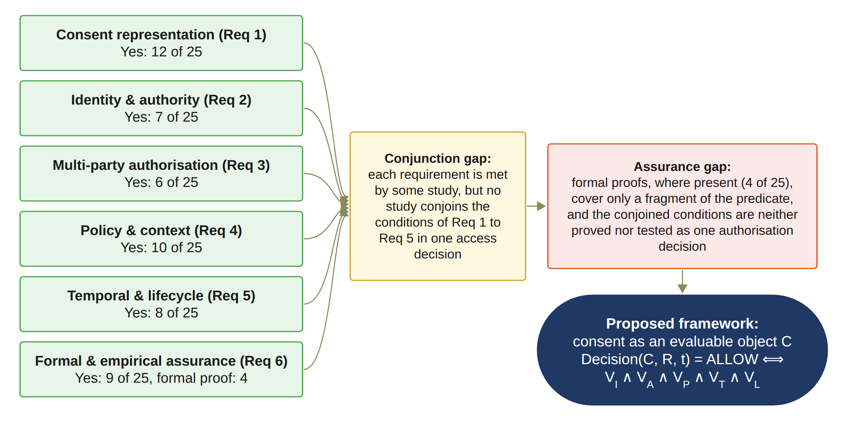
LITERATURE REVIEW: WHAT I FOUND
Conjunction gap
Each condition exists somewhere, but no study joins identity, authority, approval, policy and time in one decision.
Assurance gap
The whole decision is neither formally proved nor systematically tested. Proofs exist in only 4 of 25 studies.
Notes:
This figure sums up the review. The good news: every requirement is covered by some study. The problem: no study puts all the conditions together in one access decision. I call this the conjunction gap. And no study proves or tests the whole decision. Formal proofs exist in only 4 of the 25 studies, and they cover only a small part. I call this the assurance gap. These two gaps are what my research fills.

Slide 17
RESEARCH GAP
Existing research on healthcare consent and access control provides many of the building blocks, but there is still a need for an integrated Trust Computing framework that treats patient consent as an evaluable authorisation object. Such a framework should:
• represent the trust conditions of the consent
• verify the participants and their authority
• establish collective authorisation where required
• enforce the policy and data-scope constraints of the consent
• enforce the time window and lifecycle state of the consent
Notes:
This is the research gap of my study. Existing healthcare consent and access-control research provides many of the necessary technological building blocks, but there remains a need for an integrated Trust Computing framework that treats patient consent as a security-bearing and evaluable authorisation object. Such a framework should be capable of representing the relevant trust conditions, verifying the participating entities and their authority, establishing collective authorisation where required, and enforcing the policy and data-scope constraints associated with the consent.

Slide 18
MAIN RESEARCH QUESTION
How can a trust-oriented computing framework establish and enforce trustworthy multi-party consent for decentralised healthcare data sharing under identity, authority, and policy constraints?

Slide 19
SUB RESEARCH QUESTIONS
RQ1
How can patient consent be modelled as a trust-aware authorisation object that explicitly represents identity, authority requirements, policy constraints, and authorisation evidence?
RQ2
How can decentralised identities and verifiable credentials establish trustworthy participants while explicitly separating identity authentication from authorisation authority?
RQ3
How can multiple independently verified participants jointly establish a trustworthy consent decision without allowing a single participant to unilaterally authorise sensitive healthcare data access?
RQ4
How can policy, purpose, and data-scope constraints be incorporated into authorisation decisions so that valid identities and sufficient approvals cannot be used to obtain unauthorised healthcare data?
RQ5
How can temporal validity and consent lifecycle controls ensure that an authorisation remains valid only within its permitted time interval and lifecycle state, and is rejected after expiration, revocation, or an unauthorised state transition?
RQ6
How can the security properties of the proposed trust-oriented authorisation mechanism be formally defined and empirically evaluated to demonstrate that the implemented framework correctly enforces authorised and unauthorised healthcare data-access decisions?
Notes:
So this is my main research question. How can a trust-oriented computing framework establish and enforce trustworthy multi-party consent for decentralised healthcare data sharing, under identity, authority and policy constraints? It has six sub-questions. How to model consent. How to check identity and authority. How several guardians can approve together. How purpose and scope are checked. How time and lifecycle are checked. And how to prove and test the security.

Slide 20
RESEARCH OBJECTIVES
Objective | Description
RO1 – Trust-Centric Consent Model | To develop a trust-aware consent model that represents patient consent as a structured and evaluable authorisation object.
RO2 – Decentralised Identity and Authority Trust | To develop a decentralised identity and authority verification mechanism using decentralised identifiers and verifiable credentials.
RO3 – Trustworthy Multi-Party Authorisation | To develop a threshold-based multi-party authorisation mechanism through which multiple independently verified participants and guardians can jointly establish a trustworthy consent decision.
RO4 – Policy- and Context-Aware Access Control | To develop a policy-aware authorisation mechanism that evaluates the purpose and data scope of a requested operation against the constraints defined by the consent.
RO5 – Temporal and Lifecycle Trust | To extend the trust-oriented framework with temporal validity and consent lifecycle controls.
RO6 – Formal Security Assurance and Empirical Validation | To formally analyse and empirically evaluate whether the implemented framework satisfies its defined trust and authorisation properties under representative healthcare data-sharing scenarios.
Notes:
Each question has one objective. RO1 to RO4 are done, and they are validated with the prototype. RO5 is time and lifecycle. It is in progress. The validity window and the revocation already work. The suspended state, the transition check, consent changes, delegation and guardian changes are for the next stage. RO6 is partly completed. The automated tests, the attack tests and the measurements are done. The formal proofs are for the next stage.

Slide 21
RESEARCH METHODOLOGY
1
2
3
4
5
6
7
Problem
Consent is a passive record; no single trusted decision
Literature review
PRISMA 2020; 25 primary studies
Gap and questions
Research gap; RQ1 to RQ6
Objectives
RO1 to RO6
Design
MVC architecture, consent object C, Algorithms 1 to 4
Prototype
HALAH; ConsentSBTv3 on Sepolia
Evaluation
Live scenarios, measurements and 13 attack tests; formal proofs next
From the problem to the evaluated prototype
Notes:
These are the steps I followed. Step one, I identified the problem. Step two, I did the systematic review. Step three, from the review I found the research gap and wrote the questions. Step four, I set the objectives. Step five, I designed the framework: the architecture, the consent object, and four algorithms. Step six, I built the prototype on the Sepolia test network. Step seven, I evaluated it with live scenarios, measurements and attack tests. The formal proofs are the next stage.

Slide 22
RESEARCH METHODOLOGY: DSR
Goal Knowledge
Awareness of
problem
Suggestion
Design and
development
Evaluation
Conclusion
Fragmented trust
conditions
SLR: 25 primary studies
RQ1–RQ6
RO1–RO6
Integrated trust model
Consent object and MVC
Algorithms 1–6
HALAH on Sepolia
Access scenarios
46 automated tests
13 attack scenarios
Gas and timing
Proposal
Design
HALAH
artifact
Performance measure
Results
) Design Science Research Methodology Process Model
20
Notes:
This slide aligns the activities documented in my report with a generic five-stage Design Science Research process: awareness of the problem, suggestion, design and development, evaluation, and conclusion. It is an organising adaptation of the reported work. It does not claim that a new DSR protocol was registered or that these stages occurred as five separate, completed chronological phases.
Awareness of the problem maps to Sections 1 to 3: the healthcare authorisation problem, the six requirements, and the literature-derived gaps. The SLR findings are those recorded on 10 September 2026 and are bounded by that checkpoint.
Suggestion maps to Sections 2.6, 3 and 4: a trust-oriented framework, six project research questions and six objectives. The consent object in this uploaded report is C = (I, A, P, T, L, E).
Design and development maps to Section 5 and Sections 6 to 11. MVC separates interaction, enforcement and persistent consent state. Algorithms 1 to 6 describe creation, identity and authority verification, multi-party approval, policy decisions, lifecycle validation and evaluation. HALAH is the implemented artefact, using synthetic Synthea records and Ethereum Sepolia. The report describes parts of the algorithms that remain planned; a diagrammed algorithm is not evidence that every step is implemented.
Evaluation maps to Section 11. The report records six live scenarios, 46 automated tests, thirteen attack scenarios, and cost and timing measurements. All 46 tests pass; twelve attacks are refused. A11 is neutral because its changed audit digest is not checked. These are empirical results, not formal verification. Section 11.6 documents revisions after failed service-level checks, which supports the idea of refinement and retesting without inventing a sequence of DSR cycles.
Conclusion maps to the synthesis of the contribution and limitations, Sections 10.4 and 11.7, and the publications and research plan in Sections 12 and 13. RO1 to RO4 are Done. RO5 is In Progress and RO6 is Partially completed. Formal proofs or model checking, remaining lifecycle controls, and evaluation under load are future work. Conclusion therefore means reflection and planning at this stage, not completion of the whole project.
Report source: Yasir_CA2_Report_Template_Structure (9).docx, Sections 1–13, particularly Sections 2–5 and 10–11. SLR reporting checkpoint: 10 September 2026.
Method source: Vaishnavi, V., Kuechler, W. and Duraisamy, S. (2025 update), Design Science Research in Information Systems, Figure 3, p. 11. https://designsciences.org/design-science-research-in-information-systems.pdf . This five-stage cycle develops the process introduced by Takeda et al. (1990). The five phases organise the reported HALAH activities. The shorter feedback loop represents evaluation-driven refinement, supported by the service-layer hardening reported in Section 11.6. The dashed loop represents lessons informing the next stage. The screenshot’s conceptual/perceptual/practical labels are omitted because they are not part of the source cycle.
Peffers et al. (2007), A Design Science Research Methodology for Information Systems Research, JMIS 24(3), 45–77, is a separate six-activity model: https://www.jmis-web.org/articles/765 ; https://doi.org/10.2753/MIS0742-1222240302 .

Slide 23
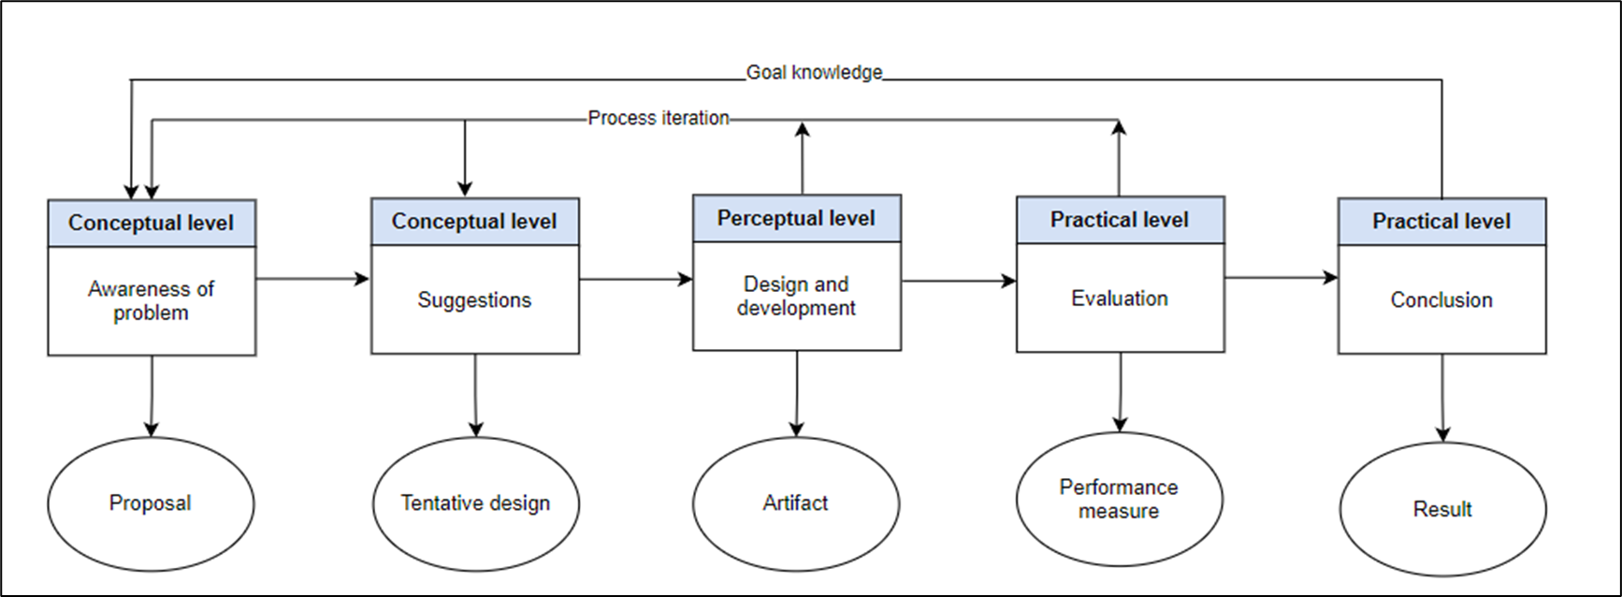
Research Methodology
RESEARCH METHODOLOGY: DSR
) Design Science Research Methodology Process Model (Peffers et al. 2007
Notes:
I used The design science research methodology (DSR) to satisfy the research objectives, Because The aim of this research is designing an artifact,
The proposed solutions are divided into phases. The first one is to identify the problem and then to define the objectives and solutions then to design the artifact and then evaluate the solutions ,
In this stag we can go back to first and second phase. Final stage is to communicate our results through publications.

Slide 24
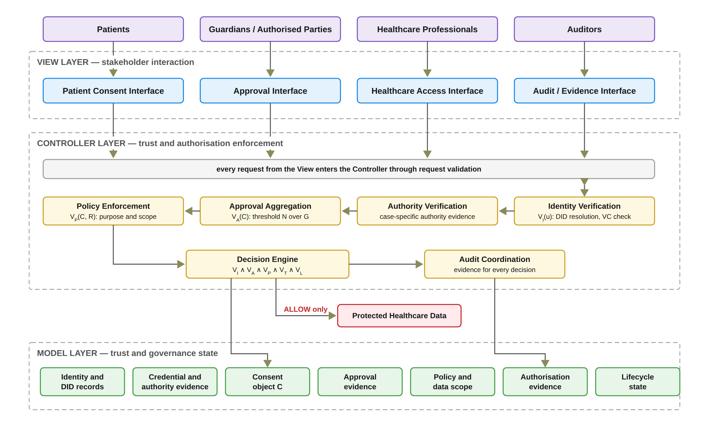
THE FRAMEWORK: ARCHITECTURE
Notes:
The framework uses the Model, View, Controller pattern. The View is the four screens: patient, guardian, doctor and auditor. The View never decides who gets access. Every security decision is made in the Controller. It checks identity and authority, collects the approvals, enforces the policy, and records the evidence. The Model keeps the consent, the approvals and the evidence. Health data is released only when the Controller says ALLOW.

Slide 25
THE FRAMEWORK: THE DECISION RULE
Decision(C, R, t) = ALLOW ⟺ VI(u) ∧ VA(C) ∧ VP(C, R) ∧ VT(C, t) ∧ VL(C)
VI
Identity and authority validity
VA
Collective authorisation validity
VP
Policy and contextual compliance
VT
Temporal validity
VL
Consent lifecycle validity
One failed check is enough to say DENY.
A Groth16 zero-knowledge proof must also verify before any data is released.
Every access decision, allowed or denied, is written to the off-chain audit ledger with its decision matrix.
Notes:
This is the heart of the framework. Access is allowed only when five checks are all true. VI is identity and authority validity. VA is collective authorisation validity: all the required guardians approved. VP is policy and contextual compliance: the purpose and the requested data are inside what was agreed. VT is temporal validity: the request is inside the validity time. VL is consent lifecycle validity: the consent is in a valid state, for example active and not revoked. If any one check fails, the answer is DENY. In the prototype, a Groth16 zero-knowledge proof must also pass before any data is released. And every access decision, allowed or denied, is written to the off-chain audit ledger.

Slide 26
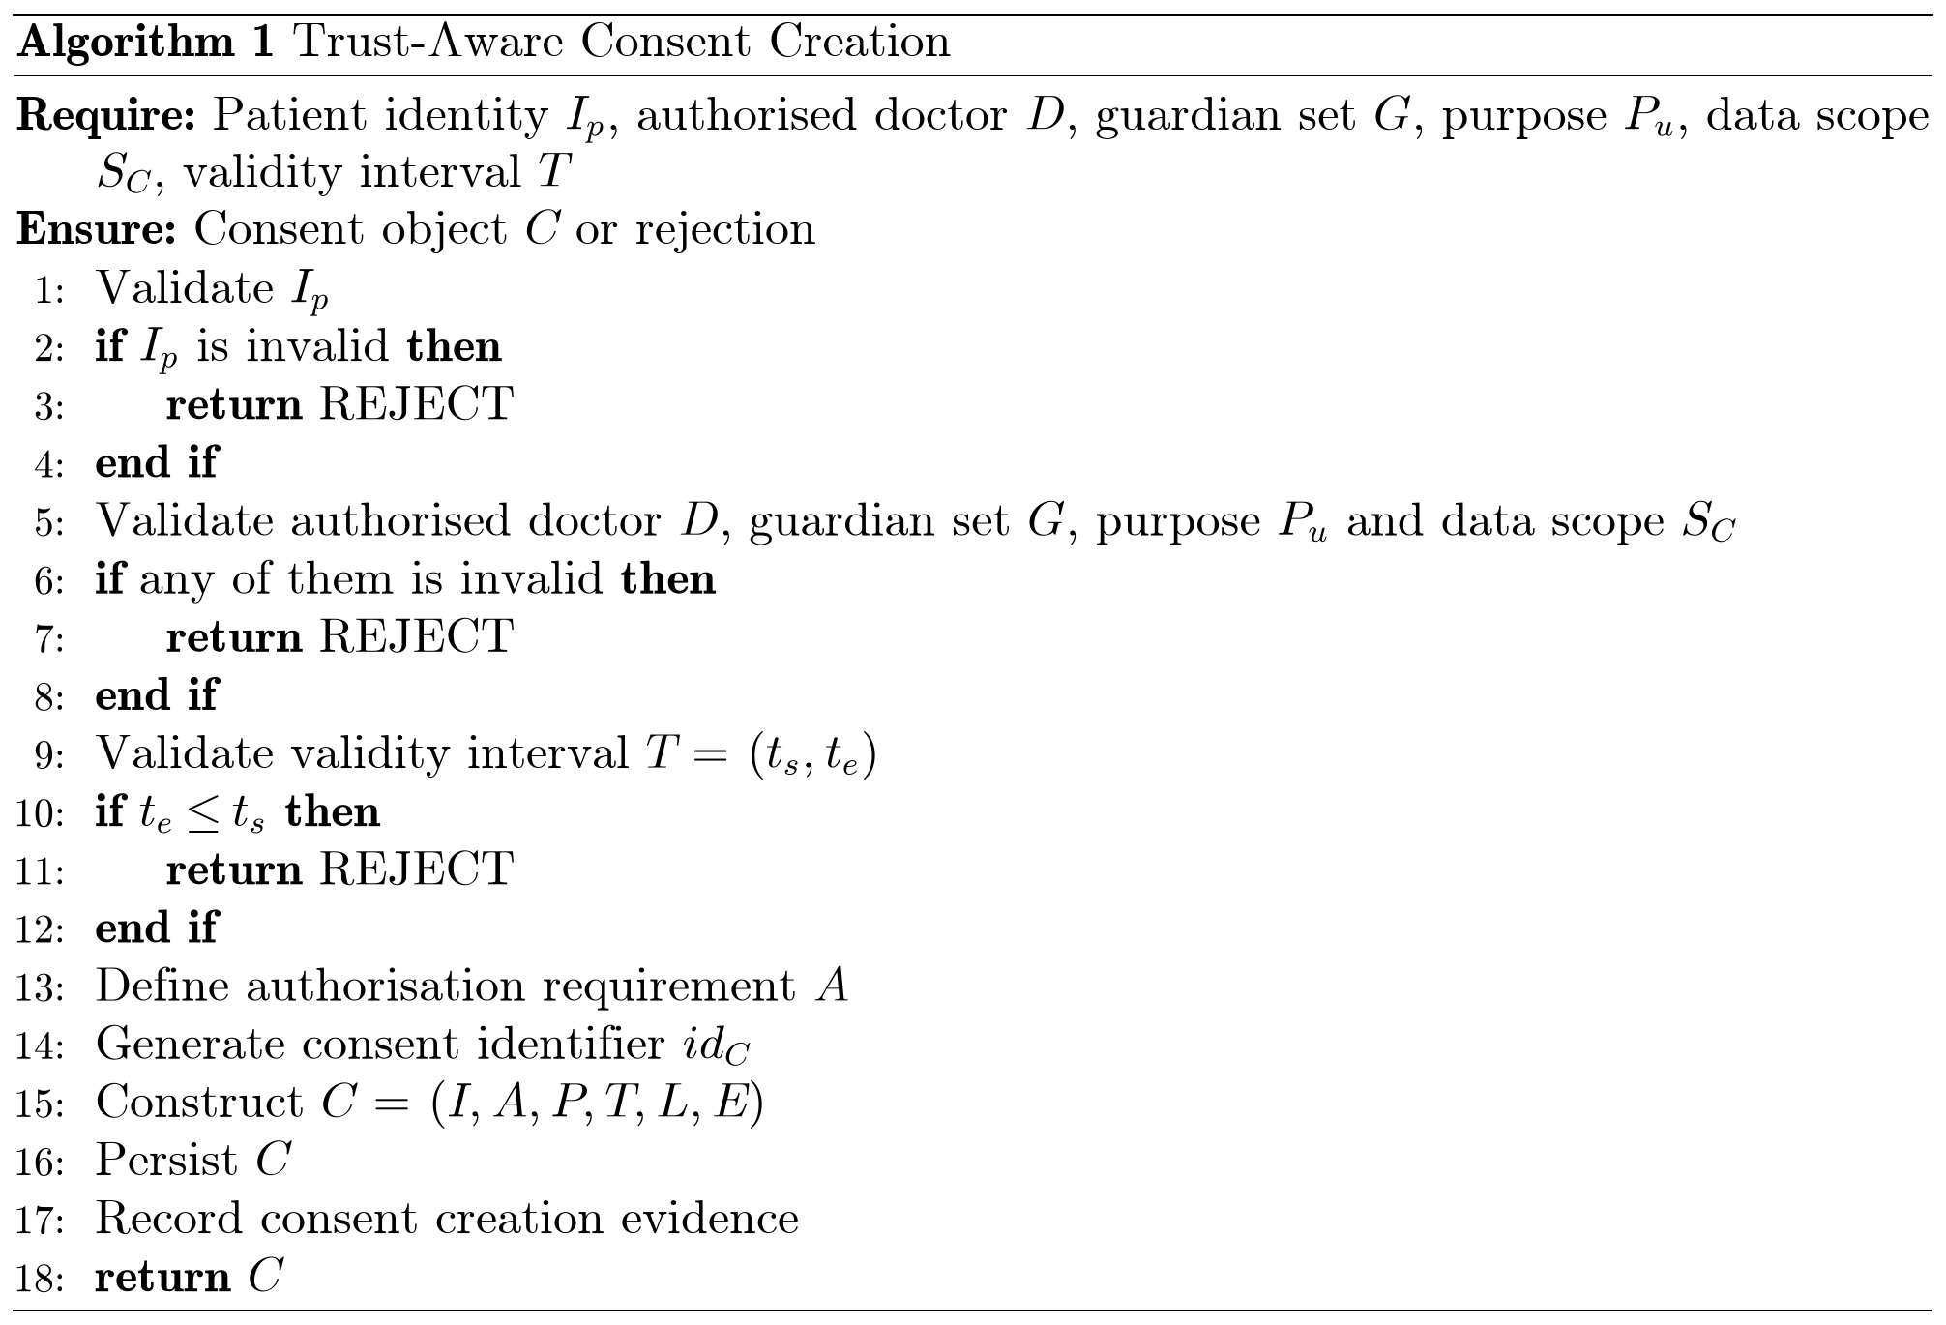
Proposed solution for objective 1
RO1: Trust-Centric Consent Model
Status: Done
The patient chooses the doctor, the guardians, the data modules, and the start and expiry time.
In this prototype the purpose is fixed to Treatment.
Bad input is rejected, for example an empty data scope or a malformed guardian DID.
The system creates the consent object, assigns a consent identifier, persists the record, and records the creation event in the audit layer.
Notes:
I will explain objective 1 which focuses on develop a trust-aware consent model that represents patient consent as a structured and evaluable authorisation object.
This is thr algortithm shows the steps of the prosses .
Step one. The patient creates the consent. The patient chooses the doctor, the guardians, the data modules, and the start and end time. The system checks every field. For example, an empty data scope or a bad guardian DID is rejected. Then the system creates the consent object, assigns a consent identifier, persists the record, and records the creation event in the audit layer. Nothing goes to the blockchain yet. This is RO1, and it is done.
Algorithm 1: Trust-Aware Consent Creation
The box on the right of the slide is Algorithm 1 from my report. The next slide shows the same algorithm as a flowchart.
Inputs and Output
Require: Patient identity I_p, authorised doctor D, guardian set G, purpose P_u, data scope S_C, validity interval T
Explanation: The algorithm starts by receiving the information required to create a consent.
Ensure: Consent object C or rejection
Explanation: The algorithm either creates a valid consent or rejects the request.
Step-by-Step Explanation
Line 1: Validate I_p
First, we verify the patient’s identity.
Line 2: if I_p is invalid then
We check whether the patient’s identity is invalid.
Line 3: return REJECT
If the identity is invalid, the request is rejected.
Line 4: end if
This completes the identity validation check.
Line 5: Validate authorised doctor D, guardian set G, purpose P_u and data scope S_C
Next, we check the other parts of the consent: that the doctor is authorised, that the guardians are valid, that the purpose of using the patient’s data is valid, and that the data scope, which is the patient data that can be accessed, is valid.
Line 6: if any of them is invalid then
We check whether any of these four parts is invalid.
Line 7: return REJECT
If one of them is invalid, the request is rejected, and no consent is created.
Line 8: end if
This completes these four checks.
Line 9: Validate validity interval T = (t_s, t_e)
We check the consent’s start and end times.
Line 10: if t_e ≤ t_s then
We check whether the end time is earlier than or equal to the start time.
Line 11: return REJECT
If the time interval is invalid, the request is rejected.
Line 12: end if
This completes the time validation check.
Line 13: Define authorisation requirement A
We define the conditions that must be met later before access can be granted, such as the required guardian approvals.
Line 14: Generate consent identifier id_C
We generate a unique identifier for the consent.
Line 15: Construct C = (I, A, P, T, L, E)
We build the consent object from its six parts: identity I, authorisation requirements A, policy P (the purpose and the data scope), time T (the validity interval), the lifecycle state L, which starts as pending until the guardians approve, and evidence E.
Line 16: Persist C
We store the newly created consent object.
Line 17: Record consent creation evidence
We record evidence of the consent creation for auditing and traceability.
Line 18: return C
Finally, we return the successfully created consent object.
Note: In the prototype, the purpose is fixed to Treatment. The consent is saved off-chain in the state PENDING_SIGNATURE, and nothing goes on the blockchain until all guardians approve.

Slide 27
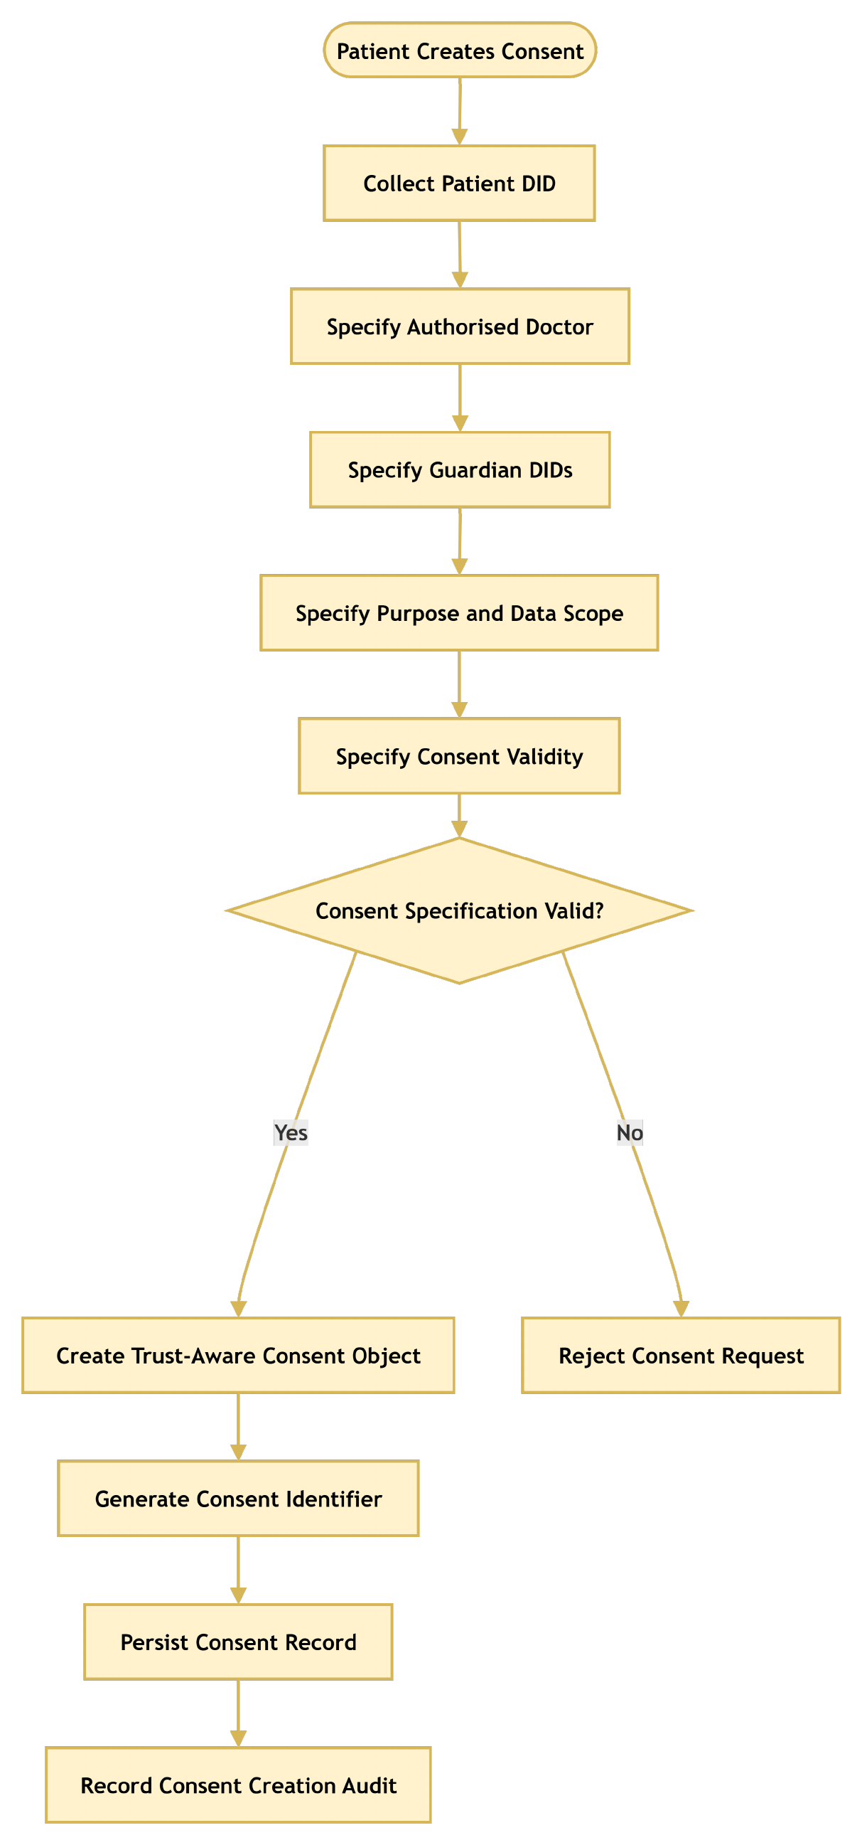
RO1: Trust-Centric Consent Model
Notes:
This slide shows Algorithm 1 as a flowchart. It shows the main steps in a simpler form: it collects all the inputs, runs one combined validity check with a Yes and a No branch, and then creates and stores the consent and records an audit entry.
First, the patient starts to create a consent, and the system collects the patient DID.
Second, the patient specifies the authorised doctor and the guardian DIDs.
Third, the patient specifies the purpose and the data scope, and then the consent validity, which is the start and end time.
Fourth, the system checks if the consent specification is valid. If it is not valid, the No branch rejects the consent request.
Finally, if it is valid, the system creates the trust-aware consent object, generates the consent identifier, stores the consent record, and records the creation in the audit log.

Slide 28
RO1 VALIDATION: TRUST-CENTRIC CONSENT MODEL
Evidence | What it checks | Pass rule | Result
Live scenario 1 (Demo 1) | The patient creates the consent object C: doctor, guardians, data scope, start and expiry | Consent created in state PENDING_SIGNATURE, nothing anchored yet | Scenario 1: consent created, creation event recorded in the audit ledger
Input validation | Bad input: empty data scope, malformed guardian DID, expiry before start | Request rejected, no consent created | Rejected in the interface and in the service layer (A5 empty scope refused after hardening)
Audit evidence | Every consent event is recorded with the consent id | Event present in the ledger | Ledger of 24 September: 8 consent events in 60 events
Automated tests | Consent creation and the six components of C = (I, A, P, T, L, E) | All pass | Pass (part of the 46 passing tests)
Validation asks: does the consent model do what it should? The evidence comes from the live scenario of 24 September 2026, the input checks, the audit ledger and the automated tests.
Notes:
This slide shows how objective 1 was validated. First, the live scenario: the patient created a consent and it was stored in the PENDING_SIGNATURE state, with nothing on the chain yet. Second, bad input is rejected: an empty scope, a malformed guardian DID, or an expiry before the start. Third, every consent event is recorded in the audit ledger. Fourth, the automated tests cover consent creation and the six parts of C. All of them pass.

Slide 29
RO1 EVALUATION: TRUST-CENTRIC CONSENT MODEL
Component | Median | Min | Max | n
Decision rule over C, five predicates (11 Oct) | 5.92 µs | 5.36 µs | 72.07 µs | 1,000
On-chain checkValid read of the anchored consent | 573.5 ms | 568.2 ms | 715.5 ms | 20
On-chain checkValidAt read of the anchored consent | 574.6 ms | 568.2 ms | 745.6 ms | 20
Creating a consent costs nothing on-chain: the record is stored off-chain and anchored only after all guardians approve (see RO3). Evaluating the consent object takes about 6 microseconds; reading it back from Sepolia takes about 0.6 seconds. Indicative only.
Notes:
This slide shows how objective 1 was evaluated. Evaluating the consent object with the five predicates takes about 6 microseconds, measured over 1,000 runs on 11 October 2026. Reading the anchored consent back from Sepolia takes about 0.6 seconds. Creating a consent costs nothing on-chain, because the record is anchored only after all guardians approve. These numbers are indicative.

Slide 30
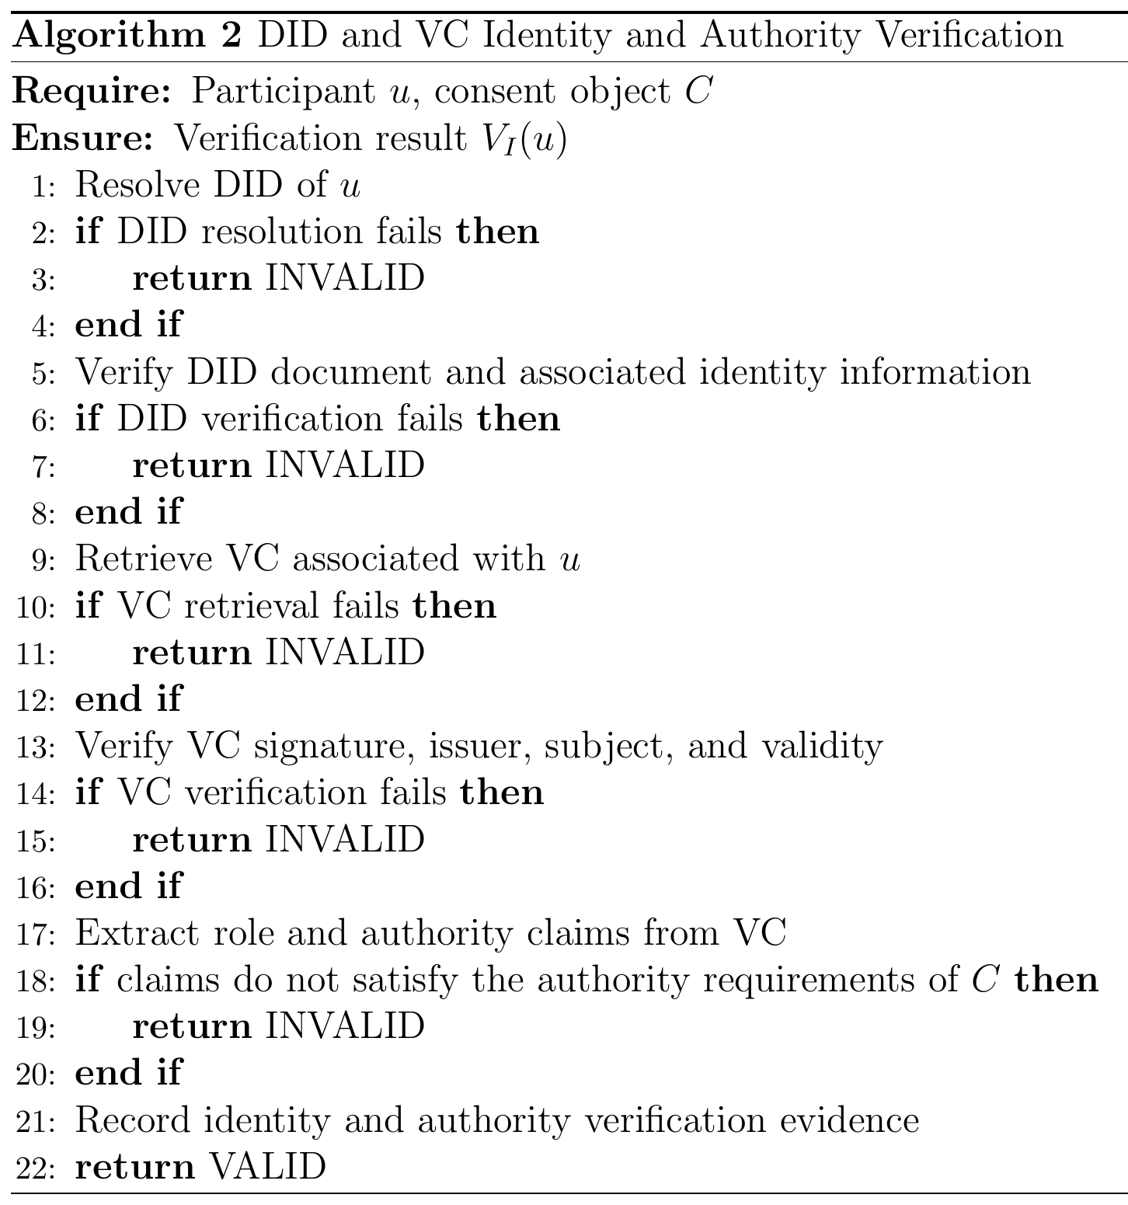
Proposed solution for objective 2
RO2: Decentralised Identity and Authority Trust
Status: Done
Identity is checked through the DID; authority through a verifiable credential.
Identity is not authority: a valid DID alone never gives access.
In the HALAH implementation, the Guardian workflow uses a selected guardian DID and invokes VC verification before adding the guardian's signature to the consent.
Full DID resolution is planned for the next stage.
Notes:
Step two. I separate two questions: who are you, and what may you do? The DID answers the first question. The credential answers the second. A valid identity alone never gives access. In the HALAH implementation, the guardian workflow uses a selected guardian DID and invokes VC verification before adding the guardian's signature to the consent. Full DID resolution is planned for the next stage. So RO2 is done at the design level and in the prototype.
Algorithm 2: DID and VC Identity and Authority Verification
The box on the right of the slide is Algorithm 2 from my report. The next slide shows the same algorithm as a flowchart.
Inputs and Output
Require: Participant u, consent object C
Explanation: The algorithm starts by receiving the participant who wants to take part and the consent object that defines the required authority.
Ensure: Verification result V_I(u)
Explanation: The algorithm returns VALID if both the participant’s identity and authority are verified, or INVALID otherwise. This result is not an access decision by itself; the later stages use it.
Step-by-Step Explanation
Line 1: Resolve DID of u
First, we resolve the participant’s DID to find their DID document.
Line 2: if DID resolution fails then
We check whether the DID could not be resolved.
Line 3: return INVALID
If the DID cannot be resolved, the participant is invalid and the process stops.
Line 4: end if
This completes the DID resolution check.
Line 5: Verify DID document and associated identity information
Next, we check that the DID document is well formed and that its keys can be trusted.
Line 6: if DID verification fails then
We check whether the DID verification failed.
Line 7: return INVALID
If it failed, we return INVALID.
Line 8: end if
This completes the DID verification check.
Line 9: Retrieve VC associated with u
Then, we retrieve the participant’s verifiable credential, which holds claims such as their role.
Line 10: if VC retrieval fails then
We check whether a credential could not be found.
Line 11: return INVALID
Without a credential, the participant cannot show any authority, so we return INVALID.
Line 12: end if
This completes the credential retrieval check.
Line 13: Verify VC signature, issuer, subject, and validity
We check that the signature is correct, the issuer is trusted, the credential belongs to this participant, and it is still within its valid time period.
Line 14: if VC verification fails then
We check whether any of these four checks failed.
Line 15: return INVALID
If any check fails, we return INVALID.
Line 16: end if
This completes the credential verification check.
Line 17: Extract role and authority claims from VC
Next, we read the role and authority claims from the credential, for example doctor or guardian.
Line 18: if claims do not satisfy the authority requirements of C then
We compare these claims with the authorisation requirements of consent C.
Line 19: return INVALID
If the claims do not meet the requirements, we return INVALID. A valid identity alone never gives access.
Line 20: end if
This completes the authority check.
Line 21: Record identity and authority verification evidence
We record the evidence, such as the DID, the credential, the issuer, the claims and the time, for auditing.
Line 22: return VALID
Finally, we return VALID, which means the participant’s identity and authority are both verified.
Note: Today, the guardian workflow verifies the guardian’s credential before adding the signature to the consent. Full DID resolution, in lines 1 to 8, is planned for the next stage.

Slide 31
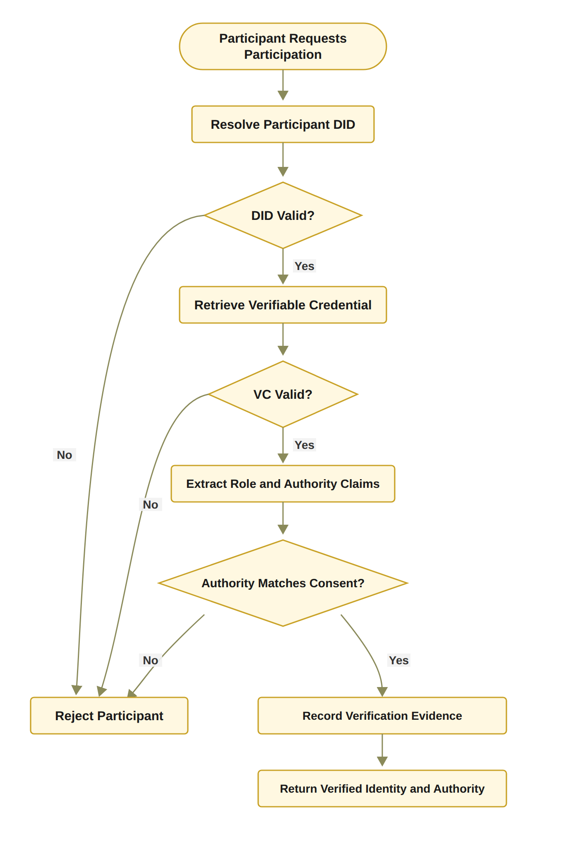
RO2: Decentralised Identity and Authority Trust
Notes:
This slide shows Algorithm 2 as a flowchart. It follows the same order as the algorithm, but it joins the two DID checks into one “DID Valid?” decision and the two credential checks into one “VC Valid?” decision. Every “No” leads to Reject Participant, which is the INVALID result.
First, a participant asks to take part, and the system resolves the participant’s DID.
Second, it checks if the DID is valid. If not, the participant is rejected.
Third, it retrieves the verifiable credential and checks if it is valid. If not, the participant is rejected.
Fourth, it extracts the role and authority claims, and checks if they match what the consent requires. If not, the participant is rejected.
Finally, if all checks pass, it records the verification evidence and returns the verified identity and authority.
This flowchart is the target design. Full DID resolution is planned for the next stage.

Slide 32
RO2 VALIDATION: DECENTRALISED IDENTITY AND AUTHORITY
Evidence | What it checks | Pass rule | Result
Credential check | Credential of each guardian before signing and of the doctor at access: signature, issuer, subject, validity time and role | Invalid credential refused | Refused (A13 invalid or forged credential, 11 October 2026)
Replayed signature | A guardian signature taken from another consent | Identity check fails | A2 refused
Requester binding | The DID entered by the doctor must hold a doctor credential and be the doctor named in the consent | VI fails otherwise | Refused and recorded in the ledger (11 October 2026)
Automated tests | 7 credential tests, A2 and A13 | All pass | Pass
Identity (who are you) and authority (what may you do) are checked separately. Full DID resolution is planned for the next stage.
Notes:
This slide shows how objective 2 was validated. The credential of each guardian is checked before the guardian signs, and the credential of the doctor is checked at access time: the signature, the issuer, the subject, the validity time and the role. An invalid or forged credential is refused, which is attack A13. A signature replayed from another consent fails the identity check, which is attack A2. And the DID entered by the doctor must be the doctor named in the consent. The seven credential tests and the two attack tests all pass. Full DID resolution is planned for the next stage.

Slide 33
RO2 EVALUATION: DECENTRALISED IDENTITY AND AUTHORITY
Component | Median | Min | Max | n
Credential check, one credential (11 Oct) | 6.42 ms | 6.18 ms | 8.33 ms | 20
EIP-712 signature recovery, one signature | 10.93 ms | 10.55 ms | 15.64 ms | 20
Checking one credential takes about 6 milliseconds and recovering one guardian signature about 11 milliseconds. Both are small next to the Groth16 proof of RO4. Measured on 11 October 2026 (credential) and 1 October 2026 (signature); indicative only.
Notes:
This slide shows how objective 2 was evaluated. Checking one credential takes about 6 milliseconds, and recovering one guardian signature takes about 11 milliseconds. Both are small compared with the Groth16 proof. These numbers are indicative.

Slide 34
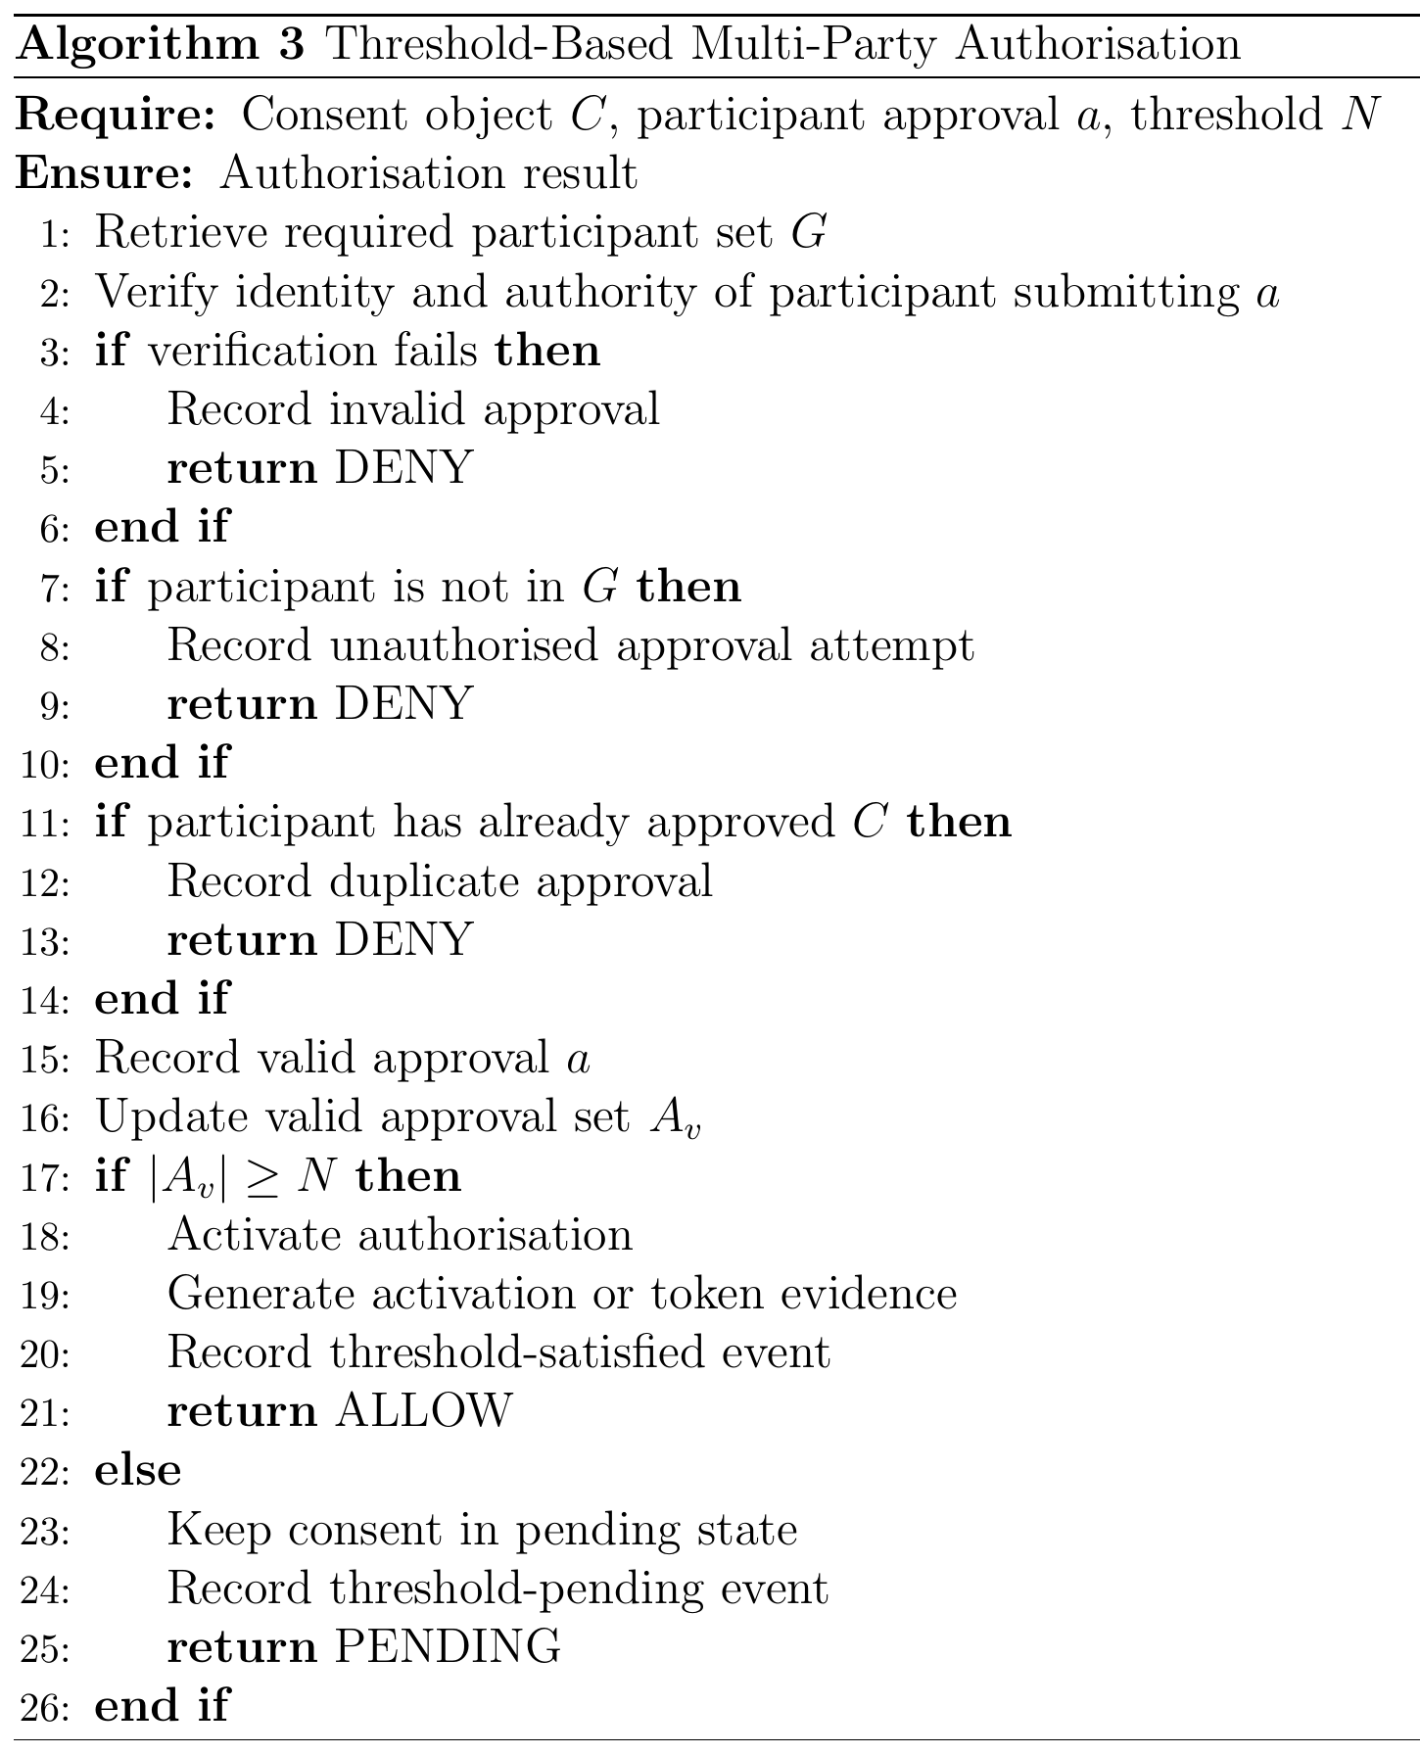
Proposed solution for objective 3
RO3: Trustworthy Multi-Party Authorisation
Status: Done
The guardian set G is fixed when the consent is created.
Each guardian signs an EIP-712 approval; the system recovers the signer and checks it is in G.
Approvals from outsiders and duplicates are not counted; a signature replayed from another consent fails the identity check.
N-of-N rule: every listed guardian must sign (2-of-2 in the demo).
When all have signed, a soulbound token is minted on Sepolia in the background.
In the prototype the guardian keys are derived from the guardian DIDs; wallet-held keys are for the next stage.
Notes:
Step three. No single person can approve alone. Each guardian signs with an EIP-712 signature. The system recovers the signer and checks that this person is one of the listed guardians. Outsiders and duplicates are not counted, and a signature replayed from another consent fails the identity check. In the demo, two of two guardians must sign. When both have signed, a soulbound token is minted on the Sepolia test network in the background. One honest note: in the prototype, the guardian keys are derived from the guardian DIDs. Wallet-held keys are for the next stage. RO3 is done.
Algorithm 3: Threshold-Based Multi-Party Authorisation
The box on the right of the slide is Algorithm 3 from my report. The next slide shows the same algorithm as a flowchart.
Inputs and Output
Require: Consent object C, participant approval a, threshold N
Explanation: The algorithm receives the consent, one approval from a participant, and the number of valid approvals that are needed.
Ensure: Authorisation result
Explanation: The algorithm returns ALLOW, PENDING or DENY for this approval.
Step-by-Step Explanation
Line 1: Retrieve required participant set G
First, we retrieve the set G of participants who are allowed to approve this consent, for example the guardians.
Line 2: Verify identity and authority of participant submitting a
Next, we verify the identity and authority of the person who submitted the approval. This can use the DID and VC check from Algorithm 2.
Line 3: if verification fails then
We check whether this verification has failed.
Line 4: Record invalid approval
If it failed, we record the approval as invalid.
Line 5: return DENY
The approval is denied, and it does not count towards the threshold.
Line 6: end if
This completes the identity and authority check.
Line 7: if participant is not in G then
Then, we check whether the participant is outside the required participant set G.
Line 8: Record unauthorised approval attempt
If so, we record it as an unauthorised approval attempt.
Line 9: return DENY
The approval is denied, because only members of G can be counted.
Line 10: end if
This completes the membership check.
Line 11: if participant has already approved C then
Next, we check whether this participant has already approved this consent.
Line 12: Record duplicate approval
If so, we record a duplicate approval.
Line 13: return DENY
The extra approval is denied, so one person cannot be counted twice.
Line 14: end if
This completes the duplicate check.
Line 15: Record valid approval a
The approval has passed all three checks, so we record it as valid.
Line 16: Update valid approval set A_v
We add this approval to the set of valid approvals, A_v.
Line 17: if |A_v| ≥ N then
We check whether the number of valid approvals has reached the threshold N.
Line 18: Activate authorisation
If it has, we activate the authorisation, so the consent can move on to the access-control stage.
Line 19: Generate activation or token evidence
We generate evidence of the activation, such as a consent token. It can include the consent identifier, the threshold N and the approving participants.
Line 20: Record threshold-satisfied event
We record in the audit log that the threshold was met, for traceability.
Line 21: return ALLOW
The result is ALLOW.
Line 22: else
Otherwise, the threshold has not been reached yet.
Line 23: Keep consent in pending state
We keep the consent in the pending state, so access is not activated.
Line 24: Record threshold-pending event
We record a threshold-pending event, so we can see later how many approvals are still needed.
Line 25: return PENDING
The result is PENDING, and the consent waits for more approvals.
Line 26: end if
Finally, this completes the threshold check, and the algorithm ends.
Note: In the prototype, N is the number of guardians, so the demo needs 2-of-2. When the threshold is met, a local token is recorded, and the mint is anchored on the Sepolia test network in the background.

Slide 35
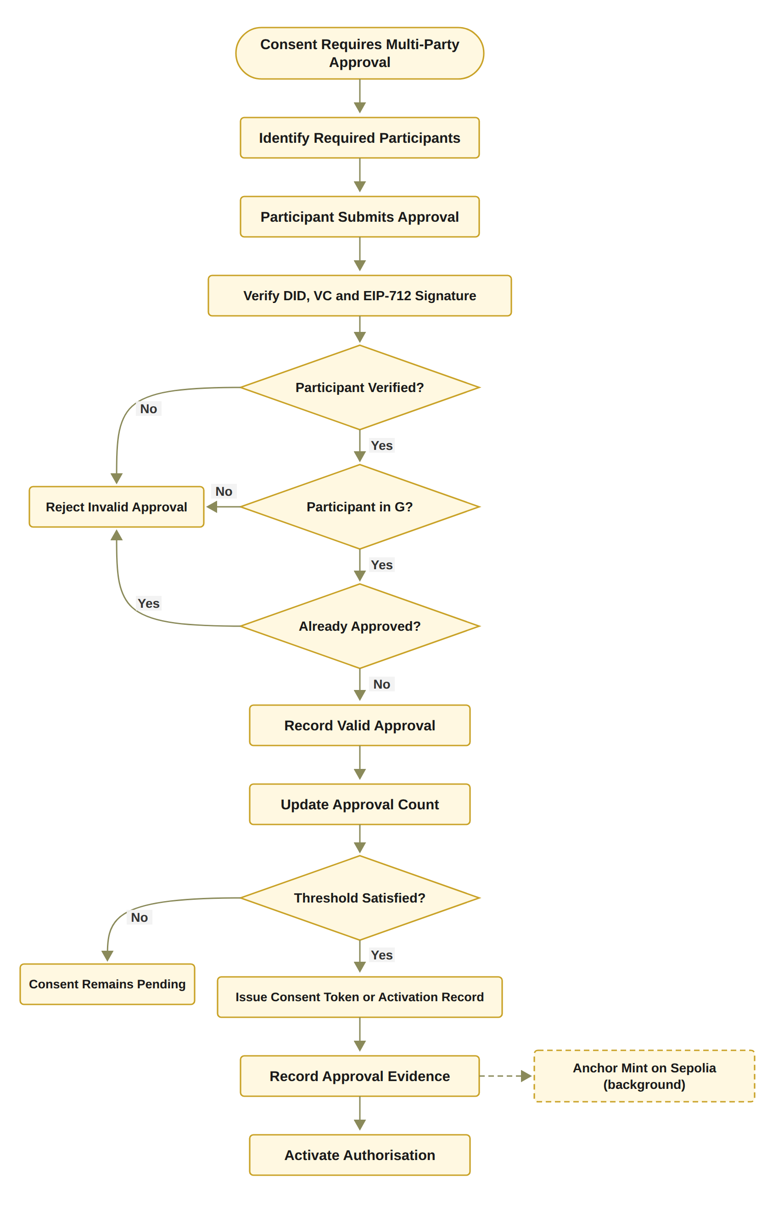
RO3: Trustworthy Multi-Party Authorisation
Status: Done
Notes:
This slide shows Algorithm 3 as a flowchart. It shows the same three checks in the same order, with the identity check drawn as the prototype runs it: the DID, the credential and the EIP-712 signature. It joins the three rejections into one box, and it shows activation last, after the token and the evidence.
First, the consent needs approval from several people, so the system identifies the required participants.
Second, a participant submits an approval, and the system verifies the DID, the credential and the EIP-712 signature.
Third, it asks three questions: is the participant verified, is the participant in the guardian set G, and has the participant already approved? If the participant is not verified, is not in G, or has already approved, the approval is rejected.
Fourth, a valid approval is recorded, and the approval count goes up.
Fifth, the system checks if the threshold is met. If not, the consent stays pending.
Finally, if it is met, the system issues the consent token or activation record, records the approval evidence, and activates the authorisation.
The dashed box shows that the mint on the Sepolia test network runs in the background, so it does not delay the guardians or the doctor. In the prototype, the consent becomes active once its start time is reached.

Slide 36
RO3 VALIDATION: TRUSTWORTHY MULTI-PARTY AUTHORISATION
Evidence | What it checks | Pass rule | Result
Live scenario 2 (Demo 2 and 3) | Both guardians sign with EIP-712; the threshold N = |G| is reached and the token is minted | 2 of 2 signatures, token anchored on Sepolia | Scenario 2: 2 of 2 signed, token minted, anchored in the background
Signer outside G | An approval signed by someone who is not a listed guardian | Not counted | A1 refused after hardening
Duplicate approval | The same guardian approves twice to reach N | Not counted | A3 refused after hardening
Contract ownership | Mint or revoke by a non-owner, or a token transfer | Transaction reverts | A12 refused (in-memory EVM)
Independent check | On-chain token state against the local consent state | Local state = on-chain state | Scenario 6: all checks passed
No single guardian can approve alone when G has more than one member: every listed guardian must sign. In the prototype the guardian keys are derived from the guardian DIDs; wallet-held keys are for the next stage.
Notes:
This slide shows how objective 3 was validated. In the live scenario both guardians signed and the token was minted and anchored on Sepolia. Attack A1, a signer outside the guardian set, and attack A3, the same guardian signing twice, are not counted after the hardening of 1 October. Attack A12, a mint or revoke by a non-owner or a token transfer, is refused by the contract. And the independent check confirms that the token state on the chain matches the local consent state. One honest note: in the prototype the guardian keys are derived from the guardian DIDs; wallet-held keys are for the next stage.

Slide 37
RO3 EVALUATION: TRUSTWORTHY MULTI-PARTY AUTHORISATION
Component | Median | Min | Max | n
EIP-712 signature recovery, one signature | 10.93 ms | 10.55 ms | 15.64 ms | 20
Anchoring confirmation on Sepolia | 11.5 s | 4.9 s | 22.1 s | 5
Gas used: mint #1 196,406; revoke #1 32,980. No fee above 0.00021 ETH. The mint runs in the background, so the guardians and the doctor do not wait for the block. Gas and anchoring from the five Sepolia transactions of September 2026; indicative only.
Notes:
This slide shows how objective 3 was evaluated. Recovering one guardian signature takes about 11 milliseconds. Anchoring on Sepolia takes about 11.5 seconds, between 5 and 22 seconds, over five transactions. The mint costs about 196 thousand gas and the revoke about 33 thousand, and no fee was above 0.00021 ETH. The mint runs in the background, so nobody waits for it. These numbers are indicative.

Slide 38
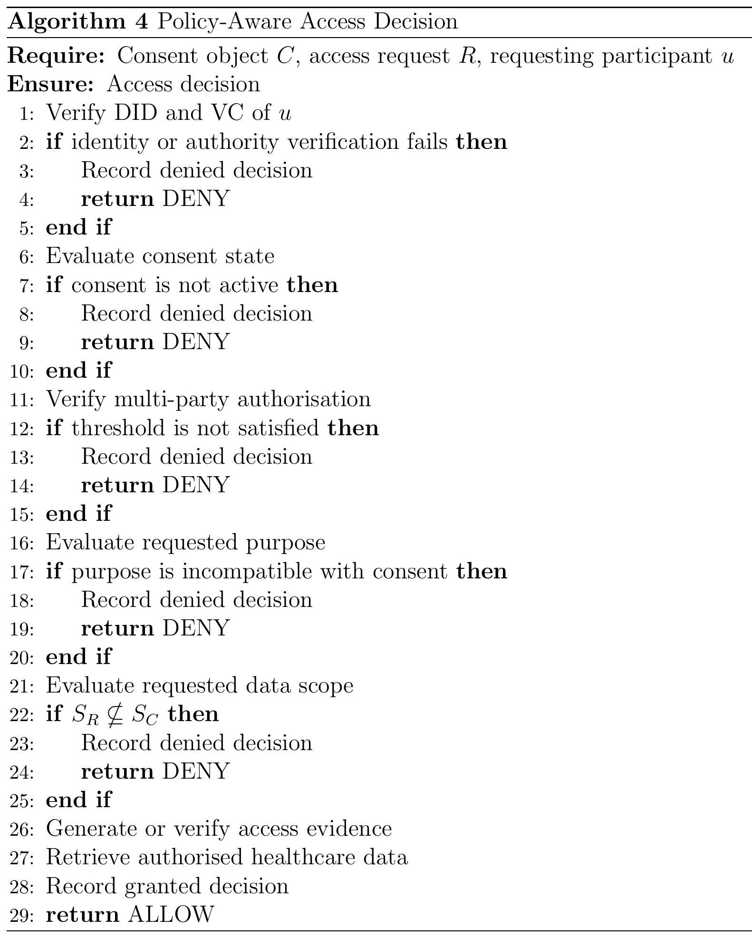
Proposed solution for objective 4
RO4: Policy- and Context-Aware Access Control
Status: Done
The requested data must be a non-empty subset of the agreed data scope.
The purpose must be a supported purpose of the consent.
Time and the lifecycle state are checked in the same decision.
A Groth16 proof must verify before any data is retrieved.
Example: asking for Procedure when only Observation and Medication were agreed gives DENY.
Notes:
Step four. A valid identity and all the approvals are still not enough. The requested data must be inside the agreed data scope. For example, if the consent allows Observation and Medication, a request that also asks for Procedure is denied. The purpose, the time and the lifecycle state are checked in the same decision. And a Groth16 proof must pass before any data is released. RO4 is done.
Algorithm 4: Policy-Aware Access Decision
The box on the right of the slide is Algorithm 4 from my report. The next slide shows the same algorithm as a flowchart.
Inputs and Output
Require: Consent object C, access request R, requesting participant u
Explanation: The algorithm starts with the patient’s consent, the request for data, and the participant who makes the request, for example a doctor.
Ensure: Access decision
Explanation: The algorithm returns one decision, ALLOW or DENY, and it records that decision.
Step-by-Step Explanation
Line 1: Verify DID and VC of u
First, we verify the decentralised identifier and the verifiable credential of the requester. This uses the identity check from Algorithm 2.
Line 2: if identity or authority verification fails then
We check whether the identity or authority check for the requester has failed.
Line 3: Record denied decision
If it has failed, we record the denied decision for auditing.
Line 4: return DENY
The request is denied and stops here.
Line 5: end if
This completes the identity and authority check.
Line 6: Evaluate consent state
Next, we check the current state of the consent. It must be active, within its validity period, and not revoked.
Line 7: if consent is not active then
We check whether the consent is not active.
Line 8: Record denied decision
If the consent is not active, we record the denied decision.
Line 9: return DENY
The request is denied.
Line 10: end if
This completes the consent state check.
Line 11: Verify multi-party authorisation
Then, we verify the multi-party authorisation. We compare the number of valid approvals, |A_v|, with the required threshold N.
Line 12: if threshold is not satisfied then
We check whether there are fewer valid approvals than the threshold.
Line 13: Record denied decision
If there are not enough approvals, we record the denied decision.
Line 14: return DENY
The request is denied.
Line 15: end if
This completes the multi-party authorisation check.
Line 16: Evaluate requested purpose
Next, we compare the purpose of the request with the purpose the patient allowed in the consent.
Line 17: if purpose is incompatible with consent then
We check whether the purpose does not match the consent. This stops valid credentials from being used for a purpose the patient did not allow.
Line 18: Record denied decision
If the purpose does not match, we record the denied decision.
Line 19: return DENY
The request is denied.
Line 20: end if
This completes the purpose check.
Line 21: Evaluate requested data scope
We look at the data the request asks for, S_R, and the data the patient allowed, S_C.
Line 22: if S_R ⊈ S_C then
We check whether the request asks for data outside the allowed scope. For example, the request may ask for Procedure records when only Observation and Medication records are allowed.
Line 23: Record denied decision
If the request goes outside the scope, we record the denied decision.
Line 24: return DENY
The request is denied.
Line 25: end if
This completes the data scope check.
Line 26: Generate or verify access evidence
All checks have passed, so we generate or verify the evidence for this decision. In the flowchart on the next slide, this is the Groth16 proof, which must be valid before any data is released.
Line 27: Retrieve authorised healthcare data
Then, we retrieve only the data inside the authorised scope, and nothing more.
Line 28: Record granted decision
We record the granted decision, so an auditor can see why and when access was given.
Line 29: return ALLOW
Finally, we return ALLOW, and the requester receives the authorised data.
Note: In the prototype, the request uses the consent’s own purpose, so the purpose check confirms that it is a supported healthcare purpose. The requested scope must also be non-empty.

Slide 39
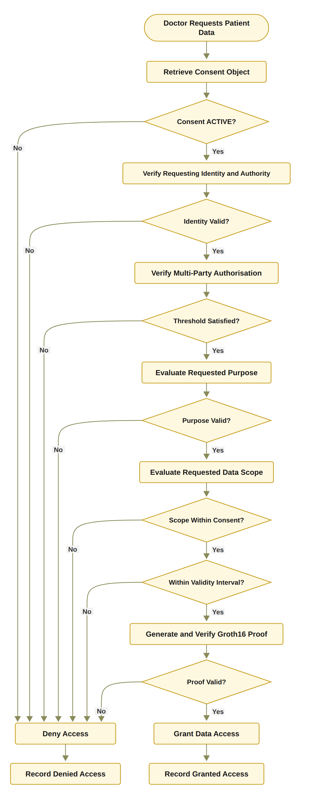
RO4: Policy- and Context-Aware Access Control
Notes:
This slide shows Algorithm 4 as a flowchart. It has the same checks, but it checks the consent state before the identity, and it shows the validity interval check and the Groth16 zero-knowledge proof as separate steps before access is granted.
First, the doctor requests patient data, and the system retrieves the consent object.
Second, it checks if the consent is ACTIVE.
Third, it verifies the identity and authority of the requester.
Fourth, it verifies the multi-party authorisation: is the threshold satisfied?
Fifth, it checks the requested purpose, and then the requested data scope, which must be inside the consent.
Sixth, it checks that the request is within the validity interval.
Seventh, it generates and verifies the Groth16 proof.
If any answer is No, access is denied, and the denied access is recorded.
Finally, if every answer is Yes, data access is granted, and the granted access is recorded.

Slide 40
RO4 VALIDATION: POLICY- AND CONTEXT-AWARE ACCESS CONTROL
Evidence | What it checks | Pass rule | Result
Live scenario 3 (Demo 4 and 5) | A doctor request inside the agreed purpose and data scope | All five checks PASS and the Groth16 proof verifies: ALLOW, GRANTED | Five ledger rows of 24 September: all PASS, ALLOW, GRANTED, groth16
Over-scope request | Requested data outside the authorised scope | DENY | A4 refused
Empty scope | A request with no data module selected | DENY | A5 refused after hardening
Policy context mismatch | Requester declares a different jurisdiction | DENY | A7 refused; one live refusal on 24 September (Scenario 4)
Tampered proof | A changed Groth16 proof or public signal | DENY | A9 refused
Only the records inside the authorised scope are released, and only after the proof verifies. Every decision, allowed or denied, is recorded with its decision matrix.
Notes:
This slide shows how objective 4 was validated. In the live scenario the doctor requested data inside the agreed scope: all five checks passed, the Groth16 proof verified, and access was granted. The five ledger rows of 24 September show this. The attacks on policy are refused: an over-scope request, A4; an empty scope, A5; a different jurisdiction, A7, which was also refused live on 24 September; and a tampered proof, A9. Only the records inside the scope are released.

Slide 41
RO4 EVALUATION: POLICY- AND CONTEXT-AWARE ACCESS CONTROL
Component | Median | Min | Max | n
Decision rule, five predicates (11 Oct) | 5.92 µs | 5.36 µs | 72.07 µs | 1,000
Groth16 proof generation | 1,401.1 ms | 1,342.8 ms | 5,349.6 ms | 20
Groth16 proof verification | 465.3 ms | 441.0 ms | 525.1 ms | 20
The decision rule itself is negligible; the Groth16 proof dominates an access request, about 1.9 seconds to generate and verify. Measured on 1 October 2026 (proof) and 11 October 2026 (decision rule); indicative only.
Notes:
This slide shows how objective 4 was evaluated. The five checks of the decision rule take about 6 microseconds. The Groth16 proof is the slowest part: about 1.4 seconds to generate and about half a second to verify, so an access request takes about 1.9 seconds end to end. These numbers are indicative.

Slide 42
Proposed solution for objective 5 مختصر
RO5: Temporal and Lifecycle Trust
Status: In Progress
Working now: the validity window is stored on-chain and checked at every request.
Working now: revocation end to end, including an on-chain revoke transaction.
Design: L is the lifecycle state (CREATED, PENDING, ACTIVE, SUSPENDED, REVOKED, EXPIRED), checked by VL(C) = ValidState(C) ∧ ValidTransition(C).
Working now: a clear lifecycle: PENDING_SIGNATURE, PENDING_TOKEN, NOT_STARTED, ACTIVE, EXPIRED, REVOKED.
Next stage: the SUSPENDED state, the lifecycle transition check, consent modification, delegation, guardian-set changes and a formal lifecycle model.
Notes:
Step five. Time and lifecycle. What works now: the validity window is stored on-chain and checked at every request. Revocation works end to end, with an on-chain transaction. And the consent moves through a clear lifecycle. In the design, L is the lifecycle state: created, pending, active, suspended, revoked or expired, and VL checks a valid state and a valid transition. What is still open: the suspended state, the lifecycle transition check, consent modification, delegation, changes to the guardian set, and a formal lifecycle model. That is why RO5 is in progress.
Algorithm 5: Temporal and Lifecycle Validation
The box on the right of the slide is Algorithm 5 from my report. The next slide shows the same algorithm as a flowchart.
Inputs and Output
Require: Consent object C, current time t, requested transition q
Explanation: The algorithm receives the consent, the time of the request, and the requested transition, which is the change of lifecycle state being asked for.
Ensure: Lifecycle validity result
Explanation: The algorithm returns VALID if the consent can still be used at this time and in its current state, or INVALID if it cannot.
Step-by-Step Explanation
Line 1: Retrieve consent start time t_s and expiry time t_e
First, we read the start time and the expiry time stored in the consent.
Line 2: if t < t_s or t > t_e then
We check whether the current time is before the start time or after the expiry time.
Line 3: Record temporal invalidity
If so, we record that the consent is not valid at this time.
Line 4: return INVALID
The request is outside the validity interval, so we return INVALID.
Line 5: end if
This completes the time check.
Line 6: Retrieve current lifecycle state of C
Next, we read the current lifecycle state of the consent, for example pending, active or revoked.
Line 7: if current state does not permit the requested operation then
We check whether this state does not allow the requested operation. For example, data access is allowed only when the consent is active.
Line 8: Record invalid lifecycle state
If the state does not allow it, we record that the consent is in an invalid lifecycle state.
Line 9: return INVALID
The operation is not allowed in this state, so we return INVALID.
Line 10: end if
This completes the lifecycle state check.
Line 11: Check whether C has been revoked
Then, we check whether the consent has been revoked.
Line 12: if C is revoked then
We test whether the consent is revoked.
Line 13: Record revocation-based invalidity
If it is revoked, we record that the consent is invalid because of revocation.
Line 14: return INVALID
A revoked consent must not be used, even if it was approved before, so we return INVALID.
Line 15: end if
This completes the revocation check.
Line 16: Validate requested transition q
Next, we check the requested transition, which is the change from the current state to a new state.
Line 17: if transition q is not permitted then
We check whether this change of state is not allowed.
Line 18: Record unauthorised state transition
If it is not allowed, we record an unauthorised state transition.
Line 19: return INVALID
The transition is rejected, so we return INVALID.
Line 20: end if
This completes the transition check.
Line 21: Record valid temporal and lifecycle evidence
All checks have passed, so we record evidence that the consent is valid in time and in state.
Line 22: return VALID
Finally, we return VALID, so the system can continue with the remaining authorisation conditions.
Note: Today, the prototype checks the validity interval, the lifecycle state and revocation for every access request. The transition check in lines 16 to 20 is planned for the next stage.

Slide 43
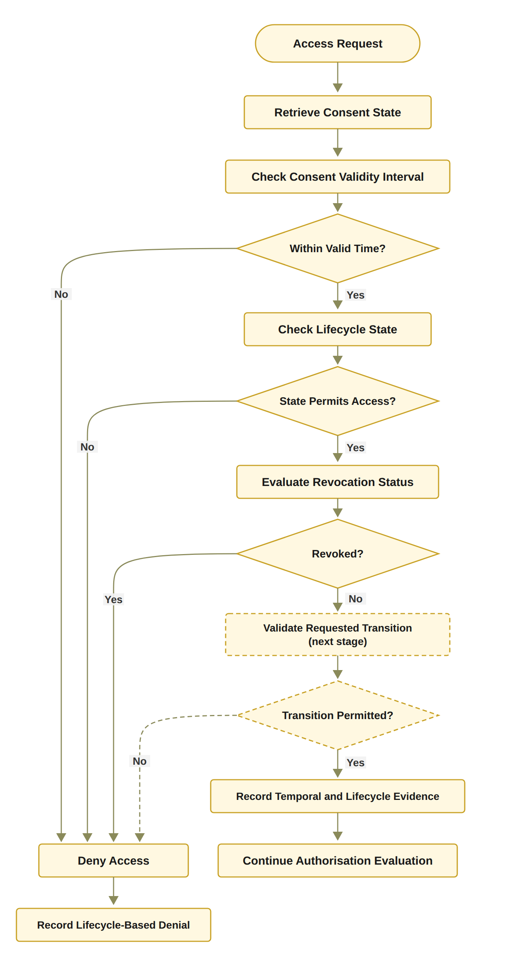
RO5: Temporal and Lifecycle Trust
Notes:
This slide shows Algorithm 5 as a flowchart. It shows the same four checks in the same order. The transition check is drawn in dashed lines because it is planned for the next stage. INVALID leads to Deny Access, and VALID leads to Continue Authorisation Evaluation.
First, an access request comes in, and the system retrieves the consent state.
Second, it checks the consent validity interval: is the request within the valid time?
Third, it checks the lifecycle state: does the state permit access?
Fourth, it checks the revocation status: has the consent been revoked?
Fifth, in the next stage, it will also check if the requested state transition is permitted.
If any check fails, access is denied, and a lifecycle-based denial is recorded.
Finally, if all checks pass, the system records the temporal and lifecycle evidence and continues with the rest of the authorisation decision.

Slide 44
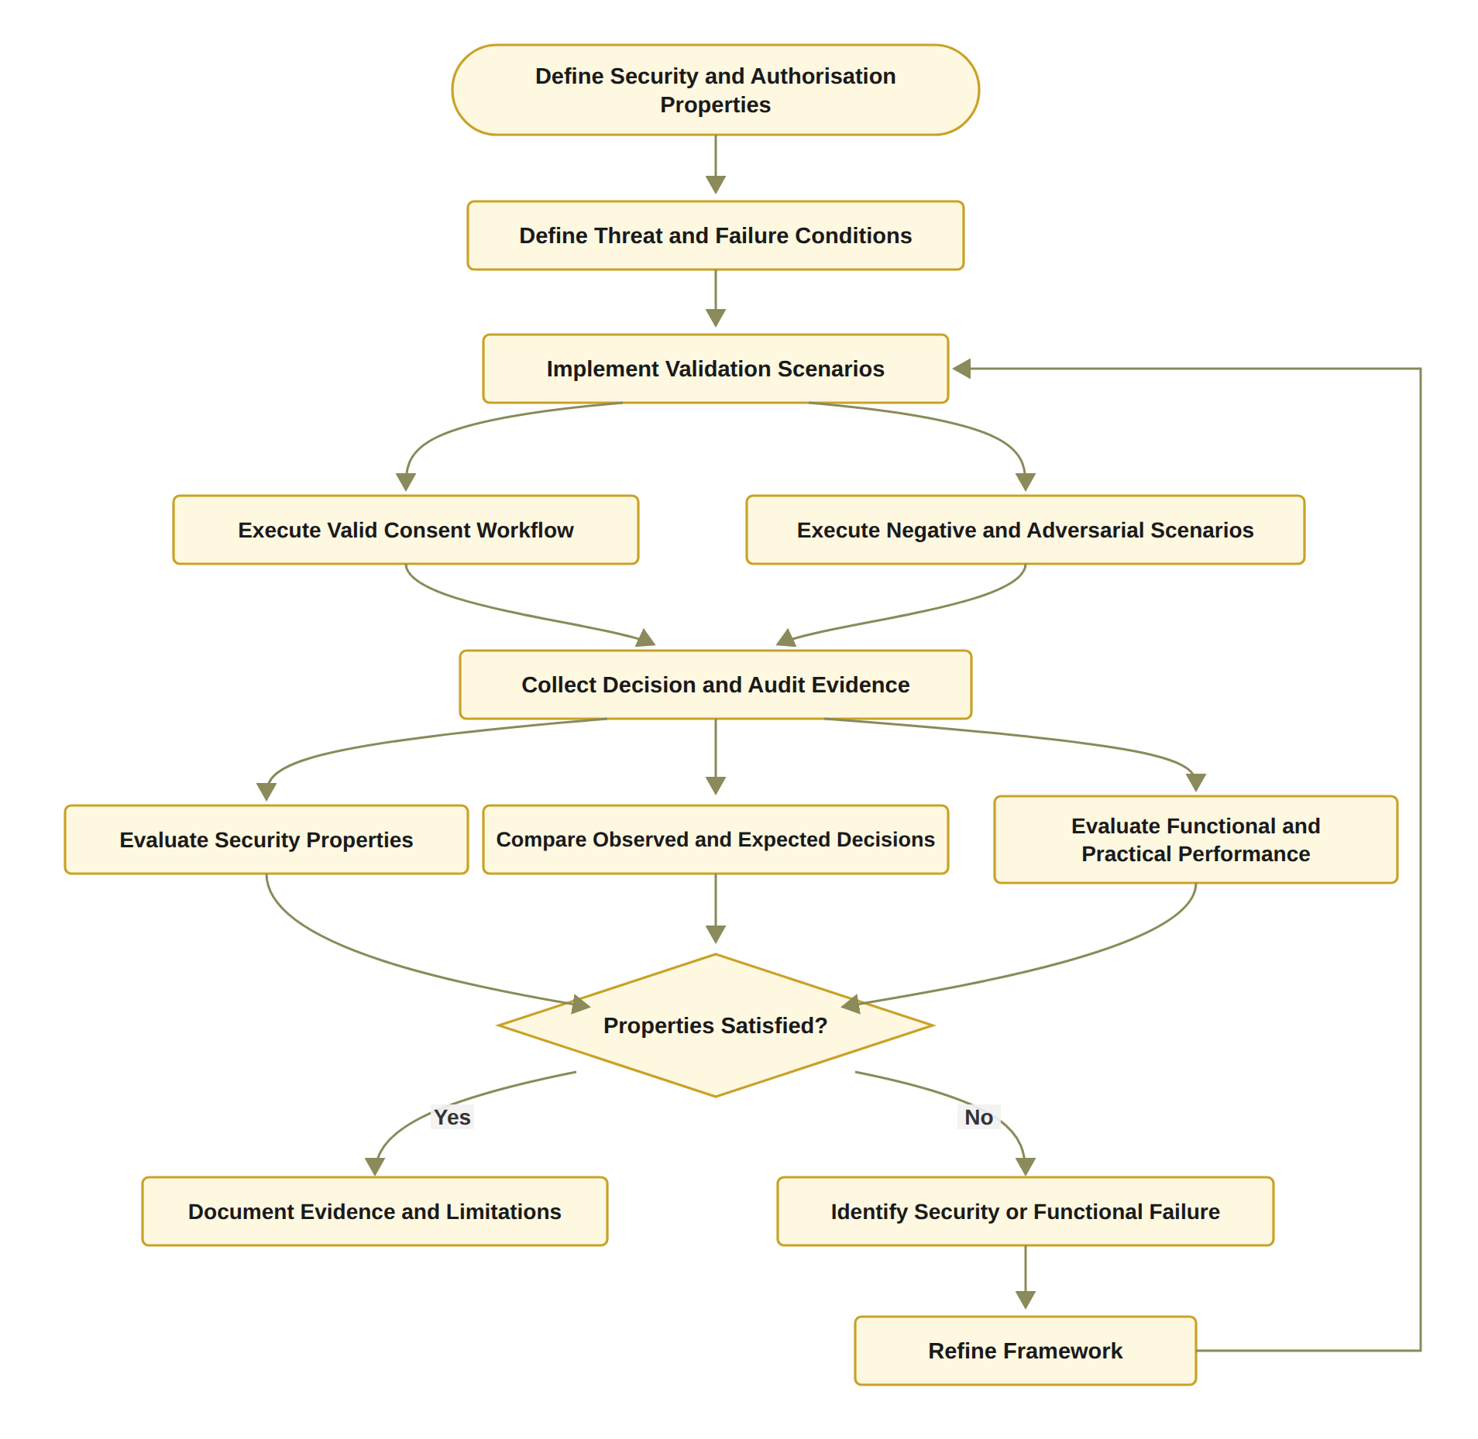
Proposed solution for objective 6
RO6: Formal Security Assurance and Empirical Validation
Status: Partially completed
Done: 46 automated tests pass, including 13 attack scenarios A1 to A13.
Done: gas, confirmation latency and processing time measured.
Next stage: formal proofs or model checking of the security properties, and a larger evaluation under load.
Notes:
Step six. Prove it and test it. The testing part is done. 46 automated tests pass, including thirteen attack scenarios. I also measured the cost and the timing. The proof part is the next stage: formal proofs or model checking of the security properties, and a bigger evaluation under load. That is why RO6 is partly completed.
Algorithm 6: Formal and Empirical Authorisation Validation
The box on the right of the slide is Algorithm 6 from my report. The next slide shows the same algorithm as a flowchart.
Inputs and Output
Require: Framework implementation F, validation scenarios S, security properties P
Explanation: The algorithm starts with the implemented framework, the set of test scenarios, and the security properties that the framework should satisfy.
Ensure: Validation evidence and evaluation results
Explanation: The algorithm produces evidence and results that show whether the framework really meets these properties.
Step-by-Step Explanation
Line 1: Define expected authorisation properties P
First, we define the security properties that the framework must satisfy, such as soundness, correct denial, threshold correctness, policy and scope compliance, and audit consistency. These are the criteria we use to judge the results.
Line 2: Define valid scenarios S_valid
We define legitimate requests that should be allowed, with valid identities, active consent and enough approvals. They show that the framework does not wrongly reject valid requests.
Line 3: Define negative scenarios S_negative
We define requests that break at least one condition, such as expired or revoked consent, too few approvals, or data outside the consent scope. They test that access is refused when a requirement is not met.
Line 4: Define adversarial scenarios S_adv
We define deliberate attempts to bypass the controls, such as replayed (reused) or duplicate approvals, forged credentials, or use of a revoked consent. They test whether the framework can resist attacks.
Line 5: for each scenario s in S_valid ∪ S_negative ∪ S_adv do
Next, we combine the three groups into one set and repeat the following steps for every scenario. Each scenario has an expected decision.
Line 6: Execute s using framework F
We run the scenario on the implemented framework. The framework performs its consent, identity, approval, policy, scope and lifecycle checks.
Line 7: Collect authorisation decision
We record the decision that the framework actually made, for example ALLOW, DENY or PENDING.
Line 8: Collect identity, approval, policy, and audit evidence
We also collect the evidence behind the decision, such as identity and credential results, approvals, policy checks, timestamps and audit records.
Line 9: Compare observed decision with expected decision
We compare the actual decision with the expected decision. The scenario passes only when the two are the same.
Line 10: Record pass or failure result
We record whether the scenario passed or failed. For a failure, we keep the details and the evidence for later analysis.
Line 11: end for
This completes the loop over all scenarios.
Line 12: Evaluate soundness property
Then, we check soundness. Every request that was allowed must really satisfy all the authorisation conditions.
Line 13: Evaluate denial property
We check that every invalid or unauthorised request was refused. This is most important for the negative and adversarial scenarios.
Line 14: Evaluate threshold correctness
We check that consent is authorised only when the number of verified approvals reaches the required threshold. Duplicate or unauthorised approvals must not be counted.
Line 15: Evaluate policy-scope enforcement
We check that every allowed request matches the consent’s purpose and stays inside the permitted data scope. This must be true even when the requester has a valid identity and credential.
Line 16: Evaluate audit consistency
We check that the audit records match the decisions that were actually made. Important evidence, such as the requester, the consent, the result and the time, must not be missing.
Line 17: Analyse failures and limitations
We study each failed scenario to find its cause, for example an implementation defect, a policy error, an integration problem or a limit of the test environment. The aim is to explain failures openly, not to hide them.
Line 18: return Validation results
Finally, we return the combined validation results, which bring together the scenario results and the result for each security property.
Note: Today, the testing part is done with 46 automated tests, including 13 attack scenarios. Formal proofs or model checking of these properties, and a larger evaluation under load, are planned for the next stage.

Slide 45
THE HALAH PROTOTYPE
Four interfaces
Patient, guardian, doctor and auditor
Smart contract
ConsentSBTv3, a soulbound ERC-721 token (ERC-5484) on the Sepolia testnet
Guardian approval
EIP-712 typed signatures, verified by signature recovery
Access proof
Groth16 zero-knowledge proof over a Poseidon commitment
Data
Synthetic Synthea records: Observation, Medication, Condition, Procedure
Evidence
Off-chain audit ledger of consent events and access decisions; no medical content on-chain
Notes:
Now the demo. I show it through real screens from the prototype. All the prototype screens were taken on 24 September 2026.
HALAH means History Access Link for Authorised Healthcare. The boxes show its parts: four screens, a smart contract on the Sepolia test network, guardian signatures, an access proof, synthetic data, and an audit ledger.
The demo follows the steps of a consent.
First, the patient creates the consent. This is RO1.
Second, the two guardians sign it, and the consent goes on Sepolia. This is RO2 and RO3.
Third, the doctor asks for the data. The system runs five checks, and then it shows only the agreed records. This is RO2 and RO4.
Fourth, the auditor follows the recorded steps in the ledger. This is part of RO6.
The last demo slide is about revocation, RO5. It is optional. I show it if there is time.

Slide 46
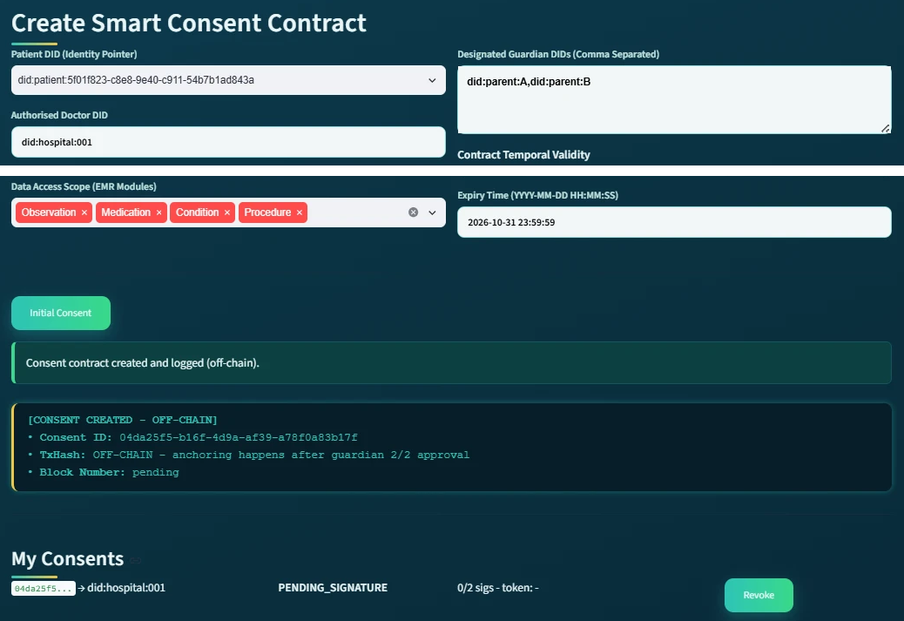
DEMO 1: THE PATIENT CREATES THE CONSENT
RO1
Consent as an evaluable object
The patient enters the doctor's DID, two guardians, the data modules and the end date.
The system saves the consent off-chain and gives it an ID.
The state is PENDING_SIGNATURE, with 0 of 2 signatures.
Nothing is on the blockchain yet.
Patient screen, consent 04da25f5 (shown in two parts)
Notes:
This is the patient screen. The picture is shown in two parts.
First, the patient chooses a patient DID from the list. Then the patient types the doctor's DID, did:hospital:001.
Second, the patient adds two guardians: parent A and parent B.
Third, the patient chooses the data that the doctor may see. Here there are four modules: Observation, Medication, Condition and Procedure. The patient also sets the end date, 31 October 2026.
Fourth, the patient presses the Initial Consent button. The system saves the consent off-chain and gives it an ID, 04da25f5.
At the bottom, you can see the state: PENDING_SIGNATURE, with zero of two signatures. Nothing is on the blockchain yet. The consent goes on the chain only after both guardians sign.
This is RO1: the consent is an object that the system can check.

Slide 47
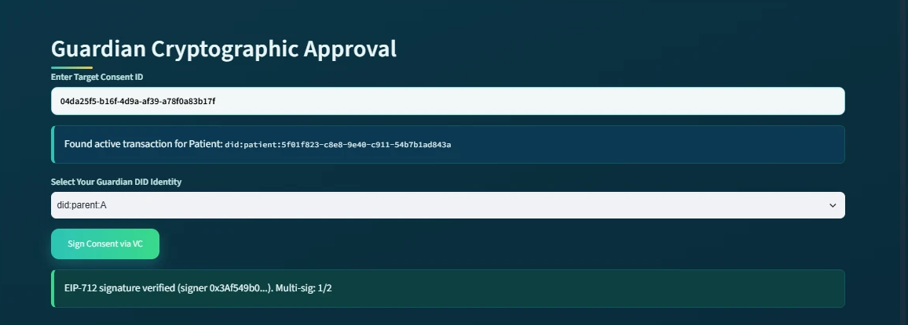
DEMO 2: THE FIRST GUARDIAN APPROVES
RO2 + RO3
Guardian A enters the consent ID and chooses their DID.
The first guardian signs an EIP-712 approval. The system checks the signature and finds the signer's address.
The counter shows 1 of 2. The consent stays pending.
Guardian screen at the first approval: signature verified, 1 of 2 signatures
Notes:
This is the guardian screen.
First, the guardian types the consent ID, 04da25f5. The system finds the consent and shows the patient's DID.
Second, the guardian chooses a guardian DID from the list, did:parent:A.
Third, the guardian presses the Sign button and signs with an EIP-712 signature. The system checks the signature and finds the address that signed it. You can see the start of that address in the green box.
Fourth, the counter shows one of two. One signature is not enough, so the consent is still waiting for the second guardian.
This is RO2, because the system checks which guardian key signed, and RO3, because more than one guardian must agree.
Possible question: The button says via VC. Was a credential checked? Not in this September version. It checked only the form of the DID. The credential check was added on 11 October 2026.

Slide 48
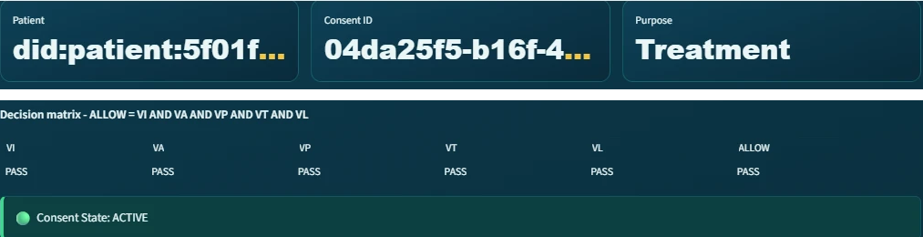
DEMO 4: THE DOCTOR IS ALLOWED
RO2 + RO4
The doctor opens the consent: patient, consent ID and purpose, Treatment. The state is ACTIVE.
The decision matrix shows VI, VA, VP, VT, VL all PASS, so ALLOW.
VP is the policy check: the purpose is checked here, and the scope when the doctor asks for the data.
Doctor screen, consent 04da25f5 (shown in two parts)
Notes:
This is the doctor screen, for the same consent, 04da25f5. The picture is shown in two parts.
First, the doctor opens the consent. At the top, you can see the patient, the consent ID and the purpose, which is Treatment.
Second, the screen shows the five checks: VI, VA, VP, VT and VL. VI checks the identity data in the consent: the doctor's and the patient's DIDs, and the guardian signatures. VA checks that both guardians signed and that the token exists. VP is the policy check, as in my report: the purpose must be allowed, and the doctor may ask only for data inside the agreed scope. On this screen, the purpose is checked. The scope is checked when the doctor asks for the data, on the next slide. VT checks the dates.
Third, all five checks show PASS, so ALLOW is also PASS. The consent state is ACTIVE.
The Groth16 proof is not on this screen. It is checked when the doctor asks for the data, and the ledger records that it was verified.
This is RO2 and RO4 together, in one decision.
Possible question: Is this the same code as today? No. These screens are from the 24 September version. Since 11 October 2026, the doctor also types their own DID and must have a valid credential. VL is now the lifecycle check from my report: the consent must be ACTIVE. On this screen, VL was an earlier, different check.

Slide 49
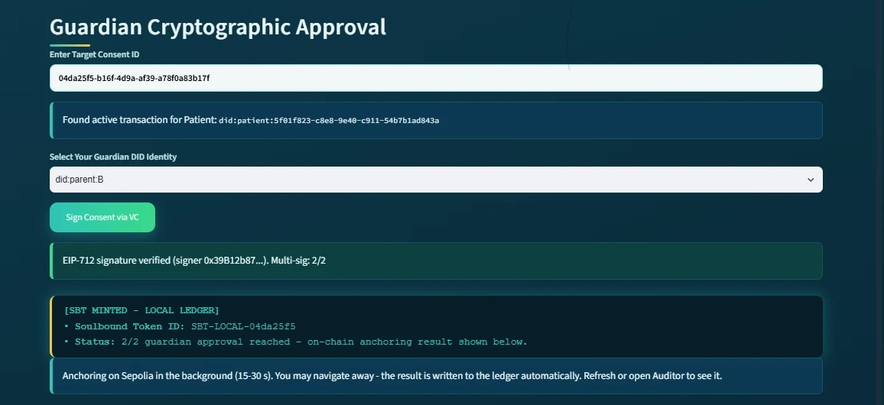
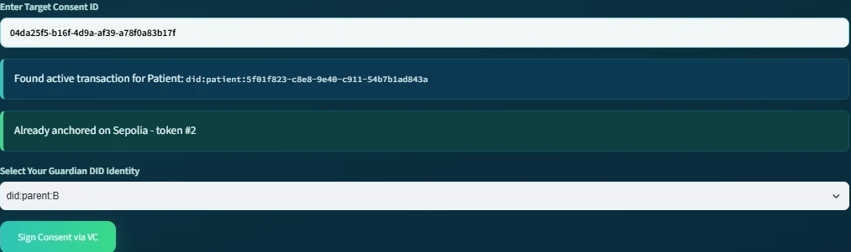
DEMO 3: SECOND APPROVAL, TOKEN MINTED
RO3
Threshold reached: 2 of 2, then anchoring in the background
The second signature is verified. Now 2 of 2 guardians have signed.
A soulbound token is minted on Sepolia in the background. The guardian does not wait.
Later, the same screen says: already anchored on Sepolia, token #2.
Second approval: 2 of 2, token recorded, anchoring starts
Same screen later: already anchored on Sepolia, token #2
Notes:
This slide shows the guardian screen two times.
First, on the left, the second guardian, did:parent:B, signs. The system checks the signature. Now the counter shows two of two, so both guardians have agreed.
Second, the system records the soulbound token for this consent. Then it mints the token on the Sepolia test network in the background, so the guardian does not have to wait.
Third, on the right is the same screen, a little later. It says: already anchored on Sepolia, token number 2.
Now the consent is approved by both guardians, and it is on the blockchain. This completes RO3.

Slide 50
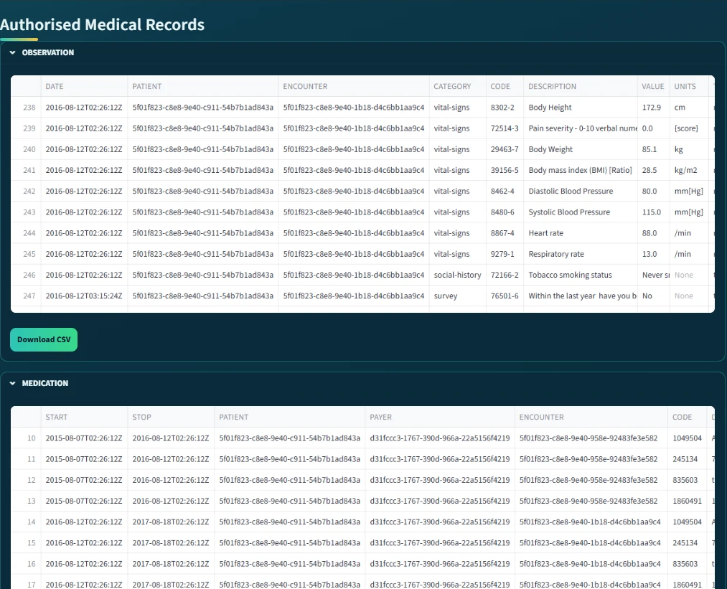
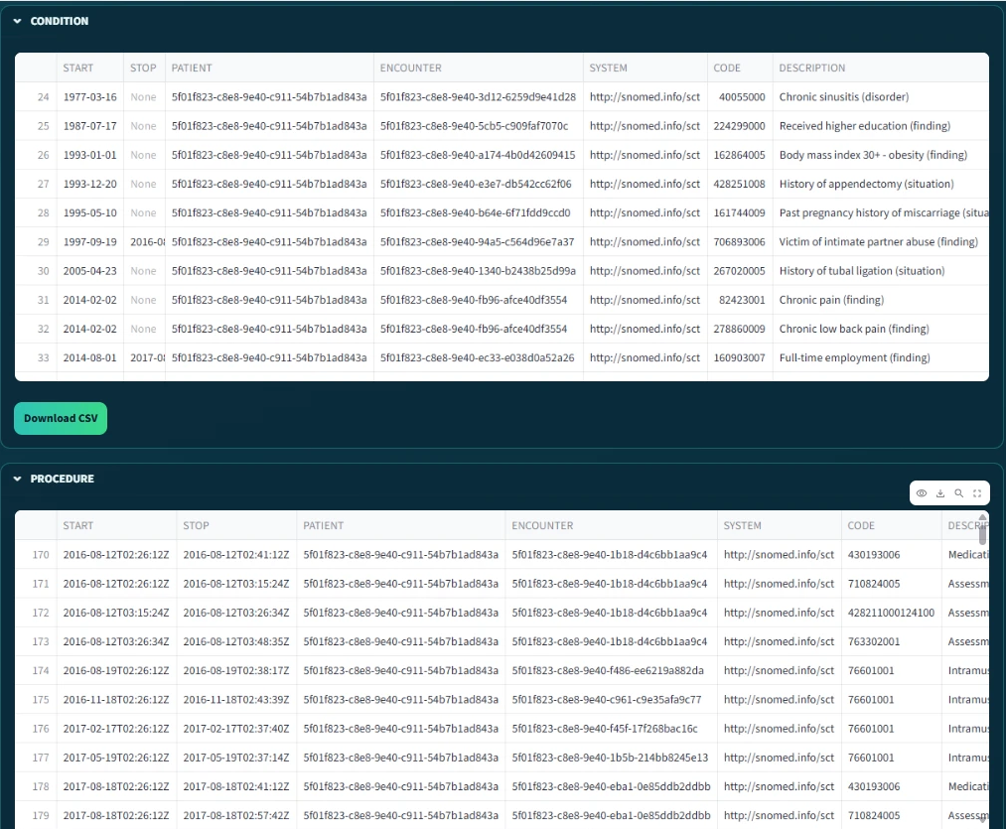
DEMO 5: ONLY THE AUTHORISED RECORDS
RO4
After ALLOW and the proof check, the screen shows the records, one table per module.
Only the four modules in the consent are shown. A request outside the scope is refused (attack test A4).
The data are synthetic Synthea records, not real patients.
Authorised records: Observation and Medication
Authorised records: Condition and Procedure
Notes:
This is the doctor screen after the decision.
First, after ALLOW, the doctor asks for the four modules. The system checks the Groth16 proof and the requested scope. You cannot see this on the screen, but the ledger rows for these requests say: proof verified, scope valid. Then the screen shows Authorised Medical Records. There is one table for each data module.
Second, on the left, you can see Observation and Medication. On the right, you can see Condition and Procedure. All the rows belong to the same patient.
Third, these are exactly the four modules in the consent. The doctor gets nothing outside them. If the doctor asked for a module outside the consent, the request would be refused. Attack test A4 checks this.
The records are synthetic Synthea data, so no real patient is shown. This is RO4.

Slide 51
RO6: Formal Security Assurance and Empirical Validation
Notes:
This slide shows Algorithm 6 as a flowchart. It has the same main steps, but it also adds a practical performance check, and a loop that refines the framework and tests again when a property fails. The algorithm itself does not include these two parts.
First, I define the security and authorisation properties, and the threat and failure conditions.
Second, I implement the validation scenarios.
Third, I run the valid consent workflow, and also the negative and adversarial scenarios.
Fourth, I collect the decision and audit evidence.
Fifth, I evaluate the security properties, compare the observed decisions with the expected ones, and evaluate the functional and practical performance.
Then I ask: are the properties satisfied? If yes, I document the evidence and the limitations.
Finally, if not, I identify the security or functional failure, refine the framework, and run the validation scenarios again.

Slide 52
VALIDATION
Evidence | What it checks | Pass rule | Result
Valid scenarios | Legitimate requests get access | Observed = expected | Scenarios 1 to 3: consent created, 2-of-2 approval, ALLOW
Negative scenarios | Wrong requests are refused | Any failed check gives DENY | Scenario 5: revoked consent refused
Attack scenarios | Deliberate attempts to bypass a check, A1 to A13 | Every attack is refused | 12 of 13 refused (A11 neutral: the audit digest is not yet checked)
Automated tests | 32 functional tests and 14 adversarial tests | All pass | 46 of 46 pass
Independent check | On-chain receipts against the local consent state | Local state = on-chain state | Scenario 6: all checks passed
Notes:
Validation asks one question: does the system do what it should? I used five kinds of evidence. Valid scenarios: the correct requests were allowed. Negative scenarios: the cancelled consent was refused. Attack scenarios: twelve of thirteen attacks are refused. Automated tests: all 46 pass. And an independent check: the state on the chain matches the local state.

Slide 53
VALIDATION: THE RECORDED DECISIONS
Time (24 Sep) | Consent | VI | VA | VP | VT | VL | Decision | Access | Proof
09:51:36 | f050c29a | PASS | PASS | PASS | PASS | PASS | ALLOW | GRANTED | groth16
09:51:39 | f050c29a | PASS | PASS | PASS | PASS | PASS | ALLOW | GRANTED | groth16
11:02:52 | 04da25f5 | PASS | PASS | PASS | PASS | PASS | ALLOW | GRANTED | groth16
11:04:16 | 04da25f5 | PASS | PASS | PASS | PASS | PASS | ALLOW | GRANTED | groth16
11:04:26 | 04da25f5 | PASS | PASS | PASS | PASS | PASS | ALLOW | GRANTED | groth16
Allowed requests: all five checks PASS, decision ALLOW, access GRANTED, proof mode Groth16 (Scenario 3).
After revocation (Scenario 5) the request was refused before any decision was logged; the prototype now logs these refusals too. The revocation is public on Sepolia, block 11,771,307.
Notes:
This table is taken directly from the audit ledger of 24 September. Each row is one real request, with the five checks and the decision. All five rows are allowed requests: all five checks PASS, the decision is ALLOW, access is GRANTED, and the proof mode is Groth16. The request after revocation is not in this table, because on 24 September a consent that was no longer active was refused before any decision was logged. The prototype now logs these refusals too. The revocation is public on Sepolia in block 11,771,307.

Slide 54
VALIDATION: THIRTEEN ATTACK SCENARIOS
ID | Attack | Target | Before hardening | After hardening
A1 | Approval signed by a signer outside G | A | Accepted* | Refused
A2 | Guardian signature replayed from another consent | I | Refused | Refused
A3 | Same guardian approves twice to reach N | A | Accepted* | Refused
A4 | Requested scope exceeds the authorised scope | P | Refused | Refused
A5 | Request with an empty scope | P | Accepted* | Refused
A6 | Request before notBefore or after expiry | T | Refused | Refused
A7 | Requester declares a different jurisdiction | P | Refused | Refused
A8 | Access after revocation | E | Refused | Refused
A9 | Tampered Groth16 proof or public signal | E | Refused | Refused
A10 | Honest proof for an expired consent | T | Refused | Refused
A11 | Mint or revoke by a non-owner, or token transfer | Contract | Refused | Refused
A12 | Invalid or forged credential | I | Accepted‡ | Refused
Notes:
I also attacked my own system thirteen times, A1 to A13. This table shows each attack, the part of the consent it targets, and the outcome before and after the hardening on the first of October. Before the hardening, three attacks got through when the service functions were called directly: A1, a signer outside the guardian set; A3, the same guardian signing twice; and A5, an empty data scope. The interface already refused them, but the service layer did not. The hardening moved these checks into the service layer, so now they are refused on every path. After the hardening, eleven of the first twelve are refused. A13, an invalid or forged credential, came with the credential check on 11 October 2026 and is refused too; before that change, a requester without a valid credential was accepted. A11 rewrites the result of a recorded audit event, so the event's digest changes. Nothing in the prototype checks that digest yet, so it is marked as differs: neutral, not refused. It is on the list for the next stage.

Slide 55
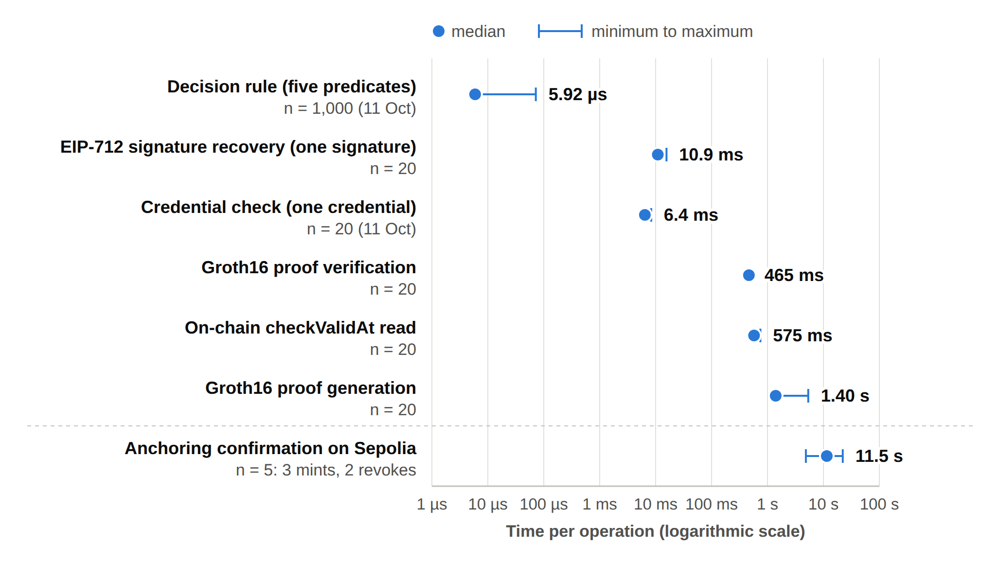
EVALUATION: HOW FAST AND HOW MUCH?
Component | Median | Min | Max | n
Decision rule, five predicates (11 Oct) | 5.92 µs | 5.36 µs | 72.07 µs | 1,000
EIP-712 signature recovery, one signature | 10.93 ms | 10.55 ms | 15.64 ms | 20
Credential check, one credential (11 Oct) | 6.42 ms | 6.18 ms | 8.33 ms | 20
Groth16 proof generation | 1,401.1 ms | 1,342.8 ms | 5,349.6 ms | 20
Groth16 proof verification | 465.3 ms | 441.0 ms | 525.1 ms | 20
On-chain checkValid read | 573.5 ms | 568.2 ms | 715.5 ms | 20
On-chain checkValidAt read | 574.6 ms | 568.2 ms | 745.6 ms | 20
Anchoring confirmation | 11.5 s | 4.9 s | 22.1 s | 5
Timings measured on 1 October 2026 (decision rule and credential check on 11 October 2026); gas and anchoring from the five Sepolia transactions of September 2026; indicative only
Gas used: mint #1 196,406; revoke #1 32,980. No fee above 0.00021 ETH.
Notes:
Evaluation asks: how fast is it, and what does it cost? The five checks of the decision rule take about 6 microseconds, and checking one credential about 6 milliseconds. Checking one guardian signature takes about 11 milliseconds. The Groth16 proof is the slowest part of an access request: about 1.4 seconds to generate and about half a second to verify. Anchoring on Sepolia takes about 11.5 seconds. The mint runs in the background, so the guardians and the doctor do not wait for it; only a revoke makes the patient wait for the block. For token 1, the revoke used about one sixth of the gas of its mint. The timings were measured on the first of October 2026; the decision rule and the credential check on the eleventh of October, after the credential check was added. The gas and the anchoring times come from the five Sepolia transactions in September. These numbers are indicative.

Slide 56
WHAT IS DIFFERENT FROM TODAY'S SYSTEMS
Aspect | Traditional EHR access control | HALAH framework
Identity | Central identity provider; institution login | A DID for every participant; identity kept separate from authority
Consent | A stored record that permission was given | An object C = (I, A, P, T, L, E), checked at every request
Approval | A static permission set by one party | All listed guardians sign (EIP-712); no single party can approve alone
Access check | Log in, then check a static permission | VI ∧ VA ∧ VP ∧ VT ∧ VL, plus a Groth16 proof before data is released
Time and revocation | Hard to verify once the permission is stored | Validity window and revocation checked each time; on-chain revoke
Audit | A record that consent occurred | Every access decision, allowed or denied, logged off-chain with its decision matrix; consent state anchored on Sepolia
Notes:
Here is the difference in plain words. Today, a central identity provider logs you in, and a fixed permission decides. Consent is a saved record. In HALAH, every person has a DID, and identity is separate from authority. Consent is an object that is checked at every request. All the guardians must approve. Five checks and a proof run before any data is released. Time and revocation are checked every time. And every access decision, allowed or denied, is logged off-chain with the reason.

Slide 57
DATASET
Aspect | Key points
Data source | Synthea 1K sample of synthetic patient records (synthea.mitre.org), CSV export; a subset of patients with their observations, conditions, medications and procedures. No real patient data is involved.
Data storage | Medical records stay off-chain in the application. No medical content is written to the chain.
On-chain record | Pseudonymous patient and requester addresses, a hash of the purpose, the validity window and a revocation flag.
Access to data | Records are released only on ALLOW and only within the agreed data scope.
Audit | Every access decision, allowed or denied, is recorded in the off-chain audit ledger with its decision matrix.
Known limitation | The plaintext purpose is passed in the mint transaction and is visible in the public transaction input.
Notes:
A few important points about the data. I use synthetic patient records from the Synthea 1K sample, in its CSV export. The prototype loads a subset of patients with their observations, conditions, medications and procedures. No real patient data is involved. The medical records stay off-chain. The token on Sepolia stores pseudonymous addresses, a hash of the purpose, the validity window and a revocation flag. Data is released only on ALLOW, and only inside the agreed scope. One known limitation: the plain-text purpose is visible in the mint transaction. I will fix this in the next stage.

Slide 58
SIGNIFICANCE OF THE RESEARCH تتغير
Scientific Significance
This research shifts the focus from determining whether consent has merely been recorded towards determining whether a data-access decision has been generated under sufficient and independently verifiable trust conditions.
It brings identity, authority, multi-party approval, policy, time and lifecycle together in one access decision that is checked at every request.
It makes multi-party approval a standing condition of access: every listed guardian must sign with EIP-712, and no single party can authorise alone.
Notes:
Why does this research matter? On the scientific side, it shifts the focus from whether consent has merely been recorded to whether a data-access decision was made under sufficient and independently verifiable trust conditions. It brings identity, authority, multi-party approval, policy, time and lifecycle together in one decision at every request. Every listed guardian must sign, so no single party can authorise alone. And the work rests on a PRISMA 2020 review of 25 studies and a working prototype on Sepolia, measured and tested with thirteen attack scenarios.

Slide 59
SIGNIFICANCE OF THE RESEARCHتتغير
Social Contributions
This research gives patients and their guardians a direct role in deciding who can see the patient's data.
It prevents a single person from authorising access to sensitive health data alone.
It makes every access decision explainable to auditors: which check passed and which failed.
It keeps medical records off-chain, so only consent evidence is shared on the blockchain.
It can support trust between hospitals and other independent parties when health data are shared.
Notes:
On the social side, patients and their guardians decide together who can see the patient's data. No single person can approve access alone. Every access decision can be explained to an auditor: which check passed and which failed. Medical records never go on the blockchain; only consent evidence is shared. And this can support trust between hospitals and other independent parties.

Slide 60
WHAT IS STILL OPEN
Identity and keys
Full DID resolution, proof that the user controls the DID, and wallet-held keys. Today: demo-issuer credentials, signature recovery, keys made from the DIDs (RO2, RO3).
Purpose on-chain
The plaintext purpose is visible in the mint transaction input.
Lifecycle
The SUSPENDED state, the lifecycle transition check, consent modification, delegation and guardian-set changes, with a formal lifecycle model (RO5).
Formal proofs
The security properties are tested, not yet proved. Next: a formal model and model checking or proofs (RO6).
Attack A11
Rewriting the result of an audit event changes its digest, but nothing checks the digest yet. It is marked neutral, not refused.
Scale
A larger evaluation under load, with more users, consents and concurrent requests.
Notes:
I want to be clear about what is not done yet, because this is what the next stage is for. First, full DID resolution, proof that the person controls the DID they enter, and wallet-held guardian keys. Today the credentials come from one demo issuer, and the guardian keys are derived from the guardian DIDs. Second, the plain-text purpose in the mint transaction. Third, the rest of the lifecycle: the suspended state, the lifecycle transition check, consent modification, delegation and guardian changes. Fourth, the formal proofs. The properties are tested, but not yet proved with a formal model. Fifth, the one open attack, A11: nothing checks the audit digest yet. Sixth, a bigger evaluation under load.

Slide 61
RESEARCH PUBLICATIONS
# | Title | Venue | Year | Status
1 | A Blockchain-Based Framework for Evaluating User Identity Trustworthiness in Real Estate | 2025 IEEE International Conference on E-Business Engineering (ICEBE) | 2025 | Published
2 | Blockchain-Based Reputation Borrowing Model to Address the Cold Start Problem for New Users in Real Estate | 2025 IEEE International Conference on E-Business Engineering (ICEBE) | 2025 | Published
3 | A Smart Contract-Governed Lifecycle Protocol for Reputation Borrowing in Blockchain-Based Real Estate Platforms | ICEBE 2026 | 2026 | Accepted
4 | A Trusted Multi-Party Consent Governance Framework for Decentralized Multi-Stakeholder Data Sharing | BWCCA 2026 | 2026 | Accepted
5 | Blockchain-Based Reputation Provenance Tracing for Newcomer Bootstrapping in Real Estate | BWCCA 2026 | 2026 | Accepted
Notes:
This slide lists my research publications. Two papers were published in 2025 at the IEEE International Conference on E-Business Engineering, ICEBE. Three more papers have been accepted in 2026: one at ICEBE 2026 and two at BWCCA 2026. Paper 4, on trusted multi-party consent governance, comes from this research.

Slide 62
RESEARCH PLAN
Task | Description | Target date | Status
Chapters 1–4 | Introduction, SLR, Research Questions and Objectives, Research Methodology | Completed | Done
Chapter 5 | Research Architecture (MVC) and framework design RO1 AND RO2 | May 2026 | Done
Chapter 6 | Proposed solution for RO3 to and the HALAH prototype | Jul–Oct 2026 | Done
Publication 1 | Conference paper submission, BWCCA 2026 | Sep 2026 | Done
Publication 2 | SLR paper journal submission | Oct 2026 | In Progress
Chapter 7 | Proposed solution for RO4 | Nov 2026 | Planned
Publication 3 | Journal paper on formal security assurance, lifecycle trust and the evaluation of HALAH | Dec 2026 | Planned
Chapter 8 | Proposed solution for RO5 | Dec 2026 | Planned
Chapter 9 | CONCLUSION AND FUTURE WORK | Dec 2026 | Planned
Final assessment | candidature assessment 3 | Jan 2027 | Planned
Thesis | Complete thesis submission | Mar 2027 | Planned
Notes:
This is the plan. Chapters one to six are done. The conference paper was submitted to BWCCA 2026 in September. The SLR journal paper is in progress. Next comes the complete evaluation, the paper on formal assurance and lifecycle trust, and the conclusion. The final assessment is planned for January 2027, and the thesis submission for March 2027.

Slide 63
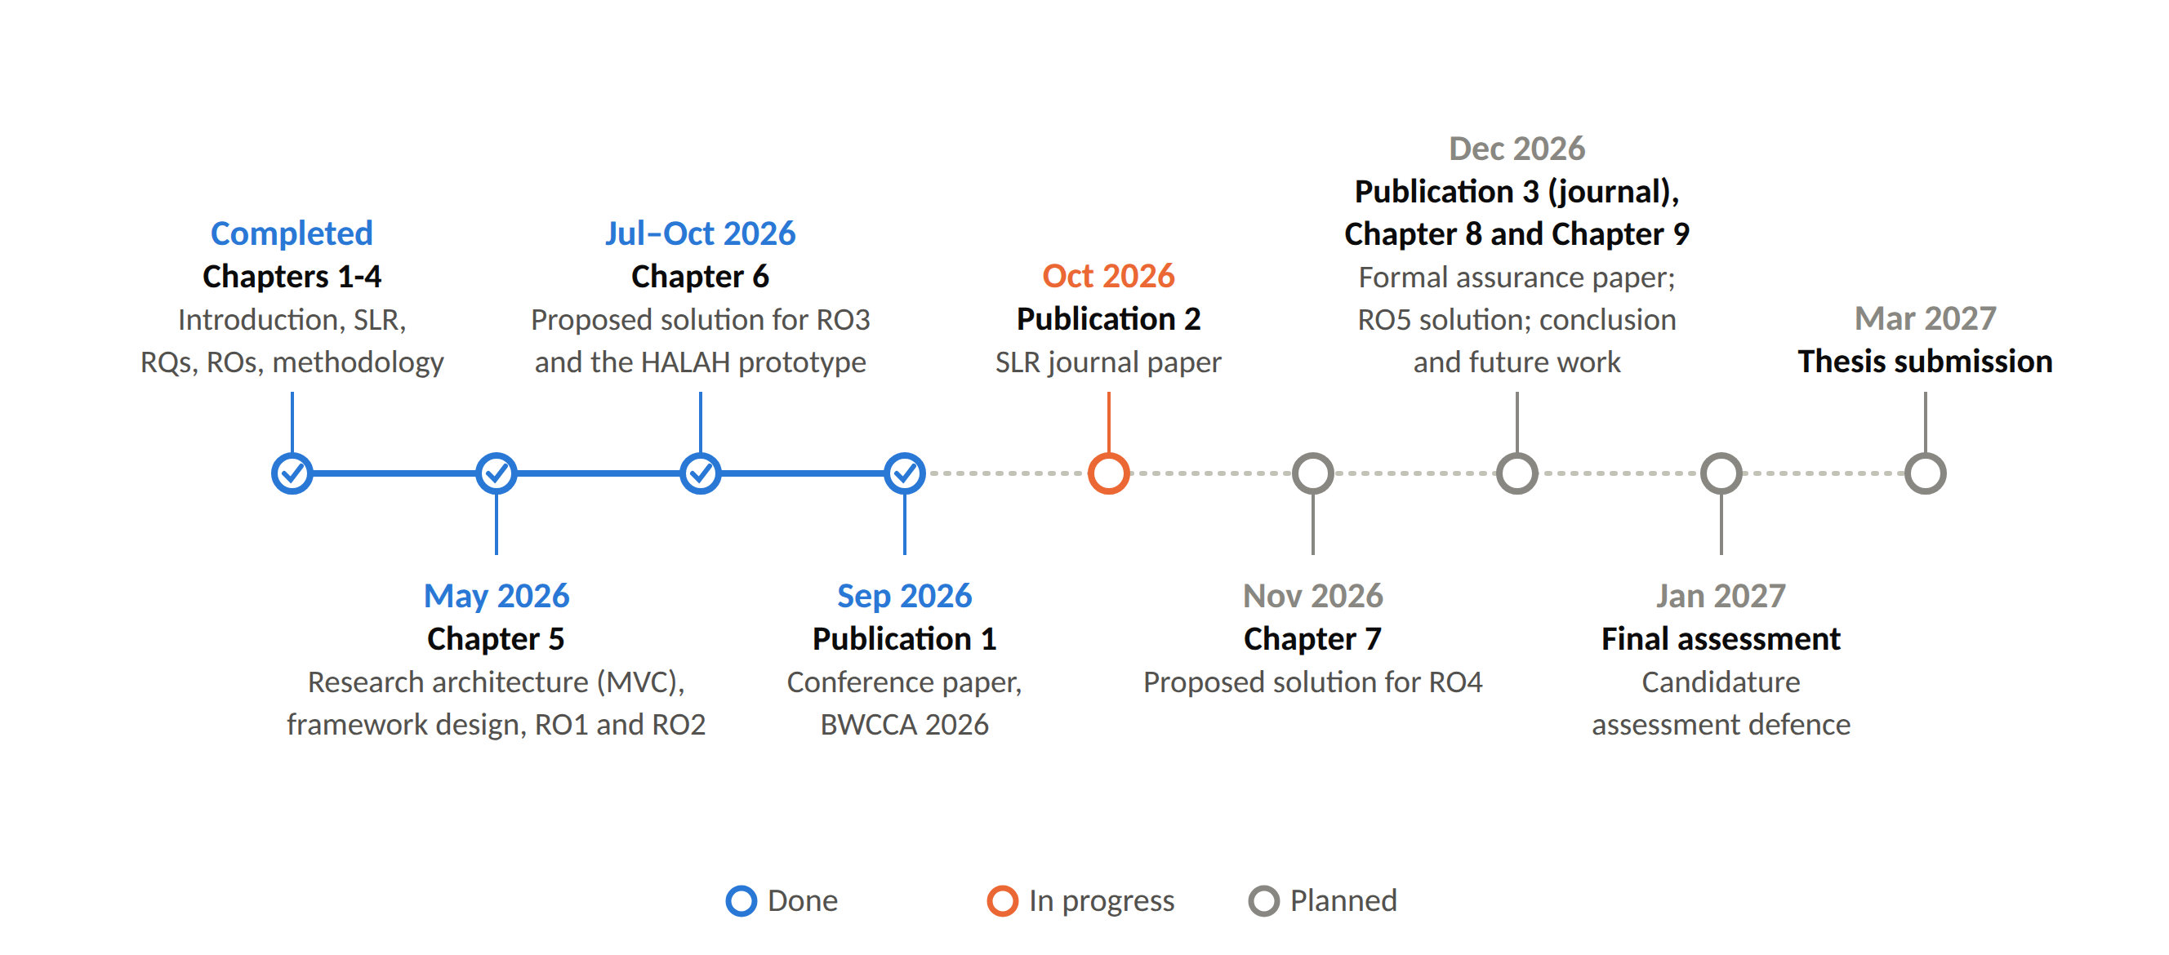
RESEARCH TIMELINE
Notes:
This is the same plan as a timeline. What is completed, what is in progress, and the planned steps up to the thesis submission in March 2027.

Slide 64
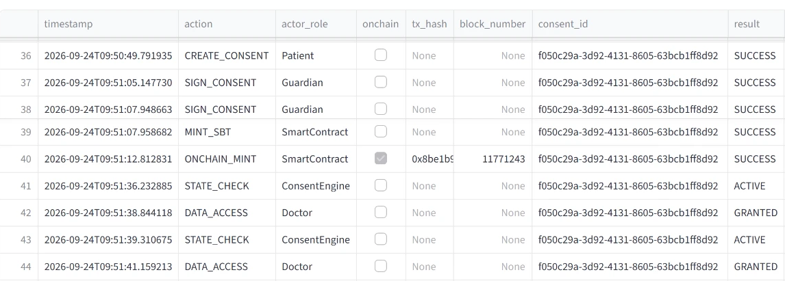
DEMO 6: THE AUDITOR FOLLOWS THE CONSENT
RO6 (part)
Notes:
This is the auditor screen. It shows the audit ledger as a table. Each row is one event, with its time.
This table is for another consent from the same day, f050c29a. It has token number 1. It went through the same steps as the consent you just saw. I use it here because this is the consent that the patient later revoked. The optional next slide shows that.
First, row 36: the patient creates the consent.
Second, rows 37 and 38: guardian A and guardian B sign.
Third, rows 39 and 40: the token is recorded, and then it is anchored on Sepolia. You can see the start of the transaction hash and the block number, 11,771,243.
Fourth, rows 41 to 44: the system checks the consent. It is ACTIVE and all five checks pass, so the doctor gets access. This happens two times.
Rows 45 and 46 are not in this picture. They record one more request from the doctor, and the system refused it.
So the auditor can follow the recorded steps, in order. This is the working part of RO6: evidence that can be checked.

Slide 65
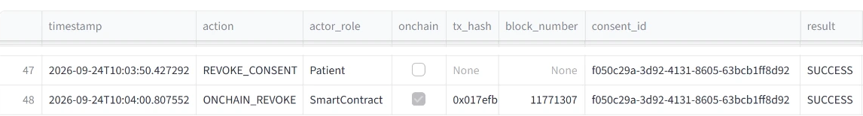
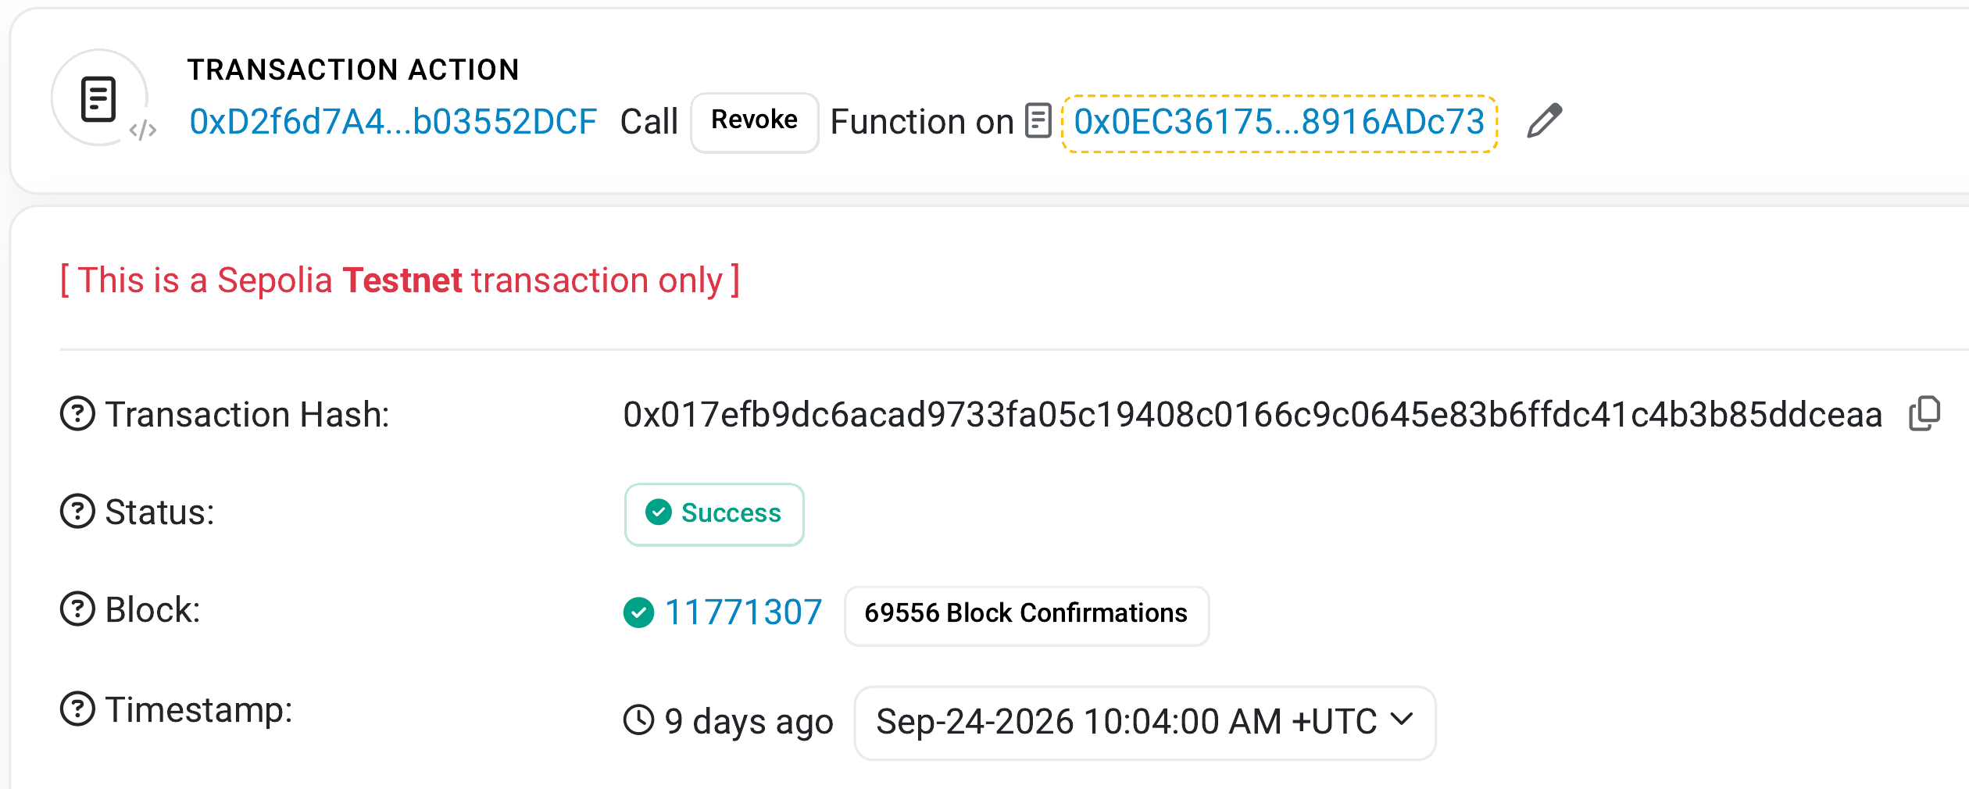
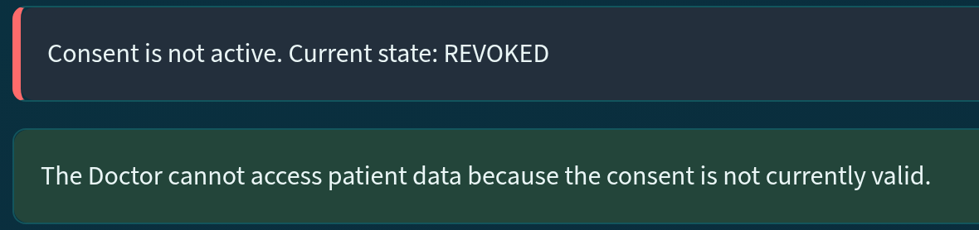
DEMO 7 (OPTIONAL): REVOKING THE CONSENT
RO5
Revocation on Sepolia, then access is refused
Audit ledger, rows 47 and 48: the patient revokes, then the revoke transaction goes on Sepolia
Doctor screen after the revocation: access refused
The revoke transaction is public on Sepolia, in block 11,771,307.
The doctor opens the consent again and is refused: the state is REVOKED.
Sepolia Etherscan: Revoke, Success, block 11,771,307
Notes:
This slide is optional. I show it if there is time. It is about RO5: revocation. It is the same consent as on the previous slide, f050c29a.
First, at the top is the audit ledger. In row 47, the patient revokes the consent. In row 48, the revoke transaction is sent to Sepolia. It is in block 11,771,307.
Second, at the bottom left is the same transaction on Sepolia Etherscan. This is a public page. I opened it some days later, so it says 9 days ago. The action is Revoke, the status is Success, and the block is 11,771,307, on 24 September 2026.
Third, at the bottom right, the doctor opens the consent again. The screen says: Consent is not active. Current state: REVOKED. The doctor cannot see the data. On 24 September, this refusal was not yet written to the ledger. Now, when the doctor presses Request Data Access, the prototype writes this refusal to the ledger.
So after the patient revokes, the consent cannot be used any more, and anyone can check the revoke transaction on Sepolia.

Slide 66
REFERENCES
Bloemen, R., Logvinov, L. & Evans, J. 2017, EIP-712: Typed structured data hashing and signing, Ethereum Improvement Proposals, no. 712, viewed 6 October 2026, <https://eips.ethereum.org/EIPS/eip-712>.
Cai, B. 2022, ERC-5484: Consensual soulbound tokens, Ethereum Improvement Proposals, no. 5484, viewed 6 October 2026, <https://eips.ethereum.org/EIPS/eip-5484>.
Entriken, W., Shirley, D., Evans, J. & Sachs, N. 2018, ERC-721: Non-fungible token standard, Ethereum Improvement Proposals, no. 721, viewed 6 October 2026, <https://eips.ethereum.org/EIPS/eip-721>.
Ethereum Foundation 2026b, Networks, ethereum.org developer documentation, viewed 7 October 2026, <https://ethereum.org/en/developers/docs/networks/>.
Grassi, L., Khovratovich, D., Rechberger, C., Roy, A. & Schofnegger, M. 2021, 'Poseidon: A new hash function for zero-knowledge proof systems', Proceedings of the 30th USENIX Security Symposium, pp. 519–535.
Groth, J. 2016, 'On the size of pairing-based non-interactive arguments', Advances in Cryptology – EUROCRYPT 2016, LNCS, vol. 9666, pp. 305–326, Springer, <https://doi.org/10.1007/978-3-662-49896-5_11>.
Page, M.J., McKenzie, J.E., Bossuyt, P.M., Boutron, I., Hoffmann, T.C., Mulrow, C.D. et al. 2021, 'The PRISMA 2020 statement: An updated guideline for reporting systematic reviews', BMJ, vol. 372, p. n71, <https://doi.org/10.1136/bmj.n71>.
Walonoski, J., Kramer, M., Nichols, J., Quina, A., Moesel, C., Hall, D. et al. 2018, 'Synthea: An approach, method, and software mechanism for generating synthetic patients and the synthetic electronic health care record', Journal of the American Medical Informatics Association, vol. 25, no. 3, pp. 230–238, <https://doi.org/10.1093/jamia/ocx079>.
Wood, G. 2014, Ethereum: A secure decentralised generalised transaction ledger, Ethereum Project Yellow Paper.
Notes:
These are the references I used in this talk. They follow the UTS Harvard style, so they are listed by author name, not by number.ABA 7

Slide 67
Thank You
Notes:
Thank you for listening. I am happy to take your questions.
Likely questions and short answers:
1. Why blockchain, if the data stays off-chain? Because it gives a shared record that cannot be changed quietly: the consent state and the revocation. No medical data is on the chain.
2. What is new? The consent object carries all the conditions. Multi-party approval is a condition of every access. And the whole decision is tested against attacks.
3. Why is RO6 only partly done? The testing is done. The formal proofs are the next stage.
4. Why Groth16? The prototype proves that it knows the secret and the expiry behind a Poseidon commitment, and that the consent has not expired, without showing them. Today the prover and the verifier run on the same server, so this shows that the zero-knowledge step works; it is not yet an extra privacy guarantee. It is the slowest part of an access request, about 1.4 seconds, and that is fine for a consent decision.
5. Why did three attacks pass before the hardening? They passed only when the service functions were called directly, not through the screens. The hardening moved the checks into the service layer, so now they are refused on every path.

