Slide 1
UTS · CANDIDATURE ASSESSMENT 2
V_{I}
Identity and authority
A Trusted Authorisation Framework for Multi-Party Patient Consent in Healthcare Data Sharing
V_{A}
Approval
V_{P}
Policy
Design, HALAH prototype and evidence for RO1–RO4, with the plan for RO5–RO6
V_{T}
Time
Yasir Dhaifallah O Alyoubi
Student ID 24724078
Principal Supervisor: Professor Farookh Hussain
Co-Supervisor: Dr Firas Al-Doghman
September 2026
V_{L}
Lifecycle
current stage
next stage
Notes:
My name is Yasir Dhaifallah O Alyoubi, and this is my Candidature Assessment 2 (CA2) presentation. My research asks how a healthcare data-access decision can be trusted when several independent parties, such as a patient, a guardian and a healthcare professional, take part in consent. I will cover the background and literature review, the research design, the architecture and proposed solution, the HALAH prototype and its evidence, and finally my progress and the plan for the next stage. One idea runs through the whole talk: a valid identity is not valid authority.

Slide 2
Five parts of this presentation
A
Background and literature
Chapters 1–2: context, problem, key requirements and systematic review
B
Research design
Chapters 3–4: research gap, main question, SRQ1–SRQ6 and RO1–RO6
C
Architecture and solution
Chapters 5–6: MVC architecture; workflow and algorithm for each RO
D
HALAH prototype and evidence
Chapter 7: four subsystems, code mapping, tests and on-chain evidence
E
Progress and research plan
Chapters 8–10: progress per RO, publications and next-stage work (RO5–RO6)
A Trusted Authorisation Framework for Multi-Party Patient Consent · CA2
2 / 43
Notes:
Here is the structure of the talk. It follows the ten chapters of the report in five parts. Part A covers Chapters 1 and 2: the research context, the problem, the five key requirements and the systematic literature review of 33 studies. In Part B, Chapters 3 and 4, the gap becomes one main research question, six sub-research questions, SRQ1 to SRQ6, and six research objectives, RO1 to RO6. Part C covers the Model–View–Controller architecture in Chapter 5 and, in Chapter 6, the workflow, procedure and algorithm for each objective. Part D is the HALAH prototype in Chapter 7, with its four subsystems, test evidence and on-chain evidence. Part E, Chapters 8 to 10, covers progress, the publication plan and the research plan for the current and next stages.

Slide 3
A
PART A · CHAPTERS 1–2
Background and literature
Consent is recorded, not evaluated; none of the 33 studies combines all five requirements in one decision
3 / 43
Notes:
This first part sets up the argument. In Chapter 1 I describe the research context, including the Australian regulatory setting, and the problem. Consent is usually stored as a record, but the record does not necessarily show that the participants were legitimate, that they held the required authority, that all of them took part in the decision, or that a later request stays within the conditions originally authorised. Chapter 2 is the systematic literature review. It defines five key requirements and shortlists 33 studies published between 2022 and 2026, through a four-step process that follows PRISMA 2020. The review shows that at least one stream of research addresses each requirement on its own, but no existing approach combines them into one independently verifiable authorisation decision.

Slide 4






Who shares healthcare data, and under which rules
Sections 1.1, 2.2, 2.4.1 and 5.1: authorisation as a distributed governance problem in the Australian setting
Several independent parties take part in healthcare data sharing, and no single participant may hold enough authority to decide access alone.
Patients
Guardians, authorised parties
Healthcare professionals
Initiate consent and should have greater control over how their data is accessed, shared and reused
Hold part of the authority in paediatric, aged-care and shared-guardianship settings
A valid credential shows a registered practitioner, not authority for this patient, purpose and data
Institutions and auditors
Privacy Act 1988 and APPs
My Health Records and HI Acts
Institutions may hold part of the authority; auditors inspect authorisation evidence and audit history
Sensitive information: collect with consent (APP 3); use for primary or directly related purpose (APP 6)
My Health Records Act 2012: consumers control provider access; Healthcare Identifiers Act 2010: IHI, HPI-I, HPI-O
A Trusted Authorisation Framework for Multi-Party Patient Consent · CA2
4 / 43
Notes:
This slide summarises the research context from Section 1.1, with the participant roles drawn from Sections 2.2, 2.4.1 and 5.1. Healthcare data sharing involves patients, guardians, healthcare professionals and institutional authorities, and no single participant may have enough authority to decide access alone. That is why I treat authorisation as a distributed governance problem, not just authenticating a user and checking a static permission. The last two cards show the Australian setting. Under the Privacy Act 1988, health information is sensitive information; APP 3 ties collection to consent, and APP 6 ties use to the primary or a directly related purpose. The My Health Records Act 2012 lets consumers control which provider organisations can access their record, and the Healthcare Identifiers Act 2010 governs the national identifiers. HALAH reflects this through purpose-bound consent, module-level data scope and a jurisdiction attribute that defaults to AU.

Slide 5

The core problem
Section 1.2: consent often remains a passive artefact, separate from the access decision
1
Identity without authority
An immutable record does not prove participants were legitimate; authentication does not prove authority
2
One party acting alone
Identity is not authority; recorded consent is not evaluated consent
Guardians, clinicians or institutions may also need to approve; one participant should not decide alone
3
Requests beyond scope
A verified, approved professional may still request data outside the purpose or scope the patient authorised
A Trusted Authorisation Framework for Multi-Party Patient Consent · CA2
5 / 43
Notes:
This slide states the core problem from Section 1.2. Existing approaches usually represent authorisation through database records, access-control entries, smart contracts or blockchain transactions. That improves integrity, traceability and auditability, but consent itself often remains a passive artefact. The key point here is the gap between representing consent and enforcing authorisation in a way that can be trusted. First, immutability protects the record but does not show the participants were legitimate, and authentication identifies an entity but does not give it authority over a particular patient's information. Second, when guardians, healthcare professionals or institutional authorities also take part, no single participant should decide alone. Third, even with verified identities and enough approvals, a request can still exceed the authorised purpose or data scope. What is missing is one integrated mechanism that connects these conditions.

Slide 6
Research scope and progression
Table 1.1: four objectives in the current stage, two in the next stage
Current stage (CA2)
Next stage (CA3)
RO1
Trust-Centric Consent Model
RO5
Temporal and Lifecycle Trust
RO2
Decentralised Identity and Authority Trust
Validity periods, expiration, revocation and controlled consent-state transitions
RO3
Trustworthy Multi-Party Authorisation
RO6
Formal Security Assurance and Empirical Validation
RO4
Policy- and Context-Aware Access Control
Formal security and authorisation properties; empirical evaluation with negative and adversarial scenarios
CA2 lays the foundations of trustworthy multi-party authorisation; CA3 extends it over time and validates it formally and empirically
A Trusted Authorisation Framework for Multi-Party Patient Consent · CA2
6 / 43
Notes:
Table 1.1 shows how the research is split into two stages. In the current stage, CA2, I work on four foundational dimensions: RO1, a trust-centric consent model; RO2, decentralised identity, with authority kept separate from identity; RO3, multi-party authorisation among independently verified participants; and RO4, policy- and context-aware access control, which stops valid identities and approvals from reaching data beyond the authorised scope. The next stage, CA3, adds RO5, temporal and lifecycle trust, because a consent that was valid when approved can later expire or be revoked. It also adds RO6, formal security assurance and empirical validation of the complete HALAH implementation, including negative and adversarial scenarios.

Slide 7
SLR method: PRISMA 2020 in four steps
Section 2.3: peer-reviewed studies, 2022–2026, on consent, identity, authorisation and access control
1
Literature search
SLR Search Query
Terms within a group are joined by OR; the four groups are joined by AND.
Seven databases, 2022–2026, Boolean search string (Figure 2.1); searched 15 August 2026
Multi-Party Trust Management
distributed trust OR multiparty trust OR decentralisation
2
Inclusion/exclusion
AND
Six inclusion and six exclusion criteria set before screening (peer-reviewed, full text, English)
Healthcare Context
healthcare OR EHR OR health data OR medical data
AND
3
Screening and quality
Consent Management
consent OR patient consent OR dynamic consent OR consent management
Title-abstract, then full-text screening; each study scored 1, 0.5 or 0 on QA1–QA5; below 2.5 of 5 excluded
AND
Supporting Requirements
access control OR authentication OR DID OR verifiable credential OR privacy OR auditability OR interoperability
4
Extract and categorise
Predefined extraction framework; 33 studies coded S1–S33 and placed in six categories (Table 2.3)
Final Search Results
Figure 2.1: SLR search string definition
A Trusted Authorisation Framework for Multi-Party Patient Consent · CA2
7 / 43
Notes:
Section 2.3 describes how I shortlisted the studies, following the PRISMA 2020 guideline in four steps. In Step 1 I searched seven databases: IEEE Xplore, ACM Digital Library, ScienceDirect, SpringerLink, PubMed, Scopus and Web of Science. Figure 2.1 shows the search string: four concept groups, with OR inside each group and AND between them. The search covered 2022 to 2026 and was run on 15 August 2026. In Step 2 I applied six inclusion and six exclusion criteria, defined before screening. Step 3 screened titles and abstracts, then full texts, and scored each full text on QA1 to QA5. In Step 4 I extracted the data with a predefined framework and placed the 33 studies in six categories, listed in Table 2.3.

Slide 8




PRISMA selection: from 125 records to 33 studies
Figure 2.2 and Table 2.2: identification, screening, eligibility and inclusion
125
Identified in seven databases
42 removed before screening
35 duplicate records (same DOI, title and authors) and 7 marked ineligible by automation tools
83
Screened by title and abstract
40 excluded at screening
Unrelated to healthcare data sharing, consent, identity, access control, privacy or auditability
43
Sought for full-text retrieval
3 full texts not retrieved
43 reports were sought for retrieval; 3 could not be obtained, so 40 were assessed
40
Full texts assessed (QA1–QA5)
7 excluded at full text
3 scored below 2.5 on QA1–QA5; 4 were outside the review scope
33
Studies included in the review
A Trusted Authorisation Framework for Multi-Party Patient Consent · CA2
8 / 43
Notes:
This funnel follows the PRISMA flow in Figure 2.2 and Table 2.2. The search returned 125 records: 31 from IEEE Xplore, 14 from ACM, 23 from ScienceDirect, 18 from SpringerLink, 12 from PubMed, 17 from Scopus and 10 from Web of Science. Before screening I removed 35 duplicates and 7 records flagged by automation tools, which left 83. Title and abstract screening excluded 40 unrelated records, so 43 full texts were sought. Three could not be retrieved, and I scored the 40 I assessed on QA1 to QA5. Three scored below 2.5 and four were outside the review scope, which left 33 included studies. Five of them come from outside healthcare, because their mechanisms transfer directly to healthcare authorisation.

Slide 9




Five requirements for a trustworthy decision
Section 2.2: derived from the Chapter 1 problem and the Australian regulatory setting
The framework must meet five requirements for a trustworthy data-access decision; each of the 33 studies is assessed against them.
REQ 1
REQ 2
REQ 3
REQ 4
REQ 5
Evaluable consent object
Identity is not authority
Multi-party threshold
Purpose- and scope-bound
Lifecycle validity and audit
Structured consent: who may access, under which authority, for which purpose and data, and for how long
Verify who the party is, then separately whether they hold the authority the consent requires
Independent approvals from defined participants; consent activates only at a predefined threshold
Requested purpose and data scope evaluated against the consent as a condition of the decision
Expiry, revocation and state checked at each request; evidence of every decision kept for review
Addressed by 9 of 33 studies
Addressed by 11 of 33 studies
Addressed by 3 of 33 studies
Addressed by 17 of 33 studies
Addressed by 18 of 33 studies
A Trusted Authorisation Framework for Multi-Party Patient Consent · CA2
9 / 43
Notes:
Now I set out the five requirements of Section 2.2, drawn from the Chapter 1 problem and the Australian setting: the Australian Privacy Principles (APPs) of the Privacy Act 1988, the My Health Records Act 2012 and the Healthcare Identifiers Act 2010. Req 1 asks for consent that can be evaluated, not just recorded. Req 2 separates identity from authority: a valid credential shows someone is a registered practitioner or legal guardian, not that they are authorised for this patient, this purpose and this data. Req 3 reflects paediatric, aged-care and shared-guardianship settings, where no single party should grant access alone. Req 4 follows the APPs, which limit the use of health information to the primary purpose of collection or a directly related purpose. Req 5 adds expiry, revocation and evidence. Section 2.4 assesses every study against them.

Slide 10


33 studies in six categories
Table 2.3: categorisation of the shortlisted studies S1–S33 (Step 4, Section 2.3.6)
Consent governance leads
Nine studies stress autonomy and informed consent, but consent remains a record, not an evaluated object
Security layers stay separate
Identity (7), access control (7) and blockchain (5) each secure one layer; no single mechanism makes the access decision trustworthy
Few multi-party studies
Four multi-party studies and one Trusted Computing study; approval as a consent condition gets less attention
A Trusted Authorisation Framework for Multi-Party Patient Consent · CA2
10 / 43
Notes:
This slide shows how the 33 included studies, S1 to S33 in Table 2.3, fall into six categories. In Step 4 I analysed each paper by its scope, topic area, authors, venue, contribution and limitations, and placed it in one of six areas. Healthcare consent and privacy governance is the largest group with nine studies, then decentralised identity and policy-based access control with seven each, blockchain with five, multi-party governance with four, and a single Trusted Computing study on remote attestation. The key point is that each group builds its own mechanism: as Section 2.4.7 notes, these contributions address different layers of the security problem. I kept five studies from outside healthcare because their mechanisms transfer directly to healthcare authorisation. Integrating trusted execution is left as future work in Section 10.2.

Slide 11
No study covers more than three requirements
Tables 2.4–2.9: number of studies in each category that address each requirement
Category | Studies | Req 1 | Req 2 | Req 3 | Req 4 | Req 5
Healthcare consent and privacy governance | 9 | 7 | 1 | 0 | 1 | 5
Blockchain-based healthcare data governance | 5 | 1 | 0 | 0 | 4 | 5
Decentralised identity and verifiable credentials | 7 | 0 | 7 | 1 | 2 | 1
Multi-party and decentralised governance | 4 | 1 | 2 | 2 | 3 | 2
Policy-based and healthcare access control | 7 | 0 | 1 | 0 | 7 | 5
Trusted Computing and secure execution | 1 | 0 | 0 | 0 | 0 | 0
All studies | 33 | 9 | 11 | 3 | 17 | 18
Req 4 (17 studies) and Req 5 (18) are addressed most often, Req 3 by only three. No study addresses more than three of the five; S7, S22 and S24 reach three.
Coverage follows category
Req 1 comes mostly from consent governance (7 of 9) and Req 2 from identity studies (7 of 11)
Req 3 is the weakest
Only S15, S23 and S25 address it, and none attaches an approval threshold to the patient's consent
Number = studies addressing the requirement (√ in Tables 2.4–2.9); shade = share of the category's studies.
A Trusted Authorisation Framework for Multi-Party Patient Consent · CA2
11 / 43
Notes:
Here I summarise Tables 2.4 to 2.9. Each study is marked as addressing or not addressing each requirement, and the matrix counts those studies per category. Req 4 and Req 5 are the best covered, with 17 and 18 studies, much of that from the blockchain and access-control categories. Req 1 is addressed by nine studies and Req 2 by eleven, but they cluster in the consent-governance and identity categories. Req 3, multi-party threshold authorisation, is addressed by only three studies: S15, S23 and S25. No single study reaches more than three of the five; S7, S22 and S24 reach three, and S1 and S33 reach none. As Section 2.6 concludes, each requirement is addressed in isolation by at least one stream, but no approach combines them into a single, independently verifiable decision.

Slide 12
Five gaps, one per requirement
Section 2.5: research gaps in the existing studies from the requirement perspective
Consent recorded, not evaluated
Nine studies record, encrypt, execute or legally define consent; none carries the conditions to evaluate a later request
Req 1
Identity verified, authority not
Eleven studies establish who a participant is; none verifies the authority a consent requires as a separate condition
Req 2
No threshold on the consent
S15, S23 and S25 offer multi-party mechanisms, but no threshold of verified approvals is attached to the consent
Req 3
Policy not bound to consent scope
Policy follows roles, attributes or risk, not the consented purpose and scope, so approved requesters can exceed it
Req 4
Consent lifecycle not checked
Expiry, revocation and state not evaluated at request time; evidence records transactions, not trust conditions
Req 5
The gaps map in order to RO1–RO5 (Req 1 to Req 5); RO6 provides formal and empirical validation of the resulting decisions.
A Trusted Authorisation Framework for Multi-Party Patient Consent · CA2
12 / 43
Notes:
Next I turn the coverage into gaps, following Section 2.5. The common thread is fragmentation: a valid blockchain record does not show that legitimate participants made the decision, a verified identity does not imply permission, and sufficient approvals do not keep a request within the authorised purpose or data scope. The gaps map in order onto RO1 to RO5, and RO6 validates the resulting decisions formally and empirically. So the central gap is the lack of an integrated Trust Computing framework that relates these conditions. In the current stage, CA2, the foundational decision is Equation 6: Decision(C, R) = ALLOW if and only if V_I(u) ∧ V_A(C) ∧ V_P(C, R). In the next stage, CA3, I will extend it towards lifecycle trust, formal security assurance, adversarial evaluation and empirical validation with the HALAH prototype.

Slide 13
Each stream addresses one layer
Table 2.10 (condensed): comparison of the existing research streams and the proposed framework
Research stream | Main contribution | Limitation for authorisation
Healthcare consent and privacy governance | Patient autonomy, informed consent and controlled data sharing | Consent treated as permission, not an evaluable authorisation object
Blockchain-based healthcare data governance | Tamper-resistant records, distributed auditability and transparency | Immutable records do not establish legitimacy, authority or compliance
Decentralised identity and verifiable credentials | Self-controlled identity, verifiable attributes and authentication | Identity and credential validity alone do not authorise access
Multi-party and decentralised governance | Collaborative participation and distributed verification or governance | Limited integration between collective approval thresholds, consent and access decisions
Policy-based and healthcare access control | Fine-grained restriction by attributes, risk, context and constraints | Policy separated from decentralised identity and multi-party consent
Trusted Computing and secure execution | Hardware-supported isolation, execution integrity and attestation | Secure execution does not decide if authorisation conditions suffice
Proposed framework | Integrated evaluation: consent, identity, authority, approval, policy | Still to add: lifecycle trust, formal assurance, empirical validation
A Trusted Authorisation Framework for Multi-Party Patient Consent · CA2
13 / 43
Notes:
Table 2.10 puts the six research streams side by side with the proposed framework. Reading across, each stream makes a real contribution: consent governance brings patient autonomy, blockchain brings tamper-resistant records, and identity work brings verifiable attributes. Reading down the limitation column, none of them on its own establishes that a data-access decision is trustworthy. As Section 2.4.7 puts it, a blockchain record does not establish participant authority, a valid DID does not establish access permission, and secure execution does not guarantee that the policy is correct. So my contribution is not to replace these technologies but to relate them within one authorisation process. I kept the framework's own limitation on the slide: lifecycle trust, formal assurance and empirical validation remain for the next stage, CA3.

Slide 14
B
PART B · CHAPTERS 3–4
Research design
The Chapter 2 gap becomes one main question, six SRQs and six ROs, staged across CA2 and CA3
14 / 43
Notes:
In this part I move from the literature review to the research design. Chapter 3 states the research gap, the main research question and the six sub-research questions, SRQ1 to SRQ6. Chapter 4 turns each question into a research objective, RO1 to RO6, and Tables 4.1 and 4.2 map them one to one. RO1 to RO5 each answer one requirement from Section 2.2, Req 1 to Req 5, and RO6 provides the formal and empirical assurance that they are met. The key point is the staging. RO1 to RO4 form the foundational model for the current stage, CA2, and RO5 and RO6 are the principal agenda for CA3. The split reflects research scope and maturity, not a different set of questions.

Slide 15

The missing piece is an integrated trust model
Research gap (Section 3.1) and main research question (Section 3.2)
1
Fragmented mechanisms
Blockchain consent, DIDs, VCs, policy control and multi-party approval are studied separately, not as one model.
How can a trust-oriented computing framework establish and enforce trustworthy multi-party consent for decentralised healthcare data sharing under identity, authority and policy constraints?
2
Consent kept as a record
Access may rest mainly on a stored record and an authenticated requester, not proven authority, approvals or scope.
3
No single source of trust
Immutability, identity or approval alone cannot make access trustworthy; trust emerges from a verifiable process.
A Trusted Authorisation Framework for Multi-Party Patient Consent · CA2
15 / 43
Notes:
The key point here is that the gap is not a missing technology. Section 3.1 notes that blockchain consent, decentralised identity, verifiable credentials, policy-based authorisation and multi-party approval are each well studied, but usually as independent technical solutions. Against the five requirements, no study meets more than three, and none meets both Req 1, consent as an evaluable object, and Req 3, threshold authorisation. A blockchain can make a consent event immutable without making its participants legitimate, and a valid DID says who someone is, not what they may do. So I treat trust as an emergent property of a verifiable authorisation process. The main research question in Section 3.2 follows from this. Establish covers how participants, authority and collective decisions are created; enforce covers how they are evaluated when a request is made.

Slide 16
Six questions, six objectives, two stages
SRQ1–SRQ6 map one-to-one onto RO1–RO6 (Tables 4.1–4.2); RO1–RO4 in CA2, RO5–RO6 in CA3
SRQ | Question focus | Objective | Stage
SRQ1 | Consent as a trust-aware, evaluable authorisation object | RO1: Trust-Centric Consent Model | Current (CA2)
SRQ2 | DIDs and VCs, with identity separated from authority | RO2: Decentralised Identity and Authority Trust | Current (CA2)
SRQ3 | Verified parties jointly decide; no unilateral authorisation | RO3: Trustworthy Multi-Party Authorisation | Current (CA2)
SRQ4 | Policy, purpose and data-scope constraints in authorisation | RO4: Policy- and Context-Aware Access Control | Current (CA2)
SRQ5 | Validity interval, expiry, revocation and state transitions | RO5: Temporal and Lifecycle Trust | Next (CA3)
SRQ6 | Formal security properties and empirical validation | RO6: Formal Security Assurance and Empirical Validation | Next (CA3)
A Trusted Authorisation Framework for Multi-Party Patient Consent · CA2
16 / 43
Notes:
This table condenses Tables 4.1 and 4.2 in Chapter 4. Each sub-research question has one matching objective. SRQ1 and RO1 model consent as an evaluable authorisation object. SRQ2 and RO2 verify identity through DIDs and authority through VCs, as separate conditions. SRQ3 and RO3 require a threshold of independently verified approvals, so no single participant can authorise alone where collective approval is required. SRQ4 and RO4 check purpose and data scope, so a valid identity and enough approvals still cannot reach data outside the consent. These four form the current stage. SRQ5 and RO5 add the validity interval, expiry, revocation and controlled state transitions, and SRQ6 and RO6 add formal analysis and empirical validation through the HALAH prototype, including negative and adversarial testing. Both are next-stage work for CA3.

Slide 17
Access is a conjunction of trust conditions
Eq. 6 decides access now (CA2); Eq. 24 adds temporal and lifecycle checks in CA3
Consent object (Eq. 7)
C = (I, A, P, E)
I identity · A authority and authorisation requirements · P policy and data scope · E evidence
Current-stage decision (Eq. 6)
Decision(C, R) = ALLOW ⇔ V_{I}(u) ∧ V_{A}(C) ∧ V_{P}(C, R)
Next-stage decision (Eq. 24)
Decision(C, R, t) = ALLOW ⇔ V_{I}(u) ∧ V_{A}(C) ∧ V_{P}(C, R) ∧ V_{T}(C, t) ∧ V_{L}(C)
V_{I}
Identity and authority
V_{A}
Multi-party authorisation
V_{P}
Policy and scope compliance
V_{T}
Temporal validity
V_{L}
Lifecycle validity
VerifyDID(u) ∧ VerifyVC(u): DID shows who u is, VC shows role or authority (Eq. 8)
Holds only if |A_{v}| ≥ N verified approvals; |A_{v}| < N ⇒ DENY (Eqs. 9–10)
R must meet the consent's purpose and scope; S_{R} ⊈ S_{C} ⇒ reject (Eqs. 11, 5)
Next stage: t_{s} ≤ t ≤ t_{e}, time t lies within the consent's validity interval (Eq. 12)
Next stage: ValidState(C) ∧ ValidTransition(C); not expired, revoked or invalid (Eq. 15)
Identity is not authorisation (Eq. 1). ALLOW only when every predicate holds; if any one fails, the decision is DENY (Eq. 18).
A Trusted Authorisation Framework for Multi-Party Patient Consent · CA2
17 / 43
Notes:
This slide brings the questions together in one decision rule. The consent object C = (I, A, P, E) from Eq. 7 holds identity information, authority requirements, policy constraints and authorisation evidence. In the current stage, Eq. 6 allows access only when V_I, V_A and V_P all hold. Eq. 24 in Section 3.4 extends this for the next stage with V_T for the validity interval and V_L for the lifecycle state. That matches the extended object C = (I, A, P, T, L, E) already used by the HALAH prototype (Section 7.2). The key point is Eq. 1: identity is not authorisation, so a verified DID does not by itself grant access. Any failed predicate means DENY. SRQ6 is not a sixth predicate; it is the assurance layer that checks these properties formally and empirically.

Slide 18
C
PART C · CHAPTERS 5–6
Architecture and solution
MVC separates security state, interaction and enforcement; a workflow and an algorithm for each of RO1–RO6
18 / 43
Notes:
In this part I move from the research design to the solution. Chapter 5 presents the research architecture, a layered Model-View-Controller design. The Model holds the trust and governance state, the View lets independent stakeholders submit or inspect operations, and the Controller evaluates the trust predicates and produces the decision. Chapter 6 then presents the solution objective by objective, with a workflow, a step-by-step procedure and an algorithm for each of RO1 to RO6. RO1 to RO4 belong to the current stage, CA2, and RO5 and RO6 belong mainly to the next stage, CA3. The key point I want to carry through this part is that MVC itself is not the security claim. Security comes from placing trust-sensitive operations in the Controller, structuring security state in the Model and keeping security decisions out of the View.

Slide 19



Every sensitive decision passes through the Controller
Section 5.1: the View submits claims, the Controller decides, the Model holds security state
Patients
Guardians / Authorised Parties
Healthcare Professionals
Auditors
VIEW
Patient Consent Interface
Approval Interface
Healthcare Access Interface
Audit / Evidence Interface
Request Validation
DID / VC Verification
Authority Verification
Multi-Party Threshold Evaluation
Policy & Scope Evaluation
Authorisation Decision
Audit Event Generation
Protected Healthcare Data
CONTROLLER
Identity & DID Records
Credential / Authority Evidence
Consent Object
Approval Evidence
Policy & Data Scope
Lifecycle State
Authorisation Evidence
MODEL
Figure 5.1: Layered MVC architecture and component decomposition of the HALAH framework
View: interaction boundary
Controller: enforcement
Model: security state
Role interfaces for patients, guardians, healthcare professionals and auditors; actions are claims, not decisions
Validates requests; verifies DID, VC and authority; checks threshold and policy; decides; generates audit evidence
DIDs, credentials, consent objects, approvals, policy and scope, evidence, lifecycle; state is not permission
A Trusted Authorisation Framework for Multi-Party Patient Consent · CA2
19 / 43
Notes:
Here I show Figure 5.1, the layered MVC architecture of HALAH from Section 5.1. The View has role-specific interfaces for patients, guardians or other authorised participants, healthcare professionals and auditors. Anything submitted there I treat as a request or claim, not a trusted outcome. The Controller is the security enforcement boundary. It coordinates request validation, decentralised identity verification, credential and authority verification, multi-party approval evaluation, policy and data-scope evaluation and final authorisation, and it generates audit evidence. The Model holds the security state, but a consent, credential or approval record does not by itself produce an access decision. Protected healthcare data sit outside the three layers and are reached only through the Controller. As Section 5.1.4 says, I do not claim that MVC itself provides security. Section 7.10 maps each layer to the code.

Slide 20
Access requires every trust predicate to hold
Figure 5.3, Table 5.1: the Controller checks V_{I}, V_{A}, V_{P}, V_{T}, V_{L}; any false predicate gives DENY (Eq. 18)
Authority separation
MODEL — trust and governance state
identity and DID records · credentials and authority evidence · consent object · approvals · policy and data scope · validity period · lifecycle state
Identity and authority evidence checked separately; authentication alone does not authorise
evidence
Multi-party authorisation integrity
CONTROLLER — trust predicate evaluation
Threshold on verified approvals; no unilateral access when collective approval is required
V_{I}(u)
V_{A}(C)
V_{P}(C, R)
V_{T}(C, t)
V_{L}(C)
Policy-bounded access
YES
All Required Predicates = TRUE?
Purpose and requested scope checked against the consent; approvals cannot exceed its scope
NO
ALLOW
DENY
Authorisation evidence
Verification results, approvals, policy outcome and decision recorded for both ALLOW and DENY
Generate Authorisation Evidence
Figure 5.3: Trust predicate evaluation and authorisation decision flow
A Trusted Authorisation Framework for Multi-Party Patient Consent · CA2
20 / 43
Notes:
This is Figure 5.3, from Section 5.1.2, which shows how the Controller evaluates the trust predicates using evidence held in the Model. V_I checks identity and authority, V_A the approval threshold, V_P purpose and data scope, V_T time validity and V_L lifecycle state. The integrated decision is Eq. 24, and if any required predicate is false the decision is DENY, as in Eq. 18. Both successful and unsuccessful decisions are associated with authorisation evidence. The four points are four of the six security properties in Table 5.1, Section 5.9. The other two are identity-dependent participation and the separation of interaction and enforcement. The key point I want to make is that these properties come from the interaction of the three layers, not from any single technology. V_T and V_L are the next-stage extension; the current-stage decision is Eq. 6.

Slide 21
From consent specification to audited decision
Section 5.2: consent becomes an evaluable authorisation object, checked before data are released
Consent specification
Patient Creates Consent
Consent Specification: Purpose · Data Scope · Conditions
Patient defines purpose, permitted data scope and conditions: the policy context for later requests
DID / VC Verification: Identity & Authority Validation
Identity and
Authority Valid?
No
Yes
Identity and authority
Identify Authorisation Participants
DIDs and VCs establish identity and claimed role or authority; this alone does not grant access
Multi-Party Approval: Collect Independent Approvals
Threshold Satisfied?
No
Yes
Multi-party approval
Policy Evaluation: Purpose & Data-Scope Validation
Policy Compliant?
No
Independent approvals collected; unless |A_{v}| ≥ N (Eq. 9), the process ends in DENY
Yes
Authorisation Decision: V_{I} ∧ V_{A} ∧ V_{P} (Eq. 6)
Decision = ALLOW?
Deny
Allow
Policy, decision and audit
ALLOW: Grant Data Access
Access Healthcare Data
DENY: Reject Access
Purpose and S_{R} ⊆ S_{C} checked; V_{I} ∧ V_{A} ∧ V_{P} (Eq. 6) decides; ALLOW and DENY both recorded
Record Audit Evidence
Figure 5.4: End-to-end workflow of the trust-oriented consent authorisation framework
A Trusted Authorisation Framework for Multi-Party Patient Consent · CA2
21 / 43
Notes:
Here I walk through Figure 5.4, the end-to-end workflow in Section 5.2. It puts into practice my premise that trustworthy access cannot come from a single mechanism, such as a blockchain record or an authenticated identity. First, the patient specifies purpose, scope and conditions. DID and VC verification establishes identity and authority, but this alone does not grant access to patient data. Next, the required participants, for example a patient with one or more guardians, give independent approvals, and if the threshold is not met the request is denied. Policy evaluation then catches a legitimate participant asking for data outside the consent, such as the request in Eq. 4, which adds Observation to a consent for Medication and Procedure. The decision is the conjunction in Eq. 6, and both granted and denied decisions are recorded in the audit layer.

Slide 22


RO1: consent as an evaluable object
Section 6.1 and Algorithm 1: the consent sets the conditions a later request is evaluated against
C = (I, A, P, E)
Patient Creates Consent
Consent Specification Valid?
No
Reject Consent Request
I = identity, A = authorisation requirements, P = purpose and data-scope policy, E = authorisation evidence
Yes
Collect Patient DID
Define Authorisation Requirement
Validate, then construct
Specify Authorised Doctor
Generate Consent Identifier
Patient, doctor, guardians, purpose, scope S_{C} and interval T checked; t_{e} must be later than t_{s}
Specify Guardian DIDs
Create Trust-Aware Consent Object C = (I, A, P, E)
Algorithm 1: C or REJECT
Does not grant access directly; assigns id_{C}, persists C and records creation evidence for audit
Specify Purpose and Data Scope
Persist Consent Record
Specify Consent Validity
Record Consent Creation Audit
Prototype status
Patient, doctor and guardian checks (Steps 1–3) not yet enforced at creation; VC authority checks in CA3; t_{e} > t_{s} check (Step 6) implemented
Return Consent Object C
Figure 6.1: RO1 workflow for trust-centric consent creation
A Trusted Authorisation Framework for Multi-Party Patient Consent · CA2
22 / 43
Notes:
With RO1 I answer SRQ1 by turning consent into a structured and evaluable authorisation object, C = (I, A, P, E), from Eq. 7. Figure 6.1 shows the creation workflow. In HALAH the patient selects a patient DID, an authorised doctor, guardian DIDs, data modules such as Observation, Medication, Condition and Procedure, and a start and expiry time. Algorithm 1 validates these inputs and returns the consent object C or REJECT. It does not grant access directly; it sets the conditions that RO2, RO3 and RO4 later evaluate through I, A and P. On status, Section 6.1.2 is explicit. Steps 1 to 3 are not yet enforced at creation, a syntactic DID check is applied later at guardian approval and doctor access, and credential-based authority validation is scheduled for Stage 2, CA3. Step 6, the time check, is implemented.

Slide 23

RO2: identity is not authorisation
Section 6.2 and Algorithm 2: DID and VC checks yield V_{I}(u), an input to RO3 and RO4, not an access grant
DID and VC verification
Participant Requests Participation
DID resolved and verified, then VC signature, issuer, subject and validity period checked
Resolve Participant DID
DID Valid?
No
Authority match
Yes
Extracted role and authority claims must satisfy the consent's requirement A_{C}, otherwise INVALID
Retrieve Verifiable Credential
VC Retrieved and Valid?
No
Yes
Extract Role and Authority Claims
Authority Matches Consent?
No
Output: V_{I}(u)
Algorithm 2 returns VALID or INVALID and records evidence; it does not grant access by itself
Yes
Record Verification Evidence
Reject Participant
Prototype status
Return Verified Identity and Authority
Guardian DID syntax check; EIP-712 approval signatures; W3C VC verification scheduled for CA3
Figure 6.2: RO2 workflow for decentralised identity and authority verification
A Trusted Authorisation Framework for Multi-Party Patient Consent · CA2
23 / 43
Notes:
With RO2 I answer SRQ2, and it rests on Eq. 1: identity is not authorisation. A DID gives an identity reference and a VC gives evidence of role or authority, and neither grants access on its own. Figure 6.2 and Algorithm 2 resolve and verify the DID, retrieve and verify the VC, and check the extracted claims against the consent's authority requirements, returning INVALID at the first failure. In HALAH this happens in two steps. The guardian DID is checked for syntax, and the approval is an EIP-712 typed-data signature over the consent identifier that counts only if the recovered address matches the address bound to that DID. For the demonstration, guardian keys are derived from the DID. Full W3C VC verification is specified but scheduled for Stage 2, CA3, so I do not yet verify credential-based authority.

Slide 24
RO3: no unilateral activation below the threshold
Section 6.3, Figure 6.3, Algorithm 3: only verified, eligible, non-duplicate approvals enter A_{v}
Threshold condition
Consent Requires
Multi-Party Approval
Identify Required Participants
Define Authorisation Threshold N
Participant Submits Approval
V_{A}(C) = 1 when |A_{v}| ≥ N (Eq. 9), with 1 ≤ N ≤ |G|; below N the consent stays PENDING
Verify DID and VC
Participant Verified?
No
Reject Invalid Approval
Yes
Rejected approvals
Check Membership of Required Set G
Participant in
Required Set G?
No
Reject Unauthorised Approval
Invalid identity or authority, participant not in G, or a duplicate approval: recorded, returns DENY
Yes
Check for Prior Approval
Already Approved?
Yes
Reject Duplicate Approval
No
Activation evidence
Record Valid Approval
When |A_{v}| ≥ N: authorisation activated, token evidence generated, threshold-satisfied event recorded
No
Update Approval Count
Threshold Satisfied?
Consent Remains Pending
Yes
Activate Authorisation
Record Threshold-Pending Event
Prototype: 2-of-2 guardians
N = |G| (all guardians sign); EIP-712 signatures verified, duplicates refused, Sepolia SBT minted; configurable k-of-n in CA3
Generate Activation or Token Evidence
Record Threshold-Satisfied Event
Figure 6.3: RO3 workflow for threshold-based multi-party authorisation
A Trusted Authorisation Framework for Multi-Party Patient Consent · CA2
24 / 43
Notes:
In this part I present RO3, which answers SRQ3. The key point is that the threshold counts only approvals that pass three checks. Algorithm 3 first verifies the identity and authority of the approving participant, then checks that the participant belongs to the required set G, and then refuses a second approval from the same participant. Each failure is recorded and returns DENY. Only an approval that passes all three is added to A_v. If |A_v| ≥ N, the authorisation is activated and a threshold-satisfied event is recorded; otherwise the consent stays pending. In HALAH, N equals |G|, so with two guardians one signature leaves the consent in PENDING_SIGNATURE, and two signatures plus the SBT mint activate it. The SBT represents the consent state; it is not the source of trust. This is Section 6.3 and Figure 6.3.

Slide 25



RO4: a valid approval is not unlimited access
Section 6.4, Figure 6.4, Algorithm 4: purpose and data scope are checked before any data are released
Ordered checks
Doctor Requests Patient Data
Retrieve Consent Object
V_{I}(u), active consent, |A_{v}| ≥ N, purpose, then scope; any failure is recorded and returns DENY
Verify Requesting Identity and Authority
Identity and
Authority Valid?
No
Scope containment
Yes
Evaluate Consent State
Consent Active?
No
S_{R} ⊆ S_{C} (Eq. 25), with V_{P} = V_{U} ∧ V_{S} (Eq. 32); returned data must also stay within S_{C}
Yes
Verify Multi-Party Authorisation
Threshold Satisfied?
No
Yes
Prototype: scope enforced
Evaluate Requested Purpose
Purpose Valid?
No
Only consented modules offered; service layer re-checks S_{R} ⊆ S_{C}; a failure is logged as ACCESS DENIED
Yes
Evaluate Requested Data Scope
Scope Within Consent?
No
Yes
Prototype: purpose partly checked
Generate or Verify Access Evidence
Deny Access
Consent purpose checked against {Treatment, Research, Emergency}; P_{R} ⊨ P_{C} comparison is CA3 work
Grant Data Access
Record Granted Access
Record Denied Access
Figure 6.4: RO4 workflow for policy- and context-aware access control
A Trusted Authorisation Framework for Multi-Party Patient Consent · CA2
25 / 43
Notes:
Here I move to RO4, which answers SRQ4. The point is that a legitimate doctor with a valid, fully approved consent may still ask for too much. Algorithm 4 checks identity, consent state and the threshold first, and only then purpose and scope, before any data are released. For example, the request in Eq. 4 adds Observation to a consent for Medication and Procedure, so it must be denied. In HALAH the scope check is enforced in the doctor interface and again in the service layer, and a failure is written to the audit log. Purpose is only partly implemented: the requester does not yet declare a purpose, so the comparison is planned for CA3. Routing the release gate through the full decision matrix is a small planned change. This is Section 6.4 and Figure 6.4.

Slide 26


RO5: an existing consent is not always usable
Primarily CA3. Section 6.5, Figure 6.5, Algorithm 5: V_{T}(C, t) and V_{L}(C) extend the decision (Eq. 24)
Two added predicates
Access Request
Retrieve Consent Validity Interval
V_{T}(C, t): t_{s} ≤ t ≤ t_{e} (Eq. 12); V_{L}(C): valid state and valid transition (Eq. 15)
Check Consent Validity Interval
Within Valid Time?
No
Prototype: state order
Yes
Retrieve and Check Lifecycle State
State Permits Operation?
No
REVOKED, PENDING_SIGNATURE, PENDING_TOKEN, NOT_STARTED, EXPIRED, ACTIVE; only ACTIVE releases data
Yes
Evaluate Revocation Status
Revoked?
Yes
Prototype: revocation
No
Patient revocation sets REVOKED and calls revoke() on the contract; v3 enforces the interval on-chain
Validate Requested Transition
Transition Permitted?
No
Yes
Record Temporal and Lifecycle Evidence
Record Lifecycle-Based Denial
Remaining for CA3
Specification of legal state transitions, formal analysis of Eqs. 20–21, and adversarial evaluation
Continue Authorisation Evaluation
Deny Access
Figure 6.5: RO5 planned workflow for temporal and consent lifecycle trust
A Trusted Authorisation Framework for Multi-Party Patient Consent · CA2
26 / 43
Notes:
RO5 answers SRQ5 and belongs primarily to the next stage, CA3; Figure 6.5 shows the planned workflow. The key point is that an existing consent is not necessarily usable: once it has expired or been revoked, it must not stay usable just because its approval threshold was once met. Algorithm 5 checks the time interval, whether the current state permits the operation, whether the consent has been revoked, and whether the requested transition is permitted; any failure returns INVALID. HALAH already has a first version: the consent engine checks states in a fixed order, only ACTIVE releases data, V_T is computed in the decision matrix, and a patient revocation calls revoke() on the consent contract. One notation point: the prototype labels a jurisdiction check VL; it will be renamed V_J, so V_L means lifecycle validity. This is Section 6.5.

Slide 27


RO6: successful execution is not proof of security
Primarily CA3. Section 6.6, Figure 6.6, Algorithm 6: observed decisions tested against formal properties
Three scenario classes
Define Security and Authorisation Properties
Define Valid, Negative and Adversarial Scenarios
Construct Validation Scenario Set
S = S_{valid} ∪ S_{negative} ∪ S_{adv}: legitimate workflows, rule violations and bypass attempts
Execute Valid Consent Workflow
Execute Negative and Adversarial Scenarios
Six properties
P_{sound}, P_{deny}, P_{threshold}, P_{policy}, P_{scope}, P_{audit}; every ALLOW needs V_{I} ∧ V_{A} ∧ V_{P} (Eq. 33)
Collect Decision and Audit Evidence
Compare Observed and Expected Decisions
Observed vs expected
A scenario passes only when D_{obs}(s) = D_{exp}(s); each failure is traced to its condition and evidence
Evaluate Security Properties (soundness, denial, threshold, policy scope, audit consistency)
Properties Satisfied?
No
Analyse Failures and Limitations
Implementation basis
Yes
HALAH logs consent, approval, minting, state-check and access events (Sections 7.11–7.12)
Document Evidence and Limitations
Figure 6.6: RO6 planned workflow for formal security assurance and empirical validation
A Trusted Authorisation Framework for Multi-Party Patient Consent · CA2
27 / 43
Notes:
RO6 answers SRQ6 and is the assurance layer. It belongs mainly to the next stage, CA3, and is only partly done so far. The key point is that a system can return data without showing that it should have. So Algorithm 6 defines six expected properties, then runs three scenario classes: valid workflows; negative cases such as expired or revoked consent and out-of-scope requests; and adversarial cases such as replayed or duplicate approvals and forged credentials. A scenario passes only when the observed decision equals the expected one, and the evidence is kept so a failure can be traced back to its condition. Formal reasoning defines what the framework should guarantee, and testing checks whether the implementation does. The current HALAH evidence in Sections 7.11 and 7.12 is my starting point. This is Section 6.6 and Figure 6.6.

Slide 28
Six algorithms, one authorisation lifecycle
Section 6.7: Algorithms 1–4 form the current stage (CA2); Algorithms 5–6 extend them in the next stage (CA3)
Algorithm | Objective | Input | Output | Predicate
1: Trust-Aware Consent Creation | RO1: Trust-Centric Consent Model | I_{p}, doctor D, guardians G, P_{u}, S_{C}, T | Consent object C or rejection | Builds C = (I, A, P, E) (Eq. 7)
2: DID and VC Identity and Authority Verification | RO2: Decentralised Identity and Authority Trust | Participant u, consent object C | V_{I}(u): VALID or INVALID | V_{I}(u) (Eq. 8)
3: Threshold-Based Multi-Party Authorisation | RO3: Trustworthy Multi-Party Authorisation | Consent C, approval a, threshold N | Authorisation: ALLOW, PENDING or DENY | V_{A}(C): |A_{v}| ≥ N (Eq. 9)
4: Policy-Aware Access Decision | RO4: Policy- and Context-Aware Access Control | Consent C, request R, participant u | Access decision: ALLOW or DENY | V_{P}(C, R) = V_{U} ∧ V_{S} (Eq. 32)
5: Temporal and Lifecycle Validation | RO5: Temporal and Lifecycle Trust | Consent C, time t, transition q | Lifecycle validity: VALID or INVALID | V_{T}(C, t), V_{L}(C) (Eqs. 12, 15)
6: Formal and Empirical Authorisation Validation | RO6: Formal Security Assurance and Empirical Validation | Framework implementation F | Validation evidence and results | Six properties P; Eqs. 33–34
A Trusted Authorisation Framework for Multi-Party Patient Consent · CA2
28 / 43
Notes:
This table brings the six algorithms together, as Section 6.7 does. Each algorithm maps to one objective, and together they form a progressive structure. Algorithm 1 builds the consent object but grants no access. Algorithm 2 turns DID and VC evidence into V_I, Algorithm 3 turns verified approvals into V_A, and Algorithm 4 checks the specific request against purpose and scope before data are released. Together these give the current-stage decision in Eq. 6. Algorithms 5 and 6 are next-stage work for CA3: temporal and lifecycle validity complete Eq. 24, and formal and empirical validation tests whether the whole lifecycle keeps its security properties. The point I want to leave you with is that blockchain contributes integrity and auditability, but trust comes from all of these conditions holding together.

Slide 29
D
PART D · CHAPTER 7
HALAH prototype and evidence
Four role-based subsystems, the code mapping, 18 automated tests and consent tokens anchored on Sepolia
29 / 43
Notes:
This brings me to Part D, which is Chapter 7 of the report. So far I have described the model and the six algorithms. In this part I show how the current-stage (CA2) mechanisms are realised in the HALAH prototype. I start with an overview of the four subsystems, then walk through the patient, guardian, doctor and auditor views using the screenshots in Figures 7.1 to 7.5. After that I show how the MVC layers map to the source code in Table 7.2, the automated test results in Table 7.3, and the consent tokens anchored on the Sepolia testnet in Table 7.4. I close the part with the limitations in Section 7.13, because they define what the next stage, CA3, still has to demonstrate.

Slide 30
One consent lifecycle, four subsystems
A role-based consent management platform that operationalises the framework (Sections 7.1, 7.8–7.10)
Patient view (Section 7.2)
Guardian view (Section 7.3)
Doctor view (Section 7.4)
Create consent: patient DID, doctor DID, EMR-module scope, guardian DIDs, start / expiry
Guardian signs EIP-712 approval
audit: SIGN_CONSENT
Doctor enters consent ID and selects EMR modules
Reject approval
No
Signature valid and not a duplicate?
State = ACTIVE, access proof valid and S_{R} ⊆ S_{C} ?
audit: STATE_CHECK
Expiry later than start?
No
No: wait for next guardian
No
Reject input
Yes
Yes
Approvals = N = |G| ?
Yes
Consent stored; state = PENDING_SIGNATURE
audit: CREATE_CONSENT
Yes
ACCESS GRANTED: release Synthea modules
audit: DATA_ACCESS
ACCESS DENIED
audit: DATA_ACCESS
Mint consent SBT (local ID + Sepolia anchor); consent becomes ACTIVE
audit: MINT_SBT, ONCHAIN_MINT
Audit log (Section 7.5): CREATE_CONSENT · SIGN_CONSENT · MINT_SBT · ONCHAIN_MINT · STATE_CHECK · DATA_ACCESS (GRANTED / DENIED)
Figure 7.6: HALAH prototype workflow from consent creation to audited access decision
Patient: create consent
Guardian: approve, activate
Doctor: verified access
Auditor: trace the evidence
Patient, doctor and guardian DIDs, module scope and start / expiry time
Verifies guardian identities, records both signatures and mints the SBT
Checks the consent is ACTIVE; access limited to the authorised modules
Rebuilds the lifecycle from event-level records and the audit ledger
A Trusted Authorisation Framework for Multi-Party Patient Consent · CA2
30 / 43
Notes:
This slide gives the overview of HALAH, from Sections 7.1 and 7.8 to 7.10. The platform is role-based: patient, guardian, doctor and auditor all work on the same consent lifecycle, and the blockchain and cryptographic mechanisms sit inside the workflow rather than being shown as separate components. Figure 7.6 traces one consent through the four views. The consent is stored as PENDING_SIGNATURE, guardians sign EIP-712 approvals until N = |G| is reached, and then the SBT is minted and the consent becomes ACTIVE. The doctor gets access only when the state is ACTIVE, the access proof is valid and S_R ⊆ S_C. The figure also shows which events each step writes to the audit log, and Table 7.1 maps the framework components to the subsystems that implement them.

Slide 31
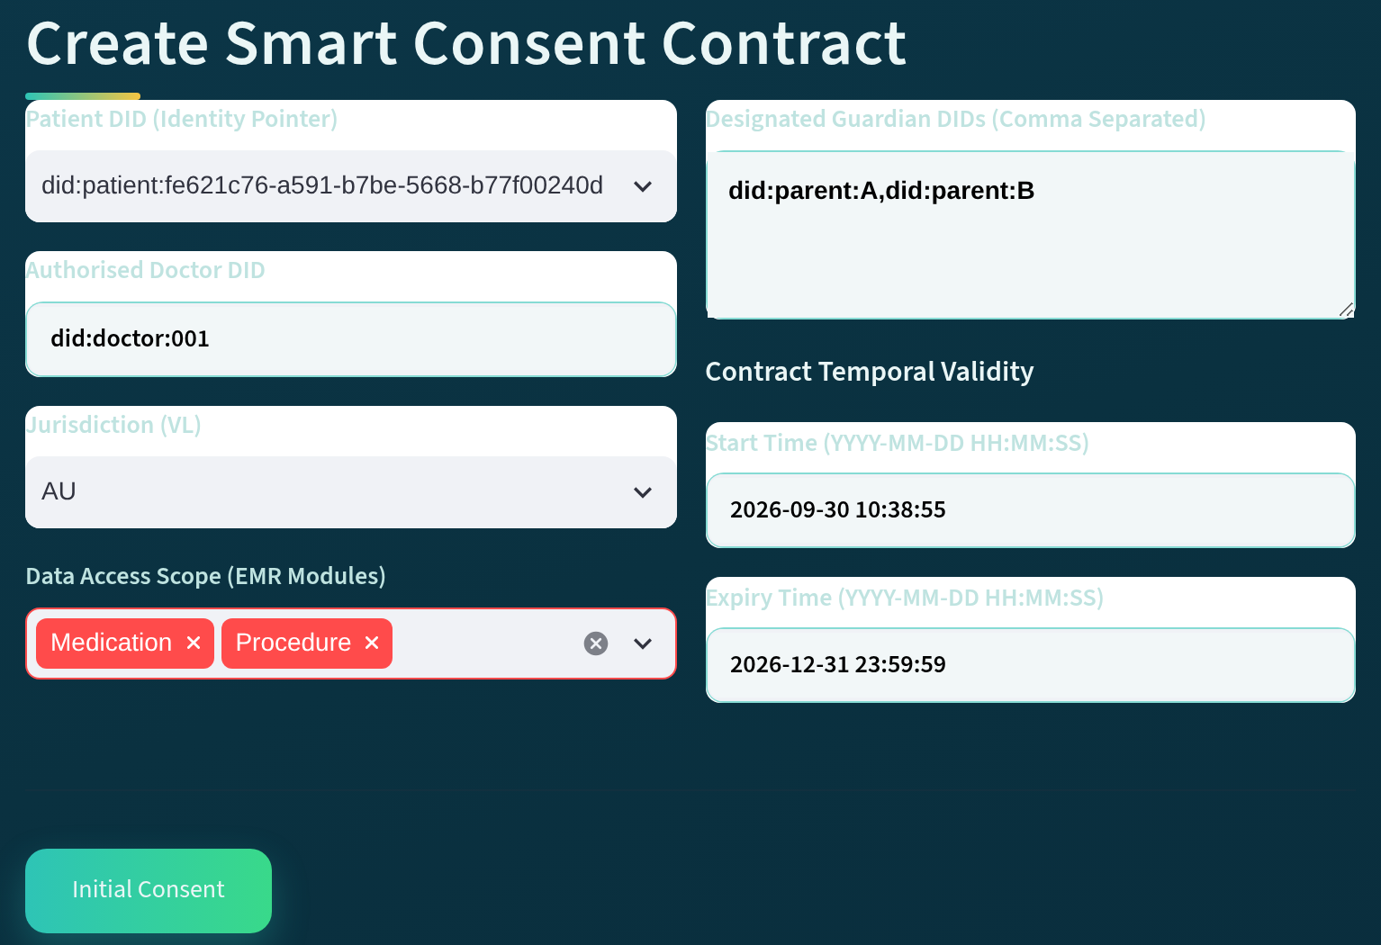
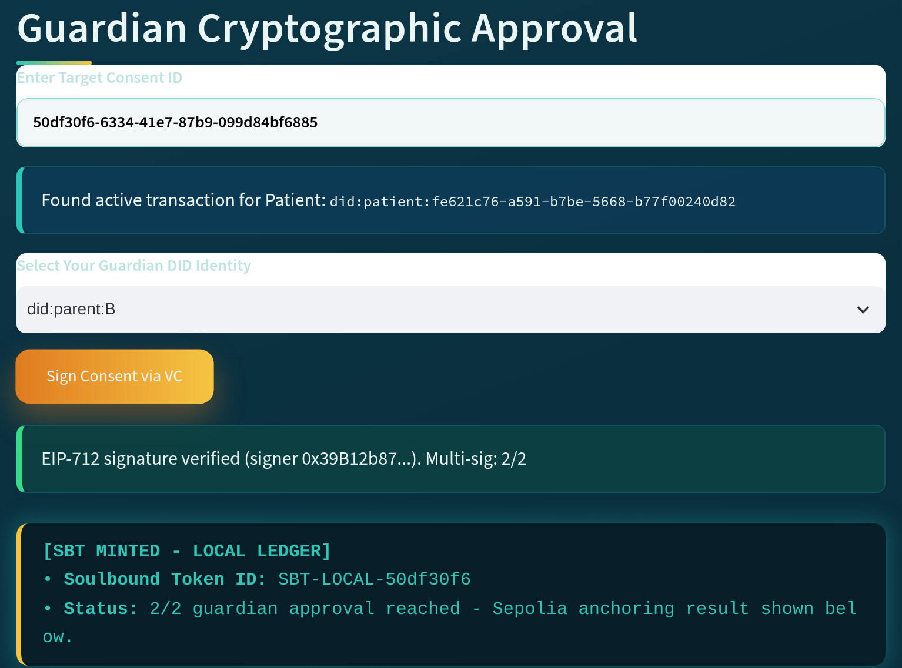
Patient creates, guardians activate
Multi-party consent is built in when the consent contract is constructed (Sections 7.2–7.3)
Verified 2/2
Scope: Medication, Procedure
Validity window
SBT minted
Figure 7.1 (cropped): Patient subsystem – Create Smart Consent Contract
Figure 7.2 (cropped): Guardian subsystem – Guardian Cryptographic Approval
Patient: Create Smart Consent Contract
Guardian: Cryptographic Approval
Patient DID, authorised doctor DID, EMR-module scope, guardian DIDs and start/expiry time form the consent object C
Each guardian verifies their DID and signs; at 2/2 approvals the SBT is minted and the consent is fully activated
A Trusted Authorisation Framework for Multi-Party Patient Consent · CA2
31 / 43
Notes:
Here I show the first two subsystems. On the left is the patient's Create Smart Consent Contract module, from Section 7.2. The patient sets the Patient DID, the Authorised Doctor DID, the data access scope as EMR modules such as medication and procedure, the designated guardian DIDs, and the start and expiry time. Together these build the consent object C = (I, A, P, T, L, E), so consent is bound to a specific subject and a specific actor, and the guardians are part of it from the start. On the right, from Section 7.3, each guardian enters the Consent ID, selects their Guardian DID and signs. The consent is not activated just because the patient created it. Only when both signatures are present is the SBT minted and the consent fully activated.

Slide 32
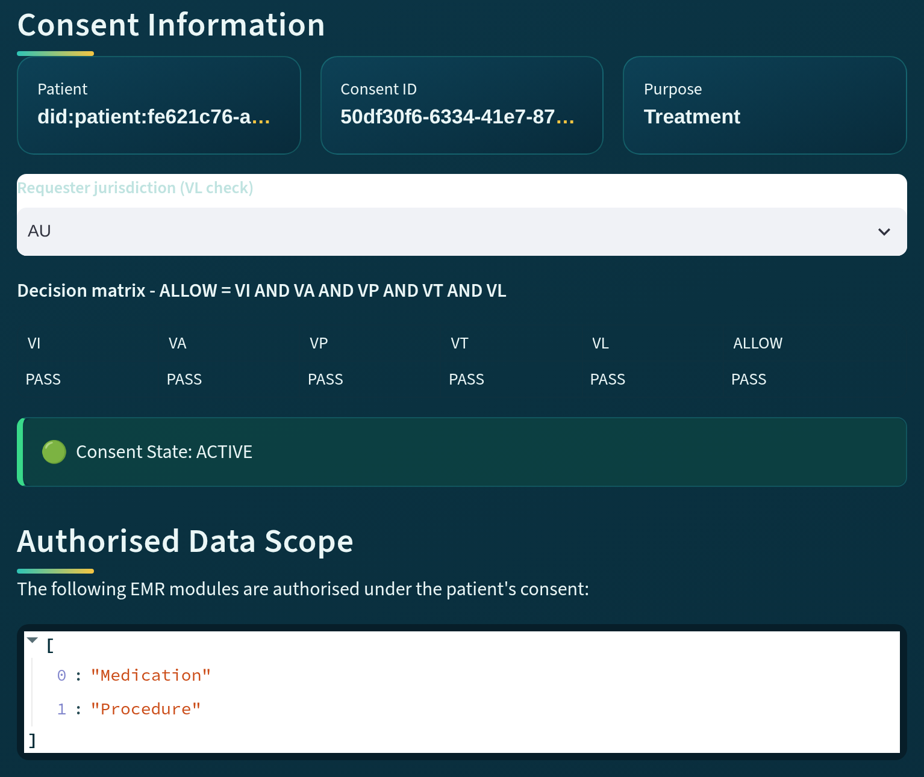
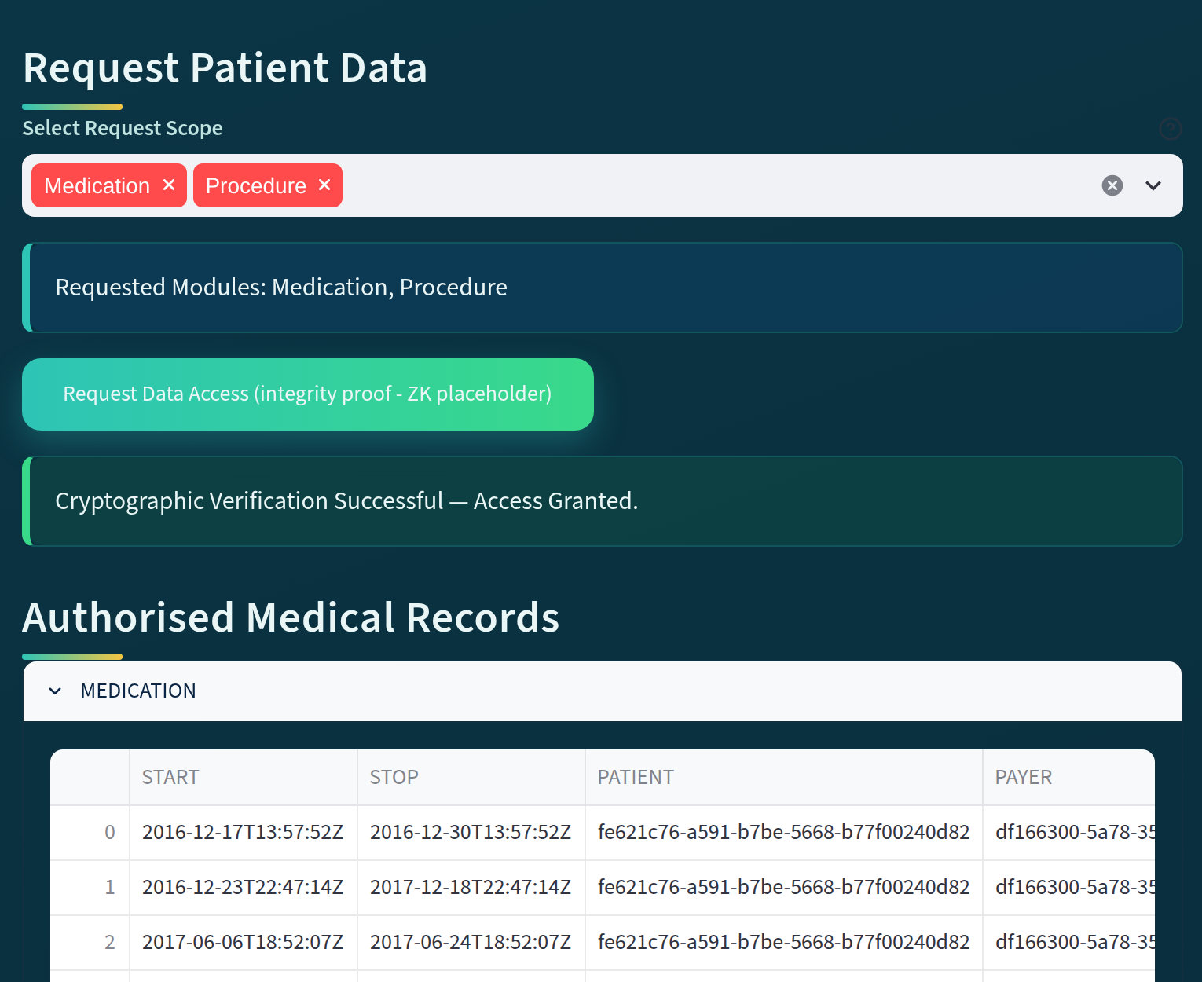
Consent is checked before data are released
Consent → Verification → AccessDecision in the doctor subsystem (Section 7.4)
Requested scope
Access granted
State: ACTIVE
Authorised scope
Figure 7.3 (cropped): Doctor subsystem – consent information, state and authorised scope
Figure 7.4 (cropped): Doctor subsystem – requested modules, access decision and records
Consent state and authorised scope
Requested modules and access decision
The doctor enters the Consent ID and sees patient DID, purpose, State = ACTIVE and Scope = {Medication, Procedure}
Requested modules are verified, then only MEDICATION and PROCEDURE records are released; the ZK integrity proof is a v1 placeholder
A Trusted Authorisation Framework for Multi-Party Patient Consent · CA2
32 / 43
Notes:
This slide is the doctor side, from Section 7.4. In Figure 7.3 the doctor enters an authorised Consent ID and the system shows the patient DID, the consent ID, the purpose and the current state, here ACTIVE, with the authorised data scope of Medication and Procedure. Holding a Consent ID is not enough, because the system first checks that the authorisation is still valid. In Figure 7.4 the doctor selects the modules to request, the system verifies the request and reports Access Granted, and only the MEDICATION and PROCEDURE records are released. The key point is that consent and data access are separate events: consent, then verification, then the access decision. In version 1 the integrity proof is a placeholder until the zero-knowledge circuit is built.

Slide 33
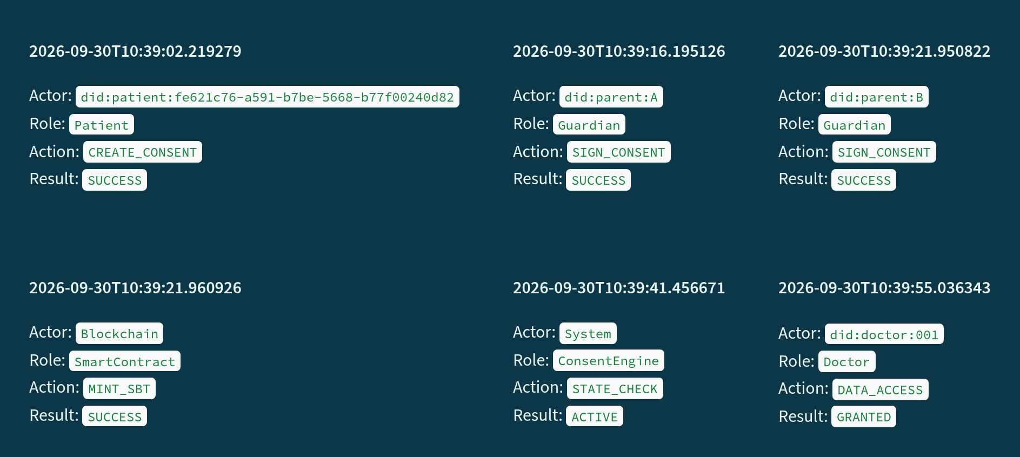

Access can be traced back to its consent
Consent Lifecycle, Detailed Audit Records and Complete Blockchain Audit Ledger (Sections 7.5–7.7)
Lifecycle reconstruction
1
2
3
CREATE_CONSENT, SIGN_CONSENT by each guardian, MINT_SBT, STATE_CHECK, then DATA_ACCESS with GRANTED
Event-level records
Each event carries actor, role, action, result, timestamp and consent context as forensic evidence
4
5
6
Ledger integrity
21 total events, 3 consent events, 3 access requests; Blockchain Integrity = VERIFIED
Figure 7.5 (event blocks arranged in time order): Auditor subsystem – Blockchain Audit & Consent Lifecycle
The auditor can reconstruct who accessed the data and why: in the demo, DATA_ACCESS is GRANTED only after consent is ACTIVE
A Trusted Authorisation Framework for Multi-Party Patient Consent · CA2
33 / 43
Notes:
The fourth subsystem is the auditor view, from Sections 7.5 to 7.7. It first gives aggregate indicators: 21 total events, 3 consent events and 3 access requests, with Blockchain Integrity shown as VERIFIED. The Consent Lifecycle section in Figure 7.5 then reconstructs the chain of evidence: the patient creates the consent, guardians A and B sign, the smart contract mints the SBT, the Consent Engine checks the state, and the doctor's DATA_ACCESS is GRANTED. Repeated state checks are left out of the figure, and on this slide I have arranged its six event blocks in time order, numbered 1 to 6. The Detailed Audit Records give the event-level evidence, and the Complete Blockchain Audit Ledger records the whole lifecycle, not only successful access. The key point is that this gives the evidence base for accountability, traceability, integrity and non-repudiation.

Slide 34
From architecture to source code
MVC layers of Chapter 5 in the HALAH prototype, repository commit 0a960ca (Section 7.10, Table 7.2)
Layer | HALAH module(s) | Responsibility
View | app.py (Patient, Guardian, Doctor, Auditor); halah_theme.py | Role-specific interaction; submits requests only
Controller | services/consent_service.py | Consent creation (Algorithm 1)
Controller | services/identity_service.py | DID check; EIP-712 approval signing and verification (Algorithms 2–3, V_{I})
Controller | services/state_service.py | Consent state checks (Algorithm 5; V_{A}, V_{T}, V_{L})
Controller | services/access_service.py | Scope check, release gate, decision matrix (Algorithm 4, V_{P})
Controller | services/blockchain_service.py; services/anchor_service.py | SBT minting, revocation and on-chain anchoring (evidence E)
Model | models/consent.py; models/access.py; database/ (SQLite) | C = (I, A, P, T, L, E) and request R; consent, approval and audit state
Protected resource | data/synthea/*.csv via database/repository.py | Synthetic EMR modules, released only after authorisation
Smart contract | contracts/ConsentSBTv3.sol (v2 for the Table 7.4 evidence) | Soulbound consent token; on-chain validity; ERC-5484 burn
A Trusted Authorisation Framework for Multi-Party Patient Consent · CA2
34 / 43
Notes:
In Table 7.2, from Section 7.10, I map the MVC architecture of Chapter 5 onto the code at repository commit 0a960ca of 22 September 2026, so the architectural claims can be checked against the source. The View is app.py with the four role pages, and it only submits requests. The Controller services hold the logic: consent creation for Algorithm 1, the scope check, release gate and decision matrix for Algorithm 4, and SBT minting, revocation and on-chain anchoring as the evidence E. The Model holds the consent object C = (I, A, P, T, L, E), the access request R, and the SQLite persistence with the audit log and DID mapping. The synthetic Synthea EMR modules are the protected resource, released only after authorisation.

Slide 35
18 automated tests, none failed
pytest 9.1.1, Python 3.11, run on 28 September 2026 (Section 7.11, Table 7.3)
16
tests passed
ID | Scenario | Predicate | Result
T1 | EIP-712 guardian approval | V_{I} | Pass
T2 | Decision matrix | V_{I}–V_{L} | Pass
T3 | End-to-end lifecycle, chain mocked | V_{A}, V_{L} | Pass
T4 | Revocation state | V_{L} | Pass
T5 | v3 contract routing | V_{T} | Pass
T6 | Persistence (3 tests) | E | Pass
T7 | Audit honesty (2 tests) | E | Pass
T8 | Configuration & honesty (6 tests) | – | Pass
T9 | Groth16 zero-knowledge (2 tests) | V_{T} | Skipped
2
skipped
ZK circuit not built
0
failed
Functional unit and integration tests with the blockchain mocked; not yet the full valid, negative and adversarial scenario set of Algorithm 6
A Trusted Authorisation Framework for Multi-Party Patient Consent · CA2
35 / 43
Notes:
Table 7.3 in Section 7.11 gives the automated test evidence. The suite was run with pytest 9.1.1 on Python 3.11 on 28 September 2026: 16 tests passed, 2 were skipped and none failed. T1 checks that a valid EIP-712 approval is accepted and that a wrong guardian, a wrong consent ID or a missing signature is rejected. T2 checks that the decision matrix returns ALLOW when all conditions hold and that each tested violation fails the corresponding predicate. T3 and T4 cover the lifecycle and revocation. The two Groth16 tests are skipped because the circuit is not built. These are functional tests with a mocked blockchain, giving initial evidence for SRQ1 to SRQ4 and the first SRQ5 checks. Stage 2 (CA3) still has to add insufficient approvals at the release gate, a duplicate approval, an out-of-scope request submitted directly to the service interface, and a request with a mismatched declared purpose.

Slide 36

Consent tokens anchored on Sepolia
Four consent SBTs minted by ConsentSBTv2 on the Ethereum Sepolia testnet (Section 7.12, Table 7.4)
Token | Block | Transaction hash (shortened)
#1 | 11750525 | 0x5bfb45ee…c0de105367
#2 | 11750632 | 0x1b964596…e56fc522907
#3 | 11750702 | 0x6812ab16…aabef251121
#4 | 11750722 | 0xa4c4156b…eff497e014a
Ethereum Sepolia testnet
Chain ID 11155111
ConsentSBTv2 contract
0xb0dA0440Abd6bd74bE0aebE226D593492124A6e7
Full hashes: Table 7.4 in the report.
Anchored activation
DID-to-address binding
v2 deployed, v3 current
When the threshold is reached, the consent is anchored by minting a non-transferable consent token
The holder of token #4 equals the address derived from the patient DID 'did:patient:demo'
Evidence recorded with ConsentSBTv2; ConsentSBTv3 is the current source and is exercised by test T5
The tokens show on-chain anchoring and the DID-to-address binding; Sepolia is a public testnet, not a production network (Section 7.13)
A Trusted Authorisation Framework for Multi-Party Patient Consent · CA2
36 / 43
Notes:
Here I show the on-chain evidence from Section 7.12. Table 7.4 lists four consent tokens anchored on the Ethereum Sepolia testnet, chain ID 11155111, by the ConsentSBTv2 contract at the address shown, in blocks 11750525 to 11750722. The full transaction hashes are in the report. ConsentSBTv2 was the deployed version when this evidence was recorded; ConsentSBTv3, listed in Table 7.2, is the current source and is exercised by test T5. The holder of token number four equals the address derived from the patient DID did:patient:demo, which demonstrates the DID-to-address binding the prototype uses. The key point is that this is testnet evidence of anchoring, not a production deployment, as Section 7.13 states.

Slide 37

Implementation status and limitations
Figures 7.1–7.5 come from the first version; the current version is v1.1 (Section 7.13)
v1.1 records EIP-712 guardian approvals, reports on-chain anchoring per event and labels the data-access proof a placeholder unless the ZK circuit is built.
Identity evidence
Fixed threshold
Purpose and release gate
Guardian keys derived from the DID for demonstration; DID check is syntactic; no W3C VC yet (CA3)
N = |G|, so all designated guardians must approve; configurable k-of-n thresholds are not yet supported
Fixed purpose list; per-request binding in CA3; release gated by state, proof and scope, not the full decision matrix
Synthetic data, testnet
Zero-knowledge proof
Functional evaluation
Healthcare data are synthetic (Synthea); the blockchain is a public testnet, not a production network
Groth16 circuit covers consent validity only; development-only trusted setup; not built for the test run (T9 skipped)
18 automated tests to date; performance and adversarial measurements are CA3 work
A Trusted Authorisation Framework for Multi-Party Patient Consent · CA2
37 / 43
Notes:
I close Part D with the implementation status and limitations in Section 7.13. The screenshots in Figures 7.1 to 7.5 come from the first version. The current version, v1.1, records guardian approvals as EIP-712 signatures, labels the data-access proof as a placeholder unless the zero-knowledge circuit is built, and reports on-chain anchoring per event. Guardian keys are derived from the DID for demonstration, whereas a deployment would use each guardian's own wallet. DID verification is syntactic, and no Verifiable Credential is issued or verified yet. The threshold is all designated guardians, purpose uses a fixed list with per-request binding left to Stage 2, and release is not yet gated by the full decision matrix. Performance and adversarial measurements are also Stage 2, that is CA3, work.

Slide 38
E
PART E · CHAPTERS 8–10
Progress and research plan
Where each objective stands, the publication plan and the next-stage (CA3) work on RO5 and RO6
38 / 43
Notes:
This brings me to Part E, which covers Chapters 8 to 10. Having shown the architecture and the HALAH evidence, I now report where each research objective stands, what I plan to publish and what the next stage will add. The key point here is the split between the two stages. RO1 to RO4 form the current stage, CA2, and have been implemented at prototype level. RO5 and RO6 belong to the next stage, CA3, although a first version of RO5, covering expiry and revocation, already runs in the prototype. I will go through Chapter 8 objective by objective, then Table 9.1 on publications and Table 10.1 on the research plan.

Slide 39
RO1–RO4 completed at prototype level; RO5–RO6 partial
Chapter 8: the status of each research objective and the evidence behind it
RO1
Trust-Centric Consent Model
Completed
Consent as an evaluable object C = (I, A, P, E) (Eq. 7); HALAH uses C = (I, A, P, T, L, E)
RO2
Decentralised Identity and Authority
Completed (prototype; W3C VC in CA3)
Identity ≠ authorisation (Eq. 1); wrong guardian, consent ID or missing signature rejected (T1)
RO3
Trustworthy Multi-Party Authorisation
Completed
|A_{v}| ≥ N (Eq. 9); 1/2 approvals: consent PENDING_SIGNATURE; 2/2 plus SBT mint: ACTIVE (T3)
RO4
Policy-Aware Access Control
Completed (prototype level)
S_{R} ⊆ S_{C} enforced in the service layer (Eq. 25); out-of-scope request: ACCESS DENIED, logged
RO5
Temporal and Lifecycle Trust
Partially completed (prototype)
First version (expiry and revocation) operational; formal lifecycle analysis in CA3
RO6
Security Assurance and Validation
Partially completed (SRQ1–SRQ4)
16 automated tests passed (Table 7.3); formal properties and adversarial tests in CA3
A Trusted Authorisation Framework for Multi-Party Patient Consent · CA2
39 / 43
Notes:
This slide summarises Chapter 8, one row per objective. The report's Stage 2 is the next stage, CA3, as Section 1.3 defines it. RO1 turns consent into the evaluable object C = (I, A, P, E), and the prototype implements the extended form with T and L. RO2 separates identity from authority; guardian approvals are EIP-712 signatures, and W3C credential verification comes in CA3. RO3 enforces the threshold: with two guardians, one approval leaves the consent pending. RO4 enforces S_R ⊆ S_C in the service layer, while binding the declared purpose to the consented purpose is CA3 work. RO5 and RO6 are partial: expiry and revocation already run and 16 automated tests passed, but formal and adversarial evaluation come next.

Slide 40
Publication plan: three research outputs
Table 9.1: the first paper is drafted, with submission to Computers & Security planned for November 2026
Research output | Target venue | Status
Trust-Centric Consent Framework: model, multi-party policies | Computers & Security (Elsevier) | Draft complete; submission planned November 2026
HALAH Prototype & Validation: implementation and evaluation | Systems / Security Conference | In progress
Formal Security & Lifecycle Analysis: temporal constraints | Specialised Workshop / Journal | Planned
A Trusted Authorisation Framework for Multi-Party Patient Consent · CA2
40 / 43
Notes:
Chapter 9 sets out three research outputs, summarised here from Table 9.1. The first is the Trust-Centric Consent Framework paper on the model architecture and multi-party authorisation policies. The draft is complete and I plan to submit it to Computers and Security, published by Elsevier, in November 2026. It is the core architectural contribution and addresses SRQ1 to SRQ4. The second covers the HALAH prototype, the empirical validation platform, with its decentralised implementation and functional security evaluation; it is aimed at a systems or security conference and is in progress. The third, formal security and lifecycle analysis of temporal constraints and state transitions, is planned for a specialised workshop or journal as the next-stage extension. So the current stage lays the foundation, and the next stage adds formal analysis and empirical validation.

Slide 41
Next-stage plan: four research focuses
Section 10.2, Table 10.1: whether trust can be maintained over time, formally justified and demonstrated
Next stage (CA3): RO5 and RO6
1
RO5
2
RO6
3
RO6
4
RO5–RO6
Temporal and lifecycle trust
Formal security assurance
Empirical validation
Integrated evaluation
Add validity periods, expiry, revocation and controlled transitions; confirm consent is still valid at access
Define security properties; analyse invalid identity, too few approvals, policy violation, expiry, revocation
Extend HALAH with positive and negative scenarios; measure runtime, overhead and enforcement accuracy
Combine temporal, lifecycle, formal and empirical modules; evaluate interactions, scalability and feasibility
Outcome: A mechanism that checks whether consent is still active at the point of access
Outcome: A formal security model with explicit security guarantees
Outcome: Empirical evidence and benchmark datasets on enforcement
Outcome: One integrated, validated framework for multi-party consent
A Trusted Authorisation Framework for Multi-Party Patient Consent · CA2
41 / 43
Notes:
Here I follow Section 10.2 and Table 10.1: the four focuses of the next stage, CA3, in order. First, temporal and lifecycle trust, because a consent that was valid when approved may no longer be valid when it is used. Second, formal security assurance: explicit security properties, analysed under invalid identities, insufficient approvals, policy violations, expired or revoked consent and illegal transitions. Third, empirical validation in HALAH, checking that ALLOW is produced only when all trust conditions hold and DENY otherwise, and measuring runtime, overhead and enforcement accuracy. Fourth, which appears only in Table 10.1, is integrated end-to-end evaluation. Under Eq. (35), the final decision is ALLOW only when identity and authority, multi-party approval, policy, and temporal and lifecycle validity all hold; a denial should keep enough evidence to explain its reason.

Slide 42
From recorded consent to an evaluated decision
Contributions of the current stage (Chapters 1, 5, 10 and Section 2.6) and the path to CA3
No single mechanism makes access trustworthy. The contribution is one explainable decision built from independently verifiable conditions.
Consent as an evaluable object
MVC research architecture
HALAH prototype
Evidence and path to CA3
C = (I, A, P, E)
Decision(C, R) = ALLOW
⇔ V_{I} ∧ V_{A} ∧ V_{P}
Consent is evaluated, not just stored as a record
View submits claims, Controller evaluates predicates, Model holds trust state; data only via the Controller
Patient, guardian, doctor and auditor subsystems; EIP-712 guardian approvals; consent SBTs on Ethereum Sepolia
Initial evidence: 16 tests passed, SRQ1–SRQ4; CA3 adds lifecycle trust, formal assurance, empirical validation
Evidence: Eq. (6), Eq. (7); Chapter 5
Evidence: Chapter 5; Table 7.2
Evidence: Chapter 7; Tables 7.1 and 7.4
Evidence: Table 7.3: 16 passed, 2 skipped, 0 failed
A Trusted Authorisation Framework for Multi-Party Patient Consent · CA2
42 / 43
Notes:
To conclude, I bring the contributions together, drawing on Chapters 1, 5 and 10 and the conclusion in Section 2.6. The review found that each requirement is addressed in isolation, but no existing approach combines them into one independently verifiable decision. My response has four parts. The conceptual model treats consent as an evaluable object and makes access the conjunction of V_I, V_A and V_P. The MVC architecture routes every sensitive decision through the Controller, so neither the interface nor a stored record can decide access on its own. HALAH implements these conditions at prototype level in a decentralised healthcare setting. The evidence so far is functional; CA3 adds temporal and lifecycle trust, formal assurance and empirical validation, moving from static consent management to dynamic trustworthy authorisation.

Slide 43

Thank you
Questions and feedback
Yasir Dhaifallah O Alyoubi
YasirDhaifallahO.Alyoubi@student.uts.edu.au
Principal Supervisor: Professor Farookh Hussain · Co-Supervisor: Dr Firas Al-Doghman
Notes:
Thank you to the panel for your time and attention. I am happy to take questions on any part of the report. There are two points where your feedback would be most useful to me. The first is the gap analysis in Section 2.5: whether the gaps I derived from the 33 shortlisted studies, one for each of the five requirements, are stated fairly and map correctly to RO1 to RO5. The second is the integrated decision in Section 6.7: whether expressing trustworthy access as a conjunction of predicates, Eq. (6) for the current stage, CA2, and Eq. (24) for CA3, is the right basis for the formal and empirical work in the next stage.

