Slide 1

A Trusted Authorization Framework for Multi-Party Patient Consent in Healthcare Data Sharing
Candidature Reassessment
Principal Supervisor: Professor Farookh Hussain
Co-Supervisor: Dr. Firas Al-Doghman
Presenter: Yasir Dhaifallah O Alyoubi
STUDENT ID #: 24724078
Notes:
Hello everyone. My name is Yasir Alyoubi. My principal supervisor is Professor Farookh Hussain, and my co-supervisor is Dr Firas Al-Doghman. Today I present my candidature reassessment.
My title is A Trusted Authorization Framework for Multi-Party Patient Consent in Healthcare Data Sharing. In simple words, before patient data is shared, how can a system check consent, identity, authority, approvals, policy and time in one decision?

Slide 2
INTRODUCTION
Healthcare data is sensitive and is shared by independent parties: patients, guardians, doctors and hospitals.
Consent is usually kept as a passive record of permission.
A valid identity does not prove the authority to access a patient's data.
Even with approval, a request can go beyond the allowed purpose or data scope.
The central problem
No integrated, trust-oriented mechanism connects identity, authority, multi-party approval, policy, time and lifecycle in one authorisation decision whose security is formally and empirically shown.
Key idea: consent as an evaluable authorisation object
C = (I, A, P, T, L, E)
Identity (I) · Authority (A: guardian set G, threshold N) · Policy (P: purpose, scope) · Time (T) · Jurisdiction (L) · Evidence and lifecycle state (E)
Notes:
Healthcare data is very sensitive, and it moves between independent parties like patients, guardians, doctors and hospitals. But consent is usually kept as a passive record. Also, identity is not authority. A system may know who you are, but that does not mean you may see this patient's data. And even with approval, a request can ask for more data, or another purpose, than the patient allowed.
The box on the right is the central problem. No current mechanism links all these conditions in one decision and also shows it is secure, with exact definitions and with tests.
The bottom box is my key idea. Consent becomes an object the system can check. I is identity. A is authority, with the guardian set G and the threshold N, the number of approvals needed. P is purpose and data scope. T is time, L is jurisdiction, and E is the evidence and lifecycle state, for example active or revoked.

Slide 3
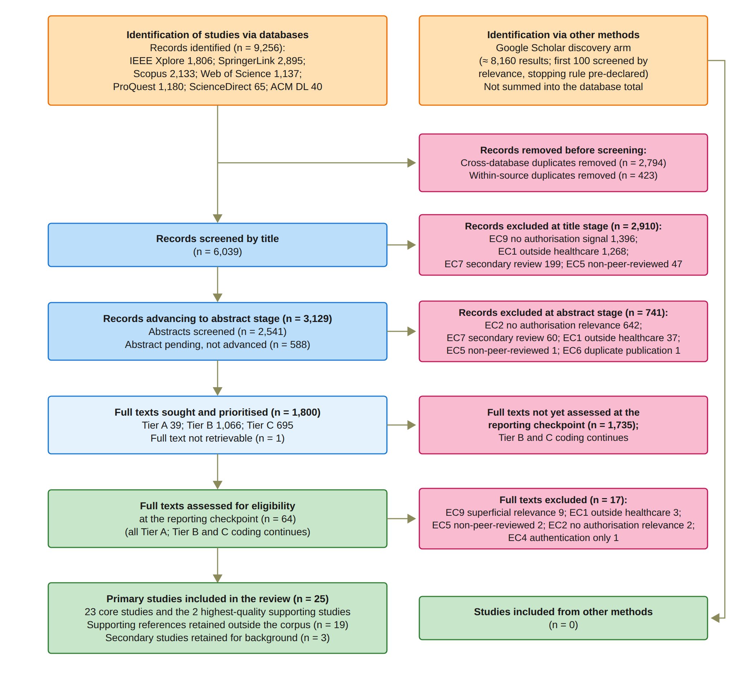
SYSTEMATIC LITERATURE REVIEW
Stage | Details
Protocol | PRISMA 2020; written protocol (v1.1) fixed before screening
Search | One master query, three concept blocks; seven databases; Google Scholar as discovery arm
Dates | 24 and 25 August 2026; ACM DL on 5 September 2026
Screening | Title, abstract, then full text; IC1 to IC7, EC1 to EC9
Quality | Included when QA1 + QA2 + QA3 + QA4 ≥ 3.0 (Yes 1, Partial 0.5, No 0)
Result | 25 primary studies: 23 core and 2 supporting
Notes:
This slide shows how I ran the systematic literature review. The table on the left reads from top to bottom.
I followed PRISMA 2020, a standard guide for clear and repeatable reviews. My written protocol was fixed before screening. I used one master query and searched seven databases. Google Scholar was only a discovery arm, so I report it separately. The main searches were on 24 and 25 August, and ACM on 5 September. A study passes quality when its four QA scores add up to at least 3.0.
The flow diagram on the right shows the numbers. The databases gave 9,256 records, and 6,039 were screened by title. Then 3,129 reached the abstract stage, and 1,800 full texts were sought. 64 were assessed at the reporting checkpoint. The result is 25 primary studies: 23 core and 2 supporting.
Possible question: Why was ACM searched later? My UTS Library account was put on hold after I downloaded many full-text PDFs, so I had no access through the library. After I contacted them, the hold was removed, but this took some time. I used the same search string and fields.

Slide 4
COMPARISON AGAINST THE REQUIREMENTS
Study | Req 1 | Req 2 | Req 3 | Req 4 | Req 5 | Req 6
S1 [50] Abbasi et al. (2026) | Partial | Partial | Partial | Partial | Partial | Partial
S2 [48] Albalwy et al. (2021) | Yes | Partial | No | Yes | Partial | Yes
S3 [51] Al Amin et al. (2023) | Yes | Partial | Partial | Partial | Partial | Partial
S4 [27] Ekholm et al. (2025) | Partial | Yes | Yes | No | Partial | Partial
S5 [28] Eneh et al. (2026) | Yes | Partial | No | Yes | Yes | Partial
S6 [52] Hagström et al. (2024) | Partial | Yes | Partial | Partial | Yes | Yes
S7 [47] Jaiman and Urovi (2020) | Yes | Partial | No | Yes | Partial | Yes
S8 [53] Zhao and Su (2024) | Partial | Partial | Yes | Partial | No | Yes
S9 [49] Li et al. (2026) | Partial | Partial | No | Yes | Yes | Partial
S10 [23] Madine et al. (2020) | Yes | Yes | Yes | Partial | Yes | Partial
S11 [54] Maruthi and Singh (2025) | Partial | Partial | Yes | No | No | Yes
S12 [55] Mei et al. (2026) | Partial | Partial | No | Yes | Yes | Yes
S13 [29] Panagoulias et al. (2026) | Yes | Partial | No | Yes | Yes | Yes
S14 [21] Phuyal et al. (2026) | Yes | Yes | No | Partial | Partial | Yes
S15 [56] Phuyal et al. (2026) | Partial | Partial | No | Partial | Partial | Partial
S16 [25] Punia et al. (2025) | Partial | Partial | Yes | Yes | Yes | Partial
S17 [30] Román-Martínez et al. (2023) | Yes | Partial | No | Yes | No | Partial
S18 [57] Hema et al. (2026) | Yes | Partial | No | Yes | Yes | Partial
S19 [58] SooHoo et al. (2026) | Partial | Partial | No | Partial | Partial | Partial
S20 [26] Tan et al. (2024) | Yes | Yes | Yes | No | Partial | Partial
S21 [24] Tith et al. (2020) | Yes | Partial | No | Yes | Partial | Partial
S22 [59] Tremper et al. (2026) | Partial | Partial | No | Partial | Partial | Partial
S23 [60] Tseng et al. (2025) | Partial | Yes | No | Partial | Partial | Partial
S24 [61] Wu et al. (2022) | Partial | Partial | Partial | Partial | Partial | Partial
S25 [22] Wu and Zhang (2025) | Yes | Yes | No | No | No | Yes
Notes:
This table compares the 25 studies against my six requirements. Req means requirement. Each row is one study, and each column is one requirement. The requirements follow my problem, from the consent object to security assurance. Green Yes means fully met. Gold Partial means partly met. Red No means not met.
First, read down the columns. Every requirement is fully met by at least one study. Req 3, multi-party approval, is the weakest. Only 6 studies get a Yes.
Now read across the rows. No study meets all six. The best are S10, Madine et al., and S13, Panagoulias et al., with four Yes each. Five studies have no Yes at all.
So the pieces exist in the literature. But no study puts them together in one decision, and that is where my work fits.

Slide 5
RESEARCH GAPS
Gap 1
Consent is treated as a record of permission; evaluable objects carry only some conditions and are issued by one party.
Gap 2
Identity shows who a participant is, not what they may do; authority is verified separately in only 10 of 25 studies.
Gap 3
Multi-party approval is a contingency path or a registration step, not a standing condition of every access decision.
Gap 4
Purpose, data scope and jurisdiction are rarely bound to the same decision as identity, authority and approval.
Gap 5
Time, lifecycle and revocation are often checked on a credential or at registration, not at each access request.
Gap 6
The decision as a whole is neither formally proved nor systematically tested; proofs cover only a fragment.
Notes:
From the review, I defined six research gaps. Each gap has the same number as the requirement it comes from.
Gap 1: consent is kept as a record of permission. Where it can be checked, it holds only some conditions, and only one party issues it.
Gap 2: identity tells us who someone is, not what they may do. Only 10 of the 25 studies check authority separately.
Gap 3: multi-party approval is used as a backup path or a registration step, not at every access.
Gap 4: purpose, data scope and jurisdiction are rarely checked in the same decision as identity, authority and approval. Jurisdiction means the legal region where the consent applies.
Gap 5: time, lifecycle and revocation are often checked on a credential or at registration, not at each request.
Gap 6: nobody proves or tests the whole decision. Any proof covers only a small part.

Slide 6
RESEARCH QUESTIONS
Main question: How can a trust-oriented computing framework establish and enforce trustworthy multi-party consent for decentralised healthcare data sharing under identity, authority, and policy constraints?
RQ1
How can patient consent be modelled as a trust-aware authorisation object with identity, authority, policy and evidence?
RQ2
How can DIDs and VCs establish trustworthy participants while separating authentication from authority?
RQ3
How can independently verified participants jointly approve, so no single participant can authorise alone?
RQ4
How can purpose and data-scope constraints stop valid identities and approvals from reaching unauthorised data?
RQ5
How can time and lifecycle controls reject access after expiry, revocation or an unauthorised state change?
RQ6
How can the security properties be formally defined and empirically evaluated?
Notes:
These gaps lead to my main research question at the top. How can a trust-oriented framework establish and enforce multi-party consent for healthcare data sharing, under identity, authority and policy limits?
Establish means building trust in the participants and in the shared consent. Enforce means checking the conditions every time someone asks for data. Multi-party means one person alone cannot approve.
I split it into six sub-questions, one for each gap. RQ1 models consent as an object. RQ2 uses DIDs and VCs. A DID is a decentralised identifier, and a VC is a verifiable credential, like proof of a role. They help keep identity separate from authority. RQ3 asks how verified participants approve together. RQ4 uses purpose and data scope to block the wrong data. RQ5 rejects access after expiry or revocation. RQ6 defines the security properties and tests them.
RQ1 to RQ5 build the decision. RQ6 checks it.

Slide 7
RESEARCH OBJECTIVES
Objective | Description | Status
RO1 | Trust-centric consent model: consent as a structured, evaluable authorisation object | Done
RO2 | Decentralised identity and authority verification (DID, VC), separating identity from authority | Done
RO3 | Threshold-based multi-party authorisation with EIP-712 guardian approvals | Done
RO4 | Policy- and context-aware access control (purpose, data scope) | Done
RO5 | Temporal validity and consent lifecycle control | In Progress
RO6 | Formal security assurance and empirical validation | Partially completed
Notes:
From the questions, I set six research objectives. Each objective answers the question with the same number. The last column shows the status.
RO1 is the consent model. Consent becomes a structured object the system can check. It is done.
RO2 checks identity and authority with DIDs and VCs, and keeps them apart. It is done.
RO3 is multi-party approval. Each guardian signs with EIP-712, a standard for signing structured data. In the prototype, every listed guardian must sign. It is done.
RO4 checks purpose and data scope when access is requested. It is done.
RO5, time and lifecycle, is in progress. The validity window and revocation already work. Next I will add consent changes, delegation and guardian-set changes.
RO6 is partially completed. The automated tests and attack scenarios are done. The formal analysis comes in the next stage.

Slide 8
RESEARCH METHODOLOGY
1
2
3
4
5
6
7
Problem
Consent is a passive record; no integrated trusted decision
Literature review
PRISMA 2020; 25 primary studies
Gaps and RQs
Gap 1 to Gap 6; RQ1 to RQ6
Objectives
RO1 to RO6
Design
MVC architecture, consent object C, Algorithms 1 to 4
Prototype
HALAH prototype; ConsentSBTv3 on Sepolia
Evaluation
Live scenarios, measurements and 12 attack scenarios; formal assurance in the next stage
From the problem to the evaluated prototype
Notes:
My research method has seven steps, from left to right.
Step 1 is the problem. Consent is only a passive record, and there is no single trusted decision. Step 2 is the literature review. I followed PRISMA 2020, a standard guide for reporting reviews, and I analysed 25 primary studies.
Step 3 gives six gaps and six research questions. Step 4 turns them into six objectives, RO1 to RO6.
Step 5 is the design: an MVC architecture, the consent object C and four algorithms. Step 6 is my prototype, HALAH. Its smart contract, ConsentSBTv3, runs on Sepolia, which is an Ethereum test network.
Step 7 is the evaluation. I used live scenarios, measurements and twelve attack scenarios. The formal assurance comes in the next stage.
The arrow at the bottom shows the whole path, from the problem to the evaluated prototype.

Slide 9
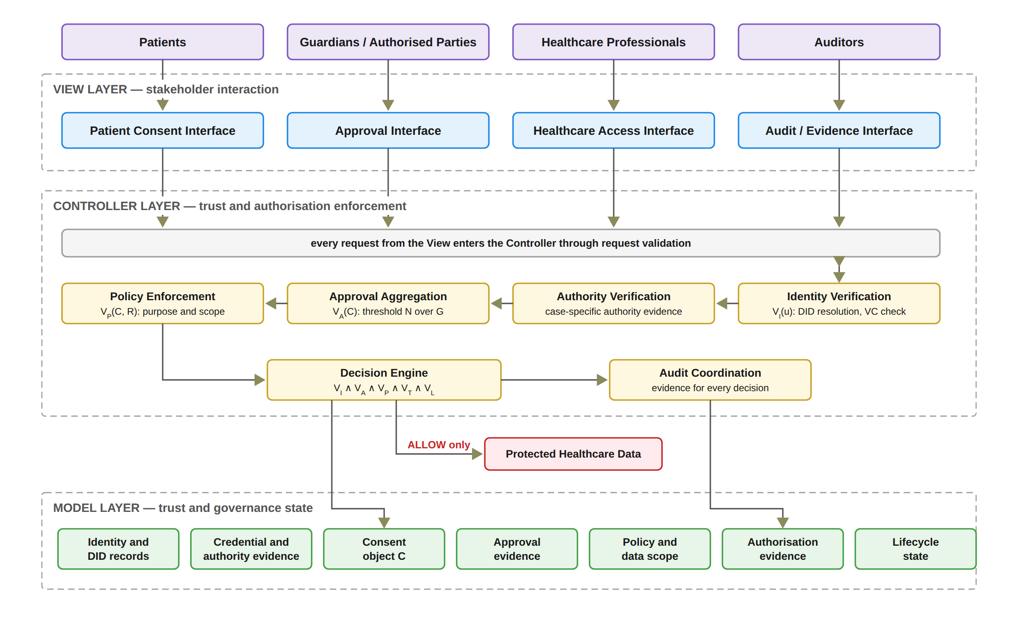
ARCHITECTURE AND SOLUTION OVERVIEW
Decision(C, R, t) = ALLOW ⟺ VI(u) ∧ VA(C) ∧ VP(C, R) ∧ VT(C, t) ∧ VL(C, R)
VI Identity and authority
VA All approvals, token, not revoked
VP Purpose and data scope
VT Inside the validity window
VL Jurisdiction matches
Any failed check gives DENY. In the prototype, a Groth16 proof must also verify before data is released.
Notes:
This is my architecture. It uses MVC, which means Model, View and Controller. Each of the four user groups has its own interface. The View only sends requests and never decides access. The checks run in the Controller. The Decision Engine joins the checks, and Audit Coordination records evidence for each decision. The Model layer keeps the state, such as the consent object C. Health data are released only on ALLOW.
The box at the top is my decision rule. For consent C, request R and time t, it is ALLOW only if all five checks pass. VI checks identity and authority. VA checks approvals, the token and that consent is not revoked. VP checks purpose and data scope. VT checks the validity window. VL checks jurisdiction. If any check fails, the answer is DENY.
In the prototype, a Groth16 proof must also verify. This zero-knowledge proof shows something is true without showing the secret.

Slide 10
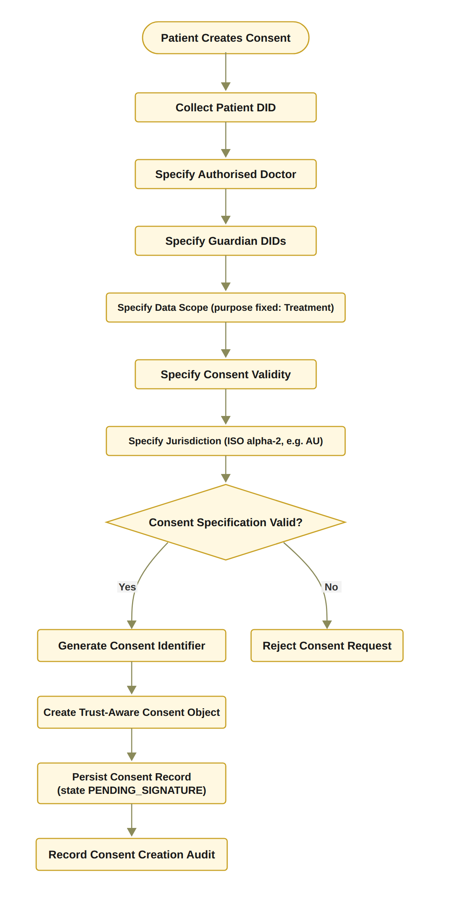
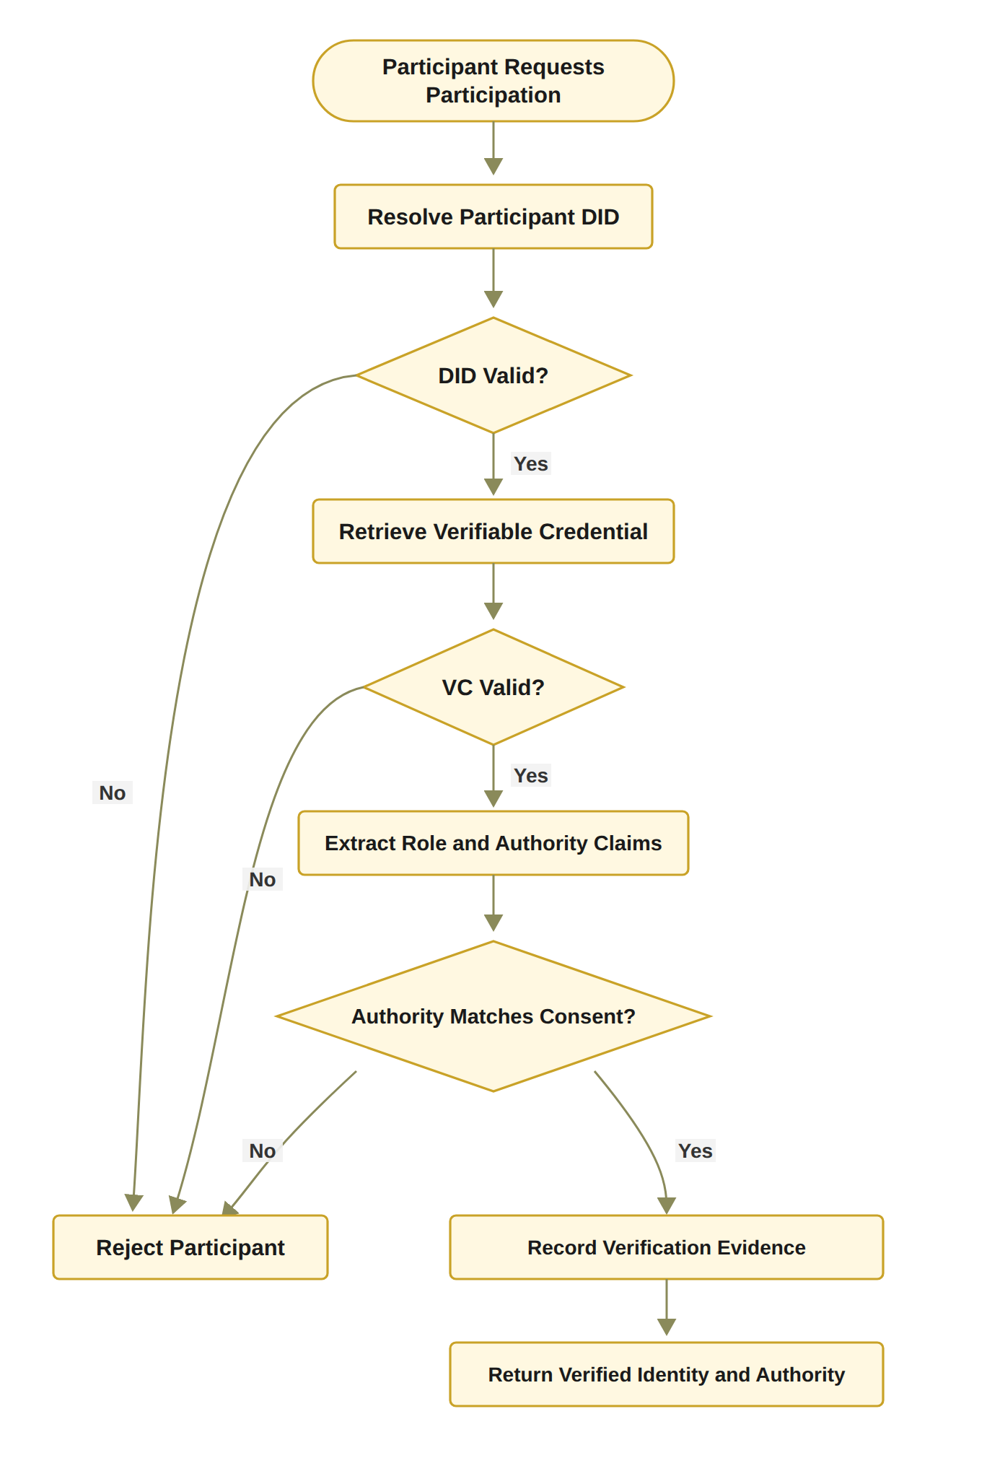
THE PROPOSED SOLUTION FOR RO1 AND RO2
RO1: Trust-centric consent model
RO2: Identity and authority
Status: Done
Status: Done
The patient selects the DID, doctor, guardians, data scope, time and jurisdiction; the purpose is fixed to Treatment.
Invalid input is rejected, for example an empty scope.
C = (I, A, P, T, L, E) is stored as PENDING_SIGNATURE and the creation is logged.
DID shows who the participant is; a VC shows what they may do.
A valid DID alone never gives access.
Prototype: DID-format check and EIP-712 signature recovery; full DID and VC checks next stage.
Notes:
RO1 is the trust-centric consent model, and it is Done. The patient selects their DID, the doctor, the guardians, the data scope, the time and the jurisdiction. For now the purpose is fixed to Treatment. Invalid input is rejected, for example an empty scope. Then the system builds the consent object C. C has six parts: identity, authority, policy, time, jurisdiction and evidence. It is saved as PENDING_SIGNATURE, and the creation is logged.
RO2 is identity and authority. It is also Done. A DID, or decentralised identifier, shows who the person is. A VC, or verifiable credential, shows what they may do. So a valid DID alone never gives access. In the prototype I check the DID format and recover each EIP-712 signature. EIP-712 is a typed signature format on Ethereum. Full DID and VC checks come in the next stage.

Slide 11
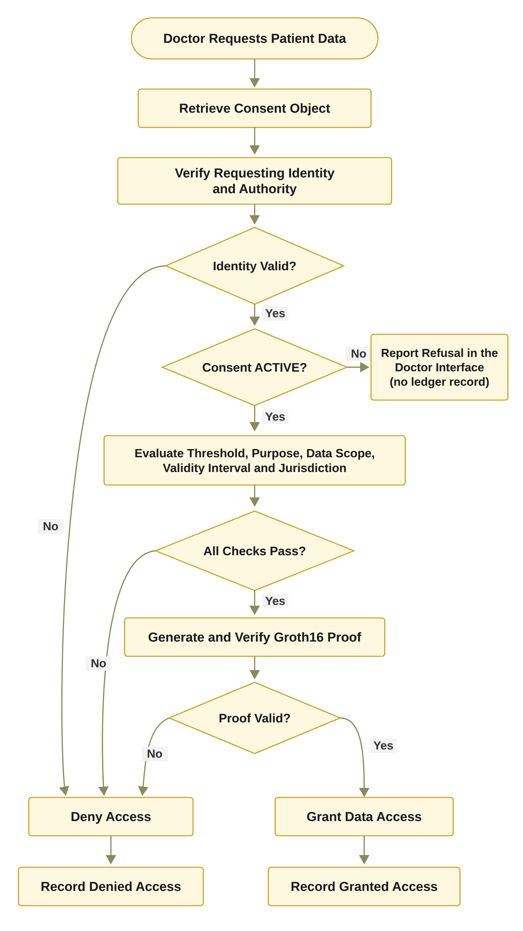
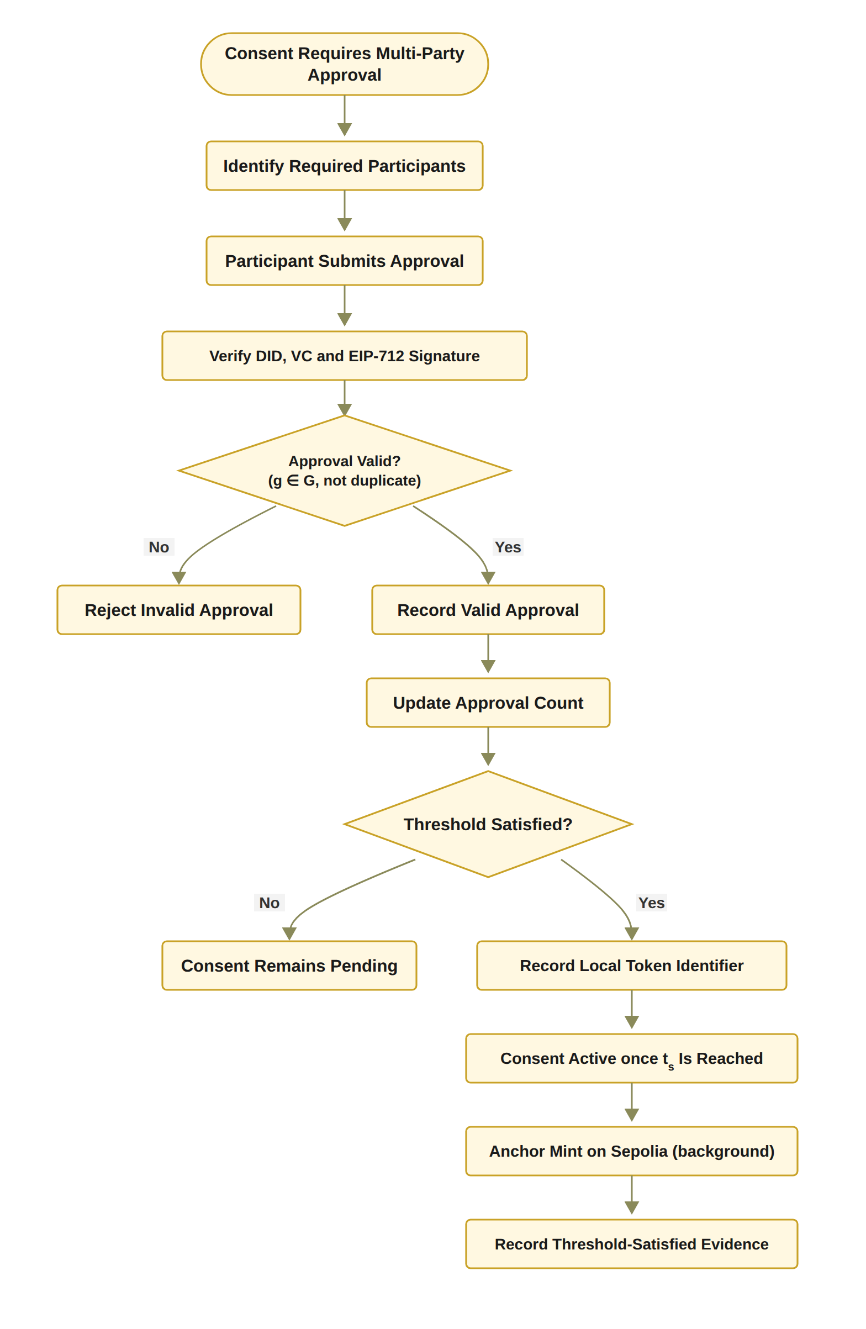
THE PROPOSED SOLUTION FOR RO3 AND RO4
RO3: Multi-party authorisation
RO4: Policy and context
Status: Done
Status: Done
Guardian set G is fixed at creation; each guardian signs an EIP-712 approval.
Outsider, replayed and duplicate approvals are not counted.
N-of-N rule (2-of-2 in the demo); then the mint is anchored on Sepolia in the background.
Requested scope must be a non-empty subset of the authorised scope.
Purpose, time and jurisdiction are checked in the same decision.
A Groth16 proof must verify; asking for Procedure when only Observation and Medication are allowed gives DENY.
Notes:
RO3 is multi-party authorisation, and it is Done. The guardian set G is fixed when the consent is created. Each guardian signs an EIP-712 approval. Approvals from outsiders are not counted, and replayed or duplicate approvals are not counted either. The rule is N-of-N, so every listed guardian must sign. In the demo that means 2-of-2. Then the mint is anchored on Sepolia in the background, so nobody has to wait for it.
RO4 is policy and context. It is also Done. The requested scope must not be empty, and it must sit inside the scope the patient allowed. Purpose, time and jurisdiction are checked in the same decision. Then a Groth16 proof must verify before any data is released. So if the consent allows only Observation and Medication, a request that adds Procedure gets DENY.

Slide 12
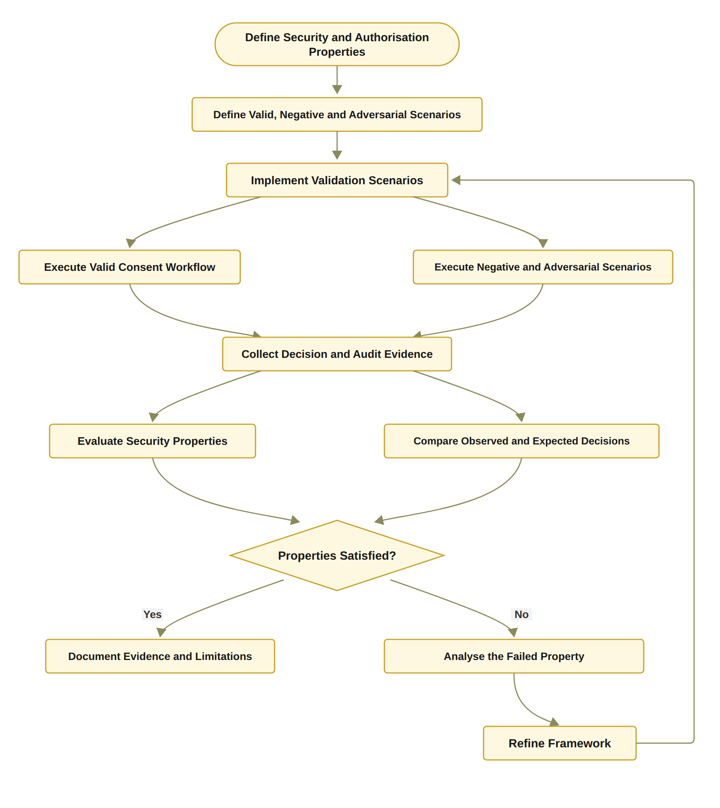
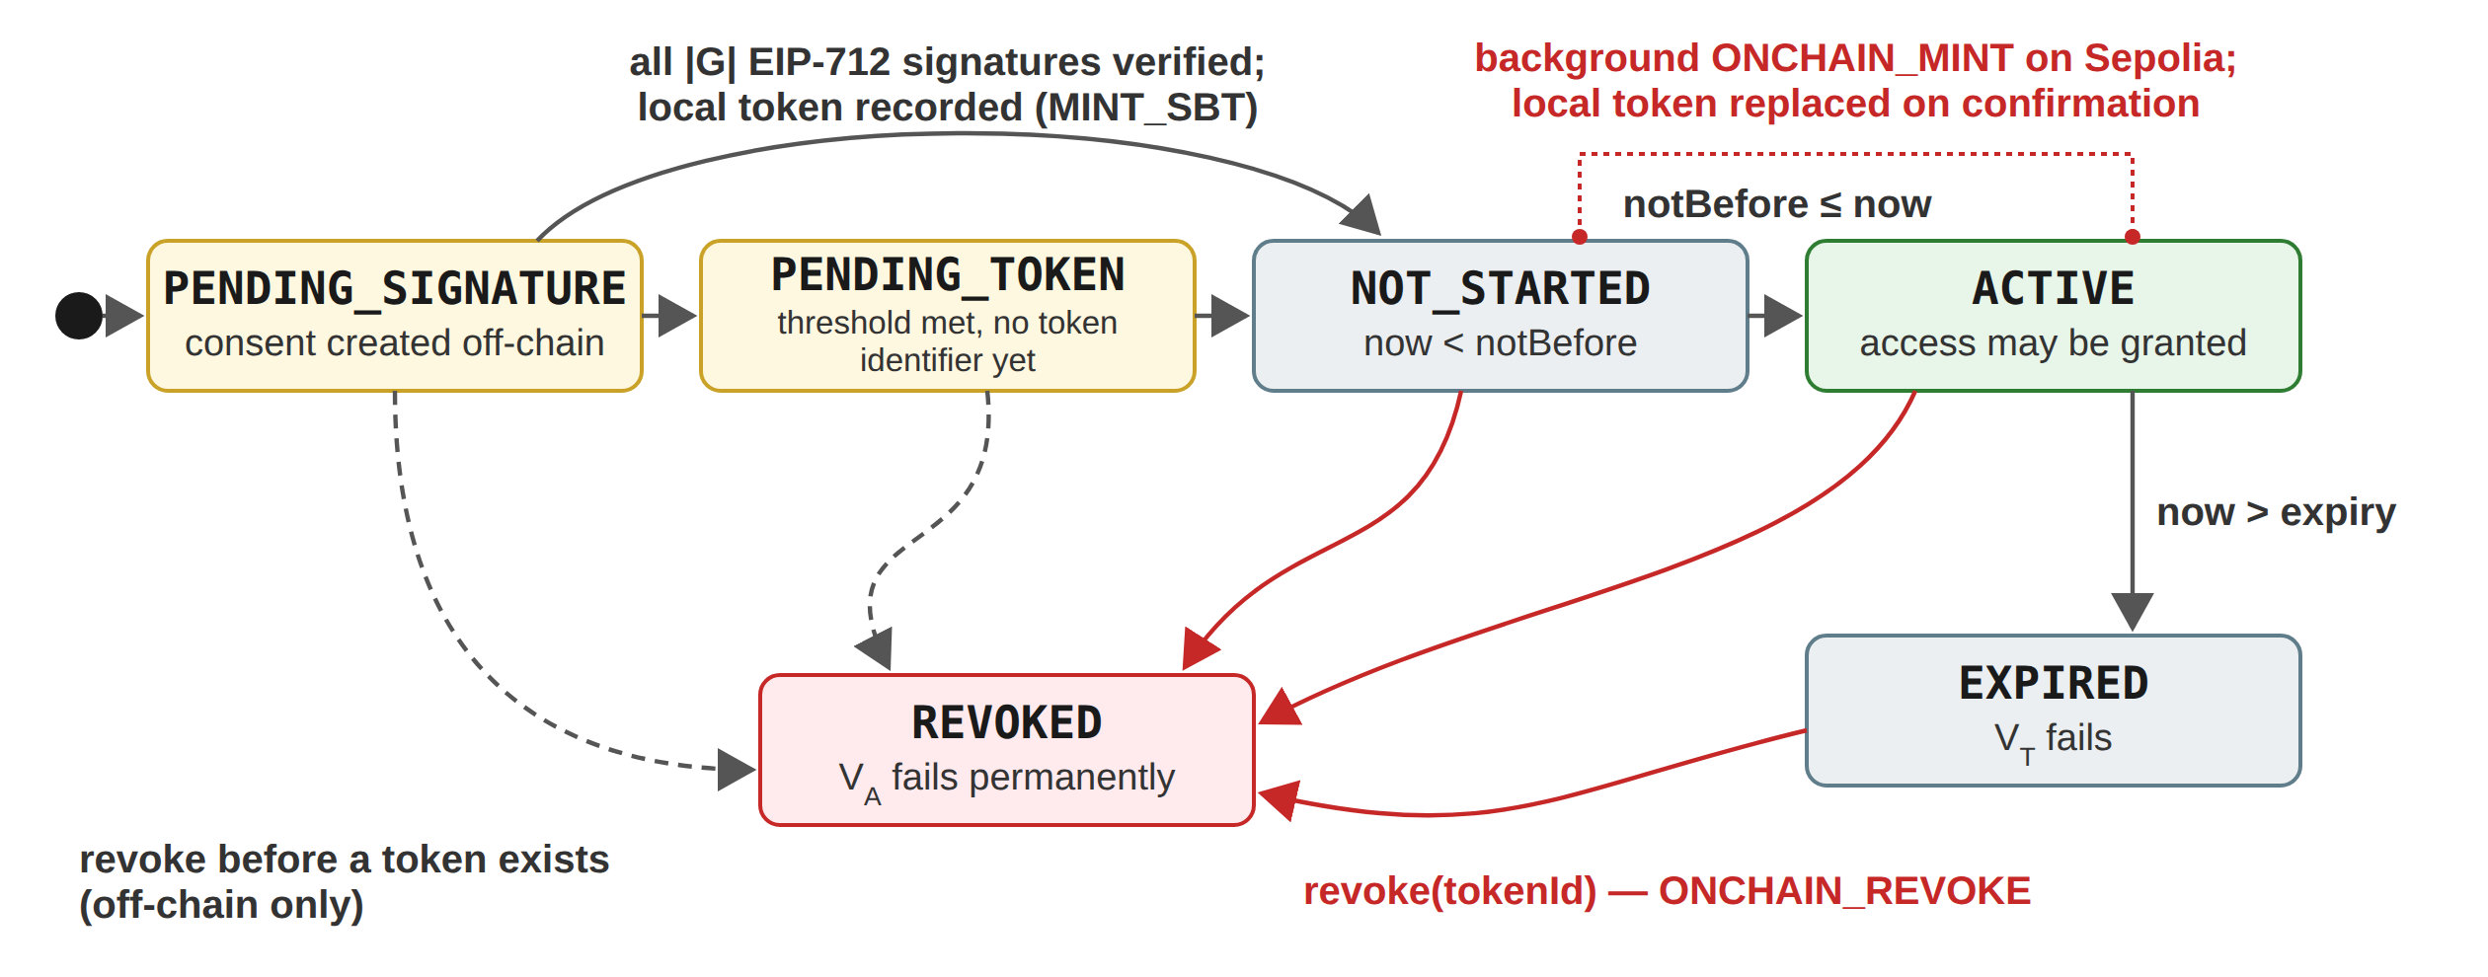
THE PROPOSED SOLUTION FOR RO5 AND RO6
RO5: Temporal and lifecycle trust
RO6: Assurance and validation
Status: In Progress
Status: Partially completed
Validity window stored on-chain and checked at every request (VT).
Revocation works end to end, with an on-chain revoke.
Next stage: transition check, modification, delegation, guardian-set changes, formal lifecycle model.
Done: 36 automated tests, including attack scenarios A1 to A12.
Done: cost, latency and processing time measured; a live wrong-jurisdiction request was refused.
Next stage: formal proofs or model checking and a larger evaluation under load.
Notes:
RO5 is about time and the consent lifecycle, and it is In Progress. The validity window is stored on-chain, and VT checks it at every request. Revocation works end to end, with an on-chain revoke. A consent starts as PENDING_SIGNATURE, then PENDING_TOKEN. Before its start time it is NOT_STARTED. Inside the window it is ACTIVE, and only then is access given. After expiry it is EXPIRED, and it can also be REVOKED. The red arrows are the mint and the revoke on Sepolia. Next stage, I will add a transition check, consent changes, delegation, guardian-set changes and a formal lifecycle model.
RO6 is assurance and validation. It is partially completed. I have 36 automated tests, including twelve attack scenarios, A1 to A12. I also measured cost, latency and processing time, and a live wrong-jurisdiction request was refused. The next stage adds formal proofs or model checking, and a larger evaluation under load.

Slide 13
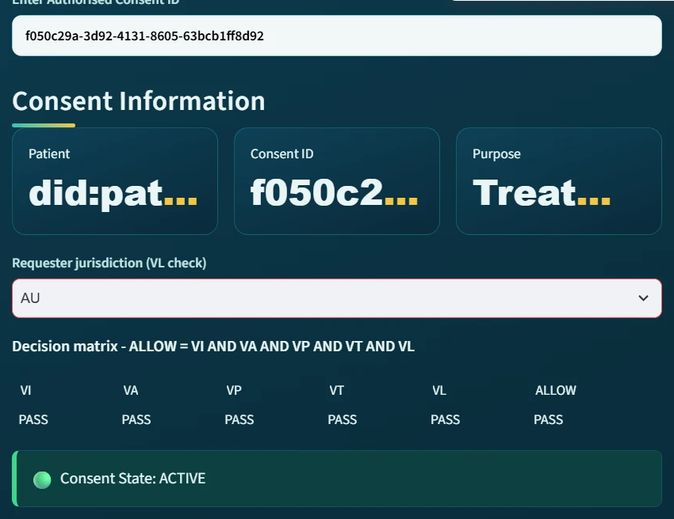
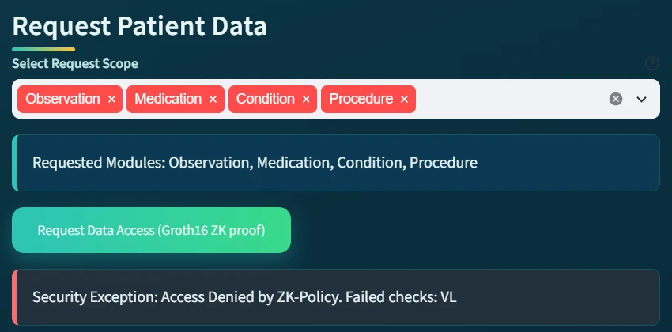
IMPLEMENTATION AND LIVE SCENARIOS
Interfaces
Patient, guardian, doctor and auditor
Smart contract
ConsentSBTv3, soulbound ERC-721 (ERC-5484) on Sepolia
Guardian approval
EIP-712 typed signatures
Access proof
Groth16 proof over a Poseidon commitment
Data
Synthetic Synthea records, four modules
Evidence
Audit ledger; no medical content on-chain
Evaluated consent, jurisdiction AU: all five checks pass, ALLOW
Same request, jurisdiction SA: VL fails, access denied
Notes:
This is the HALAH prototype. The boxes at the top list its parts. There are four interfaces: patient, guardian, doctor and auditor. The smart contract, ConsentSBTv3, is a soulbound token on Sepolia. Soulbound means it cannot be moved to another account. Guardians approve with EIP-712 signatures. The access proof is a Groth16 proof over a Poseidon commitment, which is a kind of hash. The data are synthetic Synthea records in four modules, so no real patient is used. The audit ledger keeps the evidence, and no medical content goes on-chain.
On the left, the doctor declares the jurisdiction as AU, which matches the consent. All five checks pass, so the answer is ALLOW.
On the right, the same request is made with SA instead. Every check passes except VL. My rule needs all five checks, so one failure is enough. Access is denied, and the screen names VL as the failed check.

Slide 14
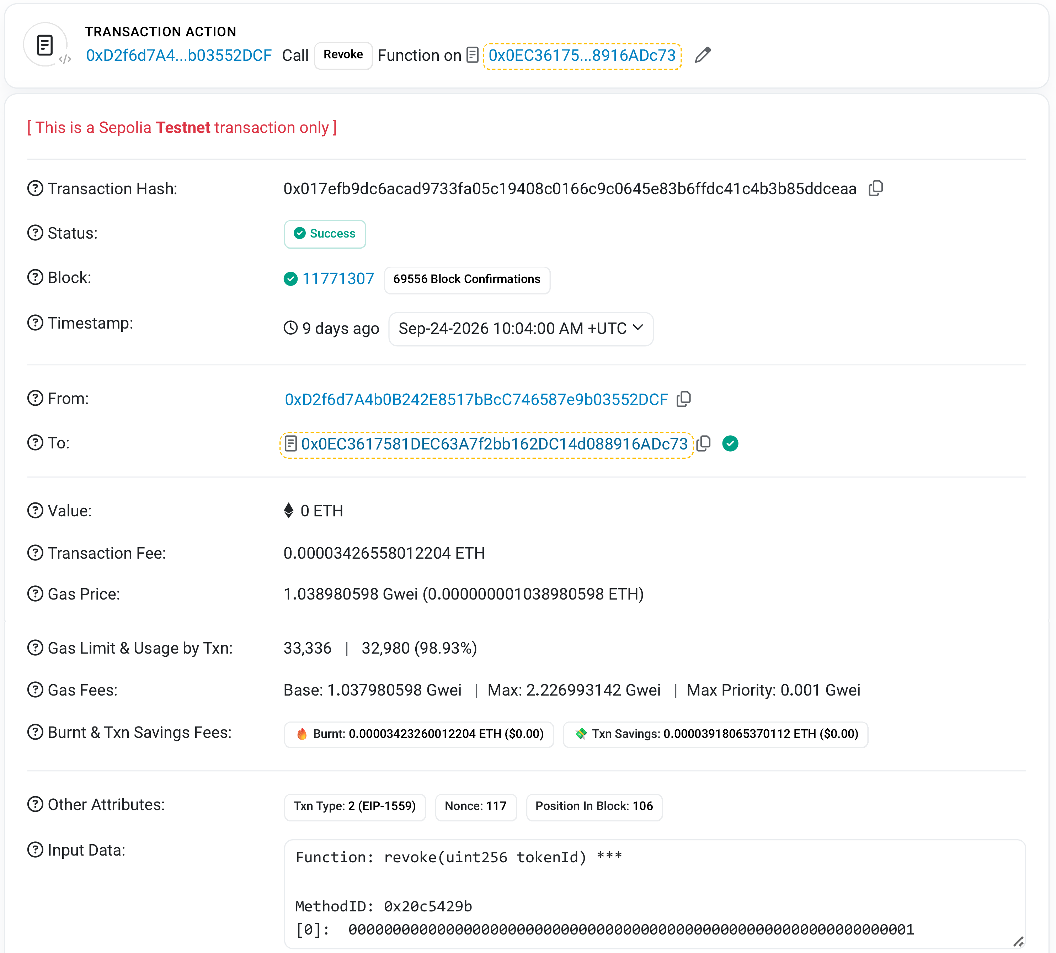
IMPLEMENTATION: ON-CHAIN EVIDENCE
Revocation of token #1 on Sepolia Etherscan, block 11,771,307
Notes:
This slide shows the public evidence on the Sepolia test network.
On the left is the Sepolia Etherscan page for the revoke of token number 1. It was confirmed in block 11,771,307 on 24 September 2026, and the status says Success. The input data shows the revoke function with the token ID. Anyone can check this record, so the evidence is not only in my own database.
On the right is the gas used by the five anchored transactions. Gas is the unit of computing work on Ethereum. The first two bars are token 8 from the earlier deployment. The other three are on the current contract.
A mint creates a token and writes a full consent record, so it costs more. A revoke changes only one flag. For token 1, the revoke used about one sixth of the gas of its mint.

Slide 15
VALIDATION
Validation | Definition | Criterion | Result
Valid scenarios | Legitimate requests must obtain authorised access | Pass(s) ⟺ Dobs(s) = Dexp(s) | Scenarios 1 to 3: consent created, 2-of-2 approval, ALLOW (RQ1 to RQ4)
Negative scenarios | Invalid requests must be refused | Any failed check ⇒ DENY | Scenario 4: jurisdiction SA, VL fails, refused. Scenario 5: revoked consent refused at VA
Adversarial scenarios | Deliberate attempts to bypass a condition, A1 to A12 | Refused / 12 | 11 of 12 refused after the hardening (A11: the changed digest is not yet compared)
Automated tests | 23 functional and regression tests and 13 adversarial tests | All tests pass | 36 of 36 pass
Independent verification | On-chain receipts compared with the local consent state | Local state = on-chain state | Scenario 6: RESULT: ALL CHECKS PASSED
Notes:
Validation asks one simple question. Does the system make the right decision?
In the valid scenarios, a test passes only when the observed decision equals the expected one. In scenarios 1 to 3, the consent was created, both guardians approved, and the doctor got ALLOW. These cover RQ1 to RQ4.
In the negative scenarios, any failed check gives DENY. In scenario 4 the doctor declared the jurisdiction SA, so the jurisdiction check, VL, failed. In scenario 5 the consent was revoked, so the request failed at VA.
Next are twelve attack scenarios, A1 to A12. After the hardening, eleven are refused. In A11, a rewritten audit event changes its digest, but nothing compares the digest yet.
All 36 automated tests pass. Last, a separate tool compared the Sepolia receipts with the local consent state, and all checks passed.

Slide 16
EVALUATION
Metric | Definition | Formula | Measured result
Gas used | Gas consumed by each anchored transaction, from its receipt | gasUsed | Mint #1: 196,406; Revoke #1: 32,980
Transaction fee | Fee paid for each anchored transaction | Fee = gasUsed × gasPrice | No fee above 0.00021 ETH (Sepolia ETH has no monetary value)
Submit-to-confirmation latency | Time between the local event and the on-chain event | L = t(on-chain) − t(local) | Median 11.5 s (4.9 to 22.1 s, n = 5), in the background
Processing time | Time of each decision component over repeated runs | Median, minimum and maximum over n runs | Decision rule 2.37 µs; one EIP-712 signature 10.93 ms; Groth16 proof 1,401.1 ms to generate, 465.3 ms to verify
On-chain read | Time of a checkValid or checkValidAt call on Sepolia | Median over n = 20 | 573.5 ms and 574.6 ms
Measured on 1 October 2026; indicative only
Notes:
Evaluation asks a different question. How much does the system cost, and how fast is it?
Gas used comes from each transaction receipt. The mint of token 1 used 196,406 gas, and its revoke used 32,980.
The fee is gas used times the gas price. No fee was above 0.00021 ETH. Sepolia ETH has no money value, so gas is the fair way to compare cost.
Latency is the time from the local event to the on-chain event. The median was 11.5 seconds over five transactions. It runs in the background, so the guardians and the doctor do not wait for it.
The decision rule takes about 2 microseconds. One guardian signature takes about 11 milliseconds. The Groth16 proof is the slow part. It takes about 1.4 seconds to make and under half a second to verify.
Reading the contract on Sepolia takes a little over half a second. I measured all this on 1 October 2026, so the results are indicative only.

Slide 17
TRADITIONAL EHR VS HALAH, DATA AND PRIVACY
Differences from traditional EHR access control
Data management and privacy
Aspect | Traditional EHR | HALAH framework
Identity | Central identity providers | A DID for every participant; identity separate from authority
Consent | A passive record of permission | Object C = (I, A, P, T, L, E), checked at every request
Approval | Static permission set by one party | All N guardians sign (EIP-712); no one approves alone
Access check | Log in, then a static permission | VI ∧ VA ∧ VP ∧ VT ∧ VL, plus a Groth16 proof
Time and revocation | Hard to verify once stored | Checked at each request; on-chain revoke
Audit | Shows that consent occurred | Each decision logged with its decision matrix
Aspect | Key point
Data source | Synthetic Synthea records; no real patient data
Storage | Medical records stay off-chain
On-chain record | Pseudonymous addresses, purpose hash, validity window, jurisdiction code, revocation flag
Access | Released only on ALLOW and only within the authorised scope
Known limitation | Plaintext purpose visible in the public mint input
Notes:
The left table compares traditional EHR access control with my HALAH framework. EHR means electronic health record.
In HALAH, every participant has a DID, a decentralised identifier, and identity is kept separate from authority. Consent is not a passive record. It is an object C with six parts, checked at every request. All N guardians must sign with EIP-712, so no one approves alone. In the access check, the wedge symbol means AND. All five checks must be true, plus a Groth16 proof. Time and revocation are checked at each request, and each decision is logged with its decision matrix.
The right table is about data and privacy. I use synthetic Synthea records, not real patient data. Medical records stay off-chain. The token holds only pseudonymous addresses, a purpose hash, the validity window, a jurisdiction code and a revocation flag. Data is released only on ALLOW, within the authorised scope. One limitation is that the plain purpose text is visible in the public mint input.

Slide 18
SIGNIFICANCE OF THE RESEARCH
Scientific significance
Social contributions
Consent becomes an evaluable object, C = (I, A, P, T, L, E), not a stored record.
Multi-party approval is a standing condition of every access decision, and the patient defines who must approve.
Identity is separated from authority, and all conditions are checked in one decision.
A PRISMA 2020 review of 25 primary studies shows the conjunction gap and the assurance gap.
A working prototype on Sepolia, evaluated with measurements and twelve attack scenarios.
Patients and guardians get a direct role in deciding who sees the patient's data.
No single person can authorise access to sensitive health data alone.
Every access decision is explainable and auditable.
Medical records stay off-chain; only consent evidence is anchored.
Supports trust when data is shared between hospitals and other independent parties.
Notes:
This slide shows why the research matters.
On the scientific side, consent becomes an object the system checks, not just a stored record. Multi-party approval is a condition of every access decision, and the patient decides who must approve. Identity is kept separate from authority, and all conditions are checked in one decision. My PRISMA 2020 review of 25 primary studies found two gaps. The conjunction gap means no study combines all these conditions in one decision. The assurance gap means they are not proved or tested together. Last, the prototype works on Sepolia, and I tested it with measurements and twelve attack scenarios.
On the social side, patients and guardians get a direct role in who sees the patient's data. No single person can approve access alone. Every decision can be explained and checked later. Medical records stay off-chain, and only consent evidence is anchored. This helps build trust when hospitals and other independent parties share data.

Slide 19
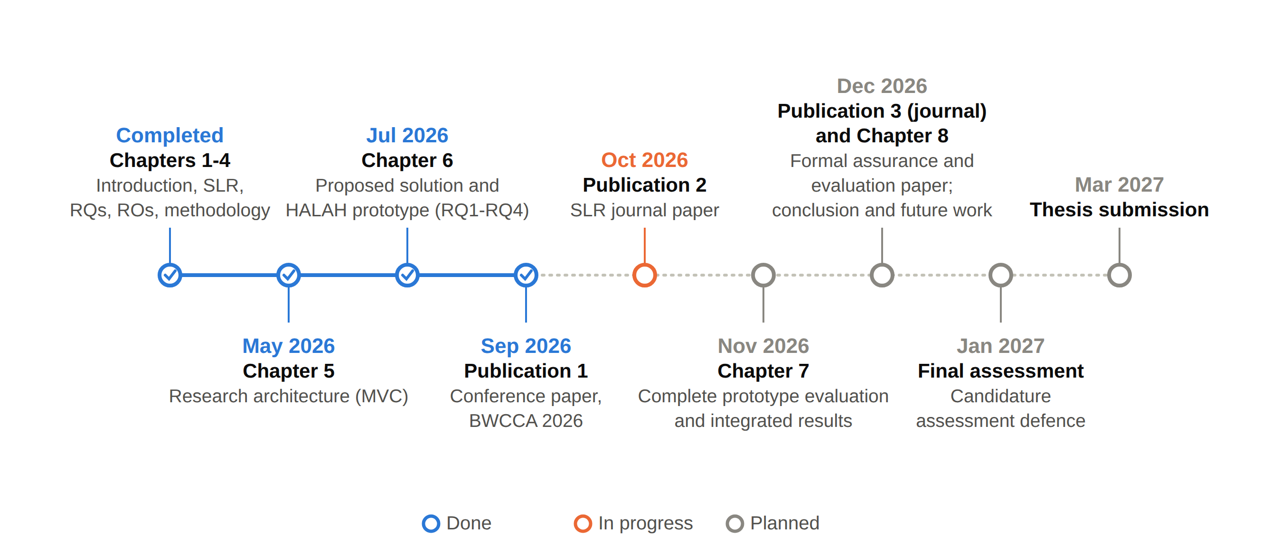
RESEARCH PLAN
Notes:
This is my research plan as a timeline. Blue means done, orange means in progress, and grey means planned.
Chapters 1 to 4 are completed. They cover the introduction, the review, the research questions and objectives, and the methodology. Chapter 5, the research architecture based on MVC, Model View Controller, was done in May 2026. Chapter 6, the proposed solution for RQ1 to RQ4 and the HALAH prototype, was done in July. In September I submitted my first paper to the BWCCA 2026 conference.
The orange point is October 2026. This is the SLR journal paper, and I am working on it now.
Chapter 7, the complete evaluation, is planned for November. The third paper and Chapter 8 come in December. The final assessment is in January 2027, and I plan to submit the thesis in March 2027.
So RO1 to RO4 are done. RO5 is in progress, and RO6 is partially completed.

Slide 20
REFERENCES (1/6)
[1] A. Ghafoor, I. Symeonidis, A. Rydberg, C. Lindahl, and A. Q. Abbasi. Towards empowering stakeholders through decentralized trust and secure livestock data sharing. Cryptography, 9(3):52, 2025. doi:10.3390/cryptography9030052
[2] R. K. Lomotey, S. Kumi, and R. Deters. Data trusts as a service: Providing a platform for multi-party data sharing. International Journal of Information Management Data Insights, 2(1):100075, 2022. doi:10.1016/j.jjimei.2022.100075
[3] T. L. Nguyen, L. Nguyen, T. Hoang, D. Bandara, Q. Wang, Q. Lu, et al. Blockchain-empowered trustworthy data sharing: Fundamentals, applications, and challenges. ACM Computing Surveys, 57(8):195, 2025. doi:10.1145/3718082
[4] E. C. Webber, D. Brick, J. P. Scibilia, P. Dehnel, Council on Clinical Information Technology, et al. Electronic communication of the health record and information with pediatric patients and their guardians. Pediatrics, 144(1):e20191359, 2019. doi:10.1542/peds.2019-1359
[5] C. Welzel, M. Ostermann, H. L. Smith, T. Minssen, T. Kirsten, and S. Gilbert. Enabling secure and self determined health data sharing and consent management. npj Digital Medicine, 8(1):560, 2025. doi:10.1038/s41746-025-01945-z
[6] M. R. Narkhede, N. I. Wankhede, and A. M. Kamble. Enhancing patient autonomy in data ownership: Privacy models and consent frameworks for healthcare. Journal of Digital Health, 4(1):1–23, 2025. doi:10.55976/jdh.4202513361-23
[7] R. McClelland and C. M. Harper. Information privacy in healthcare — the vital role of informed consent. European Journal of Health Law, 30(4):469–480, 2023. doi:10.1163/15718093-bja10097
[8] K. Kaplow, M. Downey, D. Stewart, A. B. Massie, J. D. Motter, L. Taylor, et al. Data professionals’ attitudes on data privacy, sharing, and consent in healthcare and research. Digital Health, 10:20552076241290964, 2024. doi:10.1177/20552076241290964
[9] A. Nazir, M. H. Rehmani, B. Butler, and D. O’Shea. Access control in healthcare IoT: A comprehensive survey. Engineering Reports, 8(4):e70766, 2026. doi:10.1002/eng2.70766
[10] A. M. Tawfik, A. Al-Ahwal, A. S. Tag Eldien, and H. H. Zayed. Blockchain-based access control and privacy preservation in healthcare: A comprehensive survey. Cluster Computing, 28:529, 2025. doi:10.1007/s10586-025-05308-x
[11] A. M. Ibrahim, H. R. Abdel-Aziz, H. A. H. Mohamed, D. E. F. Zaghamir, N. M. I. Wahba, G. A. Hassan, et al. Balancing confidentiality and care coordination: Challenges in patient privacy. BMC Nursing, 23(1):564, 2024. doi:10.1186/s12912-024-02231-1
[12] L. Theodorakopoulos, A. Theodoropoulou, and C. Halkiopoulos. Enhancing decentralized decision-making with big data and blockchain technology: A comprehensive review. Applied Sciences, 14(16):7007, 2024. doi:10.3390/app14167007
Notes:
These are my references, numbered 1 to 72 to match the citations in my report. I will not read them, and the full details are in the report.

Slide 21
REFERENCES (2/6)
[13] A. Al Mamun, S. Azam, and C. Gritti. Blockchain-based electronic health records management: A comprehensive review and future research direction. IEEE Access, 10:5768–5789, 2022. doi:10.1109/ACCESS.2022.3141079
[14] R. Hellstern, D. C. Park, V. Lemieux, and G. Salimjan. Leveraging blockchain-based archival solutions for sensitive documentation: A Xinjiang case study. Digital Society, 1(1):4, 2022. doi:10.1007/s44206-022-00007-1
[15] L. Li, C. Z. Liu, and S. Shrestha. Analytical entropy approach for measuring blockchain immutability and tamper-resilient trust. Entropy, 28(6):690, 2026. doi:10.3390/e28060690
[16] C. Mazzocca, A. Acar, A. S. Uluagac, R. Montanari, P. Bellavista, and M. Conti. A survey on decentralized identifiers and verifiable credentials. IEEE Communications Surveys & Tutorials, 27(6):3641–3671, 2025. doi:10.1109/COMST.2025.3543197
[17] A. Flamini, G. Sciarretta, M. Scuro, A. Sharif, A. Tomasi, and S. Ranise. On cryptographic mechanisms for the selective disclosure of verifiable credentials. Journal of Information Security and Applications, 83:103789, 2024. doi:10.1016/j.jisa.2024.103789
[18] J. Andrew, D. P. Isravel, K. M. Sagayam, B. Bhushan, Y. Sei, and J. Eunice. Blockchain for healthcare systems: Architecture, security challenges, trends and future directions. Journal of Network and Computer Applications, 215:103633, 2023. doi:10.1016/j.jnca.2023.103633
[19] M. I. Khalid, M. Ahmed, M. Helfert, and J. Kim. Privacy-first paradigm for dynamic consent management systems: Empowering data subjects through decentralized data controllers and privacy-preserving techniques. Electronics, 12(24):4973, 2023. doi:10.3390/electronics12244973
[20] V. Jesus and H. J. Pandit. Consent receipts for a usable and auditable web of personal data. IEEE Access, 10:28545–28563, 2022. doi:10.1109/ACCESS.2022.3157850
[21] S. Phuyal, M. Bhandari, R. Bista, and J. C. Ferreira. Enabling cross-institution health data sharing in Norway: EUDI wallets, on-chain consent, and openEHR↔FHIR translation. IEEE Access, 14:20309–20327, 2026. doi:10.1109/ACCESS.2026.3661642
[22] Z. Wu and D. Zhang. HealthDID: An efficient and authorizable multi-party privacy-preserving EMR sharing system based on DID. Computer Standards & Interfaces, 93:103967, 2025. doi:10.1016/j.csi.2024.103967
[23] M. M. Madine, K. Salah, R. Jayaraman, I. Yaqoob, Y. Al-Hammadi, S. Ellahham, et al. Fully decentralized multi-party consent management for secure sharing of patient health records. IEEE Access, 8:225777–225791, 2020. doi:10.1109/ACCESS.2020.3045048
[24] D. Tith, J.-S. Lee, H. Suzuki, W. M. A. B. Wijesundara, N. Taira, T. Obi, et al. Patient consent management by a purpose-based consent model for electronic health record based on blockchain technology. Healthcare Informatics Research, 26(4):265–273, 2020. doi:10.4258/hir.2020.26.4.265

Slide 22
REFERENCES (3/6)
[25] A. Punia, P. Gulia, N. S. Gill, D. Kaushik, N. Alduaiji, P. K. Shukla, et al. An access control system for cloud-based healthcare systems driven by blockchain. Journal of Cloud Computing, 14(1):78, 2025. doi:10.1186/s13677-025-00831-z
[26] K.-L. Tan, C.-H. Chi, and K.-Y. Lam. Secure and privacy-preserving sharing of personal health records with multi-party pre-authorization verification. Wireless Networks, 30(4):4773–4795, 2024. doi:10.1007/s11276-022-03114-6
[27] K. Ekholm, A. Augustinsson, J. Sundström, C. Johansen, M. Storgärds, L. Ljöstad, et al. Implementing electronic informed consent in rare disease genomics. Scientific Reports, 15(1):44419, 2025. doi:10.1038/s41598-025-32740-1
[28] A. U. Eneh, L. A. C. Ahakonye, J. M. Lee, and D.-S. Kim. Demo: EdgeConsent: On-chain attribute-based access control for data consent management. In 2026 IEEE International Conference on Blockchain and Cryptocurrency (ICBC), 2026. doi:10.1109/ICBC67748.2026.11575534
[29] D. P. Panagoulias, A. I. Damian, C. Stamate, V. Toderian, P. Butusina, A. De Franceschi, et al. Blockchain-enabled trust and compliance for clinical AI: Decentralized governance without decentralized data storage. Electronics, 15(14):3046, 2026. doi:10.3390/electronics15143046
[30] I. Román-Martínez, J. Calvillo-Arbizu, V. J. Mayor-Gallego, G. Madinabeitia-Luque, A. J. Estepa-Alonso, and R. M. Estepa-Alonso. Blockchain-based service-oriented architecture for consent management, access control, and auditing. IEEE Access, 11:12727–12741, 2023. doi:10.1109/ACCESS.2023.3242605
[31] B. Khayer, S. Mirzaei, H. Alavizadeh, and A. Salehi Shahraki. Blockchain for secure IoT: A review of identity management, access control, and trust mechanisms. IoT, 6(4):65, 2025. doi:10.3390/iot6040065
[32] J. C. Ferreira, R. Correia, L. Rosário, and A. Vila. Blockchain integration for trust and consent management in MCP-enabled FHIR systems. In 2025 IEEE International Conference on Distributed Ledger Technologies (ICDLT), pages 1–10, 2025. doi:10.1109/ICDLT66400.2025.11466653
[33] J. Ménétrey, C. Göttel, A. Khurshid, M. Pasin, P. Felber, V. Schiavoni, et al. Attestation mechanisms for trusted execution environments demystified. In IFIP International Conference on Distributed Applications and Interoperable Systems (DAIS 2022), LNCS, vol. 13272, pages 95–113. Springer, 2022. doi:10.1007/978-3-031-16092-9_7
[34] L. Li, C. Z. Liu, K. Huang, R. Deng, M. A. Alrowaily, M. Alghamdi, et al. Trust-aware environmental state consensus for smart agriculture with TEE-enabled sensing and Byzantine-resilient blockchain coordination. Sensors, 26(14):4577, 2026. doi:10.3390/s26144577
[35] J. Walonoski, M. Kramer, J. Nichols, A. Quina, C. Moesel, D. Hall, et al. Synthea: An approach, method, and software mechanism for generating synthetic patients and the synthetic electronic health care record. Journal of the American Medical Informatics Association, 25(3):230–238, 2018. doi:10.1093/jamia/ocx079
[36] A. Kharlamov, R. Hohmann, and G. Parry. Data sharing decisions: Perceptions and intentions in healthcare. Strategic Change, 32(6):223–237, 2023. doi:10.1002/jsc.2558

Slide 23
REFERENCES (4/6)
[37] P. K. Ghosh, A. Chakraborty, M. Hasan, K. Rashid, and A. H. Siddique. Blockchain application in healthcare systems: A review. Systems, 11(1):38, 2023. doi:10.3390/systems11010038
[38] M. S. Arbabi, C. Lal, N. R. Veeraragavan, D. Marijan, J. F. Nygård, and R. Vitenberg. A survey on blockchain for healthcare: Challenges, benefits, and future directions. IEEE Communications Surveys & Tutorials, 25(1):386–424, 2023. doi:10.1109/COMST.2022.3224644
[39] M. N. Turan, I. A. Hashimzai, and M. Q. Qiam. A blockchain-based framework for secure and transparent environmental data sharing in smart cities: Enhancing trust, integrity, and interoperability in urban sustainability systems. Nata Palemahan: Journal of Environmental Engineering Innovations, 2(2):70–79, 2025. doi:10.38043/natapalemahan.v2i2.6996
[40] J. Yin, Y. Xiao, Q. Chen, Y. Z. Lim, X. Liu, Q. Pei, et al. DP-DID: A dynamic and proactive decentralized identity system. IEEE Transactions on Information Forensics and Security, 20:4999–5014, 2025. doi:10.1109/TIFS.2025.3561662
[41] H. Deng, J. Liang, C. Zhang, X. Liu, L. Zhu, and S. Guo. FutureDID: A fully decentralized identity system with multi-party verification. IEEE Transactions on Computers, 73(8):2051–2065, 2024. doi:10.1109/TC.2024.3398509
[42] C. D. Nassar Kyriakidou, A. M. Papathanasiou, and G. C. Polyzos. Decentralized identity with applications to security and privacy for the internet of things. Computer Networks and Communications, 1(2):244–271, 2023. doi:10.37256/cnc.1220233048
[43] R. P. Parameswarath, P. Gope, and B. Sikdar. User-empowered privacy-preserving authentication protocol for electric vehicle charging based on decentralized identity and verifiable credential. ACM Transactions on Management Information Systems, 13(4):44, 2022. doi:10.1145/3532869
[44] H. Yin, Y. Zhao, L. Zhang, B. Qiao, W. Chen, and H. Wang. Attribute-based searchable encryption with decentralized key management for healthcare data sharing. Journal of Systems Architecture, 148:103081, 2024. doi:10.1016/j.sysarc.2024.103081
[45] R. Jiang, X. Chen, Y. Yu, Y. Zhang, and W. Ding. Risk and UCON-based access control model for healthcare big data. Journal of Big Data, 10(1):104, 2023. doi:10.1186/s40537-023-00783-8
[46] M. J. Page, J. E. McKenzie, P. M. Bossuyt, I. Boutron, T. C. Hoffmann, C. D. Mulrow, et al. The PRISMA 2020 statement: An updated guideline for reporting systematic reviews. BMJ, 372:n71, 2021. doi:10.1136/bmj.n71
[47] V. Jaiman and V. Urovi. A consent model for blockchain-based health data sharing platforms. IEEE Access, 8:143734–143745, 2020. doi:10.1109/ACCESS.2020.3014565
[48] F. Albalwy, A. Brass, and A. Davies. A blockchain-based dynamic consent architecture to support clinical genomic data sharing (ConsentChain): Proof-of-concept study. JMIR Medical Informatics, 9(11):e27816, 2021. doi:10.2196/27816

Slide 24
REFERENCES (5/6)
[49] H. Li, D. Li, G. Lv, N. Crespi, R. Minerva, W. Shao, et al. Privacy-preserving fine-grained EMR access control for IoMT: A hybrid RBAC-smart contract scheme with attribute-based authorization. IEEE Internet of Things Journal, 13(2):2970–2987, 2026. doi:10.1109/JIOT.2025.3633504
[50] A. Abbasi, M. N. Humeidi, and Q. Wang. Nexa: Enabling secure, scalable, and decentralized management of electronic health records using threshold cryptography and public blockchains. IEEE Access, 14:50791–50810, 2026. doi:10.1109/ACCESS.2026.3677499
[51] M. Al Amin, A. Altarawneh, and I. Ray. Informed consent as patient driven policy for clinical diagnosis and treatment: A smart contract based approach. In Proceedings of the 20th International Conference on Security and Cryptography (SECRYPT 2023), pages 159–170. SciTePress, 2023. doi:10.5220/0012090600003555
[52] J. Hagström, M. Hägglund, M. Holmroos, P. Lähteenmäki, and I. Hörhammer. Minors’ and guardian access to and use of a national patient portal: A retrospective comparative case study of Sweden and Finland. International Journal of Medical Informatics, 187:105465, 2024. doi:10.1016/j.ijmedinf.2024.105465
[53] J. Zhao and Q. Su. A threshold traceable delegation authorization scheme for data sharing in healthcare. Computers & Security, 139:103686, 2024. doi:10.1016/j.cose.2023.103686
[54] V. Maruthi and K. Singh. Enhancing security and privacy of IoMT data for unconscious patient with blockchain. IEEE Transactions on Network and Service Management, 22(6):5223–5238, 2025. doi:10.1109/TNSM.2025.3602117
[55] L. Mei, K. Huang, X. Li, H. Wang, and X. Zhang. Efficient dual-revocation CP-ABE for secure and fine-grained data sharing in IoMT. IEEE Internet of Things Journal, 13(14):30933–30940, 2026. doi:10.1109/JIOT.2026.3685269
[56] S. Phuyal, M. Bhandari, R. Bista, and J. C. Ferreira. A blockchain-based architecture for dynamic and auditable patient consent in secondary use of health data. Blockchain in Healthcare Today, 9(1), 2026. doi:10.30953/bhty.v9.491
[57] S. Hema, G. B. S. Reddy, and R. Shalini. Patient centric cryptographic protection of cloud electronic health records. In 2026 6th International Conference on Expert Clouds and Applications (ICOECA), pages 293–300, 2026. doi:10.1109/ICOECA68095.2026.11485301
[58] S. L. SooHoo, M. S. Keller, Y. Chen, D. Hu, S.-C. Huang, T.-T. Kuo, et al. Development of the authentication and authorization processes for the iAgree portal, a platform for patient-controlled data sharing across health systems. JAMIA Open, 9(3):ooag111, 2026. doi:10.1093/jamiaopen/ooag111
[59] G. Tremper, T. Brenner, M. Ben Amor, T. Kussel, and M. Lablans. Mainzelliste: Ten years of pseudonymization, record linkage, and informed consent management. Patterns, 7(1):101432, 2026. doi:10.1016/j.patter.2025.101432
[60] C.-H. Tseng, Y.-H. Hsieh, H.-Y. Lin, and S.-M. Yuan. EMR-Chain: Decentralized electronic medical record exchange system. Technologies, 13(10):446, 2025. doi:10.3390/technologies13100446

Slide 25
REFERENCES (6/6)
[61] Y. Wu, C. Liu, L. Sebald, P. Nguyen, and Y. Yesha. Apply trust computing and privacy preserving smart contracts to manage, share, and analyze multi-site clinical trial data. In Proceedings of the International Conference on Deep Learning, Big Data and Blockchain (DBB 2022), LNNS, vol. 541, pages 3–14. Springer, 2022. doi:10.1007/978-3-031-16035-6_1
[62] S. Akter and T. F. Sanam. A blockchain framework for secure healthcare data management using role-based access control and smart contracts. In 2025 International Conference on Electrical, Computer and Communication Engineering (ECCE), pages 1–6, 2025. doi:10.1109/ECCE64574.2025.11013162
[63] M. S. Prashanth, R. Karnati, M. S. Velpuru, and H. Venkateshwara Reddy. Enhancing health record security and privacy with blockchain-based access management. In Pervasive Knowledge and Collective Intelligence on Web and Social Media (PerSOM 2023), LNICST, vol. 517, pages 182–202. Springer, 2024. doi:10.1007/978-3-031-66044-3_13
[64] L. Zhang, H. Kan, and H. Huang. Patient-centered cross-enterprise document sharing and dynamic consent framework using consortium blockchain and ciphertext-policy attribute-based encryption. In Proceedings of the 19th ACM International Conference on Computing Frontiers (CF ’22), pages 58–66, 2022. doi:10.1145/3528416.3530228
[65] A. Teeda and Y. V. Subba Rao. A patient-centric blockchain based electronic health records for data privacy and confidentiality. In International Conference on Smart Computing and Informatics, LNNS, vol. 1684, pages 179–192. Springer, 2026. doi:10.1007/978-3-032-08246-6_15
[66] R. Bloemen, L. Logvinov, and J. Evans. EIP-712: Typed structured data hashing and signing. Ethereum Improvement Proposals, no. 712, 2017.
[67] M. Shanmugham and C. Senthilkumar. Blockchain enabled self-sovereign identity and consent framework for secure healthcare data access. In 2026 3rd International Conference on Emerging Trends in Engineering and Medical Sciences (ICETEMS), pages 1–6, 2026. doi:10.1109/ICETEMS66917.2026.11469586
[68] N. M. Sawant and J. Gomes. A decentralized solution for smarter and safer healthcare systems with FabricMedChain. Iranian Journal of Science and Technology, Transactions of Electrical Engineering, 50:2843–2869, 2026. doi:10.1007/s40998-025-00994-0
[69] J. Groth. On the size of pairing-based non-interactive arguments. In Advances in Cryptology – EUROCRYPT 2016, LNCS, vol. 9666, pages 305–326. Springer, 2016. doi:10.1007/978-3-662-49896-5_11
[70] L. Grassi, D. Khovratovich, C. Rechberger, A. Roy, and M. Schofnegger. Poseidon: A new hash function for zero-knowledge proof systems. In Proceedings of the 30th USENIX Security Symposium, pages 519–535, 2021.
[71] W. Entriken, D. Shirley, J. Evans, and N. Sachs. ERC-721: Non-fungible token standard. Ethereum Improvement Proposals, no. 721, 2018.
[72] B. Cai. ERC-5484: Consensual soulbound tokens. Ethereum Improvement Proposals, no. 5484, 2022.

Slide 26
Thank You
Questions and discussion
Notes:
Thank you for listening. I am happy to answer your questions.
Possible question: Why use blockchain at all? It gives a lasting, checkable record of the consent state, while the token stores only pseudonymous addresses, a purpose hash, the validity window, a jurisdiction code and a revocation flag.
Possible question: What is new in this work? Multi-party approval is a standing condition of every access decision, the patient defines who must approve, and after the hardening eleven of the twelve attack scenarios are refused.
Possible question: What is left for the next stage? RO5, on temporal and lifecycle trust, is in progress, and RO6, on formal security assurance and empirical validation, is partially completed.

Slide 27
Backup Slides
Details for questions
Notes:
These are backup slides. I will only show them if a question needs more detail.

Slide 28
BACKUP: QUALITY ASSESSMENT
Item | Question | Used for
QA1 | Does the study deal with patient consent or consent-governed data access at the healthcare level? | Inclusion
QA2 | Does it deal with an authorisation or access-decision mechanism, not storage or recording only? | Inclusion
QA3 | Does it introduce a proper framework, model, protocol or architecture to address its aim? | Inclusion
QA4 | Is the proposed methodology validated by a proof of concept or an implementation? | Inclusion
QA5 to QA8 | Further quality items scored for every included study | Evidence tier only
Rule | Yes = 1, Partial = 0.5, No = 0; included when QA1 + QA2 + QA3 + QA4 ≥ 3.0 | —
Notes:
This slide shows my quality assessment. QA1 to QA4 decide inclusion. They check for consent at the healthcare level, a real access-decision mechanism, a proper framework, and a proof of concept or an implementation.
Yes scores 1, Partial 0.5 and No 0. A study is included when QA1 to QA4 add up to at least 3.0. QA5 to QA8 only place a study in an evidence tier.

Slide 29
BACKUP: KEY REQUIREMENTS
Req 1
Consent as an evaluable authorisation object
Req 2
Decentralised verification of identity and authority
Req 3
Multi-party authorisation through a verifiable threshold
Req 4
Policy- and context-aware enforcement at access time
Req 5
Temporal validity and lifecycle control of consent
Req 6
Verifiable auditability and security assurance
Notes:
These are the six key requirements I took from the literature. Each one matches a research question.
Req 1 makes consent something the system can evaluate at access time. Req 2 checks identity and authority in a decentralised way. Req 3 needs a set number of approvals, called the threshold. Req 4 keeps access inside the allowed purpose and scope. Req 5 stops expired or revoked consent. Req 6 keeps evidence for every decision.

Slide 30
BACKUP: THE 25 PRIMARY STUDIES
Study | Author(s) | Year | Title | Category
S1 | Abbasi et al. [50] | 2026 | Nexa: Enabling Secure, Scalable, and Decentralized Management of Electronic Health Records Using Threshold Cryptography and Public Blockchains | Multi-party authorisation (Req 3)
S2 | Albalwy et al. [48] | 2021 | A Blockchain-based dynamic consent architecture to support clinical genomic data sharing (ConsentChain): Proof-of-concept study | Policy and context (Req 4)
S3 | Al Amin et al. [51] | 2023 | Informed Consent as Patient Driven Policy for Clinical Diagnosis and Treatment: A Smart Contract Based Approach | Consent representation (Req 1)
S4 | Ekholm et al. [27] | 2025 | Implementing electronic informed consent in rare disease genomics | Multi-party authorisation (Req 3)
S5 | Eneh et al. [28] | 2026 | Demo: EdgeConsent: On-Chain Attribute-Based Access Control for Data Consent Management | Temporal and lifecycle (Req 5)
S6 | Hagström et al. [52] | 2024 | Minors’ and guardian access to and use of a national patient portal: A retrospective comparative case study of Sweden and Finland | Multi-party authorisation (Req 3)
S7 | Jaiman and Urovi [47] | 2020 | A Consent Model for Blockchain-Based Health Data Sharing Platforms | Policy and context (Req 4)
S8 | Zhao and Su [53] | 2024 | A threshold traceable delegation authorization scheme for data sharing in healthcare | Security assurance (Req 6)
S9 | Li et al. [49] | 2026 | Privacy-Preserving Fine-Grained EMR Access Control for IoMT: A Hybrid RBAC-Smart Contract Scheme With Attribute-Based Authorization | Temporal and lifecycle (Req 5)
S10 | Madine et al. [23] | 2020 | Fully Decentralized Multi-Party Consent Management for Secure Sharing of Patient Health Records | Multi-party authorisation (Req 3)
S11 | Maruthi and Singh [54] | 2025 | Enhancing Security and Privacy of IoMT Data for Unconscious Patient With Blockchain | Security assurance (Req 6)
S12 | Mei et al. [55] | 2026 | Efficient Dual-Revocation CP-ABE for Secure and Fine-Grained Data Sharing in IoMT | Security assurance (Req 6)
S13 | Panagoulias et al. [29] | 2026 | Blockchain-Enabled Trust and Compliance for Clinical AI: Decentralized Governance Without Decentralized Data Storage | Temporal and lifecycle (Req 5)
Notes:
This table lists the first 13 of my 25 primary studies, S1 to S13. Each row gives the authors, year, title and category. The category is the requirement where the study fits most strongly. Each study sits in one category only.
For example, S10 by Madine and others, from 2020, is about decentralised multi-party consent. So it sits under Req 3.

Slide 31
BACKUP: THE 25 PRIMARY STUDIES (CONT.)
Study | Author(s) | Year | Title | Category
S14 | Phuyal et al. [21] | 2026 | Enabling Cross-Institution Health Data Sharing in Norway: EUDI Wallets, On-Chain Consent, and openEHR↔FHIR Translation | Identity and authority (Req 2)
S15 | Phuyal et al. [56] | 2026 | A Blockchain-Based Architecture for Dynamic and Auditable Patient Consent in Secondary Use of Health Data | Identity and authority (Req 2)
S16 | Punia et al. [25] | 2025 | An access control system for cloud-based healthcare systems driven by blockchain | Multi-party authorisation (Req 3)
S17 | Román-Martínez et al. [30] | 2023 | Blockchain-Based Service-Oriented Architecture for Consent Management, Access Control, and Auditing | Policy and context (Req 4)
S18 | Hema et al. [57] | 2026 | Patient Centric Cryptographic Protection of Cloud Electronic Health Records | Temporal and lifecycle (Req 5)
S19 | SooHoo et al. [58] | 2026 | Development of the authentication and authorization processes for the iAgree portal, a platform for patient-controlled data sharing across health systems | Consent representation (Req 1)
S20 | Tan et al. [26] | 2024 | Secure and privacy-preserving sharing of personal health records with multi-party pre-authorization verification | Multi-party authorisation (Req 3)
S21 | Tith et al. [24] | 2020 | Patient consent management by a purpose-based consent model for electronic health record based on blockchain technology | Policy and context (Req 4)
S22 | Tremper et al. [59] | 2026 | Mainzelliste: Ten years of pseudonymization, record linkage, and informed consent management | Consent representation (Req 1)
S23 | Tseng et al. [60] | 2025 | EMR-Chain: Decentralized Electronic Medical Record Exchange System | Identity and authority (Req 2)
S24 | Wu et al. [61] | 2022 | Apply Trust Computing and Privacy Preserving Smart Contracts to Manage, Share, and Analyze Multi-site Clinical Trial Data | Multi-party authorisation (Req 3)
S25 | Wu and Zhang [22] | 2025 | HealthDID: An efficient and authorizable multi-party privacy-preserving EMR sharing system based on DID | Security assurance (Req 6)
Notes:
This slide continues the list with S14 to S25. Together the two slides show all 25 studies.
Most of these are very recent. Eight of these twelve are from 2025 or 2026, so the topic is active right now. The categories are mixed. For example, S14, S15 and S23 are under identity and authority. S25, HealthDID, is under security assurance.

Slide 32
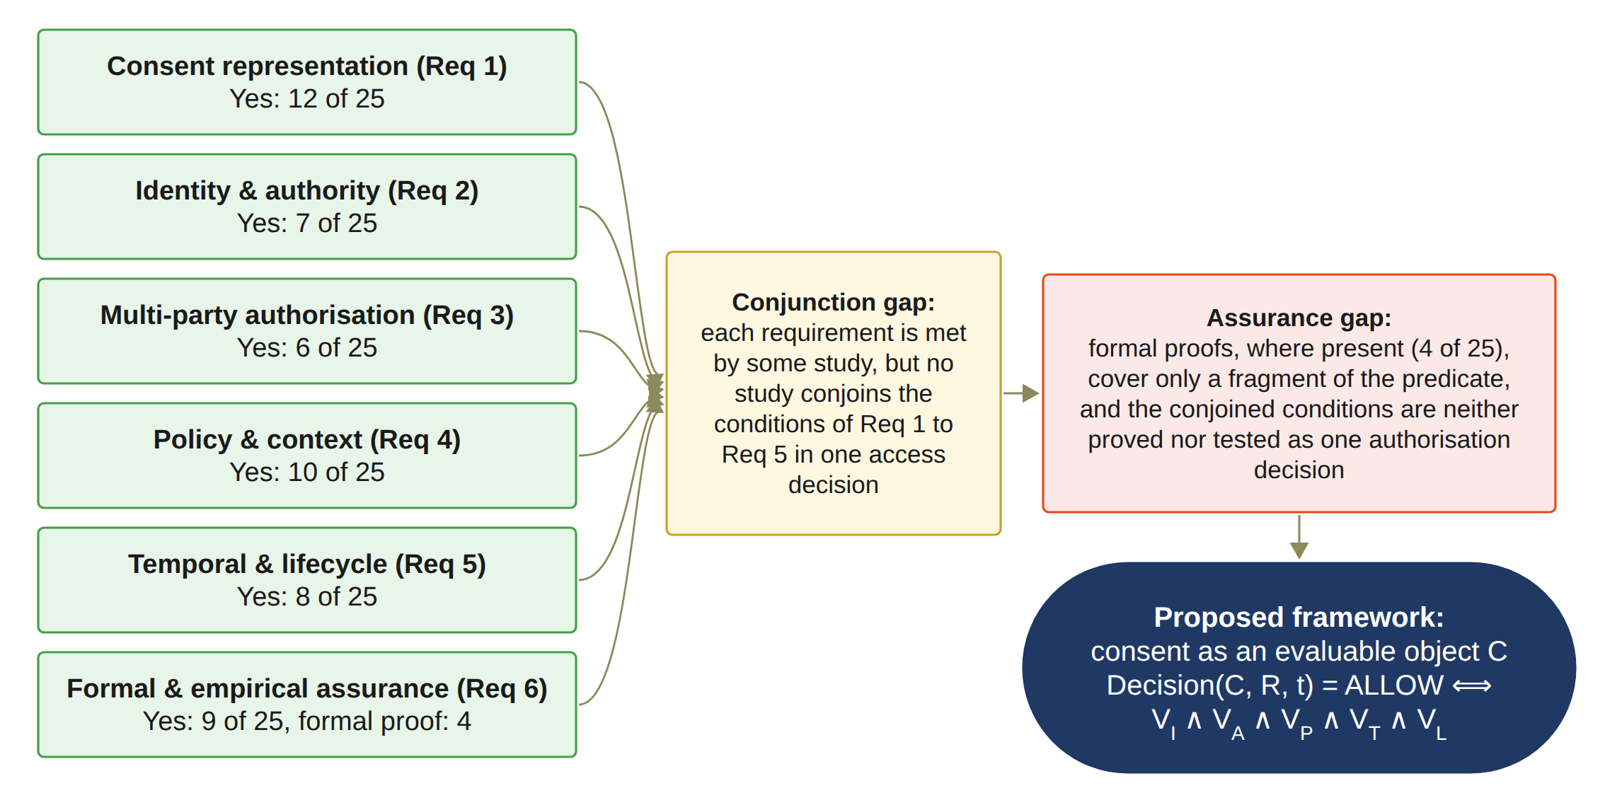
BACKUP: SYNTHESIS OF THE REVIEW
Notes:
This figure sums up the review. On the left, each requirement shows how many of the 25 studies get a full Yes. Assurance has 9, but only 4 have a formal proof.
The yellow box is the conjunction gap. No study joins Req 1 to Req 5 in one access decision. The red box is the assurance gap. The dark box is my proposed framework. It allows access only when all five checks pass. The symbol ∧ means AND.

Slide 33
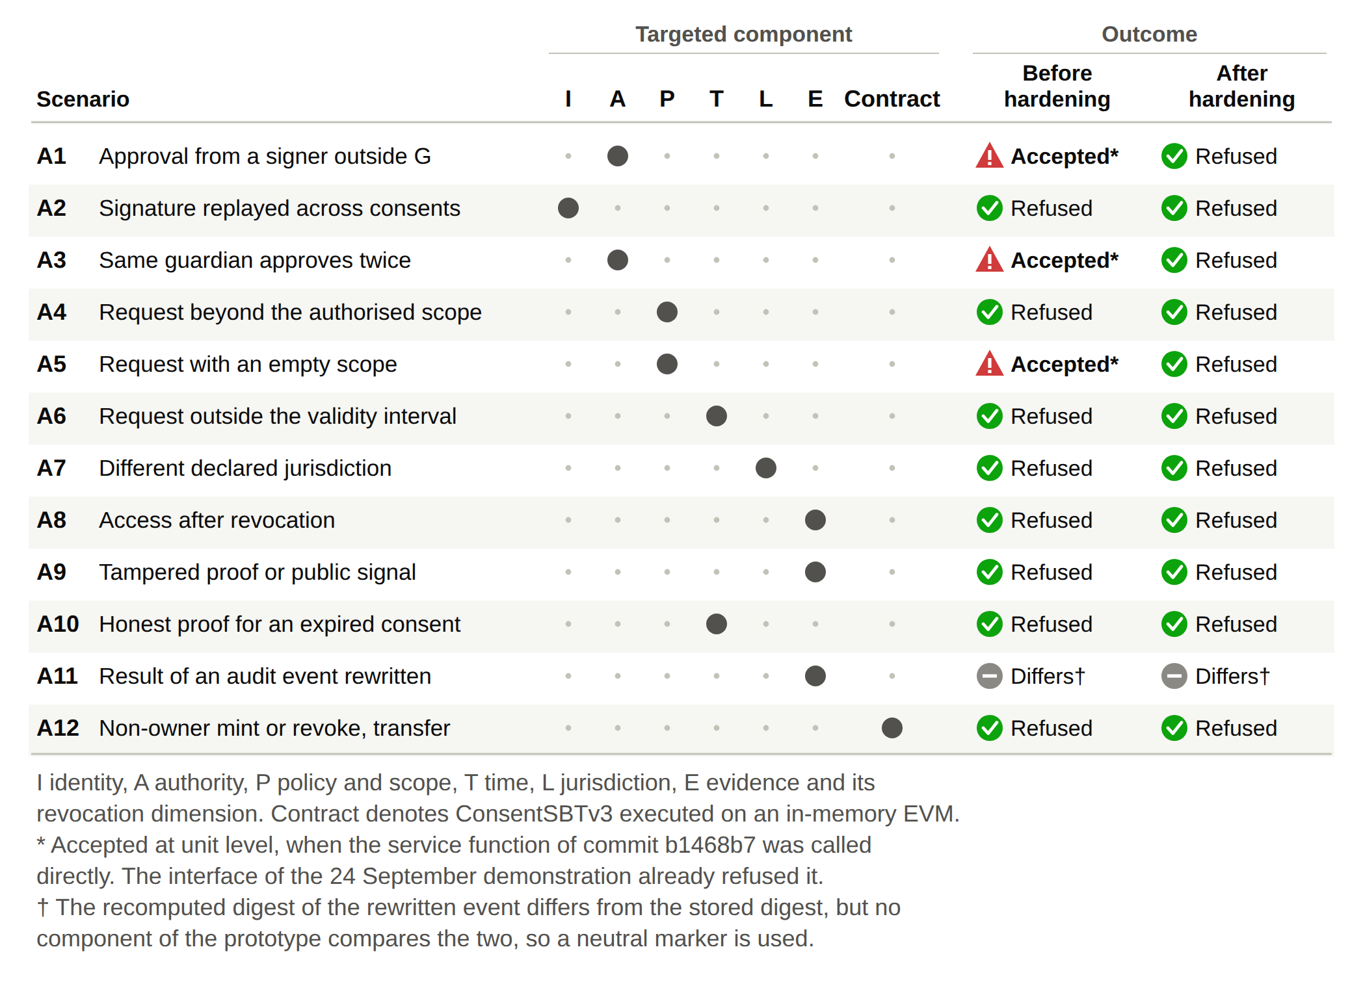
BACKUP: ADVERSARIAL TESTS
12
attack scenarios, A1 to A12
11 / 12
refused after the hardening
36
automated tests pass
Notes:
Here I tested the prototype against twelve attack scenarios, A1 to A12. The dots show which part each attack targets, such as identity, authority or time.
Before the hardening, A1, A3 and A5 were accepted when the service function was called directly. The demonstration interface already refused them. After the hardening, eleven of twelve are refused and all 36 automated tests pass. A11 is marked neutral, because nothing compares the audit digest yet.

Slide 34
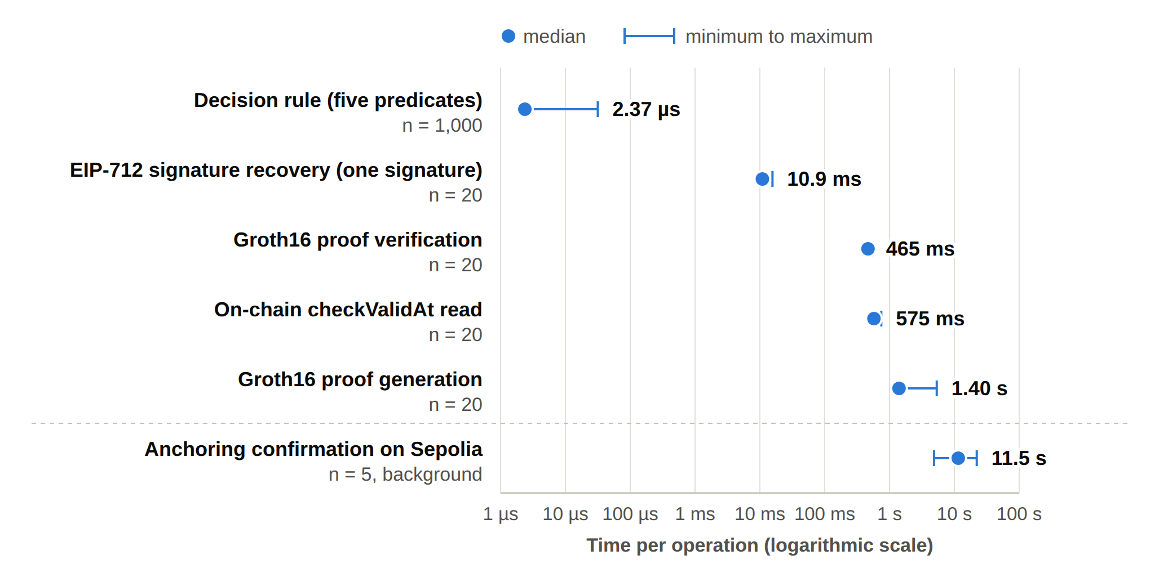
BACKUP: PROCESSING TIME
Component | Median | Minimum | Maximum | n
Decision rule, five predicates | 2.37 µs | 2.32 µs | 31.59 µs | 1,000
EIP-712 signature recovery, one signature | 10.93 ms | 10.55 ms | 15.64 ms | 20
Groth16 proof generation | 1,401.1 ms | 1,342.8 ms | 5,349.6 ms | 20
Groth16 proof verification | 465.3 ms | 441.0 ms | 525.1 ms | 20
On-chain checkValid read | 573.5 ms | 568.2 ms | 715.5 ms | 20
On-chain checkValidAt read | 574.6 ms | 568.2 ms | 745.6 ms | 20
Anchoring confirmation | 11.5 s | 4.9 s | 22.1 s | 5
Measured on 1 October 2026; indicative only
Notes:
This slide shows processing time, measured on 1 October 2026. The results are indicative only. The median is the middle value, and n is how many times I measured each step.
The decision rule takes about 2 microseconds. The Groth16 proof is the slow part. It takes about 1.4 seconds to generate. Anchoring on Sepolia takes about 11.5 seconds, but it runs in the background, so nobody waits for it.

Slide 35
BACKUP: RESEARCH PLAN TABLE
Task | Description | Target date | Status
Chapters 1–4 | Introduction, SLR, Research Questions and Objectives, Research Methodology | Completed | Done
Chapter 5 | Research Architecture (MVC) and framework design | May 2026 | Done
Chapter 6 | Proposed solution for RQ1 to RQ4 and the HALAH prototype | Jul 2026 | Done
Publication 1 | Conference paper submission, BWCCA 2026 | Sep 2026 | Done
Publication 2 | SLR paper journal submission | Oct 2026 | In Progress
Chapter 7 | Complete prototype evaluation and integrated results | Nov 2026 | Planned
Publication 3 | Journal paper on formal security assurance, lifecycle trust and the evaluation of HALAH | Dec 2026 | Planned
Chapter 8 | Conclusion and future work | Dec 2026 | Planned
Final assessment | Final candidature assessment defence | Jan 2027 | Planned
Thesis | Complete thesis submission | Mar 2027 | Planned
Notes:
This is my full research plan. Chapters 1 to 6 are done. My first paper was submitted to BWCCA 2026 in September. The SLR journal paper is in progress for October.
Chapter 7, the complete prototype evaluation, is planned for November. The third paper and Chapter 8 are planned for December. The final assessment is in January 2027, and thesis submission is in March 2027.

