Slide 1
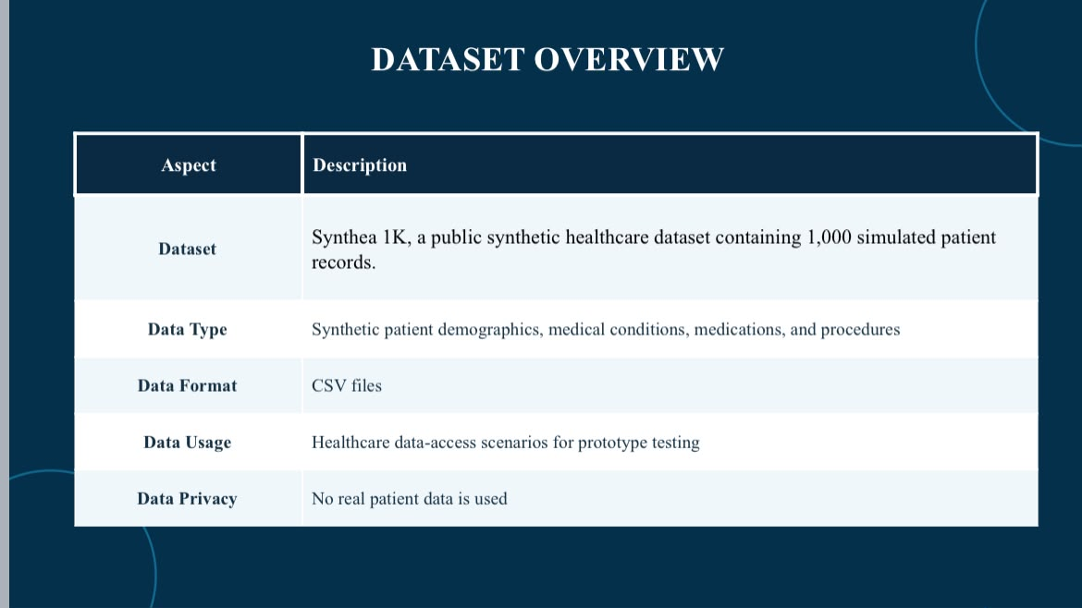
DATASET OVERVIEW
Aspect | Description
Dataset | Synthea 1K, a public synthetic healthcare dataset containing 1,000 simulated patient records.
Data Type | Synthetic patient demographics, medical conditions, medications, and procedures
Data Format | CSV files
Data Usage | Healthcare data-access scenarios for prototype testing
Data Privacy | No real patient data is used
Notes:
This slide shows the dataset used in my research.
I used Synthea 1K, a public synthetic healthcare dataset.
It contains 1,000 simulated patient records.
The data includes patient information, medical conditions, medications, and procedures.
The data is stored in CSV files.
I used this dataset to test healthcare data access in my prototype.
No real patient data was used.

