Slide 1

A Trusted Authorisation Framework for Multi-Party Patient Consent in Healthcare Data Sharing
Principal Supervisor: Professor Farookh Hussain
Co-Supervisor: Dr. Firas Al-Doghman
Presenter: Yasir Dhaifallah O Alyoubi
STUDENT ID #: 24724078
Notes:
Good afternoon everyone. My name is Yasir Alyoubi. My principal supervisor is Professor Farookh Hussain, and my co-supervisor is Dr Firas Al-Doghman.
My research asks one simple question: when a doctor asks for a patient's data, how can the system be sure the request is really allowed? Not only who is asking, but also: did the patient and the guardians agree, and is the request still inside what they agreed to?

Slide 2
OUTLINE
01
RESEARCH PROBLEM
06
OVERVIEW SOLUTION OF OBJECTIVES
02
LITERATURE REVIEW
07
RESEARCH CONTRIBUTIONS
03
RESEARCH GAP
08
PUBLICATIONS
04
RESEARCH QUESTIONS AND OBJECTIVES
09
RESEARCH PLAN
05
RESEARCH METHODOLOGY
10
REFERENCES
Notes:
This is the outline. I start with the research problem, then the literature review and the research gap. Then I present the research questions and objectives, and the research methodology. After that, I give an overview of the solution for each objective, with the prototype and its validation. I finish with the research contributions, my publications and my research plan.

Slide 3
THE RESEARCH PROBLEM
Healthcare data is shared between many independent parties: patient, guardians, doctor, hospital.
Today, consent is a stored record. It shows that permission was given, but it checks nothing at access time.
A valid identity does not prove the right to see this patient's data.
A request can ask for more data than allowed, or arrive after the consent expired or was revoked.
None of the reviewed studies proves or tests the whole decision.
The main problem is that there is no trusted mechanism that checks identity, authority, multi-party approval, policy, time and lifecycle together in one access decision, with evidence that it is secure.
Notes:
Let me start with the problem. Health data is shared between many independent parties: the patient, the guardians, the doctor and the hospital.
Today, consent is usually just a stored record. It says that permission was given, but it does not check anything when someone asks for the data.
A valid login does not prove you have the right to see this patient's data. A request can also ask for more data than agreed, or come after the consent has expired or been revoked.
So the main problem is: there is no trusted mechanism that checks all these conditions together, in one decision, with evidence that it is secure.

Slide 4
THE KEY IDEA
Consent is not a stored record. It is an object checked at every request.
C = (I, A, P, T, L, E)
I Identity
Who is the patient, the doctor and each guardian (DID).
A Authorisation
The guardian set G and how many approvals are needed (N).
P Policy
The purpose and the data scope that were agreed.
T Time
When the consent starts and when it expires.
L Lifecycle
The state of the consent, from creation to expiry or revocation.
E Evidence
Signatures, the token, and whether it is revoked.
Notes:
My key idea is simple. Consent should not be a record that we store. It should be an object that the system checks at every request.
I call this object C, and it has six parts. I is identity: who the patient, doctor and guardians are. A is authorisation: the guardian set G and how many approvals are needed. P is policy: the purpose and the data scope. T is time: when the consent starts and ends. L is lifecycle: the current state of the consent. E is evidence: signatures, the token, and the revocation status.

Slide 5
Systematic Literature Review
Study Selection Process (PRISMA 2020)
179 Records Identified
21 Duplicates Removed
158 Titles Screened
76 Records Excluded by Title
82 Abstracts Screened
43 Records Excluded
39 Full-text Studies Assessed
14 Studies Excluded
25 Studies Included in Analysis
5
Notes:
This slide shows how I selected the studies for my literature review.
First, I identified 179 records.
I removed 21 duplicates, leaving 158 records.
Next, I screened the titles and excluded 76 records.
Then, I screened 82 abstracts and excluded 43 records.
After that, I assessed 39 full-text studies and excluded 14.
Finally, I included 25 studies in my analysis.

Slide 6
Database Search Results
A total of 179 records were identified from seven academic databases before removing duplicates.
Publication range: 2020–2026
Search String
("Healthcare" OR "Health Data" OR "Medical Records") AND
("Consent" OR "Authorisation" OR "Authorization") AND
("Trust" OR "Multi-party" OR "Multi-party Approval")
6
Notes:
This slide shows my database search results.
First, I searched seven academic databases.
I found 179 records before removing duplicates.
SpringerLink gave the most results, with 46 records.
Scopus gave 38, and IEEE Xplore gave 27.
The other four databases gave 68 records.
I included studies published from 2020 to 2026.
I used search words about healthcare, consent, authorisation, trust, and multi-party approval.

Slide 7
Inclusion and exclusion criteria
Included
Excluded
Healthcare data sharing
Outside healthcare or the authorisation scope
Consent or authorisation relevant to data access
Authentication alone or a superficial mention of consent
A model, mechanism, system or evaluation that addresses a review question
Non-peer-reviewed work and duplicate publications
Peer-reviewed English paper with full text
Publication between 2020 and 2026
7
Notes:
Step two is the inclusion and exclusion criteria. They were defined before screening.
A study was included if it was about healthcare data sharing, dealt with consent or authorisation for data access, proposed a model, system or evaluation, and was a peer-reviewed English paper with full text, published between 2020 and 2026.
I excluded studies outside healthcare, studies about authentication only or with only a superficial mention of consent, non-peer-reviewed work, and duplicate publications.

Slide 8
QUALITY ASSESSMENT
Quality inclusion uses QA1–QA4
Item | Inclusion question
QA1 | Patient consent or consent-governed healthcare access?
QA2 | An authorisation or access-decision mechanism?
QA3 | A framework, model, protocol or architecture?
QA4 | Validation by proof of concept or implementation?
8
Notes:
Step four is quality assessment. Each study was checked with four questions. QA1: is it about patient consent or consent-governed access? QA2: does it have an access-decision mechanism? QA3: does it propose a real framework, model or architecture? QA4: is it validated with a proof of concept or an implementation?

Slide 9
LIST OF THE ANALYSED STUDIES
Study | Authors and year | Article title
S1 | Abbasi et al. (2026) | Nexa: Enabling Secure, Scalable, and Decentralized Management of Electronic Health Records Using Threshold Cryptography and Public Blockchains
S2 | Albalwy et al. (2021) | A Blockchain-based dynamic consent architecture to support clinical genomic data sharing (ConsentChain): Proof-of-concept study
S3 | Al Amin et al. (2023) | Informed Consent as Patient Driven Policy for Clinical Diagnosis and Treatment: A Smart Contract Based Approach
S4 | Ekholm et al. (2025) | Implementing electronic informed consent in rare disease genomics
S5 | Eneh et al. (2026) | Demo: EdgeConsent: On-Chain Attribute-Based Access Control for Data Consent Management
S6 | Hagström et al. (2024) | Minors’ and guardian access to and use of a national patient portal: A retrospective comparative case study of Sweden and Finland
S7 | Jaiman and Urovi (2020) | A Consent Model for Blockchain-Based Health Data Sharing Platforms
S8 | Zhao and Su (2024) | A threshold traceable delegation authorization scheme for data sharing in healthcare
S9 | Li et al. (2026a) | Privacy-Preserving Fine-Grained EMR Access Control for IoMT: A Hybrid RBAC-Smart Contract Scheme With Attribute-Based Authorization
S10 | Madine et al. (2020) | Fully Decentralized Multi-Party Consent Management for Secure Sharing of Patient Health Records
S11 | Maruthi and Singh (2025) | Enhancing Security and Privacy of IoMT Data for Unconscious Patient With Blockchain
S12 | Mei et al. (2026) | Efficient Dual-Revocation CP-ABE for Secure and Fine-Grained Data Sharing in IoMT
S13 | Panagoulias et al. (2026) | Blockchain-Enabled Trust and Compliance for Clinical AI: Decentralized Governance Without Decentralized Data Storage
S14 | Phuyal et al. (2026b) | Enabling Cross-Institution Health Data Sharing in Norway: EUDI Wallets, On-Chain Consent, and openEHR↔FHIR Translation
S15 | Phuyal et al. (2026a) | A Blockchain-Based Architecture for Dynamic and Auditable Patient Consent in Secondary Use of Health Data
S16 | Punia et al. (2025) | An access control system for cloud-based healthcare systems driven by blockchain
S17 | Román-Martínez et al. (2023) | Blockchain-Based Service-Oriented Architecture for Consent Management, Access Control, and Auditing
S18 | Hema et al. (2026) | Patient Centric Cryptographic Protection of Cloud Electronic Health Records
S19 | SooHoo et al. (2026) | Development of the authentication and authorization processes for the iAgree portal, a platform for patient-controlled data sharing across health systems
S20 | Tan et al. (2024) | Secure and privacy-preserving sharing of personal health records with multi-party pre-authorization verification
S21 | Tith et al. (2020) | Patient consent management by a purpose-based consent model for electronic health record based on blockchain technology
S22 | Tremper et al. (2026) | Mainzelliste: Ten years of pseudonymization, record linkage, and informed consent management
S23 | Tseng et al. (2025) | EMR-Chain: Decentralized Electronic Medical Record Exchange System
S24 | Wu et al. (2022) | Apply Trust Computing and Privacy Preserving Smart Contracts to Manage, Share, and Analyze Multi-site Clinical Trial Data
S25 | Wu and Zhang (2025) | HealthDID: An efficient and authorizable multi-party privacy-preserving EMR sharing system based on DID
9
Notes:
Here is the list of the 25 primary studies in the comparative analysis, from S1 to S25.

Slide 10
STUDY COMPARISON: S1–S13
Study | Req 1 | Req 2 | Req 3 | Req 4 | Req 5 | Req 6
S1 Abbasi et al. (2026) | NO | NO | NO | NO | NO | NO
S2 Albalwy et al. (2021) | Yes | NO | NO | Yes | NO | Yes
S3 Al Amin et al. (2023) | Yes | NO | NO | NO | NO | NO
S4 Ekholm et al. (2025) | NO | Yes | Yes | NO | NO | NO
S5 Eneh et al. (2026) | Yes | NO | NO | Yes | Yes | NO
S6 Hagström et al. (2024) | NO | Yes | NO | NO | Yes | Yes
S7 Jaiman and Urovi (2020) | Yes | NO | NO | Yes | NO | Yes
S8 Zhao and Su (2024) | NO | NO | Yes | NO | NO | Yes
S9 Li et al. (2026a) | NO | NO | NO | Yes | Yes | NO
S10 Madine et al. (2020) | Yes | Yes | Yes | NO | Yes | NO
S11 Maruthi and Singh (2025) | NO | NO | Yes | NO | NO | Yes
S12 Mei et al. (2026) | NO | NO | NO | Yes | Yes | Yes
S13 Panagoulias et al. (2026) | Yes | NO | NO | Yes | Yes | Yes
10
Notes:
This table compares studies S1 to S13 against my six requirements. Yes means the study fully meets the requirement. NO means it does not fully meet it.
You can see that each study is strong in some areas but weak in others. For example, Madine and colleagues meet four requirements, but not policy and assurance. No row is Yes across all six columns.

Slide 11
STUDY COMPARISON: S14–S25
Study | Req 1 | Req 2 | Req 3 | Req 4 | Req 5 | Req 6
S14 Phuyal et al. (2026b) | Yes | Yes | NO | NO | NO | Yes
S15 Phuyal et al. (2026a) | NO | NO | NO | NO | NO | NO
S16 Punia et al. (2025) | NO | NO | Yes | Yes | Yes | NO
S17 Román-Martínez et al. (2023) | Yes | NO | NO | Yes | NO | NO
S18 Hema et al. (2026) | Yes | NO | NO | Yes | Yes | NO
S19 SooHoo et al. (2026) | NO | NO | NO | NO | NO | NO
S20 Tan et al. (2024) | Yes | Yes | Yes | NO | NO | NO
S21 Tith et al. (2020) | Yes | NO | NO | Yes | NO | NO
S22 Tremper et al. (2026) | NO | NO | NO | NO | NO | NO
S23 Tseng et al. (2025) | NO | Yes | NO | NO | NO | NO
S24 Wu et al. (2022) | NO | NO | NO | NO | NO | NO
S25 Wu and Zhang (2025) | Yes | Yes | NO | NO | NO | Yes
11
Notes:
This is the second half of the comparison, studies S14 to S25. The pattern is the same. Multi-party approval, in the Req 3 column, is mostly missing.
For example, Phuyal and colleagues are strong on identity and assurance, but consent is given by one patient only, with no multi-party approval. So no single study meets all six requirements, and this is the gap my research addresses.

Slide 12
RESEARCH GAP
Existing healthcare consent and access-control research provides many of the necessary technological building blocks. However, there is still a need for an integrated Trust Computing framework that treats patient consent as a verifiable authorisation object, verifies identity, trust, and authority, supports multi-party authorisation, and enforces access policies and data-scope restrictions.
Notes:
This leads to the research gap. Existing research gives us many of the building blocks. But we still need one integrated Trust Computing framework that treats patient consent as a verifiable authorisation object.
This framework must verify identity, trust and authority, support multi-party authorisation, and enforce the access policy and the data scope of the consent.

Slide 13
MAIN RESEARCH QUESTION
How can a trust-oriented computing framework establish and enforce trustworthy multi-party consent for decentralised healthcare data sharing under identity, authority, and policy constraints?
Notes:
From this gap comes my main research question: How can a trust-oriented computing framework establish and enforce trustworthy multi-party consent for decentralised healthcare data sharing, under identity, authority and policy constraints?
----------------------------------------------------------------------------------------------------------------------------------------------
Establish means creating trusted participants and a collective decision. Enforce means checking these conditions every time someone asks for data.

Slide 14
SUB-RESEARCH QUESTIONS
RQ1
How can patient consent be modelled as a trust-aware authorisation object that explicitly represents identity, authority requirements, policy constraints, and authorisation evidence?
RQ2
How can decentralised identities and verifiable credentials establish trustworthy participants while explicitly separating identity authentication from authorisation authority?
RQ3
How can multiple independently verified participants jointly establish a trustworthy consent decision without allowing a single participant to unilaterally authorise sensitive healthcare data access?
RQ4
How can policy, purpose, and data-scope constraints be incorporated into authorisation decisions so that valid identities and sufficient approvals cannot be used to obtain unauthorised healthcare data?
RQ5
How can temporal validity and consent lifecycle controls ensure that an authorisation remains valid only within its permitted time interval and lifecycle state, and is rejected after expiration, revocation, or an unauthorised state transition?
RQ6
How can the security properties of the proposed trust-oriented authorisation mechanism be formally defined and empirically evaluated to demonstrate that the implemented framework correctly enforces authorised and unauthorised healthcare data-access decisions?
Notes:
The main question is divided into six sub-questions, one for each requirement.
RQ1 How can patient consent be modelled as a trust-aware authorisation object that explicitly represents identity, authority requirements, policy constraints, and authorisation evidence?
. RQ2 How can decentralised identities and verifiable credentials establish trustworthy participants while explicitly separating identity authentication from authorisation authority?
. RQ3 How can multiple independently verified participants jointly establish a trustworthy consent decision without allowing a single participant to unilaterally authorise sensitive healthcare data access?
. RQ4 How can policy, purpose, and data-scope constraints be incorporated into authorisation decisions so that valid identities and sufficient approvals cannot be used to obtain unauthorised healthcare data?
. RQ5 How can temporal validity and consent lifecycle controls ensure that an authorisation remains valid only within its permitted time interval and lifecycle state, and is rejected after expiration, revocation, or an unauthorised state transition.
RQ6 How can the security properties of the proposed trust-oriented authorisation mechanism be formally defined and empirically evaluated to demonstrate that the implemented framework correctly enforces authorised and unauthorised healthcare data-access decisions?

Slide 15
RESEARCH OBJECTIVES
Objective | Description
RO1 | To develop a trust-aware consent model that represents patient consent as a structured and evaluable authorisation object.
RO2 | To develop a decentralised identity and authority verification mechanism using decentralised identifiers and verifiable credentials.
RO3 | To develop a threshold-based multi-party authorisation mechanism through which multiple independently verified participants and guardians can jointly establish a trustworthy consent decision.
RO4 | To develop a policy-aware authorisation mechanism that evaluates the purpose and data scope of a requested operation against the constraints defined by the consent.
RO5 | To extend the trust-oriented framework with temporal validity and consent lifecycle controls.
RO6 | To formally analyse and empirically evaluate whether the implemented framework satisfies its defined trust and authorisation properties under representative healthcare data-sharing scenarios.
Notes:
Each research question has one objective.
RO1 builds the consent model. RO2 verifies identity and authority with DIDs and verifiable credentials. RO3 builds the multi-party approval with a threshold. RO4 checks the purpose and the data scope of each request. RO5 adds time and lifecycle controls. RO6 analyses and tests the security of the whole framework.
--------------------------------------------------------------------------------------------------------------------------
RO1 turns consent from a stored record into an object with six parts: identity, authorisation, policy, time, lifecycle and evidence. At every request, the system checks the request against these parts. For example, if the consent allows only Observation and Medication, a request for Procedure is denied, even from the right doctor.”
--------------------------------------------------------------------------------------------------------------------------------
“RO2 separates identity from authority. The DID shows who the participant is, and the verifiable credential shows what they are allowed to do, for example that they are a doctor or a guardian. A valid DID alone never gives access. In the prototype, each guardian’s credential is checked before their signature is accepted, and the doctor’s credential is checked at every request, together with a check that this is the doctor named in the consent. Full DID resolution is planned for the next stage.”
---------------------------------------------------------------------------------------------------------------------
“RO3 makes consent a collective decision. The patient defines a guardian set G, and the consent becomes active only when the required number of guardians approve. Each guardian signs a digital approval, and the system checks that the signer is in G. Approvals from outsiders and repeated approvals are not counted, so no single person can activate the consent alone. In the prototype, every listed guardian must sign: two of two in the demo.”
------------------------------------------------------------------------------------------------------------------------
“The rule is N-of-N, so every guardian in G must sign. The prototype accepts more than two guardians, but I showed and tested it with two, so two of two.”
-------------------------------------------
RO3 makes consent a collective decision. The patient chooses a guardian set G, and the consent becomes active only when every guardian in G signs. Each guardian signs a digital approval, and the system checks that the signer is in G. Approvals from outsiders and repeated approvals are not counted, so no single person can activate the consent alone. I tested it with two guardians, so two of two. Then the consent becomes active.”
----------------------------------------------------------------
“RO4 checks each request against the consent policy. A valid identity and all the approvals are still not enough. The requested data must be inside the scope the patient agreed to, and the purpose must be a supported purpose. For example, if the consent allows only Observation and Medication, a request for Procedure is denied. An empty request is also denied. In the prototype, the request uses the consent’s own purpose, so comparing a separate request purpose is planned for the next stage.”
------------------------------------------------------------------------
“RO5 adds time and lifecycle. A consent is not valid forever. It has a start and an end time, and a state such as pending, active, expired or revoked. At every request, the system checks the time window and the state, and access is allowed only when the consent is ACTIVE. Today, the validity window is stored on-chain, and revocation works end to end, with an on-chain revoke transaction. In the next stage I will add the SUSPENDED state, the transition check, consent changes and a formal lifecycle model.”
-----------------------------------------------------------------------------------------
“RO6 checks that the framework really does what it should, in two ways. The testing part is done: 46 automated tests pass, including twelve attack scenarios, and all attacks are refused. I also measured the processing time of each check. The formal part is for the next stage: proofs or model checking, to show that no path in the system can give access when a condition fails.”
------------------------------------------------------------------------------------------------
“The six objectives build on each other to answer one question: is this data request really allowed? Take a patient, Ahmed, who is a minor. In RO1, Ahmed creates a consent as an object, not just a record: it names Dr Khalid, two guardians, the purpose Treatment, only Observation and Medication data, and a time window from October to December. In RO2, the system checks each person’s identity with a DID and their authority with a verifiable credential, and identity alone never gives access. In RO3, the consent becomes active only when both guardians sign, so no single person can approve alone. In RO4, when Dr Khalid asks for data, a request for Observation is allowed, but a request for Procedure is denied. In RO5, if he asks in January after the consent has expired, or after Ahmed revokes it, the request is denied. In RO6, I showed that all of this works: 46 tests pass and all twelve attacks are refused, and formal proofs come in the next stage. So Dr Khalid sees the data only when every condition is true at the same time.”

Slide 16
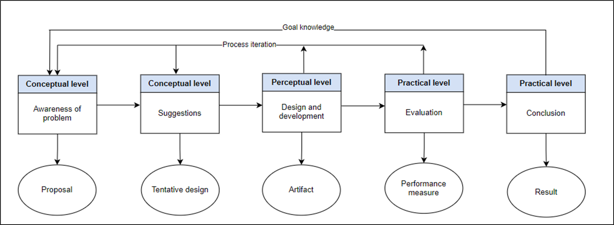
Research Methodology
RESEARCH METHODOLOGY
DSR METHODOLOGY
Design Science Research Methodology Process Model (Peffers et al. 2007)
Notes:
My research methodology is Design Science Research, based on the process model of Peffers and colleagues, 2007.
It has five stages. First, awareness of the problem came from the systematic review, and its output is the research proposal.
Second, suggestion gives a tentative design: the questions, the objectives and the trust model.
Third, design and development gives the artifact: the framework and the HALAH prototype.
Fourth, evaluation gives performance measures: scenarios, attack tests and processing time.
Finally, conclusion gives the results.
----------------------------------------------------------------------------------------------------------------------
The arrows show that knowledge from each stage goes back into the process, so the design improves in each iteration.

Slide 17
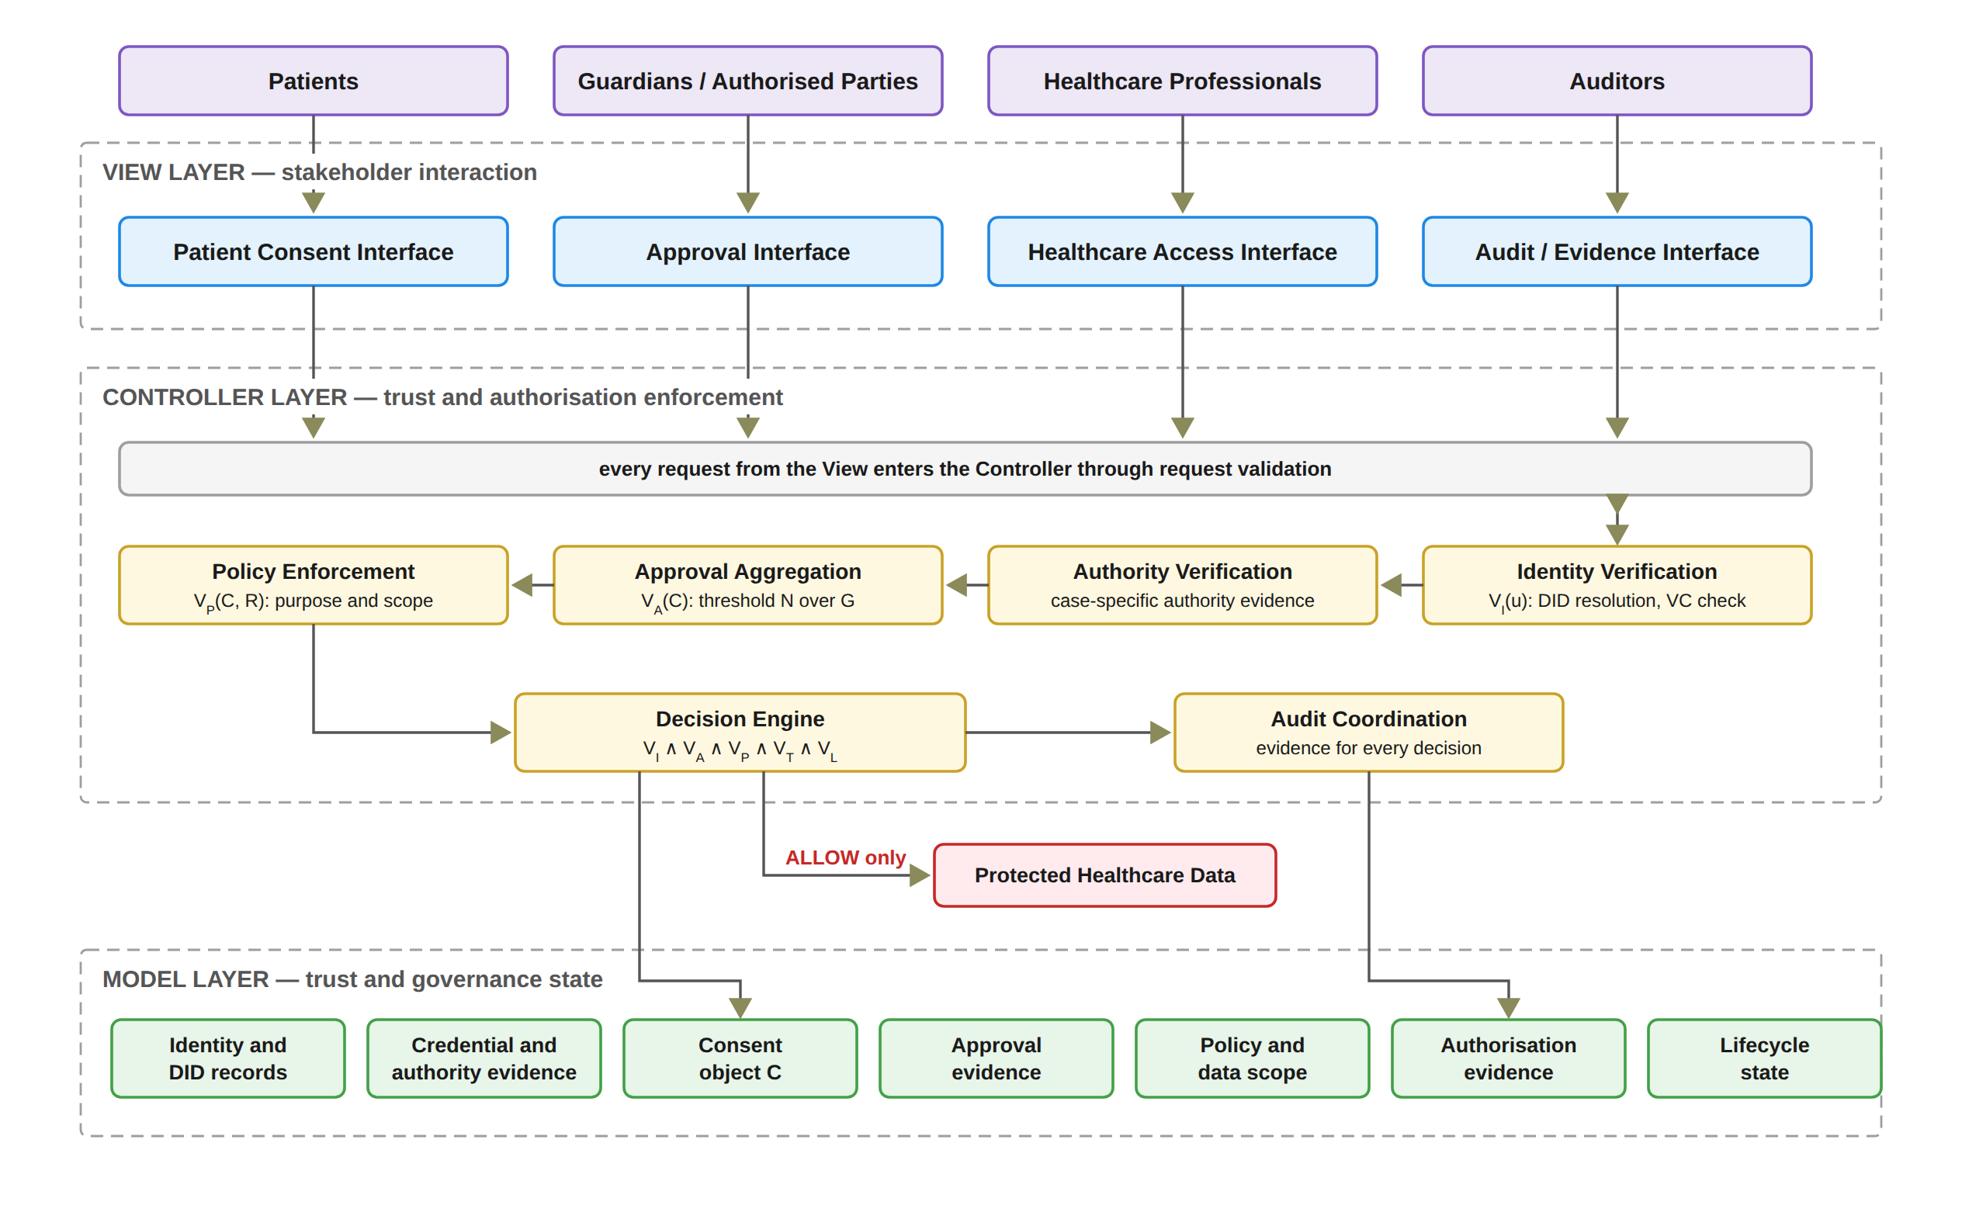
FRAMEWORK ARCHITECTURE
Notes:
This is the architecture of the framework. It uses the Model-View-Controller pattern.
The View is the four interfaces: patient, guardian, doctor and auditor. The View never decides on access.
The Controller is the security boundary. It checks identity, authority, approvals, policy, time and lifecycle, makes the final decision, and records the audit evidence.
The Model holds the state: identities, credentials, the consent object, approvals, policy, evidence and lifecycle. The medical data sit outside, and can only be reached through the Controller.

Slide 18
THE DECISION RULE
Decision(C, R, t) = ALLOW ⟺ VI(u) ∧ VA(C) ∧ VP(C, R) ∧ VT(C, t) ∧ VL(C)
VI
Identity and authority validity
VA
Collective authorisation validity
VP
Policy and contextual compliance
VT
Temporal validity
VL
Consent lifecycle validity
One failed check is enough to say DENY.
Every access decision, allowed or denied, is written to the audit ledger with its decision matrix.
Notes:
This is the heart of the framework. Access is allowed only when five checks are all true.
VI checks identity and authority. VA checks that all required guardians approved. VP checks the purpose and data scope. VT checks the time window. VL checks the lifecycle state.
If any one check fails, the answer is DENY. Every decision, allowed or denied, is written to the audit ledger.
------------------------------------------------------------------------
C The consent object C = (I, A, P, T, L, E): who is involved, which guardians must approve, the purpose and data scope, the time window, the lifecycle state and the evidence.
R The access request: what the doctor asks for, meaning the data modules (S_R) and the purpose.
t The time of the request: the moment the doctor asks for the data.
u The requesting participant, for example the doctor.
“t is the time of the request. VT is the check that uses it: it compares t with the consent’s validity window T, and passes only when t is between the start and the end time.”

Slide 19
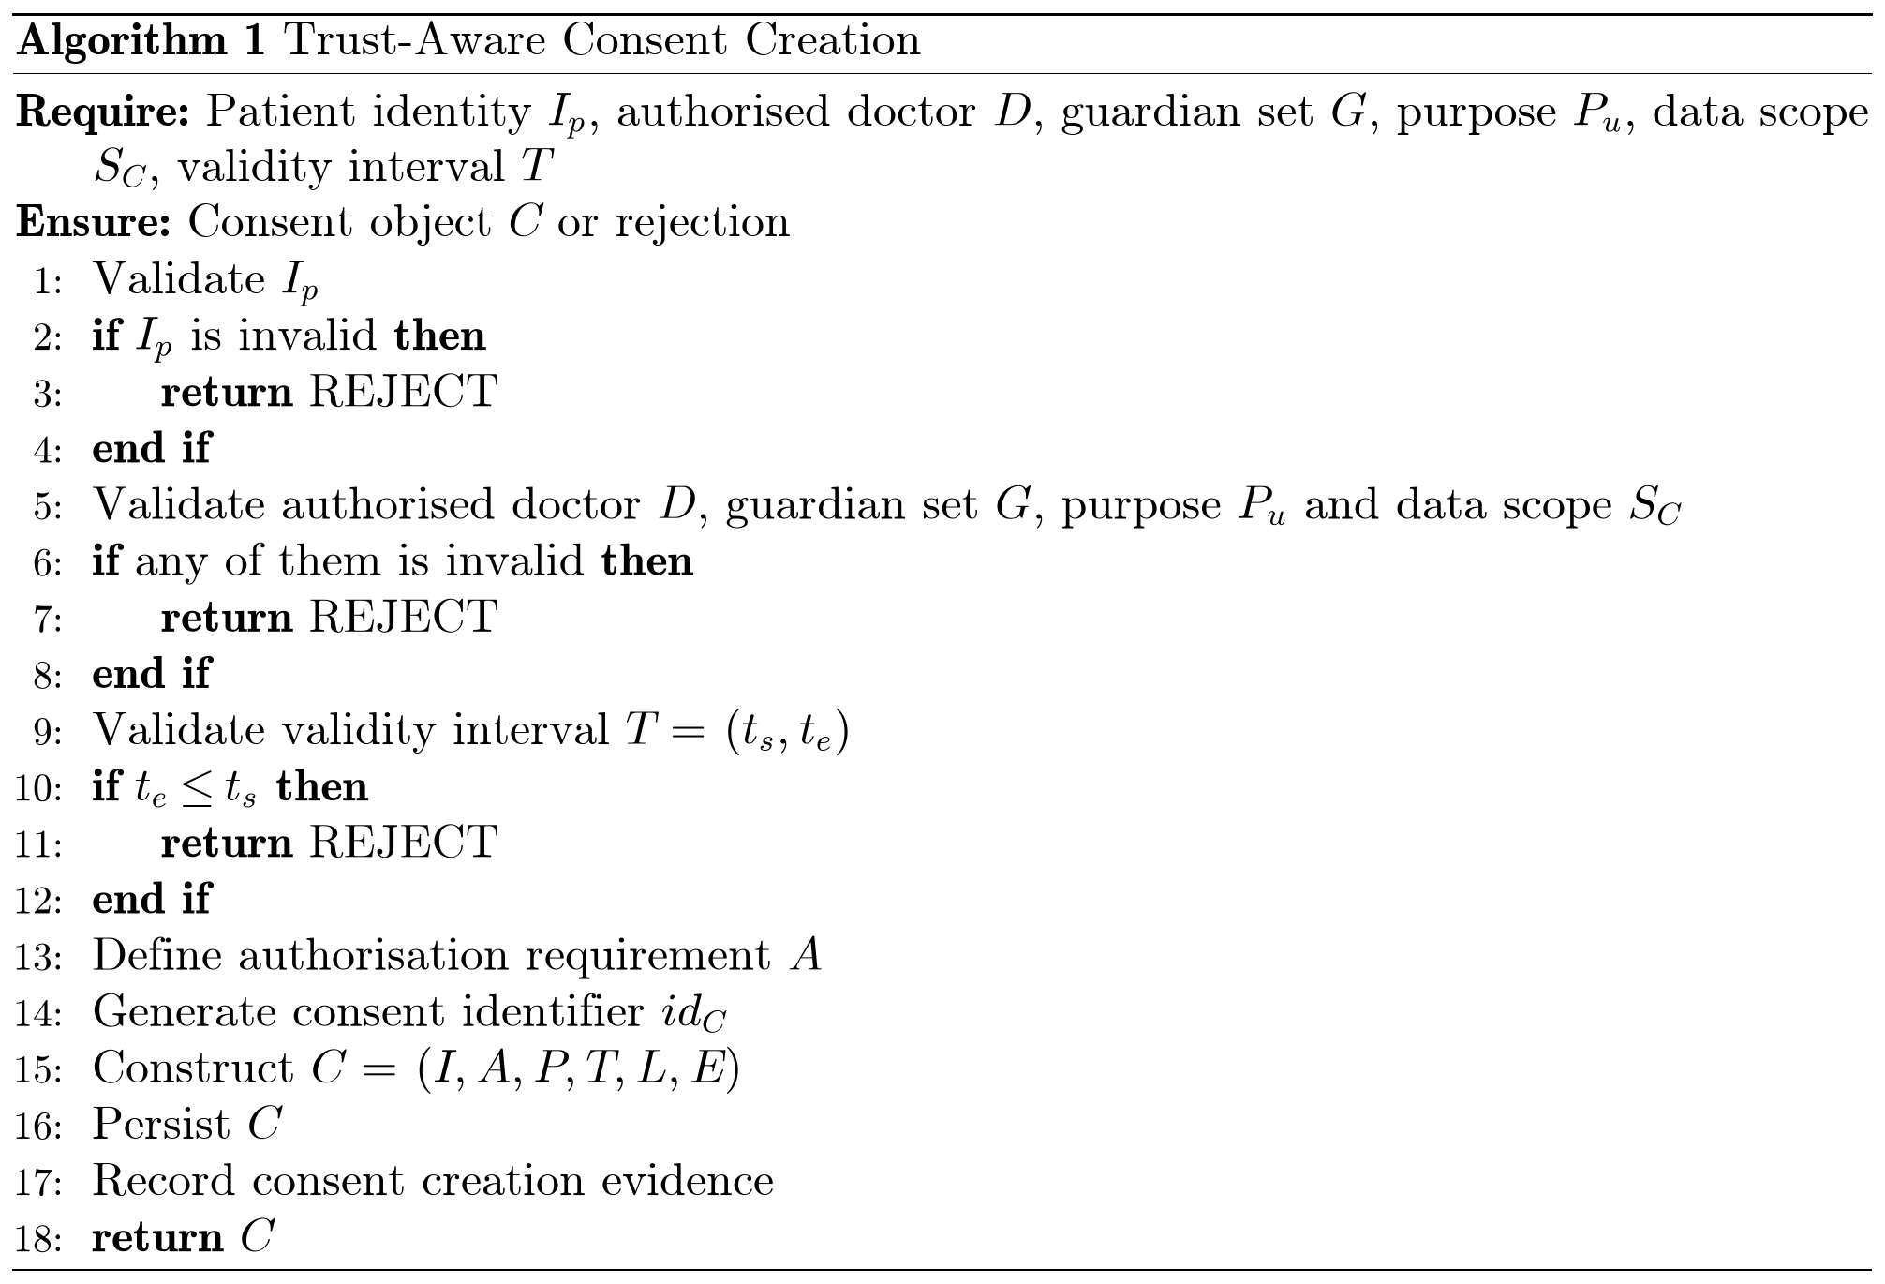
Proposed solution for objective 1
RO1: Trust-Centric Consent Model
Status: Done
The patient chooses the doctor, the guardians, the data modules, and the start and expiry time.
In this prototype the purpose is fixed to Treatment.
Bad input is rejected, for example an empty data scope or a malformed guardian DID.
The system creates the consent object, assigns a consent identifier, persists the record, and records the creation event in the audit layer.
Notes:
Objective one: the consent model. It is done.
The patient chooses the doctor, the guardians, the data modules, and the start and expiry time. In this prototype, the purpose is fixed to Treatment.
Bad input is rejected, for example an empty data scope or a malformed guardian DID, which is a decentralised identifier. Then the system creates the consent object, gives it an ID, saves it, and records the event in the audit log.
--------------------------------------------------------------------------------------------------------------------------------------------
Inputs and Output
Require: Patient identity I_p, authorised doctor D, guardian set G, purpose P_u, data scope S_C, validity interval T
Explanation: The algorithm starts by receiving the information required to create a consent.
Ensure: Consent object C or rejection
Explanation: The algorithm either creates a valid consent or rejects the request.
Step-by-Step Explanation
Line 1: Validate I_p
First, we verify the patient’s identity.
Line 2: if I_p is invalid then
We check whether the patient’s identity is invalid.
Line 3: return REJECT
If the identity is invalid, the request is rejected.
Line 4: end if
This completes the identity validation check.
Line 5: Validate authorised doctor D, guardian set G, purpose P_u and data scope S_C
Next, we check the other parts of the consent: that the doctor is authorised, that the guardians are valid, that the purpose of using the patient’s data is valid, and that the data scope, which is the patient data that can be accessed, is valid.
Line 6: if any of them is invalid then
We check whether any of these four parts is invalid.
Line 7: return REJECT
If one of them is invalid, the request is rejected, and no consent is created.
Line 8: end if
This completes these four checks.
Line 9: Validate validity interval T = (t_s, t_e)
We check the consent’s start and end times.
Line 10: if t_e ≤ t_s then
We check whether the end time is earlier than or equal to the start time.
Line 11: return REJECT
If the time interval is invalid, the request is rejected.
Line 12: end if
This completes the time validation check.
Line 13: Define authorisation requirement A
We define the conditions that must be met later before access can be granted, such as the required guardian approvals.
Line 14: Generate consent identifier id_C
We generate a unique identifier for the consent.
Line 15: Construct C = (I, A, P, T, L, E)
We build the consent object from its six parts: identity I, authorisation requirements A, policy P (the purpose and the data scope), time T (the validity interval), the lifecycle state L, which starts as pending until the guardians approve, and evidence E.
Line 16: Persist C
We store the newly created consent object.
Line 17: Record consent creation evidence
We record evidence of the consent creation for auditing and traceability.
Line 18: return C
Finally, we return the successfully created consent object.
Note: In the prototype, the purpose is fixed to Treatment. The consent is saved in the state PENDING_SIGNATURE until all guardians approve.

Slide 20
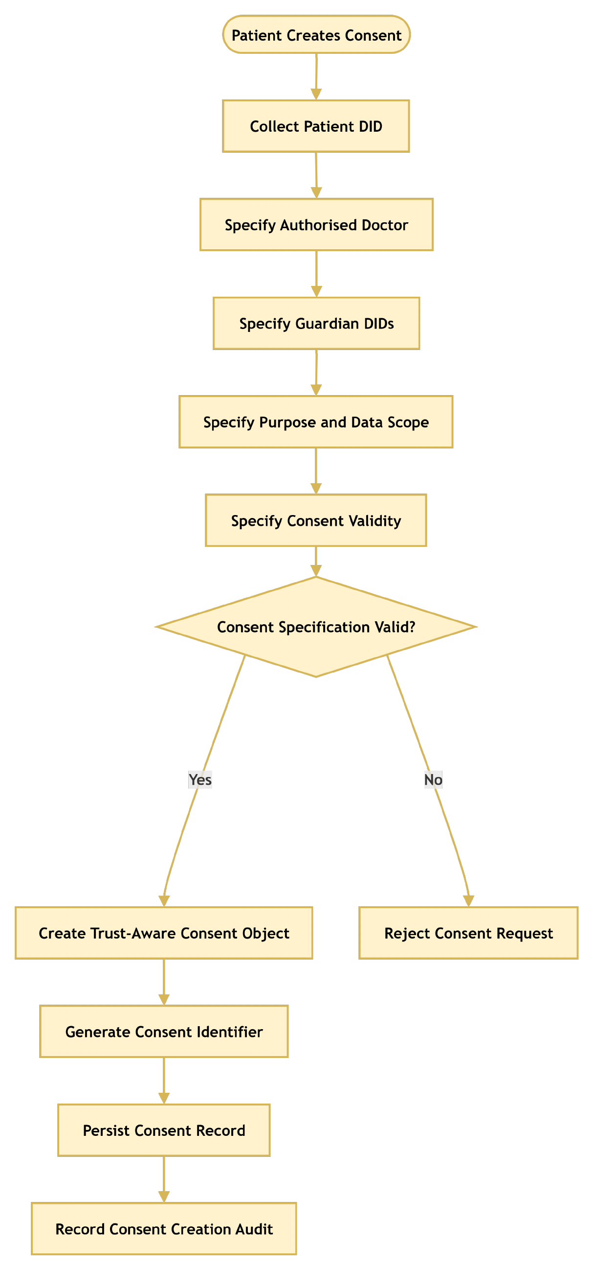
RO1: Trust-Centric Consent Model
Notes:
This flowchart shows Algorithm 1 in a simpler form. The system collects the inputs and validates them. If something is invalid, the request is rejected. Otherwise, it creates the consent, gives it an identifier, saves it, and records the creation event.

Slide 21
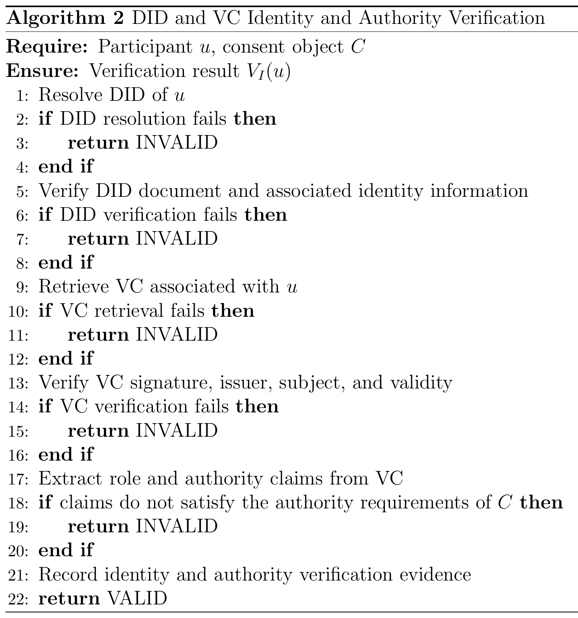
Proposed solution for objective 2
RO2: Decentralised Identity and Authority Trust
Status: Done
Identity is checked through the DID; authority through a verifiable credential.
Identity is not authority: a valid DID alone never gives access.
In the HALAH implementation, the Guardian workflow uses a selected guardian DID and invokes VC verification before adding the guardian's signature to the consent.
Full DID resolution is planned for the next stage.
Notes:
Objective two: identity and authority. It is done.
I separate two questions: who are you, and what are you allowed to do? The DID answers the first question. The verifiable credential answers the second. A valid DID alone never gives access.
In the prototype, the guardian's credential is checked before the signature is added. Full DID resolution is planned for the next stage.
------------------------------------------------------------------------------------------------------------------
Inputs and Output
Require: Participant u, consent object C
Explanation: The algorithm starts by receiving the participant who wants to take part and the consent object that defines the required authority.
Ensure: Verification result V_I(u)
Explanation: The algorithm returns VALID if both the participant’s identity and authority are verified, or INVALID otherwise. This result is not an access decision by itself; the later stages use it.
Step-by-Step Explanation
Line 1: Resolve DID of u
First, we resolve the participant’s DID to find their DID document.
Line 2: if DID resolution fails then
We check whether the DID could not be resolved.
Line 3: return INVALID
If the DID cannot be resolved, the participant is invalid and the process stops.
Line 4: end if
This completes the DID resolution check.
Line 5: Verify DID document and associated identity information
Next, we check that the DID document is well formed and that its keys can be trusted.
Line 6: if DID verification fails then
We check whether the DID verification failed.
Line 7: return INVALID
If it failed, we return INVALID.
Line 8: end if
This completes the DID verification check.
Line 9: Retrieve VC associated with u
Then, we retrieve the participant’s verifiable credential, which holds claims such as their role.
Line 10: if VC retrieval fails then
We check whether a credential could not be found.
Line 11: return INVALID
Without a credential, the participant cannot show any authority, so we return INVALID.
Line 12: end if
This completes the credential retrieval check.
Line 13: Verify VC signature, issuer, subject, and validity
We check that the signature is correct, the issuer is trusted, the credential belongs to this participant, and it is still within its valid time period.
Line 14: if VC verification fails then
We check whether any of these four checks failed.
Line 15: return INVALID
If any check fails, we return INVALID.
Line 16: end if
This completes the credential verification check.
Line 17: Extract role and authority claims from VC
Next, we read the role and authority claims from the credential, for example doctor or guardian.
Line 18: if claims do not satisfy the authority requirements of C then
We compare these claims with the authorisation requirements of consent C.
Line 19: return INVALID
If the claims do not meet the requirements, we return INVALID. A valid identity alone never gives access.
Line 20: end if
This completes the authority check.
Line 21: Record identity and authority verification evidence
We record the evidence, such as the DID, the credential, the issuer, the claims and the time, for auditing.
Line 22: return VALID
Finally, we return VALID, which means the participant’s identity and authority are both verified.
Note: Today, the guardian workflow verifies the guardian’s credential before adding the signature to the consent. Full DID resolution, in lines 1 to 8, is planned for the next stage.

Slide 22
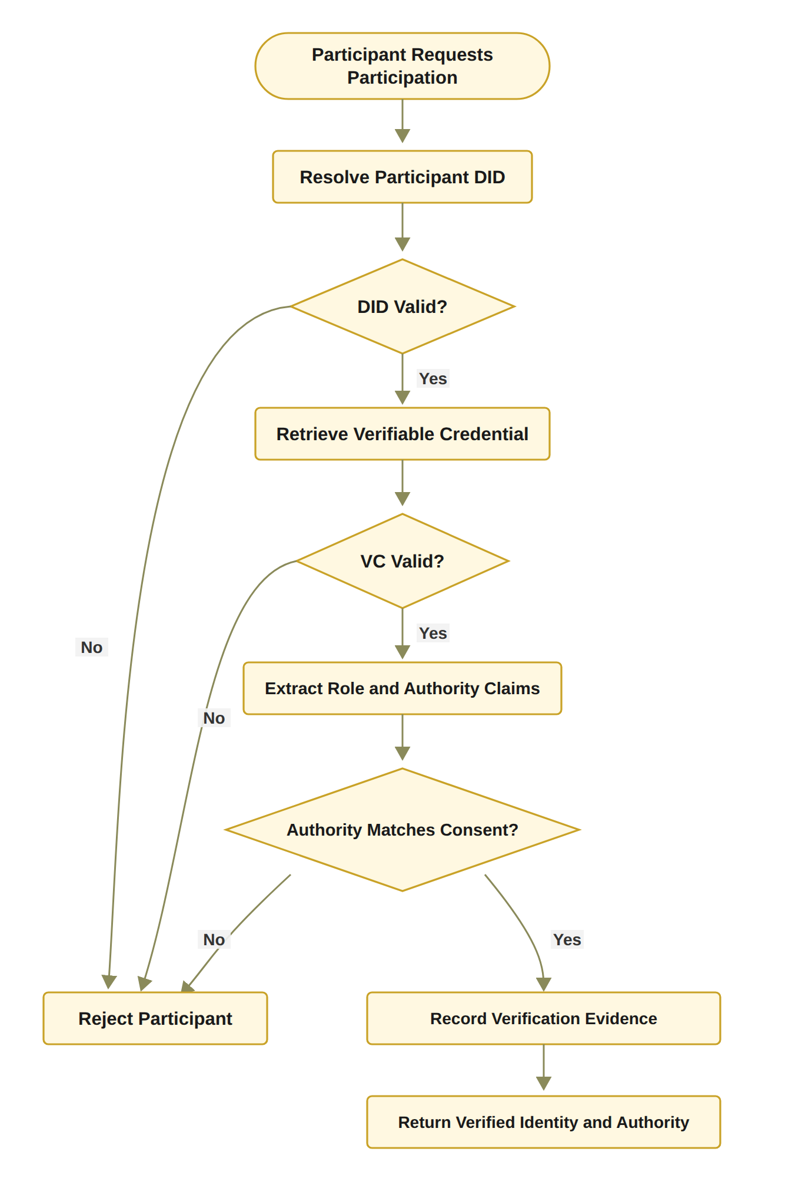
RO2: Decentralised Identity and Authority Trust
Notes:
This flowchart shows Algorithm 2. The system checks the DID, then retrieves and verifies the credential, then checks that the role matches what the consent requires. If any step fails, the participant is rejected. If all pass, the evidence is recorded.

Slide 23
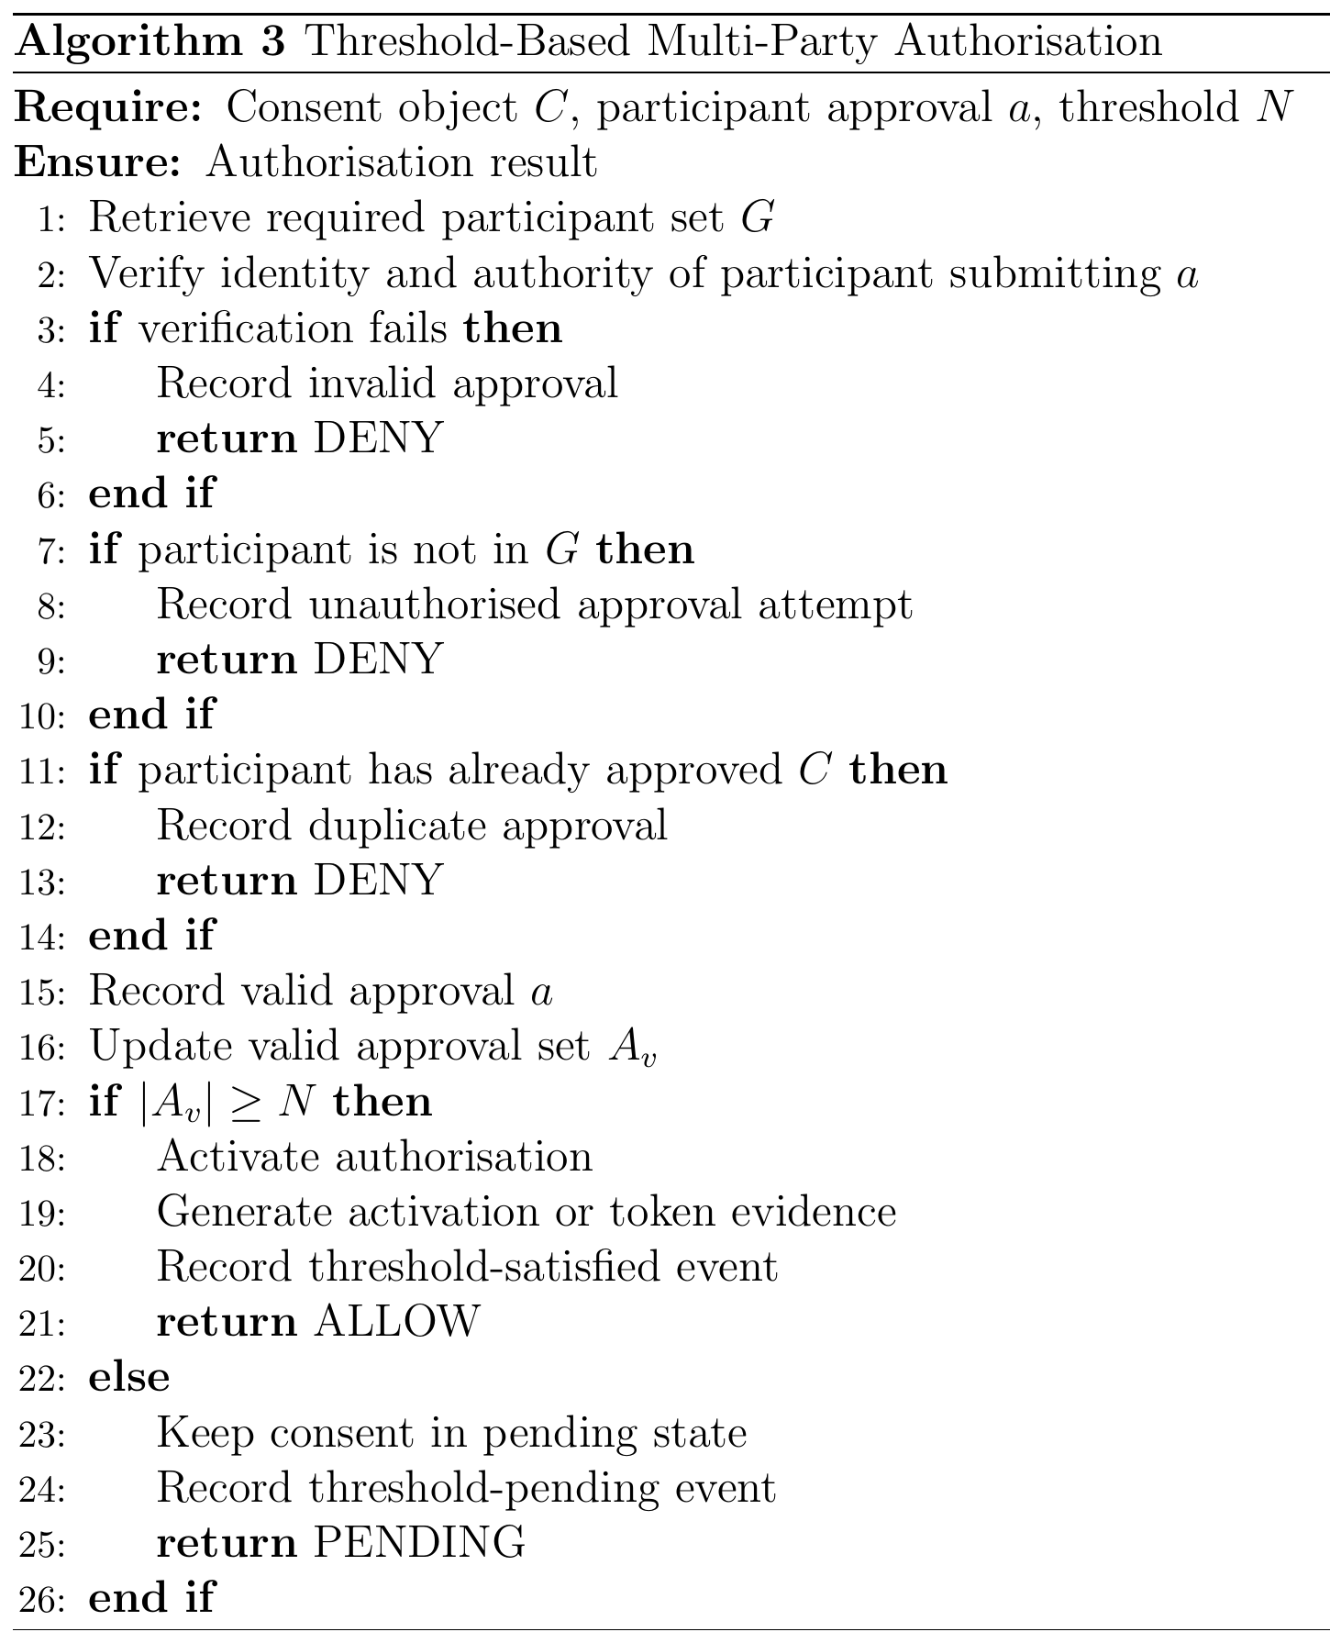
Proposed solution for objective 3
RO3: Trustworthy Multi-Party Authorisation
Status: Done
The guardian set G is fixed when the consent is created.
Each guardian signs a digital approval; the system checks who signed and that this person is in G.
Approvals from outsiders and duplicates are not counted; a signature replayed from another consent fails the identity check.
N-of-N rule: every listed guardian must sign (2-of-2 in the demo).
When all have signed, the consent becomes active.
In the prototype the guardian keys are derived from the guardian DIDs; wallet-held keys are for the next stage.
Notes:
Objective three: multi-party approval. It is done. No single person can approve alone.
The guardian set G is fixed when the consent is created. Each guardian signs a digital approval. The system checks who signed and that this person is in G. Approvals from outsiders and duplicate approvals are not counted.
In the prototype, every listed guardian must sign: two of two in the demo. Then the consent becomes active.
One limitation: guardian keys are currently derived from the DIDs. Wallet-held keys come in the next stage.
---------------------------------------------------------------------------------------------------------------------------------
Note: In the prototype, N is the number of guardians, so the demo needs 2-of-2. When the threshold is met, a local token is recorded and the consent becomes active.
--------------------------------------------------------------------------------------------------------------------------------------
Inputs and Output
Require: Consent object C, participant approval a, threshold N
Explanation: The algorithm receives the consent, one approval from a participant, and the number of valid approvals that are needed.
Ensure: Authorisation result
Explanation: The algorithm returns ALLOW, PENDING or DENY for this approval.
Step-by-Step Explanation
Line 1: Retrieve required participant set G
First, we retrieve the set G of participants who are allowed to approve this consent, for example the guardians.
Line 2: Verify identity and authority of participant submitting a
Next, we verify the identity and authority of the person who submitted the approval. This can use the DID and VC check from Algorithm 2.
Line 3: if verification fails then
We check whether this verification has failed.
Line 4: Record invalid approval
If it failed, we record the approval as invalid.
Line 5: return DENY
The approval is denied, and it does not count towards the threshold.
Line 6: end if
This completes the identity and authority check.
Line 7: if participant is not in G then
Then, we check whether the participant is outside the required participant set G.
Line 8: Record unauthorised approval attempt
If so, we record it as an unauthorised approval attempt.
Line 9: return DENY
The approval is denied, because only members of G can be counted.
Line 10: end if
This completes the membership check.
Line 11: if participant has already approved C then
Next, we check whether this participant has already approved this consent.
Line 12: Record duplicate approval
If so, we record a duplicate approval.
Line 13: return DENY
The extra approval is denied, so one person cannot be counted twice.
Line 14: end if
This completes the duplicate check.
Line 15: Record valid approval a
The approval has passed all three checks, so we record it as valid.
Line 16: Update valid approval set A_v
We add this approval to the set of valid approvals, A_v.
Line 17: if |A_v| ≥ N then
We check whether the number of valid approvals has reached the threshold N.
Line 18: Activate authorisation
If it has, we activate the authorisation, so the consent can move on to the access-control stage.
Line 19: Generate activation or token evidence
We generate evidence of the activation, such as a consent token. It can include the consent identifier, the threshold N and the approving participants.
Line 20: Record threshold-satisfied event
We record in the audit log that the threshold was met, for traceability.
Line 21: return ALLOW
The result is ALLOW.
Line 22: else
Otherwise, the threshold has not been reached yet.
Line 23: Keep consent in pending state
We keep the consent in the pending state, so access is not activated.
Line 24: Record threshold-pending event
We record a threshold-pending event, so we can see later how many approvals are still needed.
Line 25: return PENDING
The result is PENDING, and the consent waits for more approvals.
Line 26: end if
Finally, this completes the threshold check, and the algorithm ends.
Note: In the prototype, N is the number of guardians, so the demo needs 2-of-2. When the threshold is met, a local token is recorded and the consent becomes active.

Slide 24
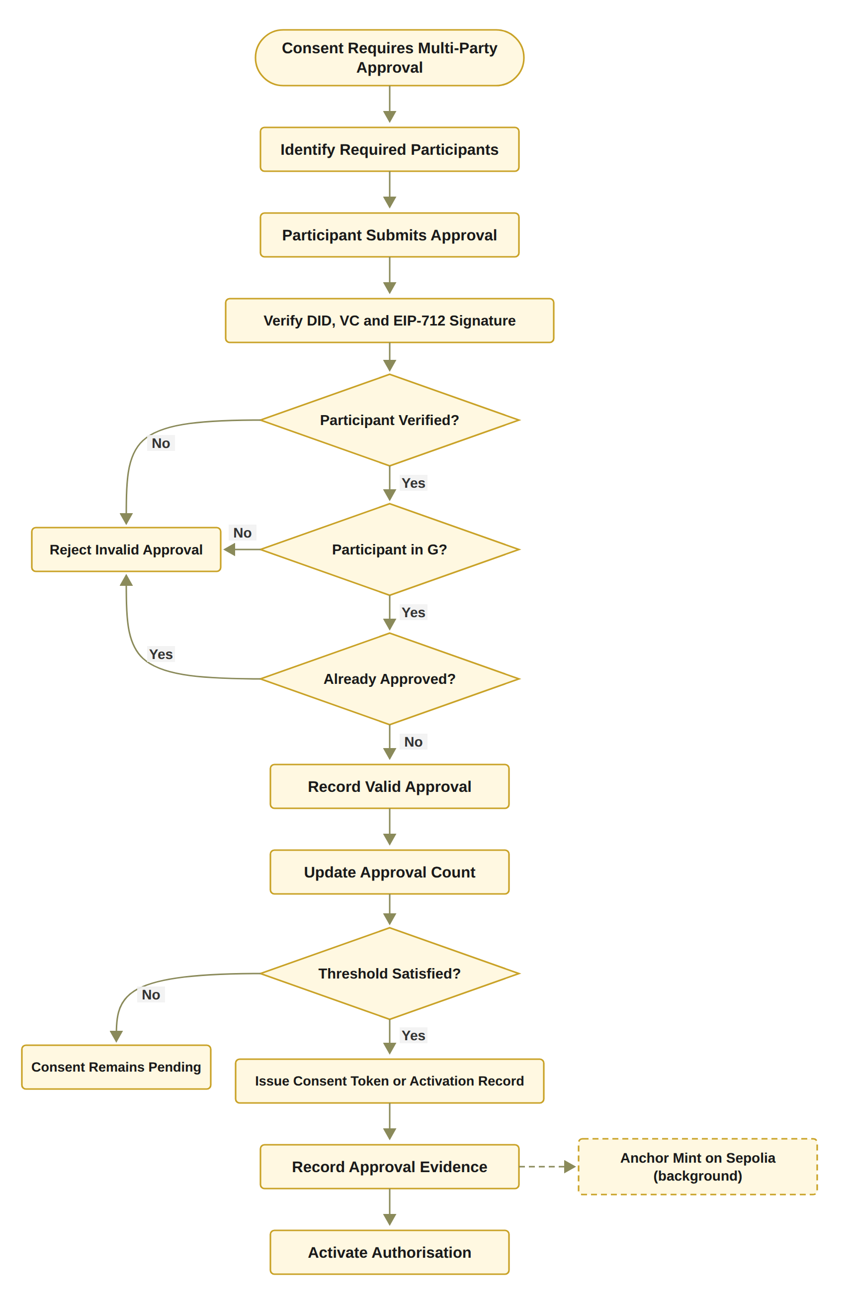
RO3: Trustworthy Multi-Party Authorisation
Status: Done
Notes:
This flowchart shows Algorithm 3. Each approval goes through three checks: is the signer verified, is the signer in G, and has the signer already approved? Only approvals that pass all three are counted. When the count reaches the threshold, the consent is activated and a consent token is recorded. Otherwise, it stays pending.

Slide 25
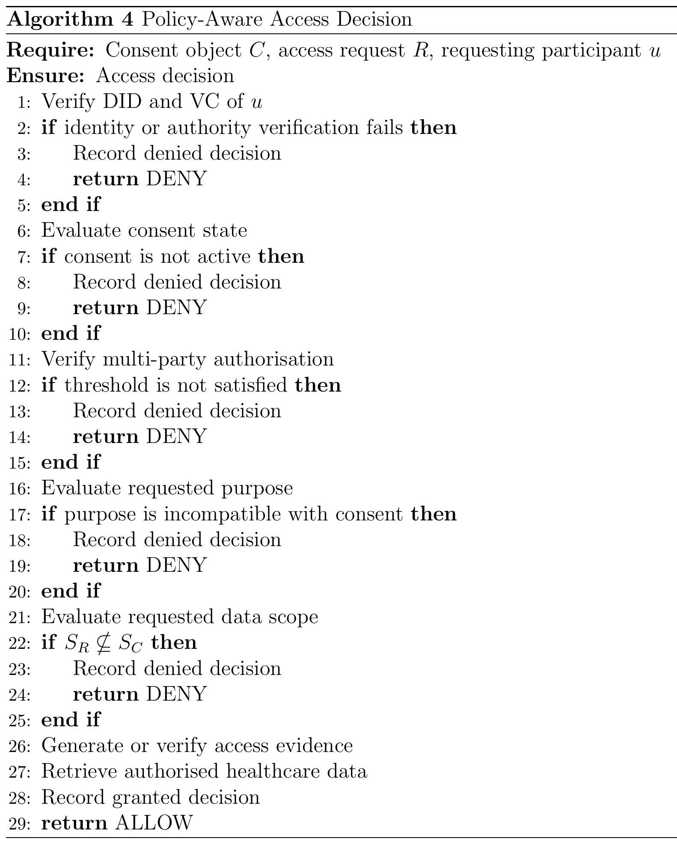
Proposed solution for objective 4
RO4: Policy- and Context-Aware Access Control
Status: Done
The requested data must be a non-empty subset of the agreed data scope.
The purpose must be a supported purpose of the consent.
Time and the lifecycle state are checked in the same decision.
Access evidence must be verified before any data is retrieved.
Example: asking for Procedure when only Observation and Medication were agreed gives DENY.
Notes:
Objective four: policy and data scope. It is done.
A valid identity and all approvals are still not enough. The requested data must be inside the agreed scope. For example, if the consent covers Observation and Medication, a request for Procedure is denied.
The purpose must also be a supported purpose. Time and lifecycle are checked in the same decision, and the access evidence must be verified before any data is returned.
----------------------------------------------------------------------------------------------------------------------------------
Inputs and Output
Require: Consent object C, access request R, requesting participant u
Explanation: The algorithm starts with the patient’s consent, the request for data, and the participant who makes the request, for example a doctor.
Ensure: Access decision
Explanation: The algorithm returns one decision, ALLOW or DENY, and it records that decision.
Step-by-Step Explanation
Line 1: Verify DID and VC of u
First, we verify the decentralised identifier and the verifiable credential of the requester. This uses the identity check from Algorithm 2.
Line 2: if identity or authority verification fails then
We check whether the identity or authority check for the requester has failed.
Line 3: Record denied decision
If it has failed, we record the denied decision for auditing.
Line 4: return DENY
The request is denied and stops here.
Line 5: end if
This completes the identity and authority check.
Line 6: Evaluate consent state
Next, we check the current state of the consent. It must be active, within its validity period, and not revoked.
Line 7: if consent is not active then
We check whether the consent is not active.
Line 8: Record denied decision
If the consent is not active, we record the denied decision.
Line 9: return DENY
The request is denied.
Line 10: end if
This completes the consent state check.
Line 11: Verify multi-party authorisation
Then, we verify the multi-party authorisation. We compare the number of valid approvals, |A_v|, with the required threshold N.
Line 12: if threshold is not satisfied then
We check whether there are fewer valid approvals than the threshold.
Line 13: Record denied decision
If there are not enough approvals, we record the denied decision.
Line 14: return DENY
The request is denied.
Line 15: end if
This completes the multi-party authorisation check.
Line 16: Evaluate requested purpose
Next, we compare the purpose of the request with the purpose the patient allowed in the consent.
Line 17: if purpose is incompatible with consent then
We check whether the purpose does not match the consent. This stops valid credentials from being used for a purpose the patient did not allow.
Line 18: Record denied decision
If the purpose does not match, we record the denied decision.
Line 19: return DENY
The request is denied.
Line 20: end if
This completes the purpose check.
Line 21: Evaluate requested data scope
We look at the data the request asks for, S_R, and the data the patient allowed, S_C.
Line 22: if S_R ⊈ S_C then
We check whether the request asks for data outside the allowed scope. For example, the request may ask for Procedure records when only Observation and Medication records are allowed.
Line 23: Record denied decision
If the request goes outside the scope, we record the denied decision.
Line 24: return DENY
The request is denied.
Line 25: end if
This completes the data scope check.
Line 26: Generate or verify access evidence
All checks have passed, so we generate or verify the evidence for this decision. It must be valid before any data is released.
Line 27: Retrieve authorised healthcare data
Then, we retrieve only the data inside the authorised scope, and nothing more.
Line 28: Record granted decision
We record the granted decision, so an auditor can see why and when access was given.
Line 29: return ALLOW
Finally, we return ALLOW, and the requester receives the authorised data.
Note: In the prototype, the request uses the consent’s own purpose, so the purpose check confirms that it is a supported healthcare purpose. The requested scope must also be non-empty.

Slide 26
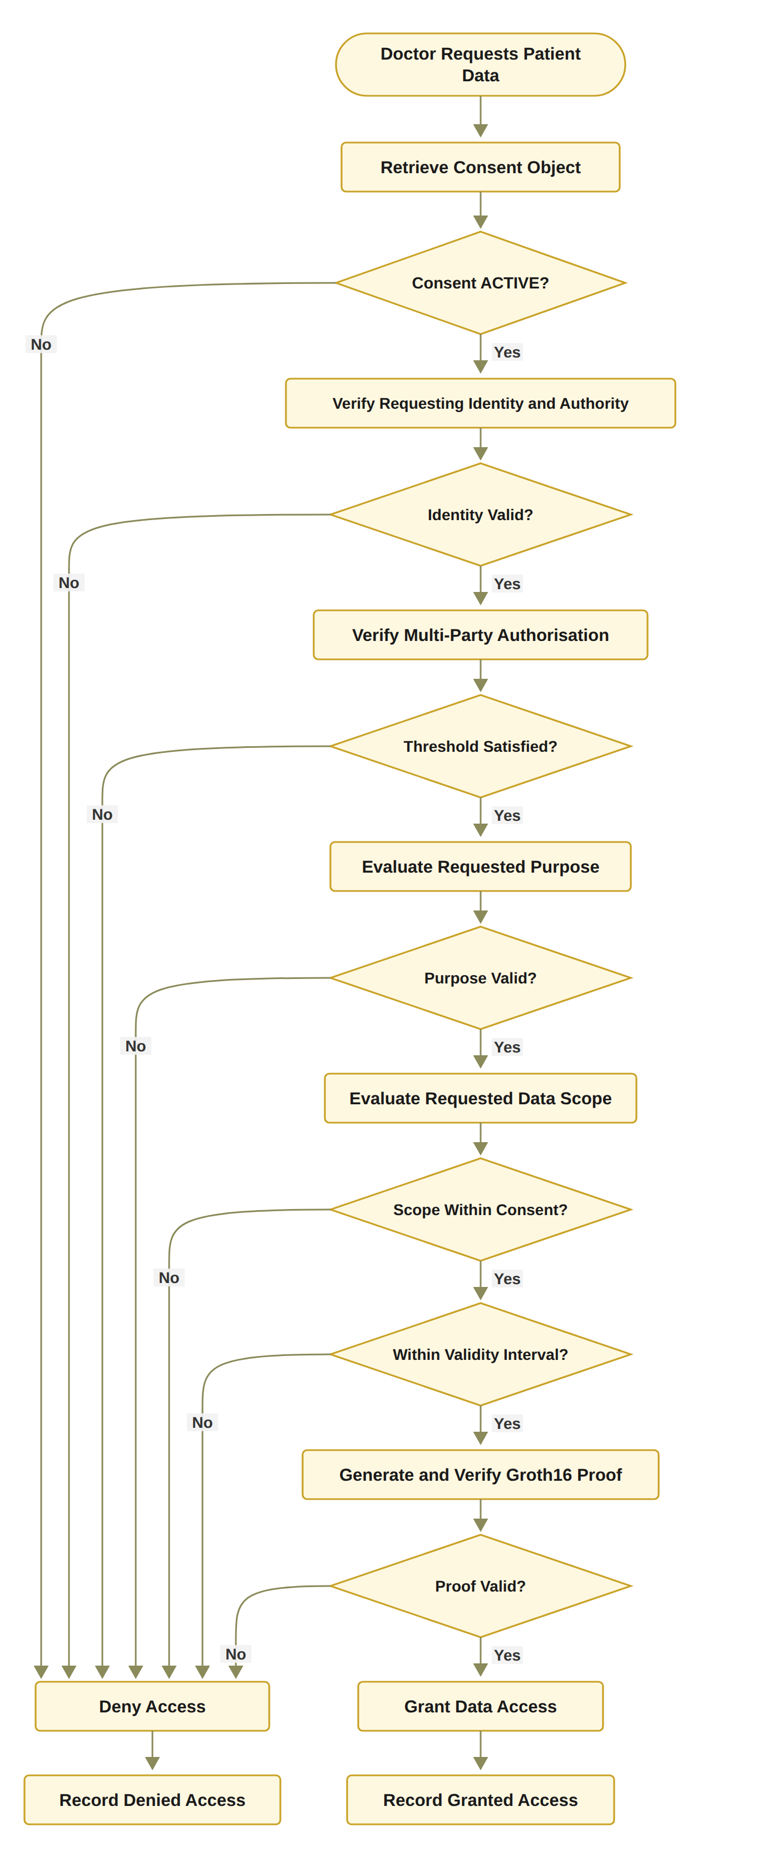
RO4: Policy- and Context-Aware Access Control
Notes:
This flowchart shows Algorithm 4. It checks the consent state, then the identity, then the approvals, then the purpose, then the data scope, then the time window, and finally the access proof. Any failure gives DENY and is recorded. Only when everything passes does the system return the authorised data.

Slide 27
Proposed solution for objective 5
RO5: Temporal and Lifecycle Trust
Status: In Progress
Working now: the validity window is stored on-chain and checked at every request.
Working now: revocation end to end, including an on-chain revoke transaction.
Design: L is the lifecycle state (CREATED, PENDING, ACTIVE, SUSPENDED, REVOKED, EXPIRED), checked by VL(C) = ValidState(C) ∧ ValidTransition(C).
Working now: a clear lifecycle: PENDING_SIGNATURE, PENDING_TOKEN, NOT_STARTED, ACTIVE, EXPIRED, REVOKED.
Next stage: the SUSPENDED state, the lifecycle transition check, consent modification, delegation, guardian-set changes and a formal lifecycle model.
Notes:
Objective five: time and lifecycle. This is in progress.
What works now: the validity window is stored on-chain and checked at every request. Revocation works end to end, including an on-chain revoke transaction. The prototype has clear states, such as PENDING_SIGNATURE, ACTIVE, EXPIRED and REVOKED, and access is allowed only when the consent is ACTIVE.
Next stage: the SUSPENDED state, the transition check, consent modification, delegation, guardian changes, and a formal lifecycle model.

Slide 28
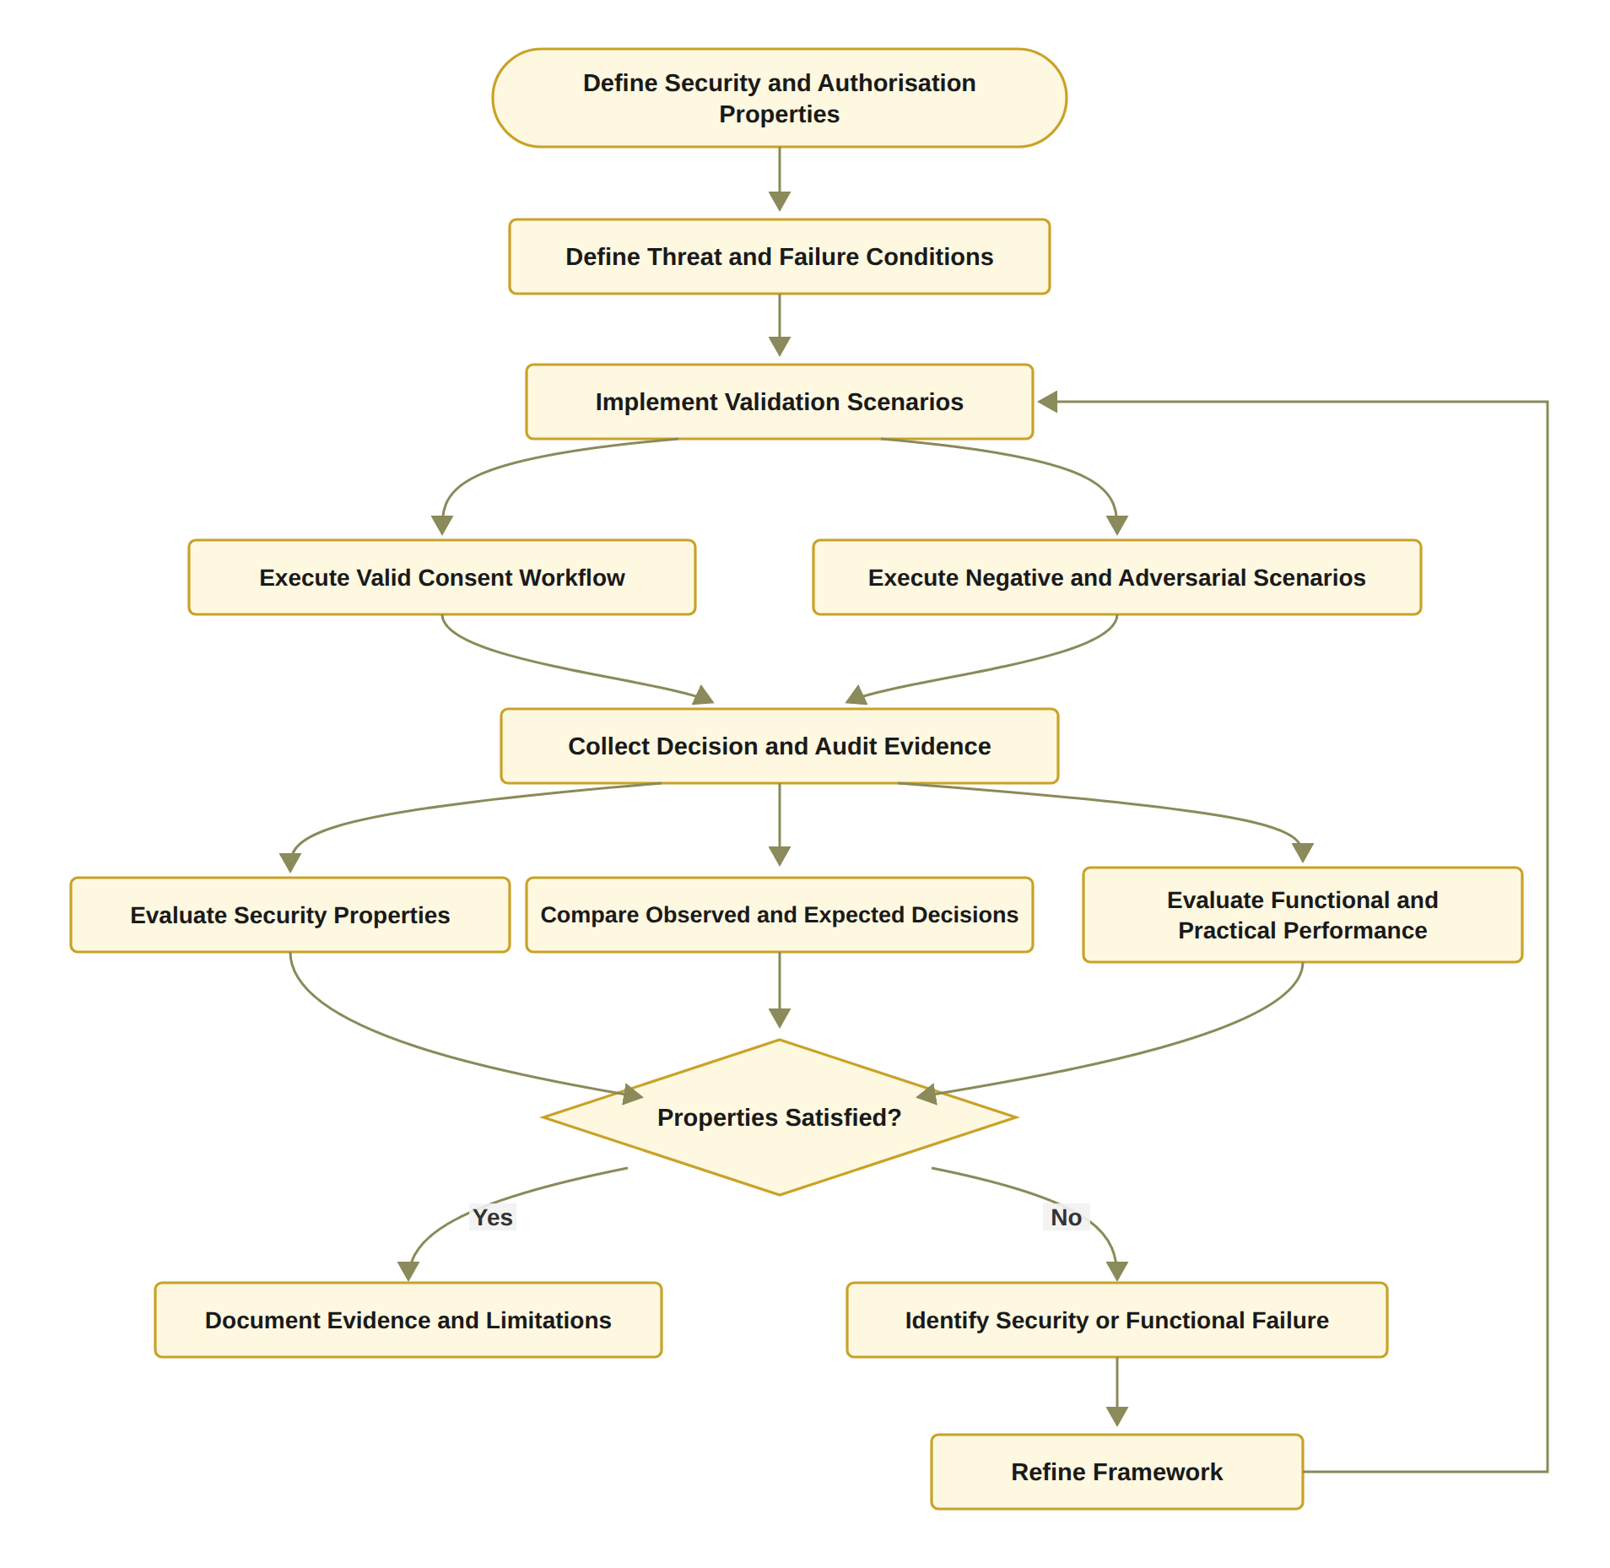
Proposed solution for objective 6
RO6: Formal Security Assurance and Empirical Validation
Status: Partially completed
Done: 46 automated tests pass, including 12 attack scenarios A1 to A12.
Done: processing time of each check measured.
Next stage: formal proofs or model checking of the security properties, and a larger evaluation under load.
Notes:
Objective six: security assurance and validation. It is partially completed.
The testing part is done: 46 automated tests pass, including the attack scenarios. I also measured the processing time of each check.
The flowchart shows the process: define the security properties, run valid and attack scenarios, compare the results with what we expect, and improve the framework when something fails.
The next stage adds formal proofs or model checking, and a larger evaluation under load.

Slide 29
THE HALAH PROTOTYPE
Four interfaces
Patient, guardian, doctor and auditor
Identity and credentials
A DID for every participant; a verifiable credential is checked before access or approval
Multi-party approval
Every listed guardian signs a digital approval; the consent becomes active only when all have signed
Decision engine
VI ∧ VA ∧ VP ∧ VT ∧ VL checked at every request; one failed check gives DENY
Data
Synthetic Synthea records: Observation, Medication, Condition, Procedure
Evidence
Audit ledger of consent events and access decisions; medical records stay inside the application
Notes:
Now let me show the prototype. HALAH means History Access Link for Authorised Healthcare.
It has four interfaces: patient, guardian, doctor and auditor. Every participant has a DID, and a verifiable credential is checked before access or approval. Every listed guardian must sign, and the consent becomes active only when all have signed. The decision engine checks the five conditions at every request, and one failed check gives DENY. The data are synthetic Synthea records. The audit ledger keeps all events, and the medical records stay inside the application.

Slide 30
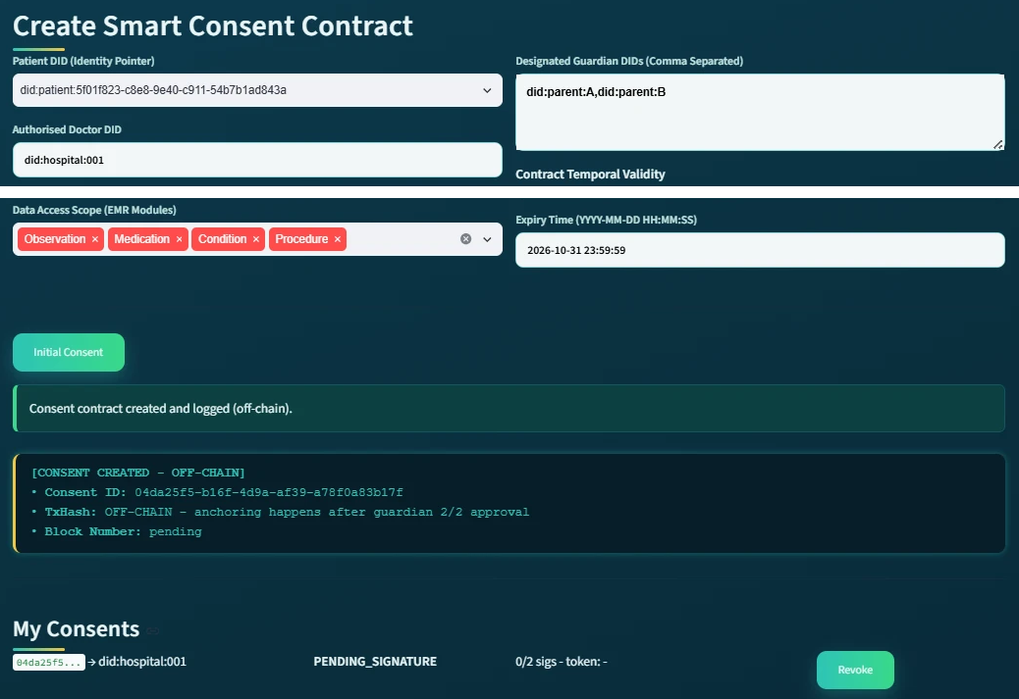
DEMO 1: THE PATIENT CREATES THE CONSENT
RO1
Consent as an evaluable object
The patient enters the doctor's DID, two guardians, the data modules and the end date.
The system saves the consent and gives it an ID.
The state is PENDING_SIGNATURE, with 0 of 2 signatures.
The consent is not active yet.
Patient screen, consent 04da25f5 (shown in two parts)
Notes:
This is the patient screen. The patient enters the doctor’s DID, two guardians, the data modules and the end date.
The system saves the consent and gives it an ID. The state is PENDING_SIGNATURE, with zero of two signatures. The consent is not active yet.
--------------------------------------------------------------------------------------
:
لو سألوا "ليش الموافقة مو فعالة؟":
“It is pending until both guardians approve. Only then does it become active.”
لو سألوا "وين RO1 هنا؟":
“This is RO1. The consent is created as a structured object with identity, guardians, data scope and time, so it can be checked at every request later.”
لو سألوا "هل النظام يتحقق من المدخلات؟":
“Yes. Bad input is rejected, for example an empty data scope, a malformed DID, or an end date before the start date.”

Slide 31
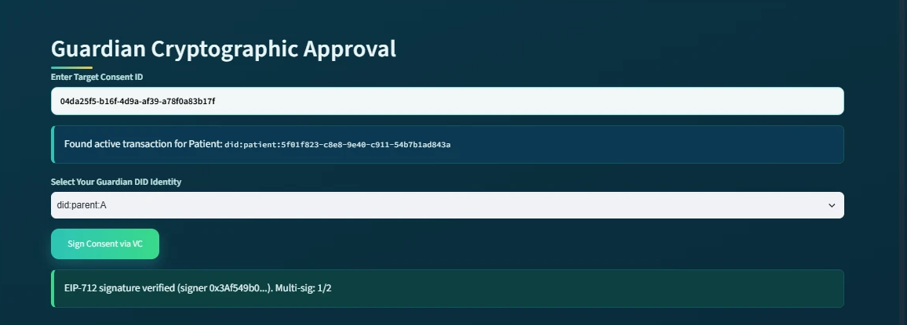
DEMO 2: THE FIRST GUARDIAN APPROVES
RO2 + RO3
Guardian A enters the consent ID and chooses their DID.
The first guardian signs a digital approval. The system checks the signature and finds who signed.
The counter shows 1 of 2. The consent stays pending.
Guardian screen at the first approval: signature verified, 1 of 2 signatures
Notes:
This is the guardian screen. The first guardian enters the consent ID and chooses their DID. The guardian signs a digital approval, and the system checks the signature and finds who signed.
The counter now shows one of two. One signature is not enough, so the consent stays pending.

Slide 32
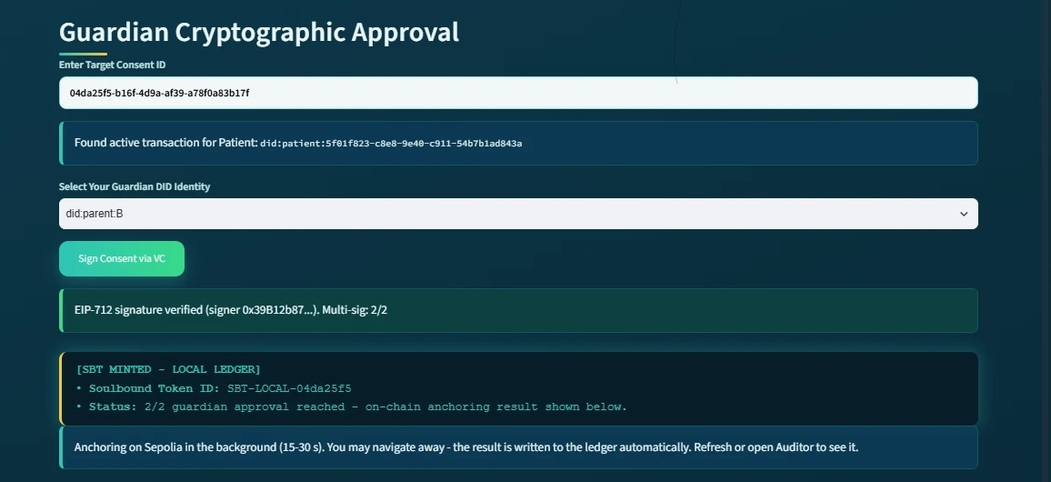
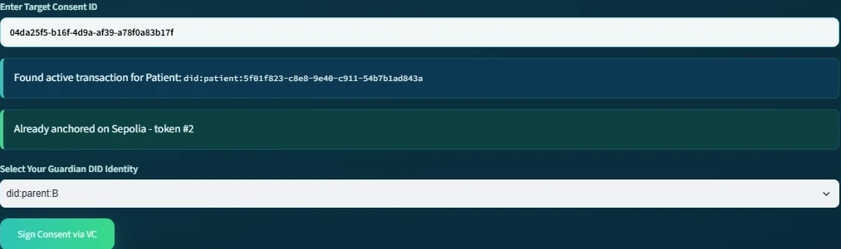
DEMO 3: SECOND APPROVAL, CONSENT ACTIVE
RO3
Threshold reached: 2 of 2, the consent becomes active
The second signature is verified. Now 2 of 2 guardians have signed.
The consent becomes active.
Second approval: 2 of 2 guardians signed
Same screen, later
Notes:
Now the second guardian signs. The signature is verified, and two of two guardians have signed, so the threshold is reached and the consent becomes active.

Slide 33
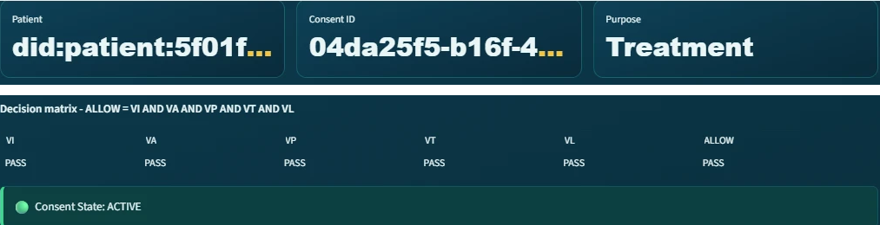
DEMO 4: THE DOCTOR IS ALLOWED
RO2 + RO4
The doctor opens the consent: patient, consent ID and purpose, Treatment. The state is ACTIVE.
The decision matrix shows VI, VA, VP, VT, VL all PASS, so ALLOW.
VP is the policy check: the purpose is checked here, and the scope when the doctor asks for the data.
Doctor screen, consent 04da25f5 (shown in two parts)
Notes:
This is the doctor screen for the same consent. At the top you see the patient, the consent ID and the purpose, Treatment. The state is ACTIVE.
The decision matrix shows all checks PASS, so the decision is ALLOW. The purpose is checked here, and the data scope is checked when the doctor asks for the data.

Slide 34
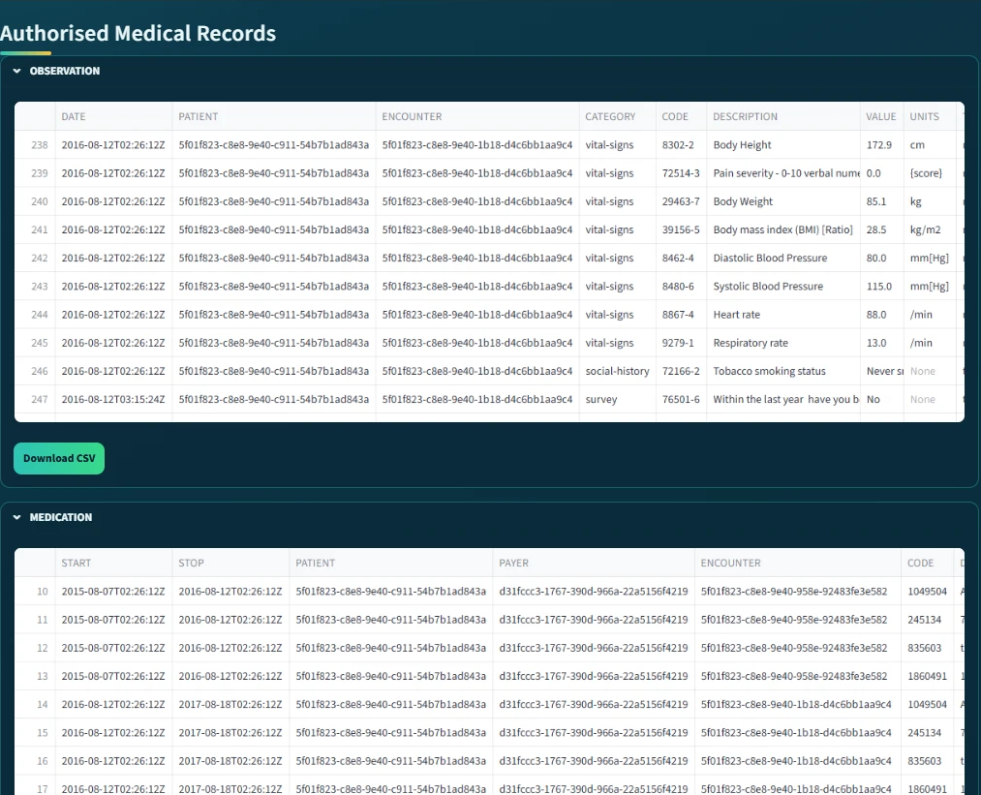
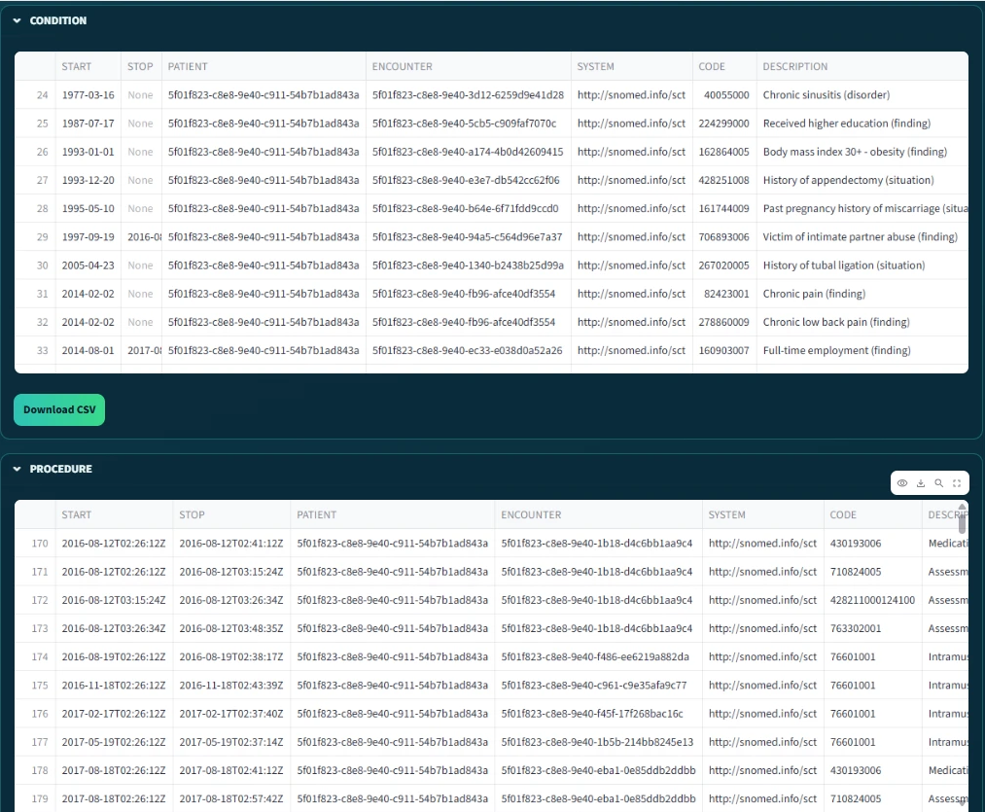
DEMO 5: ONLY THE AUTHORISED RECORDS
RO4
After ALLOW and the proof check, the screen shows the records, one table per module.
Only the four modules in the consent are shown. A request outside the scope is refused (attack test A4).
The data are synthetic Synthea records, not real patients.
Authorised records: Observation and Medication
Authorised records: Condition and Procedure
Notes:
After ALLOW and the proof check, the doctor sees the records, one table per module. Only the four modules in the consent are shown.
If the doctor asks for data outside the scope, the request is refused, as attack test A4 shows. These are synthetic Synthea records, not real patients.

Slide 35
VALIDATION
Evidence | What it checks | Pass rule | Result
Valid scenarios | Legitimate requests get access | Observed = expected | Scenarios 1 to 3: consent created, 2-of-2 approval, ALLOW
Negative scenarios | Wrong requests are refused | Any failed check gives DENY | Scenario 5: revoked consent refused
Attack scenarios | Deliberate attempts to bypass a check, A1 to A12 | Every attack is refused | 12 of 12 refused
Automated tests | 32 functional tests and 14 adversarial tests | All pass | 46 of 46 pass
Notes:
Validation asks one question: does the system do what it should?
I used four kinds of evidence. Valid scenarios: correct requests were allowed. Negative scenarios: wrong requests were refused, for example a revoked consent. Attack scenarios: all twelve deliberate attempts to bypass a check were refused. Automated tests: all 46 pass.

Slide 36
VALIDATION: THE RECORDED DECISIONS
Time (24 Sep) | Consent | VI | VA | VP | VT | VL | Decision | Access
09:51:36 | f050c29a | PASS | PASS | PASS | PASS | PASS | ALLOW | GRANTED
09:51:39 | f050c29a | PASS | PASS | PASS | PASS | PASS | ALLOW | GRANTED
11:02:52 | 04da25f5 | PASS | PASS | PASS | PASS | PASS | ALLOW | GRANTED
11:04:16 | 04da25f5 | PASS | PASS | PASS | PASS | PASS | ALLOW | GRANTED
11:04:26 | 04da25f5 | PASS | PASS | PASS | PASS | PASS | ALLOW | GRANTED
Allowed requests: all five checks PASS, decision ALLOW, access GRANTED (Scenario 3).
After revocation (Scenario 5) the request was refused before any decision was logged; the prototype now logs these refusals too. The revocation is public on Sepolia, block 11,771,307.
Notes:
This table comes directly from the audit ledger of 24 September. Each row is one real request, with the five checks and the decision. All five requests passed every check, so access was granted.
After revocation, the request was refused. At that time the refusal was not logged, but the prototype now logs these refusals too. The revocation is public on Sepolia.

Slide 37
VALIDATION: THE RECORDED DECISIONS
Date and time | Consent | VI | VA | VP | VT | VL | Decision | Access
24 Sep 09:51:36 | f050c29a | PASS | PASS | PASS | PASS | PASS | ALLOW | GRANTED
24 Sep 09:51:39 | f050c29a | PASS | PASS | PASS | PASS | PASS | ALLOW | GRANTED
24 Sep 11:02:52 | 04da25f5 | PASS | PASS | PASS | PASS | PASS | ALLOW | GRANTED
24 Sep 11:04:16 | 04da25f5 | PASS | PASS | PASS | PASS | PASS | ALLOW | GRANTED
24 Sep 11:04:26 | 04da25f5 | PASS | PASS | PASS | PASS | PASS | ALLOW | GRANTED
11 Oct 17:42:04 | 18ab9b62 | FAIL | PASS | PASS | PASS | PASS | DENY | DENIED
11 Oct 17:42:39 | 18ab9b62 | PASS | FAIL | PASS | PASS | FAIL | DENY | DENIED
Allowed requests (24 September): all five checks PASS, decision ALLOW, access GRANTED (Scenario 3).
After revocation (Scenario 5) the request was refused before any decision was logged.
The prototype now logs every refusal. Local test run, 11 October 2026: a doctor not named in the consent fails VI, and the request after revocation fails VA and VL. Both are DENY.
Notes:
This table comes directly from the audit ledger. The first five rows are real requests from 24 September. All five passed every check, so access was granted.
After the revocation of 24 September, the request was refused, but at that time the refusal was not logged.
The prototype now logs these refusals too. The last two rows are from a local test run on 11 October. In the first, a doctor who is not named in the consent asked for the data, so VI failed. In the second, the patient revoked the consent, so VA and VL failed. Both decisions were DENY, and both refusals were recorded.

Slide 38
VALIDATION: ATTACK SCENARIOS
ID | Attack | Target | Before hardening | After hardening
A1 | Approval signed by a signer outside G | A | Accepted* | Refused
A2 | Guardian signature replayed from another consent | I | Refused | Refused
A3 | Same guardian approves twice to reach N | A | Accepted* | Refused
A4 | Requested scope exceeds the authorised scope | P | Refused | Refused
A5 | Request with an empty scope | P | Accepted* | Refused
A6 | Request before notBefore or after expiry | T | Refused | Refused
A7 | Requester declares a different jurisdiction | P | Refused | Refused
A8 | Access after revocation | L | Refused | Refused
A9 | Tampered Groth16 proof or public signal | E | Refused | Refused
A10 | Honest proof for an expired consent | T | Refused | Refused
A11 | Mint or revoke by a non-owner, or token transfer | Contract | Refused | Refused
A12 | Invalid or forged credential | I | Accepted‡ | Refused
Notes:
I also attacked my own system. This table shows each attack, the part of the consent it targets, and the result before and after hardening.
Some attacks, marked Accepted, passed at unit level before the hardening, when the service function was called directly. For A1, A3 and A5, the interface already blocked them. A12 was accepted before the credential check was added. After hardening, all twelve attacks in this table are refused.
-------------------------------------------------------------------------------------------------------------------
A11 attacks the smart contract itself. An account that is not the owner tries to mint a consent token, revoke someone else’s consent, or transfer the token. All three are refused: only the owner can mint or revoke, and the token is soulbound, so it cannot be transferred. This test runs the contract code on a local test chain, not on Sepolia.

Slide 39
Traditional EHR vs. HALAH Framework
Aspect | Traditional EHR access control | HALAH framework
Identity | Central identity provider; institution login | A DID for every participant; identity kept separate from authority
Consent | A stored record that permission was given | An object C = (I, A, P, T, L, E), checked at every request
Approval | A static permission set by one party | All listed guardians sign a digital approval; no single party can approve alone
Access check | Log in, then check a static permission | VI ∧ VA ∧ VP ∧ VT ∧ VL checked at every request; one failed check gives DENY
Time and revocation | Hard to verify once the permission is stored | Validity window and revocation checked at every request
Audit | A record that consent occurred | Every access decision, allowed or denied, logged with its decision matrix
Notes:
Here is the difference in plain words. In a traditional EHR system, a central provider logs you in, and a static permission decides. Consent is just a saved record.
In HALAH, every participant has a DID, and identity is separate from authority. Consent is an object checked at every request. All guardians must sign, so no single party can approve alone. Time and revocation are checked every time, and every decision is logged with its reasons.

Slide 40
DATASET OVERVIEW
Aspect | Description
Dataset | Synthea 1K, a public synthetic healthcare dataset containing 1,000 simulated patient records.
Data Type | Synthetic patient demographics, medical conditions, medications, and procedures
Data Format | CSV files
Data Usage | Healthcare data-access scenarios for prototype testing
Data Privacy | No real patient data is used
Notes:
This slide shows the dataset used in my research.
I used Synthea 1K, a public synthetic healthcare dataset.
It contains 1,000 simulated patient records.
The data includes patient information, medical conditions, medications, and procedures.
The data is stored in CSV files.
I used this dataset to test healthcare data access in my prototype.
No real patient data was used.

Slide 41
RESEARCH CONTRIBUTIONS
Scientific Contributions
This research proposes a trust-centric consent model that integrates identity, authority,
multi-party approval, and policy constraints into a unified healthcare authorisation framework.
This research proposes a multi-party authorisation mechanism that requires approval from
multiple verified participants before granting healthcare data access, where collective consent is required.
This research proposes a trust-aware authorisation approach that evaluates identity, authority,
collective approval, and policy compliance when determining healthcare data-access permissions.
Notes:
Now the contributions of this research. On the scientific side, it proposes three things.
First, a trust-centric consent model that brings identity, authority, multi-party approval and policy into one healthcare authorisation framework.
Second, a multi-party authorisation mechanism: access needs approval from several verified participants when collective consent is required.
Third, a trust-aware authorisation approach that checks identity, authority, collective approval and policy compliance before giving access to healthcare data.

Slide 42
RESEARCH CONTRIBUTIONS
Social Contributions
This research aims to help patients and their guardians manage consent for sharing sensitive healthcare information, supporting greater control over healthcare data access.
This research aims to support patient privacy by restricting healthcare data access according to authorised purposes and data scopes.
This research aims to support transparency and accountability in healthcare data sharing by providing verifiable records of consent activities and access decisions.
Notes:
On the social side, the research has three aims.
It helps patients and their guardians manage consent, so they have more control over who can access their health data.
It supports patient privacy, because access is limited to the agreed purpose and data scope.
And it supports transparency and accountability, because every consent activity and access decision has a verifiable record.

Slide 43
RESEARCH PUBLICATIONS
# | Title | Venue | Year | Status
1 | A Blockchain-Based Framework for Evaluating User Identity Trustworthiness in Real Estate | 2025 IEEE International Conference on E-Business Engineering (ICEBE) | 2025 | Published
2 | Blockchain-Based Reputation Borrowing Model to Address the Cold Start Problem for New Users in Real Estate | 2025 IEEE International Conference on E-Business Engineering (ICEBE) | 2025 | Published
3 | A Smart Contract-Governed Lifecycle Protocol for Reputation Borrowing in Blockchain-Based Real Estate Platforms | ICEBE 2026 | 2026 | Accepted
4 | A Trusted Multi-Party Consent Governance Framework for Decentralized Multi-Stakeholder Data Sharing | BWCCA 2026 | 2026 | Accepted
5 | Blockchain-Based Reputation Provenance Tracing for Newcomer Bootstrapping in Real Estate | BWCCA 2026 | 2026 | Accepted
Notes:
These are my publications. Two papers were published in 2025 at the IEEE ICEBE conference. Three more papers were accepted in 2026: one at ICEBE 2026 and two at BWCCA 2026. Paper 4, on trusted multi-party consent governance, comes directly from this research.

Slide 44
RESEARCH PLAN
Task | Description | Target date | Status
Chapters 1–4 | Introduction, SLR, Research Questions and Objectives, Research Methodology | Completed | Done
Chapter 5 | Research Architecture (MVC) and framework design and Proposed solution for RO2 | May 2026 | Done
Chapter 6 | Proposed solution for RO3 | Jul 2026 | Done
Publication 1 | Conference paper submission, BWCCA 2026 | Sep 2026 | Done
Chapter 7 | Proposed solution for RO4 | Sep 2026 | Done
Publication 2 | SLR paper journal submission | Oct 2026 | Ready for submission
Chapter 8 | Proposed solution for RO5 | Nov 2026 | In progress
Chapter 9 | Conclusion and Future work | Dec 2026 | Planned
Publication 3 | Journal paper on formal security assurance, lifecycle trust and the evaluation of HALAH | Jan 2027 | Planned
Final assessment | Candidature Assessment 3 | Feb 2027 | Planned
Thesis | Complete thesis submission | May 2027 | Planned
Notes:
This is my research plan. Chapters one to four are done: introduction, literature review, research questions and objectives, and methodology. Chapters 5, 6 and 7 are done: the architecture and the solutions for RO2, RO3 and RO4. The BWCCA conference paper is done, and the SLR journal paper is ready for submission.
In progress: Chapter 8, the solution for RO5.
Planned: Chapter 9 with the conclusion in December, the journal paper on formal assurance in January 2027, the next candidature assessment in February 2027, and thesis submission in May 2027.
-------------------------------------------------------------------------------------------
yes I am confident to finish my PhD research on time I have a clear research plan and time plan .
اذا الجواب no
I believe I can finish on time but if I need more time I can apply for an extension
Ca3 gap thesis
Get the feedback from my supervisor then proofread my thesis and prepare for final submission
I need 3 months for addressing my supervisor feedback and proofread my thesis before final submission

Slide 45
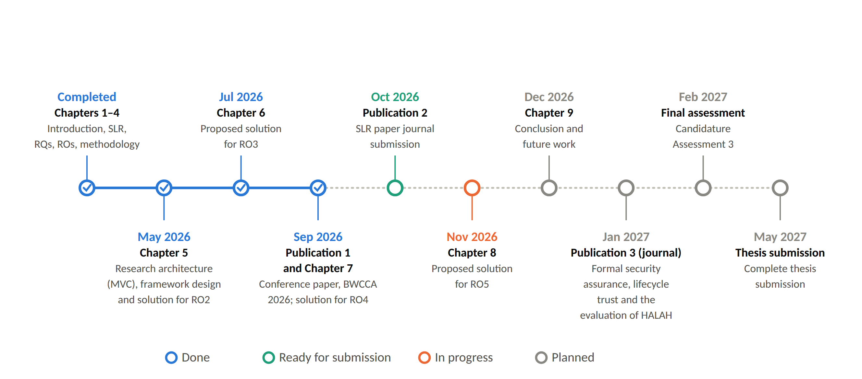
RESEARCH TIMELINE
Notes:
This is my research timeline. Chapters one to seven and the BWCCA conference paper are done. The SLR journal paper is ready for submission, and Chapter 8 on RO5 is in progress. In December, Chapter 9 with the conclusion. In January 2027, the journal paper on formal assurance. Then the next candidature assessment in February 2027, and thesis submission in May 2027.

Slide 46
REFERENCES
Bloemen, R., Logvinov, L. & Evans, J. 2017, EIP-712: Typed structured data hashing and signing, Ethereum Improvement Proposals, no. 712, viewed 6 October 2026, https://eips.ethereum.org/EIPS/eip-712.
Groth, J. 2016, 'On the size of pairing-based non-interactive arguments', Advances in Cryptology – EUROCRYPT 2016, LNCS, vol. 9666, pp. 305–326, Springer, https://doi.org/10.1007/978-3-662-49896-5_11.
Page, M.J., McKenzie, J.E., Bossuyt, P.M., Boutron, I., Hoffmann, T.C., Mulrow, C.D. et al. 2021, 'The PRISMA 2020 statement: An updated guideline for reporting systematic reviews', BMJ, vol. 372, p. n71, https://doi.org/10.1136/bmj.n71.
Peffers, K., Tuunanen, T., Rothenberger, M.A. & Chatterjee, S. 2007, ‘A design science research methodology for information systems research’, Journal of Management Information Systems, vol. 24, no. 3, pp. 45–77, https://doi.org/10.2753/MIS0742-1222240302.
Walonoski, J., Kramer, M., Nichols, J., Quina, A., Moesel, C., Hall, D. et al. 2018, 'Synthea: An approach, method, and software mechanism for generating synthetic patients and the synthetic electronic health care record', Journal of the American Medical Informatics Association, vol. 25, no. 3, pp. 230–238, https://doi.org/10.1093/jamia/ocx079.
Notes:
These are the references I used in this presentation.

Slide 47
Thank You
Notes:
Thank you for your attention.
Likely questions and short answers:
1. Why blockchain, if the data stays off-chain?
It gives a shared record that cannot be changed quietly: the consent state and the revocation. No medical data is on the chain.
2. What is new?
The consent object carries all the conditions. Multi-party approval is a condition of every access, not a backup path. And the whole decision is tested against attacks.
3. Why is RO6 only partly done?
The testing is done. The formal proofs are the next stage.
4. Why Groth16?
It proves the consent has not expired without showing the secret. Today the prover and verifier run on the same server, so it shows the ZK step works; it is not yet an extra privacy guarantee.
5. Why did some attacks pass before the hardening?
Only when the service functions were called directly, not through the screens. The checks are now in the service layer, so they are refused on every path.
6. The guardian keys come from the DIDs. Can someone else sign?
In the prototype, yes in principle. That is a known limitation. Wallet-held keys and full DID resolution are planned for the next stage.
7. Why N-of-N and not k-of-n?
N-of-N is the safest setting: no guardian can be bypassed. k-of-n is a direct generalisation for future work.

Slide 48
Type | What it means | Used in HALAH
Language | Used to write the code | Python (the system), circom (the proof circuit)
Platform | Where the system runs | GitHub Codespaces (Linux cloud), Python 3.11 and Node.js 20 runtimes, web browser
Tool | Software used to build, run or test | Streamlit (interface), SQLite (database), snarkjs (proof), pytest (46 tests), Playwright (screen runs)
Library | Ready-made code inside the system | pandas, eth-account, circomlib
Protocol / standard | Agreed rules for how something works | DID and VC (W3C identity), EIP-712 (signed approval), Groth16 (zero-knowledge proof)
Algorithm | A calculation method | SHA-256 (audit digest), Poseidon (hash inside the proof)
Other | Design pattern, data and file format | MVC (architecture pattern), Synthea 1K (synthetic dataset), CSV (file format)

