Slide 1

A Trusted Authorisation Framework for Multi-Party Patient Consent in Healthcare Data Sharing
Candidature Reassessment
Principal Supervisor: Professor Farookh Hussain
Co-Supervisor: Dr. Firas Al-Doghman
Presenter: Yasir Dhaifallah O Alyoubi
STUDENT ID #: 24724078
Notes:
Hello everyone. My name is Yasir Alyoubi. My principal supervisor is Professor Farookh Hussain, and my co-supervisor is Dr Firas Al-Doghman. Today I present my candidature reassessment.
My research title is A Trusted Authorization Framework for Multi-Party Patient Consent in Healthcare Data Sharing. My research asks one main question. Before any patient data is shared, how can a system check the patient's consent together with identity, authority, approvals, policy and time, all in one decision?

Slide 2
OUTLINE
01
INTRODUCTION
07
THE PROPOSED SOLUTIONS
02
SYSTEMATIC LITERATURE REVIEW
08
IMPLEMENTATION AND EVALUATION
03
​RESEARCH GAP
09
SIGNIFICANCE OF THE RESEARCH
04
RESEARCH QUESTIONS
10
RESEARCH PLAN
05
RESEARCH OBJECTIVES
11
REFERENCES
06
RESEARCH METHODOLOGY
Notes:
This slide is the outline of my talk. It has eleven parts.
I start with the introduction and the systematic literature review. Then I show the research gap, the research questions and the research objectives. After that I explain the research methodology and the proposed solutions.
Next, I show the implementation and evaluation of my prototype. I finish with the significance of the research, the research plan and the references.

Slide 3
INTRODUCTION
Healthcare data is very sensitive and is shared across many independent parties: patients, guardians, doctors and hospitals.
Consent is usually stored as a passive record of permission.
A valid identity does not prove the authority to access a patient's data.
Even with approval, a request can exceed the authorised purpose or data scope.
We need one trusted decision that checks identity, authority, multi-party approval, policy, time and lifecycle together.
The central problem
There is no integrated, trust-oriented mechanism that connects identity, authority, multi-party approval, policy, temporal and lifecycle conditions in one authorisation decision, and whose security is formally and empirically shown.
Notes:
This slide explains why this research is needed.
First, healthcare data is very sensitive. It is shared between many independent parties, like patients, guardians, doctors and hospitals.
Second, consent is usually kept as a passive record. It only says that permission was given.
Third, identity is not authority. A system may know who you are. That does not mean you may see this patient's data.
Fourth, even with approval, a request can ask for more data, or for another purpose, than the patient allowed.
So the last point is that we need one trusted decision that checks all these conditions together.
The box on the right states the central problem. No current mechanism links all these conditions in one decision and also shows that it is secure. "Formally" means with exact definitions. "Empirically" means with tests and measurements.

Slide 4
INTRODUCTION: KEY CONCEPTS
Identity
Can the participant be reliably identified? (DID)
Authority
Does the participant hold the role or permission for this decision? (VC)
Multi-party approval
Have all required, independently verified guardians approved?
Policy
Is the request inside the authorised purpose and data scope?
Time and lifecycle
Is the consent within its validity window, and not expired or revoked?
Consent as an evaluable authorisation object
C = (I, A, P, T, L, E)
Identity (I) · Authorisation (A: guardian set G, threshold N) · Policy (P: purpose, scope) · Time (T) · Lifecycle (L) · Evidence (E)
Notes:
This slide defines the key ideas I use in the whole research.
The top row has three questions. Identity asks if we can reliably know who the participant is. For this I use a DID, which means a decentralised identifier. Authority asks if the participant has the right role or permission. For this I use a VC, which means a verifiable credential. Multi-party approval asks if all required guardians approved, and if each one was checked on their own.
In the second row, Policy asks if the request stays inside the allowed purpose and data scope. Time and lifecycle asks if the consent is still valid, and not expired or revoked.
The dark box brings it together. Consent becomes an object the system can evaluate: C equals I, A, P, T, L, E. That is identity, authorisation, policy, time, lifecycle and evidence. Authorisation holds the guardian set G and the threshold N, which is the number of approvals needed. L means lifecycle.

Slide 5
SYSTEMATIC LITERATURE REVIEW
Stage | Method | Details
Protocol | PRISMA 2020, written protocol (v1.1) | Review questions, databases, master query, criteria, codebook and quality items fixed before screening
Search | One master query, three concept blocks | IEEE Xplore, ACM DL, ScienceDirect, SpringerLink, ProQuest Science and Technology, Scopus, Web of Science; Google Scholar as discovery arm
Dates | Main searches in August 2026 | 24 and 25 August 2026; ACM DL on 5 September 2026
Screening | Title, abstract, then full text | Inclusion criteria IC1 to IC7, exclusion criteria EC1 to EC9
Quality | QA1 to QA4 (Yes 1, Partial 0.5, No 0) | A study is included when QA1 + QA2 + QA3 + QA4 ≥ 3.0
Notes:
This slide shows how I ran the systematic literature review. I read the table from top to bottom.
Protocol: I followed PRISMA 2020. This is a standard guide that makes a review clear and repeatable. A written protocol, version 1.1, fixed the questions, databases, query, criteria and quality items before screening started.
Search: I used one master query with three concept blocks joined by AND. The blocks cover healthcare data, consent and authorisation, and trust and multi-party ideas. I searched seven databases. Google Scholar was only a discovery arm, so its results are reported separately.
Dates: the main searches were on 24 and 25 August 2026. ACM Digital Library was searched later, on 5 September 2026.
Screening went from title, to abstract, to full text, with seven inclusion and nine exclusion criteria. For quality, a study is included when QA1 to QA4 add up to at least 3.0.
Possible question: Why was ACM searched later? My UTS Library account was put on hold after I downloaded many full-text PDFs, so I had no access. The library removed the hold, but it took time. I used the same string and fields.

Slide 6
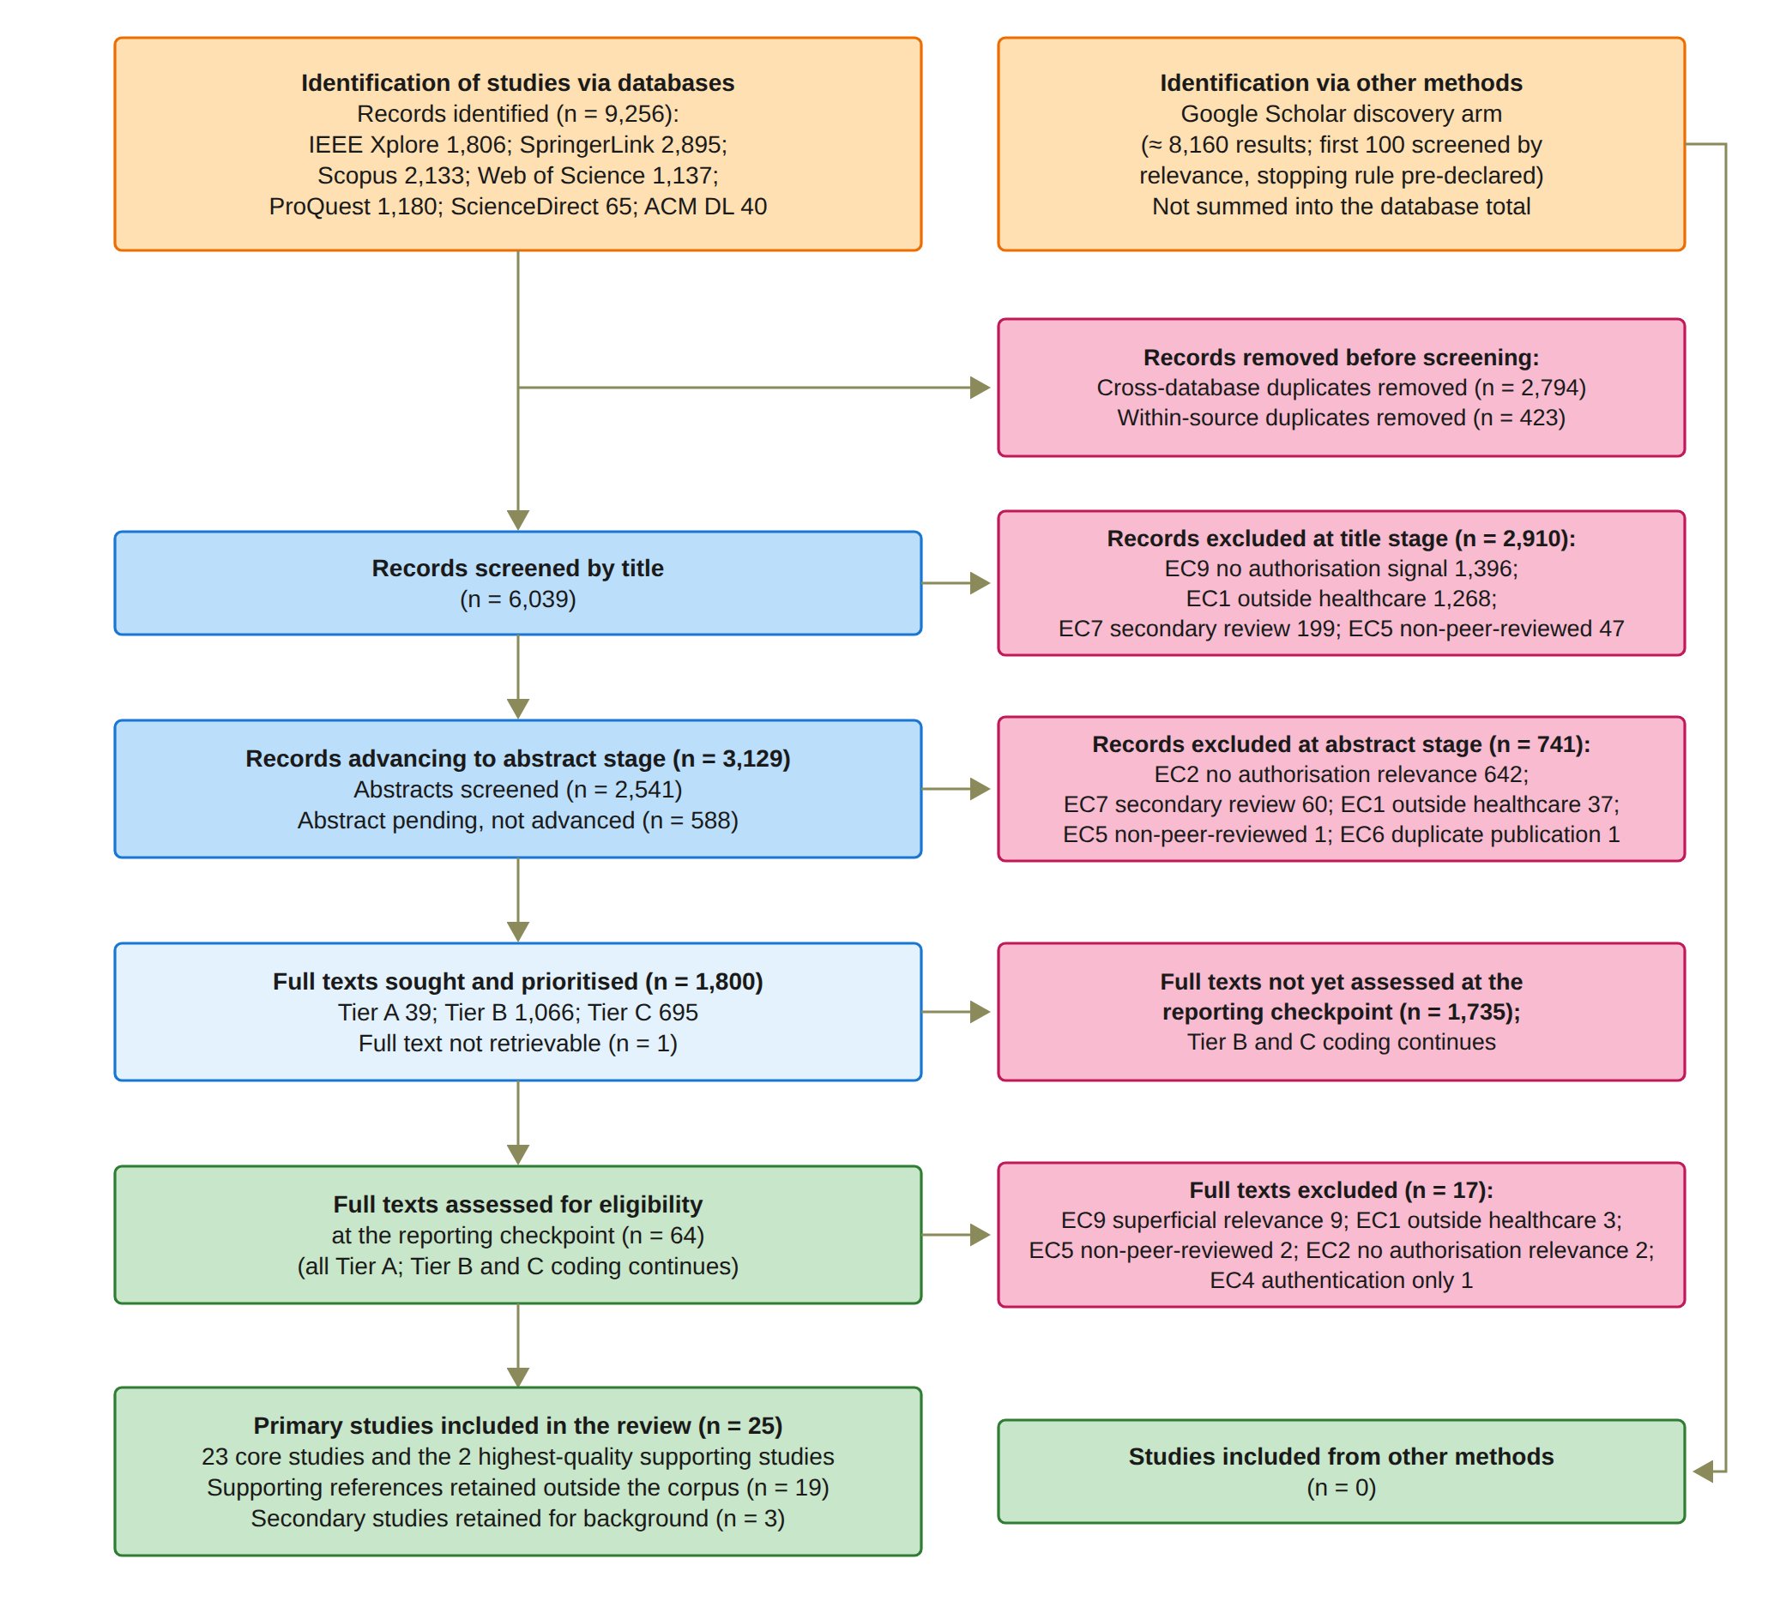
SYSTEMATIC LITERATURE REVIEW PROCESS
Notes:
This is the PRISMA flow diagram. It shows how the number of papers went down at each step.
The seven databases returned 9,256 records. Google Scholar, on the right, was only a discovery arm, so it is not added to this total.
After removing duplicates, 6,039 records were screened by title. 2,910 were excluded, mostly because they had no authorisation signal or were outside healthcare. That left 3,129 records for the abstract stage. 2,541 abstracts were screened and 741 were excluded. 588 could not be screened, because the export had no abstracts.
Next, 1,800 full texts were sought and sorted into priority tiers A, B and C. At the reporting checkpoint, 64 full texts were assessed. That is all 39 in Tier A and 25 more. 17 were excluded. The other 1,735 are not assessed yet, and that work continues.
The last box shows the 25 primary studies: 23 core studies plus the 2 supporting studies with the highest quality score.
Possible question: Why does the report say 44 studies? The 25 primary and 19 supporting studies make 44. The 3 secondary studies are kept only for background.

Slide 7
QUALITY ASSESSMENT
Item | Question | Used for
QA1 | Does the study deal with patient consent or consent-governed data access at the healthcare level? | Inclusion
QA2 | Does it deal with an authorisation or access-decision mechanism, not storage or recording only? | Inclusion
QA3 | Does it introduce a proper framework, model, protocol or architecture to address its aim? | Inclusion
QA4 | Is the proposed methodology validated by a proof of concept or an implementation? | Inclusion
QA5 to QA8 | Further quality items scored for every included study | Evidence tier only
Rule | Yes = 1, Partial = 0.5, No = 0; included when QA1 + QA2 + QA3 + QA4 ≥ 3.0 | —
Notes:
This slide gives the quality assessment rules.
QA1 asks if the study is about patient consent, or data access controlled by consent, in healthcare. QA2 asks if it has a real authorisation or access-decision mechanism, not only storage or recording. QA3 asks if it offers a proper framework, model, protocol or architecture. QA4 asks if the method is tested with a proof of concept or an implementation.
These four items decide inclusion. QA5 to QA8 are extra quality items. They were scored for every included study, but they only place a study in an evidence tier: A, B, C or Background. They do not decide inclusion. These evidence tiers are not the same as the priority tiers on the PRISMA slide.
The last row is the rule. Yes scores 1, Partial scores 0.5 and No scores 0. A study is included when QA1 to QA4 add up to at least 3.0 out of 4.

Slide 8
KEY REQUIREMENTS
Req 1
Consent as an evaluable authorisation object
Req 2
Decentralised verification of identity and authority
Req 3
Multi-party authorisation through a verifiable threshold
Req 4
Policy- and context-aware enforcement at access time
Req 5
Temporal validity and lifecycle control of consent
Req 6
Verifiable auditability and security assurance
Notes:
From the literature, I defined six key requirements for trustworthy multi-party consent. Each requirement matches one research question, and later one research objective.
Req 1: consent should be an object the system can evaluate at access time, not only a record.
Req 2: identity and authority are checked in a decentralised way, with DIDs and verifiable credentials. Identity tells us who the person is. Authority tells us what they may do.
Req 3: multi-party authorisation. A set number of independent approvals, called the threshold, must be reached. So no single person can approve alone.
Req 4: policy and context. Even an approved request must stay inside the allowed purpose and data scope.
Req 5: time and lifecycle. Expired or revoked consent must not work.
Req 6: auditability and security assurance. Every decision keeps evidence that explains why it was made. The security properties are also defined and tested.

Slide 9
LIST OF THE 25 PRIMARY STUDIES
Study | Author(s) | Year | Title | Category
S1 | Abbasi, Humeidi & Wang (2026) | 2026 | Nexa: Enabling Secure, Scalable, and Decentralized Management of Electronic Health Records Using Threshold Cryptography and Public Blockchains | Multi-party authorisation (Req 3)
S2 | Albalwy, Brass & Davies (2021) | 2021 | A Blockchain-based dynamic consent architecture to support clinical genomic data sharing (ConsentChain): Proof-of-concept study | Policy and context (Req 4)
S3 | Al Amin, Altarawneh & Ray (2023) | 2023 | Informed Consent as Patient Driven Policy for Clinical Diagnosis and Treatment: A Smart Contract Based Approach | Consent representation (Req 1)
S4 | Ekholm et al. (2025) | 2025 | Implementing electronic informed consent in rare disease genomics | Multi-party authorisation (Req 3)
S5 | Eneh et al. (2026) | 2026 | Demo: EdgeConsent: On-Chain Attribute-Based Access Control for Data Consent Management | Temporal and lifecycle (Req 5)
S6 | Hagström et al. (2024) | 2024 | Minors’ and guardian access to and use of a national patient portal: A retrospective comparative case study of Sweden and Finland | Multi-party authorisation (Req 3)
S7 | Jaiman & Urovi (2020) | 2020 | A Consent Model for Blockchain-Based Health Data Sharing Platforms | Policy and context (Req 4)
S8 | Zhao & Su (2024) | 2024 | A threshold traceable delegation authorization scheme for data sharing in healthcare | Security assurance (Req 6)
S9 | Li et al. (2026a) | 2026 | Privacy-Preserving Fine-Grained EMR Access Control for IoMT: A Hybrid RBAC-Smart Contract Scheme With Attribute-Based Authorization | Temporal and lifecycle (Req 5)
S10 | Madine et al. (2020) | 2020 | Fully Decentralized Multi-Party Consent Management for Secure Sharing of Patient Health Records | Multi-party authorisation (Req 3)
S11 | Maruthi & Singh (2025) | 2025 | Enhancing Security and Privacy of IoMT Data for Unconscious Patient With Blockchain | Security assurance (Req 6)
S12 | Mei et al. (2026) | 2026 | Efficient Dual-Revocation CP-ABE for Secure and Fine-Grained Data Sharing in IoMT | Security assurance (Req 6)
S13 | Panagoulias et al. (2026) | 2026 | Blockchain-Enabled Trust and Compliance for Clinical AI: Decentralized Governance Without Decentralized Data Storage | Temporal and lifecycle (Req 5)
Notes:
This table lists the 25 primary studies from my review. This slide shows S1 to S13. The next slide shows S14 to S25.
For each study you see the code, the authors with the reference number, the year, the title and the category. The category shows which of my six requirements the study is placed under. Each study sits in one group only, normally the one it is coded most strongly on.
For example, S10 by Madine and others, from 2020, is about fully decentralised multi-party consent. So it sits under Req 3. The years run from 2020 to 2026, which matches the date range of the search.
S2 and S9 are the two supporting studies with the highest quality score, 7.0. The other studies in the list are core studies.

Slide 10
LIST OF THE 25 PRIMARY STUDIES (CONT.)
Study | Author(s) | Year | Title | Category
S14 | Phuyal et al. (2026b) | 2026 | Enabling Cross-Institution Health Data Sharing in Norway: EUDI Wallets, On-Chain Consent, and openEHR↔FHIR Translation | Identity and authority (Req 2)
S15 | Phuyal et al. (2026a) | 2026 | A Blockchain-Based Architecture for Dynamic and Auditable Patient Consent in Secondary Use of Health Data | Identity and authority (Req 2)
S16 | Punia et al. (2025) | 2025 | An access control system for cloud-based healthcare systems driven by blockchain | Multi-party authorisation (Req 3)
S17 | Román-Martínez et al. (2023) | 2023 | Blockchain-Based Service-Oriented Architecture for Consent Management, Access Control, and Auditing | Policy and context (Req 4)
S18 | Hema, Reddy & Shalini (2026) | 2026 | Patient Centric Cryptographic Protection of Cloud Electronic Health Records | Temporal and lifecycle (Req 5)
S19 | SooHoo et al. (2026) | 2026 | Development of the authentication and authorization processes for the iAgree portal, a platform for patient-controlled data sharing across health systems | Consent representation (Req 1)
S20 | Tan, Chi & Lam (2024) | 2024 | Secure and privacy-preserving sharing of personal health records with multi-party pre-authorization verification | Multi-party authorisation (Req 3)
S21 | Tith et al. (2020) | 2020 | Patient consent management by a purpose-based consent model for electronic health record based on blockchain technology | Policy and context (Req 4)
S22 | Tremper et al. (2026) | 2026 | Mainzelliste: Ten years of pseudonymization, record linkage, and informed consent management | Consent representation (Req 1)
S23 | Tseng et al. (2025) | 2025 | EMR-Chain: Decentralized Electronic Medical Record Exchange System | Identity and authority (Req 2)
S24 | Wu et al. (2022) | 2022 | Apply Trust Computing and Privacy Preserving Smart Contracts to Manage, Share, and Analyze Multi-site Clinical Trial Data | Multi-party authorisation (Req 3)
S25 | Wu & Zhang (2025) | 2025 | HealthDID: An efficient and authorizable multi-party privacy-preserving EMR sharing system based on DID | Security assurance (Req 6)
Notes:
This slide continues the list of primary studies. It shows S14 to S25, so with the last slide we have all 25 studies.
Each row gives the study number, the authors with the reference number, the year, the title and the category. The category is the stream where I placed the study. Each stream matches one requirement.
Most of these studies are very recent. Eight of these twelve are from 2025 or 2026. This shows the topic is active right now.
You can also see that the streams are mixed. S14, S15 and S23 are under identity and authority. S16, S20 and S24 are under multi-party authorisation. S25, HealthDID, is under security assurance.
Each study sits in one stream only. Normally this is the requirement where it is graded most strongly. On the next slide, I compare all 25 studies against all six requirements.

Slide 11
COMPARISON AGAINST THE REQUIREMENTS
Study | Req 1 | Req 2 | Req 3 | Req 4 | Req 5 | Req 6
S1 Abbasi, Humeidi & Wang (2026) | Partial | Partial | Partial | Partial | Partial | Partial
S2 Albalwy, Brass & Davies (2021) | Yes | Partial | No | Yes | Partial | Yes
S3 Al Amin, Altarawneh & Ray (2023) | Yes | Partial | Partial | Partial | Partial | Partial
S4 Ekholm et al. (2025) | Partial | Yes | Yes | No | Partial | Partial
S5 Eneh et al. (2026) | Yes | Partial | No | Yes | Yes | Partial
S6 Hagström et al. (2024) | Partial | Yes | Partial | Partial | Yes | Yes
S7 Jaiman & Urovi (2020) | Yes | Partial | No | Yes | Partial | Yes
S8 Zhao & Su (2024) | Partial | Partial | Yes | Partial | No | Yes
S9 Li et al. (2026a) | Partial | Partial | No | Yes | Yes | Partial
S10 Madine et al. (2020) | Yes | Yes | Yes | Partial | Yes | Partial
S11 Maruthi & Singh (2025) | Partial | Partial | Yes | No | No | Yes
S12 Mei et al. (2026) | Partial | Partial | No | Yes | Yes | Yes
S13 Panagoulias et al. (2026) | Yes | Partial | No | Yes | Yes | Yes
S14 Phuyal et al. (2026b) | Yes | Yes | No | Partial | Partial | Yes
S15 Phuyal et al. (2026a) | Partial | Partial | No | Partial | Partial | Partial
S16 Punia et al. (2025) | Partial | Partial | Yes | Yes | Yes | Partial
S17 Román-Martínez et al. (2023) | Yes | Partial | No | Yes | No | Partial
S18 Hema, Reddy & Shalini (2026) | Yes | Partial | No | Yes | Yes | Partial
S19 SooHoo et al. (2026) | Partial | Partial | No | Partial | Partial | Partial
S20 Tan, Chi & Lam (2024) | Yes | Yes | Yes | No | Partial | Partial
S21 Tith et al. (2020) | Yes | Partial | No | Yes | Partial | Partial
S22 Tremper et al. (2026) | Partial | Partial | No | Partial | Partial | Partial
S23 Tseng et al. (2025) | Partial | Yes | No | Partial | Partial | Partial
S24 Wu et al. (2022) | Partial | Partial | Partial | Partial | Partial | Partial
S25 Wu & Zhang (2025) | Yes | Yes | No | No | No | Yes
Notes:
This table is the heart of the review. Each row is one of the 25 studies. Each column is one of the six requirements. Req means requirement.
Green Yes means the study fully meets the requirement. Gold Partial means it meets only part of it. Red No means it does not meet it.
First, read down the columns. Every requirement is met by at least one study. Requirement 3, multi-party authorisation, is the weakest. Only 6 studies get a Yes.
Now read across the rows. No study meets all six. The best are S10, Madine et al., and S13, Panagoulias et al., with four Yes each. Five studies have no Yes at all.
For Requirement 6, each study takes the higher of two grades: its formal assurance grade and its empirical validation grade.
So the pieces exist, but no study puts them together in one decision.
Possible question: Why is S6 in the multi-party stream but only Partial on Req 3? It is placed there for its guardian access gate, but it does not fully meet the requirement.

Slide 12
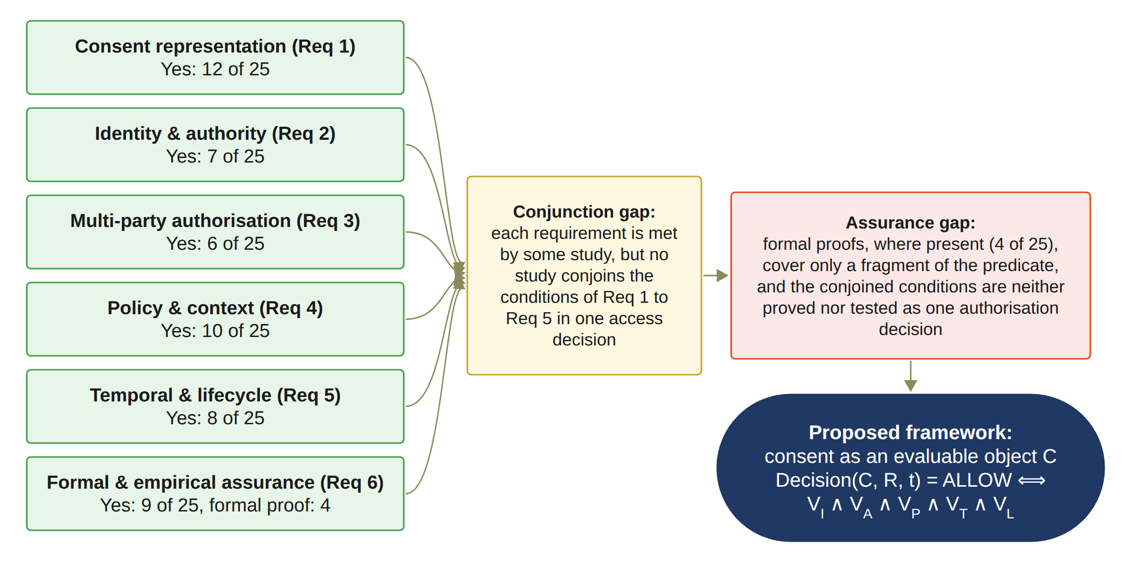
SYNTHESIS OF THE REVIEW
Notes:
This figure sums up the whole review in one picture. Please read it from left to right.
On the left are the six requirements. Each box shows how many of the 25 studies get a full Yes. Consent representation has 12. Identity and authority has 7. Multi-party authorisation has 6. Policy and context has 10. Temporal and lifecycle has 8. Assurance has 9, but only 4 have a formal proof.
All the arrows lead to the yellow box, the conjunction gap. Conjunction means joining conditions with AND. Each requirement is met somewhere, but no study joins Requirements 1 to 5 in one access decision.
The next box is the assurance gap. The few proofs cover only a small part of the decision. The joined conditions are never proved or tested as one decision.
The dark box at the bottom is my answer. Consent becomes an object C that can be checked. R is the request and t is the time. Access is allowed only when all five checks pass: identity, approval, policy, time and lifecycle. The symbol ∧ means AND.

Slide 13
​RESEARCH GAP
​Existing healthcare consent and access-control research provides many of the necessary technological building blocks, but there remains a need for an integrated Trust Computing framework that treats patient consent as a security-bearing and evaluable authorisation object. Such a framework should be capable of representing the relevant trust conditions, verifying the participating entities and their authority, establishing collective authorisation where required, and enforcing the policy and data-scope constraints associated with the consent.
Notes:
This is the research gap of my study.
Existing healthcare consent and access-control research provides many of the necessary technological building blocks, but there remains a need for an integrated Trust Computing framework that treats patient consent as a security-bearing and evaluable authorisation object. Such a framework should be capable of representing the relevant trust conditions, verifying the participating entities and their authority, establishing collective authorisation where required, and enforcing the policy and data-scope constraints associated with the consent.

Slide 14
THE MAIN RESEARCH QUESTION
How can a trust-oriented computing framework establish and enforce trustworthy multi-party consent for decentralised healthcare data sharing under identity, authority, and policy constraints?
Notes:
This gap leads to my main research question. Let me read it.
How can a trust-oriented computing framework establish and enforce trustworthy multi-party consent for decentralised healthcare data sharing under identity, authority, and policy constraints?
Two words are the key here. Establish is about creating trust. That means trusted participants, their authority, and a shared consent decision. Enforce is about checking these conditions each time someone asks for healthcare data.
Trust-oriented means my focus is trust, not one technology. Blockchain, decentralised identity and credentials are tools that support the trust model.
Multi-party means one person alone cannot give the approval. A set of chosen participants must each approve.
The last part of the question names the limits on every decision. These are who the person is, what they are allowed to do, and what the policy permits.

Slide 15
SUB RESEARCH QUESTIONS
RQ1
​How can patient consent be modelled as a trust-aware authorisation object that explicitly represents identity, authority requirements, policy constraints, and authorisation evidence?
RQ2
​How can decentralised identities and verifiable credentials establish trustworthy participants while explicitly separating identity authentication from authorisation authority?
RQ3
​How can multiple independently verified participants and guardians jointly establish a trustworthy consent decision without allowing a single participant to unilaterally authorise sensitive healthcare data access?
RQ4
​How can policy, purpose, and data-scope constraints be incorporated into authorisation decisions so that valid identities and sufficient approvals cannot be used to obtain unauthorised healthcare data?
RQ5
​How can temporal validity and consent lifecycle controls ensure that an authorisation remains valid only within its permitted time interval and lifecycle state, and is rejected after expiration, revocation, or an unauthorised state transition?
RQ6
​How can the security properties of the proposed trust-oriented authorisation mechanism be formally defined and empirically evaluated to demonstrate that the implemented framework correctly enforces authorised and unauthorised healthcare data-access decisions?
Notes:
I split the main question into six sub-questions.
RQ1 asks how to model consent as an object that holds identity, authority, policy and evidence.
RQ2 asks how DIDs and VCs can give us trusted participants. A DID is a decentralised identifier. It does not depend on one central identity provider. A VC is a verifiable credential, for example proof of a role. The key point is to keep proof of identity separate from authority.
RQ3 asks how verified participants can approve together, so no single person can approve alone.
RQ4 asks how purpose and data scope can stop a valid user from reaching data they should not see.
RQ5 asks how to reject access after expiry, revocation or a wrong state change.
RQ6 asks how to define the security properties formally and test them in practice.
RQ1 to RQ5 build the decision. RQ6 checks it.

Slide 16
RESEARCH OBJECTIVES
Objective | Description | Status
​RO1 – Trust-Centric Consent Model | ​To develop a trust-aware consent model that represents patient consent as a structured and evaluable authorisation object. | Done
​RO2 – Decentralised Identity and Authority Trust | ​To develop a decentralised identity and authority verification mechanism using decentralised identifiers and verifiable credentials. | Done
​RO3 – Trustworthy Multi-Party Authorisation | ​To develop a threshold-based multi-party authorisation mechanism through which multiple independently verified participants and guardians can jointly establish a trustworthy consent decision. | Done
​RO4 – Policy- and Context-Aware Access Control | ​To develop a policy-aware authorisation mechanism that evaluates the purpose and data scope of a requested operation against the constraints defined by the consent. | Done
​RO5 – Temporal and Lifecycle Trust | ​To extend the trust-oriented framework with temporal validity and consent lifecycle controls. | In Progress
​RO6 – Formal Security Assurance and Empirical Validation | ​To formally analyse and empirically evaluate whether the implemented framework satisfies its defined trust and authorisation properties under representative healthcare data-sharing scenarios. | Partially completed
Notes:
From the questions, I set six research objectives. Each objective answers the question with the same number. The table shows each one and its status.
RO1 is the consent model. Consent becomes a structured object that can be checked. It is done.
RO2 checks identity and authority with DIDs and VCs, and keeps them apart. It is done.
RO3 is multi-party approval. Each guardian signs with EIP-712, a standard for signing typed data. In the prototype, every listed guardian must sign. It is done.
RO4 checks purpose and data scope. It is done.
So RO1 to RO4 are delivered and validated with the prototype.
RO5, time and lifecycle, is in progress. The validity window and revocation already work. Next I will extend them to consent changes, delegation and guardian-set changes.
RO6 is partially completed. The tests and first measurements are done. The formal analysis comes in the next stage.

Slide 17
RESEARCH METHODOLOGY
1
2
3
4
5
6
7
Problem
Consent is a passive record; no integrated trusted decision
Literature review
PRISMA 2020; 25 primary studies
​Gap and RQs
​Research gap; RQ1 to RQ6
Objectives
RO1 to RO6
Design
MVC architecture, consent object C, Algorithms 1 to 4
Prototype
HALAH prototype; ConsentSBTv3 on Sepolia
Evaluation
Live scenarios, measurements and 12 attack scenarios; formal assurance in the next stage
From the problem to the evaluated prototype
Notes:
This slide shows my research method as seven steps, from left to right.
Step 1 is the problem. Consent is a passive record, and there is no integrated trusted decision.
Step 2 is the systematic literature review. I followed PRISMA 2020, a standard guide for reporting reviews, and analysed 25 primary studies.
Step 3 gives the research gap and the six research questions. Step 4 sets the six objectives.
Step 5 is the design. It has the MVC architecture, the consent object C and four algorithms.
Step 6 is the prototype, called HALAH. That stands for History Access Link for Authorised Healthcare. Its smart contract, ConsentSBTv3, runs on Sepolia, an Ethereum test network.
Step 7 is the evaluation. I used live scenarios, measurements and twelve attack scenarios. The formal assurance comes in the next stage.
The arrow at the bottom shows the whole path, from the problem to the evaluated prototype.

Slide 18
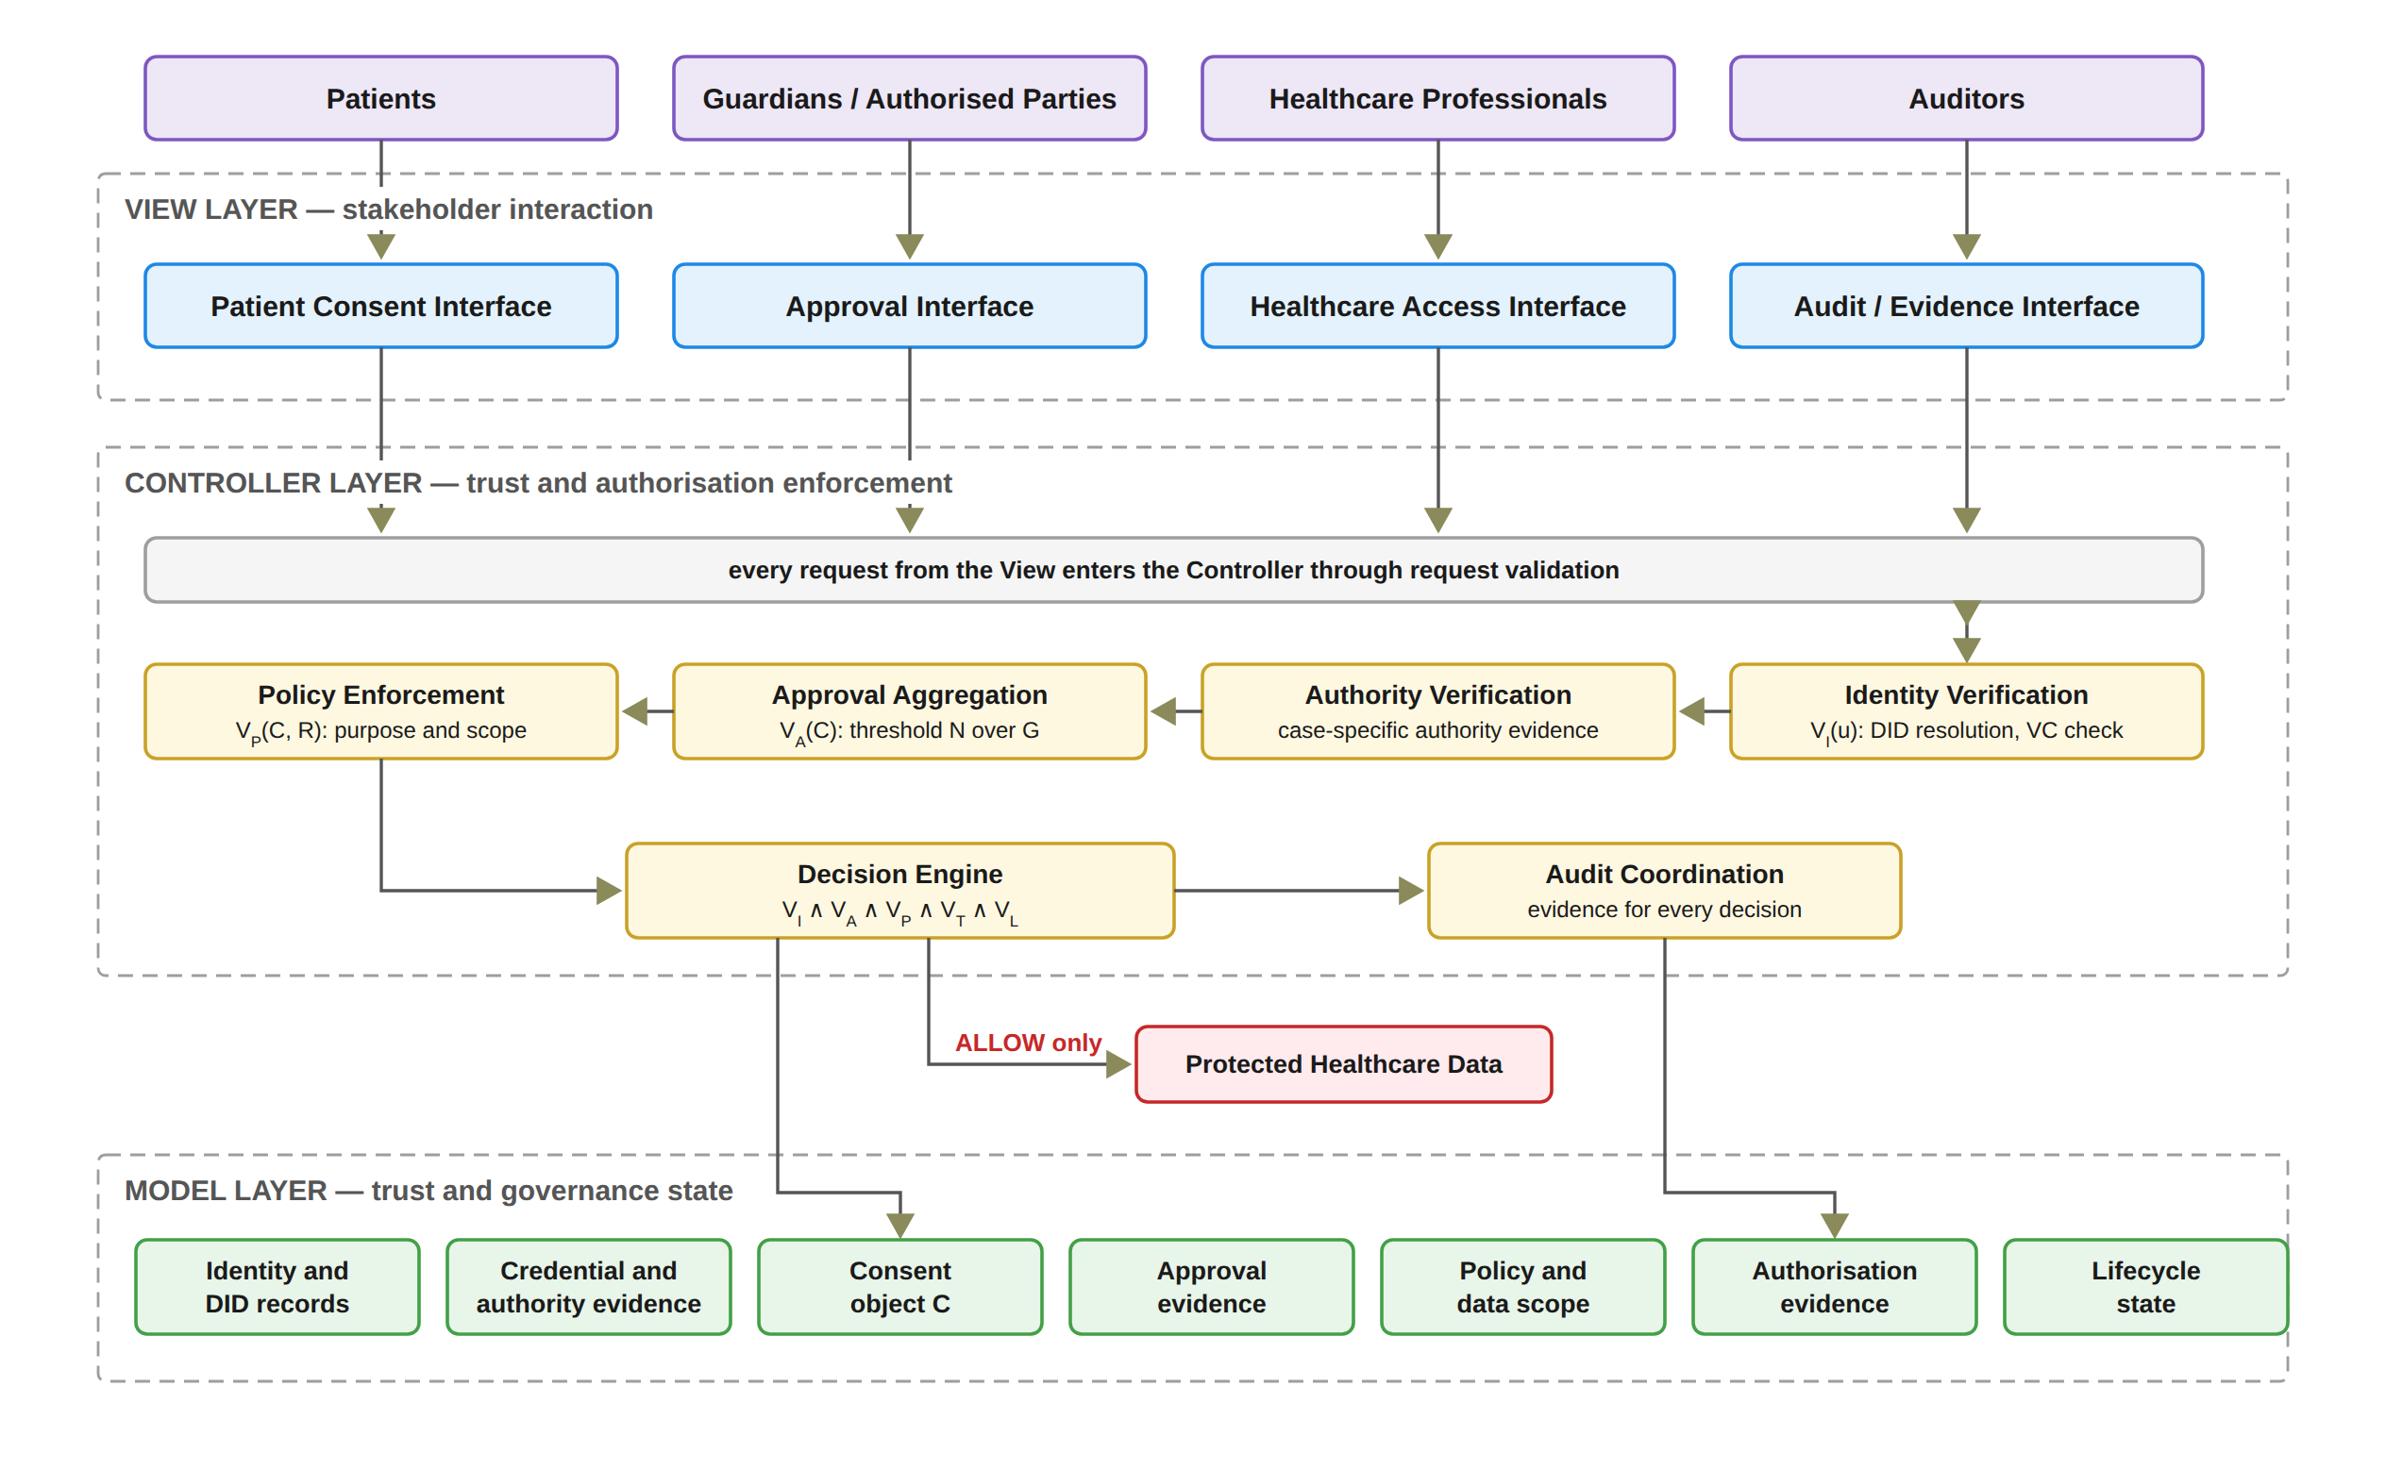
RESEARCH ARCHITECTURE: MVC
Notes:
This figure shows my research architecture. It uses MVC, which means Model, View and Controller. Please read it from top to bottom.
At the top are the four user groups: patients, guardians, healthcare professionals and auditors. Each group has its own interface in the View layer. The View only sends requests. It never decides access.
Every request enters the Controller layer through request validation. The security checks happen here. Identity Verification checks the DID. Authority Verification checks evidence of authority for the case. Approval Aggregation counts the valid approvals from the guardian set G against the threshold N. Policy Enforcement checks purpose and scope. The Decision Engine joins all five checks. Audit Coordination records evidence for every decision.
At the bottom, the Model layer stores the state. This includes identity records, credentials, the consent object C, approvals, policy, evidence and lifecycle state.
The protected healthcare data sit outside all three layers. The Controller releases them only on ALLOW.
Possible question: Does the prototype do full DID resolution now? No. It checks the DID format and invokes VC verification. Full DID resolution is planned for the next stage.

Slide 19
SOLUTION OVERVIEW
Decision(C, R, t) = ALLOW ⟺ VI(u) ∧ VA(C) ∧ VP(C, R) ∧ VT(C, t) ∧ VL(C)
VI
​Identity and authority validity
VA
​Collective authorisation validity
VP
​Policy and contextual compliance
VT
​Temporal validity
VL
​Consent lifecycle validity
Failure of any one condition gives DENY.
In the prototype, a Groth16 zero-knowledge proof must also verify before any data is released.
Every decision on an ACTIVE consent is written to the audit ledger with its decision matrix.
Notes:
This slide shows the core of my solution in one rule. The box at the top is the decision equation. It says the decision for consent C, request R, at time t is ALLOW only if all five checks are true. The small 'and' symbols mean every check must pass. The double arrow means 'if and only if'.
The five boxes explain each check with the definitions in my report. VI is identity and authority validity. VA is collective authorisation validity: all the required guardians approved. VP is policy and contextual compliance: the purpose and the data scope. VT is temporal validity: the request is inside the validity window. VL is consent lifecycle validity: the consent is in a valid state, for example active and not revoked.
The points below are simple. If any one check fails, the answer is DENY. In the prototype, a Groth16 zero-knowledge proof must also verify before any data is released. This kind of proof shows something is true without showing the secret behind it. Every decision on an ACTIVE consent is written to the audit ledger with its decision matrix. The matrix shows the result of each check, so an auditor can see why a request was allowed or denied.

Slide 20
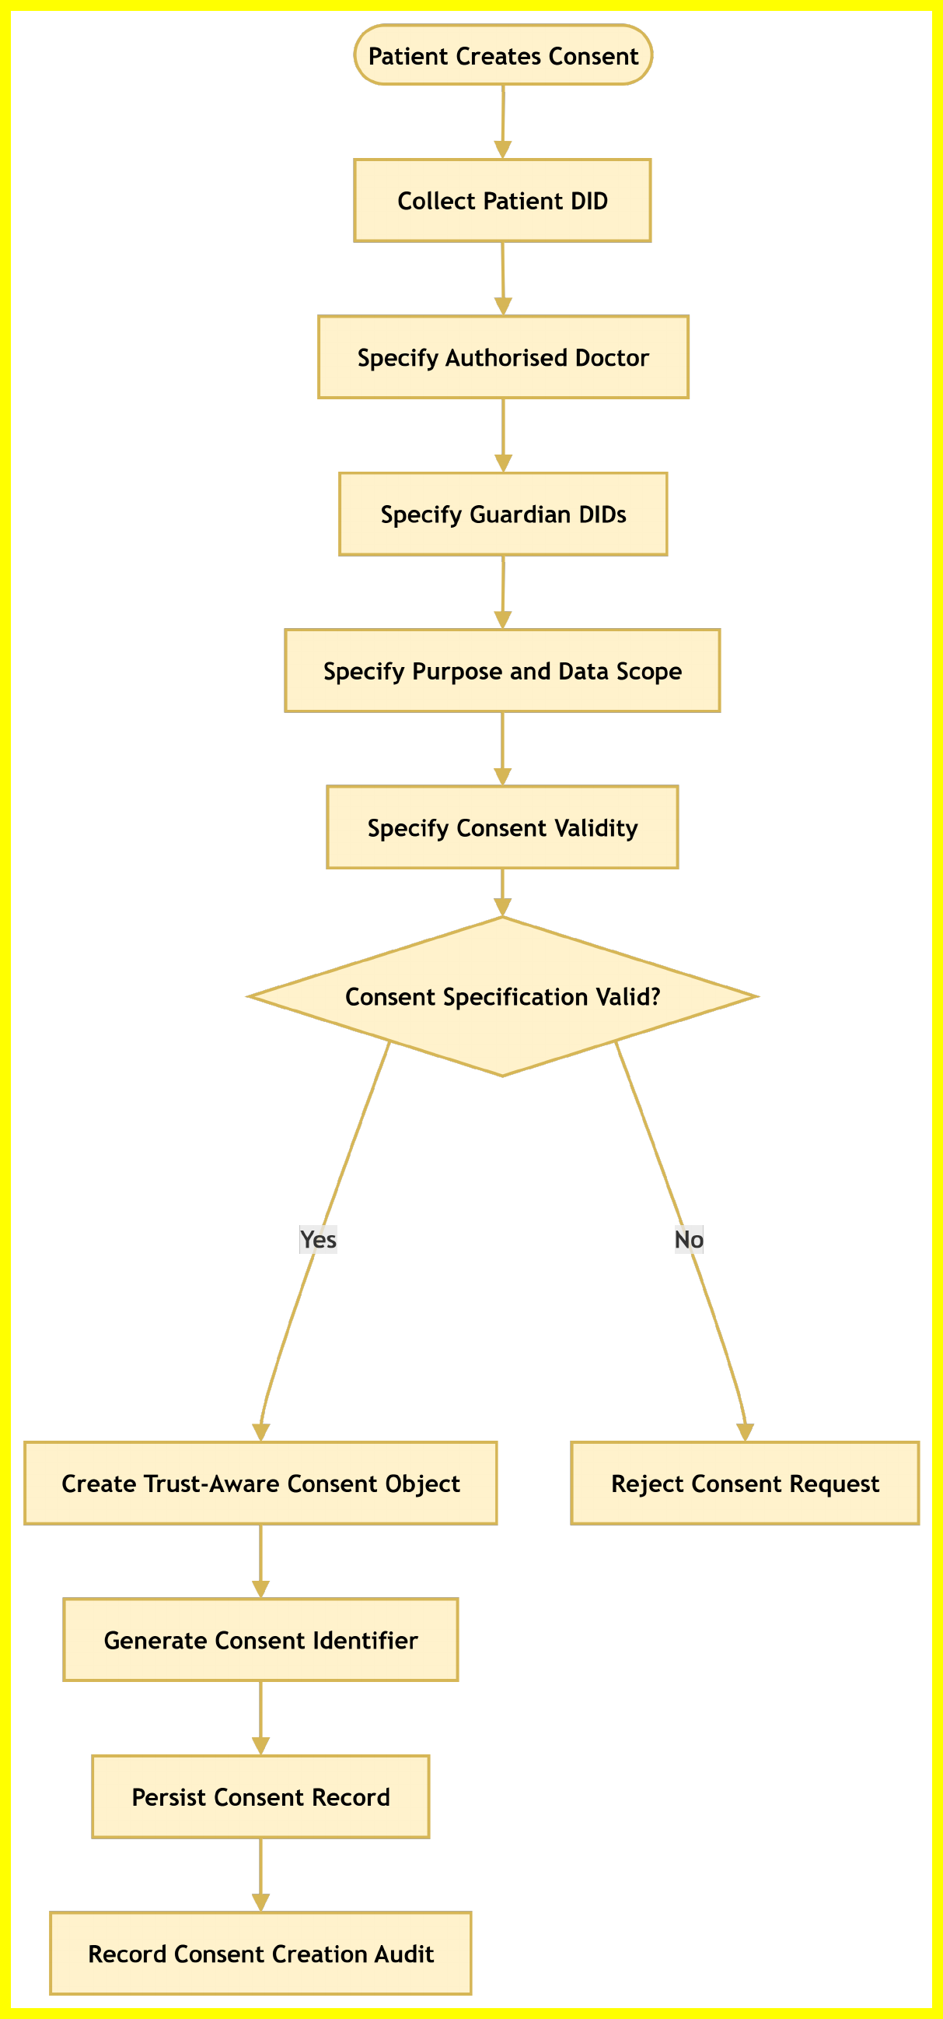
THE PROPOSED SOLUTION FOR RO1
​Trust-Centric Consent Model
Status: Done
The patient selects the patient DID, doctor, guardians, data scope and validity time; the purpose is fixed to Treatment.
The input is validated; an empty scope or a malformed guardian DID is rejected.
A consent identifier is generated and C = (I, A, P, T, L, E) is built.
The consent is stored in the state PENDING_SIGNATURE; nothing is on-chain until all guardians approve.
Creation evidence is recorded in the audit ledger.
Notes:
Now I go through each research objective. RO1 is the trust-centric consent model, and its status is Done.
The points on the left follow the steps. The patient selects the patient DID, the doctor, the guardians, the data scope and the validity time. In the current interface the purpose is fixed to Treatment. The system then checks the input. For example, an empty data scope or a badly formed guardian DID is rejected.
If the input is valid, the system makes a consent identifier and builds the consent object C. C has six parts: identity, authorisation, policy and data scope, time, lifecycle and evidence. The consent is saved in the state PENDING_SIGNATURE. Nothing goes on-chain until all guardians approve. Last, the creation is recorded in the audit ledger.
The flowchart on the right shows the same steps from top to bottom. If the input is not valid, the No branch rejects the consent request.

Slide 21
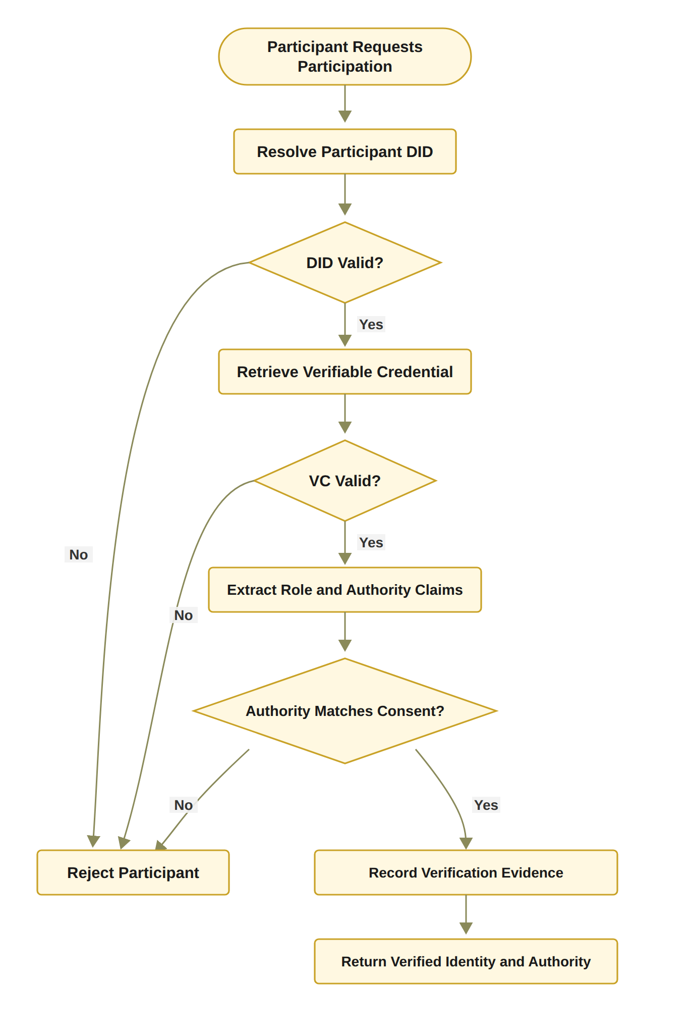
THE PROPOSED SOLUTION FOR RO2
​Decentralised Identity and Authority Trust
Status: Done
Identity is checked through the participant's DID; authority through a verifiable credential.
Identity is not authority: a valid DID alone never gives access.
VI(u) = VerifyDID(u) ∧ VerifyVC(u) ∧ Authority(u, C).
​In the HALAH implementation, the Guardian workflow uses a selected guardian DID and invokes VC verification before adding the guardian's signature to the consent.
Full DID resolution is planned for the next stage.
Notes:
RO2 is about decentralised identity and authority. The status is Done.
A DID is a decentralised identifier. It tells us who the person is. A verifiable credential, or VC, tells us what the person is allowed to do. So identity is not authority. A valid DID alone never gives access.
The formula says VI for user u is true only when the DID is valid, the credential is valid and the person has authority for this consent C.
The flowchart on the right is the target design. It resolves the DID, checks the credential, reads the role claims and compares them with the consent. Every No leads to Reject Participant. If all checks pass, the evidence is recorded.
In the HALAH implementation, the guardian workflow uses a selected guardian DID and invokes VC verification before adding the guardian's signature to the consent. Each guardian's EIP-712 signature is also recovered. EIP-712 is a typed signature format on Ethereum, so we can see who signed. Full DID resolution is planned for the next stage.

Slide 22
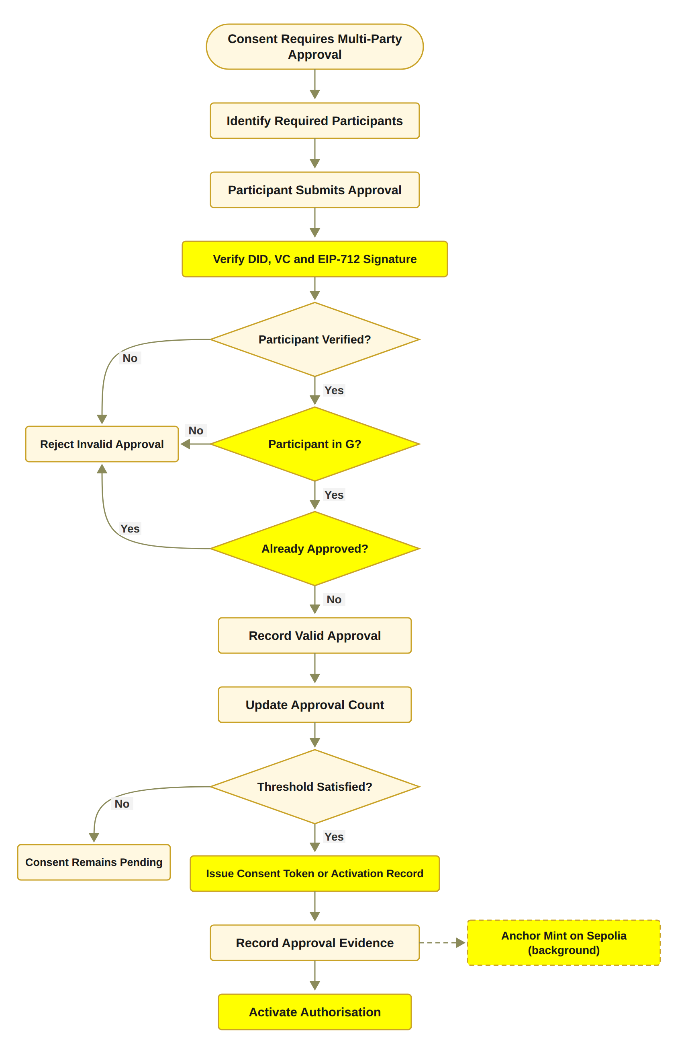
THE PROPOSED SOLUTION FOR RO3
​Trustworthy Multi-Party Authorisation
Status: Done
The guardian set G is fixed when the consent is created.
Each guardian signs an EIP-712 approval, verified by signature recovery.
Approvals from outside G, replayed or duplicate approvals are not counted.
N-of-N rule: a valid signature from every listed guardian (2-of-2 in the demo).
When the threshold is met, a local token is recorded and the mint is anchored on Sepolia in the background.
Notes:
RO3 is about multi-party authorisation. The status is Done. The idea is that no single person can approve alone.
The guardian set G is fixed when the consent is created. Each guardian signs an EIP-712 approval. The system recovers the signer from the signature and checks it. An approval from someone outside G is not counted. A replayed or duplicate approval is not counted either.
The rule is N-of-N. This means every listed guardian must give a valid signature. In the demo there are two guardians, so it is 2-of-2. One approval is not enough.
The flowchart shows this loop. Each valid approval updates the count. If the threshold is not met, the consent stays pending. When it is met, a local token identifier is recorded. The consent becomes active once its start time is reached. The mint is anchored on the Sepolia test network in the background, so it does not delay the guardians or the doctor.

Slide 23
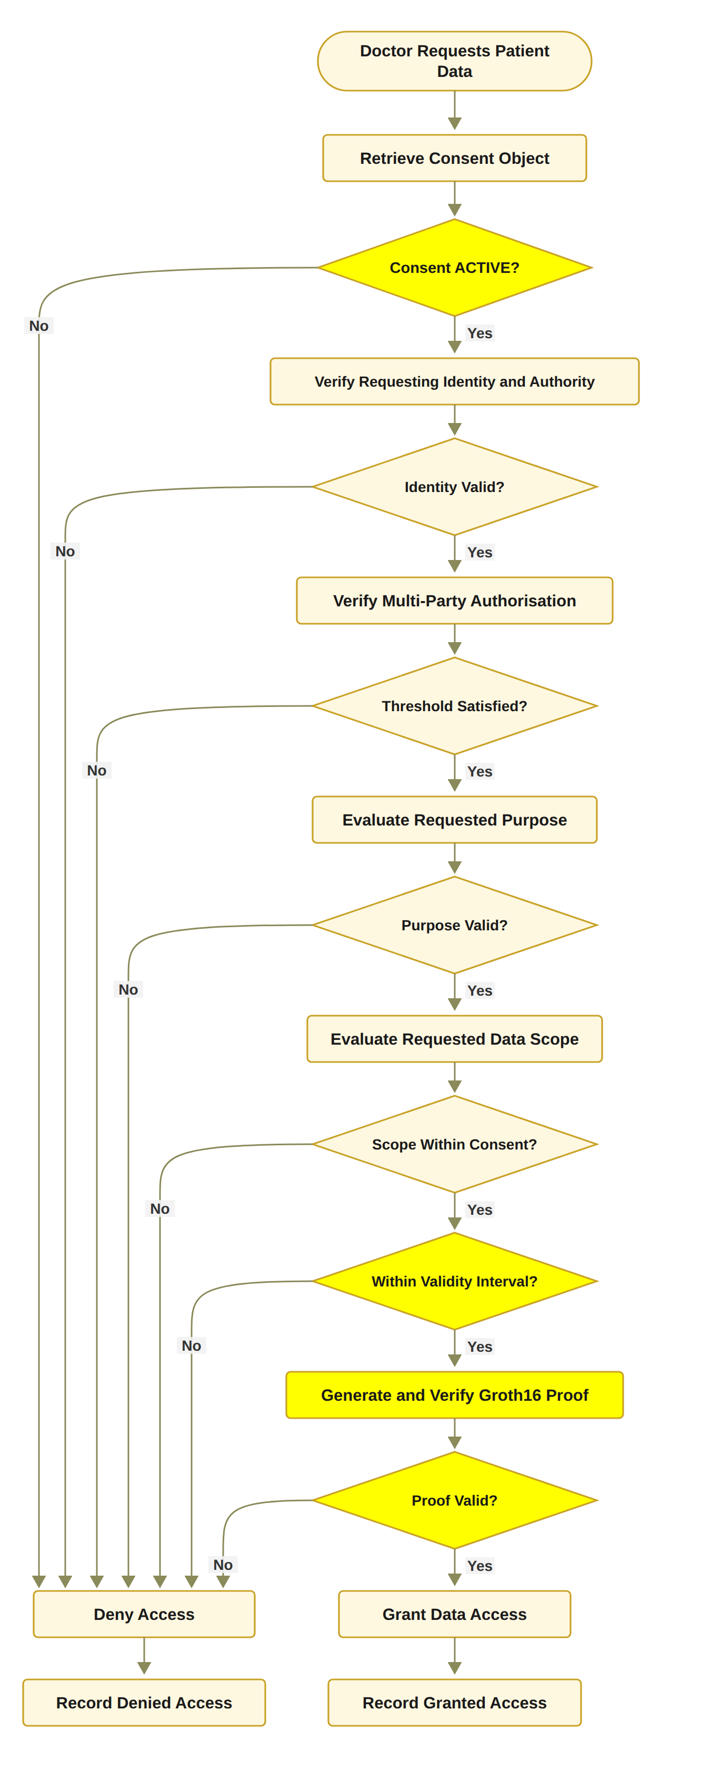
THE PROPOSED SOLUTION FOR RO4
​Policy- and Context-Aware Access Control
Status: Done
The request scope SR must be a non-empty subset of the authorised scope SC.
The purpose must be a supported healthcare purpose of the consent.
Time and the lifecycle state are checked in the same decision.
A Groth16 proof must verify before any data is retrieved; otherwise DENY.
Example: requesting Procedure when only Observation and Medication are allowed gives DENY.
Notes:
RO4 is about policy and context. The status is Done. A valid identity and full approval are still not enough.
First, the requested scope, SR, must be a non-empty subset of the authorised scope, SC. In simple words, the doctor must ask for something, and only for data the patient allowed. Second, the purpose must be a supported healthcare purpose of the consent. Time and the lifecycle state are checked in the same decision.
Then a Groth16 proof must verify before any data is retrieved. This proof shows the consent has not expired, without showing the secret behind it. If it fails, the answer is DENY.
The example makes it clear. The consent allows only Observation and Medication, so a request that adds Procedure is denied.
The flowchart follows the doctor's request from the top. A consent that is not ACTIVE, a failed identity check, failed policy or time checks, or a failed proof all lead to Deny Access, and the denied access is recorded.

Slide 24
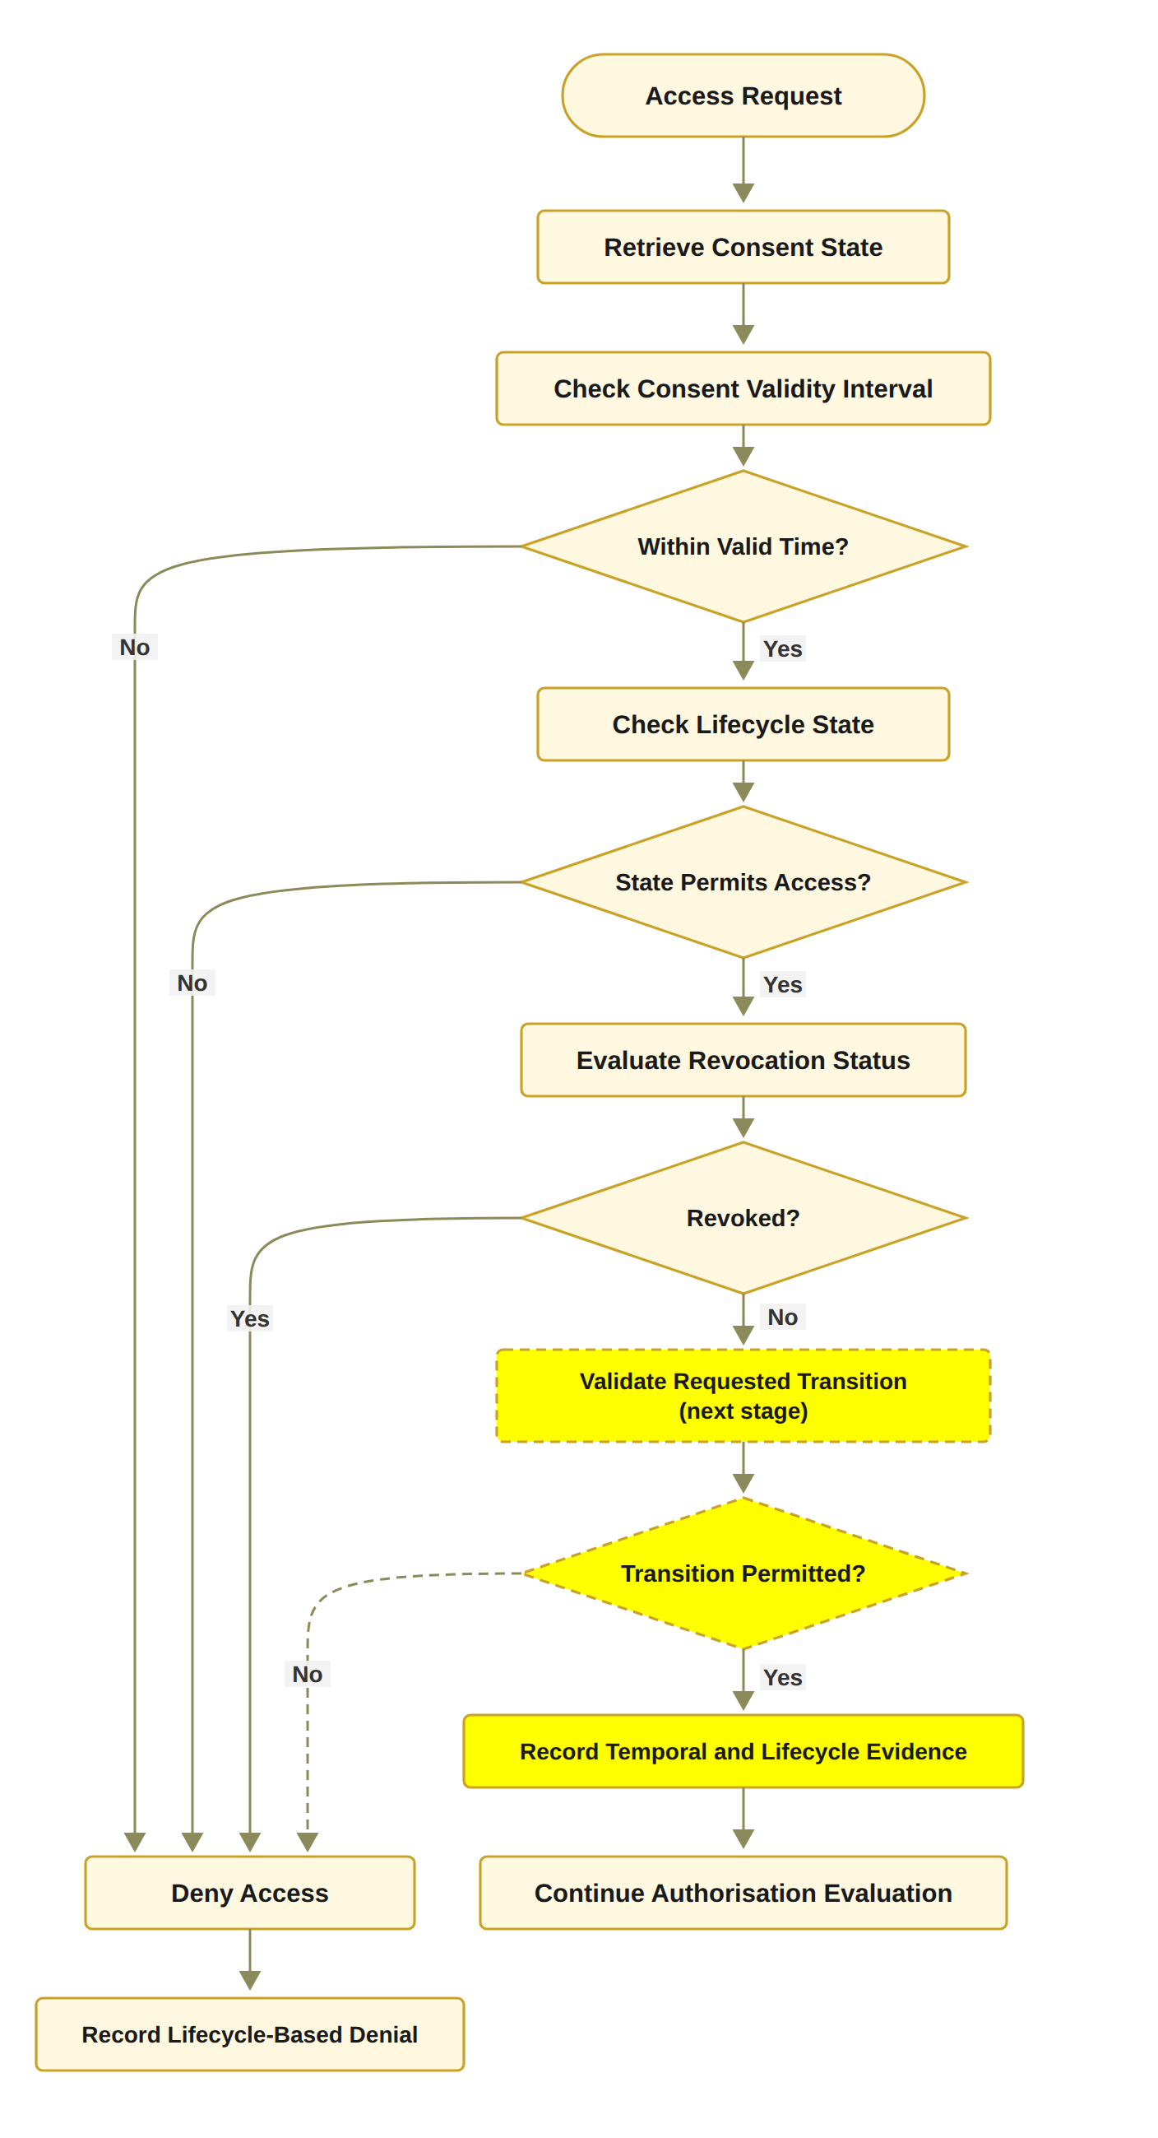
THE PROPOSED SOLUTION FOR RO5
​Temporal and Lifecycle Trust
Status: In Progress
The validity window (notBefore, expiry) is stored on-chain and checked at every request through VT.
Revocation is end to end, including an on-chain revoke transaction.
​Design: L is the lifecycle state (CREATED, PENDING, ACTIVE, SUSPENDED, REVOKED, EXPIRED), checked by VL(C) = ValidState(C) ∧ ValidTransition(C).
​Working now: an explicit lifecycle state machine: PENDING_SIGNATURE, PENDING_TOKEN, NOT_STARTED, ACTIVE, EXPIRED, REVOKED.
Next stage: the SUSPENDED state, lifecycle transition check, consent modification, delegation, guardian-set changes and a formal lifecycle model.
Notes:
RO5 is about time and the consent lifecycle. The status is In Progress.
The validity window has two times, notBefore and expiry. They are stored on-chain, and VT checks them at every request. Revocation also works end to end, including an on-chain revoke transaction.
In the design, L is the lifecycle state: CREATED, PENDING, ACTIVE, SUSPENDED, REVOKED or EXPIRED, and VL checks a valid state and a valid transition. The prototype works with six states: PENDING_SIGNATURE, PENDING_TOKEN, NOT_STARTED, ACTIVE, EXPIRED and REVOKED. Access can be granted only in ACTIVE.
The flowchart follows Algorithm 5. It checks the validity interval, then the lifecycle state, then the revocation status. The dashed steps, the transition check, are the next stage. If all checks pass, the evidence is recorded and the authorisation evaluation continues. Any failure leads to Deny Access, and the lifecycle-based denial is recorded.
The next stage adds the SUSPENDED state, a lifecycle transition check, consent modification, delegation, guardian-set changes and a formal lifecycle model.

Slide 25
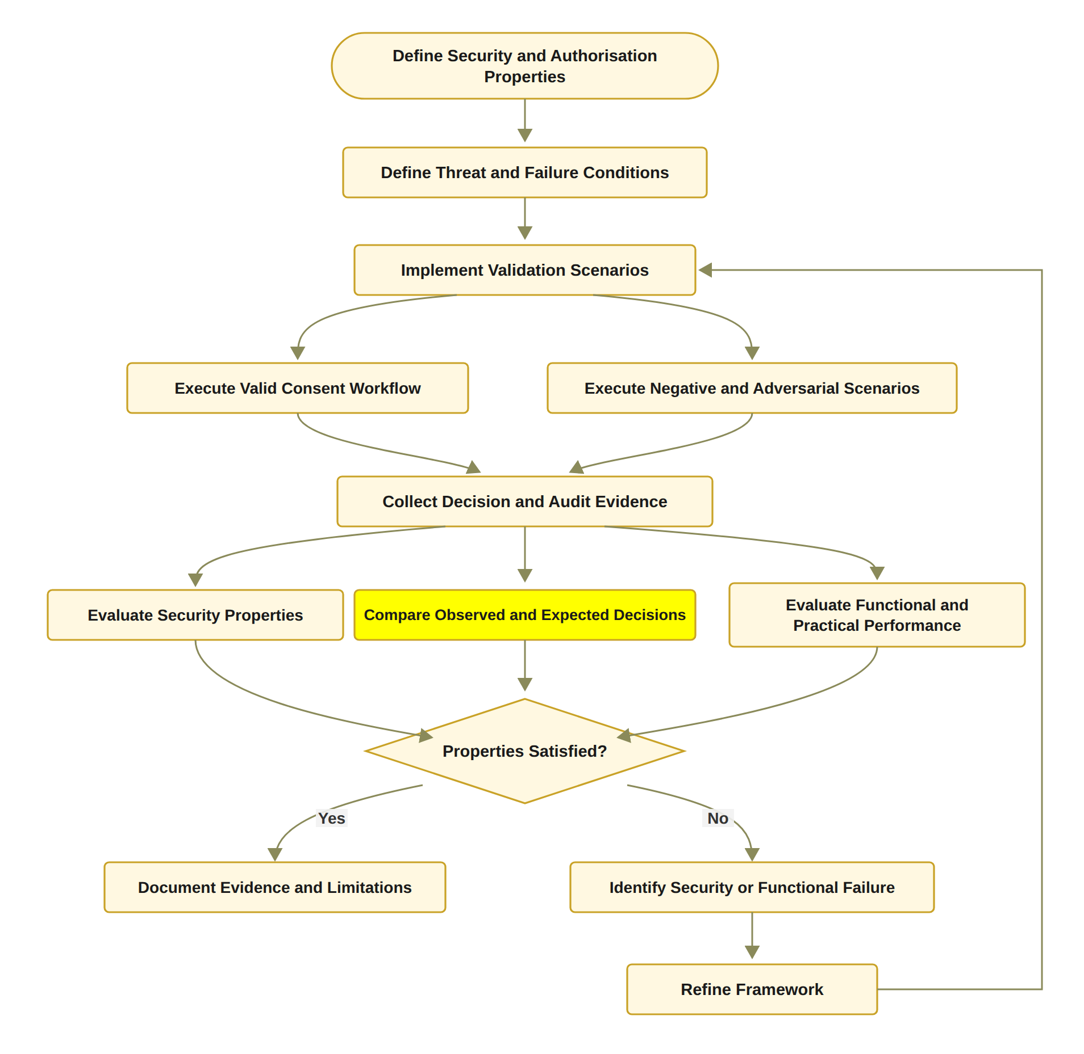
THE PROPOSED SOLUTION FOR RO6
​Formal Security Assurance and Empirical Validation
Status: Partially completed
Done: 36 automated tests, including twelve attack scenarios A1 to A12.
Done: on-chain cost, confirmation latency and processing time measured.
Next stage: formal proofs or model checking of the security properties, and a larger evaluation under load.
Notes:
RO6 is about formal assurance and empirical validation. The status is Partially completed. The slide separates what is done from what comes next.
First, I have 36 automated tests. They include twelve attack scenarios, A1 to A12. These try things like replayed approvals, unauthorised signers, requests outside the allowed scope and use of a revoked consent. Second, I measured the on-chain cost, the confirmation latency and the processing time.
The next stage covers formal proofs or model checking of the security properties. It also covers a larger evaluation under load.
The flowchart on the right shows the method. I define the security and authorisation properties and the threat and failure conditions. Then I run the valid, negative and adversarial scenarios and collect the decisions and the audit evidence. I evaluate the security properties, compare observed with expected decisions, and evaluate the practical performance. If the properties hold, I document the evidence and limitations. If one fails, I identify the failure and refine the framework.

Slide 26
IMPLEMENTATION: THE HALAH PROTOTYPE
Interfaces
Patient, guardian, doctor and auditor subsystems
Smart contract
ConsentSBTv3, a soulbound ERC-721 token (ERC-5484) on the Sepolia testnet
Guardian approval
EIP-712 typed signatures, verified by signature recovery
Access proof
Groth16 zero-knowledge proof over a Poseidon commitment
Data
Synthetic Synthea records: Observation, Medication, Condition, Procedure
Evidence
Audit ledger of every decision; no medical content on-chain
Notes:
This slide shows the HALAH prototype. HALAH stands for History Access Link for Authorised Healthcare. Each box is one part of it.
There are four interfaces, for the patient, guardian, doctor and auditor. The smart contract is ConsentSBTv3. It is a soulbound ERC-721 token that follows ERC-5484. Soulbound means it cannot be moved to another account. It runs on the Sepolia test network. Guardian approval uses EIP-712 typed signatures, checked by signature recovery.
The access proof is a Groth16 zero-knowledge proof over a Poseidon commitment. Poseidon is a hash function. The proof shows the consent has not expired, without showing the secret. The data are synthetic Synthea records: Observation, Medication, Condition and Procedure. So no real patient is involved. Last, the audit ledger keeps evidence of every decision, and no medical content goes on-chain.
Possible question: Is anything sensitive on-chain? The plaintext purpose is visible in the mint transaction input. I state this in the report.

Slide 27
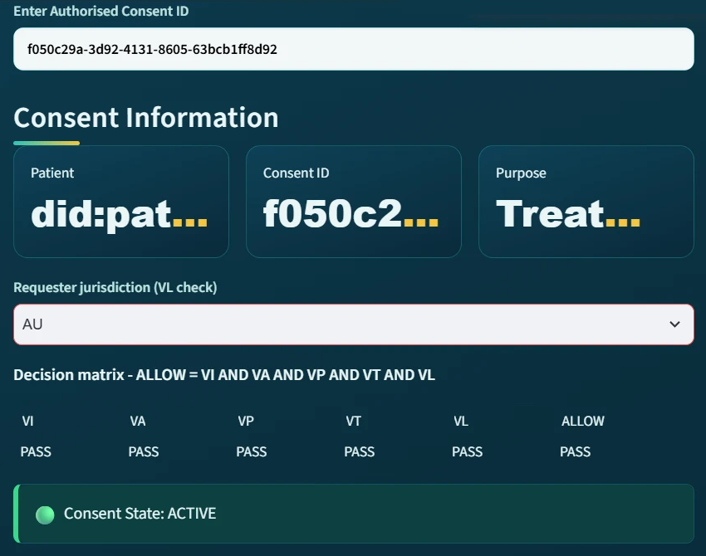
IMPLEMENTATION: LIVE SCENARIOS
All five checks pass: ALLOW
Notes:
This slide shows a real screen from the doctor subsystem of the HALAH prototype, for the evaluated consent, f050c29a.
The doctor enters the consent ID. Below that is the decision matrix. VI is identity and authority. VA is collective approval, and revocation is also checked inside VA. VP is policy and context. VT is time. All five checks show PASS, so the decision is ALLOW and the consent state is ACTIVE.

Slide 28
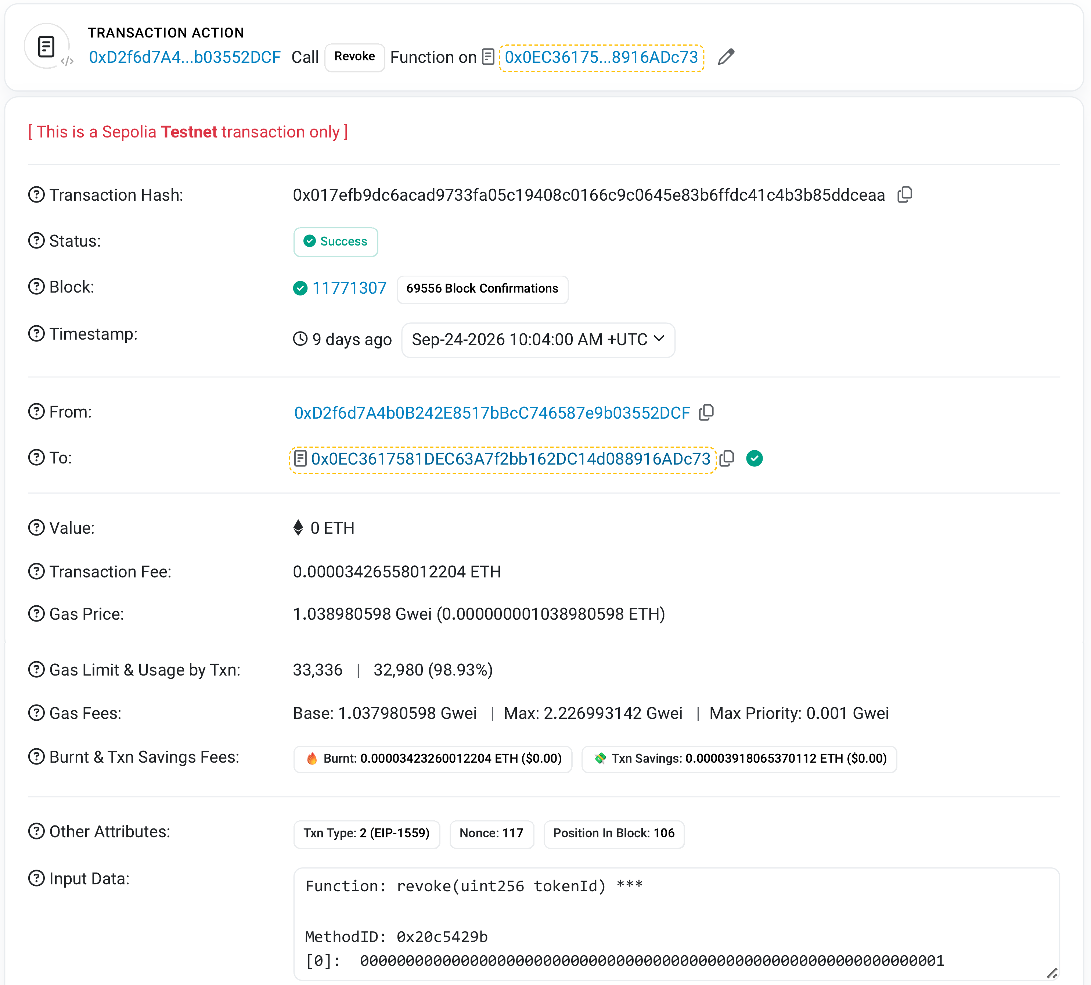
IMPLEMENTATION: ON-CHAIN EVIDENCE
Revocation of token #1 on Sepolia Etherscan, block 11,771,307
Notes:
This slide shows the public evidence on the Sepolia test network.
On the left is the Sepolia Etherscan page for the revoke transaction of token number 1. It was confirmed in block 11,771,307 on 24 September 2026. The status says Success. The input data shows the function revoke with the token ID. Anyone can check this record, so it is not only in my own database.
On the right is the gas used by the five anchored transactions. Gas is the unit of computing work on Ethereum. The first two bars are token 8 from the earlier deployment. The other three are on the current contract, ConsentSBTv3.
A mint creates a token and writes a full consent record, so it costs much more. A revoke changes only one flag. For token 1, the revoke used about one sixth of the gas of its mint.
No fee was higher than 0.00021 ETH. Sepolia ether has no money value, so gas is the fair way to compare cost.

Slide 29
VALIDATION
Validation | Definition | Criterion | Result
Valid scenarios | Legitimate requests must obtain authorised access | Pass(s) ⟺ Dobs(s) = Dexp(s) | Scenarios 1 to 3: consent created, 2-of-2 approval, ALLOW (RQ1 to RQ4)
Negative scenarios | Invalid requests must be refused | Any failed check ⇒ DENY | Scenario 5: revoked consent refused at VA
Adversarial scenarios | Deliberate attempts to bypass a condition, A1 to A12 | Refused / 12 | 11 of 12 refused after the hardening (A11: the changed digest is not yet compared)
Automated tests | 23 functional and regression tests and 13 adversarial tests | All tests pass | 36 of 36 pass
Independent verification | On-chain receipts compared with the local consent state | Local state = on-chain state | Scenario 6: RESULT: ALL CHECKS PASSED
Notes:
This slide is about validation. Validation asks one simple question: does the system make the right decision? I read the table from top to bottom.
The first row is the valid scenarios. A real, allowed request must get access. A scenario passes only when the observed decision is the same as the expected decision. In scenarios 1 to 3, the consent was created, both guardians approved, and the doctor got ALLOW. These cover RQ1 to RQ4.
The second row is the negative scenarios. A wrong request must be refused. If any one check fails, the answer is DENY. In scenario 5, the consent was revoked, so the request failed at VA.
The third row is the twelve attack scenarios, A1 to A12. After the hardening, eleven of them are refused. A11 is different. A rewritten audit event changes its digest, but nothing in the prototype compares the digest yet.
The next slide shows these twelve attacks in detail.
The fourth row is the automated tests. There are 23 functional and regression tests and 13 adversarial tests. All 36 pass.
The last row is independent verification. A separate tool reads the receipts from Sepolia and compares them with the local consent state. The result was: all checks passed.
Possible question: Which objectives does this validate? RO1 to RO4, and the parts of RO5 that already work, the validity window and revocation. This validation is the completed part of RO6. The formal proofs and a larger evaluation are planned for the next stage.

Slide 30
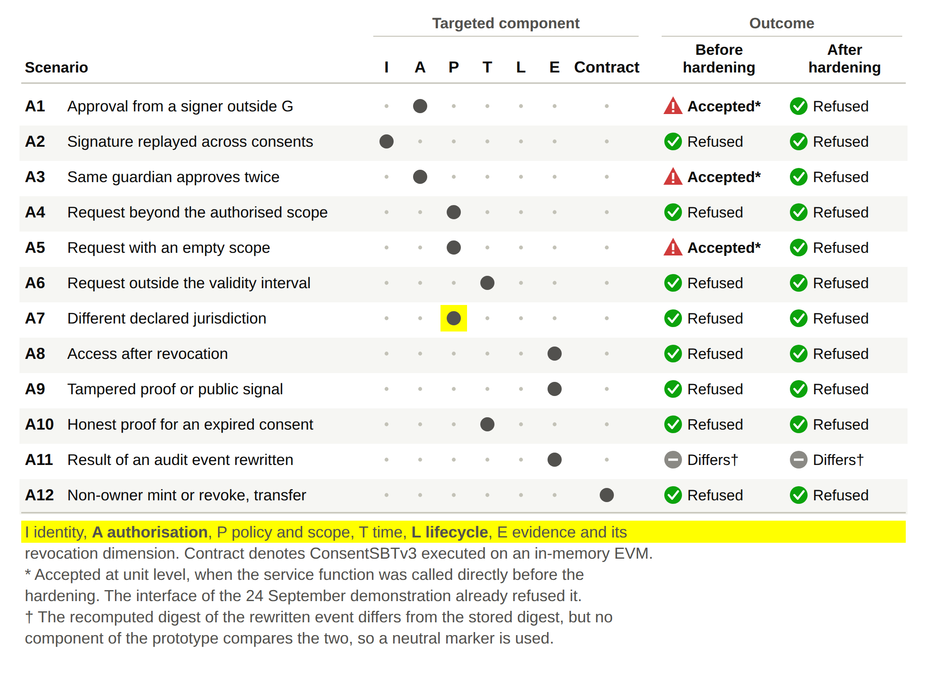
VALIDATION: ADVERSARIAL TESTS
12
attack scenarios, A1 to A12
11 / 12
refused after the hardening
36
automated tests pass
Notes:
Here I tested the system against attacks. The table lists twelve attack scenarios, A1 to A12. The dots show which part each attack targets. I is identity, A is authorisation, P is policy and scope, T is time, L is lifecycle, and E is evidence and revocation. Contract means the ConsentSBTv3 contract, run on an in-memory test machine, not on Sepolia.
Examples are a signer outside the guardian set G, a replayed signature, the same guardian approving twice, a request outside the scope, an expired or revoked consent, and a tampered proof.
The two columns on the right show the result before and after the hardening. Before, three attacks, A1, A3 and A5, were accepted when the service functions were called directly. The interface of the 24 September demonstration already refused them. After the hardening, eleven of the twelve are refused, and all 36 automated tests pass.
A11 is different. A rewritten audit event changes its digest, but no part of the prototype compares the digest yet. So I mark it as neutral, not as a pass.

Slide 31
EVALUATION
Metric | Definition | Formula | Measured result
Gas used | Gas consumed by each anchored transaction, from its receipt | gasUsed | Mint #1: 196,406; Revoke #1: 32,980
Transaction fee | Fee paid for each anchored transaction | Fee = gasUsed × gasPrice | No fee above 0.00021 ETH (Sepolia ETH has no monetary value)
Submit-to-confirmation latency | Time between the local event and the on-chain event | L = t(on-chain) − t(local) | Median 11.5 s (4.9 to 22.1 s, n = 5), in the background
Processing time | Time of each decision component over repeated runs | Median, minimum and maximum over n runs | Decision rule 2.37 µs; one EIP-712 signature 10.93 ms; Groth16 proof 1,401.1 ms to generate, 465.3 ms to verify
On-chain read | Time of a checkValid or checkValidAt call on Sepolia | Median over n = 20 | 573.5 ms and 574.6 ms
Measured on 1 October 2026; indicative only
Notes:
This slide is about evaluation. Evaluation asks a different question: how much does the system cost, and how fast is it? Each row is one metric, with its definition, its formula and the result I measured.
Gas used is the computing work of each transaction on Sepolia. The mint of token 1 used 196,406 gas. Its revoke used only 32,980, about one sixth, because a revoke changes only one flag.
The transaction fee is gas used times the gas price. No fee was above 0.00021 ETH. Sepolia ETH has no money value, so gas is the fair way to compare cost.
Latency is the time from the local event to the on-chain event. The median was 11.5 seconds, between 4.9 and 22.1 seconds over five transactions. It runs in the background, so the guardians and the doctor do not wait for it.
Processing time is the time of each part of a decision. The decision rule takes about 2 microseconds. One guardian signature takes about 11 milliseconds. The Groth16 proof is the slow part, about 1.4 seconds to generate and 0.47 seconds to verify.
The last row is the on-chain read. Reading the contract on Sepolia takes a little over half a second.
I measured these on 1 October 2026, in one container and with five transactions, so the results are indicative only.
The next slide shows all the processing times in detail.

Slide 32
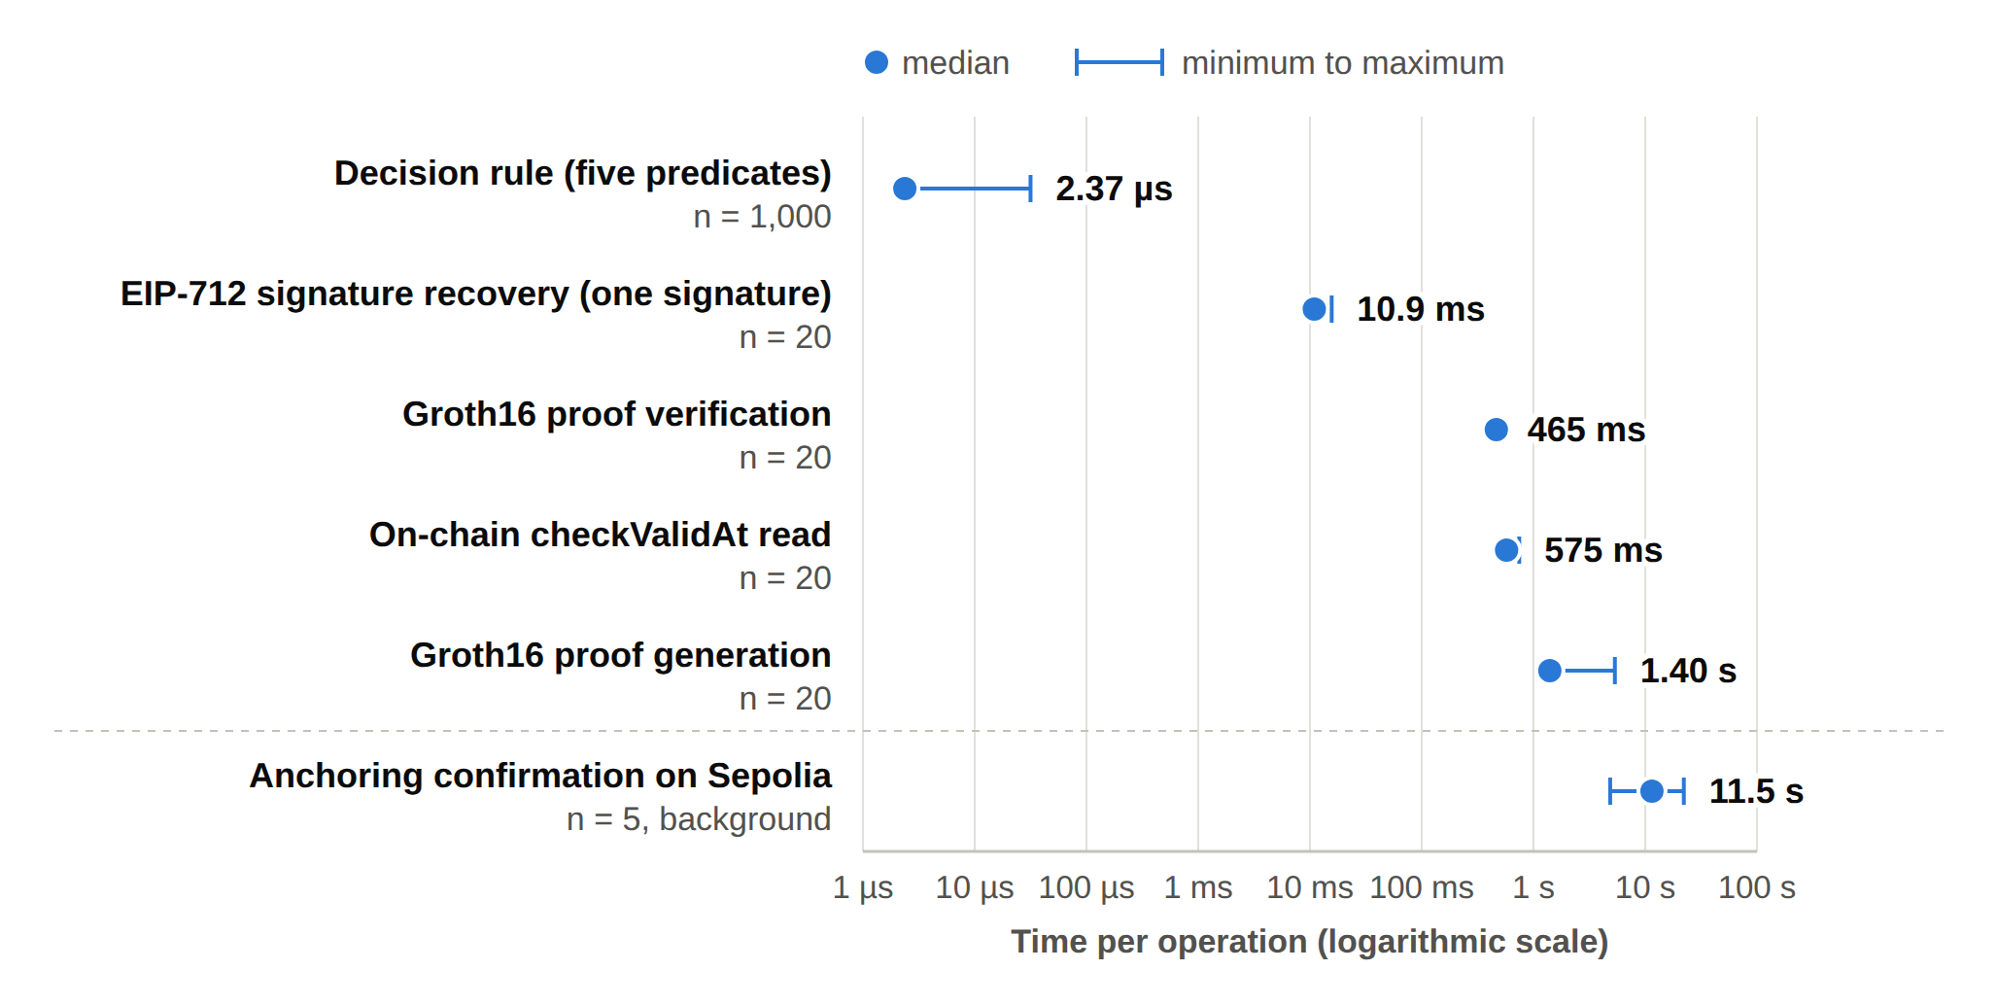
EVALUATION: PROCESSING TIME
Component | Median | Minimum | Maximum | n
Decision rule, five predicates | 2.37 µs | 2.32 µs | 31.59 µs | 1,000
EIP-712 signature recovery, one signature | 10.93 ms | 10.55 ms | 15.64 ms | 20
Groth16 proof generation | 1,401.1 ms | 1,342.8 ms | 5,349.6 ms | 20
Groth16 proof verification | 465.3 ms | 441.0 ms | 525.1 ms | 20
On-chain checkValid read | 573.5 ms | 568.2 ms | 715.5 ms | 20
On-chain checkValidAt read | 574.6 ms | 568.2 ms | 745.6 ms | 20
Anchoring confirmation | 11.5 s | 4.9 s | 22.1 s | 5
Measured on 1 October 2026; indicative only
Notes:
This slide shows how long each part of the system takes. I measured it on 1 October 2026, in the development container I used for the demonstration. The results come from one container and five transactions, so they are indicative only.
In the table, the median is the middle value. The column n is how many times I measured each step. The symbol µs means microseconds, and ms means milliseconds.
The decision rule with its five checks takes about 2 microseconds, so it costs almost nothing. Recovering one guardian signature takes about 11 milliseconds. The Groth16 proof is the slow part of an access request. It takes about 1.4 seconds to generate and about 0.47 seconds to verify. The two read functions on the Sepolia contract take a little over half a second each.
Anchoring on Sepolia is the slowest step, about 11.5 seconds at the median. But it runs in the background, so the guardians and the doctor do not wait for it. The chart on the right shows the same results on a log scale.
Possible question: Why is the proof so slow? The time includes starting the process, not only the cryptographic work.

Slide 33
DIFFERENCES BETWEEN TRADITIONAL EHR SYSTEMS AND THE HALAH FRAMEWORK
Aspect | Traditional EHR access control | HALAH framework
Identity | Centralised identity providers and institution-specific authentication | Decentralised identifiers (DIDs) for every participant; identity kept separate from authority
Consent | A passive record showing that a permission was created | An evaluable object C = (I, A, P, T, L, E), checked at every request
Approval | Relatively static permissions set by one party or institution | N-of-N guardian approvals with EIP-712 signatures; no single party can authorise alone
Access check | Authenticate the user, then check a static permission | VI ∧ VA ∧ VP ∧ VT ∧ VL, plus a Groth16 proof before data is released
Time and revocation | Validity and withdrawal are hard to verify once the permission is stored | Validity window and revocation checked at each request; on-chain revoke transaction
Audit | A record shows that consent occurred | Each decision on an ACTIVE consent logged with its decision matrix; consent state anchored on Sepolia
Notes:
This table compares traditional EHR access control with my HALAH framework, row by row. EHR means electronic health record.
Identity: traditional systems depend on a central identity provider. In HALAH, every participant uses a decentralised identifier, or DID, and identity is kept separate from authority.
Consent: traditionally it is a passive record. In HALAH it is an object, C, with six parts, and it is checked at every request.
Approval: traditional permissions are set by one party. In HALAH, all N guardians must sign with EIP-712, so no single party can authorise alone.
Access check: traditionally the system logs the user in and checks a fixed permission. In HALAH, the small wedge symbol means AND. All five checks must be true, and a Groth16 proof must pass before data is released.
Time and revocation: once a permission is stored, these are hard to verify. In HALAH, the validity window and revocation are checked at each request, and a revoke is also a transaction on the chain.
Audit: each decision on an ACTIVE consent is logged with its decision matrix, and the consent state is anchored on Sepolia.

Slide 34
DATA MANAGEMENT AND PRIVACY
Aspect | Key points
Data source | No real patient data is used. Synthetic healthcare records are derived from the Synthea dataset (Observation, Medication, Condition, Procedure).
Data storage | Medical records stay off-chain in the application; no medical content is written to the chain.
On-chain record | ConsentSBTv3 stores pseudonymous patient and requester addresses, a hash of the purpose, the validity window and a revocation flag.
Access to data | Records are released only on ALLOW and only within the authorised data scope.
Audit | Each decision on an ACTIVE consent is recorded in the audit ledger with its decision matrix.
Known limitation | The plaintext purpose is passed in the mint transaction and is visible in the public transaction input.
Notes:
This slide explains how the prototype handles data and privacy. I will go through the table from top to bottom.
Data source: I use no real patient data. The records are synthetic, made from the Synthea dataset. They cover four modules: Observation, Medication, Condition and Procedure.
Data storage: the medical records stay off-chain, inside the application. No medical content is written to the blockchain.
On-chain record: the ConsentSBTv3 token stores only pseudonymous patient and requester addresses, a hash of the purpose, the validity window and a revocation flag. Pseudonymous means the address does not show a real name.
Access to data: records are released only when the decision is ALLOW, and only inside the authorised scope.
Audit: each decision on an ACTIVE consent is saved in the audit ledger with its decision matrix.
The last row is a limitation I want to be honest about. The plain purpose text is passed in the mint transaction, so anyone can see it in the public transaction input.

Slide 35
SIGNIFICANCE OF THE RESEARCH
Scientific Significance
Consent as an object
Patient consent is an evaluable authorisation object, C = (I, A, P, T, L, E), rather than a stored record.
Standing multi-party approval
Multi-party approval is a condition of every access decision, with the approving set defined by the patient.
One integrated decision
Identity is separated from authority, and identity, authority, approval, policy, time and lifecycle are checked together.
Evidence-based review
A PRISMA 2020 review of 25 primary studies identifies the conjunction gap and the assurance gap.
Validated prototype
The framework runs on Sepolia and is evaluated with measurements and twelve attack scenarios.
Notes:
Now the scientific significance of the research. There are five boxes.
First, consent as an object. Consent is not just a stored record. It is an object, C, with six parts: identity, authorisation, policy, time, lifecycle and evidence. The system evaluates it at each request.
Second, standing multi-party approval. Approval is not a one-time step. It is a condition of every access decision, and the patient decides who must approve.
Third, one integrated decision. Identity is kept separate from authority. Then identity, authority, approval, policy, time and lifecycle are all checked together.
Fourth, the evidence-based review. My PRISMA 2020 review of 25 primary studies found two gaps. The conjunction gap means no study combines all these conditions in one decision. The assurance gap means these conditions are not proved or tested together as one decision.
Fifth, the validated prototype. The framework runs on Sepolia, and I evaluated it with measurements and twelve attack scenarios.

Slide 36
SIGNIFICANCE OF THE RESEARCH
Social Contributions
Gives patients and their guardians a direct role in deciding who can access the patient's data.
Prevents a single person from unilaterally authorising access to sensitive health data.
Keeps every access decision explainable and auditable for auditors and healthcare organisations.
Keeps medical records off-chain, so only consent evidence is shared on the blockchain.
Supports trust when health data is shared across hospitals and other independent parties.
Notes:
This second significance slide is about the social side, meaning what the research can do for people.
First, it gives patients and their guardians a direct role in deciding who can see the patient's data.
Second, it stops one person from approving access to sensitive health data alone. All the required guardians must approve.
Third, every access decision can be explained and checked later. This helps auditors and healthcare organisations.
Fourth, the medical records stay off-chain. Only the consent evidence goes on the blockchain.
Finally, these points support trust when health data is shared between hospitals and other independent parties. These parties do not belong to one organisation, so each decision needs evidence that others can check.

Slide 37
RESEARCH PLAN
Task | Description | Target date | Status
Chapters 1–4 | Introduction, SLR, Research Questions and Objectives, Research Methodology | Completed | Done
Chapter 5 | Research Architecture (MVC) and framework design | May 2026 | Done
Chapter 6 | Proposed solution for RQ1 to RQ4 and the HALAH prototype | Jul–Oct 2026 | Done
Publication 1 | Conference paper submission, BWCCA 2026 | Sep 2026 | Done
Publication 2 | SLR paper journal submission | Oct 2026 | In Progress
Chapter 7 | Complete prototype evaluation and integrated results | Nov 2026 | Planned
Publication 3 | Journal paper on formal security assurance, lifecycle trust and the evaluation of HALAH | Dec 2026 | Planned
Chapter 8 | Conclusion and future work | Dec 2026 | Planned
Final assessment | Final candidature assessment defence | Jan 2027 | Planned
Thesis | Complete thesis submission | Mar 2027 | Planned
Notes:
This table is my research plan. It lists each task, a short description, the target date and the status.
Chapters 1 to 4 are done. They cover the introduction, the review, the research questions and objectives, and the methodology. Chapter 5, the MVC architecture and framework design, was done in May 2026. Chapter 6, the solution for RQ1 to RQ4 and the HALAH prototype, was done in July 2026. My first paper was submitted to the BWCCA 2026 conference in September.
The second paper, the SLR journal paper, is in progress for October.
The rest is planned. Chapter 7 completes the prototype evaluation in November. The third paper, on formal security assurance and lifecycle trust, and Chapter 8 are planned for December. The final assessment is planned for January 2027, and thesis submission for March 2027.
The next stage focuses on RO5, which is in progress, and RO6, which is partially completed.

Slide 38
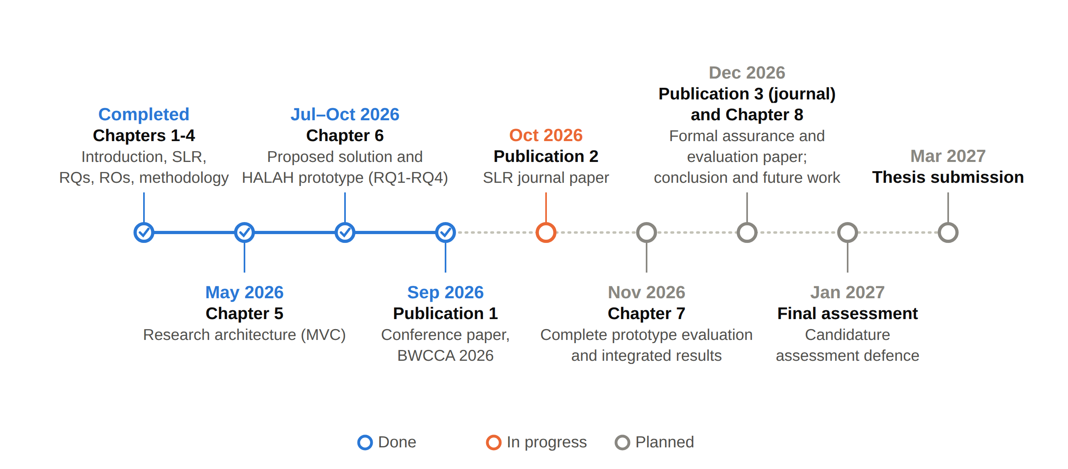
RESEARCH TIMELINE
Notes:
This slide shows my research plan as a timeline. It has the same milestones as the table on the last slide. Here you can see the order and my progress at a glance.
The legend at the bottom explains the colours. Blue means done. Orange means in progress. Grey means planned. The done points also have a tick, and the solid blue line shows the part I have already finished.
From the left, Chapters 1 to 4 are completed. They cover the introduction, the SLR, the research questions and objectives, and the methodology. Chapter 5, the research architecture based on MVC, was done in May 2026. Chapter 6, the proposed solution for RQ1 to RQ4 and the HALAH prototype, was done in July 2026. In September 2026 I submitted the first paper, a conference paper to BWCCA 2026.
The orange point is October 2026. This is the SLR journal paper, which I am working on now.
After that, everything is planned. In November 2026 comes Chapter 7, the complete prototype evaluation and the integrated results. In December 2026 come the third paper, a journal paper on formal assurance and evaluation, and Chapter 8 with the conclusion and future work. The final assessment is in January 2027, and I plan to submit the thesis in March 2027.

Slide 39
REFERENCES (1/3)
Abbasi, A., Humeidi, M.N. & Wang, Q. 2026, 'Nexa: Enabling secure, scalable, and decentralized management of electronic health records using threshold cryptography and public blockchains', IEEE Access, vol. 14, pp. 50791–50810, <https://doi.org/10.1109/ACCESS.2026.3677499>.
Al Amin, M., Altarawneh, A. & Ray, I. 2023, 'Informed consent as patient driven policy for clinical diagnosis and treatment: A smart contract based approach', Proceedings of the 20th International Conference on Security and Cryptography (SECRYPT 2023), pp. 159–170, SciTePress, <https://doi.org/10.5220/0012090600003555>.
Albalwy, F., Brass, A. & Davies, A. 2021, 'A blockchain-based dynamic consent architecture to support clinical genomic data sharing (ConsentChain): Proof-of-concept study', JMIR Medical Informatics, vol. 9, no. 11, p. e27816, <https://doi.org/10.2196/27816>.
Bloemen, R., Logvinov, L. & Evans, J. 2017, EIP-712: Typed structured data hashing and signing, Ethereum Improvement Proposals, no. 712, viewed 6 October 2026, <https://eips.ethereum.org/EIPS/eip-712>.
Cai, B. 2022, ERC-5484: Consensual soulbound tokens, Ethereum Improvement Proposals, no. 5484, viewed 6 October 2026, <https://eips.ethereum.org/EIPS/eip-5484>.
Ekholm, K., Augustinsson, A., Sundström, J., Johansen, C., Storgärds, M., Ljöstad, L. et al. 2025, 'Implementing electronic informed consent in rare disease genomics', Scientific Reports, vol. 15, no. 1, p. 44419, <https://doi.org/10.1038/s41598-025-32740-1>.
Eneh, A.U., Ahakonye, L.A.C., Lee, J.M. & Kim, D.-S. 2026, 'Demo: EdgeConsent: On-chain attribute-based access control for data consent management', 2026 IEEE International Conference on Blockchain and Cryptocurrency (ICBC), pp. 1–2, <https://doi.org/10.1109/ICBC67748.2026.11575534>.
Entriken, W., Shirley, D., Evans, J. & Sachs, N. 2018, ERC-721: Non-fungible token standard, Ethereum Improvement Proposals, no. 721, viewed 6 October 2026, <https://eips.ethereum.org/EIPS/eip-721>.
Ethereum Foundation 2026b, Networks, ethereum.org developer documentation, viewed 7 October 2026, <https://ethereum.org/en/developers/docs/networks/>.
Grassi, L., Khovratovich, D., Rechberger, C., Roy, A. & Schofnegger, M. 2021, 'Poseidon: A new hash function for zero-knowledge proof systems', Proceedings of the 30th USENIX Security Symposium, pp. 519–535.
Groth, J. 2016, 'On the size of pairing-based non-interactive arguments', Advances in Cryptology – EUROCRYPT 2016, LNCS, vol. 9666, pp. 305–326, Springer, <https://doi.org/10.1007/978-3-662-49896-5_11>.
Hagström, J., Hägglund, M., Holmroos, M., Lähteenmäki, P. & Hörhammer, I. 2024, 'Minors’ and guardian access to and use of a national patient portal: A retrospective comparative case study of Sweden and Finland', International Journal of Medical Informatics, vol. 187, p. 105465, <https://doi.org/10.1016/j.ijmedinf.2024.105465>.
Notes:
Now I come to the references. The list has three pages and holds the sources used in these slides: the 25 primary studies of my review and the standards and tools used in the prototype. It follows the UTS Harvard style, so the sources are listed by author name and year. I will not read each one. The full details are in the report.

Slide 40
REFERENCES (2/3)
Hema, S., Reddy, G.B.S. & Shalini, R. 2026, 'Patient centric cryptographic protection of cloud electronic health records', 2026 6th International Conference on Expert Clouds and Applications (ICOECA), pp. 293–300, <https://doi.org/10.1109/ICOECA68095.2026.11485301>.
HL7 International 2019, HL7 FHIR Release 4 (R4), viewed 7 October 2026, <https://hl7.org/fhir/R4/>.
Jaiman, V. & Urovi, V. 2020, 'A consent model for blockchain-based health data sharing platforms', IEEE Access, vol. 8, pp. 143734–143745, <https://doi.org/10.1109/ACCESS.2020.3014565>.
Li, H., Li, D., Lv, G., Crespi, N., Minerva, R., Shao, W. et al. 2026a, 'Privacy-preserving fine-grained EMR access control for IoMT: A hybrid RBAC-smart contract scheme with attribute-based authorization', IEEE Internet of Things Journal, vol. 13, no. 2, pp. 2970–2987, <https://doi.org/10.1109/JIOT.2025.3633504>.
Madine, M.M., Salah, K., Jayaraman, R., Yaqoob, I., Al-Hammadi, Y., Ellahham, S. et al. 2020, 'Fully decentralized multi-party consent management for secure sharing of patient health records', IEEE Access, vol. 8, pp. 225777–225791, <https://doi.org/10.1109/ACCESS.2020.3045048>.
Maruthi, V. & Singh, K. 2025, 'Enhancing security and privacy of IoMT data for unconscious patient with blockchain', IEEE Transactions on Network and Service Management, vol. 22, no. 6, pp. 5223–5238, <https://doi.org/10.1109/TNSM.2025.3602117>.
Mei, L., Huang, K., Li, X., Wang, H. & Zhang, X. 2026, 'Efficient dual-revocation CP-ABE for secure and fine-grained data sharing in IoMT', IEEE Internet of Things Journal, vol. 13, no. 14, pp. 30933–30940, <https://doi.org/10.1109/JIOT.2026.3685269>.
Page, M.J., McKenzie, J.E., Bossuyt, P.M., Boutron, I., Hoffmann, T.C., Mulrow, C.D. et al. 2021, 'The PRISMA 2020 statement: An updated guideline for reporting systematic reviews', BMJ, vol. 372, p. n71, <https://doi.org/10.1136/bmj.n71>.
Panagoulias, D.P., Damian, A.I., Stamate, C., Toderian, V., Butusina, P., De Franceschi, A. et al. 2026, 'Blockchain-enabled trust and compliance for clinical AI: Decentralized governance without decentralized data storage', Electronics, vol. 15, no. 14, p. 3046, <https://doi.org/10.3390/electronics15143046>.
Phuyal, S., Bhandari, M., Bista, R. & Ferreira, J.C. 2026a, 'A blockchain-based architecture for dynamic and auditable patient consent in secondary use of health data', Blockchain in Healthcare Today, vol. 9, no. 1, p. 491, <https://doi.org/10.30953/bhty.v9.491>.
Phuyal, S., Bhandari, M., Bista, R. & Ferreira, J.C. 2026b, 'Enabling cross-institution health data sharing in Norway: EUDI wallets, on-chain consent, and openEHR↔FHIR translation', IEEE Access, vol. 14, pp. 20309–20327, <https://doi.org/10.1109/ACCESS.2026.3661642>.
Punia, A., Gulia, P., Gill, N.S., Kaushik, D., Alduaiji, N., Shukla, P.K. et al. 2025, 'An access control system for cloud-based healthcare systems driven by blockchain', Journal of Cloud Computing, vol. 14, no. 1, p. 78, <https://doi.org/10.1186/s13677-025-00831-z>.

Slide 41
REFERENCES (3/3)
Román-Martínez, I., Calvillo-Arbizu, J., Mayor-Gallego, V.J., Madinabeitia-Luque, G., Estepa-Alonso, A.J. & Estepa-Alonso, R.M. 2023, 'Blockchain-based service-oriented architecture for consent management, access control, and auditing', IEEE Access, vol. 11, pp. 12727–12741, <https://doi.org/10.1109/ACCESS.2023.3242605>.
SooHoo, S.L., Keller, M.S., Chen, Y., Hu, D., Huang, S.-C., Kuo, T.-T. et al. 2026, 'Development of the authentication and authorization processes for the iAgree portal, a platform for patient-controlled data sharing across health systems', JAMIA Open, vol. 9, no. 3, p. ooag111, <https://doi.org/10.1093/jamiaopen/ooag111>.
Tan, K.-L., Chi, C.-H. & Lam, K.-Y. 2024, 'Secure and privacy-preserving sharing of personal health records with multi-party pre-authorization verification', Wireless Networks, vol. 30, no. 4, pp. 4773–4795, <https://doi.org/10.1007/s11276-022-03114-6>.
Tith, D., Lee, J.-S., Suzuki, H., Wijesundara, W.M.A.B., Taira, N., Obi, T. et al. 2020, 'Patient consent management by a purpose-based consent model for electronic health record based on blockchain technology', Healthcare Informatics Research, vol. 26, no. 4, pp. 265–273, <https://doi.org/10.4258/hir.2020.26.4.265>.
Tremper, G., Brenner, T., Ben Amor, M., Kussel, T. & Lablans, M. 2026, 'Mainzelliste: Ten years of pseudonymization, record linkage, and informed consent management', Patterns, vol. 7, no. 1, p. 101432, <https://doi.org/10.1016/j.patter.2025.101432>.
Tseng, C.-H., Hsieh, Y.-H., Lin, H.-Y. & Yuan, S.-M. 2025, 'EMR-Chain: Decentralized electronic medical record exchange system', Technologies, vol. 13, no. 10, p. 446, <https://doi.org/10.3390/technologies13100446>.
Walonoski, J., Kramer, M., Nichols, J., Quina, A., Moesel, C., Hall, D. et al. 2018, 'Synthea: An approach, method, and software mechanism for generating synthetic patients and the synthetic electronic health care record', Journal of the American Medical Informatics Association, vol. 25, no. 3, pp. 230–238, <https://doi.org/10.1093/jamia/ocx079>.
Wood, G. 2014, Ethereum: A secure decentralised generalised transaction ledger, Ethereum Project Yellow Paper.
Wu, Y., Liu, C., Sebald, L., Nguyen, P. & Yesha, Y. 2022, 'Apply trust computing and privacy preserving smart contracts to manage, share, and analyze multi-site clinical trial data', Proceedings of the International Conference on Deep Learning, Big Data and Blockchain (DBB 2022), LNNS, vol. 541, pp. 3–14, Springer, <https://doi.org/10.1007/978-3-031-16035-6_1>.
Wu, Z. & Zhang, D. 2025, 'HealthDID: An efficient and authorizable multi-party privacy-preserving EMR sharing system based on DID', Computer Standards & Interfaces, vol. 93, p. 103967, <https://doi.org/10.1016/j.csi.2024.103967>.
Zhao, J. & Su, Q. 2024, 'A threshold traceable delegation authorization scheme for data sharing in healthcare', Computers & Security, vol. 139, p. 103686, <https://doi.org/10.1016/j.cose.2023.103686>.

Slide 42
Thank You
Questions and discussion
Notes:
Thank you for listening. That is the end of my presentation, and I am happy to answer your questions.
Possible question: Why use blockchain at all? It gives persistence, traceability and evidence of the consent state. The token stores only pseudonymous addresses, a hash of the purpose, the validity window and a revocation flag.
Possible question: What is new in this work? Multi-party approval is a standing condition of every access decision, and the patient defines who must approve. I tested the prototype against twelve attack scenarios. After hardening, eleven of them are refused.
Possible question: What is left for the next stage? RO5, on temporal and lifecycle trust, is in progress. RO6, on formal security assurance and empirical validation, is partially completed.

