Slide 1

A Trusted Authorisation Framework for Multi-Party Patient Consent in Healthcare Data Sharing
Candidature Reassessment
Principal Supervisor: Professor Farookh Hussain
Co-Supervisor: Dr. Firas Al-Doghman
Presenter: Yasir Dhaifallah O Alyoubi
STUDENT ID #: 24724078
Notes:
Good morning everyone. My name is Yasir Alyoubi. My principal supervisor is Professor Farookh Hussain, and my co-supervisor is Dr Firas Al-Doghman. This is my candidature reassessment. My research asks one simple question. When a doctor asks for a patient's data, how can the system be sure that this request is really allowed? Not just who is asking. Also, did the patient and the guardians agree? Is the request inside the agreed data? And is the consent still valid today? I will show you the problem, what the literature says, my framework, the working prototype, and the results.

Slide 2
OUTLINE
01
THE PROBLEM
07
WHAT IS STILL OPEN
02
LITERATURE REVIEW
08
RESEARCH PLAN
03
​GAP, QUESTIONS AND OBJECTIVES
09
DEMO: THE HALAH PROTOTYPE
04
THE FRAMEWORK
10
REFERENCES
05
VALIDATION AND EVALUATION
06
WHY THIS MATTERS
Notes:
Here is the plan for my talk. First, the problem. Then the literature review. Then the gap, the questions and the objectives. After that, the framework and its six steps. Then the validation and the evaluation results. Then I talk about what is still open and the research plan. At the end, I show a demonstration of the prototype through the slides: one real consent, from the day it is created to the day it is revoked.

Slide 3
THE PROBLEM
Healthcare data is shared between many independent parties: patient, guardians, doctor, hospital.
Today, consent is a stored record. It shows that permission was given, but it checks nothing at access time.
A valid identity does not prove the right to see this patient's data.
A request can ask for more data than allowed, or arrive after the consent expired or was revoked.
None of the reviewed studies proves or tests the whole decision.
In one sentence
There is no trusted mechanism that checks identity, authority, multi-party approval, policy, time and lifecycle together in one access decision, with evidence that it is secure.
Notes:
Let me start with the problem. Health data is very sensitive. One decision to share it can involve many people: the patient, one or more guardians, the doctor, and the hospital. Today, consent is usually just a record that is saved somewhere. That record says permission was given. But it does not check anything when someone asks for the data. A valid login does not mean you have the right to see this patient's data. And even with approval, a request can ask for more data than the patient allowed, or it can come after the consent has expired or was cancelled. So the real problem is this: there is no single trusted decision that checks all of these things together.

Slide 4
THE KEY IDEA
Consent is not a stored record. It is an object checked at every request.
C = (I, A, P, T, L, E)
I Identity
Who is the patient, the doctor and each guardian (DID).
​A Authorisation
The guardian set G and how many approvals are needed (N).
P Policy
The purpose and the data scope that were agreed.
T Time
When the consent starts and when it expires.
​L Lifecycle
​The state of the consent, from creation to expiry or revocation.
E Evidence
Signatures, the token, and whether it is revoked.
Notes:
Here is my answer in simple words. Consent should not be a record that we store. It should be an object that the system checks every time. I call this object C, and it has six parts. I is identity: who is involved. A is authorisation: which guardians must approve, and how many. P is policy: the purpose and the data that was agreed. T is time: when the consent starts and when it ends. L is lifecycle: the state of the consent, from creation to expiry or revocation. And E is evidence: the signatures, the token, and whether the consent was cancelled. At every request, the system checks all six parts. If one part fails, the answer is no.

Slide 5
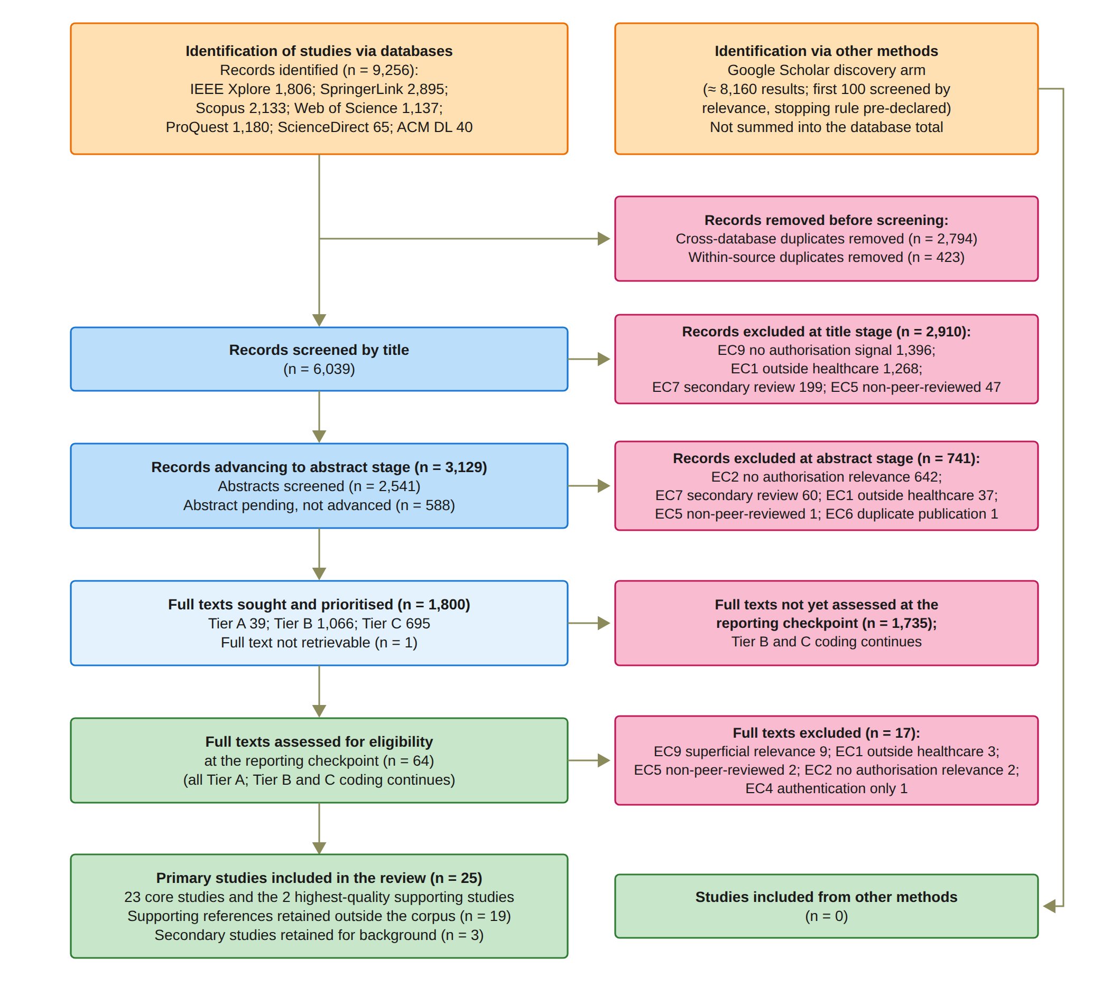
LITERATURE REVIEW: HOW I DID IT
9,256
records from seven databases
47
studies met the criteria at the checkpoint
25
primary studies analysed (23 core + 2)
Notes:
This is how I did the literature review. I followed the PRISMA 2020 method. Before I started screening, I wrote a protocol that fixed the questions, the databases, one search query, the criteria and the quality items. I searched seven databases. They gave me 9,256 records. After I removed duplicates, 6,039 were screened by title, 3,129 by abstract, and 1,800 full texts were put in order of priority. At the reporting checkpoint, 64 full texts were assessed and 47 met the criteria. From these, I analysed 25 primary studies in depth: 23 core studies and 2 supporting studies.

Slide 6
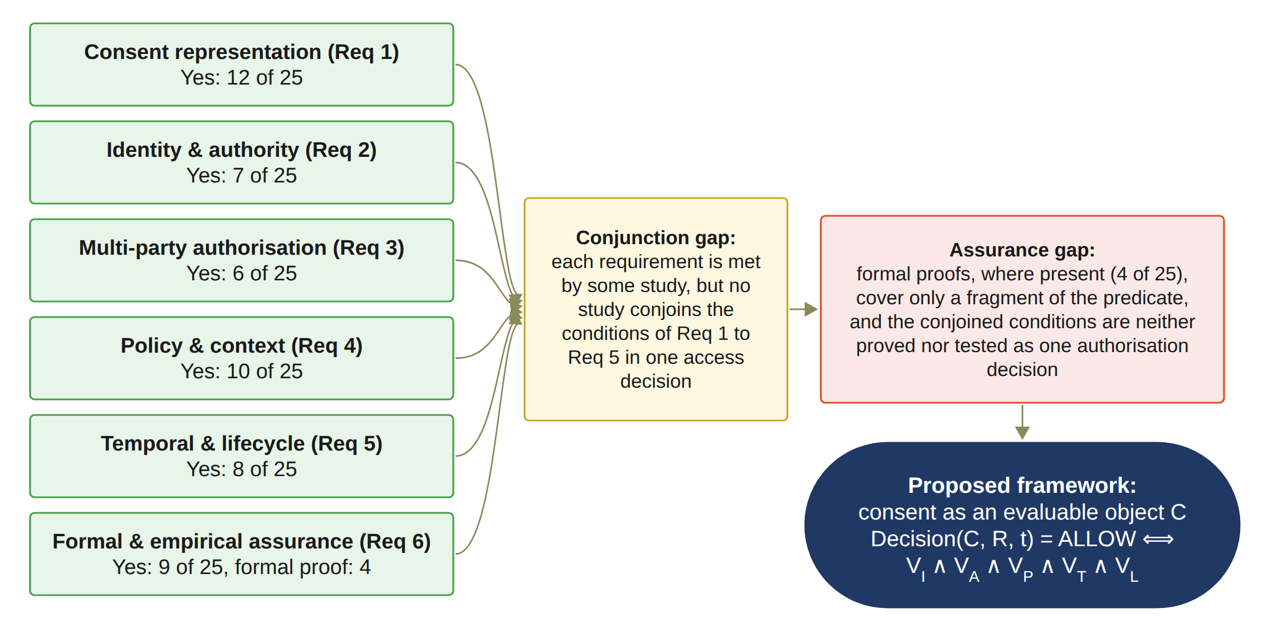
LITERATURE REVIEW: WHAT I FOUND
Conjunction gap
Each condition exists somewhere, but no study joins identity, authority, approval, policy and time in one decision.
Assurance gap
The whole decision is neither formally proved nor systematically tested. Proofs exist in only 4 of 25 studies.
Notes:
This figure sums up the review. The good news: every requirement is covered by some study. The problem: no study puts all the conditions together in one access decision. I call this the conjunction gap. And no study proves or tests the whole decision. Formal proofs exist in only 4 of the 25 studies, and they cover only a small part. I call this the assurance gap. These two gaps are what my research fills.

Slide 7
​RESEARCH GAP
​Existing healthcare consent and access-control research provides many of the necessary technological building blocks, but there remains a need for an integrated Trust Computing framework that treats patient consent as a security-bearing and evaluable authorisation object. Such a framework should be capable of representing the relevant trust conditions, verifying the participating entities and their authority, establishing collective authorisation where required, and enforcing the policy and data-scope constraints associated with the consent.
Notes:
This is the research gap of my study. Existing healthcare consent and access-control research provides many of the necessary technological building blocks, but there remains a need for an integrated Trust Computing framework that treats patient consent as a security-bearing and evaluable authorisation object. Such a framework should be capable of representing the relevant trust conditions, verifying the participating entities and their authority, establishing collective authorisation where required, and enforcing the policy and data-scope constraints associated with the consent.

Slide 8
RESEARCH QUESTIONS
How can a trust-oriented computing framework establish and enforce trustworthy multi-party consent for decentralised healthcare data sharing under identity, authority, and policy constraints?
RQ1
​How can patient consent be modelled as a trust-aware authorisation object that explicitly represents identity, authority requirements, policy constraints, and authorisation evidence?
RQ2
​How can decentralised identities and verifiable credentials establish trustworthy participants while explicitly separating identity authentication from authorisation authority?
RQ3
​How can multiple independently verified participants and guardians jointly establish a trustworthy consent decision without allowing a single participant to unilaterally authorise sensitive healthcare data access?
RQ4
​How can policy, purpose, and data-scope constraints be incorporated into authorisation decisions so that valid identities and sufficient approvals cannot be used to obtain unauthorised healthcare data?
RQ5
​How can temporal validity and consent lifecycle controls ensure that an authorisation remains valid only within its permitted time interval and lifecycle state, and is rejected after expiration, revocation, or an unauthorised state transition?
RQ6
​How can the security properties of the proposed trust-oriented authorisation mechanism be formally defined and empirically evaluated to demonstrate that the implemented framework correctly enforces authorised and unauthorised healthcare data-access decisions?
Notes:
So this is my main research question. How can a trust-oriented computing framework establish and enforce trustworthy multi-party consent for decentralised healthcare data sharing, under identity, authority and policy constraints? It has six sub-questions. How to model consent. How to check identity and authority. How several guardians can approve together. How purpose and scope are checked. How time and lifecycle are checked. And how to prove and test the security.

Slide 9
RESEARCH OBJECTIVES AND STATUS
Objective | ​Description | Status
​RO1 – Trust-Centric Consent Model | ​To develop a trust-aware consent model that represents patient consent as a structured and evaluable authorisation object. | Done
​RO2 – Decentralised Identity and Authority Trust | ​To develop a decentralised identity and authority verification mechanism using decentralised identifiers and verifiable credentials. | Done
​RO3 – Trustworthy Multi-Party Authorisation | ​To develop a threshold-based multi-party authorisation mechanism through which multiple independently verified participants and guardians can jointly establish a trustworthy consent decision. | Done
​RO4 – Policy- and Context-Aware Access Control | ​To develop a policy-aware authorisation mechanism that evaluates the purpose and data scope of a requested operation against the constraints defined by the consent. | Done
​RO5 – Temporal and Lifecycle Trust | ​To extend the trust-oriented framework with temporal validity and consent lifecycle controls. | In Progress
​RO6 – Formal Security Assurance and Empirical Validation | ​To formally analyse and empirically evaluate whether the implemented framework satisfies its defined trust and authorisation properties under representative healthcare data-sharing scenarios. | Partially completed
Notes:
Each question has one objective. RO1 to RO4 are done, and they are validated with the prototype. RO5 is time and lifecycle. It is in progress. The validity window and the revocation already work. Consent changes, delegation and guardian changes are for the next stage. RO6 is partly completed. The automated tests, the attack tests and the measurements are done. The formal proofs are for the next stage.

Slide 10
RESEARCH METHODOLOGY
1
2
3
4
5
6
7
Problem
Consent is a passive record; no single trusted decision
Literature review
PRISMA 2020; 25 primary studies
​Gap and questions
​Research gap; RQ1 to RQ6
Objectives
RO1 to RO6
Design
MVC architecture, consent object C, Algorithms 1 to 4
Prototype
HALAH; ConsentSBTv3 on Sepolia
Evaluation
Live scenarios, measurements and 12 attack tests; formal proofs next
From the problem to the evaluated prototype
Notes:
These are the steps I followed. Step one, I identified the problem. Step two, I did the systematic review. Step three, from the review I found the research gap and wrote the questions. Step four, I set the objectives. Step five, I designed the framework: the architecture, the consent object, and four algorithms. Step six, I built the prototype on the Sepolia test network. Step seven, I evaluated it with live scenarios, measurements and attack tests. The formal proofs are the next stage.

Slide 11
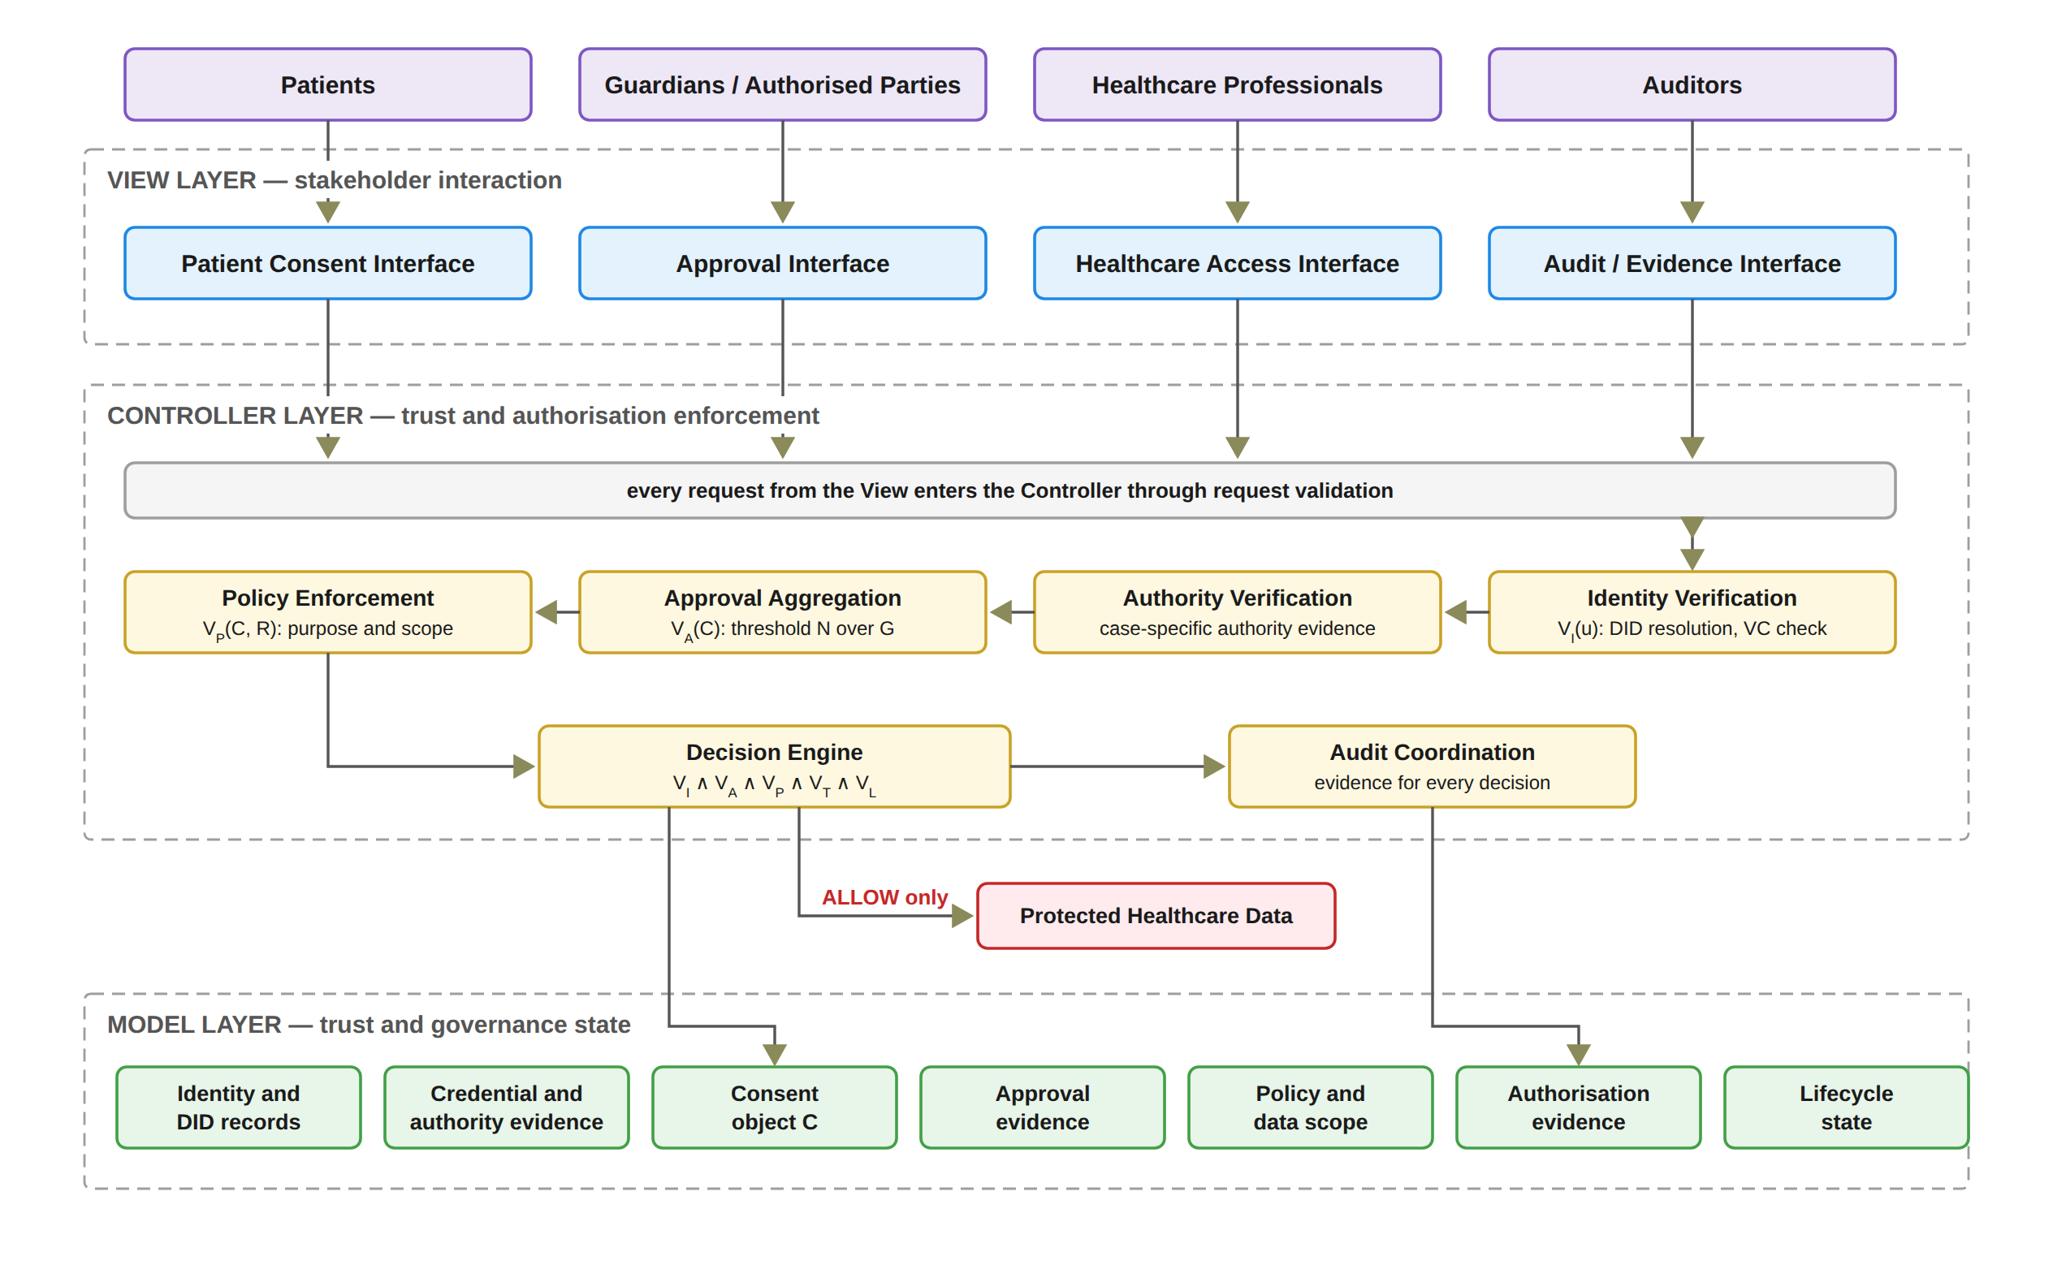
THE FRAMEWORK: ARCHITECTURE
Notes:
The framework uses the Model, View, Controller pattern. The View is the four screens: patient, guardian, doctor and auditor. The View never decides who gets access. Every security decision is made in the Controller. It checks identity and authority, collects the approvals, enforces the policy, and records the evidence. The Model keeps the consent, the approvals and the evidence. Health data is released only when the Controller says ALLOW.

Slide 12
THE FRAMEWORK: THE DECISION RULE
Decision(C, R, t) = ALLOW ⟺ VI(u) ∧ VA(C) ∧ VP(C, R) ∧ VT(C, t) ∧ VL(C)
VI
​Identity and authority validity
VA
​Collective authorisation validity
VP
​Policy and contextual compliance
VT
​Temporal validity
VL
​Consent lifecycle validity
One failed check is enough to say DENY.
A Groth16 zero-knowledge proof must also verify before any data is released.
Every decision on an ACTIVE consent is written to the audit ledger with its decision matrix.
Notes:
This is the heart of the framework. Access is allowed only when five checks are all true. VI is identity and authority validity. VA is collective authorisation validity: all the required guardians approved. VP is policy and contextual compliance: the purpose and the requested data are inside what was agreed. VT is temporal validity: the request is inside the validity time. VL is consent lifecycle validity: the consent is in a valid state, for example active and not revoked. If any one check fails, the answer is DENY. In the prototype, a Groth16 zero-knowledge proof must also pass before any data is released. And every decision on an active consent is written to the audit ledger.

Slide 13
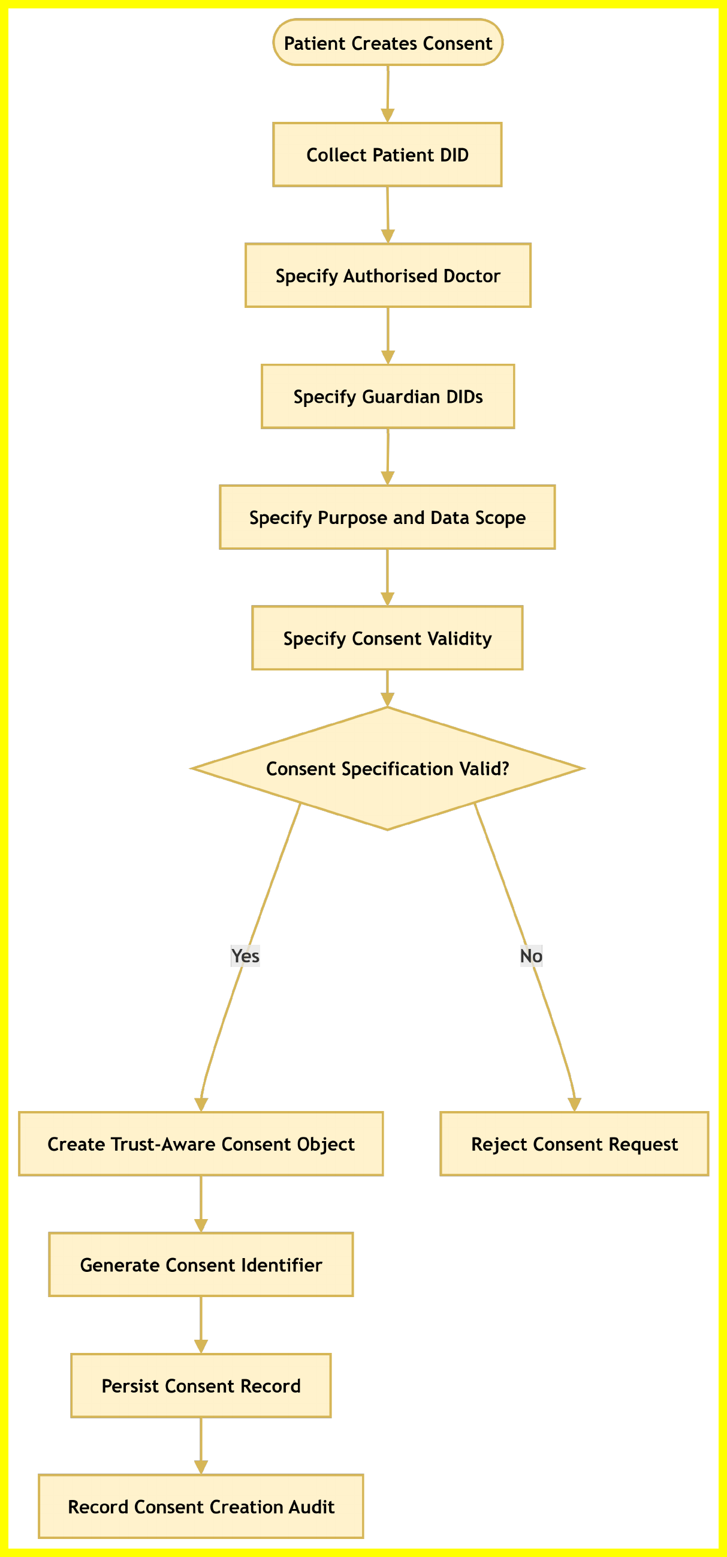
STEP 1: THE PATIENT CREATES THE CONSENT
RO1: Trust-Centric Consent Model
Status: Done
The patient chooses the doctor, the guardians, the data modules, and the start and expiry time.
In this prototype the purpose is fixed to Treatment.
Bad input is rejected, for example an empty data scope or a malformed guardian DID.
​The system creates the consent object, assigns a consent identifier, persists the record, and records the creation event in the audit layer.
Nothing goes on the blockchain until all guardians approve.
Notes:
Step one. The patient creates the consent. The patient chooses the doctor, the guardians, the data modules, and the start and end time. The system checks every field. For example, an empty data scope or a bad guardian DID is rejected. Then the system creates the consent object, assigns a consent identifier, persists the record, and records the creation event in the audit layer. Nothing goes to the blockchain yet. This is RO1, and it is done.

Slide 14
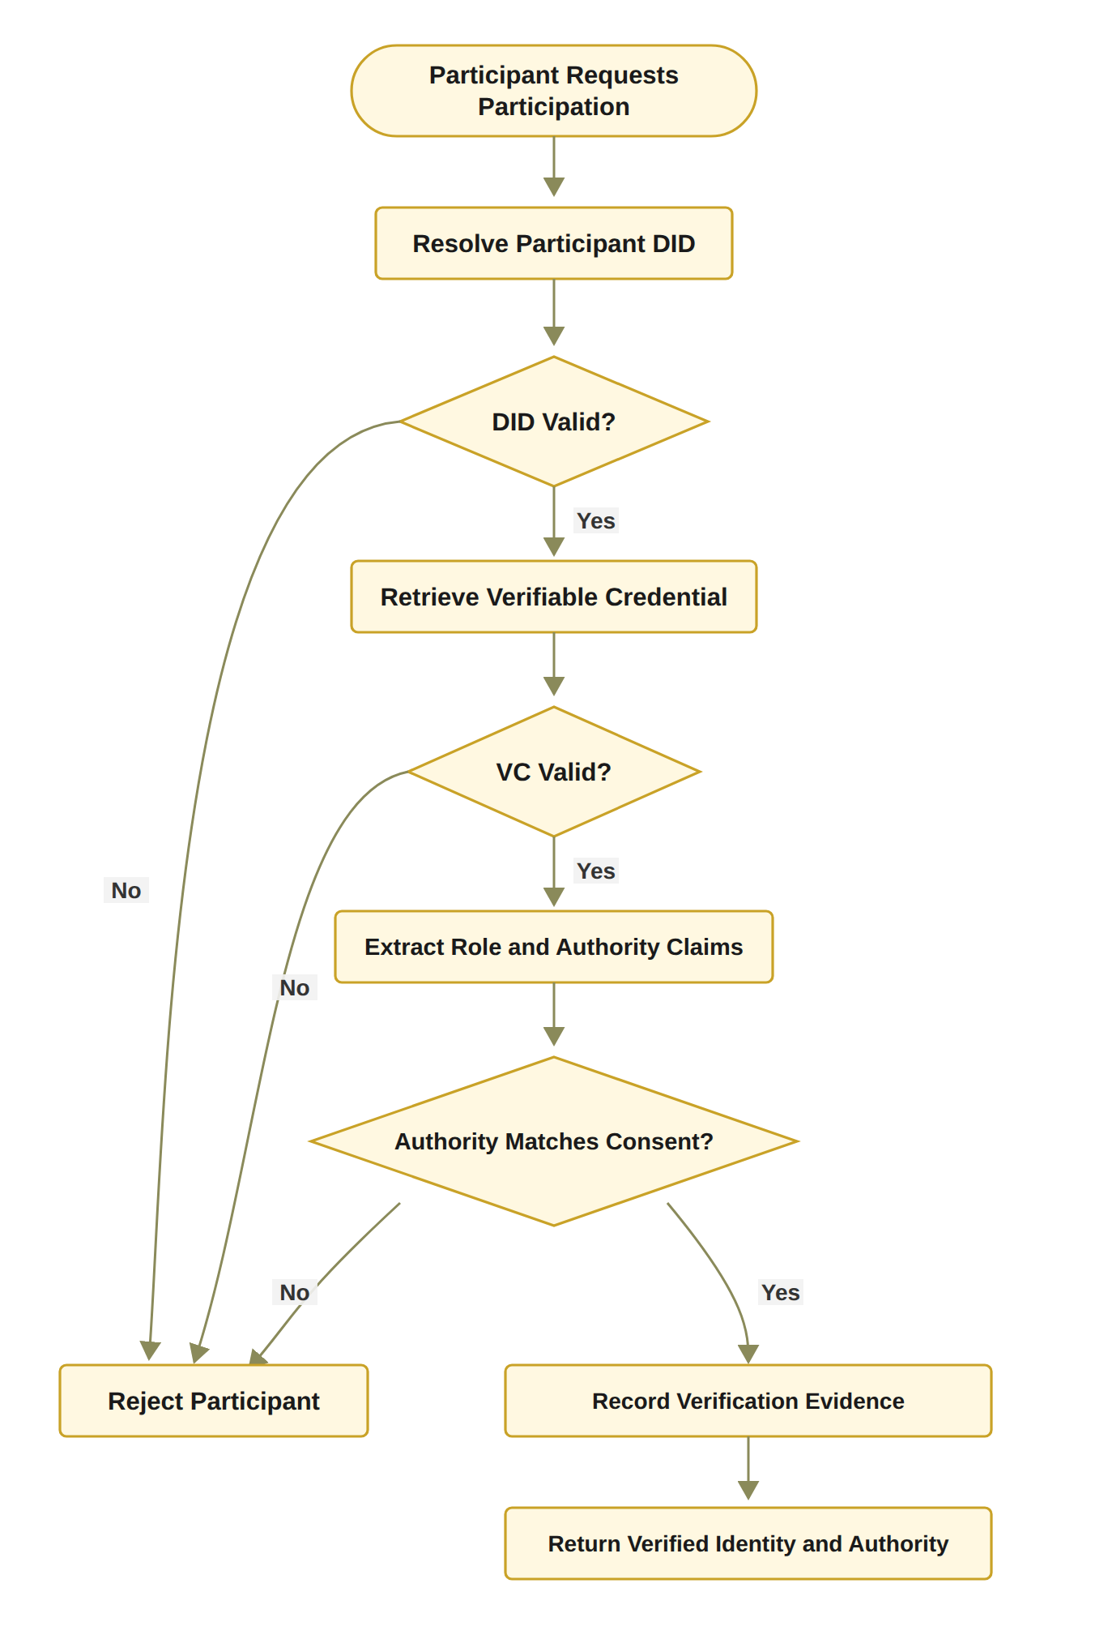
STEP 2: WHO ARE YOU, AND WHAT MAY YOU DO?
RO2: Decentralised Identity and Authority Trust
Status: Done
Identity is checked through the DID; authority through a verifiable credential.
Identity is not authority: a valid DID alone never gives access.
​In the HALAH implementation, the Guardian workflow uses a selected guardian DID and invokes VC verification before adding the guardian's signature to the consent.
Full DID resolution is planned for the next stage.
Notes:
Step two. I separate two questions: who are you, and what may you do? The DID answers the first question. The credential answers the second. A valid identity alone never gives access. In the HALAH implementation, the guardian workflow uses a selected guardian DID and invokes VC verification before adding the guardian's signature to the consent. Full DID resolution is planned for the next stage. So RO2 is done at the design level and in the prototype.

Slide 15
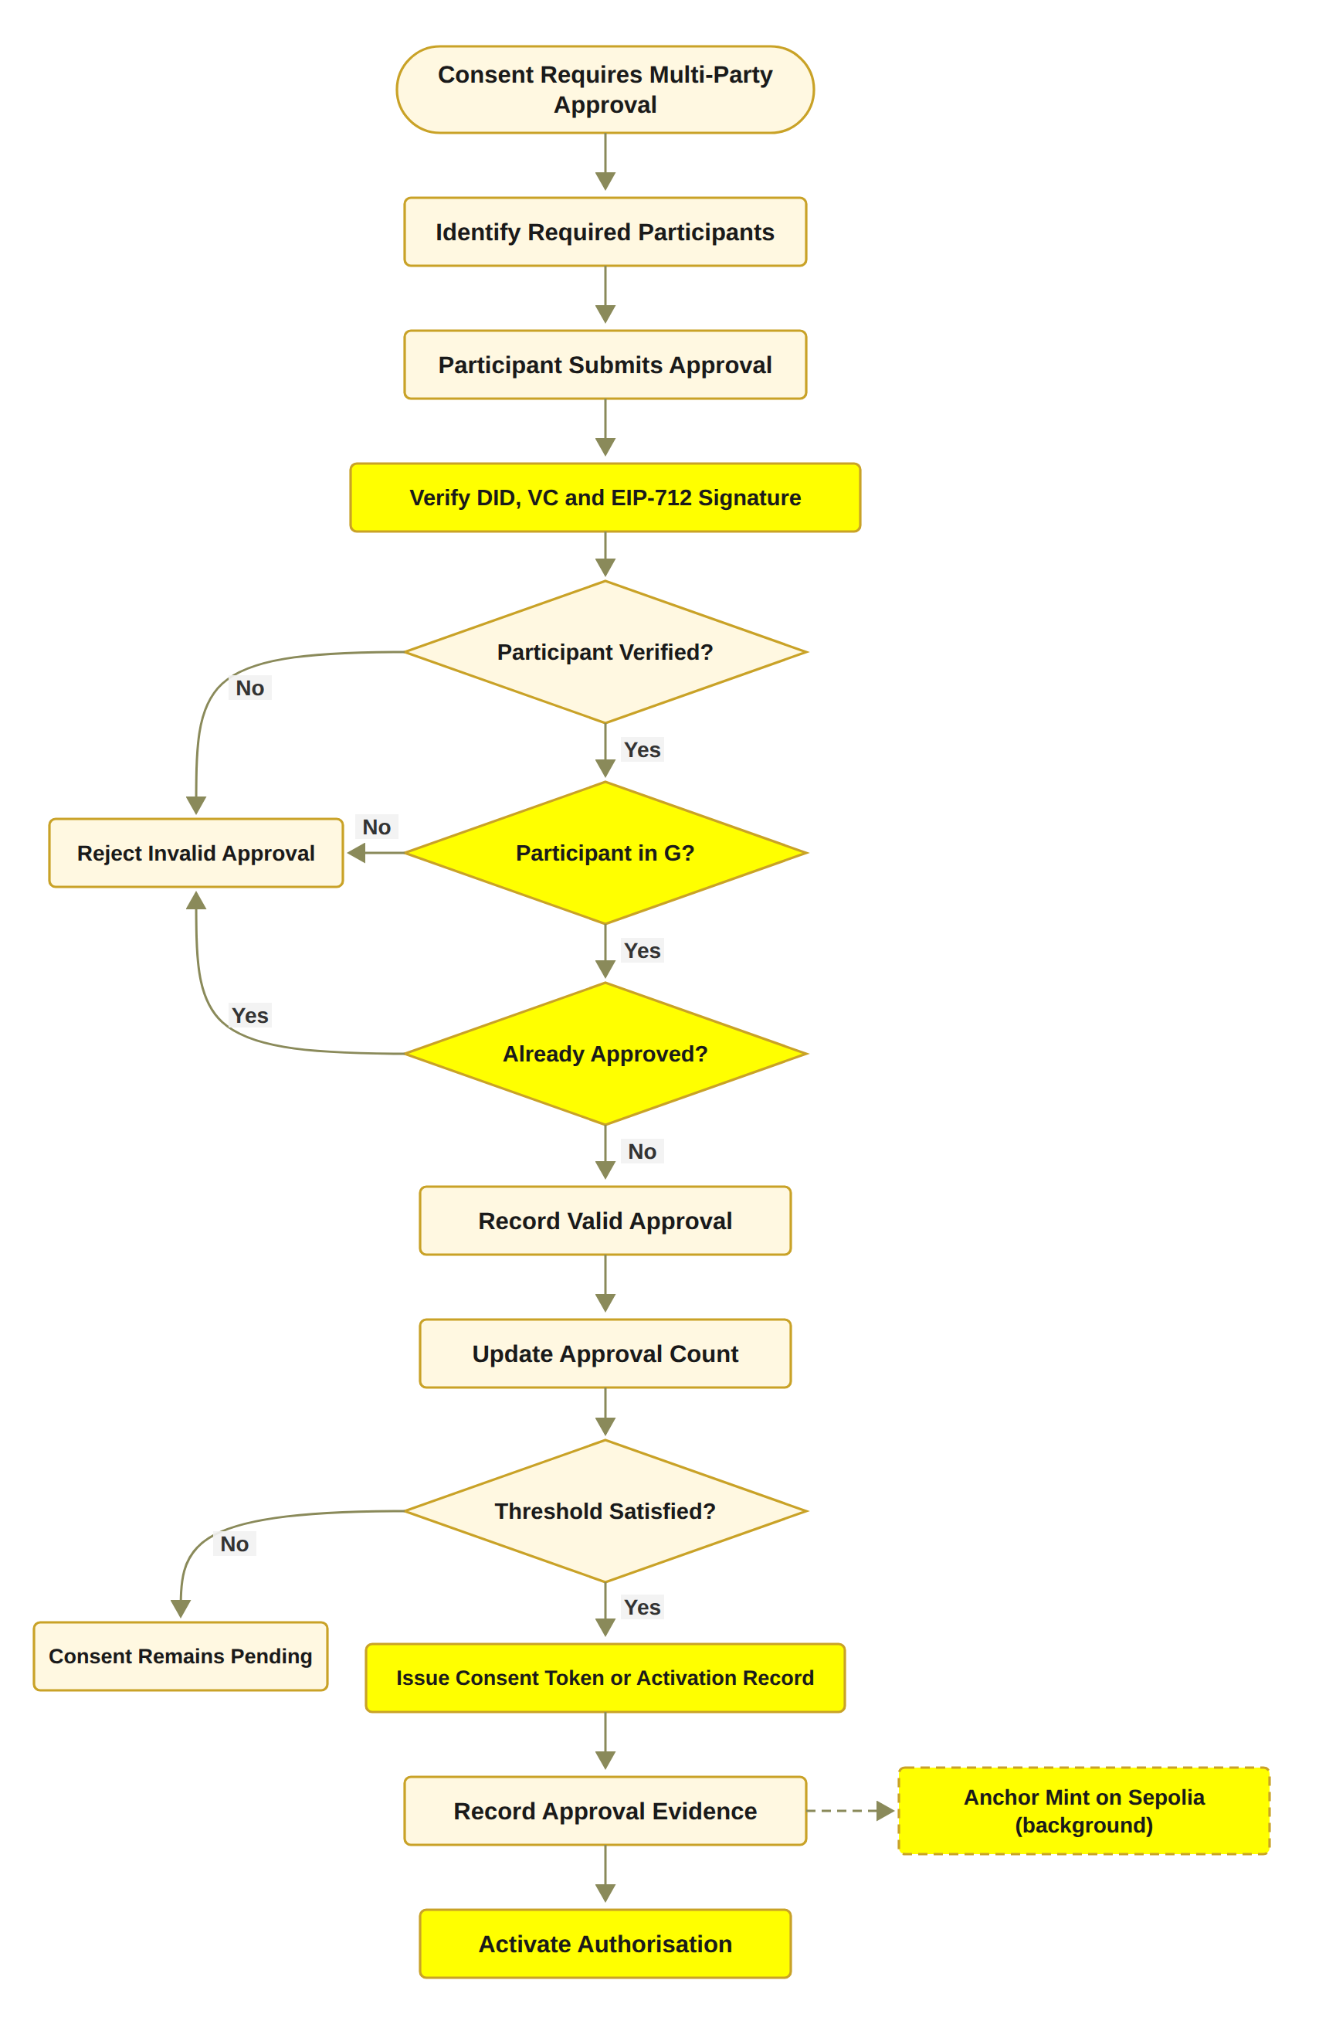
STEP 3: THE GUARDIANS APPROVE TOGETHER
RO3: Trustworthy Multi-Party Authorisation
Status: Done
The guardian set G is fixed when the consent is created.
Each guardian signs an EIP-712 approval; the system recovers the signer and checks it is in G.
Approvals from outsiders, replays and duplicates are not counted.
N-of-N rule: every listed guardian must sign (2-of-2 in the demo).
When all have signed, a soulbound token is minted on Sepolia in the background.
In the prototype the guardian keys are derived from the guardian DIDs; wallet-held keys are for the next stage.
Notes:
Step three. No single person can approve alone. Each guardian signs with an EIP-712 signature. The system recovers the signer and checks that this person is one of the listed guardians. Outsiders, replays and duplicates are not counted. In the demo, two of two guardians must sign. When both have signed, a soulbound token is minted on the Sepolia test network in the background. One honest note: in the prototype, the guardian keys are derived from the guardian DIDs. Wallet-held keys are for the next stage. RO3 is done.

Slide 16
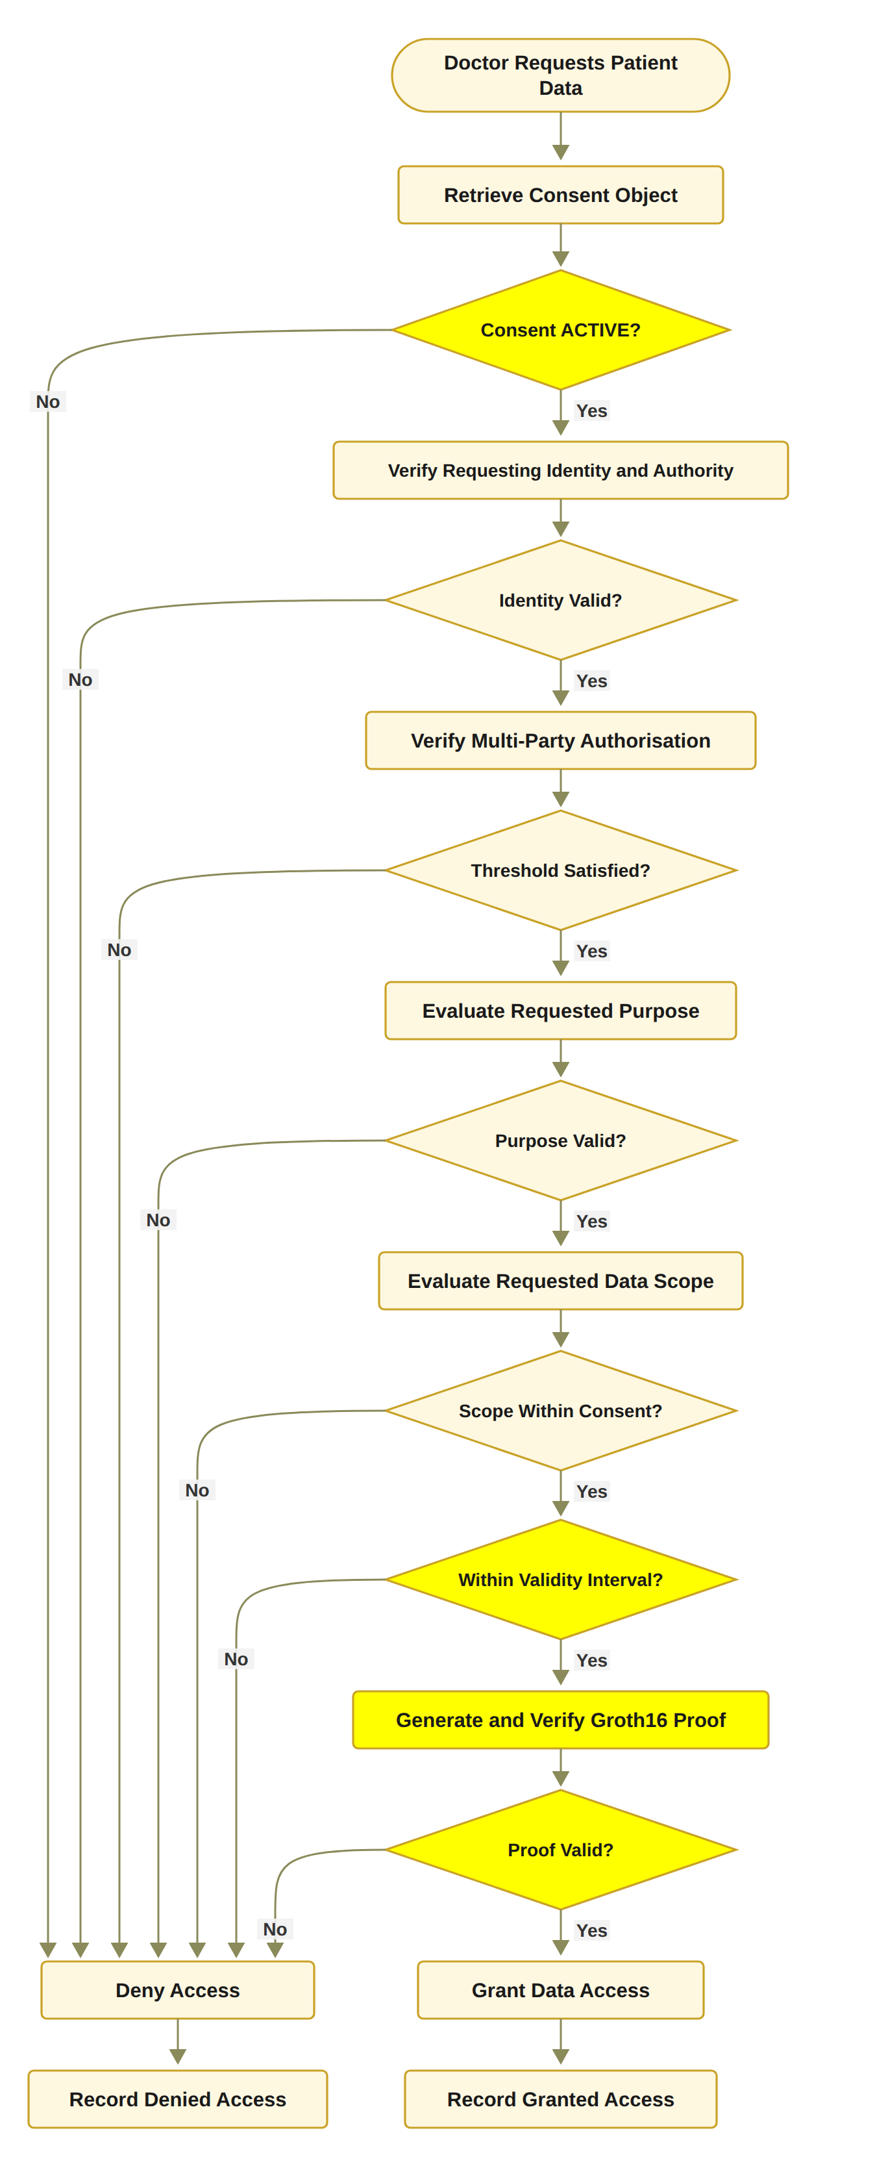
STEP 4: ONLY THE AGREED DATA AND PURPOSE
RO4: Policy- and Context-Aware Access Control
Status: Done
The requested data must be a non-empty subset of the agreed data scope.
The purpose must be a supported purpose of the consent.
Time and the lifecycle state are checked in the same decision.
A Groth16 proof must verify before any data is retrieved.
Example: asking for Procedure when only Observation and Medication were agreed gives DENY.
Notes:
Step four. A valid identity and all the approvals are still not enough. The requested data must be inside the agreed data scope. For example, if the consent allows Observation and Medication, a request that also asks for Procedure is denied. The purpose, the time and the lifecycle state are checked in the same decision. And a Groth16 proof must pass before any data is released. RO4 is done.

Slide 17
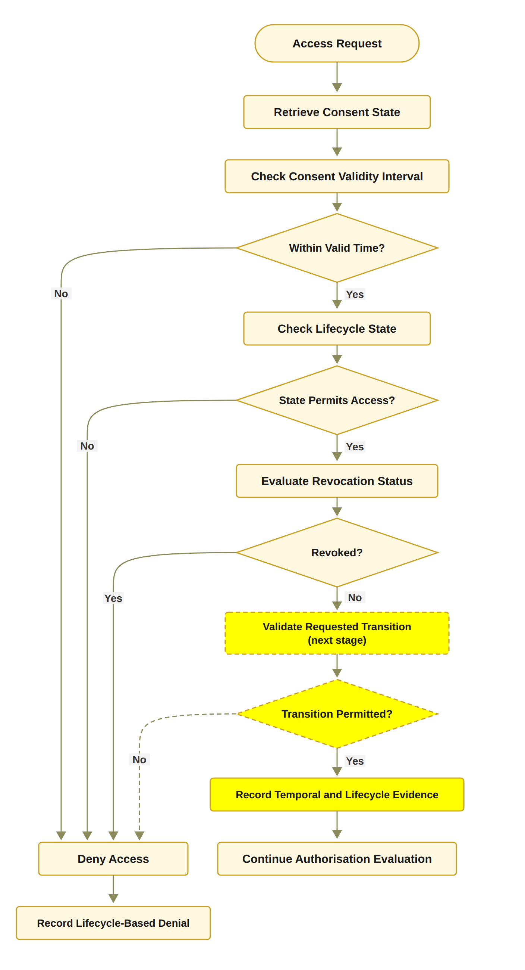
STEP 5: TIME AND LIFECYCLE
RO5: Temporal and Lifecycle Trust
Status: In Progress
Working now: the validity window is stored on-chain and checked at every request.
Working now: revocation end to end, including an on-chain revoke transaction.
​Design: L is the lifecycle state (CREATED, PENDING, ACTIVE, SUSPENDED, REVOKED, EXPIRED), checked by VL(C) = ValidState(C) ∧ ValidTransition(C).
Working now: a clear lifecycle: PENDING_SIGNATURE, PENDING_TOKEN, NOT_STARTED, ACTIVE, EXPIRED, REVOKED.
Next stage: the SUSPENDED state, the lifecycle transition check, consent modification, delegation, guardian-set changes and a formal lifecycle model.
Notes:
Step five. Time and lifecycle. What works now: the validity window is stored on-chain and checked at every request. Revocation works end to end, with an on-chain transaction. And the consent moves through a clear lifecycle. In the design, L is the lifecycle state: created, pending, active, suspended, revoked or expired, and VL checks a valid state and a valid transition. What is still open: the suspended state, the lifecycle transition check, consent modification, delegation, changes to the guardian set, and a formal lifecycle model. That is why RO5 is in progress.

Slide 18
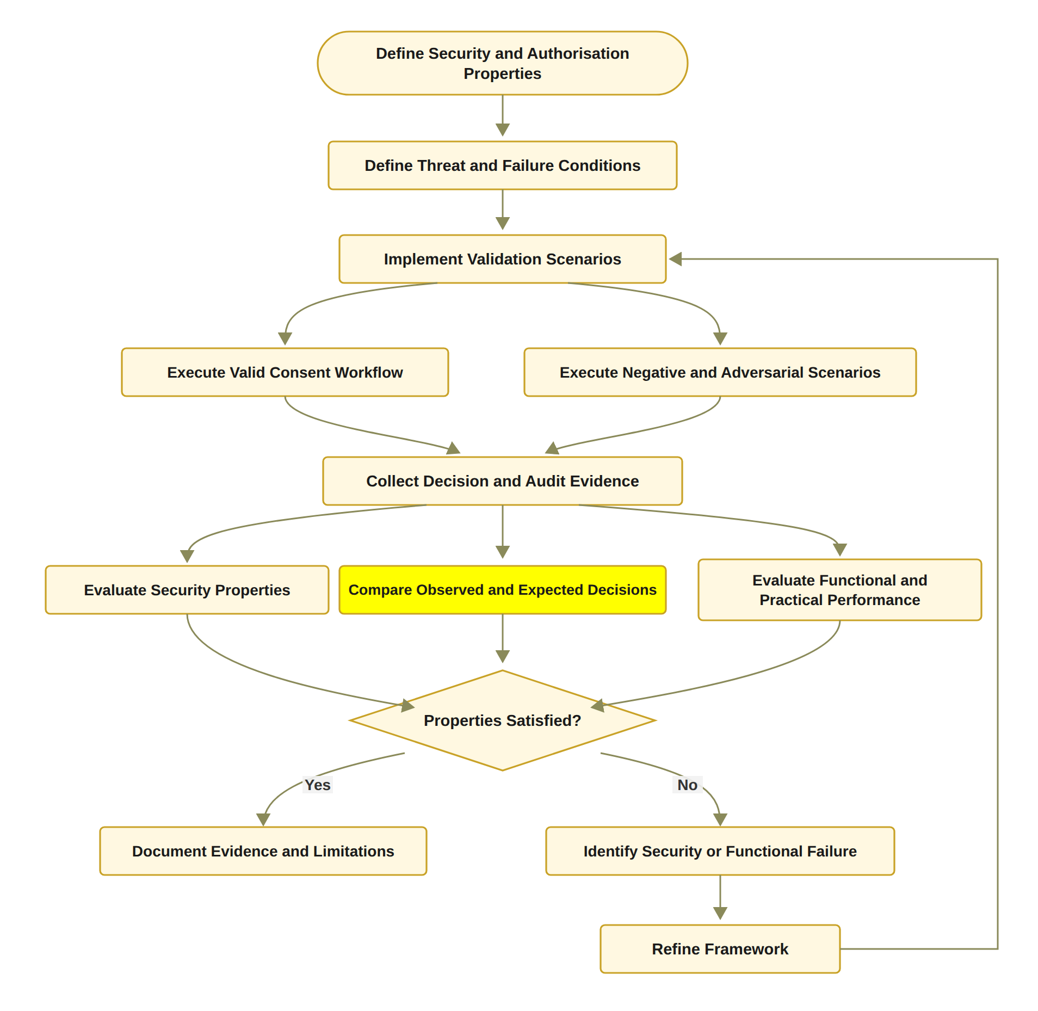
STEP 6: PROVE IT AND TEST IT
RO6: Formal Security Assurance and Empirical Validation
Status: Partially completed
Done: 36 automated tests pass, including 12 attack scenarios A1 to A12.
Done: gas, confirmation latency and processing time measured.
Next stage: formal proofs or model checking of the security properties, and a larger evaluation under load.
Notes:
Step six. Prove it and test it. The testing part is done. 36 automated tests pass, including twelve attack scenarios. I also measured the cost and the timing. The proof part is the next stage: formal proofs or model checking of the security properties, and a bigger evaluation under load. That is why RO6 is partly completed.

Slide 19
VALIDATION: DOES IT DO WHAT IT SHOULD?
Evidence | What it checks | Pass rule | Result
Valid scenarios | Legitimate requests get access | Observed = expected | Scenarios 1 to 3: consent created, 2-of-2 approval, ALLOW
Negative scenarios | Wrong requests are refused | Any failed check gives DENY | Scenario 5: revoked consent refused
Attack scenarios | Deliberate attempts to bypass a check, A1 to A12 | Every attack is refused | 11 of 12 refused after the hardening (A11: the changed digest is not yet compared)
Automated tests | 23 functional tests and 13 adversarial tests | All pass | 36 of 36 pass
Independent check | On-chain receipts against the local consent state | Local state = on-chain state | Scenario 6: all checks passed
Notes:
Validation asks one question: does the system do what it should? I used five kinds of evidence. Valid scenarios: the correct requests were allowed. Negative scenarios: the cancelled consent was refused. Attack scenarios: eleven of twelve attacks are refused after the hardening. Automated tests: all 36 pass. And an independent check: the state on the chain matches the local state.

Slide 20
VALIDATION: THE RECORDED DECISIONS
Time (24 Sep) | Consent | VI | VA | VP | VT | VL | Decision | Access | Proof
09:51:36 | f050c29a | PASS | PASS | PASS | PASS | PASS | ALLOW | GRANTED | groth16
09:51:39 | f050c29a | PASS | PASS | PASS | PASS | PASS | ALLOW | GRANTED | groth16
11:02:52 | 04da25f5 | PASS | PASS | PASS | PASS | PASS | ALLOW | GRANTED | groth16
11:04:16 | 04da25f5 | PASS | PASS | PASS | PASS | PASS | ALLOW | GRANTED | groth16
11:04:26 | 04da25f5 | PASS | PASS | PASS | PASS | PASS | ALLOW | GRANTED | groth16
Allowed requests: all five checks PASS, decision ALLOW, access GRANTED, proof mode Groth16 (Scenario 3).
After revocation (Scenario 5) the request is refused before any decision is logged (n/l = not logged); the revocation is public on Sepolia, block 11,771,307.
Notes:
This table is taken directly from the audit ledger of 24 September. Each row is one real request, with the five checks and the decision. All five rows are allowed requests: all five checks PASS, the decision is ALLOW, access is GRANTED, and the proof mode is Groth16. The request after revocation is not in this table, because a consent that is no longer active is refused before any decision is logged; its revocation is public on Sepolia in block 11,771,307.

Slide 21
VALIDATION: TWELVE ATTACK SCENARIOS
ID | Attack | Target | Before hardening | After hardening
A1 | Approval signed by a signer outside G | A | Accepted* | Refused
A2 | Guardian signature replayed from another consent | I | Refused | Refused
A3 | Same guardian approves twice to reach N | A | Accepted* | Refused
A4 | Requested scope exceeds the authorised scope | P | Refused | Refused
A5 | Request with an empty scope | P | Accepted* | Refused
A6 | Request before notBefore or after expiry | T | Refused | Refused
A7 | Requester declares a different jurisdiction | ​P | Refused | Refused
A8 | Access after revocation | E | Refused | Refused
A9 | Tampered Groth16 proof or public signal | E | Refused | Refused
A10 | Honest proof for an expired consent | T | Refused | Refused
A11 | Result of a recorded audit event rewritten | E | Differs† | Differs†
A12 | Mint or revoke by a non-owner, or token transfer | Contract | Refused | Refused
12
attack scenarios, A1 to A12
11 / 12
refused after the hardening (A11 neutral)
36
automated tests pass
* Accepted at unit level only, when the service function was called directly; the interface already refused it.
† The rewritten event's digest differs from the stored digest, but no component compares the two yet, so the result is neutral.
Target: I identity,
A authorisation, P policy and scope, T time, L lifecycle, E evidence, Contract = ConsentSBTv3 on an in-memory EVM.
Notes:
I also attacked my own system twelve times, A1 to A12. This table shows each attack, the part of the consent it targets, and the outcome before and after the hardening on the first of October. Before the hardening, three attacks got through when the service functions were called directly: A1, a signer outside the guardian set; A3, the same guardian signing twice; and A5, an empty data scope. The interface already refused them, but the service layer did not. The hardening moved these checks into the service layer, so now they are refused on every path. After the hardening, eleven of twelve are refused. The last one, A11, changes a stored digest. The prototype does not compare that digest yet, so it is marked as differs, which is neutral, not passed. It is on the list for the next stage.

Slide 22
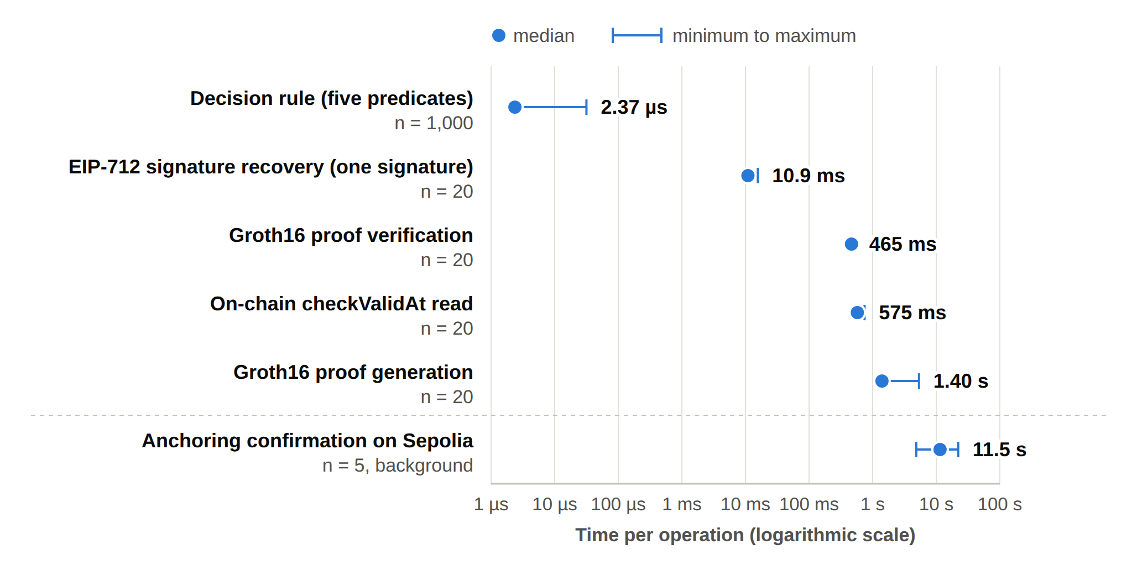
EVALUATION: HOW FAST AND HOW MUCH?
Component | Median | Min | Max | n
Decision rule, five checks | 2.37 µs | 2.32 µs | 31.59 µs | 1,000
One EIP-712 signature | 10.93 ms | 10.55 ms | 15.64 ms | 20
Groth16 proof generation | 1,401.1 ms | 1,342.8 ms | 5,349.6 ms | 20
Groth16 proof verification | 465.3 ms | 441.0 ms | 525.1 ms | 20
On-chain checkValid read | 573.5 ms | 568.2 ms | 715.5 ms | 20
On-chain checkValidAt read | 574.6 ms | 568.2 ms | 745.6 ms | 20
Anchoring confirmation | 11.5 s | 4.9 s | 22.1 s | 5
Timings measured on 1 October 2026; gas and anchoring from the five Sepolia transactions of September 2026; indicative only
Gas used: mint #1 196,406; revoke #1 32,980. No fee above 0.00021 ETH.
Notes:
Evaluation asks: how fast is it, and what does it cost? The decision rule itself takes about 2 microseconds. One guardian signature takes about 11 milliseconds. The Groth16 proof is the slowest part: about 1.4 seconds to generate and about half a second to verify. Anchoring on Sepolia takes about 11.5 seconds, but it runs in the background, so nobody waits for it. A revoke uses about one sixth of the gas of a mint. The timings were measured on the first of October 2026. The gas and the anchoring times come from the five Sepolia transactions in September. These numbers are indicative.

Slide 23
WHAT IS DIFFERENT FROM TODAY'S SYSTEMS
Aspect | Traditional EHR access control | HALAH framework
Identity | Central identity provider; institution login | A DID for every participant; identity kept separate from authority
Consent | A stored record that permission was given | An object C = (I, A, P, T, L, E), checked at every request
Approval | A static permission set by one party | All listed guardians sign (EIP-712); no single party can approve alone
Access check | Log in, then check a static permission | VI ∧ VA ∧ VP ∧ VT ∧ VL, plus a Groth16 proof before data is released
Time and revocation | Hard to verify once the permission is stored | Validity window and revocation checked each time; on-chain revoke
Audit | A record that consent occurred | Each decision on an active consent logged with its decision matrix; state anchored on Sepolia
Notes:
Here is the difference in plain words. Today, a central identity provider logs you in, and a fixed permission decides. Consent is a saved record. In HALAH, every person has a DID, and identity is separate from authority. Consent is an object that is checked at every request. All the guardians must approve. Five checks and a proof run before any data is released. Time and revocation are checked every time. And every decision on an active consent is logged with the reason.

Slide 24
DATA AND PRIVACY
Aspect | Key points
Data source | Synthea 1K sample of synthetic patient records (synthea.mitre.org), CSV export; a subset of patients with their observations, conditions, medications and procedures. No real patient data is involved.
Data storage | Medical records stay off-chain in the application. No medical content is written to the chain.
On-chain record | Pseudonymous patient and requester addresses, a hash of the purpose, the validity window and a revocation flag.
Access to data | Records are released only on ALLOW and only within the agreed data scope.
Audit | Each decision on an ACTIVE consent is recorded with its decision matrix.
Known limitation | The plaintext purpose is passed in the mint transaction and is visible in the public transaction input.
Notes:
A few important points about the data. I use synthetic patient records from the Synthea 1K sample, in its CSV export. The prototype loads a subset of patients with their observations, conditions, medications and procedures. No real patient data is involved. The medical records stay off-chain. The token on Sepolia stores only pseudonymous addresses, a hash of the purpose, the validity window and a revocation flag. Data is released only on ALLOW, and only inside the agreed scope. One known limitation: the plain-text purpose is visible in the mint transaction. I will fix this in the next stage.

Slide 25
WHY THIS MATTERS
Scientific
Social
Consent is an evaluable object, C = (I, A, P, T, L, E), not a stored record.
Multi-party approval is a standing condition of every access decision, and the patient defines who must approve.
Identity is separated from authority, and all conditions are checked in one decision.
A PRISMA 2020 review of 25 studies names the conjunction gap and the assurance gap.
A working prototype on Sepolia, measured and attacked twelve times.
Patients and their guardians decide together who may see the patient's data.
No single person can approve access to sensitive health data alone.
Every decision can be explained to an auditor: which check passed, which failed.
Medical records stay off-chain; only consent evidence is shared.
Supports trust when data move between hospitals and other independent parties.
Notes:
Why does this matter? On the scientific side: consent becomes an object that is checked, not stored. Multi-party approval is a condition of every access. Identity is separated from authority. And the whole decision is checked in one place and tested. On the social side: patients and guardians decide together who sees the data. No single person can approve alone. Every decision can be explained to an auditor. And medical records never go on the blockchain.

Slide 26
WHAT IS STILL OPEN
Formal proofs
The security properties are tested, not yet proved. Next: a formal model and model checking or proofs (RO6).
Lifecycle
Consent modification, delegation and guardian-set changes, with a formal lifecycle model (RO5).
Identity and keys
Full DID resolution and wallet-held guardian keys. Today: signature recovery and keys derived from the guardian DIDs (RO2, RO3).
Attack A11
A changed audit digest is not yet compared by any component. It is marked neutral, not refused.
Scale
A larger evaluation under load, with more users, consents and concurrent requests.
Purpose on-chain
The plaintext purpose is visible in the mint transaction input.
Notes:
I want to be clear about what is not done yet, because this is what the next stage is for. First, the formal proofs. The properties are tested, but not yet proved with a formal model. Second, the rest of the lifecycle: consent modification, delegation and guardian changes. Third, full DID resolution and wallet-held guardian keys. Today the guardian keys are derived from the guardian DIDs. Fourth, the one open attack, A11. Fifth, a bigger evaluation under load. Sixth, the plain-text purpose in the mint transaction.

Slide 27
RESEARCH PLAN
Task | Description | Target date | Status
Chapters 1–4 | Introduction, SLR, Research Questions and Objectives, Research Methodology | Completed | Done
Chapter 5 | Research Architecture (MVC) and framework design | May 2026 | Done
Chapter 6 | Proposed solution for RQ1 to RQ4 and the HALAH prototype | Jul–Oct 2026 | Done
Publication 1 | Conference paper submission, BWCCA 2026 | Sep 2026 | Done
Publication 2 | SLR paper journal submission | Oct 2026 | In Progress
Chapter 7 | Complete prototype evaluation and integrated results | Nov 2026 | Planned
Publication 3 | Journal paper on formal security assurance, lifecycle trust and the evaluation of HALAH | Dec 2026 | Planned
Chapter 8 | Conclusion and future work | Dec 2026 | Planned
Final assessment | Final candidature assessment defence | Jan 2027 | Planned
Thesis | Complete thesis submission | Mar 2027 | Planned
Notes:
This is the plan. Chapters one to six are done. The conference paper was submitted to BWCCA 2026 in September. The SLR journal paper is in progress. Next comes the complete evaluation, the paper on formal assurance and lifecycle trust, and the conclusion. The final assessment is planned for January 2027, and the thesis submission for March 2027.

Slide 28
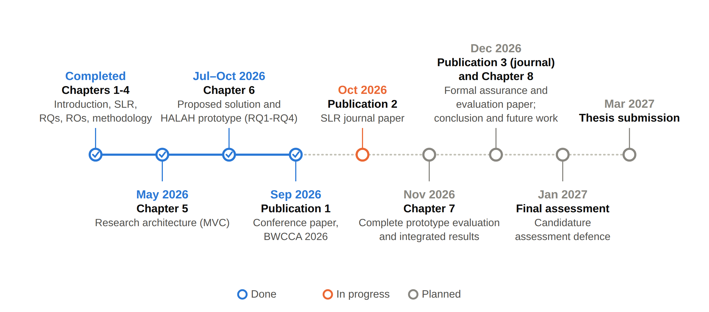
RESEARCH TIMELINE
Notes:
This is the same plan as a timeline. What is completed, what is in progress, and the planned steps up to the thesis submission in March 2027.

Slide 29
DEMO: THE HALAH PROTOTYPE
One real consent, from creation to revocation: RO1 to RO4 in full, and the working parts of RO5 and RO6.
Four interfaces
Patient, guardian, doctor and auditor
Smart contract
ConsentSBTv3, a soulbound ERC-721 token (ERC-5484) on the Sepolia testnet
Guardian approval
EIP-712 typed signatures, verified by signature recovery
Access proof
Groth16 zero-knowledge proof over a Poseidon commitment
Data
Synthetic Synthea records: Observation, Medication, Condition, Procedure
Evidence
Audit ledger of every decision on an active consent; no medical content on-chain
Notes:
Now the demonstration, through the slides. HALAH means History Access Link for Authorised Healthcare. These are its parts: four screens, a soulbound token contract on the Sepolia test network, EIP-712 guardian signatures, a Groth16 proof at access time, synthetic data, and an audit ledger. In the next slides, I walk you through one real consent, from creation to revocation. What you will see covers RO1 to RO4 in full, and the parts of RO5 and RO6 that already work.

Slide 30
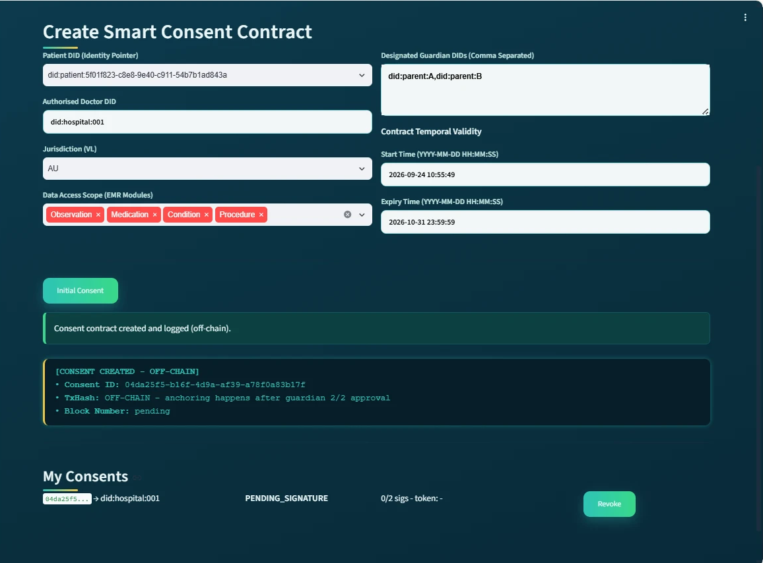
DEMO 1: THE PATIENT CREATES THE CONSENT
RO1
Consent as an evaluable object
The patient chooses the doctor, two guardians, the data modules and the validity time.
The purpose is fixed to Treatment in this prototype.
An empty data scope or a malformed guardian DID is rejected.
The consent is stored as PENDING_SIGNATURE. Nothing is on the blockchain yet.
Patient subsystem after creation: four modules, two guardians, state PENDING_SIGNATURE
Notes:
Demo step one. The patient creates the consent. On this screen you can see the four data modules, the two guardians and the state PENDING_SIGNATURE. The system checked every field before saving. Nothing has gone to the blockchain yet. This is RO1: consent as an object the system can check.

Slide 31
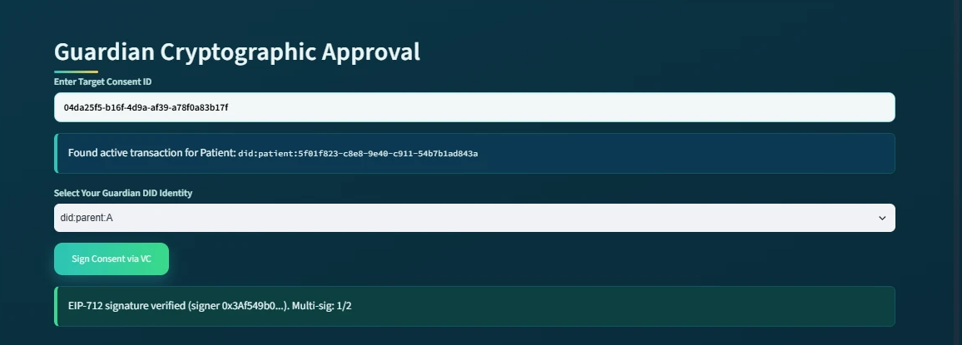
DEMO 2: THE FIRST GUARDIAN APPROVES
RO3
Multi-party approval: one signature is not enough
The first guardian signs an EIP-712 approval.
The system recovers the signer and confirms it is a listed guardian.
The counter shows 1 of 2. The consent stays pending.
Approvals from outsiders, replays and duplicates would not be counted.
Guardian subsystem at the first approval: signature verified, multi-signature count 1/2
Notes:
Demo step two. The first guardian signs. The system takes the EIP-712 signature, finds who signed it, and confirms that this address is one of the two listed guardians. The counter shows one of two. The consent is still pending, because one approval is never enough. This is RO3.

Slide 32
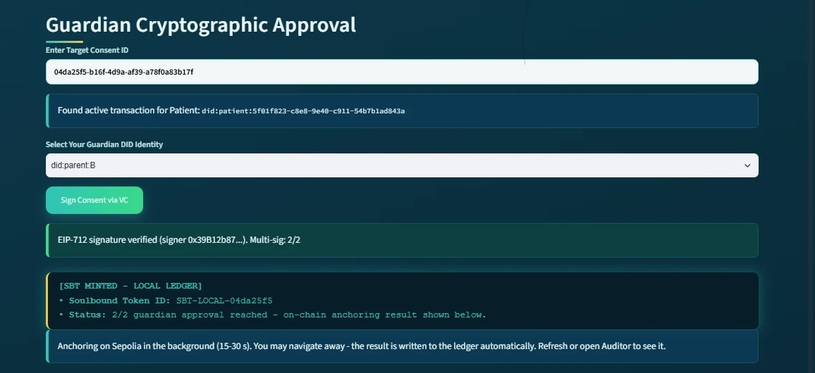
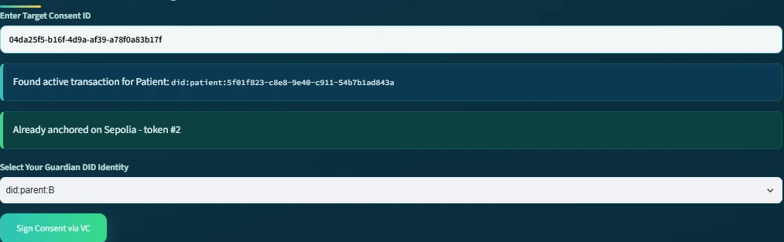
DEMO 3: SECOND APPROVAL, TOKEN MINTED
RO3
Threshold reached: 2 of 2, then anchoring in the background
Second signature verified; threshold 2 of 2 reached
A soulbound token is minted on Sepolia in the background; the user does not wait
Later the same screen reads: already anchored on Sepolia
Second approval: 2/2 reached, SBT minted in the background
Revisited after the background job: already anchored on Sepolia
Notes:
Demo step three. The second guardian signs. Now the threshold, two of two, is reached. The system records the token locally and starts the mint on Sepolia in the background. The guardian does not wait for the blockchain. On the right, the same screen a bit later: already anchored on Sepolia, with the token number. RO3 is complete.

Slide 33
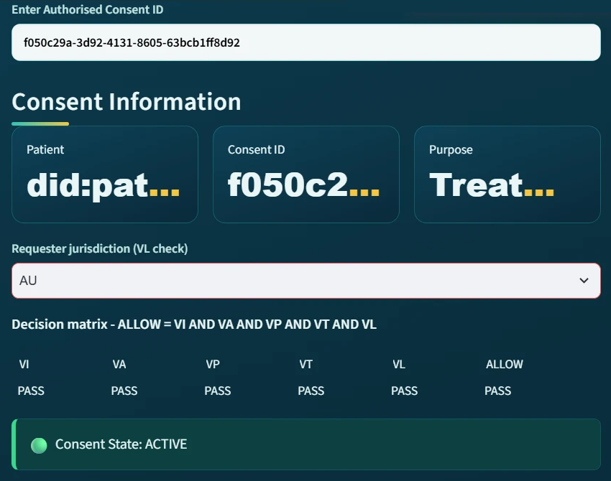
DEMO 4: THE DOCTOR IS ALLOWED
RO2 + RO4
Five checks and a proof before any data is released
The doctor selects the consent and a scope inside the agreed modules.
A Groth16 proof is generated and verified.
The decision matrix shows VI, VA, VP, VT, VL all PASS, so ALLOW.
Identity, authority, approvals, scope and time are checked in one decision.
Doctor subsystem: all five checks PASS, ALLOW
Notes:
Demo step four. The doctor asks for the patient's data. First the proof is generated and verified. Then the five checks run: VI, VA, VP, VT and VL. All five pass, so the answer is ALLOW. This is RO2 and RO4 together, in one decision.

Slide 34
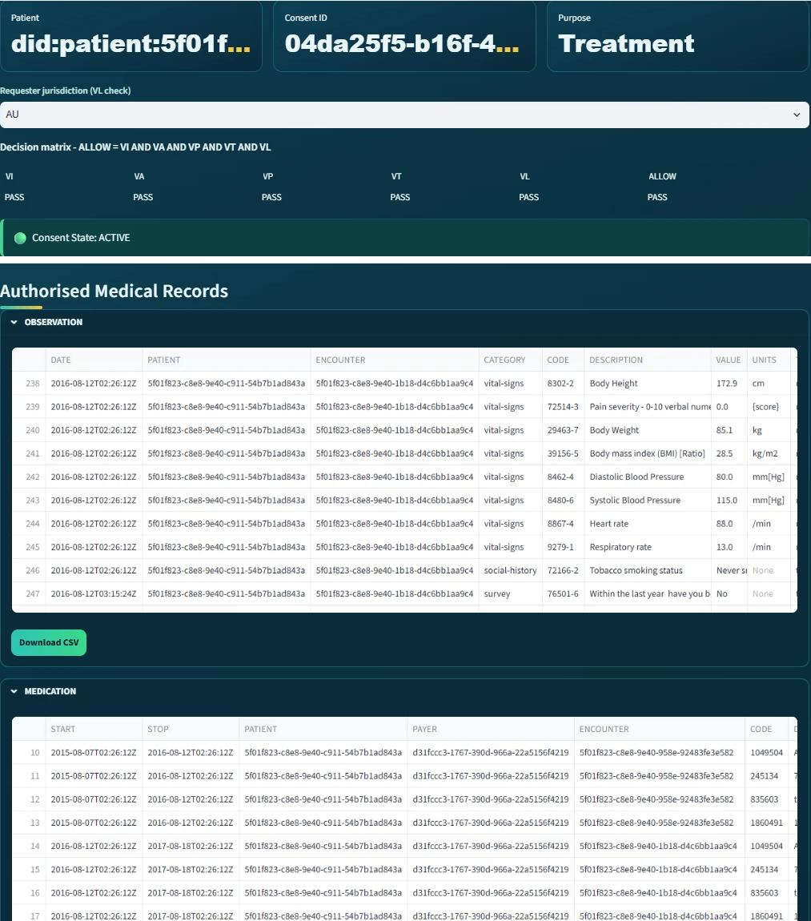
DEMO 5: ONLY THE AUTHORISED RECORDS
RO4
Data scope enforced: nothing outside the consent
Records are displayed per module: Observation, Medication, Condition, Procedure.
Only the modules inside the consent scope are returned.
A request for a module outside the scope is refused (attack test A4).
The decision is written to the audit ledger with its matrix.
Doctor subsystem after verification: access granted, records displayed per module
Notes:
Demo step five. After ALLOW, the records are shown per module. Only the modules inside the consent scope are returned. If the doctor asked for a module that was not agreed, the request would be refused. That case is covered by attack test A4. The decision and its matrix are written to the audit ledger.

Slide 35
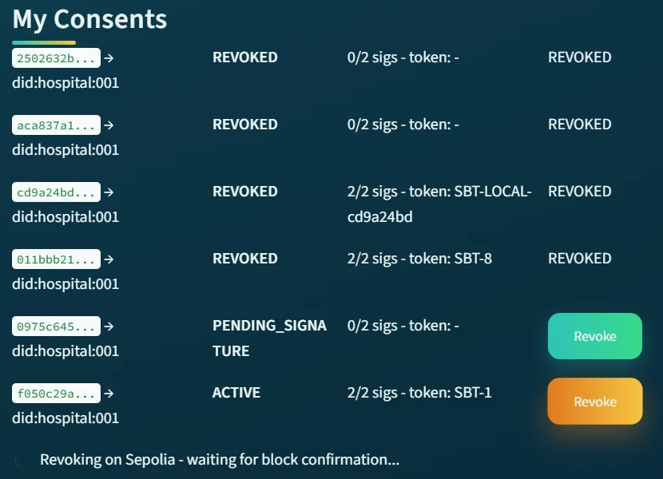
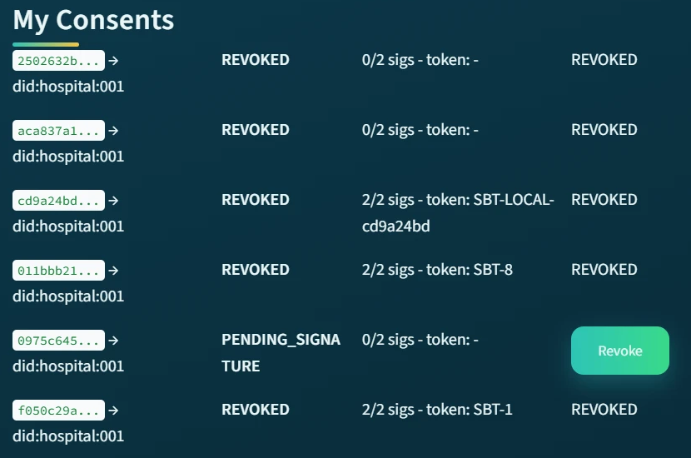
​DEMO 6: THE PATIENT REVOKES THE CONSENT
RO5
Revocation end to end, with an on-chain transaction
The patient revokes the consent
The revoke transaction is sent to Sepolia and waits for block confirmation
The consent becomes REVOKED, token #1
During revocation: waiting for block confirmation
After revocation: the consent is REVOKED, token #1
Notes:
Demo step six. The patient cancels the consent. On the left, the system is sending the revoke transaction to Sepolia and waiting for the block confirmation. On the right, the consent is now REVOKED, with its token number. This is the working part of RO5.

Slide 36
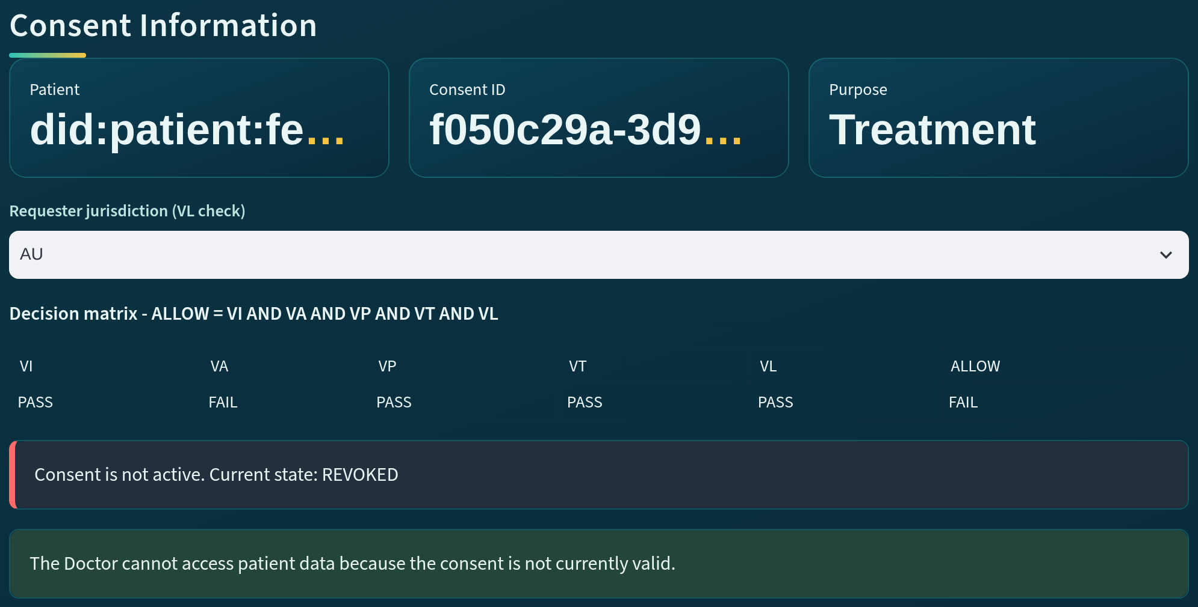
​DEMO 7: AFTER REVOCATION, REFUSED
RO5
A revoked consent cannot be used
The same doctor repeats the request.
VA reports FAIL: the consent is not active, current state REVOKED.
Access is refused.
Expired consents are refused the same way through VT.
Doctor subsystem after revocation: VA FAIL, state REVOKED
Notes:
Demo step seven. The doctor tries again. Now VA fails, because the consent is not active any more: its state is REVOKED. Access is refused. An expired consent is refused in the same way, through the time check VT. So a consent that was valid yesterday does not stay usable forever.

Slide 37
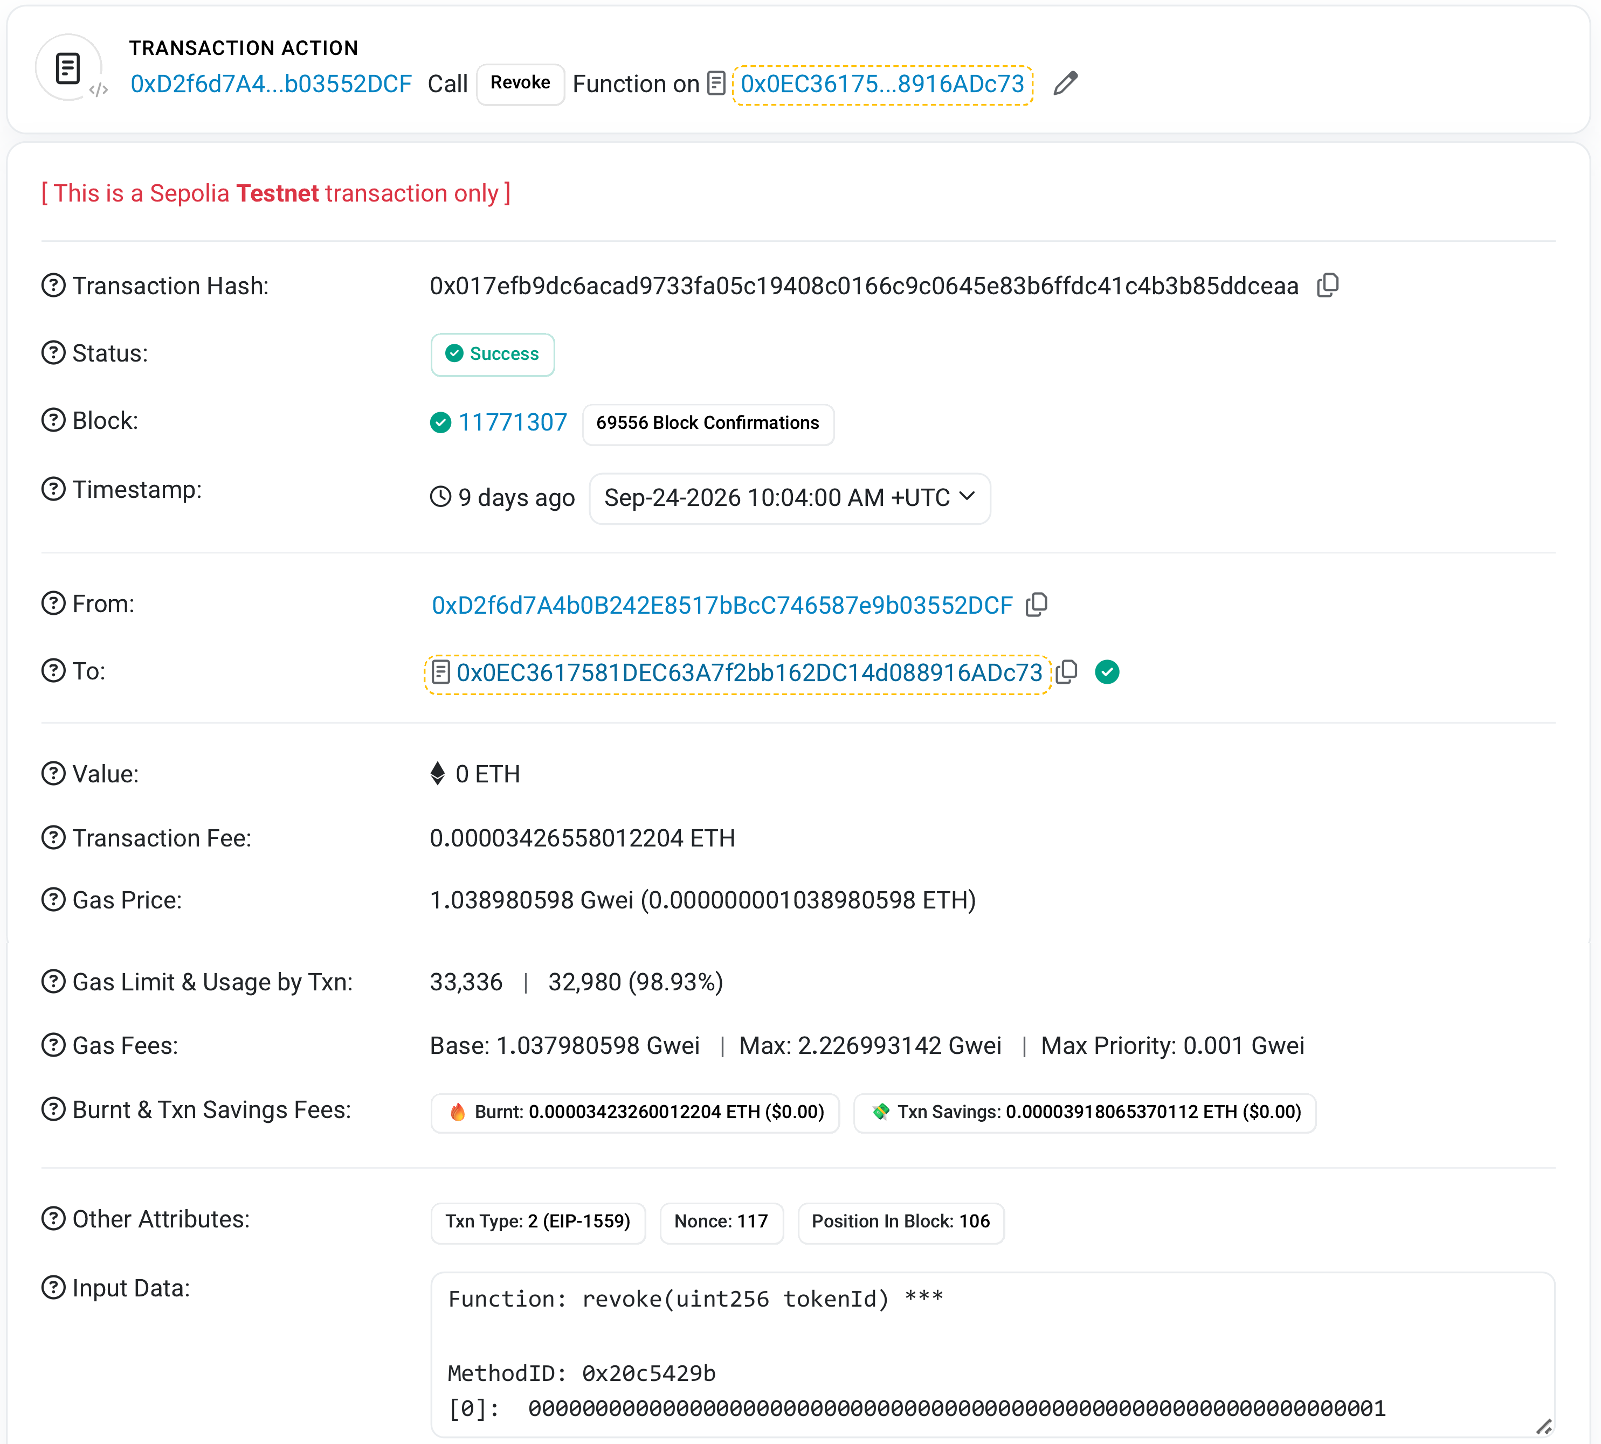
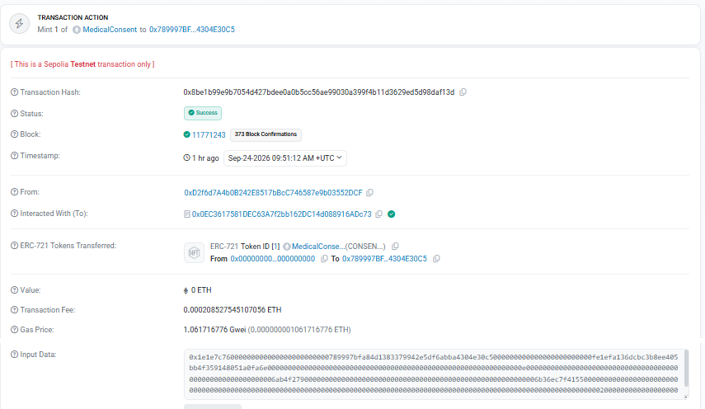
​DEMO 8: PUBLIC EVIDENCE ON SEPOLIA
RO5 + RO6
The mint and the revoke are public, verifiable transactions
Mint of the evaluated consent: block 11,771,243
Revoke of token #1: block 11,771,307, decoded input revoke(uint256 tokenId)
No medical data is on the chain, only the consent state
Anchoring transaction: status Success, block 11,771,243
Revocation transaction: status Success, block 11,771,307
Notes:
Demo step eight. Both the mint and the revoke are public transactions on Sepolia. On the left, the anchoring transaction of the consent, in block 11,771,243. On the right, the revocation, in block 11,771,307, with the decoded function revoke and token id 1. Anyone can check them. No medical data is on the chain.

Slide 38
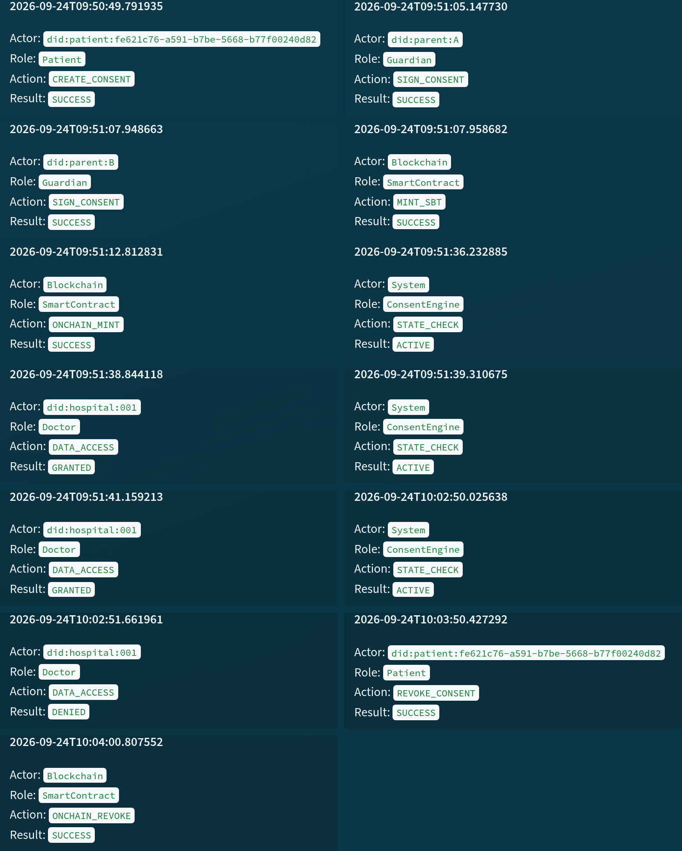
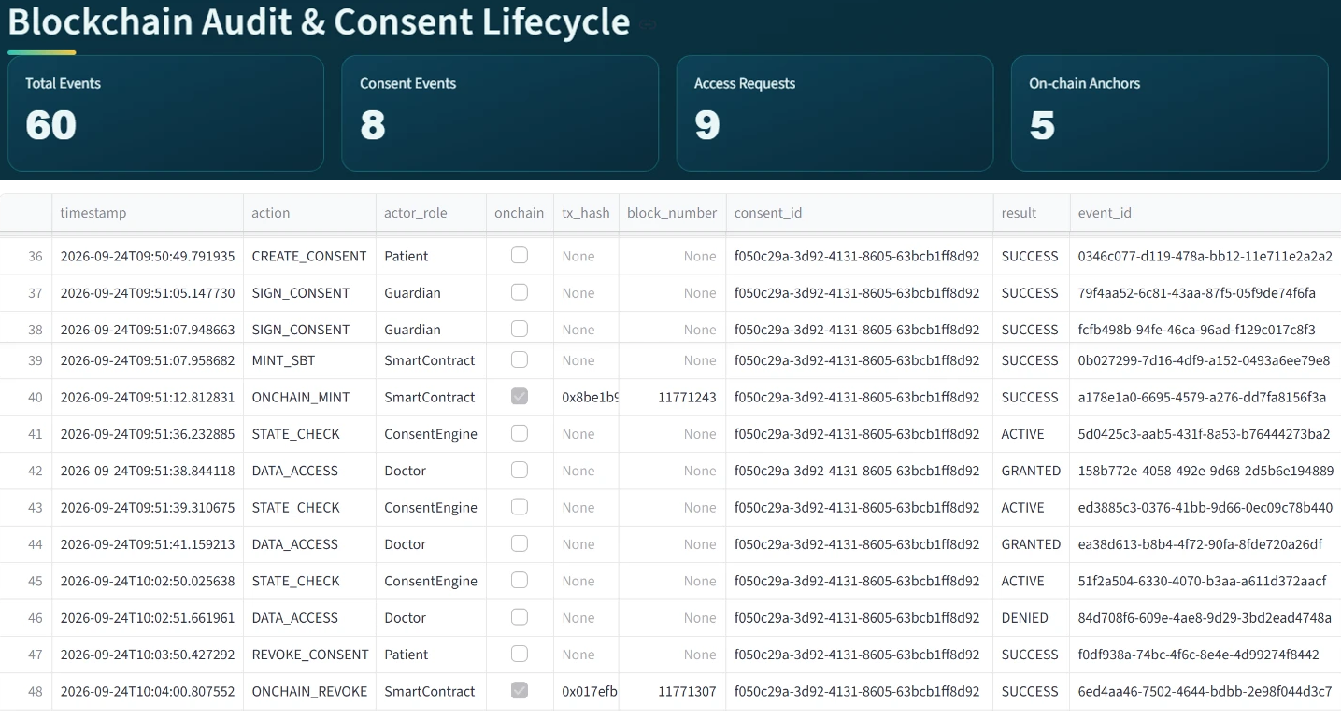
​DEMO 9: THE AUDITOR SEES EVERYTHING
RO6
Every event in order, and the chain agrees with the local records
The lifecycle of the consent: thirteen recorded events in order, from creation to revocation
Aggregate indicators of the exported ledger: 60 events, 9 access requests, 5 on-chain anchors
An independent tool re-checked Sepolia: all anchored transactions found in their recorded blocks
Auditor subsystem: lifecycle of the evaluated consent, thirteen events in order
Auditor dashboard: 60 events, 9 access requests, 5 on-chain anchors
Notes:
Demo step nine, the last one. The auditor can rebuild the full life of the consent: thirteen events in order, from creation to revocation, each with its decision matrix. The dashboard shows the exported ledger: 60 events, 9 access requests and 5 on-chain anchors. And a separate tool re-checked Sepolia and found every anchored transaction in its recorded block. All checks passed. This is the working part of RO6: evidence that can be audited.

Slide 39
REFERENCES (1/3)
Abbasi, A., Humeidi, M.N. & Wang, Q. 2026, 'Nexa: Enabling secure, scalable, and decentralized management of electronic health records using threshold cryptography and public blockchains', IEEE Access, vol. 14, pp. 50791–50810, <https://doi.org/10.1109/ACCESS.2026.3677499>.
Al Amin, M., Altarawneh, A. & Ray, I. 2023, 'Informed consent as patient driven policy for clinical diagnosis and treatment: A smart contract based approach', Proceedings of the 20th International Conference on Security and Cryptography (SECRYPT 2023), pp. 159–170, SciTePress, <https://doi.org/10.5220/0012090600003555>.
Albalwy, F., Brass, A. & Davies, A. 2021, 'A blockchain-based dynamic consent architecture to support clinical genomic data sharing (ConsentChain): Proof-of-concept study', JMIR Medical Informatics, vol. 9, no. 11, p. e27816, <https://doi.org/10.2196/27816>.
Bloemen, R., Logvinov, L. & Evans, J. 2017, EIP-712: Typed structured data hashing and signing, Ethereum Improvement Proposals, no. 712, viewed 6 October 2026, <https://eips.ethereum.org/EIPS/eip-712>.
Cai, B. 2022, ERC-5484: Consensual soulbound tokens, Ethereum Improvement Proposals, no. 5484, viewed 6 October 2026, <https://eips.ethereum.org/EIPS/eip-5484>.
Ekholm, K., Augustinsson, A., Sundström, J., Johansen, C., Storgärds, M., Ljöstad, L. et al. 2025, 'Implementing electronic informed consent in rare disease genomics', Scientific Reports, vol. 15, no. 1, p. 44419, <https://doi.org/10.1038/s41598-025-32740-1>.
Eneh, A.U., Ahakonye, L.A.C., Lee, J.M. & Kim, D.-S. 2026, 'Demo: EdgeConsent: On-chain attribute-based access control for data consent management', 2026 IEEE International Conference on Blockchain and Cryptocurrency (ICBC), pp. 1–2, <https://doi.org/10.1109/ICBC67748.2026.11575534>.
Entriken, W., Shirley, D., Evans, J. & Sachs, N. 2018, ERC-721: Non-fungible token standard, Ethereum Improvement Proposals, no. 721, viewed 6 October 2026, <https://eips.ethereum.org/EIPS/eip-721>.
Ethereum Foundation 2026b, Networks, ethereum.org developer documentation, viewed 7 October 2026, <https://ethereum.org/en/developers/docs/networks/>.
Grassi, L., Khovratovich, D., Rechberger, C., Roy, A. & Schofnegger, M. 2021, 'Poseidon: A new hash function for zero-knowledge proof systems', Proceedings of the 30th USENIX Security Symposium, pp. 519–535.
Groth, J. 2016, 'On the size of pairing-based non-interactive arguments', Advances in Cryptology – EUROCRYPT 2016, LNCS, vol. 9666, pp. 305–326, Springer, <https://doi.org/10.1007/978-3-662-49896-5_11>.
Hagström, J., Hägglund, M., Holmroos, M., Lähteenmäki, P. & Hörhammer, I. 2024, 'Minors’ and guardian access to and use of a national patient portal: A retrospective comparative case study of Sweden and Finland', International Journal of Medical Informatics, vol. 187, p. 105465, <https://doi.org/10.1016/j.ijmedinf.2024.105465>.
Notes:
These are the references I used in this talk. They follow the UTS Harvard style, so they are listed by author name, not by number.

Slide 40
REFERENCES (2/3)
Hema, S., Reddy, G.B.S. & Shalini, R. 2026, 'Patient centric cryptographic protection of cloud electronic health records', 2026 6th International Conference on Expert Clouds and Applications (ICOECA), pp. 293–300, <https://doi.org/10.1109/ICOECA68095.2026.11485301>.
HL7 International 2019, HL7 FHIR Release 4 (R4), viewed 7 October 2026, <https://hl7.org/fhir/R4/>.
Jaiman, V. & Urovi, V. 2020, 'A consent model for blockchain-based health data sharing platforms', IEEE Access, vol. 8, pp. 143734–143745, <https://doi.org/10.1109/ACCESS.2020.3014565>.
Li, H., Li, D., Lv, G., Crespi, N., Minerva, R., Shao, W. et al. 2026a, 'Privacy-preserving fine-grained EMR access control for IoMT: A hybrid RBAC-smart contract scheme with attribute-based authorization', IEEE Internet of Things Journal, vol. 13, no. 2, pp. 2970–2987, <https://doi.org/10.1109/JIOT.2025.3633504>.
Madine, M.M., Salah, K., Jayaraman, R., Yaqoob, I., Al-Hammadi, Y., Ellahham, S. et al. 2020, 'Fully decentralized multi-party consent management for secure sharing of patient health records', IEEE Access, vol. 8, pp. 225777–225791, <https://doi.org/10.1109/ACCESS.2020.3045048>.
Maruthi, V. & Singh, K. 2025, 'Enhancing security and privacy of IoMT data for unconscious patient with blockchain', IEEE Transactions on Network and Service Management, vol. 22, no. 6, pp. 5223–5238, <https://doi.org/10.1109/TNSM.2025.3602117>.
Mei, L., Huang, K., Li, X., Wang, H. & Zhang, X. 2026, 'Efficient dual-revocation CP-ABE for secure and fine-grained data sharing in IoMT', IEEE Internet of Things Journal, vol. 13, no. 14, pp. 30933–30940, <https://doi.org/10.1109/JIOT.2026.3685269>.
Page, M.J., McKenzie, J.E., Bossuyt, P.M., Boutron, I., Hoffmann, T.C., Mulrow, C.D. et al. 2021, 'The PRISMA 2020 statement: An updated guideline for reporting systematic reviews', BMJ, vol. 372, p. n71, <https://doi.org/10.1136/bmj.n71>.
Panagoulias, D.P., Damian, A.I., Stamate, C., Toderian, V., Butusina, P., De Franceschi, A. et al. 2026, 'Blockchain-enabled trust and compliance for clinical AI: Decentralized governance without decentralized data storage', Electronics, vol. 15, no. 14, p. 3046, <https://doi.org/10.3390/electronics15143046>.
Phuyal, S., Bhandari, M., Bista, R. & Ferreira, J.C. 2026a, 'A blockchain-based architecture for dynamic and auditable patient consent in secondary use of health data', Blockchain in Healthcare Today, vol. 9, no. 1, p. 491, <https://doi.org/10.30953/bhty.v9.491>.
Phuyal, S., Bhandari, M., Bista, R. & Ferreira, J.C. 2026b, 'Enabling cross-institution health data sharing in Norway: EUDI wallets, on-chain consent, and openEHR↔FHIR translation', IEEE Access, vol. 14, pp. 20309–20327, <https://doi.org/10.1109/ACCESS.2026.3661642>.
Punia, A., Gulia, P., Gill, N.S., Kaushik, D., Alduaiji, N., Shukla, P.K. et al. 2025, 'An access control system for cloud-based healthcare systems driven by blockchain', Journal of Cloud Computing, vol. 14, no. 1, p. 78, <https://doi.org/10.1186/s13677-025-00831-z>.

Slide 41
REFERENCES (3/3)
Román-Martínez, I., Calvillo-Arbizu, J., Mayor-Gallego, V.J., Madinabeitia-Luque, G., Estepa-Alonso, A.J. & Estepa-Alonso, R.M. 2023, 'Blockchain-based service-oriented architecture for consent management, access control, and auditing', IEEE Access, vol. 11, pp. 12727–12741, <https://doi.org/10.1109/ACCESS.2023.3242605>.
SooHoo, S.L., Keller, M.S., Chen, Y., Hu, D., Huang, S.-C., Kuo, T.-T. et al. 2026, 'Development of the authentication and authorization processes for the iAgree portal, a platform for patient-controlled data sharing across health systems', JAMIA Open, vol. 9, no. 3, p. ooag111, <https://doi.org/10.1093/jamiaopen/ooag111>.
Tan, K.-L., Chi, C.-H. & Lam, K.-Y. 2024, 'Secure and privacy-preserving sharing of personal health records with multi-party pre-authorization verification', Wireless Networks, vol. 30, no. 4, pp. 4773–4795, <https://doi.org/10.1007/s11276-022-03114-6>.
Tith, D., Lee, J.-S., Suzuki, H., Wijesundara, W.M.A.B., Taira, N., Obi, T. et al. 2020, 'Patient consent management by a purpose-based consent model for electronic health record based on blockchain technology', Healthcare Informatics Research, vol. 26, no. 4, pp. 265–273, <https://doi.org/10.4258/hir.2020.26.4.265>.
Tremper, G., Brenner, T., Ben Amor, M., Kussel, T. & Lablans, M. 2026, 'Mainzelliste: Ten years of pseudonymization, record linkage, and informed consent management', Patterns, vol. 7, no. 1, p. 101432, <https://doi.org/10.1016/j.patter.2025.101432>.
Tseng, C.-H., Hsieh, Y.-H., Lin, H.-Y. & Yuan, S.-M. 2025, 'EMR-Chain: Decentralized electronic medical record exchange system', Technologies, vol. 13, no. 10, p. 446, <https://doi.org/10.3390/technologies13100446>.
Walonoski, J., Kramer, M., Nichols, J., Quina, A., Moesel, C., Hall, D. et al. 2018, 'Synthea: An approach, method, and software mechanism for generating synthetic patients and the synthetic electronic health care record', Journal of the American Medical Informatics Association, vol. 25, no. 3, pp. 230–238, <https://doi.org/10.1093/jamia/ocx079>.
Wood, G. 2014, Ethereum: A secure decentralised generalised transaction ledger, Ethereum Project Yellow Paper.
Wu, Y., Liu, C., Sebald, L., Nguyen, P. & Yesha, Y. 2022, 'Apply trust computing and privacy preserving smart contracts to manage, share, and analyze multi-site clinical trial data', Proceedings of the International Conference on Deep Learning, Big Data and Blockchain (DBB 2022), LNNS, vol. 541, pp. 3–14, Springer, <https://doi.org/10.1007/978-3-031-16035-6_1>.
Wu, Z. & Zhang, D. 2025, 'HealthDID: An efficient and authorizable multi-party privacy-preserving EMR sharing system based on DID', Computer Standards & Interfaces, vol. 93, p. 103967, <https://doi.org/10.1016/j.csi.2024.103967>.
Zhao, J. & Su, Q. 2024, 'A threshold traceable delegation authorization scheme for data sharing in healthcare', Computers & Security, vol. 139, p. 103686, <https://doi.org/10.1016/j.cose.2023.103686>.

Slide 42
Thank You
Questions and discussion
Notes:
Thank you for listening. I am happy to take your questions.
Likely questions and short answers:
1. Why blockchain, if the data stays off-chain? Because it gives a shared record that cannot be changed quietly: the consent state and the revocation. No medical data is on the chain.
2. What is new? The consent object carries all the conditions. Multi-party approval is a condition of every access. And the whole decision is tested against attacks.
3. Why is RO6 only partly done? The testing is done. The formal proofs are the next stage.
4. Why Groth16? The doctor proves that they know the secret and the expiry behind the commitment stored in the consent, and that the consent has not expired, without showing them. It is the slowest part, about 1.4 seconds, and that is fine for a consent decision.
5. Why did three attacks pass before the hardening? They passed only when the service functions were called directly, not through the screens. The hardening moved the checks into the service layer, so now they are refused on every path.

