Slide 1

A Trusted Authorisation Framework for Multi-Party Patient Consent in Healthcare Data Sharing
Candidature Reassessment
Principal Supervisor: Professor Farookh Hussain
Co-Supervisor: Dr. Firas Al-Doghman
Presenter: Yasir Dhaifallah O Alyoubi
STUDENT ID #: 24724078
Notes:
Good morning everyone. My name is Yasir Alyoubi. My principal supervisor is Professor Farookh Hussain, and my co-supervisor is Dr Firas Al-Doghman. This is my candidature reassessment. My research asks one simple question. When a doctor asks for a patient's data, how can the system be sure that this request is really allowed? Not just who is asking. Also, did the patient and the guardians agree? Is the request inside the agreed data? And is the consent still valid today? I will show you the problem, what the literature says, my framework, the working prototype, and the results.

Slide 2
OUTLINE
01
THE PROBLEM
07
WHAT IS STILL OPEN
02
LITERATURE REVIEW
08
RESEARCH PLAN
03
GAPS, QUESTIONS AND OBJECTIVES
09
DEMO: THE HALAH PROTOTYPE
04
THE FRAMEWORK
10
REFERENCES
05
VALIDATION AND EVALUATION
06
WHY THIS MATTERS
Notes:
Here is the plan for my talk. First, the problem. Then the literature review. Then the gaps, the questions and the objectives. After that, the framework and its six steps. Then the validation and the evaluation results. Then I talk about what is still open and the research plan. At the end, I show a demonstration of the prototype through the slides: one real consent, from the day it is created to the day it is revoked.

Slide 3
THE PROBLEM
Healthcare data is shared between many independent parties: patient, guardians, doctor, hospital.
Today, consent is a stored record. It shows that permission was given, but it checks nothing at access time.
A valid identity does not prove the right to see this patient's data.
A request can ask for more data than allowed, or arrive after the consent expired or was revoked.
None of the reviewed studies proves or tests the whole decision.
In one sentence
There is no trusted mechanism that checks identity, authority, multi-party approval, policy, time and lifecycle together in one access decision, with evidence that it is secure.
Notes:
Let me start with the problem. Health data is very sensitive. One decision to share it can involve many people: the patient, one or more guardians, the doctor, and the hospital. Today, consent is usually just a record that is saved somewhere. That record says permission was given. But it does not check anything when someone asks for the data. A valid login does not mean you have the right to see this patient's data. And even with approval, a request can ask for more data than the patient allowed, or it can come after the consent has expired or was cancelled. So the real problem is this: there is no single trusted decision that checks all of these things together.

Slide 4
THE KEY IDEA
Consent is not a stored record. It is an object checked at every request.
C = (I, A, P, T, L, E)
I Identity
Who is the patient, the doctor and each guardian (DID).
A Authority
The guardian set G and how many approvals are needed (N).
P Policy
The purpose and the data scope that were agreed.
T Time
When the consent starts and when it expires.
L Jurisdiction
Where the request may come from.
E Evidence
Signatures, the token, and whether it is revoked.
Notes:
Here is my answer in simple words. Consent should not be a record that we store. It should be an object that the system checks every time. I call this object C, and it has six parts. I is identity: who is involved. A is authority: which guardians must approve, and how many. P is policy: the purpose and the data that was agreed. T is time: when the consent starts and when it ends. L is jurisdiction: where the request may come from. And E is evidence: the signatures, the token, and whether the consent was cancelled. At every request, the system checks all six parts. If one part fails, the answer is no.

Slide 5
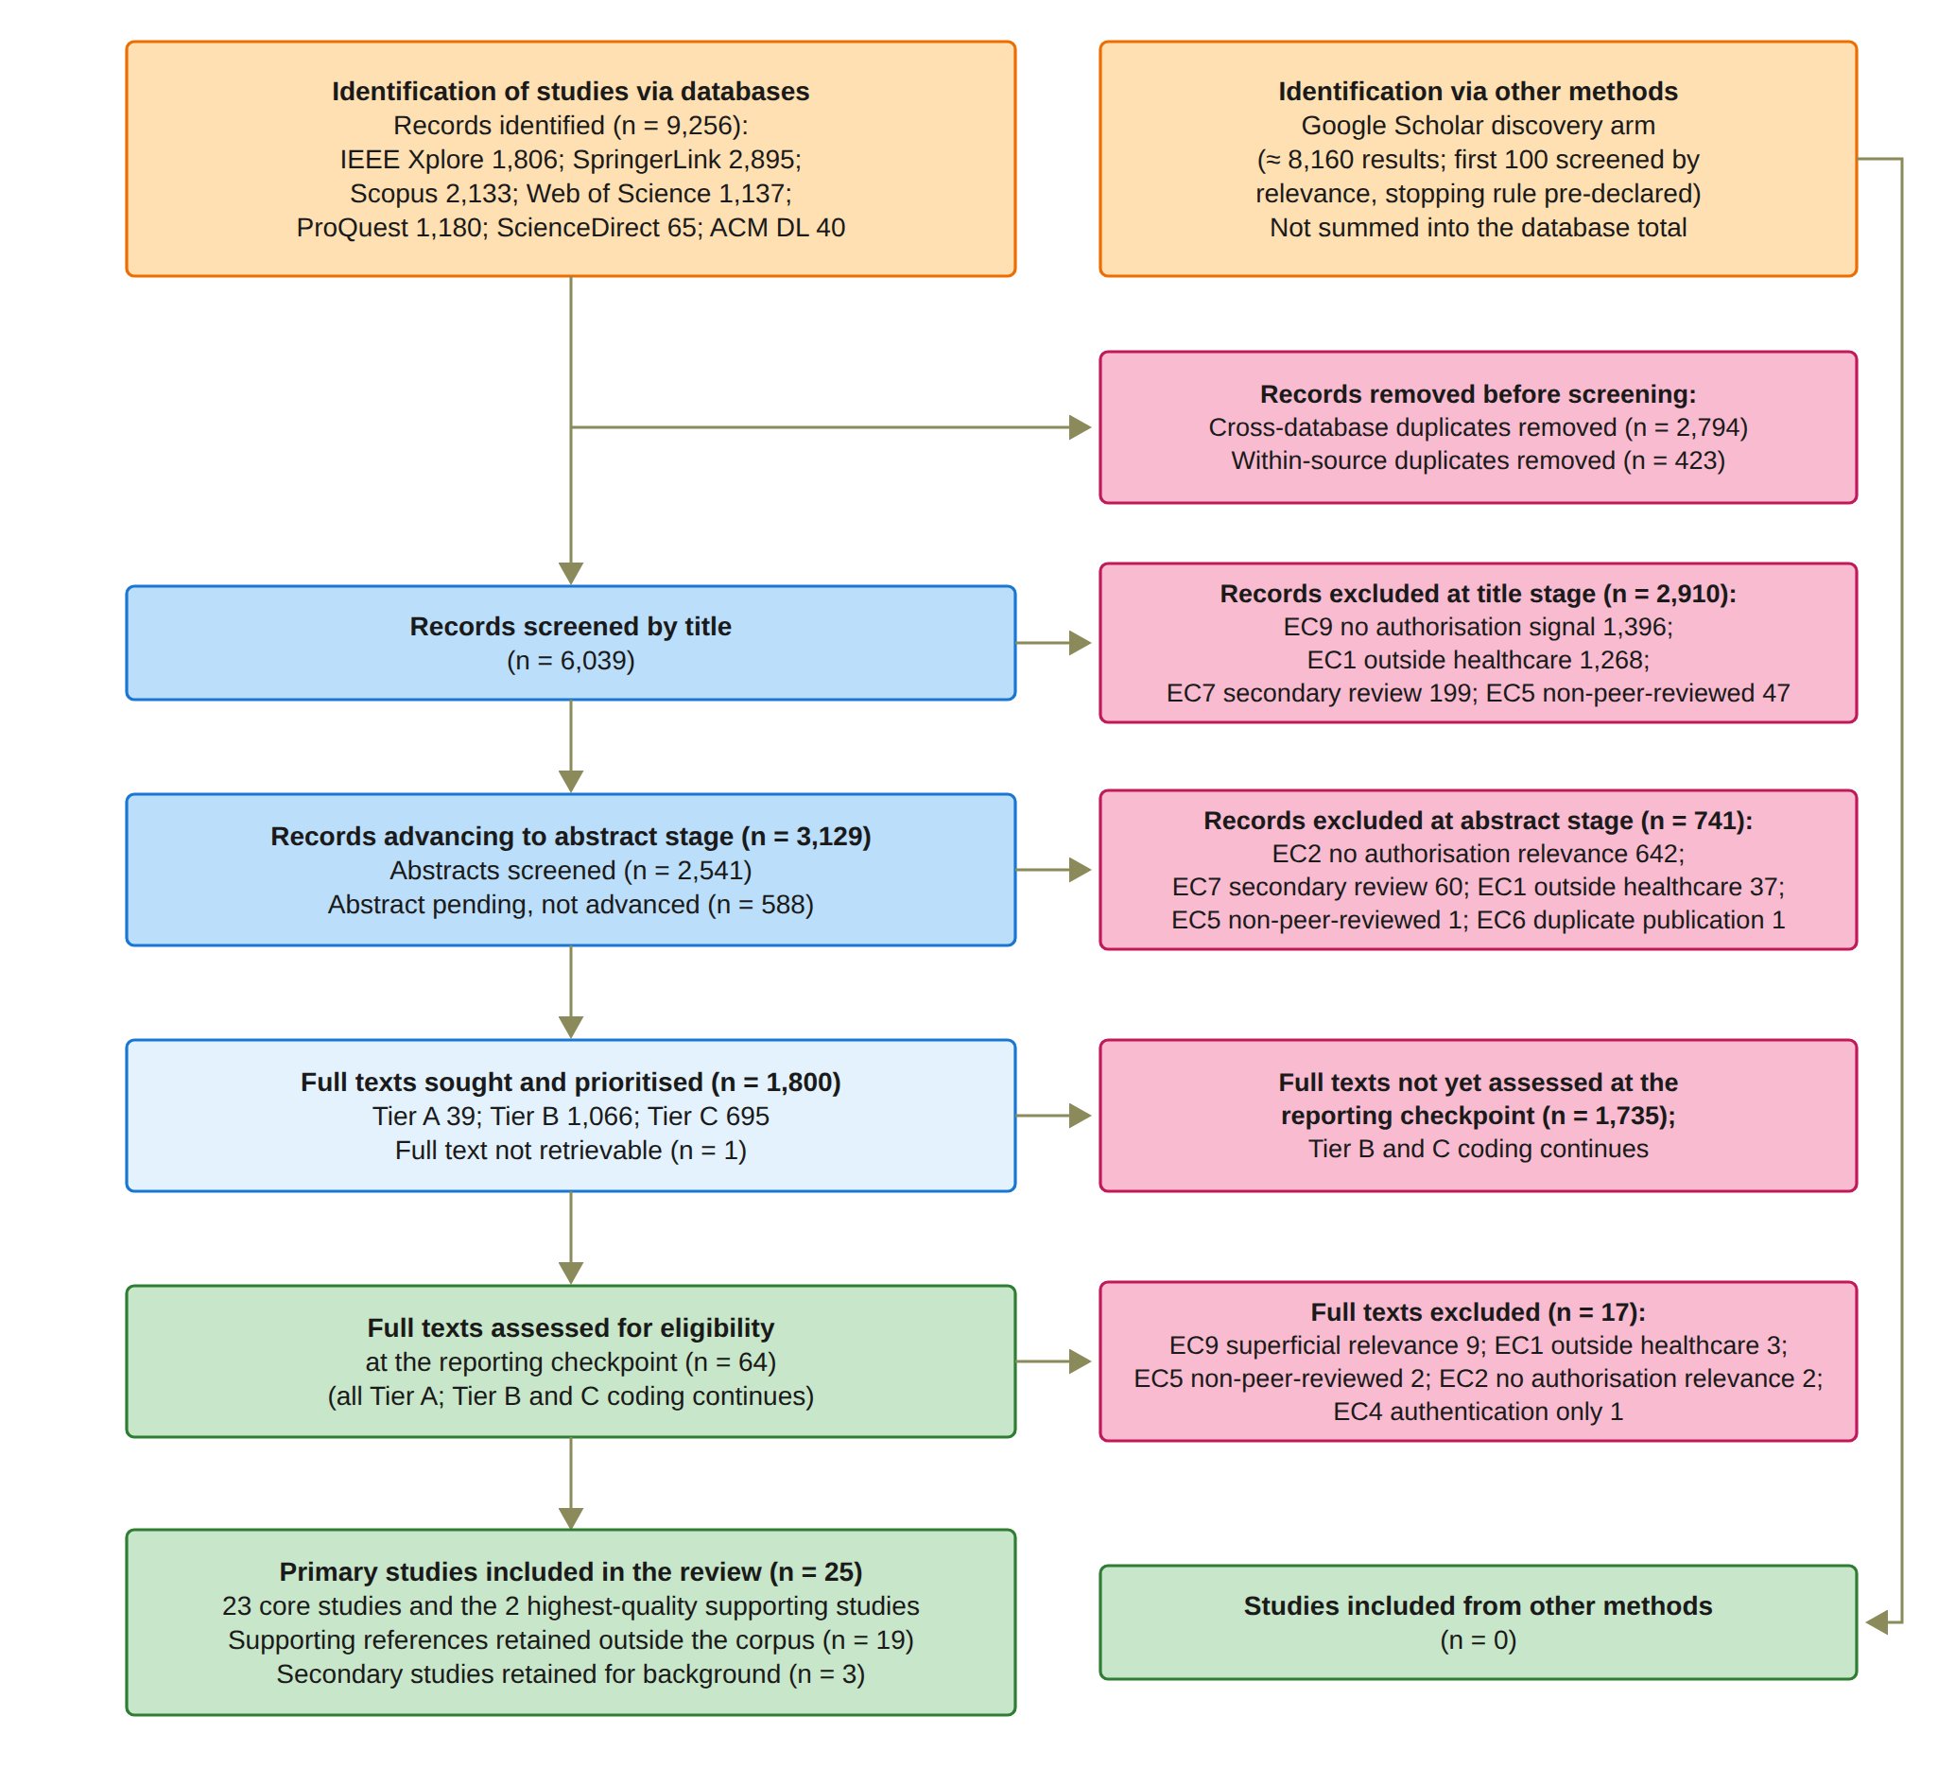
LITERATURE REVIEW: HOW I DID IT
9,256
records from seven databases
47
studies met the criteria at the checkpoint
25
primary studies analysed (23 core + 2)
Notes:
This is how I did the literature review. I followed the PRISMA 2020 method. Before I started screening, I wrote a protocol that fixed the questions, the databases, one search query, the criteria and the quality items. I searched seven databases. They gave me 9,256 records. After I removed duplicates, 6,039 were screened by title, 3,129 by abstract, and 1,800 full texts were put in order of priority. At the reporting checkpoint, 64 full texts were assessed and 47 met the criteria. From these, I analysed 25 primary studies in depth: 23 core studies and 2 supporting studies.

Slide 6
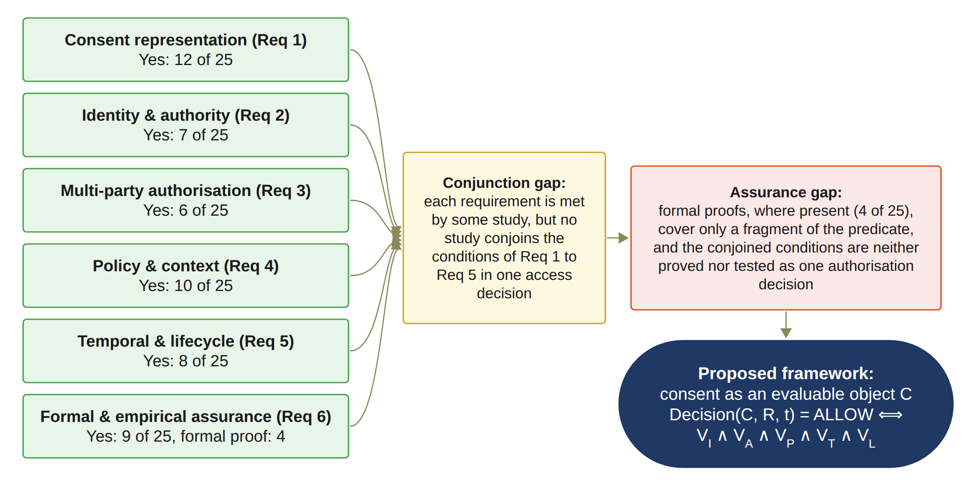
LITERATURE REVIEW: WHAT I FOUND
Conjunction gap
Each condition exists somewhere, but no study joins identity, authority, approval, policy and time in one decision.
Assurance gap
The whole decision is neither formally proved nor systematically tested. Proofs exist in only 4 of 25 studies.
Notes:
This figure sums up the review. The good news: every requirement is covered by some study. The problem: no study puts all the conditions together in one access decision. I call this the conjunction gap. And no study proves or tests the whole decision. Formal proofs exist in only 4 of the 25 studies, and they cover only a small part. I call this the assurance gap. These two gaps are what my research fills.

Slide 7
SIX RESEARCH GAPS
Gap 1
Consent is treated as a record of permission, not as something the system evaluates.
Gap 2
Identity shows who a person is, not what they may do. Only 10 of 25 studies check authority separately.
Gap 3
Multi-party approval is a backup path or a one-time step, not a condition of every access.
Gap 4
Purpose, data scope and jurisdiction are rarely checked in the same decision as identity and approval.
Gap 5
Time, lifecycle and revocation are often checked once, at registration, not at each request.
Gap 6
The decision as a whole is neither formally proved nor systematically tested.
Notes:
From the 25 studies, I found six gaps. One gap for each requirement. Gap one: consent is only a record. Gap two: identity does not prove authority. Gap three: multi-party approval is not a condition of every access. Gap four: purpose and scope are rarely checked together with identity and approval. Gap five: time and revocation are often checked only once, at registration, not at each request. Gap six: nobody proves or tests the whole decision.

Slide 8
RESEARCH QUESTIONS
How can a trust-oriented computing framework establish and enforce trustworthy multi-party consent for decentralised healthcare data sharing under identity, authority, and policy constraints?
RQ1
How can consent be modelled as an object that carries identity, authority, policy and evidence?
RQ2
How can DIDs and credentials prove who a person is and, separately, what they may do?
RQ3
How can several guardians approve together, so that no single person can approve alone?
RQ4
How can purpose and data scope stop valid identities from reaching data they were not given?
RQ5
How can time and lifecycle controls reject access after expiry or revocation?
RQ6
How can the security properties be formally defined and empirically tested?
Notes:
So this is my main research question. How can a trust-oriented computing framework establish and enforce trustworthy multi-party consent for decentralised healthcare data sharing, under identity, authority and policy constraints? It has six sub-questions, one for each gap. How to model consent. How to check identity and authority. How several guardians can approve together. How purpose and scope are checked. How time and lifecycle are checked. And how to prove and test the security.

Slide 9
RESEARCH OBJECTIVES AND STATUS
Objective | In simple words | Status
RO1 | Make consent an object the system can check: C = (I, A, P, T, L, E) | Done
RO2 | Check who a person is (DID) separately from what they may do (credential) | Done
RO3 | Require approval from all listed guardians, each with a verified signature | Done
RO4 | Allow only requests inside the agreed purpose, data scope and jurisdiction | Done
RO5 | Reject access after expiry or revocation, and control the consent lifecycle | In Progress
RO6 | Define the security properties, prove them formally and test them empirically | Partially completed
Notes:
Each question has one objective. RO1 to RO4 are done, and they are validated with the prototype. RO5 is time and lifecycle. It is in progress. The validity window and the revocation already work. Consent changes, delegation and guardian changes are for the next stage. RO6 is partly completed. The automated tests, the attack tests and the measurements are done. The formal proofs are for the next stage.

Slide 10
RESEARCH METHODOLOGY
1
2
3
4
5
6
7
Problem
Consent is a passive record; no single trusted decision
Literature review
PRISMA 2020; 25 primary studies
Gaps and questions
Gap 1 to Gap 6; RQ1 to RQ6
Objectives
RO1 to RO6
Design
MVC architecture, consent object C, Algorithms 1 to 4
Prototype
HALAH; ConsentSBTv3 on Sepolia
Evaluation
Live scenarios, measurements and 12 attack tests; formal proofs next
From the problem to the evaluated prototype
Notes:
These are the steps I followed. Step one, I identified the problem. Step two, I did the systematic review. Step three, from the review I found the gaps and wrote the questions. Step four, I set the objectives. Step five, I designed the framework: the architecture, the consent object, and four algorithms. Step six, I built the prototype on the Sepolia test network. Step seven, I evaluated it with live scenarios, measurements and attack tests. The formal proofs are the next stage.

Slide 11
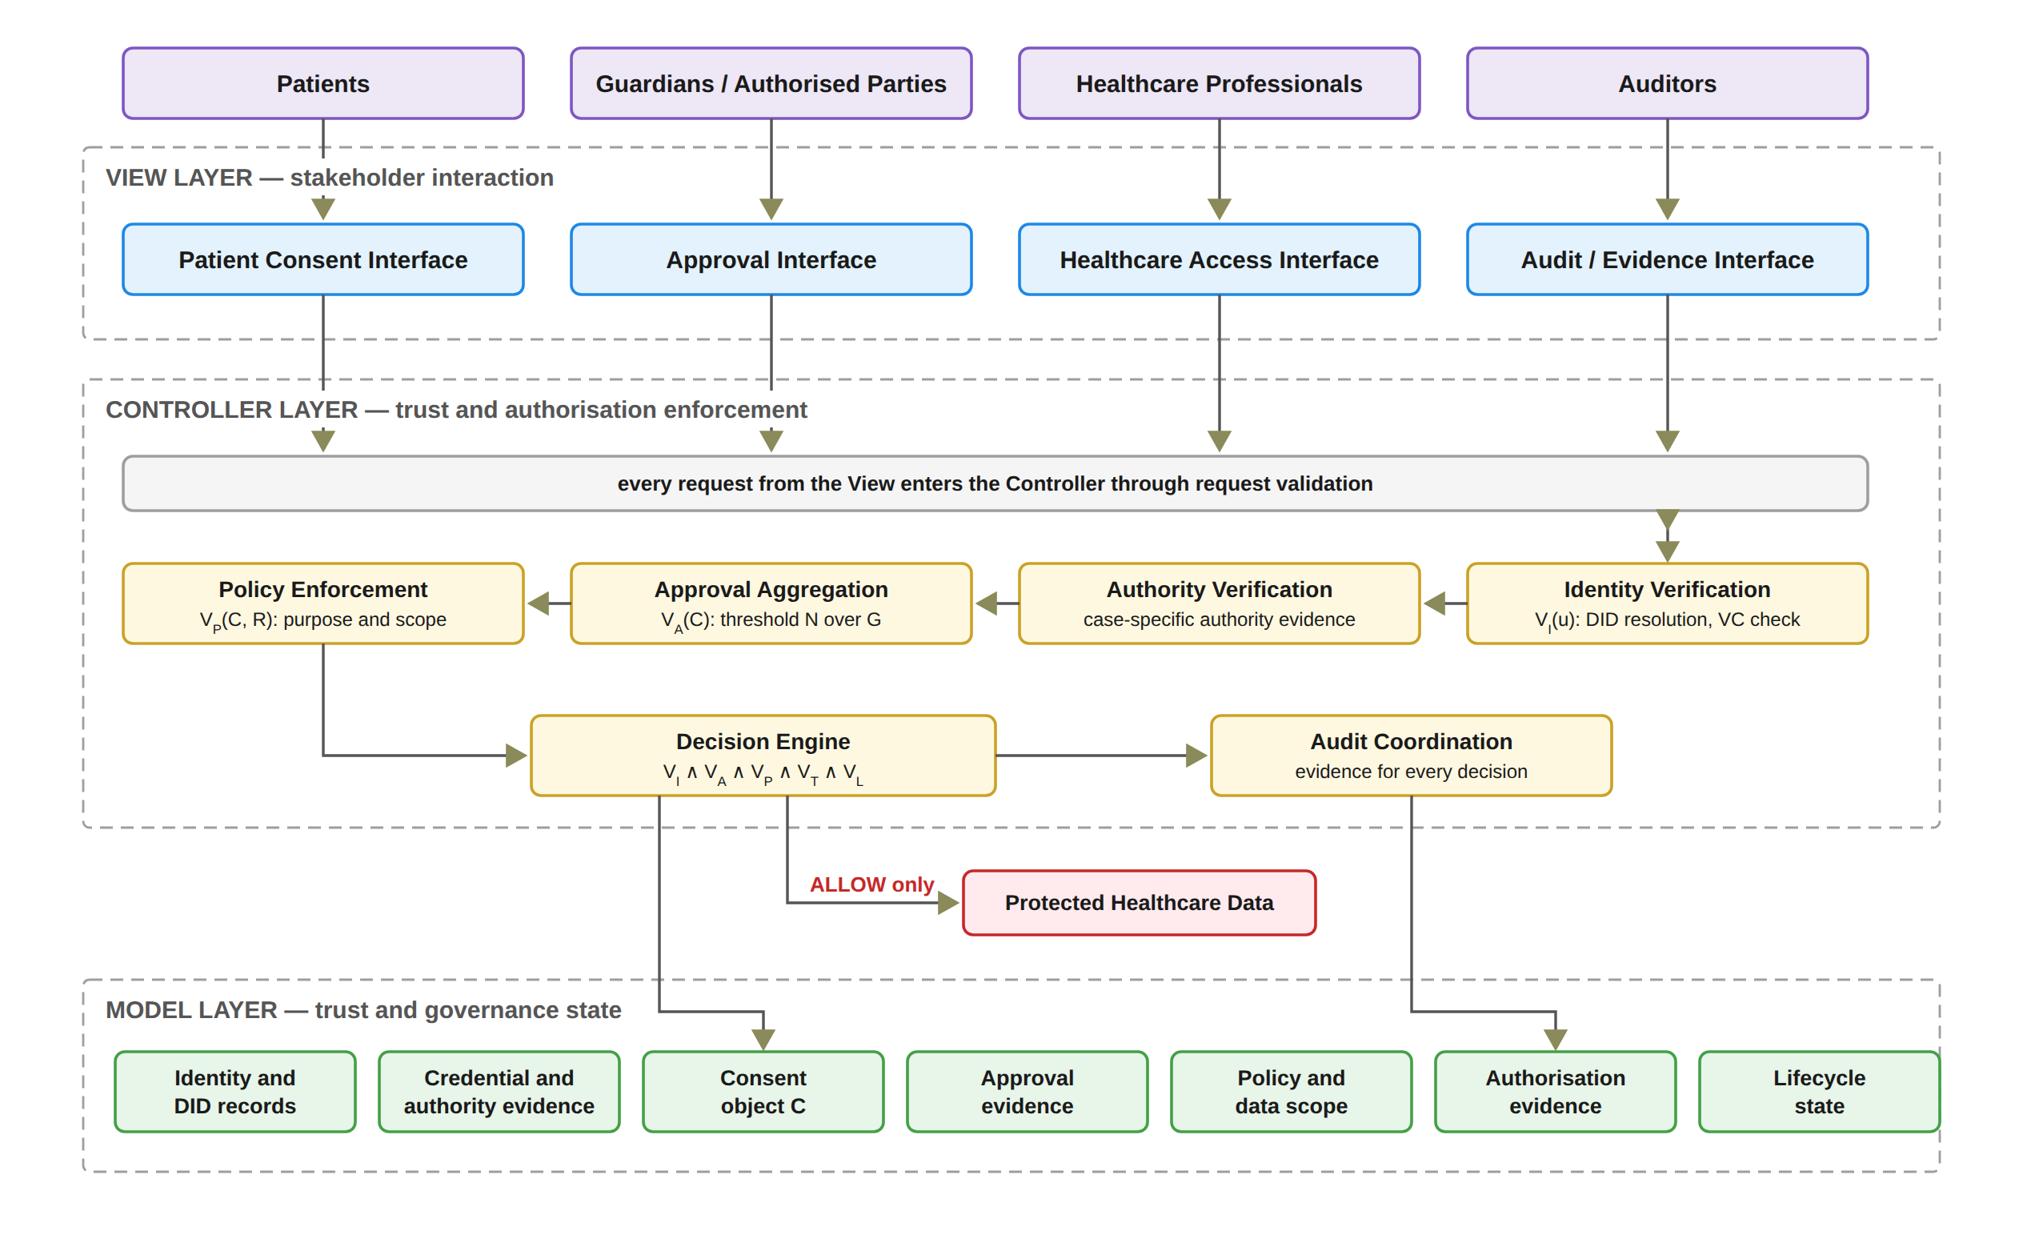
THE FRAMEWORK: ARCHITECTURE
Notes:
The framework uses the Model, View, Controller pattern. The View is the four screens: patient, guardian, doctor and auditor. The View never decides who gets access. Every security decision is made in the Controller. It checks identity and authority, collects the approvals, enforces the policy, and records the evidence. The Model keeps the consent, the approvals and the evidence. Health data is released only when the Controller says ALLOW.

Slide 12
THE FRAMEWORK: THE DECISION RULE
Decision(C, R, t) = ALLOW ⟺ VI(u) ∧ VA(C) ∧ VP(C, R) ∧ VT(C, t) ∧ VL(C, R)
VI
Identity and authority are valid
VA
All guardians approved; token exists; not revoked
VP
Purpose and data scope are inside the consent
VT
Inside the validity window
VL
Jurisdiction matches
One failed check is enough to say DENY.
A Groth16 zero-knowledge proof must also verify before any data is released.
Every decision on an ACTIVE consent is written to the audit ledger with its decision matrix.
Notes:
This is the heart of the framework. Access is allowed only when five checks are all true. VI: the identity and the authority are valid. VA: all the required guardians approved, the token exists, and the consent is not cancelled. VP: the purpose and the requested data are inside what was agreed. VT: the request is inside the validity time. VL: the jurisdiction matches. If any one check fails, the answer is DENY. In the prototype, a Groth16 zero-knowledge proof must also pass before any data is released. And every decision on an active consent is written to the audit ledger.

Slide 13
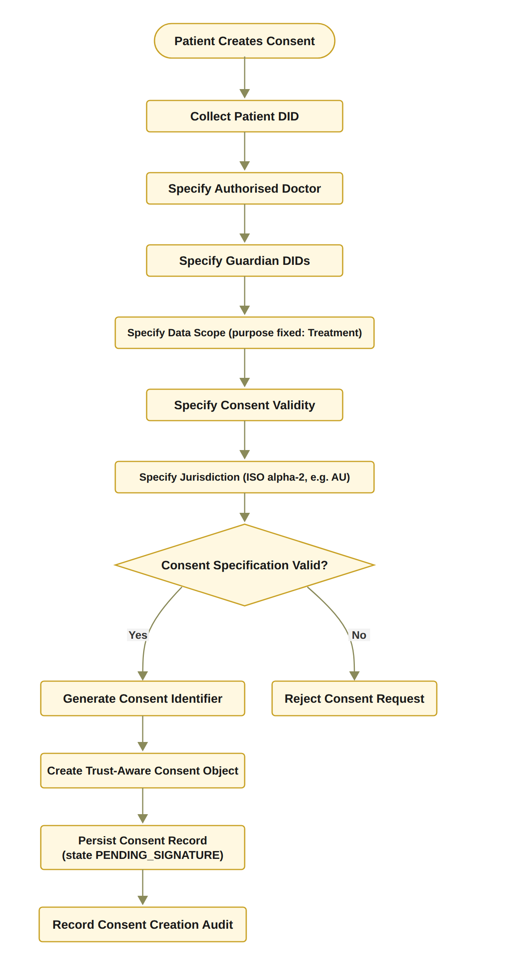
STEP 1: THE PATIENT CREATES THE CONSENT
RO1: Trust-centric consent model
Status: Done
The patient chooses the doctor, the guardians, the data modules, the start and expiry time, and the jurisdiction.
In this prototype the purpose is fixed to Treatment.
Bad input is rejected, for example an empty data scope or a malformed guardian DID.
The consent object C is built and stored as PENDING_SIGNATURE.
Nothing goes on the blockchain until all guardians approve.
Notes:
Step one. The patient creates the consent. The patient chooses the doctor, the guardians, the data modules, the start and end time, and the jurisdiction. The system checks every field. For example, an empty data scope or a bad guardian DID is rejected. Then the consent object C is built and saved as pending. Nothing goes to the blockchain yet. This is RO1, and it is done.

Slide 14
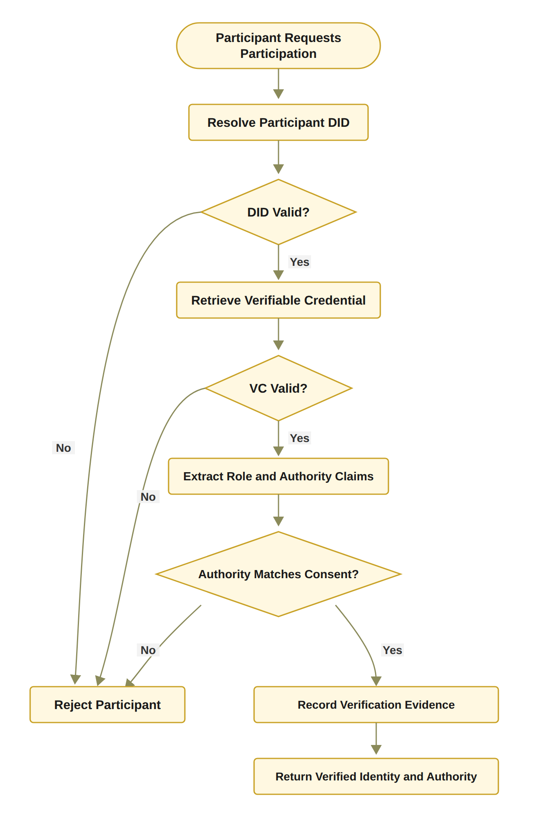
STEP 2: WHO ARE YOU, AND WHAT MAY YOU DO?
RO2: Decentralised identity and authority
Status: Done
Identity is checked through the DID; authority through a verifiable credential.
Identity is not authority: a valid DID alone never gives access.
In the prototype: a DID-format check and EIP-712 signature recovery for each guardian.
Full DID resolution and credential validation are planned for the next stage.
Target design. The prototype now performs a DID-format check and EIP-712 signature recovery.
Notes:
Step two. I separate two questions: who are you, and what may you do? The DID answers the first question. The credential answers the second. A valid identity alone never gives access. To be clear about the current state: today the prototype checks the DID format and recovers each guardian's signature. Full DID resolution and credential validation are planned for the next stage. So RO2 is done at the design level and in the prototype.

Slide 15
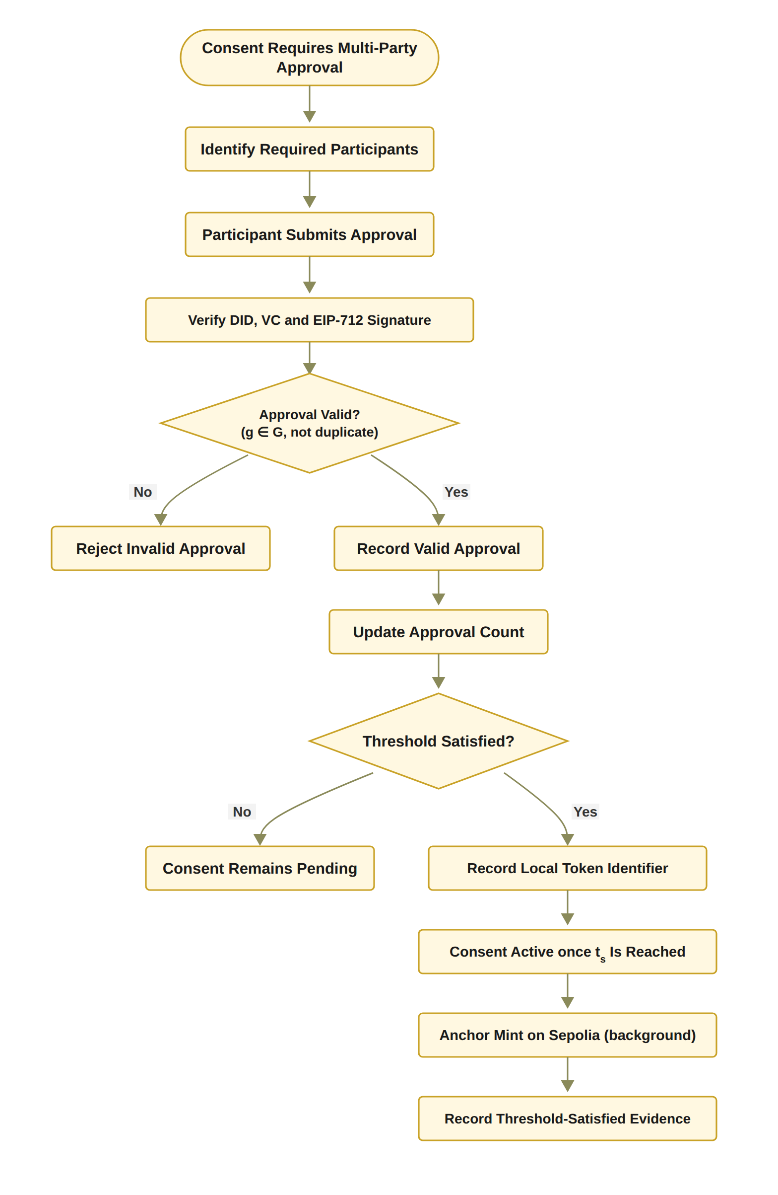
STEP 3: THE GUARDIANS APPROVE TOGETHER
RO3: Multi-party authorisation
Status: Done
The guardian set G is fixed when the consent is created.
Each guardian signs an EIP-712 approval; the system recovers the signer and checks it is in G.
Approvals from outsiders, replays and duplicates are not counted.
N-of-N rule: every listed guardian must sign (2-of-2 in the demo).
When all have signed, a soulbound token is minted on Sepolia in the background.
In the prototype the guardian keys are derived from the guardian DIDs; wallet-held keys are for the next stage.
Notes:
Step three. No single person can approve alone. Each guardian signs with an EIP-712 signature. The system recovers the signer and checks that this person is one of the listed guardians. Outsiders, replays and duplicates are not counted. In the demo, two of two guardians must sign. When both have signed, a soulbound token is minted on the Sepolia test network in the background. One honest note: in the prototype, the guardian keys are derived from the guardian DIDs. Wallet-held keys are for the next stage. RO3 is done.

Slide 16
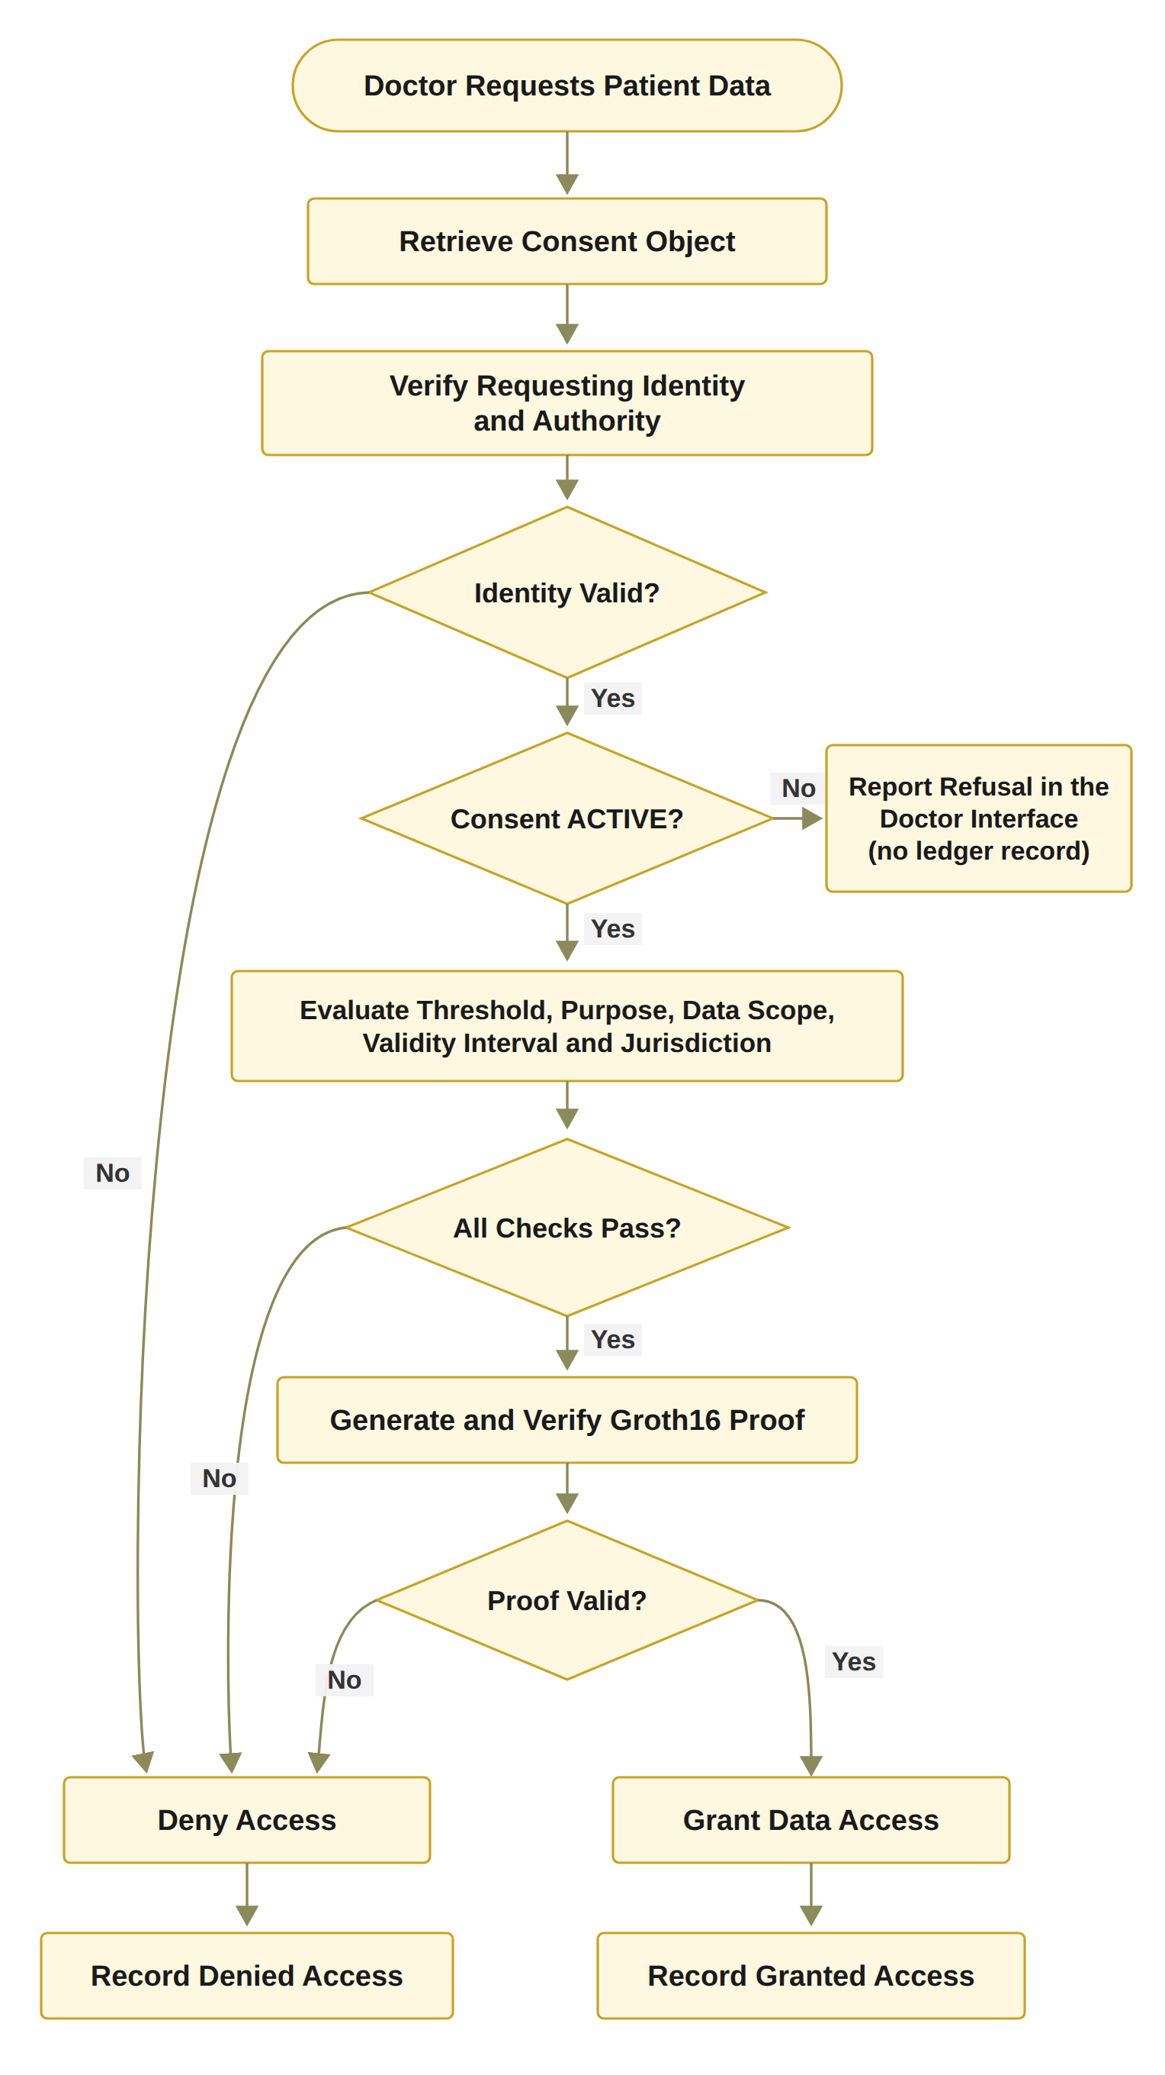
STEP 4: ONLY THE AGREED DATA AND PURPOSE
RO4: Policy- and context-aware access
Status: Done
The requested data must be a non-empty subset of the agreed data scope.
The purpose must be a supported purpose of the consent.
Time and jurisdiction are checked in the same decision.
A Groth16 proof must verify before any data is retrieved.
Example: asking for Procedure when only Observation and Medication were agreed gives DENY.
Notes:
Step four. A valid identity and all the approvals are still not enough. The requested data must be inside the agreed data scope. For example, if the consent allows Observation and Medication, a request that also asks for Procedure is denied. The purpose, the time and the jurisdiction are checked in the same decision. And a Groth16 proof must pass before any data is released. RO4 is done.

Slide 17
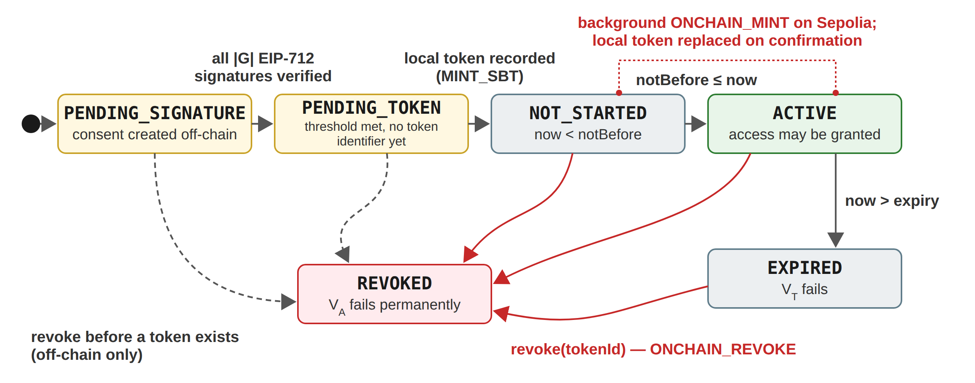
STEP 5: TIME AND LIFECYCLE
RO5: Time and lifecycle control
Status: In Progress
Working now: the validity window is stored on-chain and checked at every request.
Working now: revocation end to end, including an on-chain revoke transaction.
Working now: a clear lifecycle: PENDING_SIGNATURE, PENDING_TOKEN, NOT_STARTED, ACTIVE, EXPIRED, REVOKED.
Next stage: the lifecycle transition check, consent modification, delegation, guardian-set changes and a formal lifecycle model.
Notes:
Step five. Time and lifecycle. What works now: the validity window is stored on-chain and checked at every request. Revocation works end to end, with an on-chain transaction. And the consent moves through a clear lifecycle. What is still open: the lifecycle transition check, consent modification, delegation, changes to the guardian set, and a formal lifecycle model. That is why RO5 is in progress.

Slide 18
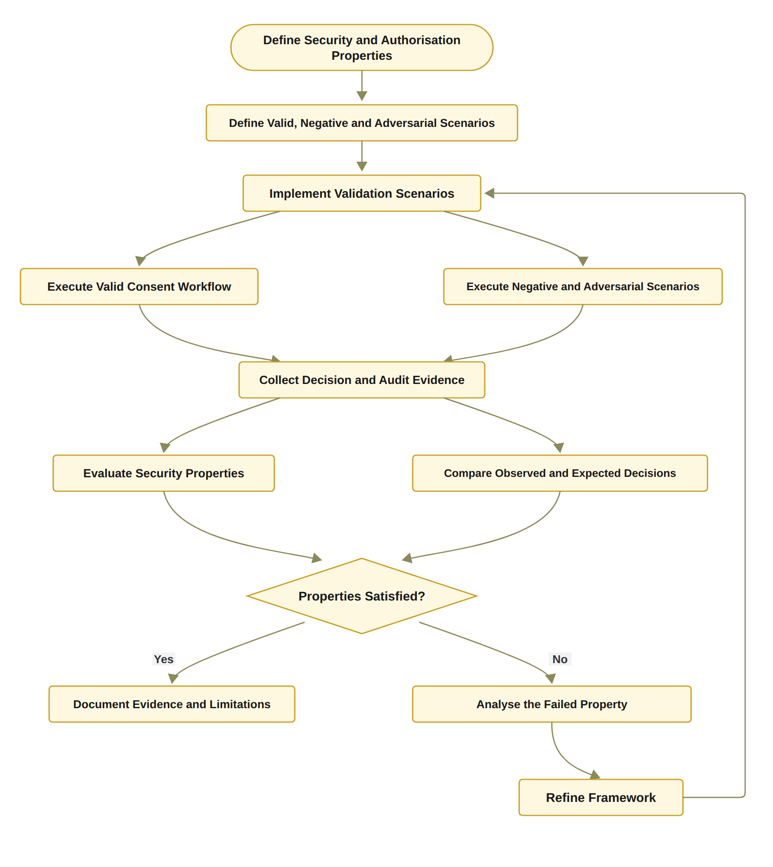
STEP 6: PROVE IT AND TEST IT
RO6: Formal assurance and validation
Status: Partially completed
Done: 36 automated tests pass, including 12 attack scenarios A1 to A12.
Done: gas, confirmation latency and processing time measured.
Done: a live request from the wrong jurisdiction was refused against a Sepolia-anchored consent.
Next stage: formal proofs or model checking of the security properties, and a larger evaluation under load.
Notes:
Step six. Prove it and test it. The testing part is done. 36 automated tests pass, including twelve attack scenarios. I also measured the cost and the timing. The proof part is the next stage: formal proofs or model checking of the security properties, and a bigger evaluation under load. That is why RO6 is partly completed.

Slide 19
VALIDATION: DOES IT DO WHAT IT SHOULD?
Evidence | What it checks | Pass rule | Result
Valid scenarios | Legitimate requests get access | Observed = expected | Scenarios 1 to 3: consent created, 2-of-2 approval, ALLOW
Negative scenarios | Wrong requests are refused | Any failed check gives DENY | Scenario 4: wrong jurisdiction refused. Scenario 5: revoked consent refused
Attack scenarios | Deliberate attempts to bypass a check, A1 to A12 | Every attack is refused | 11 of 12 refused after the hardening (A11: the changed digest is not yet compared)
Automated tests | 23 functional tests and 13 adversarial tests | All pass | 36 of 36 pass
Independent check | On-chain receipts against the local consent state | Local state = on-chain state | Scenario 6: all checks passed
Notes:
Validation asks one question: does the system do what it should? I used five kinds of evidence. Valid scenarios: the correct requests were allowed. Negative scenarios: the wrong jurisdiction and the cancelled consent were refused. Attack scenarios: eleven of twelve attacks are refused after the hardening. Automated tests: all 36 pass. And an independent check: the state on the chain matches the local state.

Slide 20
VALIDATION: THE RECORDED DECISIONS
Time (24 Sep) | Consent | VI | VA | VP | VT | VL | Decision | Access | Proof
09:51:36 | f050c29a | PASS | PASS | PASS | PASS | PASS | ALLOW | GRANTED | groth16
09:51:39 | f050c29a | PASS | PASS | PASS | PASS | PASS | ALLOW | GRANTED | groth16
10:02:50 | f050c29a (jurisdiction SA) | PASS | PASS | PASS | PASS | FAIL | DENY | DENIED | n/l
11:02:52 | 04da25f5 | PASS | PASS | PASS | PASS | PASS | ALLOW | GRANTED | groth16
11:04:16 | 04da25f5 | PASS | PASS | PASS | PASS | PASS | ALLOW | GRANTED | groth16
11:04:26 | 04da25f5 | PASS | PASS | PASS | PASS | PASS | ALLOW | GRANTED | groth16
Allowed requests: all five checks PASS, decision ALLOW, access GRANTED, proof mode Groth16 (Scenario 3).
Wrong jurisdiction: only VL fails, decision DENY, access DENIED (Scenario 4). One failed check is enough.
After revocation (Scenario 5) the request is refused before any decision is logged (n/l = not logged); the revocation is public on Sepolia, block 11,771,307.
Notes:
This table is taken directly from the audit ledger of 24 September. Each row is one real request, with the five checks and the decision. The first two rows and the last three rows are allowed requests: all five checks PASS, the decision is ALLOW, access is GRANTED, and the proof mode is Groth16. The row in the middle is the request from the wrong jurisdiction: VI, VA, VP and VT pass, VL fails, so the decision is DENY. One failed check is enough. The request after revocation is not in this table, because a consent that is no longer active is refused before any decision is logged; its revocation is public on Sepolia in block 11,771,307.

Slide 21
VALIDATION: TWELVE ATTACK SCENARIOS
ID | Attack | Target | Before hardening | After hardening
A1 | Approval signed by a signer outside G | A | Accepted* | Refused
A2 | Guardian signature replayed from another consent | I | Refused | Refused
A3 | Same guardian approves twice to reach N | A | Accepted* | Refused
A4 | Requested scope exceeds the authorised scope | P | Refused | Refused
A5 | Request with an empty scope | P | Accepted* | Refused
A6 | Request before notBefore or after expiry | T | Refused | Refused
A7 | Requester declares a different jurisdiction | L | Refused | Refused
A8 | Access after revocation | E | Refused | Refused
A9 | Tampered Groth16 proof or public signal | E | Refused | Refused
A10 | Honest proof for an expired consent | T | Refused | Refused
A11 | Result of a recorded audit event rewritten | E | Differs† | Differs†
A12 | Mint or revoke by a non-owner, or token transfer | Contract | Refused | Refused
12
attack scenarios, A1 to A12
11 / 12
refused after the hardening (A11 neutral)
36
automated tests pass
* Accepted at unit level only, when the service function was called directly; the interface already refused it.
† The rewritten event's digest differs from the stored digest, but no component compares the two yet, so the result is neutral.
Target: I identity, A authority, P policy and scope, T time, L jurisdiction, E evidence, Contract = ConsentSBTv3 on an in-memory EVM.
Notes:
I also attacked my own system twelve times, A1 to A12. This table shows each attack, the part of the consent it targets, and the outcome before and after the hardening on the first of October. Before the hardening, three attacks got through when the service functions were called directly: A1, a signer outside the guardian set; A3, the same guardian signing twice; and A5, an empty data scope. The interface already refused them, but the service layer did not. The hardening moved these checks into the service layer, so now they are refused on every path. After the hardening, eleven of twelve are refused. The last one, A11, changes a stored digest. The prototype does not compare that digest yet, so it is marked as differs, which is neutral, not passed. It is on the list for the next stage.

Slide 22
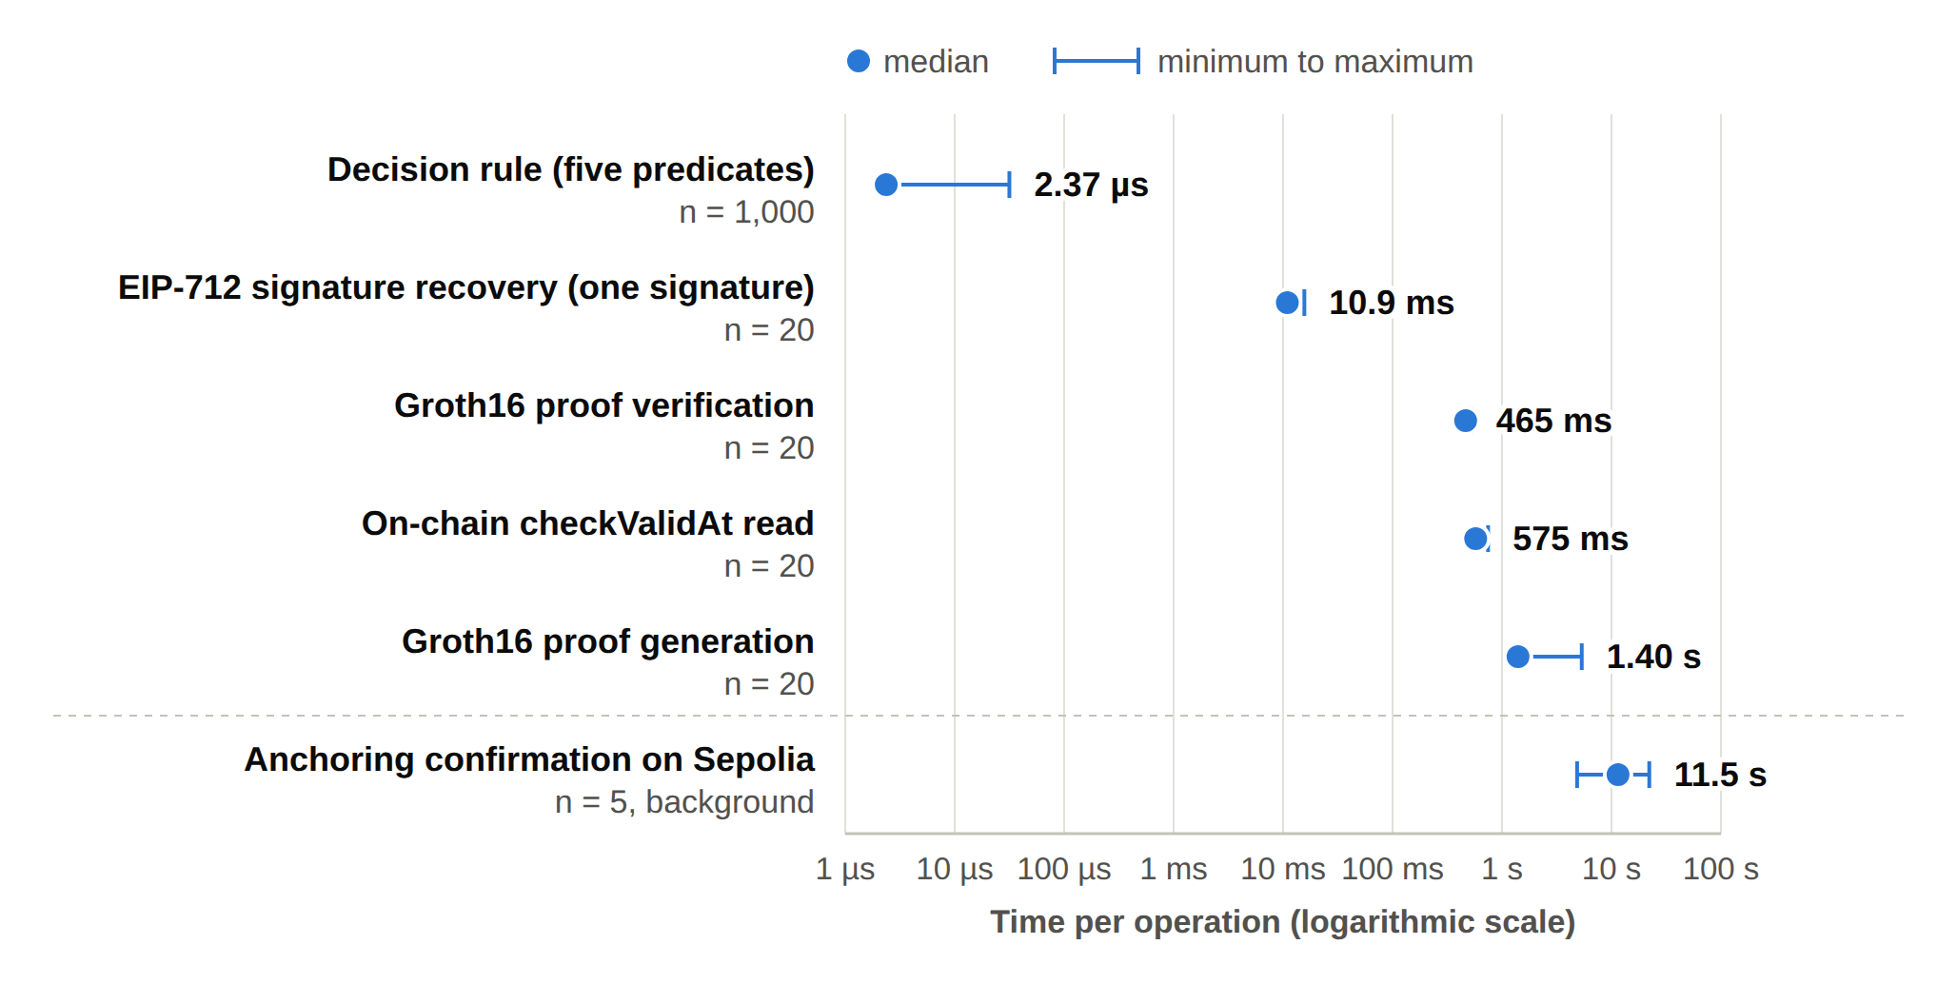
EVALUATION: HOW FAST AND HOW MUCH?
Component | Median | Min | Max | n
Decision rule, five checks | 2.37 µs | 2.32 µs | 31.59 µs | 1,000
One EIP-712 signature | 10.93 ms | 10.55 ms | 15.64 ms | 20
Groth16 proof generation | 1,401.1 ms | 1,342.8 ms | 5,349.6 ms | 20
Groth16 proof verification | 465.3 ms | 441.0 ms | 525.1 ms | 20
On-chain checkValid read | 573.5 ms | 568.2 ms | 715.5 ms | 20
On-chain checkValidAt read | 574.6 ms | 568.2 ms | 745.6 ms | 20
Anchoring confirmation | 11.5 s | 4.9 s | 22.1 s | 5
Timings measured on 1 October 2026; gas and anchoring from the five Sepolia transactions of September 2026; indicative only
Gas used: mint #1 196,406; revoke #1 32,980. No fee above 0.00021 ETH.
Notes:
Evaluation asks: how fast is it, and what does it cost? The decision rule itself takes about 2 microseconds. One guardian signature takes about 11 milliseconds. The Groth16 proof is the slowest part: about 1.4 seconds to generate and about half a second to verify. Anchoring on Sepolia takes about 11.5 seconds, but it runs in the background, so nobody waits for it. A revoke uses about one sixth of the gas of a mint. The timings were measured on the first of October 2026. The gas and the anchoring times come from the five Sepolia transactions in September. These numbers are indicative.

Slide 23
WHAT IS DIFFERENT FROM TODAY'S SYSTEMS
Aspect | Traditional EHR access control | HALAH framework
Identity | Central identity provider; institution login | A DID for every participant; identity kept separate from authority
Consent | A stored record that permission was given | An object C = (I, A, P, T, L, E), checked at every request
Approval | A static permission set by one party | All listed guardians sign (EIP-712); no single party can approve alone
Access check | Log in, then check a static permission | VI ∧ VA ∧ VP ∧ VT ∧ VL, plus a Groth16 proof before data is released
Time and revocation | Hard to verify once the permission is stored | Validity window and revocation checked each time; on-chain revoke
Audit | A record that consent occurred | Each decision on an active consent logged with its decision matrix; state anchored on Sepolia
Notes:
Here is the difference in plain words. Today, a central identity provider logs you in, and a fixed permission decides. Consent is a saved record. In HALAH, every person has a DID, and identity is separate from authority. Consent is an object that is checked at every request. All the guardians must approve. Five checks and a proof run before any data is released. Time and revocation are checked every time. And every decision on an active consent is logged with the reason.

Slide 24
DATA AND PRIVACY
Aspect | Key points
Data source | Synthea 1K sample of synthetic patient records (synthea.mitre.org), CSV export; a subset of patients with their observations, conditions, medications and procedures. No real patient data is involved.
Data storage | Medical records stay off-chain in the application. No medical content is written to the chain.
On-chain record | Pseudonymous patient and requester addresses, a hash of the purpose, the validity window, a jurisdiction code and a revocation flag.
Access to data | Records are released only on ALLOW and only within the agreed data scope.
Audit | Each decision on an ACTIVE consent is recorded with its decision matrix.
Known limitation | The plaintext purpose is passed in the mint transaction and is visible in the public transaction input.
Notes:
A few important points about the data. I use synthetic patient records from the Synthea 1K sample, in its CSV export. The prototype loads a subset of patients with their observations, conditions, medications and procedures. No real patient data is involved. The medical records stay off-chain. The token on Sepolia stores only pseudonymous addresses, a hash of the purpose, the validity window, a jurisdiction code and a revocation flag. Data is released only on ALLOW, and only inside the agreed scope. One known limitation: the plain-text purpose is visible in the mint transaction. I will fix this in the next stage.

Slide 25
WHY THIS MATTERS
Scientific
Social
Consent is an evaluable object, C = (I, A, P, T, L, E), not a stored record.
Multi-party approval is a standing condition of every access decision, and the patient defines who must approve.
Identity is separated from authority, and all conditions are checked in one decision.
A PRISMA 2020 review of 25 studies names the conjunction gap and the assurance gap.
A working prototype on Sepolia, measured and attacked twelve times.
Patients and their guardians decide together who may see the patient's data.
No single person can approve access to sensitive health data alone.
Every decision can be explained to an auditor: which check passed, which failed.
Medical records stay off-chain; only consent evidence is shared.
Supports trust when data move between hospitals and other independent parties.
Notes:
Why does this matter? On the scientific side: consent becomes an object that is checked, not stored. Multi-party approval is a condition of every access. Identity is separated from authority. And the whole decision is checked in one place and tested. On the social side: patients and guardians decide together who sees the data. No single person can approve alone. Every decision can be explained to an auditor. And medical records never go on the blockchain.

Slide 26
WHAT IS STILL OPEN
Formal proofs
The security properties are tested, not yet proved. Next: a formal model and model checking or proofs (RO6).
Lifecycle
Consent modification, delegation and guardian-set changes, with a formal lifecycle model (RO5).
Identity and keys
Full DID resolution, credential validation and wallet-held guardian keys. Today: a DID-format check, signature recovery and keys derived from the guardian DIDs (RO2, RO3).
Attack A11
A changed audit digest is not yet compared by any component. It is marked neutral, not refused.
Scale
A larger evaluation under load, with more users, consents and concurrent requests.
Purpose on-chain
The plaintext purpose is visible in the mint transaction input.
Notes:
I want to be clear about what is not done yet, because this is what the next stage is for. First, the formal proofs. The properties are tested, but not yet proved with a formal model. Second, the rest of the lifecycle: consent modification, delegation and guardian changes. Third, full DID resolution, credential validation and wallet-held guardian keys. Today it is a format check, a signature, and keys derived from the guardian DIDs. Fourth, the one open attack, A11. Fifth, a bigger evaluation under load. Sixth, the plain-text purpose in the mint transaction.

Slide 27
RESEARCH PLAN
Task | Description | Target date | Status
Chapters 1–4 | Introduction, SLR, Research Questions and Objectives, Research Methodology | Completed | Done
Chapter 5 | Research Architecture (MVC) and framework design | May 2026 | Done
Chapter 6 | Proposed solution for RQ1 to RQ4 and the HALAH prototype | Jul–Oct 2026 | Done
Publication 1 | Conference paper submission, BWCCA 2026 | Sep 2026 | Done
Publication 2 | SLR paper journal submission | Oct 2026 | In Progress
Chapter 7 | Complete prototype evaluation and integrated results | Nov 2026 | Planned
Publication 3 | Journal paper on formal security assurance, lifecycle trust and the evaluation of HALAH | Dec 2026 | Planned
Chapter 8 | Conclusion and future work | Dec 2026 | Planned
Final assessment | Final candidature assessment defence | Jan 2027 | Planned
Thesis | Complete thesis submission | Mar 2027 | Planned
Notes:
This is the plan. Chapters one to six are done. The conference paper was submitted to BWCCA 2026 in September. The SLR journal paper is in progress. Next comes the complete evaluation, the paper on formal assurance and lifecycle trust, and the conclusion. The final assessment is planned for January 2027, and the thesis submission for March 2027.

Slide 28
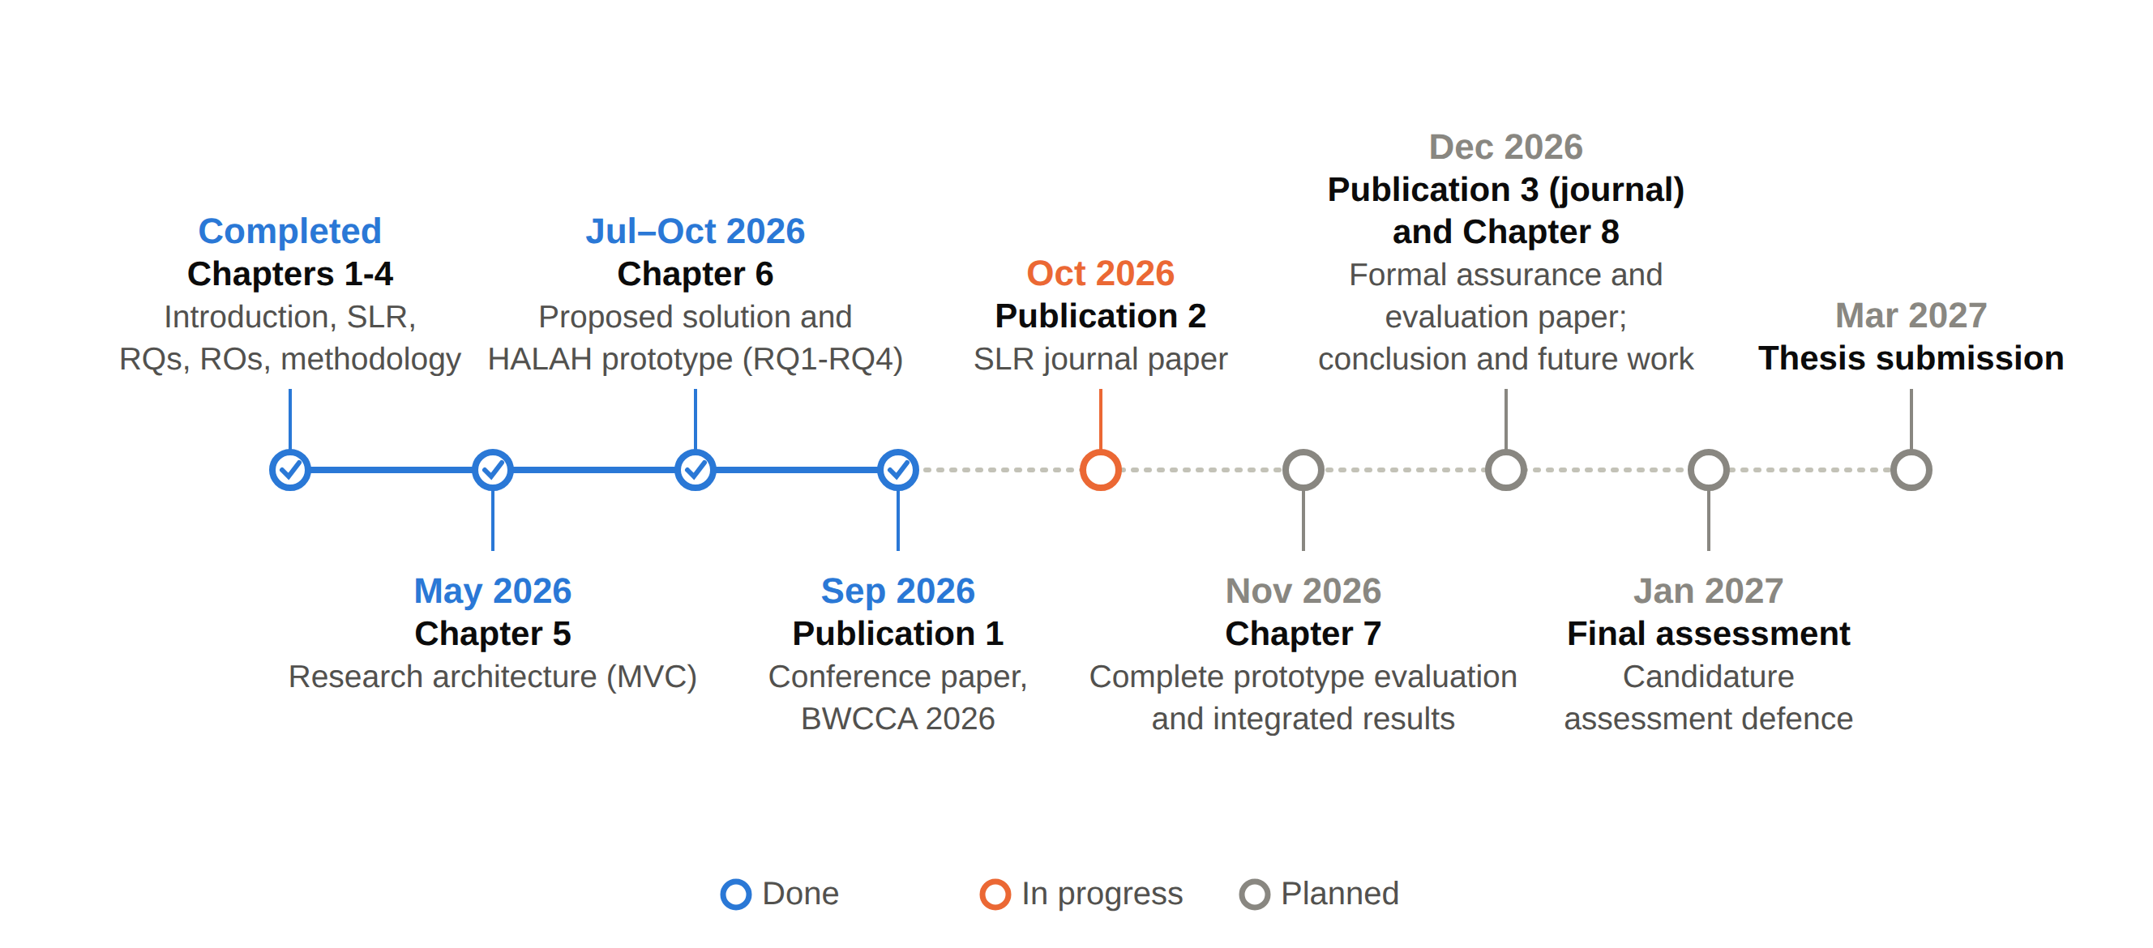
RESEARCH TIMELINE
Notes:
This is the same plan as a timeline. What is completed, what is in progress, and the planned steps up to the thesis submission in March 2027.

Slide 29
DEMO: THE HALAH PROTOTYPE
One real consent, from creation to revocation: RO1 to RO4 in full, and the working parts of RO5 and RO6.
Four interfaces
Patient, guardian, doctor and auditor
Smart contract
ConsentSBTv3, a soulbound ERC-721 token (ERC-5484) on the Sepolia testnet
Guardian approval
EIP-712 typed signatures, verified by signature recovery
Access proof
Groth16 zero-knowledge proof over a Poseidon commitment
Data
Synthetic Synthea records: Observation, Medication, Condition, Procedure
Evidence
Audit ledger of every decision on an active consent; no medical content on-chain
Notes:
Now the demonstration, through the slides. HALAH means History Access Link for Authorised Healthcare. These are its parts: four screens, a soulbound token contract on the Sepolia test network, EIP-712 guardian signatures, a Groth16 proof at access time, synthetic data, and an audit ledger. In the next slides, I walk you through one real consent, from creation to revocation. What you will see covers RO1 to RO4 in full, and the parts of RO5 and RO6 that already work.

Slide 30
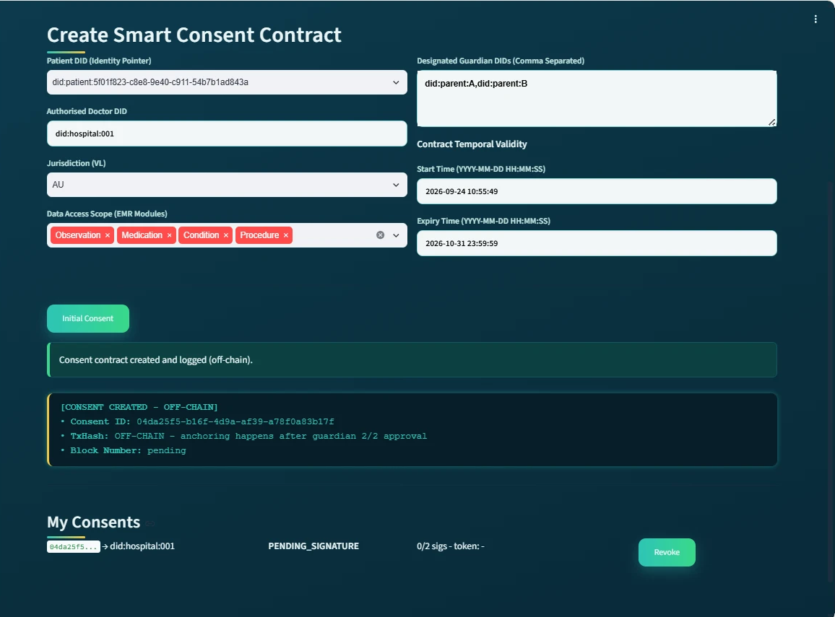
DEMO 1: THE PATIENT CREATES THE CONSENT
RO1
Consent as an evaluable object
The patient chooses the doctor, two guardians, the data modules, the validity time and the jurisdiction AU.
The purpose is fixed to Treatment in this prototype.
An empty data scope or a malformed guardian DID is rejected.
The consent is stored as PENDING_SIGNATURE. Nothing is on the blockchain yet.
Patient subsystem after creation: four modules, two guardians, jurisdiction AU, state PENDING_SIGNATURE
Notes:
Demo step one. The patient creates the consent. On this screen you can see the four data modules, the two guardians, the jurisdiction AU, and the state PENDING_SIGNATURE. The system checked every field before saving. Nothing has gone to the blockchain yet. This is RO1: consent as an object the system can check.

Slide 31
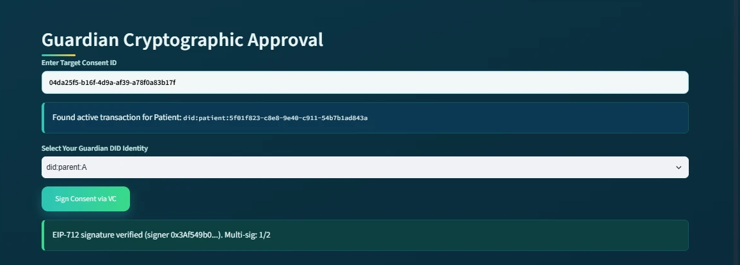
DEMO 2: THE FIRST GUARDIAN APPROVES
RO3
Multi-party approval: one signature is not enough
The first guardian signs an EIP-712 approval.
The system recovers the signer and confirms it is a listed guardian.
The counter shows 1 of 2. The consent stays pending.
Approvals from outsiders, replays and duplicates would not be counted.
Guardian subsystem at the first approval: signature verified, multi-signature count 1/2
Notes:
Demo step two. The first guardian signs. The system takes the EIP-712 signature, finds who signed it, and confirms that this address is one of the two listed guardians. The counter shows one of two. The consent is still pending, because one approval is never enough. This is RO3.

Slide 32
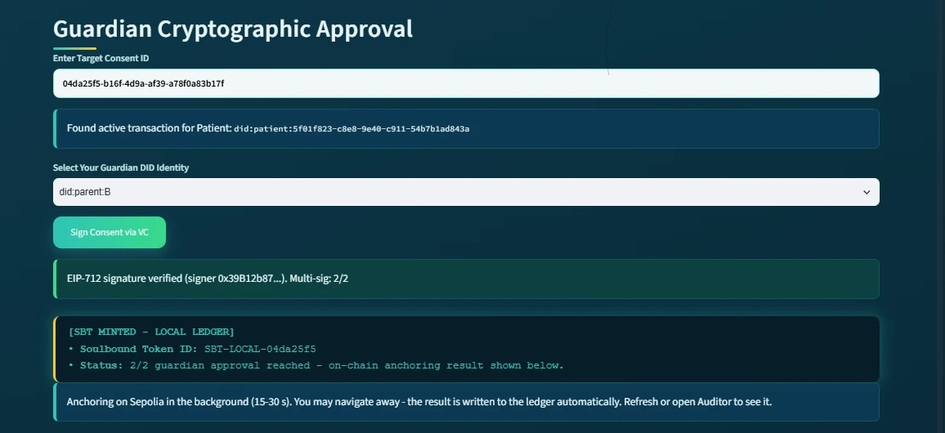
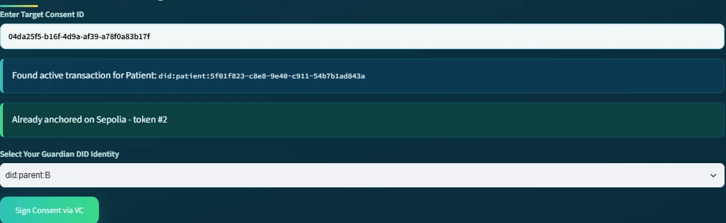
DEMO 3: SECOND APPROVAL, TOKEN MINTED
RO3
Threshold reached: 2 of 2, then anchoring in the background
Second signature verified; threshold 2 of 2 reached
A soulbound token is minted on Sepolia in the background; the user does not wait
Later the same screen reads: already anchored on Sepolia
Second approval: 2/2 reached, SBT minted in the background
Revisited after the background job: already anchored on Sepolia
Notes:
Demo step three. The second guardian signs. Now the threshold, two of two, is reached. The system records the token locally and starts the mint on Sepolia in the background. The guardian does not wait for the blockchain. On the right, the same screen a bit later: already anchored on Sepolia, with the token number. RO3 is complete.

Slide 33
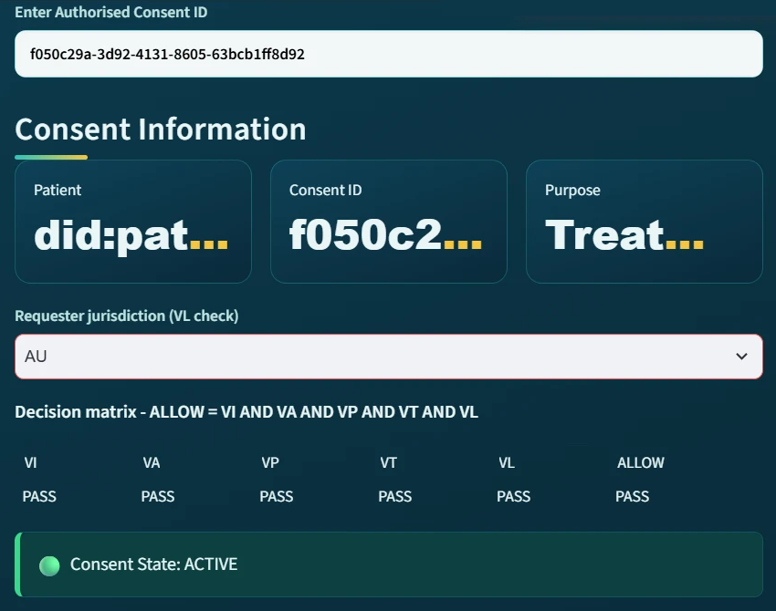
DEMO 4: THE DOCTOR IS ALLOWED
RO2 + RO4
Five checks and a proof before any data is released
The doctor selects the consent and a scope inside the agreed modules.
A Groth16 proof is generated and verified.
The decision matrix shows VI, VA, VP, VT, VL all PASS, so ALLOW.
Identity, authority, approvals, scope, time and jurisdiction are checked in one decision.
Doctor subsystem, requester jurisdiction AU: all five checks PASS, ALLOW
Notes:
Demo step four. The doctor asks for the patient's data. First the proof is generated and verified. Then the five checks run. Identity and authority, VI. Approvals and token, VA. Purpose and scope, VP. Time, VT. Jurisdiction, VL. All five pass, so the answer is ALLOW. This is RO2 and RO4 together, in one decision.

Slide 34
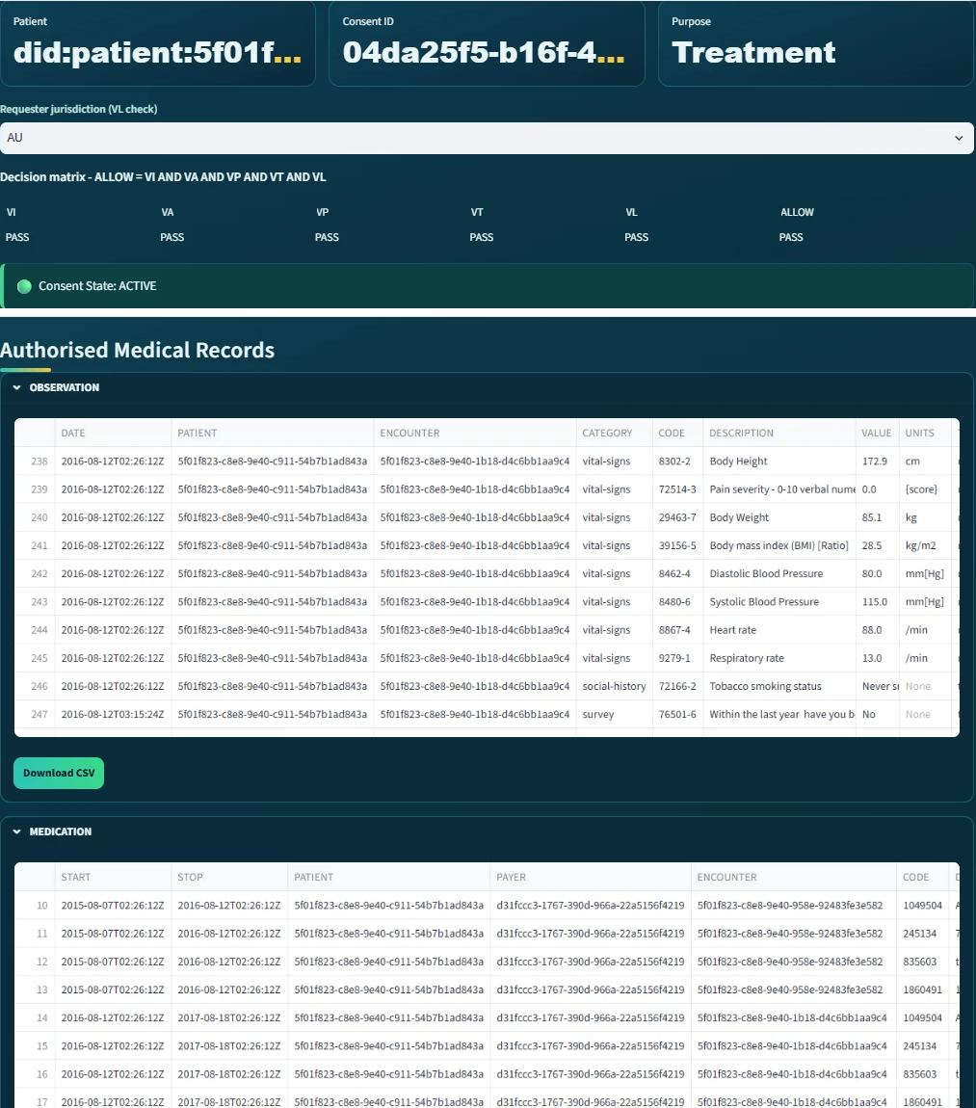
DEMO 5: ONLY THE AUTHORISED RECORDS
RO4
Data scope enforced: nothing outside the consent
Records are displayed per module: Observation, Medication, Condition, Procedure.
Only the modules inside the consent scope are returned.
A request for a module outside the scope is refused (attack test A4).
The decision is written to the audit ledger with its matrix.
Doctor subsystem after verification: access granted, records displayed per module
Notes:
Demo step five. After ALLOW, the records are shown per module. Only the modules inside the consent scope are returned. If the doctor asked for a module that was not agreed, the request would be refused. That case is covered by attack test A4. The decision and its matrix are written to the audit ledger.

Slide 35
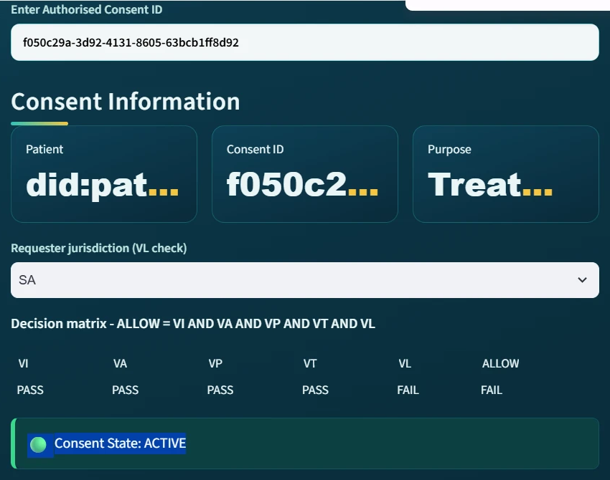
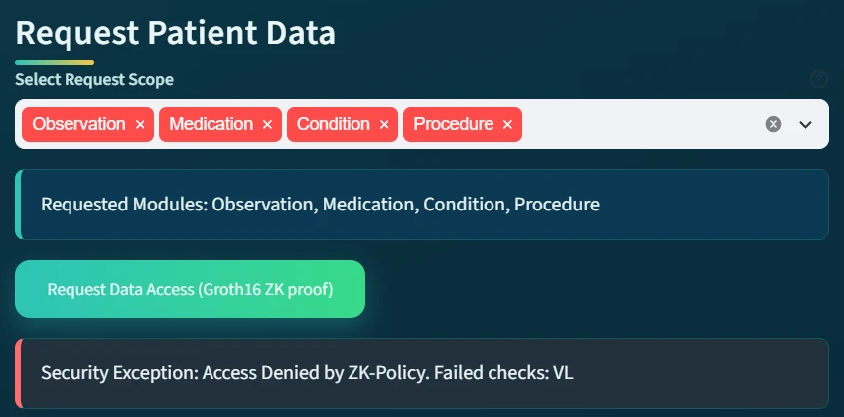
DEMO 6: THE WRONG JURISDICTION
RO4
One failed check is enough to deny
Same doctor, same active consent, jurisdiction declared as SA instead of AU
VL = FAIL, so ALLOW = FAIL
The refusal names the failed check: Security Exception, failed checks: VL
Requester jurisdiction SA: VL reports FAIL, ALLOW = FAIL
The refused request names the failed check: VL
Notes:
Demo step six. The same doctor repeats the request, but this time declares the jurisdiction as SA. The consent was issued for AU. Everything else passes, but VL fails. One failed check is enough: access is denied. The message tells the auditor exactly which check failed. This is the rule of RO4 in action.

Slide 36
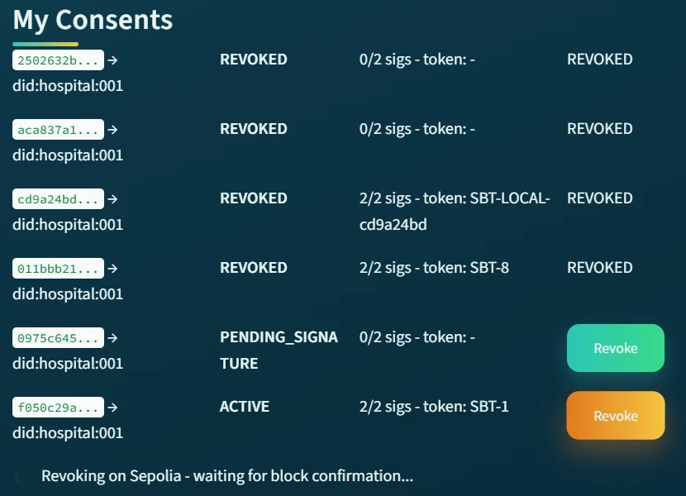
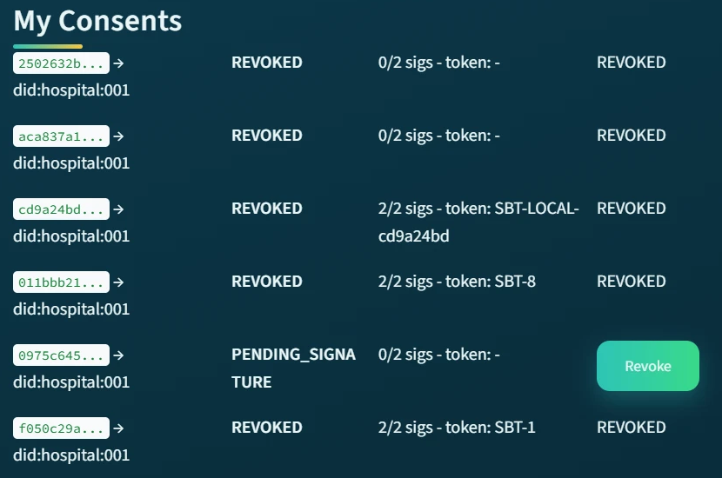
DEMO 7: THE PATIENT REVOKES THE CONSENT
RO5
Revocation end to end, with an on-chain transaction
The patient revokes the consent
The revoke transaction is sent to Sepolia and waits for block confirmation
The consent becomes REVOKED, token #1
During revocation: waiting for block confirmation
After revocation: the consent is REVOKED, token #1
Notes:
Demo step seven. The patient cancels the consent. On the left, the system is sending the revoke transaction to Sepolia and waiting for the block confirmation. On the right, the consent is now REVOKED, with its token number. This is the working part of RO5.

Slide 37
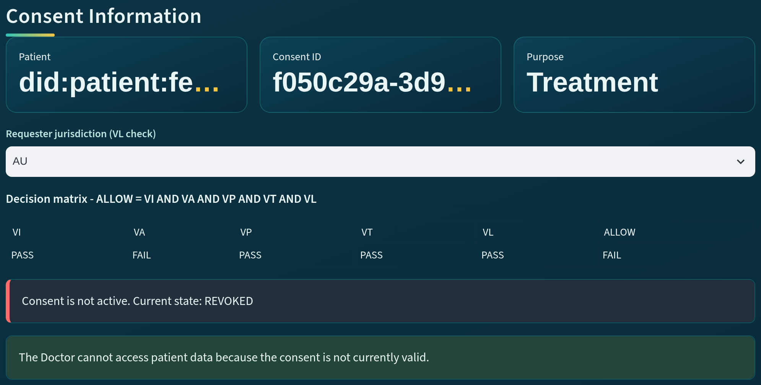
DEMO 8: AFTER REVOCATION, REFUSED
RO5
A revoked consent cannot be used
The same doctor repeats the request.
VA reports FAIL: the consent is not active, current state REVOKED.
Access is refused.
Expired consents are refused the same way through VT.
Doctor subsystem after revocation: VA FAIL, state REVOKED
Notes:
Demo step eight. The doctor tries again. Now VA fails, because the consent is not active any more: its state is REVOKED. Access is refused. An expired consent is refused in the same way, through the time check VT. So a consent that was valid yesterday does not stay usable forever.

Slide 38
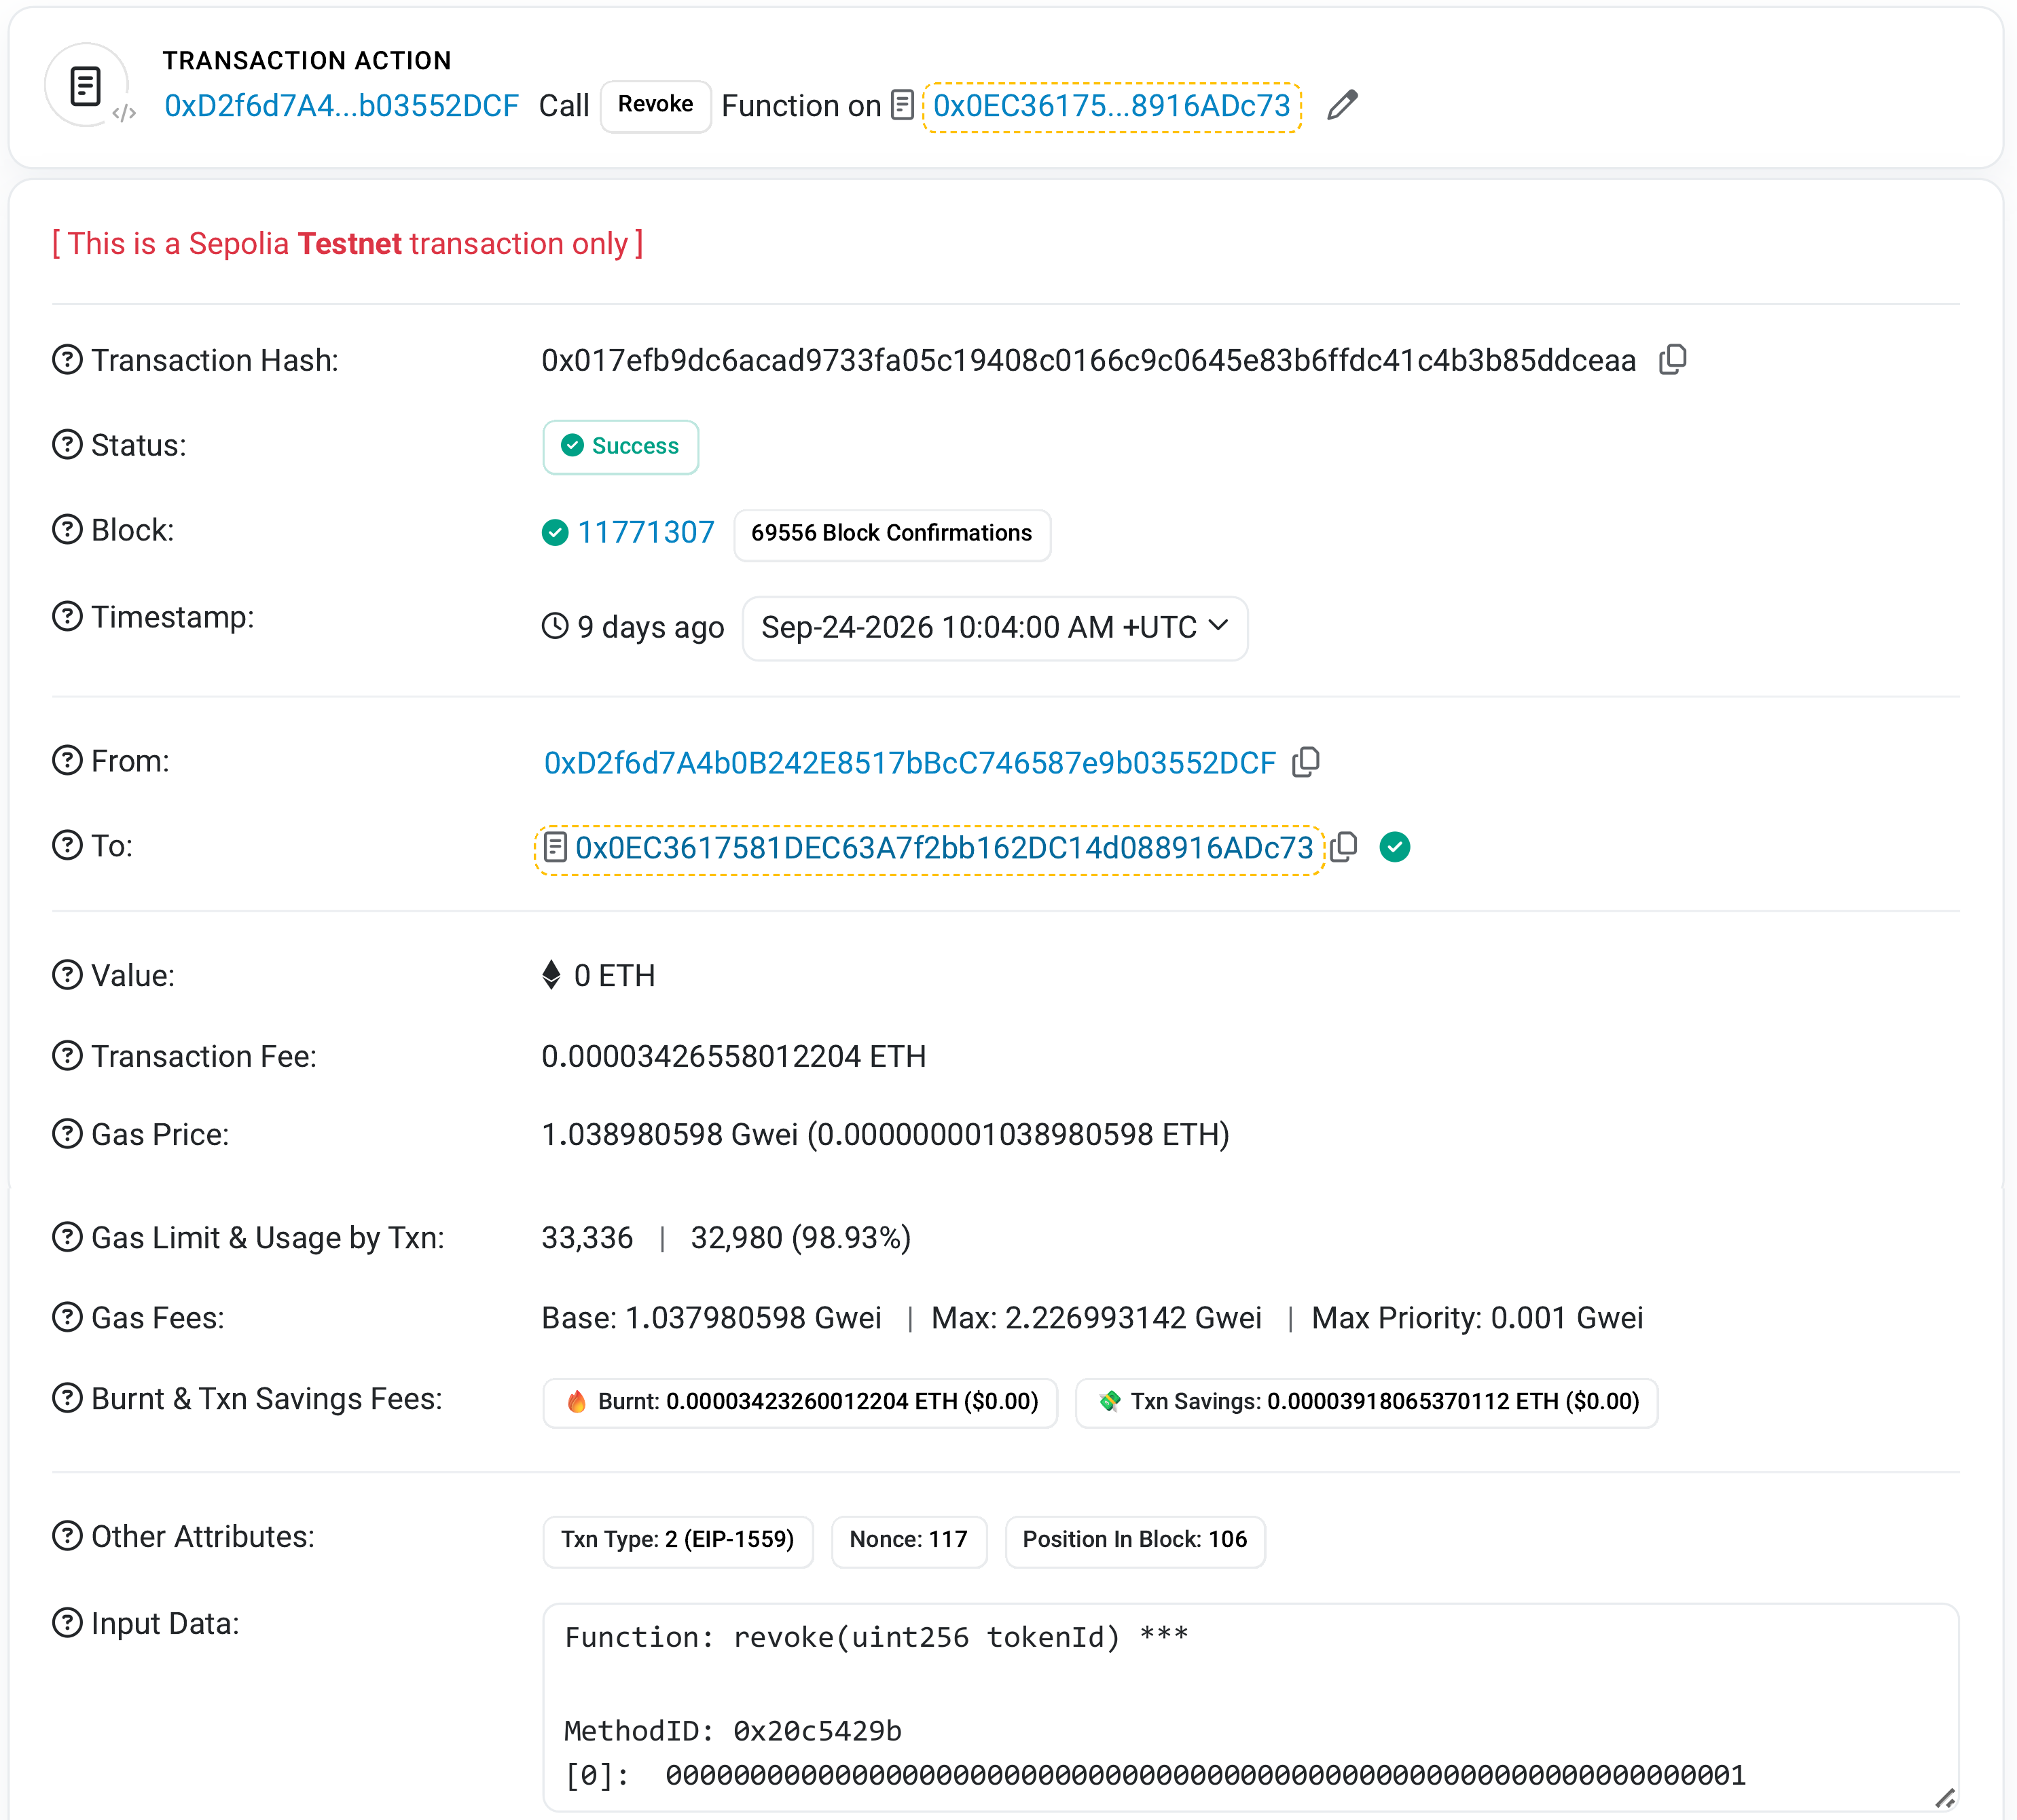
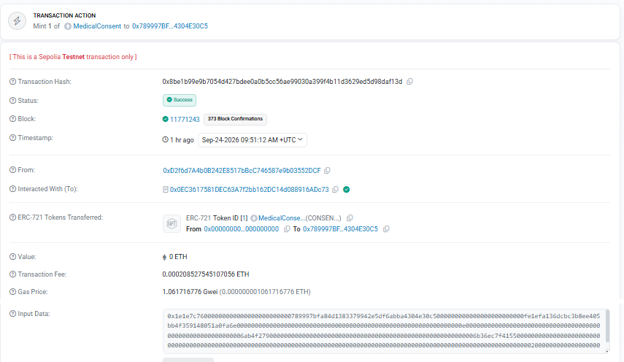
DEMO 9: PUBLIC EVIDENCE ON SEPOLIA
RO5 + RO6
The mint and the revoke are public, verifiable transactions
Mint of the evaluated consent: block 11,771,243
Revoke of token #1: block 11,771,307, decoded input revoke(uint256 tokenId)
No medical data is on the chain, only the consent state
Anchoring transaction: status Success, block 11,771,243
Revocation transaction: status Success, block 11,771,307
Notes:
Demo step nine. Both the mint and the revoke are public transactions on Sepolia. On the left, the anchoring transaction of the consent, in block 11,771,243. On the right, the revocation, in block 11,771,307, with the decoded function revoke and token id 1. Anyone can check them. No medical data is on the chain.

Slide 39
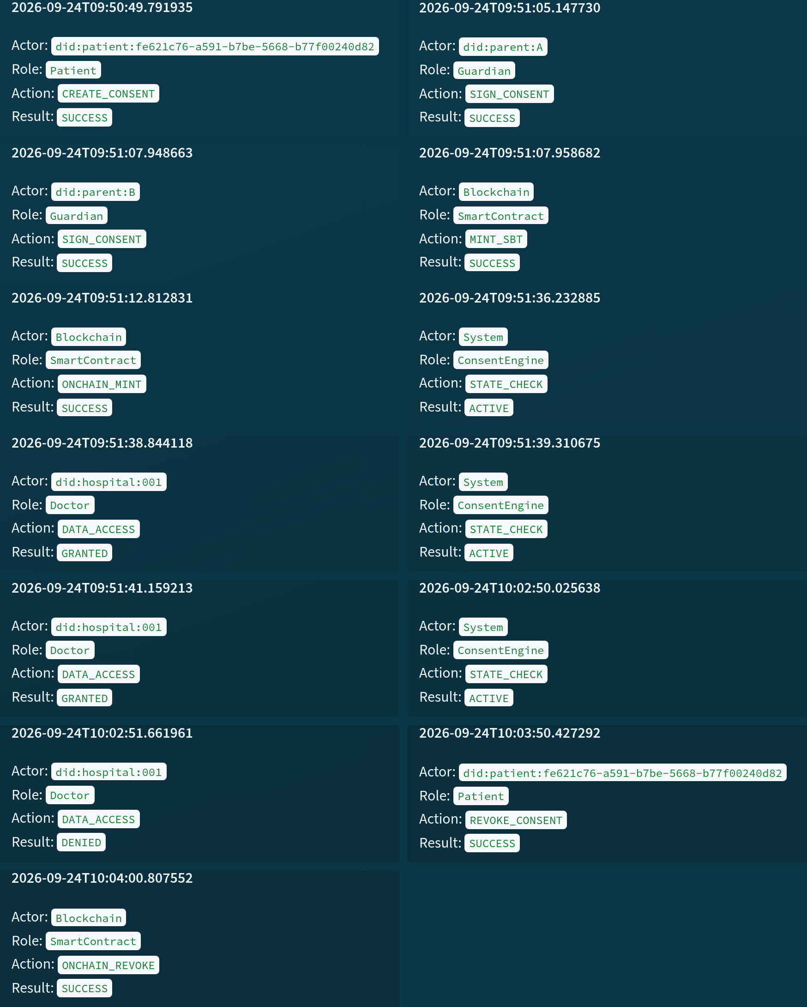
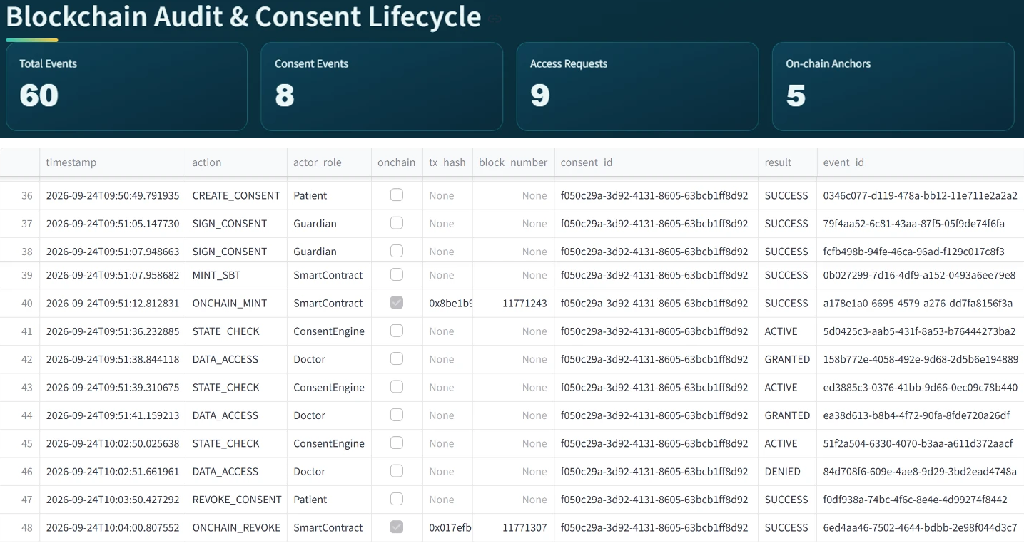
DEMO 10: THE AUDITOR SEES EVERYTHING
RO6
Every event in order, and the chain agrees with the local records
The lifecycle of the consent: thirteen recorded events in order, from creation to revocation
Aggregate indicators of the exported ledger: 60 events, 9 access requests, 5 on-chain anchors
An independent tool re-checked Sepolia: all anchored transactions found in their recorded blocks
Auditor subsystem: lifecycle of the evaluated consent, thirteen events in order
Auditor dashboard: 60 events, 9 access requests, 5 on-chain anchors
Notes:
Demo step ten, the last one. The auditor can rebuild the full life of the consent: thirteen events in order, from creation to revocation, each with its decision matrix. The dashboard shows the exported ledger: 60 events, 9 access requests and 5 on-chain anchors. And a separate tool re-checked Sepolia and found every anchored transaction in its recorded block. All checks passed. This is the working part of RO6: evidence that can be audited.

Slide 40
REFERENCES (1/6)
[1] A. Abbasi, M. N. Humeidi, and Q. Wang. Nexa: Enabling secure, scalable, and decentralized management of electronic health records using threshold cryptography and public blockchains. IEEE Access, 14:50791–50810, 2026. doi:10.1109/ACCESS.2026.3677499
[2] F. Albalwy, A. Brass, and A. Davies. A blockchain-based dynamic consent architecture to support clinical genomic data sharing (ConsentChain): Proof-of-concept study. JMIR Medical Informatics, 9(11):e27816, 2021. doi:10.2196/27816
[3] M. Al Amin, A. Altarawneh, and I. Ray. Informed consent as patient driven policy for clinical diagnosis and treatment: A smart contract based approach. In Proceedings of the 20th International Conference on Security and Cryptography (SECRYPT 2023), pages 159–170. SciTePress, 2023. doi:10.5220/0012090600003555
[4] K. Ekholm, A. Augustinsson, J. Sundström, C. Johansen, M. Storgärds, L. Ljöstad, et al. Implementing electronic informed consent in rare disease genomics. Scientific Reports, 15(1):44419, 2025. doi:10.1038/s41598-025-32740-1
[5] A. U. Eneh, L. A. C. Ahakonye, J. M. Lee, and D.-S. Kim. Demo: EdgeConsent: On-chain attribute-based access control for data consent management. In 2026 IEEE International Conference on Blockchain and Cryptocurrency (ICBC), pages 1–2, 2026. doi:10.1109/ICBC67748.2026.11575534
[6] J. Hagström, M. Hägglund, M. Holmroos, P. Lähteenmäki, and I. Hörhammer. Minors’ and guardian access to and use of a national patient portal: A retrospective comparative case study of Sweden and Finland. International Journal of Medical Informatics, 187:105465, 2024. doi:10.1016/j.ijmedinf.2024.105465
[7] V. Jaiman and V. Urovi. A consent model for blockchain-based health data sharing platforms. IEEE Access, 8:143734–143745, 2020. doi:10.1109/ACCESS.2020.3014565
[8] J. Zhao and Q. Su. A threshold traceable delegation authorization scheme for data sharing in healthcare. Computers & Security, 139:103686, 2024. doi:10.1016/j.cose.2023.103686
[9] H. Li, D. Li, G. Lv, N. Crespi, R. Minerva, W. Shao, et al. Privacy-preserving fine-grained EMR access control for IoMT: A hybrid RBAC-smart contract scheme with attribute-based authorization. IEEE Internet of Things Journal, 13(2):2970–2987, 2026. doi:10.1109/JIOT.2025.3633504
[10] M. M. Madine, K. Salah, R. Jayaraman, I. Yaqoob, Y. Al-Hammadi, S. Ellahham, et al. Fully decentralized multi-party consent management for secure sharing of patient health records. IEEE Access, 8:225777–225791, 2020. doi:10.1109/ACCESS.2020.3045048
[11] V. Maruthi and K. Singh. Enhancing security and privacy of IoMT data for unconscious patient with blockchain. IEEE Transactions on Network and Service Management, 22(6):5223–5238, 2025. doi:10.1109/TNSM.2025.3602117
[12] L. Mei, K. Huang, X. Li, H. Wang, and X. Zhang. Efficient dual-revocation CP-ABE for secure and fine-grained data sharing in IoMT. IEEE Internet of Things Journal, 13(14):30933–30940, 2026. doi:10.1109/JIOT.2026.3685269
Notes:
These are the references I used in the report and in this talk.

Slide 41
REFERENCES (2/6)
[13] D. P. Panagoulias, A. I. Damian, C. Stamate, V. Toderian, P. Butusina, A. De Franceschi, et al. Blockchain-enabled trust and compliance for clinical AI: Decentralized governance without decentralized data storage. Electronics, 15(14):3046, 2026. doi:10.3390/electronics15143046
[14] S. Phuyal, M. Bhandari, R. Bista, and J. C. Ferreira. Enabling cross-institution health data sharing in Norway: EUDI wallets, on-chain consent, and openEHR↔FHIR translation. IEEE Access, 14:20309–20327, 2026. doi:10.1109/ACCESS.2026.3661642
[15] S. Phuyal, M. Bhandari, R. Bista, and J. C. Ferreira. A blockchain-based architecture for dynamic and auditable patient consent in secondary use of health data. Blockchain in Healthcare Today, 9(1):491, 2026. doi:10.30953/bhty.v9.491
[16] A. Punia, P. Gulia, N. S. Gill, D. Kaushik, N. Alduaiji, P. K. Shukla, et al. An access control system for cloud-based healthcare systems driven by blockchain. Journal of Cloud Computing, 14(1):78, 2025. doi:10.1186/s13677-025-00831-z
[17] I. Román-Martínez, J. Calvillo-Arbizu, V. J. Mayor-Gallego, G. Madinabeitia-Luque, A. J. Estepa-Alonso, and R. M. Estepa-Alonso. Blockchain-based service-oriented architecture for consent management, access control, and auditing. IEEE Access, 11:12727–12741, 2023. doi:10.1109/ACCESS.2023.3242605
[18] S. Hema, G. B. S. Reddy, and R. Shalini. Patient centric cryptographic protection of cloud electronic health records. In 2026 6th International Conference on Expert Clouds and Applications (ICOECA), pages 293–300, 2026. doi:10.1109/ICOECA68095.2026.11485301
[19] S. L. SooHoo, M. S. Keller, Y. Chen, D. Hu, S.-C. Huang, T.-T. Kuo, et al. Development of the authentication and authorization processes for the iAgree portal, a platform for patient-controlled data sharing across health systems. JAMIA Open, 9(3):ooag111, 2026. doi:10.1093/jamiaopen/ooag111
[20] K.-L. Tan, C.-H. Chi, and K.-Y. Lam. Secure and privacy-preserving sharing of personal health records with multi-party pre-authorization verification. Wireless Networks, 30(4):4773–4795, 2024. doi:10.1007/s11276-022-03114-6
[21] D. Tith, J.-S. Lee, H. Suzuki, W. M. A. B. Wijesundara, N. Taira, T. Obi, et al. Patient consent management by a purpose-based consent model for electronic health record based on blockchain technology. Healthcare Informatics Research, 26(4):265–273, 2020. doi:10.4258/hir.2020.26.4.265
[22] G. Tremper, T. Brenner, M. Ben Amor, T. Kussel, and M. Lablans. Mainzelliste: Ten years of pseudonymization, record linkage, and informed consent management. Patterns, 7(1):101432, 2026. doi:10.1016/j.patter.2025.101432
[23] C.-H. Tseng, Y.-H. Hsieh, H.-Y. Lin, and S.-M. Yuan. EMR-Chain: Decentralized electronic medical record exchange system. Technologies, 13(10):446, 2025. doi:10.3390/technologies13100446
[24] Y. Wu, C. Liu, L. Sebald, P. Nguyen, and Y. Yesha. Apply trust computing and privacy preserving smart contracts to manage, share, and analyze multi-site clinical trial data. In Proceedings of the International Conference on Deep Learning, Big Data and Blockchain (DBB 2022), LNNS, vol. 541, pages 3–14. Springer, 2022. doi:10.1007/978-3-031-16035-6_1

Slide 42
REFERENCES (3/6)
[25] Z. Wu and D. Zhang. HealthDID: An efficient and authorizable multi-party privacy-preserving EMR sharing system based on DID. Computer Standards & Interfaces, 93:103967, 2025. doi:10.1016/j.csi.2024.103967
[26] A. Ghafoor, I. Symeonidis, A. Rydberg, C. Lindahl, and A. Q. Abbasi. Towards empowering stakeholders through decentralized trust and secure livestock data sharing. Cryptography, 9(3):52, 2025. doi:10.3390/cryptography9030052
[27] R. K. Lomotey, S. Kumi, and R. Deters. Data trusts as a service: Providing a platform for multi-party data sharing. International Journal of Information Management Data Insights, 2(1):100075, 2022. doi:10.1016/j.jjimei.2022.100075
[28] T. L. Nguyen, L. Nguyen, T. Hoang, D. Bandara, Q. Wang, Q. Lu, et al. Blockchain-empowered trustworthy data sharing: Fundamentals, applications, and challenges. ACM Computing Surveys, 57(8):195, 2025. doi:10.1145/3718082
[29] E. C. Webber, D. Brick, J. P. Scibilia, P. Dehnel, Council on Clinical Information Technology, et al. Electronic communication of the health record and information with pediatric patients and their guardians. Pediatrics, 144(1):e20191359, 2019. doi:10.1542/peds.2019-1359
[30] C. Welzel, M. Ostermann, H. L. Smith, T. Minssen, T. Kirsten, and S. Gilbert. Enabling secure and self determined health data sharing and consent management. npj Digital Medicine, 8(1):560, 2025. doi:10.1038/s41746-025-01945-z
[31] M. R. Narkhede, N. I. Wankhede, and A. M. Kamble. Enhancing patient autonomy in data ownership: Privacy models and consent frameworks for healthcare. Journal of Digital Health, 4(1):1–23, 2025. doi:10.55976/jdh.4202513361-23
[32] R. McClelland and C. M. Harper. Information privacy in healthcare — the vital role of informed consent. European Journal of Health Law, 30(4):469–480, 2023. doi:10.1163/15718093-bja10097
[33] K. Kaplow, M. Downey, D. Stewart, A. B. Massie, J. D. Motter, L. Taylor, et al. Data professionals’ attitudes on data privacy, sharing, and consent in healthcare and research. Digital Health, 10:20552076241290964, 2024. doi:10.1177/20552076241290964
[34] A. Nazir, M. H. Rehmani, B. Butler, and D. O’Shea. Access control in healthcare IoT: A comprehensive survey. Engineering Reports, 8(4):e70766, 2026. doi:10.1002/eng2.70766
[35] A. M. Tawfik, A. Al-Ahwal, A. S. Tag Eldien, and H. H. Zayed. Blockchain-based access control and privacy preservation in healthcare: A comprehensive survey. Cluster Computing, 28:529, 2025. doi:10.1007/s10586-025-05308-x
[36] A. M. Ibrahim, H. R. Abdel-Aziz, H. A. H. Mohamed, D. E. F. Zaghamir, N. M. I. Wahba, G. A. Hassan, et al. Balancing confidentiality and care coordination: Challenges in patient privacy. BMC Nursing, 23(1):564, 2024. doi:10.1186/s12912-024-02231-1

Slide 43
REFERENCES (4/6)
[37] L. Theodorakopoulos, A. Theodoropoulou, and C. Halkiopoulos. Enhancing decentralized decision-making with big data and blockchain technology: A comprehensive review. Applied Sciences, 14(16):7007, 2024. doi:10.3390/app14167007
[38] A. Al Mamun, S. Azam, and C. Gritti. Blockchain-based electronic health records management: A comprehensive review and future research direction. IEEE Access, 10:5768–5789, 2022. doi:10.1109/ACCESS.2022.3141079
[39] R. Hellstern, D. C. Park, V. Lemieux, and G. Salimjan. Leveraging blockchain-based archival solutions for sensitive documentation: A Xinjiang case study. Digital Society, 1(1):4, 2022. doi:10.1007/s44206-022-00007-1
[40] L. Li, C. Z. Liu, and S. Shrestha. Analytical entropy approach for measuring blockchain immutability and tamper-resilient trust. Entropy, 28(6):690, 2026. doi:10.3390/e28060690
[41] C. Mazzocca, A. Acar, A. S. Uluagac, R. Montanari, P. Bellavista, and M. Conti. A survey on decentralized identifiers and verifiable credentials. IEEE Communications Surveys & Tutorials, 27(6):3641–3671, 2025. doi:10.1109/COMST.2025.3543197
[42] A. Flamini, G. Sciarretta, M. Scuro, A. Sharif, A. Tomasi, and S. Ranise. On cryptographic mechanisms for the selective disclosure of verifiable credentials. Journal of Information Security and Applications, 83:103789, 2024. doi:10.1016/j.jisa.2024.103789
[43] J. Andrew, D. P. Isravel, K. M. Sagayam, B. Bhushan, Y. Sei, and J. Eunice. Blockchain for healthcare systems: Architecture, security challenges, trends and future directions. Journal of Network and Computer Applications, 215:103633, 2023. doi:10.1016/j.jnca.2023.103633
[44] M. I. Khalid, M. Ahmed, M. Helfert, and J. Kim. Privacy-first paradigm for dynamic consent management systems: Empowering data subjects through decentralized data controllers and privacy-preserving techniques. Electronics, 12(24):4973, 2023. doi:10.3390/electronics12244973
[45] V. Jesus and H. J. Pandit. Consent receipts for a usable and auditable web of personal data. IEEE Access, 10:28545–28563, 2022. doi:10.1109/ACCESS.2022.3157850
[46] B. Khayer, S. Mirzaei, H. Alavizadeh, and A. Salehi Shahraki. Blockchain for secure IoT: A review of identity management, access control, and trust mechanisms. IoT, 6(4):65, 2025. doi:10.3390/iot6040065
[47] J. C. Ferreira, R. Correia, L. Rosário, and A. Vila. Blockchain integration for trust and consent management in MCP-enabled FHIR systems. In 2025 IEEE International Conference on Distributed Ledger Technologies (ICDLT), pages 1–10, 2025. doi:10.1109/ICDLT66400.2025.11466653
[48] J. Ménétrey, C. Göttel, A. Khurshid, M. Pasin, P. Felber, V. Schiavoni, et al. Attestation mechanisms for trusted execution environments demystified. In IFIP International Conference on Distributed Applications and Interoperable Systems (DAIS 2022), LNCS, vol. 13272, pages 95–113. Springer, 2022. doi:10.1007/978-3-031-16092-9_7

Slide 44
REFERENCES (5/6)
[49] L. Li, C. Z. Liu, K. Huang, R. Deng, M. A. Alrowaily, M. Alghamdi, et al. Trust-aware environmental state consensus for smart agriculture with TEE-enabled sensing and Byzantine-resilient blockchain coordination. Sensors, 26(14):4577, 2026. doi:10.3390/s26144577
[50] J. Walonoski, M. Kramer, J. Nichols, A. Quina, C. Moesel, D. Hall, et al. Synthea: An approach, method, and software mechanism for generating synthetic patients and the synthetic electronic health care record. Journal of the American Medical Informatics Association, 25(3):230–238, 2018. doi:10.1093/jamia/ocx079
[51] A. Kharlamov, R. Hohmann, and G. Parry. Data sharing decisions: Perceptions and intentions in healthcare. Strategic Change, 32(6):223–237, 2023. doi:10.1002/jsc.2558
[52] P. K. Ghosh, A. Chakraborty, M. Hasan, K. Rashid, and A. H. Siddique. Blockchain application in healthcare systems: A review. Systems, 11(1):38, 2023. doi:10.3390/systems11010038
[53] M. S. Arbabi, C. Lal, N. R. Veeraragavan, D. Marijan, J. F. Nygård, and R. Vitenberg. A survey on blockchain for healthcare: Challenges, benefits, and future directions. IEEE Communications Surveys & Tutorials, 25(1):386–424, 2023. doi:10.1109/COMST.2022.3224644
[54] M. N. Turan, I. A. Hashimzai, and M. Q. Qiam. A blockchain-based framework for secure and transparent environmental data sharing in smart cities: Enhancing trust, integrity, and interoperability in urban sustainability systems. Nata Palemahan: Journal of Environmental Engineering Innovations, 2(2):70–79, 2025. doi:10.38043/natapalemahan.v2i2.6996
[55] J. Yin, Y. Xiao, Q. Chen, Y. Z. Lim, X. Liu, Q. Pei, et al. DP-DID: A dynamic and proactive decentralized identity system. IEEE Transactions on Information Forensics and Security, 20:4999–5014, 2025. doi:10.1109/TIFS.2025.3561662
[56] H. Deng, J. Liang, C. Zhang, X. Liu, L. Zhu, and S. Guo. FutureDID: A fully decentralized identity system with multi-party verification. IEEE Transactions on Computers, 73(8):2051–2065, 2024. doi:10.1109/TC.2024.3398509
[57] C. D. Nassar Kyriakidou, A. M. Papathanasiou, and G. C. Polyzos. Decentralized identity with applications to security and privacy for the internet of things. Computer Networks and Communications, 1(2):244–271, 2023. doi:10.37256/cnc.1220233048
[58] R. P. Parameswarath, P. Gope, and B. Sikdar. User-empowered privacy-preserving authentication protocol for electric vehicle charging based on decentralized identity and verifiable credential. ACM Transactions on Management Information Systems, 13(4):44, 2022. doi:10.1145/3532869
[59] H. Yin, Y. Zhao, L. Zhang, B. Qiao, W. Chen, and H. Wang. Attribute-based searchable encryption with decentralized key management for healthcare data sharing. Journal of Systems Architecture, 148:103081, 2024. doi:10.1016/j.sysarc.2024.103081
[60] R. Jiang, X. Chen, Y. Yu, Y. Zhang, and W. Ding. Risk and UCON-based access control model for healthcare big data. Journal of Big Data, 10(1):104, 2023. doi:10.1186/s40537-023-00783-8

Slide 45
REFERENCES (6/6)
[61] M. J. Page, J. E. McKenzie, P. M. Bossuyt, I. Boutron, T. C. Hoffmann, C. D. Mulrow, et al. The PRISMA 2020 statement: An updated guideline for reporting systematic reviews. BMJ, 372:n71, 2021. doi:10.1136/bmj.n71
[62] S. Akter and T. F. Sanam. A blockchain framework for secure healthcare data management using role-based access control and smart contracts. In 2025 International Conference on Electrical, Computer and Communication Engineering (ECCE), pages 1–6, 2025. doi:10.1109/ECCE64574.2025.11013162
[63] M. S. Prashanth, R. Karnati, M. S. Velpuru, and H. Venkateshwara Reddy. Enhancing health record security and privacy with blockchain-based access management. In Pervasive Knowledge and Collective Intelligence on Web and Social Media (PerSOM 2023), LNICST, vol. 517, pages 182–202. Springer, 2024. doi:10.1007/978-3-031-66044-3_13
[64] L. Zhang, H. Kan, and H. Huang. Patient-centered cross-enterprise document sharing and dynamic consent framework using consortium blockchain and ciphertext-policy attribute-based encryption. In Proceedings of the 19th ACM International Conference on Computing Frontiers (CF ’22), pages 58–66, 2022. doi:10.1145/3528416.3530228
[65] A. Teeda and Y. V. Subba Rao. A patient-centric blockchain based electronic health records for data privacy and confidentiality. In International Conference on Smart Computing and Informatics, LNNS, vol. 1684, pages 179–192. Springer, 2026. doi:10.1007/978-3-032-08246-6_15
[66] R. Bloemen, L. Logvinov, and J. Evans. EIP-712: Typed structured data hashing and signing. Ethereum Improvement Proposals, no. 712, 2017.
[67] M. Shanmugham and C. Senthilkumar. Blockchain enabled self-sovereign identity and consent framework for secure healthcare data access. In 2026 3rd International Conference on Emerging Trends in Engineering and Medical Sciences (ICETEMS), pages 1–6, 2026. doi:10.1109/ICETEMS66917.2026.11469586
[68] N. M. Sawant and J. Gomes. A decentralized solution for smarter and safer healthcare systems with FabricMedChain. Iranian Journal of Science and Technology, Transactions of Electrical Engineering, 50:2843–2869, 2026. doi:10.1007/s40998-025-00994-0
[69] J. Groth. On the size of pairing-based non-interactive arguments. In Advances in Cryptology – EUROCRYPT 2016, LNCS, vol. 9666, pages 305–326. Springer, 2016. doi:10.1007/978-3-662-49896-5_11
[70] L. Grassi, D. Khovratovich, C. Rechberger, A. Roy, and M. Schofnegger. Poseidon: A new hash function for zero-knowledge proof systems. In Proceedings of the 30th USENIX Security Symposium, pages 519–535, 2021.
[71] W. Entriken, D. Shirley, J. Evans, and N. Sachs. ERC-721: Non-fungible token standard. Ethereum Improvement Proposals, no. 721, 2018.
[72] B. Cai. ERC-5484: Consensual soulbound tokens. Ethereum Improvement Proposals, no. 5484, 2022.

Slide 46
Thank You
Questions and discussion
Notes:
Thank you for listening. I am happy to take your questions.
Likely questions and short answers:
1. Why blockchain, if the data stays off-chain? Because it gives a shared record that cannot be changed quietly: the consent state and the revocation. No medical data is on the chain.
2. What is new? The consent object carries all the conditions. Multi-party approval is a condition of every access. And the whole decision is tested against attacks.
3. Why is RO6 only partly done? The testing is done. The formal proofs are the next stage.
4. Why Groth16? The doctor proves that they know the secret and the expiry behind the commitment stored in the consent, and that the consent has not expired, without showing them. It is the slowest part, about 1.4 seconds, and that is fine for a consent decision.
5. Why did three attacks pass before the hardening? They passed only when the service functions were called directly, not through the screens. The hardening moved the checks into the service layer, so now they are refused on every path.

