Slide 1
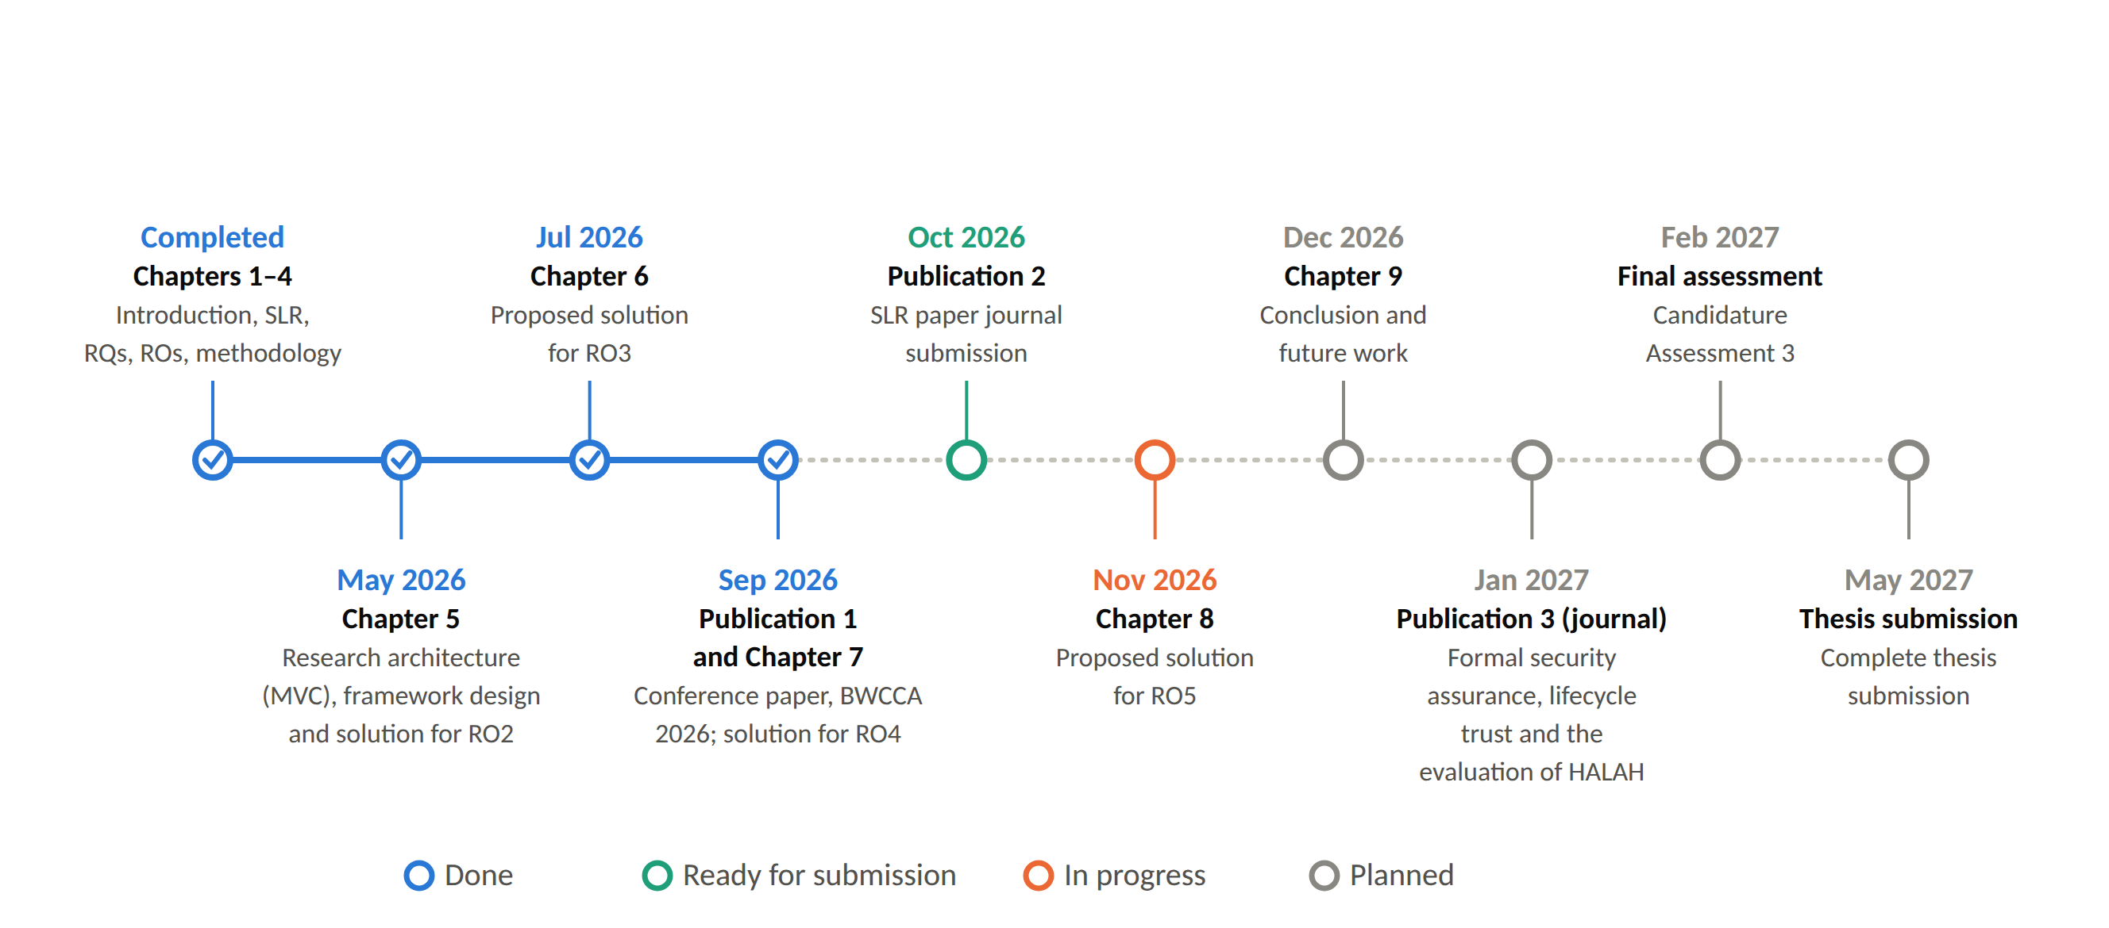
RESEARCH TIMELINE
Notes:
This is the same plan as a timeline. Chapters one to seven and the BWCCA conference paper are done. The SLR journal paper is ready for submission, and Chapter 8 on RO5 is in progress. In December, Chapter 9 with the conclusion. In January 2027, the journal paper on formal assurance. Then the next candidature assessment in February 2027, and thesis submission in May 2027.

