Slide 1
Yasser Alobaid
Summer Internship 2025
SUPERVISOR:KHALIL AL-SHUQIRAT

Slide 2

Organization: Deanship of Information Technology – Qassim University (QUIT)
Departments involved:
Information Systems Department
Networks & Technical Support Department
Software Development Department
Role: Supporting students and the university by developing practical tools and systems

Slide 3

Training Plan
Duration: 8 Weeks | Audience: Software Development Interns
Learn full-stack development with Laravel & MySQL
Use version control with GitHub (Git Flow)
Develop teamwork and collaboration skills
System Requirements Software:
Laravel 10+
MySQL / MariaDB
HTML, CSS, JavaScript
Node.js + NPM
OpenAI API Key
GitHub account
Work with JSON data and APIs
Write professional documentation (SRS)

Slide 4

cont
Week Timeline
Week 6-8
Week 4&5
SRS writing, testing, UX improvements, final documentation
week 2&3
Store data, model creation & feature development
Week 1
Data mapping & OpenAI API integration
Laravel basics, setup, GitHub, JSON

Slide 5
Team Tasks & Collaboration
Team Setup:
Collaboration Highlights:
Weekly Meetings:
5 students in one room, each assigned an individual project.
Teamwork mainly involved discussions, idea sharing, and peer support.
Assisted each other with troubleshooting and coding challenges.
Reviewed each other’s code and suggested improvements.
Met weekly with the internship supervisor.
Discussed progress, challenges, and received guidance.

Slide 6

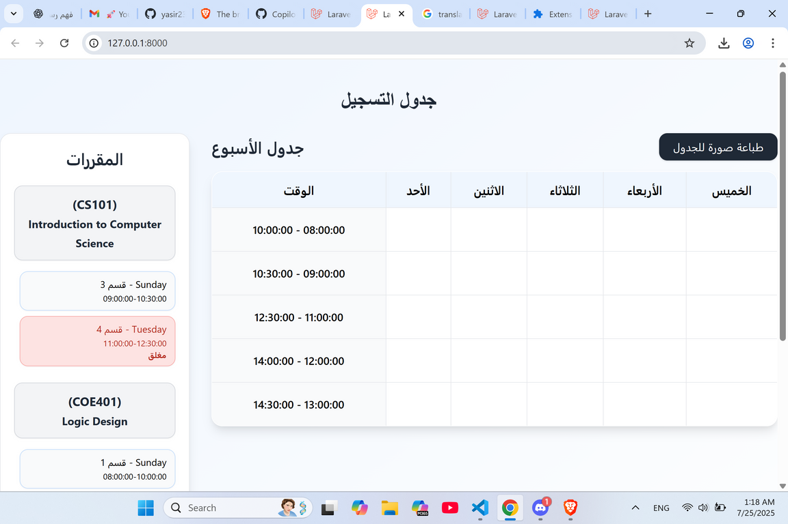
Results & Achievements During Internship
Project Name: Course & Section Scheduler
Overview:
Build a Laravel app for managing courses and sections.
Arabic UI with interactive weekly schedule.
Student login with secure actions (CSRF).
Architecture:
Framework: Laravel 12
Database: SQLite (planned to use university API)
Models: Course, Section, Student, StudentCourse
Views: Blade + Tailwind (CDN)
Scheduling: fetch POST requests with CSRF
A Laravel app that helps students register courses and sections
efficiently while preventing duplicates and scheduling conflicts.

Slide 7













ِConclusion
The summer internship provided hands-on experience in full-stack development, teamwork, and professional workflows, allowing me to apply learned skills, solve real problems, and enhance both technical and collaborative abilities.

