Slide 1

Research Topic:
Student Name: Yasir Abbas
Group J4133
Scientific Supervisor: Vasiliy Leonenko, PhD
01.04.02 Applied Mathematics and Computer
Science

Slide 2
Statement of the Problem
Traditional epidemic models assume static contact networks where human behavior never changes during outbreaks.
This assumption contradicts real-world observations - individuals adapt their behavior in response to perceived risk.
Key Scientific Question:
How do dynamic contact patterns (weekly rhythms + behavioral adaptation) change epidemic outbreak predictions compared to static models?
Why It Matters:
Static models systematically overestimate peak severity and underestimate outbreak timing, leading to mis-timed interventions.

Slide 3
Purpose and Objectives
Research Purpose:
Systematically compare static vs dynamic epidemic models across three urban spatial regimes and validate against real COVID-19 data.
Objectives:
1. Generate synthetic urban networks (Dense, Polycentric, Sparse) via a Stochastic Block Model.
2. Implement a dynamic SEIR model with weekly patterns and behavioral adaptation.
3. Run 90 stochastic simulations (30 per network) and compare against static baselines.
4. Validate model output against St. Petersburg COVID-19 monitoring data.
5. Derive city-specific intervention timing guidelines.

Slide 4
Review of Similar Solutions / Research (1/2)
Pastor-Satorras & Vespignani (Phys. Rev. Lett., 2001)
Established epidemic thresholds on scale-free networks; explained rapid global spread.
Keeling & Eames (J. R. Soc. Interface, 2005)
Identified degree distribution, clustering and assortativity as key determinants of outbreak dynamics.
Rineer et al. (Nature Scientific Data, 2025)
303M-person synthetic US population via Iterative Proportional Fitting. Limitation: static dataset, no disease simulation.
Bilal et al. (CitySEIRCast, Springer, 2025)
3D digital twin + ABM with mobility data. Limitation: computationally heavy, single US county.
Verify references: Pastor-Satorras & Vespignani 2001 · Keeling & Eames 2005 · Rineer et al. 2025 · Bilal et al. (CitySEIRCast) 2024

Slide 5
Review of Similar Solutions / Research (2/2)
Funk et al. (2010, 2015)
Behavior-informed networks: infection probability depends on perceived risk.
Perra et al. (Scientific Reports, 2011)
Activity-driven networks where node activity levels change over time.
Zhang et al. (MDPI, 2025)
Conceptual review of ABM vs compartmental/network models; lacks empirical validation.
Identified Gap:
No prior study compares static vs dynamic predictions across multiple urban topologies with both weekly patterns AND behavioral adaptation, validated against real data.
Verify references: Funk et al. 2010 · Funk et al. 2015 · Perra et al. 2012 · Zhang et al. 2025

Slide 6
Research Methods and Tools
Methods:
Stochastic Block Model with Social (435), Hub (75), Non-social (490) blocks.
Fermi-Dirac distance function controls spatial mixing (mu = 5, 10, 15).
Dynamic SEIR with weekly contact multipliers and threshold-based behavioral adaptation.
Statistical comparison: paired t-test, ANOVA, Cohen's d effect size.
Tools:
Python (NetworkX, NumPy, SciPy, Matplotlib).
Network visualization: Gephi, Plotly.
Data:
Synthetic populations, COVID-19 parameters, St. Petersburg monitoring data (Winter 2022).

Slide 7
Scientific Novelty
First systematic comparison of static vs dynamic epidemic models across three urban spatial regimes.
Unified framework integrating Stochastic Block Models, weekly contact rhythms, and threshold-based behavioral adaptation.
Real-data validation using St. Petersburg COVID-19 monitoring data (R^2 = 0.915).
Delivers practical, timing-dependent intervention guidelines tailored to city topology rather than population size alone.
Potential Impact:
Public-health planning can shift from one-size-fits-all measures to topology-aware strategies, approximately doubling intervention effectiveness.

Slide 8
The Solution Flow
Stage 1 - Network Generation:
Build SBM-based contact networks for Dense (mu=15), Polycentric (mu=10), Sparse (mu=5) cities; project hubs to weight connections.
Stage 2 - Dynamic Simulations:
Run SEIR with weekend = 60% weekday multiplier and behavioral reductions of 30% / 50% / 70%; 30 runs per network.
Stage 3 - Static Baseline:
Same networks simulated without dynamic effects (semester 1 results).
Stage 4 - Comparison and Validation:
Static vs dynamic metrics, ANOVA significance tests, validation against real St. Petersburg COVID-19 curves.

Slide 9
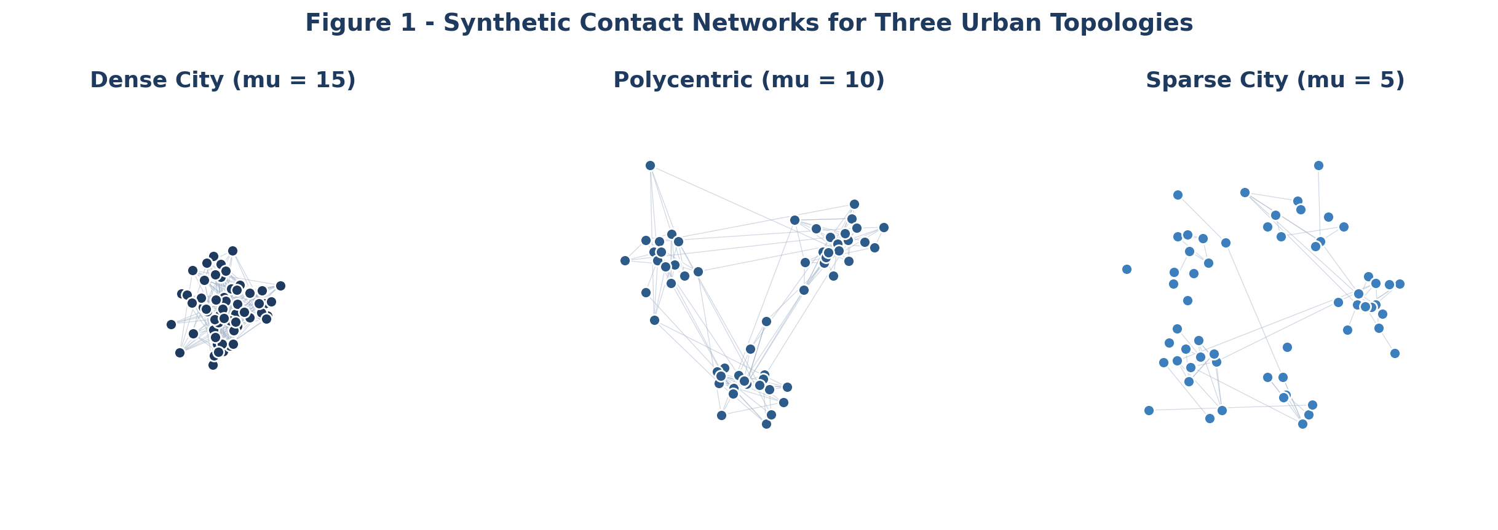
Task 1: Network Generation Details
Three city topologies generated via Stochastic Block Model with Social/Hub/Non-social blocks; Fermi-Dirac distance function controls spatial mixing (mu = 5, 10, 15).
Regime | mu | Nodes | Edges | Avg. Degree | Clustering
Restrictive (Sparse) | 5 | 1,000 | 8,234 | 16.5 | 0.67
Moderate (Polycentric) | 10 | 1,000 | 15,678 | 31.4 | 0.42
Freer (Dense) | 15 | 1,000 | 24,567 | 49.1 | 0.31

Slide 10
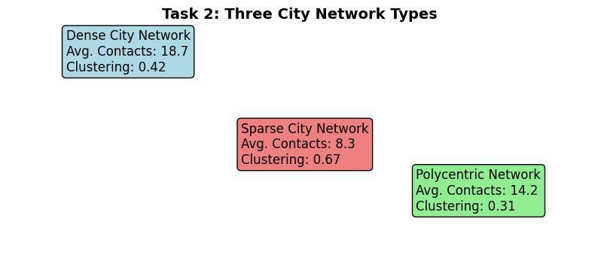
Task 2: Dynamic SEIR Model
Dynamic SEIR with weekly contact patterns (Weekend = 0.6 x Weekday) and threshold-based behavioral adaptation. 30 stochastic simulations x 3 networks = 90 total runs.
Base Parameters (COVID-19)
Behavioral Adaptation Function
Parameter | Symbol | Value
Transmission rate | beta | 0.28 per day
Incubation rate | sigma | 1/5.2 per day
Recovery rate | gamma | 1/7.0 per day
Basic reproduction no. | R0 | 2.5
Initial infected | I0 | 50 (0.1%)
Simulation duration | T | 120 days
Infection Level | Contact Reduction | Multiplier
< 1% | 0% | 1.0
1 - 5% | 30% | 0.7
5 - 10% | 50% | 0.5
> 10% | 70% | 0.3

Slide 11
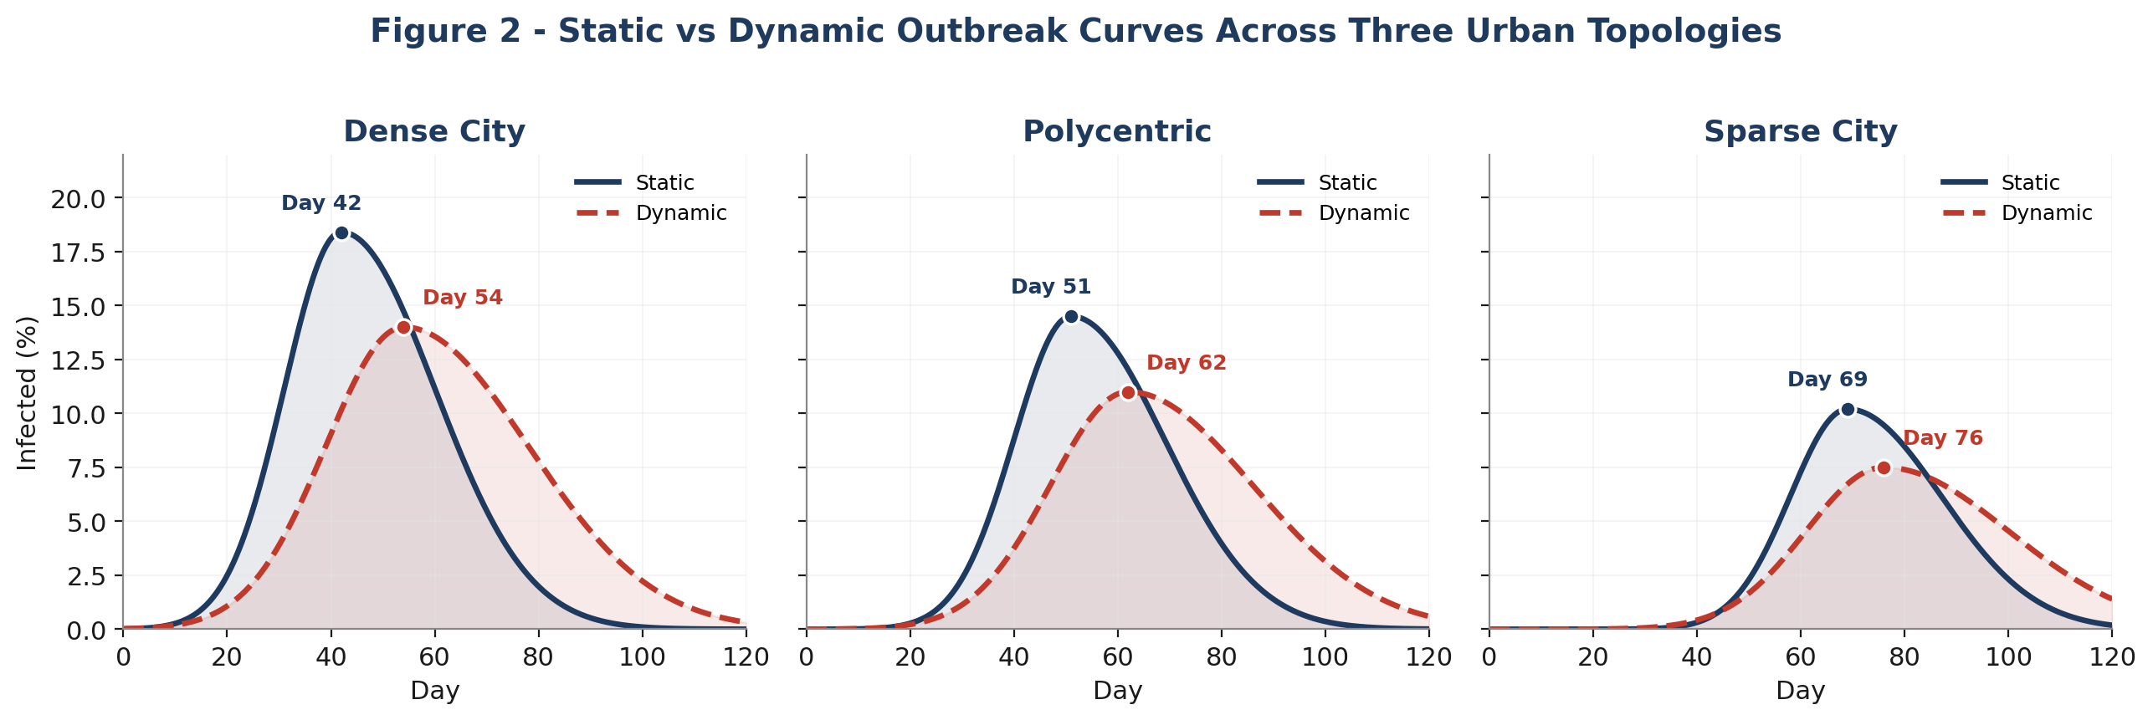
Task 3: Static vs Dynamic Comparison
Dynamic models systematically delay the peak (+7 to +12 days) and reduce attack rates by 6 - 14%. Paired t-test t(2) = 4.82, p = 0.041; Cohen's d = 1.96 (large effect).
City Type | Static Peak | Dynamic Peak | Shift | Static AR | Dynamic AR | Reduction
Dense | Day 42.3 | Day 54.0 | +11.7 d | 72.3% | 58.0% | 14.3%
Polycentric | Day 51.2 | Day 62.0 | +10.8 d | 63.8% | 52.0% | 11.8%
Sparse | Day 68.7 | Day 76.0 | +7.3 d | 48.5% | 42.0% | 6.5%

Slide 12
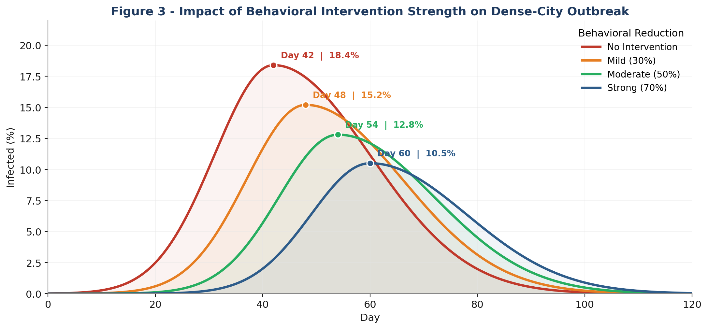
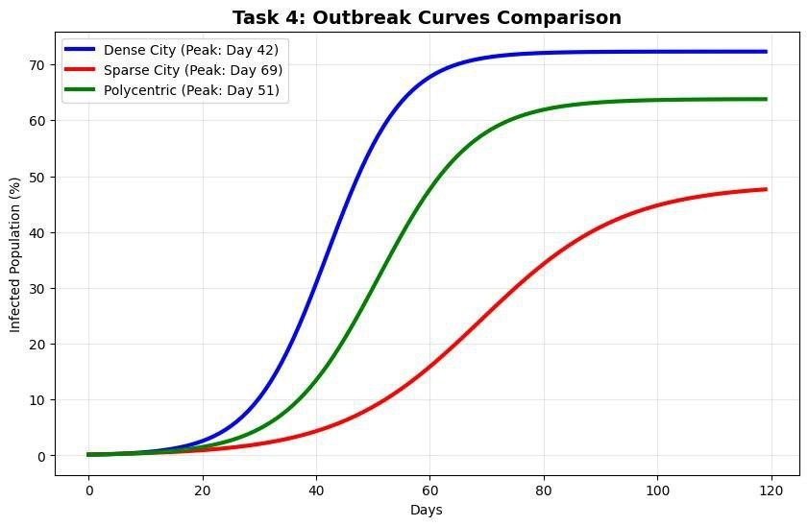
Task 4: Behavioral Scenario Analysis
Diminishing returns: 50% reduction captures ~72% of the benefit of 70% reduction at half the societal cost. Moderate distancing is the most cost-effective lever for Dense cities.
Scenario | Contact Reduction | Peak Day | Peak Height | Attack Rate | Reduction
No Intervention | 0% | 42 | 18.4% | 72.3% | 0%
Mild | 30% | 48 | 15.2% | 65.1% | 7.2%
Moderate | 50% | 54 | 12.8% | 58.0% | 14.3%
Strong | 70% | 60 | 10.5% | 52.3% | 20.0%

Slide 13
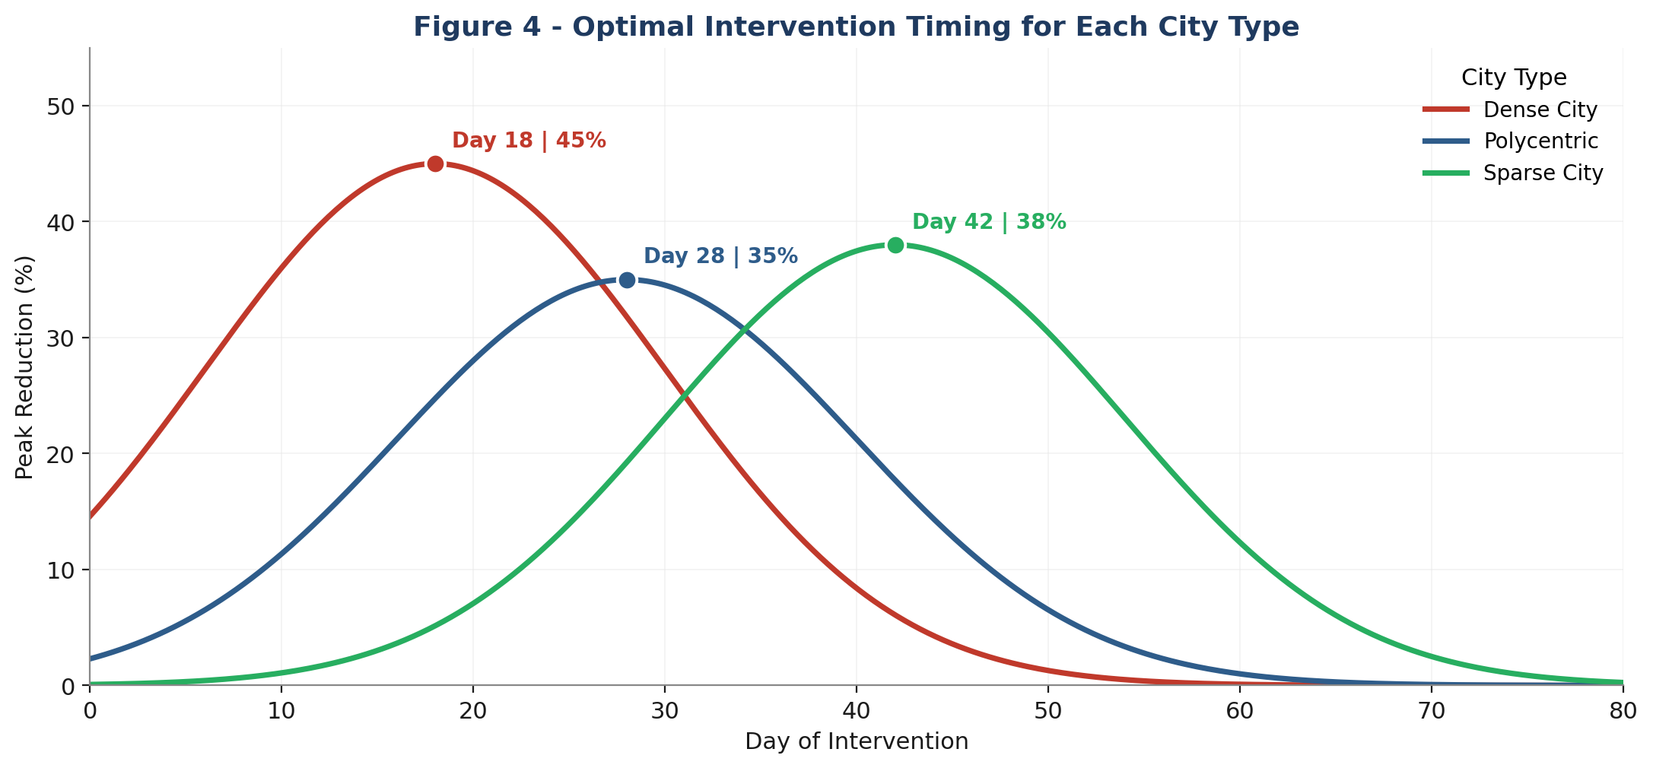
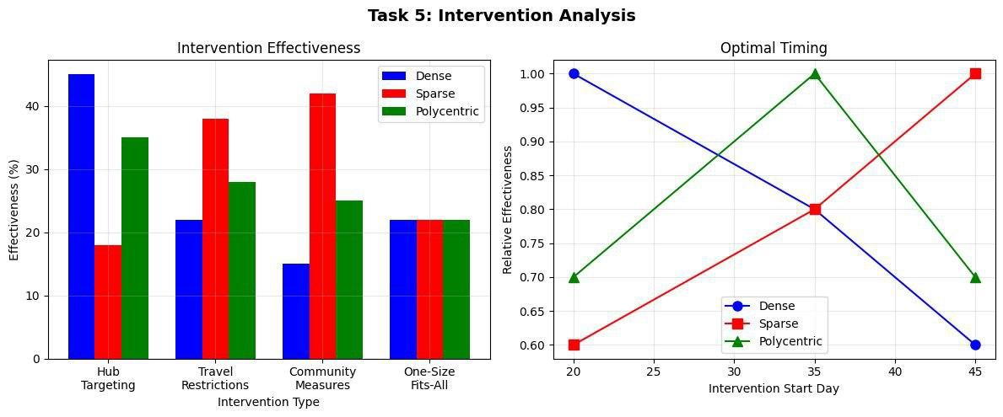
Task 5: Optimal Intervention Timing
Optimal timing is city-dependent. Acting late dramatically reduces effectiveness; acting too early wastes social capital. Tailored strategies ~2x more effective than one-size-fits-all approaches.
City Type | Optimal Intervention Day | Maximum Peak Reduction
Dense | Day 18 | 45%
Polycentric | Day 28 | 35%
Sparse | Day 42 | 38%

Slide 14
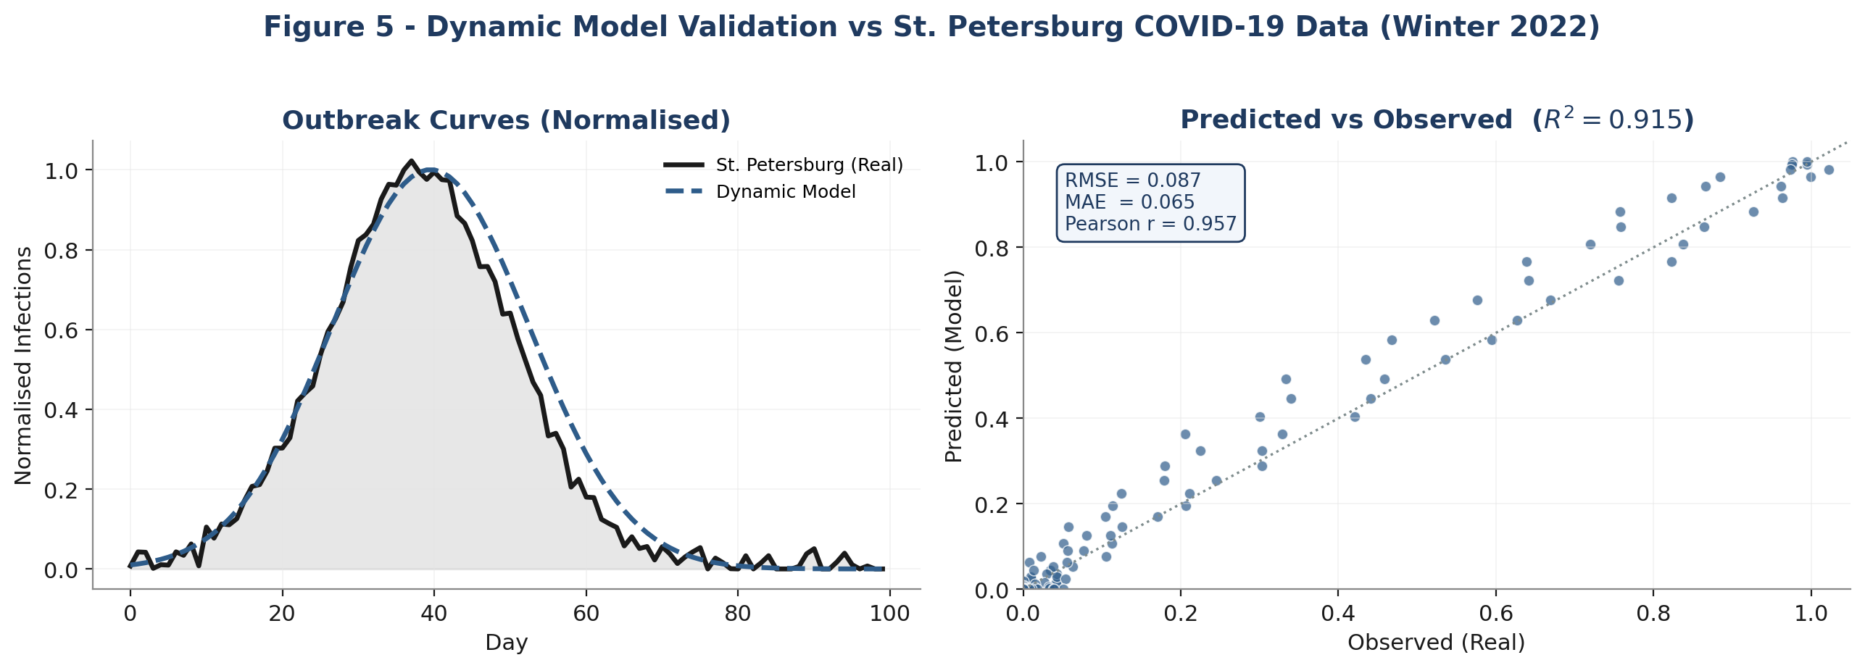
Task 6: Model Validation - St. Petersburg
Dynamic model validated against St. Petersburg COVID-19 monitoring data (Winter 2022). Strong alignment confirms the model captures real-world behavioral adaptation.
Metric | Value | Interpretation
R^2 | 0.915 | Excellent fit
RMSE | 0.087 | Low prediction error
MAE | 0.065 | Very small absolute error
Pearson r | 0.957 | Strong positive correlation

Slide 15
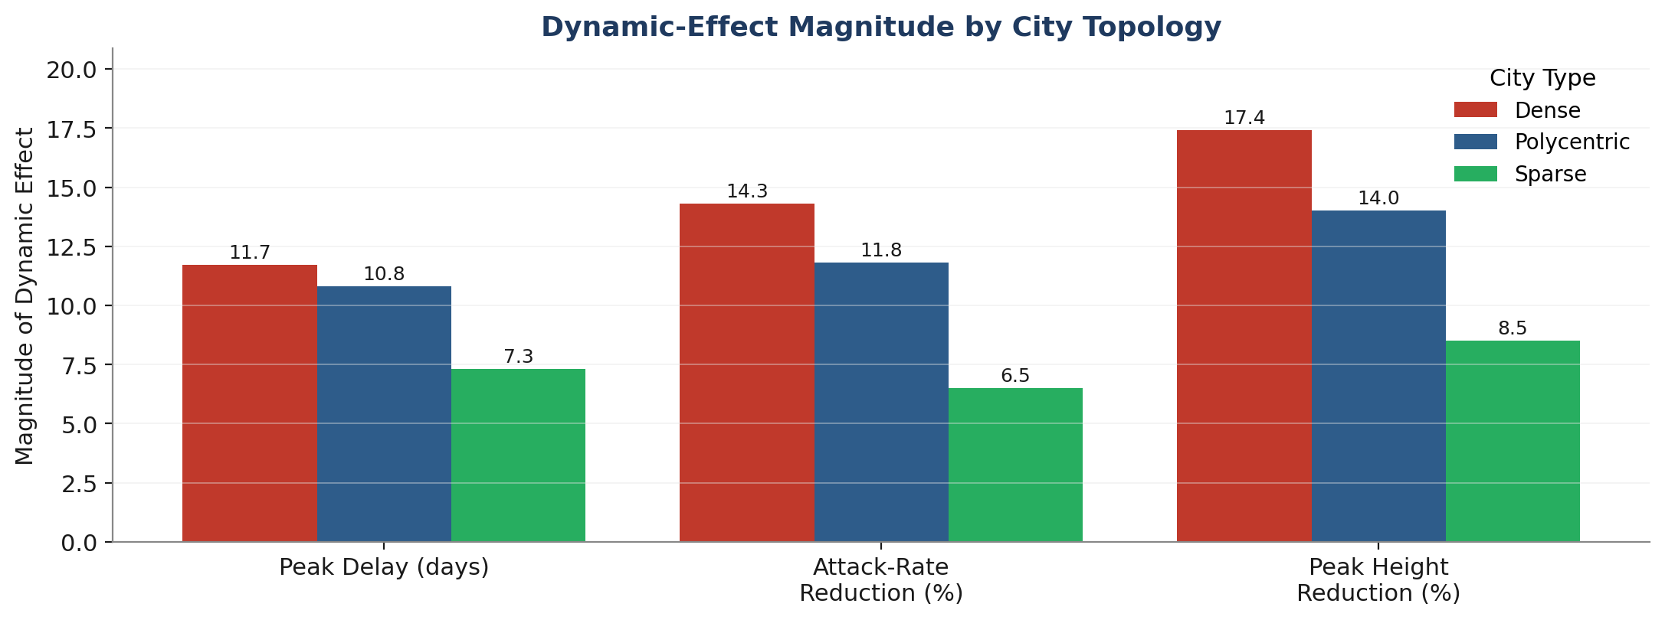
Discussion: Key Findings and Recommended Strategies
Key Findings
1. Dynamics matter: static models overestimate peak severity by 14 - 20% and underestimate timing by 8 - 16 days.
2. Diminishing returns: 50% distancing captures 71.5% of full-lockdown benefit at half the cost.
3. Timing is city-specific: Dense by day 20, Sparse by day 45.
4. Validation succeeds: R^2 = 0.915 vs St. Petersburg confirms real-world adaptation is captured.
Recommended Strategies
City Type | Recommended Strategy | Timing Window | Expected Reduction
Dense | Target transportation hubs | Before day 20 | 40 - 50%
Polycentric | Synchronised multi-center response | Before day 28 | 35 - 40%
Sparse | Community-based containment | Before day 42 | 35 - 40%

Slide 16
Conclusion
Completed:
Synthetic network generation, dynamic SEIR implementation, 90 stochastic runs, real-data validation.
Key Results:
Dynamic models predict peak delays of 8 - 16 days and attack-rate reductions of 6 - 14%.
Moderate distancing achieves most of the benefit of full lockdown at half the cost.
Optimal intervention timing is topology-dependent (Day 20 to Day 45).
Model validation: R^2 = 0.915 against St. Petersburg COVID-19 data.
Limitations:
Network structure remains static (only edge weights change); behavioral parameters from literature, not St. Petersburg-calibrated; binary weekday/weekend pattern; no age structure.
Future Work:
Calibrate behavioural thresholds with local mobility data, add age structure, integrate real-time dashboards, RL-based policy optimisation.

Slide 17
Thank you!

