Slide 1
Sales & Profit Dashboard
Prepared by: Yasir Bilal Bhat

Slide 2
Objective & Dataset
Objective:
- Build a Power BI dashboard to analyze sales & profit.
Dataset:
- Contains orders, sales, profit, category, and region data.
- Time period: 2019–2022.
Notes:
This slide introduces the dashboard's purpose and dataset details. It helps evaluators quickly understand project scope.

Slide 3
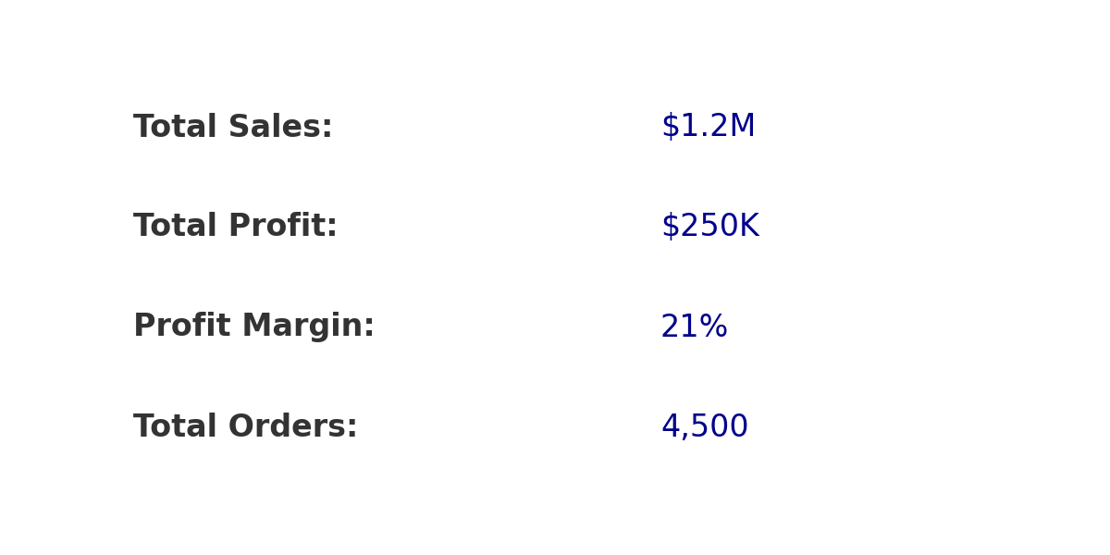
KPI Summary
Notes:
This slide highlights key metrics: total sales, total profit, margin, and orders. It provides a quick performance snapshot.

Slide 4
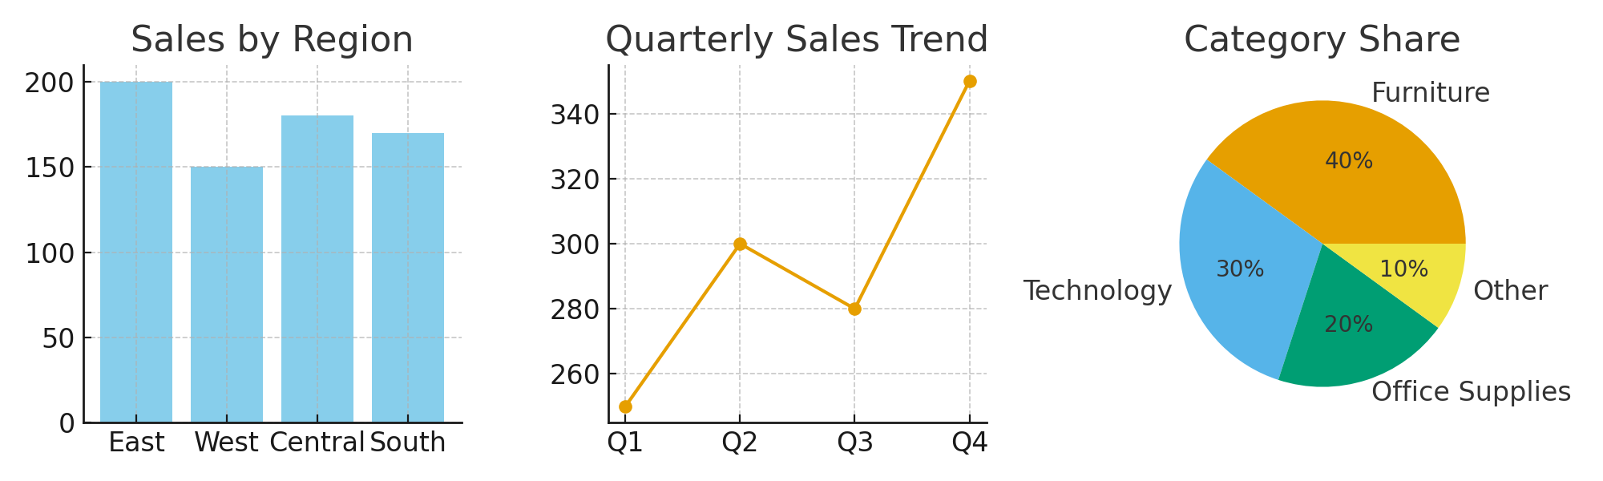
Dashboard Visuals
Notes:
This slide shows main dashboard charts: sales by region, quarterly sales trends, and category share. It demonstrates dashboard interactivity.

Slide 5
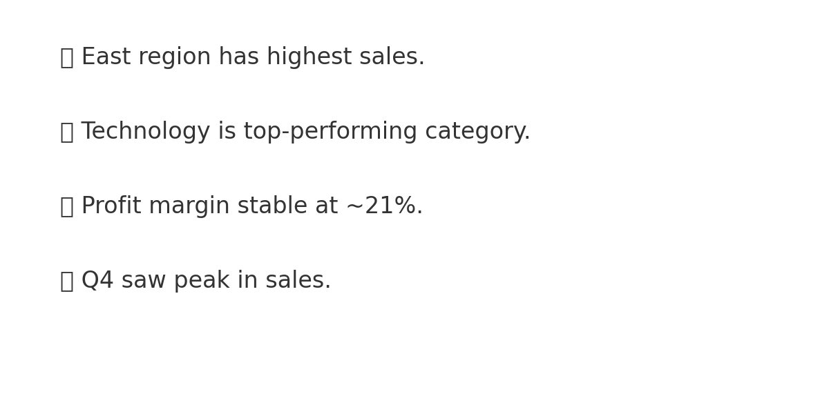
Key Findings
Notes:
This slide summarizes insights: East leads in sales, Technology is best category, margin stable, and Q4 peaks. Concise business takeaways.

Slide 6
Next Steps & GitHub Link
Next Steps:
- Explore product-level profitability.
- Add customer segmentation analysis.
GitHub Repository:
[Insert GitHub Repo Link Here]
Notes:
This slide suggests future improvements and provides the GitHub repo link. Replace placeholder with actual repo URL before submission.

