Slide 1
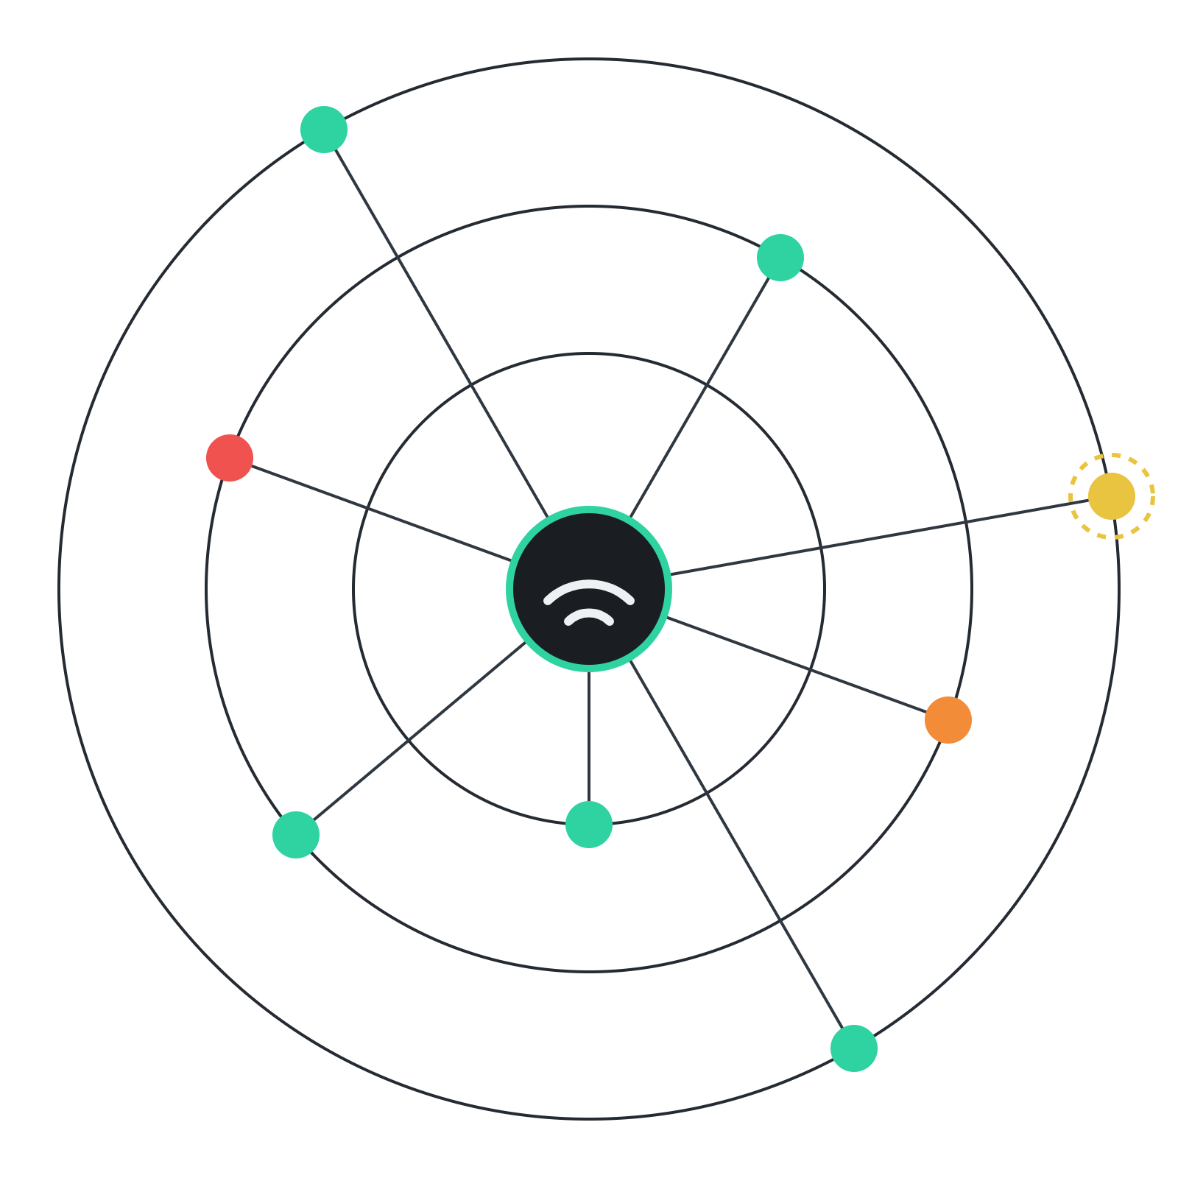
NetGuard
HOME NETWORK SECURITY
Find the weak spots in your home network, and fix them.
Product overview · Version 3.0 · October 2026 · Yasir Hassan
Notes:
Welcome. NetGuard is a desktop app that scans a home or small-office network, finds security weaknesses, explains each one in plain language and shows exactly how to fix it. In the next few minutes: the problem, how NetGuard works, what it found on a real network, why it can be trusted, and where it goes next.

Slide 2



Home networks are full of devices nobody checks
THE PROBLEM
Unmanaged devices
Risky defaults
No visibility
Cameras, TVs, smart plugs and printers rarely get updates, and most owners never check them.
Telnet, UPnP and default admin passwords often ship switched on, ready for attackers.
People can't see which devices are on their Wi-Fi, what is exposed, or when something new appears.
Security tools exist for companies. Home users get almost nothing they can understand.
NetGuard · 02
Notes:
A typical home now has phones, laptops, a smart TV, cameras, smart plugs and a router from the internet provider. Most of these are never updated and nobody looks at their settings. Risky features like Telnet and UPnP are often switched on by default. And owners have no way to see what is on their Wi-Fi or what is exposed. Professional security scanners exist, but they are built for IT teams, not for normal people.

Slide 3
NetGuard scans your network, explains every risk in plain language, and shows exactly how to fix it.
THE SOLUTION
01
02
03
Detect
Explain
Recommend
Find devices, open ports, services and weak settings.
Say why each issue matters, with the evidence behind it.
Give a clear fix for every finding, most urgent first.
NetGuard · 03
Notes:
NetGuard does three things. It detects: devices, open ports, the services behind them and weak settings. It explains: every finding says why it matters and shows the evidence it found. And it recommends: each finding has a concrete fix, sorted so the most urgent comes first. It never attacks or exploits anything; it only asks devices what they support.

Slide 4
Six steps, one click
HOW IT WORKS
01
02
03
04
05
06
Discover
Scan ports
Identify
Check config
Assess risk
Report
Ping and ARP sweep finds every device
Common ports, or 1 to 1024 in Full mode
Reads service banners, versions and TLS
40+ rules and a 0 to 100 score
Fixes, alerts, history and PDF reports
SMBv1, SNMP, anonymous FTP, UPnP, TLS
About 30 seconds for a quick scan of a typical home network.
Nothing is exploited. Every probe only asks a device what it supports.
NetGuard · 04
Notes:
One click runs six steps. First it discovers every device with a ping and ARP sweep, so even devices that ignore ping are found. Then it scans ports, identifies the services and versions behind them, and checks configuration such as SMBv1, SNMP default passwords, anonymous FTP, UPnP and old TLS. The vulnerability engine applies more than 40 rules and calculates a score. Finally it produces fixes, alerts, history and reports. A quick scan takes around 30 seconds, and nothing is ever exploited.

Slide 5






Everything in one desktop app
FEATURES
Wi-Fi survey
Device discovery
Port and service scan
Signal strength, channels and the security of every nearby network.
IP, MAC, maker, hostname, OS guess and device type, tracked over time.
Quick, Full, Single Device and Custom modes with version detection.
Vulnerability checks
Risk scoring
Reports and history
40+ rules for exposed services, weak settings and outdated software.
Per-device risk and a network score that shows what to fix first.
PDF, HTML, CSV and JSON reports, scan comparison and alerts.
NetGuard · 05
Notes:
Six feature areas, all in one desktop app. A Wi-Fi survey with signal strength, channel use and security of nearby networks. Device discovery that names each device's maker, guesses its OS and type, and remembers when it was first seen. Port and service scanning in four modes. More than 40 vulnerability rules. A risk score per device and for the whole network. And reports in four formats, plus scan comparison and alerts when something changes.

Slide 6
The issues that matter at home
WHAT IT CHECKS
Area | Examples
Wi-Fi security | Open networks, WEP, WPA with TKIP, WPA2 instead of WPA3
Exposed services | Telnet, RDP, VNC, Android debugging, SMB, databases, Docker API
Weak configuration | SMBv1, SNMP "public", anonymous FTP, UPnP on the router
Encryption | TLS 1.0 and 1.1, logins over plain HTTP, missing security headers
Outdated software | Known-bad OpenSSH and vsftpd versions, optional NVD CVE lookup
Every finding includes its evidence, a confidence level and the recommended fix.
NetGuard · 06
Notes:
The checks focus on what actually goes wrong in homes. Wi-Fi security, from open networks to WPA2 versus WPA3. Exposed services like Telnet, remote desktop, VNC, Android debugging, file sharing and databases. Weak configuration such as SMBv1, the SNMP default "public" password, anonymous FTP and UPnP on the router. Encryption problems like old TLS and logins over plain HTTP. And outdated software, with an optional lookup in the official NIST vulnerability database. Each finding shows evidence and a confidence level, so users can trust it.

Slide 7
A real home network, scanned in 36 seconds
CASE STUDY
17
13
8
54/100
devices found
open ports
findings to fix
score: fair, needs attention
HIGH
Telnet is open on the router
MEDIUM
UPnP lets any device open ports to the internet
MEDIUM
Windows file sharing is reachable on a shared Wi-Fi
NetGuard · 07 · Quick scan of the developer's own network, October 2026
Notes:
This is a real result from my own home network. A quick scan took 36 seconds and found 17 devices, 13 open ports and 8 findings worth fixing, for a score of 54 out of 100. The most serious: Telnet was open on the internet provider's router, which sends passwords in clear text and is a favourite target of IoT botnets. UPnP was enabled, so any program on the network can open ports to the internet. And Windows file sharing on my PC was reachable by others on the shared Wi-Fi. NetGuard also checked the Windows Firewall and correctly reported that a SQL Server port, open locally, was blocked for other devices, so it was not a false alarm.

Slide 8

One screen shows what matters
THE DASHBOARD
Security score
54
A security score with a plain-English verdict
What changed since the last scan
A network map coloured by risk
Top findings with the fix for each
Score trend and recent alerts
Runs in its own window or a browser
Fair, needs attention
Devices
Open ports
Score
17
13
+7
2 new
2 opened
since last scan
NetGuard · 08
Notes:
The dashboard is built so a non-expert understands it at a glance. The score comes with a verdict in plain English, here "fair, needs attention", and shows how it moved since the last scan. Cards highlight what changed: new devices and newly opened ports. Below that are a network map coloured by risk, the top findings each with its fix, a score trend over the last scans, and recent alerts. It runs in its own desktop window, or in a browser.

Slide 9






Built to be trusted on your network
SECURITY BY DESIGN
Detects, never exploits
Your network only
Data stays local
Every probe only asks a device what it supports. Nothing is attacked.
Refuses public IP ranges and asks users to confirm they are authorised.
Results stay on the PC. No telemetry and no cloud account needed.
Hardened app
Firewall-aware
Tested every build
Localhost only, per-session token, DNS-rebinding and CSP protection.
Reads Windows Firewall rules to separate real exposure from blocked ports.
46 automated tests run before any release is built.
NetGuard · 09
Notes:
A security tool must itself be trustworthy. NetGuard detects but never exploits. It refuses to scan public IP ranges and asks users on first run to confirm they own or are authorised to test the network. All results stay on the user's PC, with no telemetry. The app itself is hardened: it only listens on the local machine and protects its API against cross-site requests and DNS rebinding. On the user's own PC it reads the Windows Firewall rules, so it reports real exposure instead of false alarms. And 46 automated tests, covering the scan rules, the app's security and the licensing, run before every release.

Slide 10
Simple, proven building blocks
TECHNOLOGY
How it ships
Desktop app
pywebview, Edge WebView2
NetGuard.exe built with PyInstaller
Windows installer with Inno Setup
PDF reports with ReportLab
Signed licence keys, checked offline
Open-source parts all use permissive licences
Dashboard
HTML, CSS, JavaScript
API
Flask, token-protected
Scan engine
Python: probes and rules
Storage
SQLite on the user's PC
NetGuard · 10
Notes:
The architecture is deliberately simple. A desktop window built on Windows' own WebView2 engine shows the dashboard. The dashboard talks to a small Flask API that only listens on the local machine and requires a session token. Behind it is the Python scan engine with its probes and vulnerability rules, and a SQLite database that stores scans, devices, alerts and the audit log on the user's PC. It ships as a standalone NetGuard.exe and a Windows installer. Pro licence keys are digitally signed and verified offline, so no licence server is needed. All open-source components use permissive licences such as BSD and MIT, which allows commercial sale.

Slide 11
Two editions: Free and Pro
BUSINESS MODEL
FREE · HOME USERS
PRO · IT PROS AND SMALL BUSINESSES
Free
[$__] / year
Wi-Fi survey and device discovery
All four scan modes
Vulnerability checks with fixes
Security score and in-app alerts
Reports and one saved site
Everything in Free
Scheduled automatic scans
Unlimited sites and networks
Branded reports for clients
Email and Telegram alerts
NetGuard · 11 · Both editions available in version 3.0 · pricing to be decided
Notes:
NetGuard comes in two editions, both available now in version 3.0. Free, for home users, includes everything needed to scan a home network, understand the findings and fix them, with one saved site. Pro is for IT professionals and small businesses who look after several networks: scheduled scans, unlimited sites, branded reports for clients, and email and Telegram alerts. The price is still to be decided.

Slide 12




What Pro adds for network managers
NETGUARD PRO
Scheduled scans
Multiple sites
Daily, weekly or every few hours. A missed scan runs when NetGuard next starts.
Name every network you look after and pick one for each scan.
Email and Telegram alerts
Branded reports
One message per scan with new issues. Passwords stay encrypted on the PC.
Your company name, contact and colour on every PDF and HTML report.
14-day free trial
Signed licence keys, verified offline
No account or licence server needed
NetGuard · 12
Notes:
Pro is built for people who look after more than one network: IT professionals, small businesses and the family member everyone calls for help. Scans can run automatically on a schedule. Each network can be saved as a named site. New issues are sent by email or Telegram, one message per scan, and the mail password or bot token is stored encrypted on the PC. Reports carry your own company name and colours, ready to hand to a client. Anyone can try Pro free for 14 days. Licence keys are digitally signed and checked offline, so customers need no account and we need no licence server.

Slide 13
Five phases to a commercial release
ROADMAP
PHASE 1
PHASE 2
PHASE 3
PHASE 4
PHASE 5
Foundation
Desktop app
Editions and licensing
Pro features
Release
Done
Done
Done
In progress
App security, data storage, logging and automated tests
Native window, standalone .exe and installer script
Done
Scheduled scans, multiple sites, branded reports, alerts
Signing step ready; certificate, legal review, website and payments next
Free and Pro, signed licence keys, a 14-day trial
NetGuard · 13
Notes:
Four of the five phases are done. Phase 1 built the foundation: the app's own security, data storage, logging and automated tests. Phase 2 delivered the desktop app, the standalone executable and the installer script. Phase 3 added the Free and Pro editions, signed licence keys and a 14-day trial. Phase 4 added the Pro features. Phase 5 is in progress: the update checker and the code-signing step in the build are ready. What remains is buying the signing certificate, a lawyer's review of the licence agreement and privacy policy, and the website with payments.

Slide 14

Know what is on your network. Fix what matters.
NETGUARD
Thank you. Questions and feedback are welcome.
Yasir Hassan · [contact email] · [website]
Notes:
To sum up: NetGuard lets anyone see what is on their network and fix what matters most, safely and privately. Thank you. I'm happy to take questions, show a live scan, or hear feedback on the Free and Pro plans.

