Slide 1
Notes on Behavior Trees
Alexander Schulz-Rosengarten, Reinhard v. Hanxleden and Lingua Franca Team
als|rvh@informatik.uni-kiel.de
LF/Siemens Meeting, July 22, 2022

Slide 2
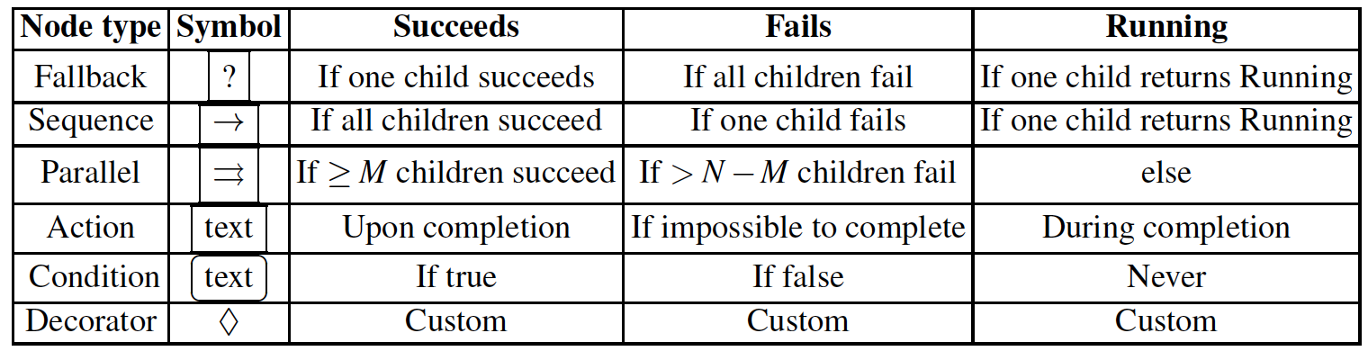
BT Building Blocks
Control Flow nodes: Sequence, Fallback/Selector, Parallel, Decorator
Execution nodes: Action/Task, Condition
Possible return values: Success, Running, Failure
Fig’s taken from Michele Colledanchise and Petter Ogren, Behavior Trees in Robotics and AI - An Introduction, 2020
https://arxiv.org/pdf/1709.00084.pdf

Slide 3
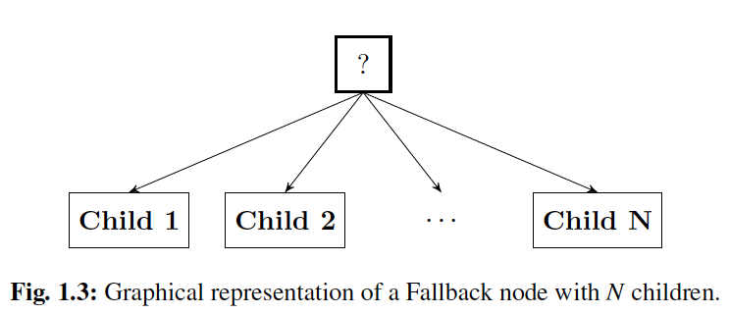
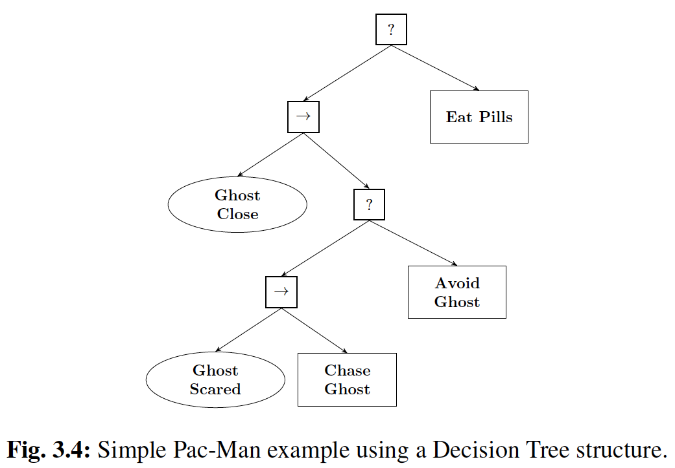
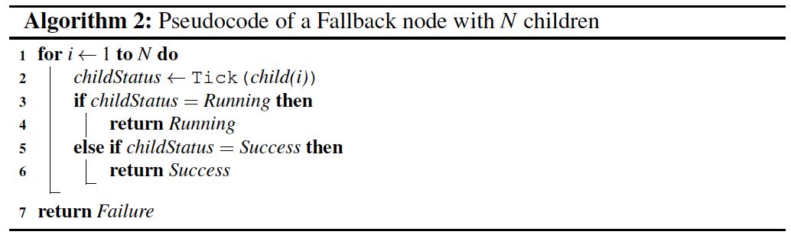
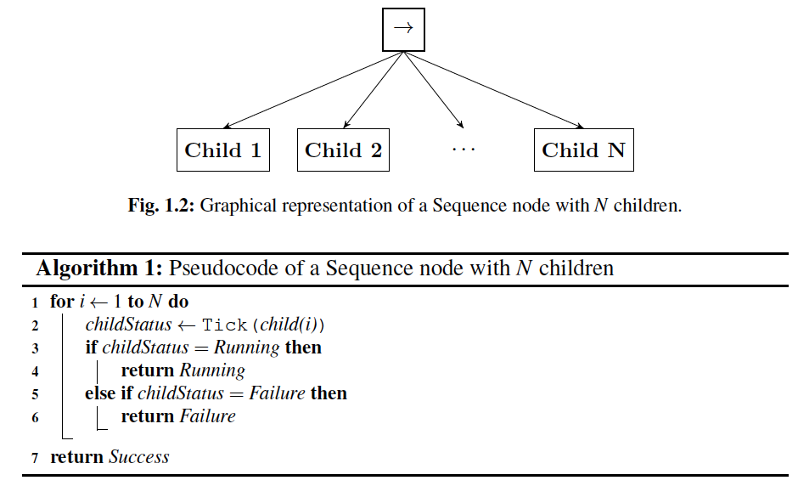
Fig’s taken from Michele Colledanchise and Petter Ogren, Behavior Trees in Robotics and AI - An Introduction, 2020
https://arxiv.org/pdf/1709.00084.pdf

Slide 4
Modes in BTs
Observations:
System has three modes (only return Running)
Current mode determined by two conditions (only return Success or Failure)
Nested use of “select mode pattern,” where one condition switches between two (inner) modes

Slide 5
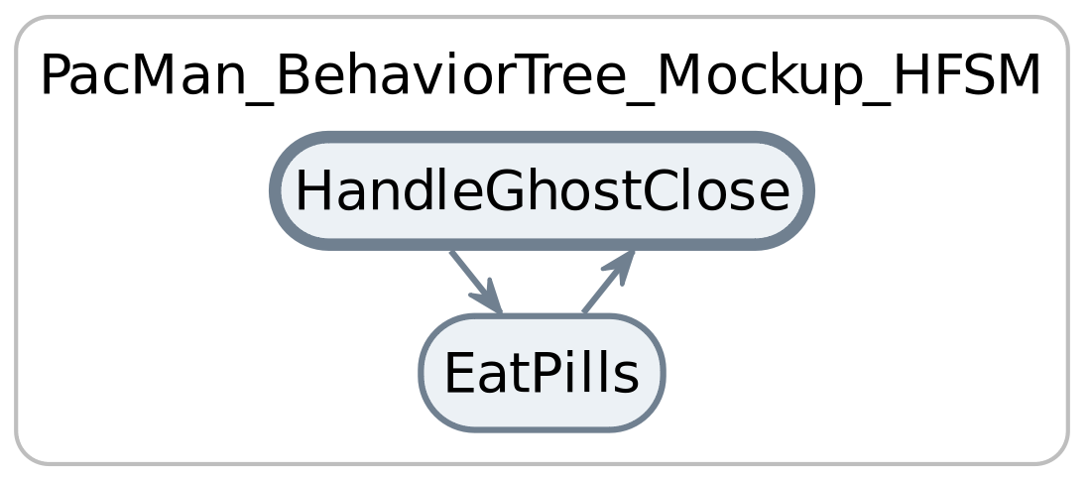
Select Mode Pattern in LF
Inner modes collapsed:

Slide 6
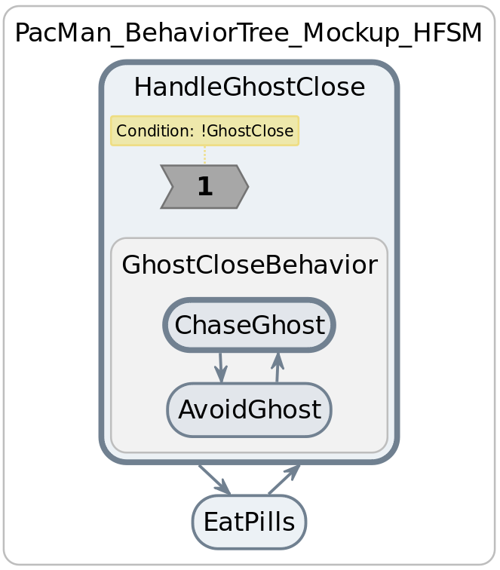
Select Mode Pattern in LF
Inner modes expanded:

Slide 7
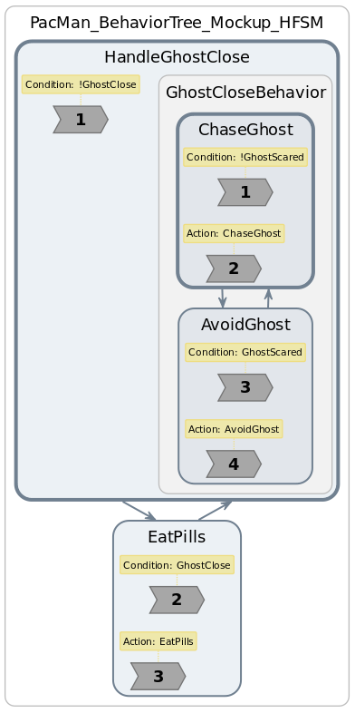
Select Mode Pattern in LF
With reactions:

Slide 8
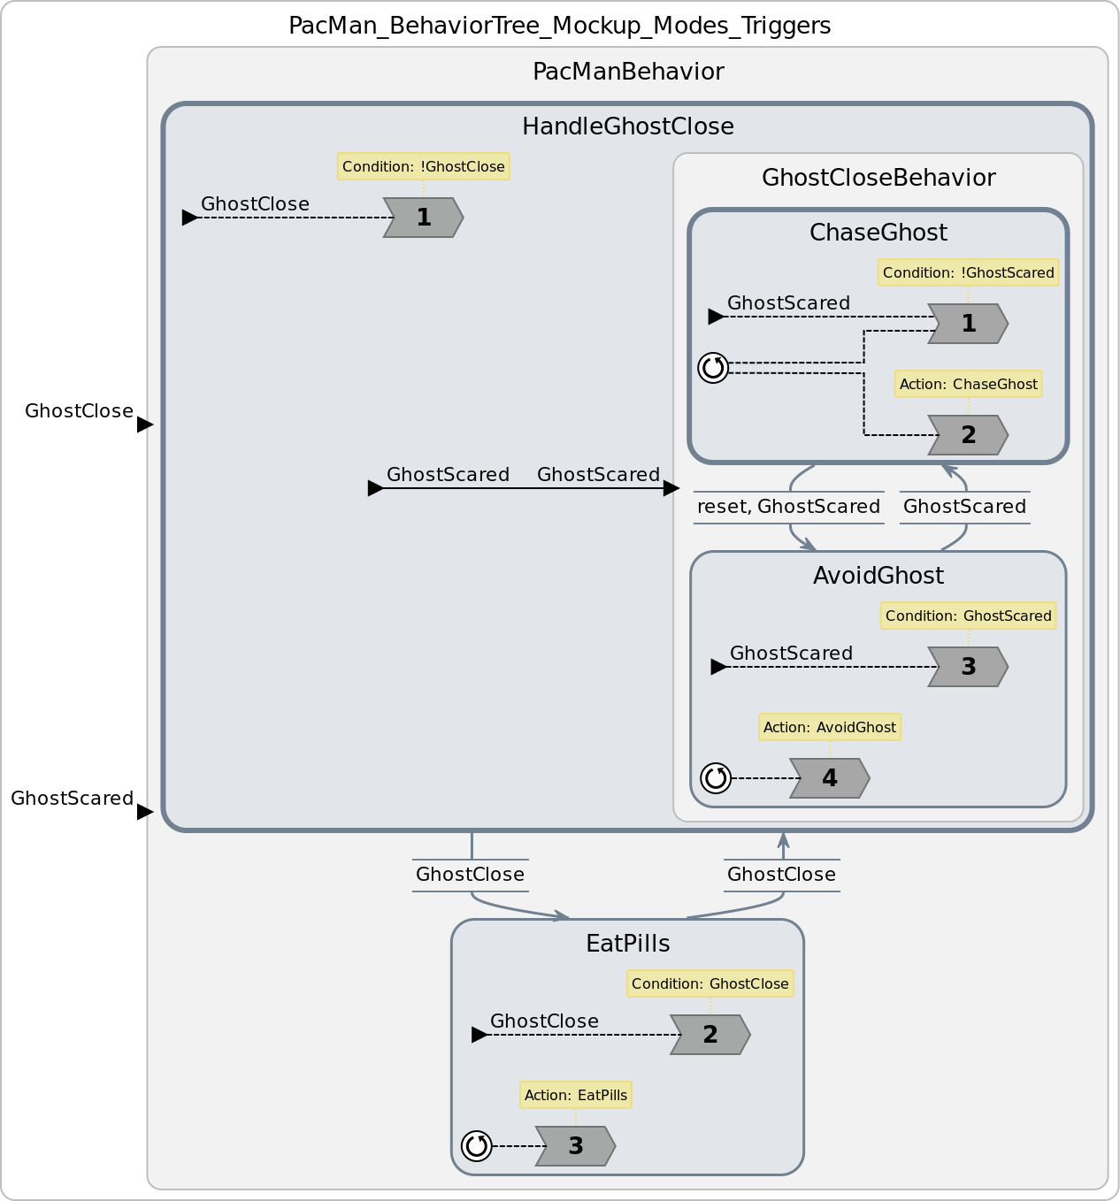
Select Mode Pattern in LF
With conditions:
This works … But is specific for this pattern

Slide 9
FSM Construction by Colledanchise and Ogren
Michele Colledanchise and Petter Ogren, Behavior Trees in Robotics and AI - An Introduction, 2020
https://arxiv.org/pdf/1709.00084.pdf

Slide 10
Michele Colledanchise and Petter Ogren, Behavior Trees in Robotics and AI - An Introduction, 2020
https://arxiv.org/pdf/1709.00084.pdf

Slide 11
Michele Colledanchise and Petter Ogren, Behavior Trees in Robotics and AI - An Introduction, 2020
https://arxiv.org/pdf/1709.00084.pdf

Slide 12
Michele Colledanchise and Petter Ogren, Behavior Trees in Robotics and AI - An Introduction, 2020
https://arxiv.org/pdf/1709.00084.pdf

Slide 13
Observations/Claims:
The nodes are not really “states,” but actors that fire when receiving an input
The edges are not really “transitions,” but denote data (token) flow
“Running” just denotes completion of reaction in absence of Success/Failure
Conclusion:
Can map this directly to reactors!
⇒ Demo by Alex

Slide 14
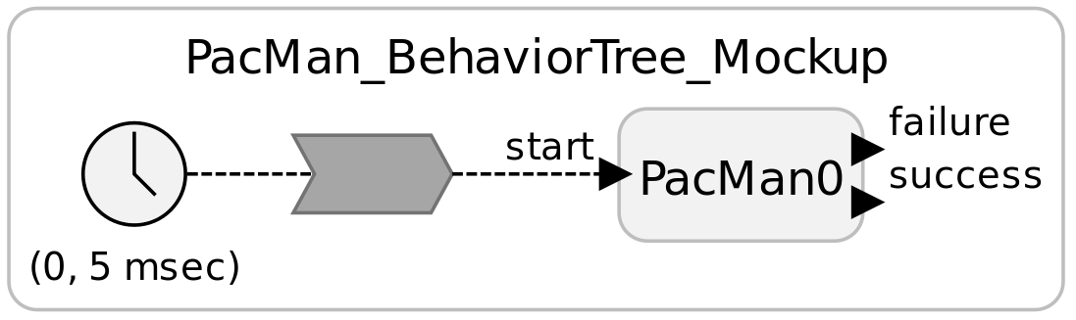
Top-Level:

Slide 15
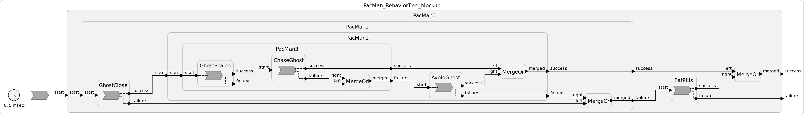
All Reactors:

Slide 16
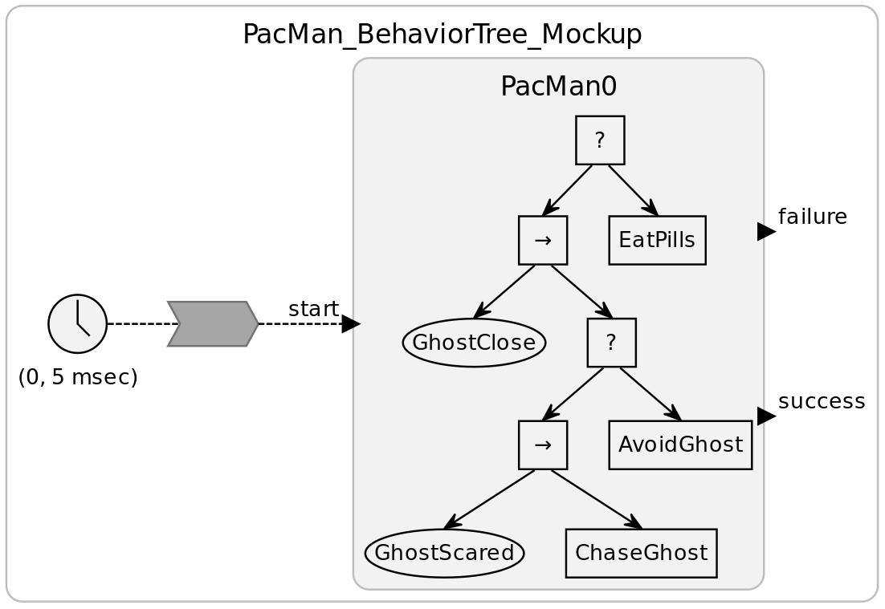
With “Behavior Tree View”:

Slide 17
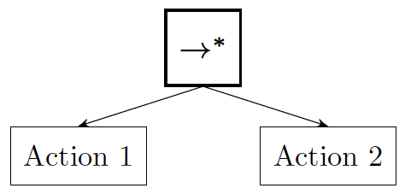
Wrap-Up
Truly modal BTs can be expressed with modal reactors
Suitable for “select mode pattern”
Must consider that modal transitions are by default “deferred”
May also apply for for BT nodes “with memory” (asterisk decorators)
For general, “reactive” BTs, an actor model may be more suitable
Modular construction
Success + Failure communicated to neighbor/parent
Can use existing LF language
Can synthesize pictorial BTs within LF diagrams, resulting in hybrid data flow/BT views

