Slide 1
Vehicle Tracking System Using GPS from Android Devices
Yasir Uddin Ahamed
ID: 11508010
Session: 2014-15
Dept. of cse, comilla university

Slide 2
This project is supervised by-
Khalil Ahammad
Lecturer
Dept. of cse
Comilla unicersity

Slide 3
Introduction
Vehicle tracking system using GPS from android devices is a project based on android OS platform
Developed using Java and XML language
As database, firebase is used
A simple app to track your vehicle using driver’s android device
Specially designed to track institutional public transport like school bus, office vehicle etc. so many people can track one vehicle at a time.
Kept as simple as possible

Slide 4
Overview of the system
Two parts of the system –
Android app
Database
As database, firebase is used to reduce complexity
Android app has two part –
Driver’s Option
Student’s Option

Slide 5
Overview of the system
The system works like this –
At first, driver will log in to his account. If driver has no account, he will register.
After log in, driver’s current location will be uploaded to the database.
Then the student’s will log in to their account and find the location of the driver from the database.

Slide 6
Data Flow Diagram (DFD) – (Level 0)
It’s called Context Diagram
Shows basic overview of whole system in a single process
Simple diagram, describe the system at a glance, just external entities and system relationship
Very easy to understand

Slide 7
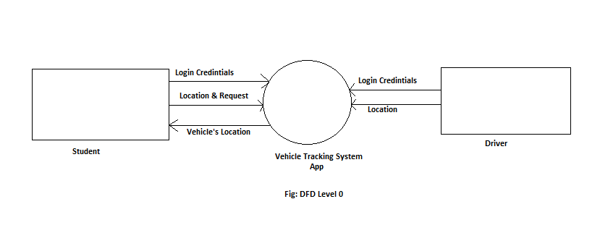
Data Flow Diagram (DFD) – Level 0

Slide 8
Data Flow Diagram (DFD) – Level 1
Provides a more detailed breakout of pieces of DFD Level 0
Notates each of the main sub-processes that together form the complete system
It can be considered as an exploded representation of Context Diagram

Slide 9
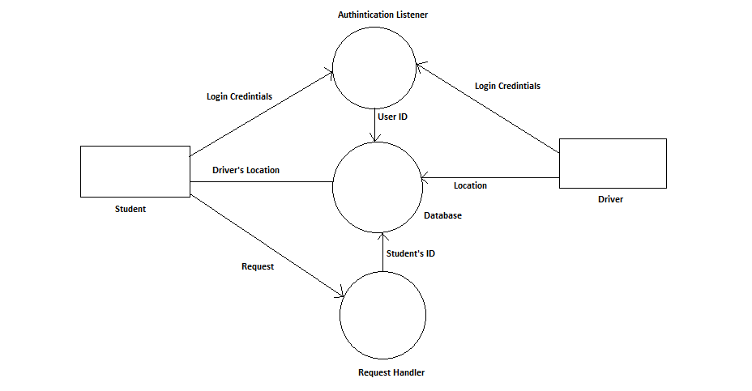
Data Flow Diagram (DFD) – Level 1
Fig: DFD Level 1 of VTS using GPS using Android
Fig: DFD Level 1

Slide 10
Use Case Diagram
Define interaction between persons and system as functional requirements for IT application
Demonstrate different ways of interaction between user and system
Model the basic flow of events in a use case

Slide 11
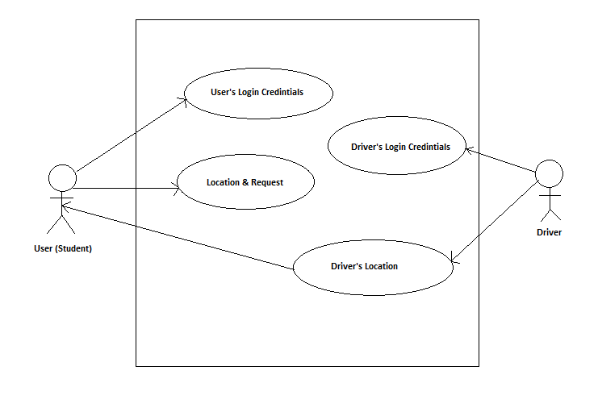
Use Case Diagram
Use Case Diagram
Fig: Use Case Model

Slide 12
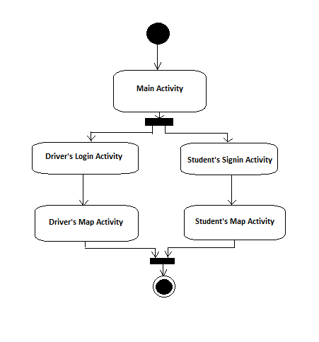
Activity Diagram
An activity diagram is a flow chart that represents flow from one activity to another
The black circle indicates start and the black circle within white circle indicates stop or exit
Fig: Activity Diagram

Slide 13
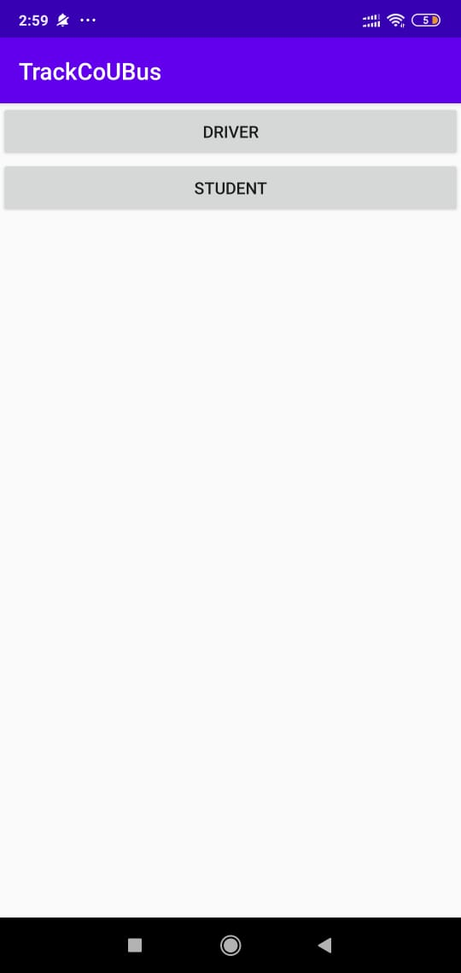
Result
Main activity

Slide 14
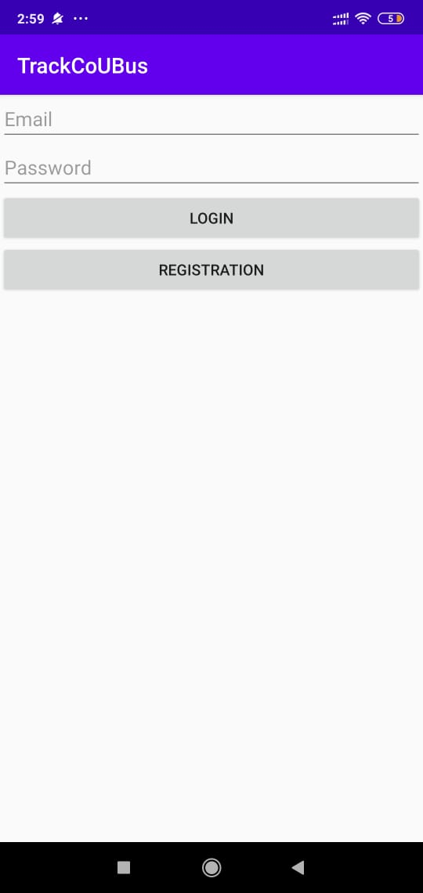
Result
Driver’s Login Activity

Slide 15
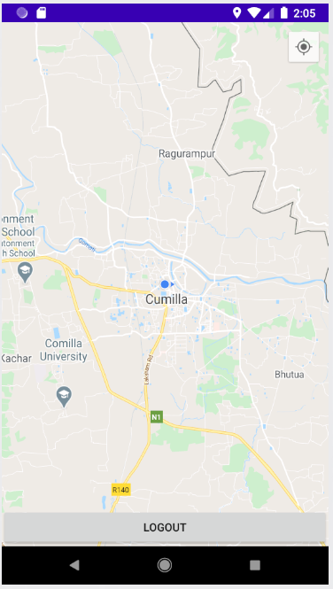
Result
Driver’s Map Activity

Slide 16
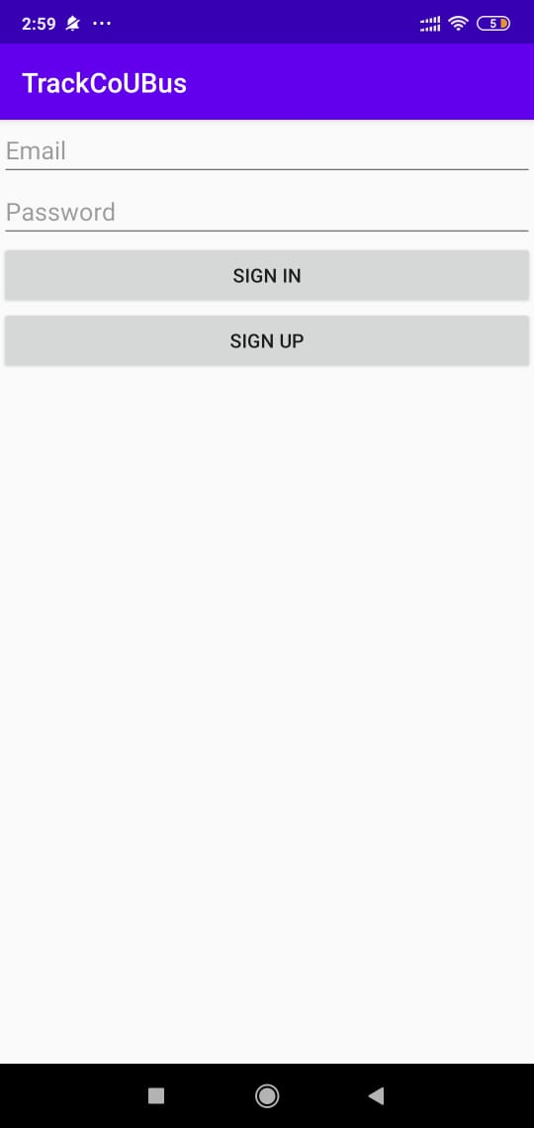
Result
Student’s Sign In Activity

Slide 17
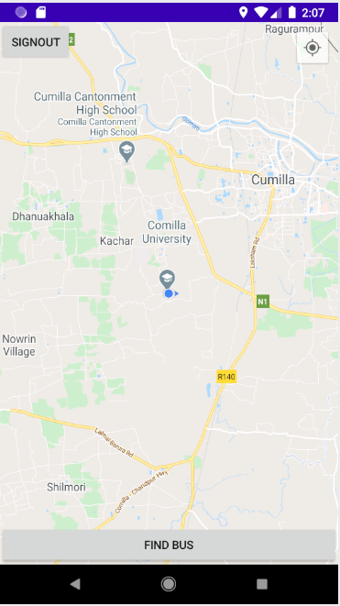
Result
Student’s Map Activity

Slide 18
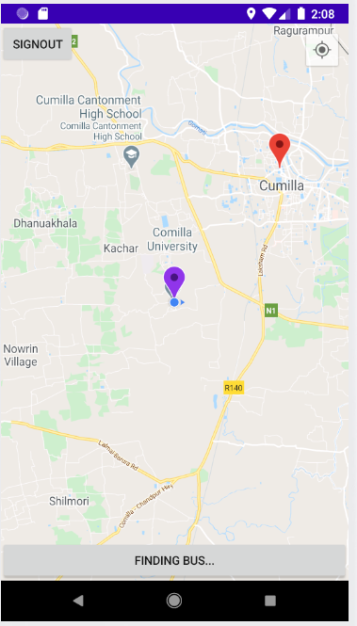
Result
Finding Bus

Slide 19
Future Direction
Amount of fuel, condition of the vehicle can be measured
Speed of vehicle, route detection etc. can be easily added
As many sensors can be added through USB jack and earphone jack, adding additional sensors is easy to add
As it has a touch screen display, there is no extra trouble to install buttons
Connectivity with driver through this app can be established
As it is a complete OS and CISC processor controlled, various AI system like accident detection and various risk detection is easy, a well known AI platform is existing for android is called Tensorflow

Slide 20
Thank You

